Slide 1
SQL Statements
RAJASEETHA M

Slide 2
What is SQL?
Structured Query Language.
Advantages of SQL?
SQL stands for Structured Query Language. It is used for storing and managing data in Relational Database Management System (RDBMS).
• High speed
• No coding needed
• Well defined standards
• Portability

Slide 3
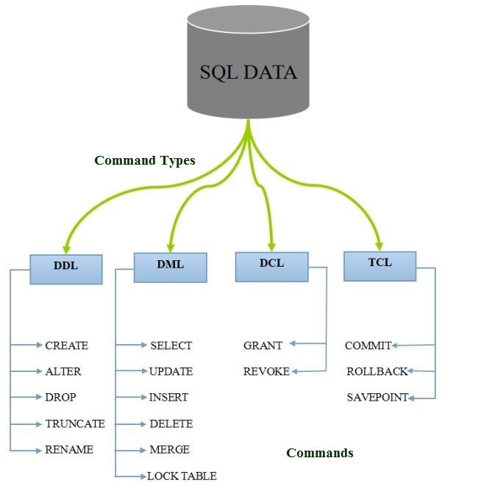
What are the 5 SQL statements?
These SQL commands are essential to perform SQL operations and aid developers and database administrators in ensuring data consistency, integrity, and accessibility.
DDL - Data Definition Language
DQL - Data Query Language
DML - Data Manipulation Language
DCL - Data Control Language

Slide 4
SELECT statement in SQL
To extract data from the database. you need to use the structured query language (SQL) SELECT statement You may need to restrict the columns that are displayed. This lesson describes all The SQL statements that you need to perform these actions.
You may want to create SELECT statements that can be used time and time again. Tins lesson also covers the use of SQL*Plus commands to execute
eg: SELECT CustomerName, City FROM Customers;

Slide 5
1. Data Definition Language (DDL):
DDL, or Data Definition Language, encompasses actions that alter the structure of tables, such as creating, deleting, or modifying them. Notably, all DDL commands are auto-committed, signifying that any alterations made are instantaneously and permanently saved within the database.
Here are some commands that come under DDL:
CREATE - CREATE TABLE TABLE_NAME
ALTER - ALTER TABLE TableName ADD ColumnName Datatype;
DROP - ALTER TABLE TableName DROP COLUMN ColumnName;
TRUNCATE - DROP TABLE TableName;

Slide 6
2.Data Query Language (DQL)
DQL, or Data Query Language, statements are utilised to execute queries on data stored within schema objects. The primary objective of DQL commands is to fetch specific schema relations based on the provided query. DQL can be defined as a segment of SQL statements dedicated to fetching data from the database and arranging it in a specified order. This functionality is encapsulated within the SELECT statement.
SELECT allows the extraction of data from the database for subsequent operations. Upon executing a SELECT statement against one or more tables, the resulting dataset is typically compiled into a temporary table, which can then be displayed or accessed by the application, such as a front-end interface.

Slide 7
3. Data Manipulation Language (DML)
DML commands are utilised to alter the database, encompassing all types of modifications.
These commands do not automatically commit changes, implying they cannot permanently store alterations within the database. They are subject to rollbacks.
INSERT - INSERT INTO TABLE_NAME VALUES (value1s value2s value3s …. valueN);
UPDATE - UPDATE table_name SET column1= values column2= valuescolumnN =value WHERE CONDITION;
DELETE - DELETE FROM Emp;

Slide 8
4. Transaction Control Language (TCL)
TCL commands can only be used in conjunction with DML commands, such as INSERT, DELETE, and UPDATE.
These actions are automatically committed in the database, hence they cannot be employed during table creation or deletion.
COMMIT - DELETE FROM CUSTOMERS WHERE AGE = 25; COMMIT;
ROLLBACK - DELETE FROM CUSTOMERS WHERE AGE = 25; ROLLBACK;
SAVEPOINT - SAVEPOINT SAVEPOINT_NAME;

Slide 9
Thanks!
mrajaseetha95@gmail.com

