Slide 1
GE8291 Environmental Science and Engineering
Rajasekaran S
Assistant Professor,
Department of Information Technology,
KGiSL Institute of Technology,
email: proffraja@gmail.com
Github:www.github.com/rajasekaranap

Slide 2
Air Pollution
Photochemical Reaction
Components of atmosphere is react with one another with a presence of sunlight to introduce another components is known as photochemical reaction.
Eg:
Moisture
NO2
HNO3
hv

Slide 3
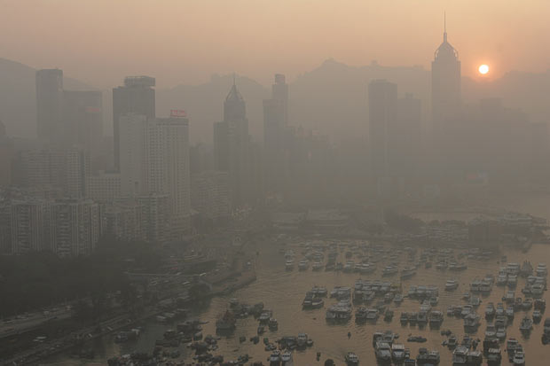
Air Pollution
Formations of smoke:
Brownish smoke appeared in large cities in the presence of sunlight.
It is visible only in noon time

Slide 4
Air Pollution
Source:
Unburnt fuel exhausted from vehicle and it reacts with oxides of nitrogen in the presence of sunlight.
Produces secodanry polutants like peroxyacyl nitrate, ozone, aldehydes and ketones.
Effect:
Breathing problems, eye, nose and throat irritation, Heart desseies.

Slide 5
Air Pollution
Control of photochemical smog:
Removing components of oxides of nitrogen by using compression or absorption techniques.
It can be controlled by recycling hydrocarbons emitted from the vehicles.

Slide 6
Oxygen and Ozone
Ozone is a allotropic from of oxygen.
Ozone contains 3 molecules.
In stratosphere continuously created by UV rays.
O2 + hϒ → O + O
O + O2 + hϒ → O3
O3 + hϒ →O2 + O
Net result is equilibrium concentration of ozone.

Slide 7
Oxygen and Ozone
The equilibrium is disturbed by chlorine, bromine ... etc.
It destroys ozone molecules and result into thinning of ozone layer it known as ozone hole.
The process of creation of hole in ozone layer due to chloro fluro carbons and nitrous oxide in the stratosphere is called ozone layer depletion.

Slide 8
Ozone Layer Depletion
Propellant in aerosol spray cans.
Refrigerants in refrigerators that contains freon gas.
High flying supersonic jets.
The detonation of nuclear weapons.
Blowing agent.
Usage of fire extinguisher.

Slide 9
Ozone Layer Depletion
Depleting Substances:
Freon – 11
Banned in many countries.
Freon – 12
It is still used in refrigerators, air conditioners and freezers.
Bromo fluoro carbons (BFC)

Slide 10
Ozone Layer Depletion
Depleting Reaction:
Step 1: Photo dissociation of Freon 12
CCl2F2 + hϒ → CClF2 + [CL]
Step 2: Ozone depletion or hole formation
[Cl] + O3 → ClO + O2
ClO + [O] → [Cl] + O2
ClO + O3 → ClO2 + O2
Aircrafts and jets produces NO
NO + O3 → NO2 + O2
NO + O3 → NO2 + [O]

Slide 11
Ozone Layer Depletion
Effects of ozone layer depletion:
It increases the UV light penetration that causes skin burns and skin cancer, kills lower fauna and flora.
It affects photosynthesis process of plants.
It also affects the climate change.
Yield of vital crops like corns, rice, soybean, bean, cotton and wheat will decrease.
Degradation of paints, plastics and other polymer materials will results in economic loss.
UV rays affect the aquatic life.

Slide 12
Ozone Layer Depletion
Control measures
Controlling CFC release.
Manufacturing of CFC is avoided.
Research alternatives for CFC.
Use of methyl bromide should be controlled.

Slide 13
Acid Rain
Acid rain means the presence of excessive acid in rain water.
If the pH of rainwater is low (below 6.5) due to the presence of CO2, SO2 and NO2 gases in the atmosphere then the rain is called acid rain.
CO2 + H2O → H2CO3
SO2 + H2O → H2SO4

Slide 14
Acid Rain
Effects of acid rain:
Decay of building which are made up of marble.
Damage of stone stages.
Damages metals and car finishes.
Aquatic life especially fish affected by the acidifications.

Slide 15
Acid Rain
Control of acid rain:
Emission of SO2, CO2 and NO2 should be controlled.
Coal with lower sulphur content must be used for thermal power plants.
Use of natural gals instead of coal.
Liming of lakes and soils should be done to minimize the effects of acid rain.
Coating of protective layer of inert polymer should be given in the interior water pipes of drinking water.
Avoiding the unnecessary usage of motor vehicles.

Slide 16
Global Warming
Green house effect or global warming is defined as “the progressive increase in earth’s temperature due to the effect of increase in composition of man-made CO2 in the atmosphere”.
Major greenhouse gases
CO2, CH4, N2O, CFC ... etc

Slide 17
Global Warming
Causes
Industrialization
Transportation
Combustion of fossil fuel
Deforestation

Slide 18
Global Warming
Impacts
Earth’s temperature increase from 1.5 ℃ to 5.5 ℃ by 2050.
Melting of polar ice leads to sea water level increase.
Change of rainfall pattern lead to spread of water borne diseases.
Leading to drought and flood causes water demand.
Species extinction due to rapid changes.

Slide 19
Global Warming
Control Measures
Reduce usage of CFC.
Use of energy effectively.
Use of renewable energy.
Shift of coal to natural gas.
Adopt sustainable agriculture.
Stabilize the population growth.

Slide 20
Particulate Matters
Particulate matters is a suspended droplets (or) solid particles or mixture of these two. It consists of inert or reactive materials is a size from 100 µ m.
Types
Inorganic dust (iron dust).
Droplets (Mist).
Fly ash (coal combustion).
Organic matters (benzene).

Slide 21
Particulate Matters
Effects
Petroleum combustion particles affects the haemoglobin formation.
Fly ash – respiratory problems
Metal dust - respiratory problems
Aerosols by airplanes – depletion of ozone layer.
Smog – effects on man and animal, cracks the rubber.
Dust coating – in effect photo synthesis.

Slide 22
Particulate Matters
Control Measures
It should be controlled at source.
Sedimentation.
Centrifugation.
Impaction.
Filtration.
Electrostatic precipitators.

Slide 23
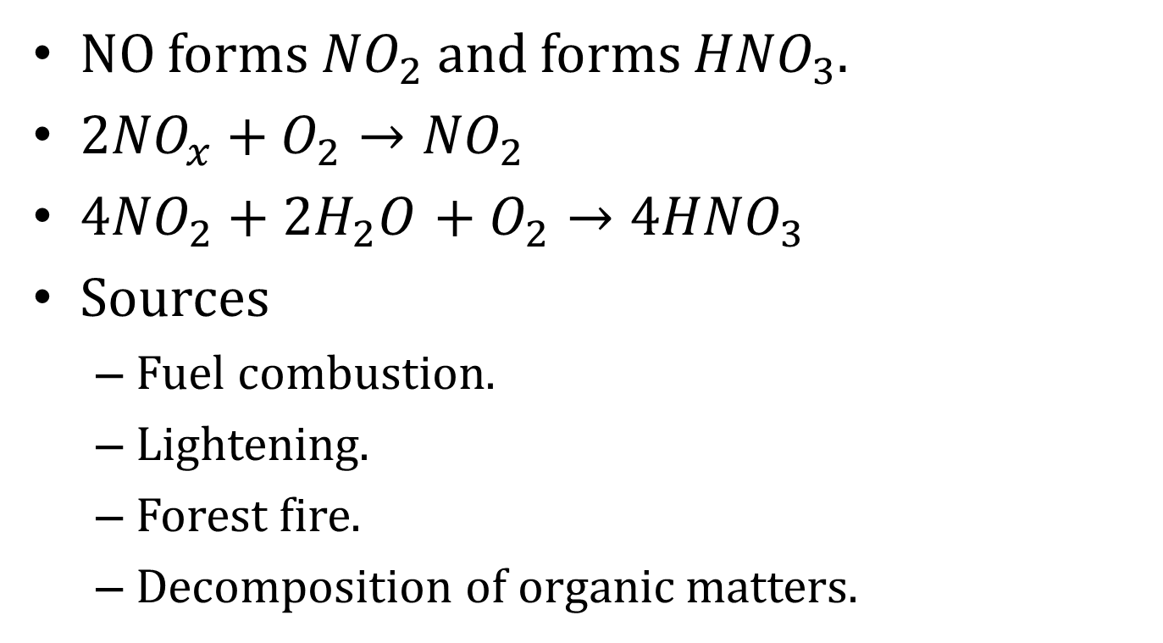
Oxides of Nitrogen (NOx)
NO forms ${NO}_{2}$ and forms ${HNO}_{3}$.
${2NO}_{x}+O_{2}→{NO}_{2}$
${4NO}_{2}+{2H}_{2}O_{ }+O_{2}→{4HNO}_{3}$
Sources
Fuel combustion.
Lightening.
Forest fire.
Decomposition of organic matters.

Slide 24
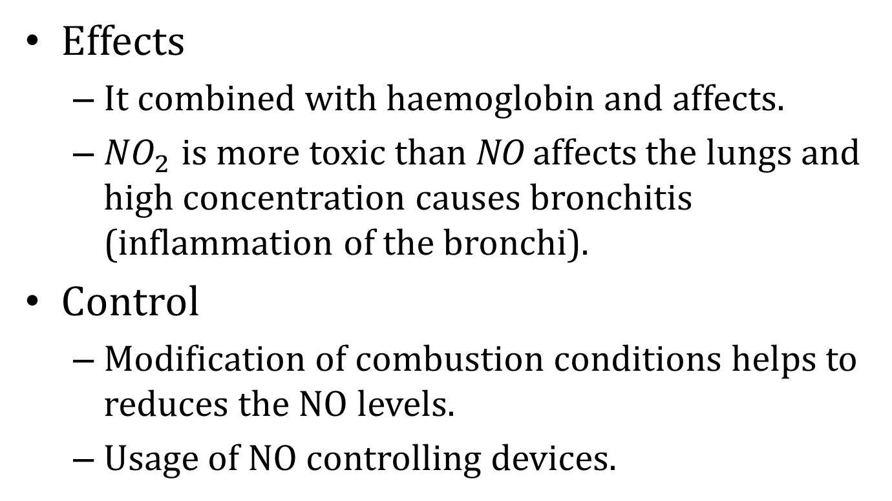
Oxides of Nitrogen (NOx)
Effects
It combined with haemoglobin and affects.
${NO}_{2}$ is more toxic than NO affects the lungs and high concentration causes bronchitis (inflammation of the bronchi).
Control
Modification of combustion conditions helps to reduces the NO levels.
Usage of NO controlling devices.

Slide 25
Carbon Monoxide
Effects
It affects the haemoglobin.
Head aches and anaemia.
Control
Adsorption
Absorption
Condensation
Combustion
Source control

Slide 26
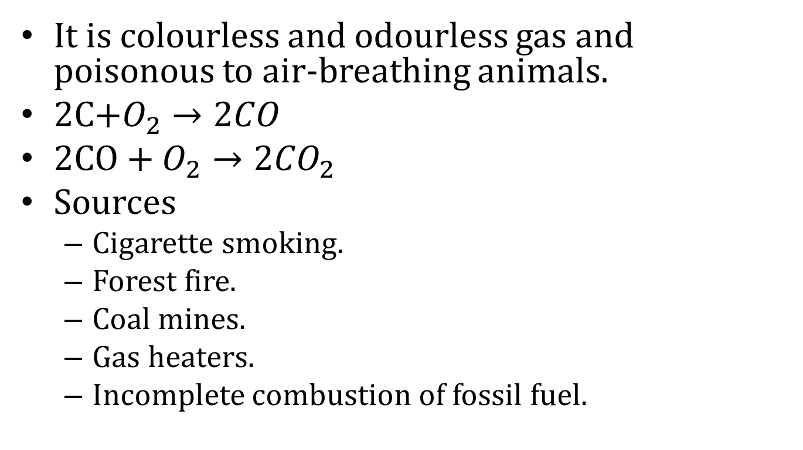
Carbon Monoxide
It is colourless and odourless gas and poisonous to air-breathing animals.
2C$+O_{2}→{2CO}_{ }$
2C$O+O_{2}→{2CO}_{2}$
Sources
Cigarette smoking.
Forest fire.
Coal mines.
Gas heaters.
Incomplete combustion of fossil fuel.

Slide 27
Sulphur Dioxides
It is colourless odourless irritating gas.
Sources
Fossil fuels
Effects
Breathing problem
Irritates the lungs.
Control
Burning fuel with less sulphur.
Liquefying coal and other sulphur contain fuels.

Slide 28
Hydrocarbons
It is produced in the atmosphere in the presence of sunlight and nitrogen.
Sources
Fossil fuels.
Effects
Irritates the eyes.
Damage the lungs.
Aggressive respiratory problems.
Control
It can be reduced by fixing catalytic convertors in the exhaust pipes in automobiles.
Controlling emission of hydrocarbons at the sources.

Slide 29
Water Pollution
Water pollution is defined as the discharging of impurities to water which alter physical, chemical or biological properties and make it unfit for drinking and domestic purpose.
Sources
Point sources.
Non point sources.

Slide 30
Water Pollution
Point Sources
It are specific sites which directly discharge effluents to water bodies.
Mining
Iron and steel
Chemical plants
Soap and detergents
Food processing
Paper and in the pulp effluents

Slide 31
Water Pollution
Non Point Sources
It is not specific sites which are scattered.
Surface runoff by agriculture.
Municipal drainage overflow.
Rain water sweeping the roads.

Slide 32
Common Water Pollutants
Industrial waste [effluents of industry]
Inorganic pollutants
Water soluble.
sulphates, cyanides, cadmium.
Organic pollutants
Cellulose fibbers.
Oils, Fats, Phenols.

Slide 33
Common Water Pollutants
Community waste or Domestic waste
Agricultural sources
Oil
Waste heat
Mining
Air pollution
Ground water pollution.

Slide 34
Water Quality Parameters
Physical Properties
Colour
Taste and Odour
Turbidity
Temperature

Slide 35
Water Quality Parameters
Colour
Due to presence of organic materials and minerals.
Measured in Hazan unit
5 Hazan is safe more than 25 Hazan is not usable for any purpose.
Taste and Odour
It is affected by living organic components and carbon dioxide , sulphur, hydrogen, oxygen, iron.
It is TTN (Threshold Taste Number).
It should not have unpleasant odour.

Slide 36
Water Quality Parameters
Turbidity
It is due presence of colloidal and suspended particles.
Expressed in nephelometric turbidity units.
Should be below 5 NTU.
Temperature
It is depend on viscosity, density, vapour pressure, surface tension.
It should be 10℃ to 15℃

Slide 37
Water Quality Parameters
Chemical Properties
Total dissolved solids
Hardness
pH
Copper
Sodium
Zinc

Slide 38
Water Quality Parameters
Total dissolved solids
Total organic and inorganic maters.
It is expressed in mg/l
~500 mg/l is safe.
Hardness
It is a ability to prevent form lather formation with soap.
300 ppm as CaCO3 safe.

Slide 39
Water Quality Parameters
pH
pH value is 7 for pure water.
pH is between 7 to 14 is for water
6.5 to 8.5 is safe to drink.
Copper
It affects the taste.
Excess of copper cause stomach and intestinal distress.
Corroding water pipes is a source.
Safe limit is 0.05 ppm.

Slide 40
Water Quality Parameters
Sodium
Excessive presence affects the heart, kidney.
It is increases the blood pressure.
Zinc
It affects the taste.
Safe limit is 5 mg/l

Slide 41
Water Quality Parameters
Biological Parameters
Bacteria
Disease causing bacteria's are known as pathogens.
It is removed by disinfection.
Algae
It is food for fish.
Presence in drinking water gives unpleasant taste and odor.
Protozoa
One cell organism (Ameba).
Causes disentery for children's.

Slide 42
Properties of Terrestrial and Seawater
Mixture of 96.5 % pure water and 3.5 % materials (salts, dissolved gases, organic substances).
60 % of animal body made of water.
It is naturally has 3 forms (solid, liquid, gas).
It affects the climate.
It has dissolved salts.

Slide 43
Properties of Terrestrial and Seawater
Absorption of Heavy metals
It is environmentally stable elements of high specific gravity and atomic weight.
Cd, Cu, Fe, Co, Zn, Hg, V, Ni, Cr, Mn, Mo.
It has binding property of metabolically active groups.
Toxicity
Solubility.
Stability.
B
Biological reactivity.

Slide 44
Thank You
Rajasekaran S
Assistant Professor,
Department of Information Technology,
KGiSL Institute of Technology,
email: proffraja@gmail.com
Github:www.github.com/rajasekaranap

