Slide 1
GE8291 Environmental Science and Engineering
Rajasekaran S
Assistant Professor,
Department of Information Technology,
KGiSL Institute of Technology,
email: proffraja@gmail.com
Github:www.github.com/rajasekaranap

Slide 2
Units
UNIT​ ​I​ ​
ENVIRONMENT, ECOSYSTEMS AND BIODIVERSITY
UNIT II
ENVIRONMENTAL POLLUTION
UNIT​ ​III​
​NATURAL RESOURCES
UNIT​ ​IV​
​SOCIAL ISSUES AND THE ENVIRONMENT
UNIT​ ​V​
​HUMAN POPULATION AND THE ENVIRONMENT

Slide 3
Definitions
Environmental Science
It is a study about the interrelationship of biotic (living) and abiotic (non - living) components present in the environment.
Environmental Engineering
It is the study of technical process which are used to minimize the pollution, asses the impact of human activities on environment and improve the quality of the environment,
Environmental Studies:
It is a process of imparting knowledge to the people for maintain healthy environment.

Slide 4
Importance of Environmental Studies
It provides information about the condition of environment that helps for planning and designing the projects.
Provides knowledge about eco system.
Provides information about biodiversity.
Helps to solve environmental problems.

Slide 5
Scope of Environmental Studies
To get an awareness and sensitivity of environmental problems.
To motivate active participation in improvement and protection of environment.
To develop the skills to solve environmental problems
To know the importance of conservation of natural resources.
To conduct environmental programs in terms of social, economic, ecological and ascetic factors

Slide 6
Need for Public Awareness
Increasing Population, Urbanisation and poverty it leads to degradation of natural resources.
It leads to public participations.
Types of participation
Pressure Group
Watch Dog
Advisory Council
Enforcing environmental laws

Slide 7
Concept of Ecosystem
Eco System
A stable self supporting system formed by the interaction of living and non living component present in the environment is called eco system.
It is basic functional unit of ecology.
Examples
Pond
Lake
Desert
Grassland
Forest
Marine
Ecosystem
Natural
Artificial

Slide 8
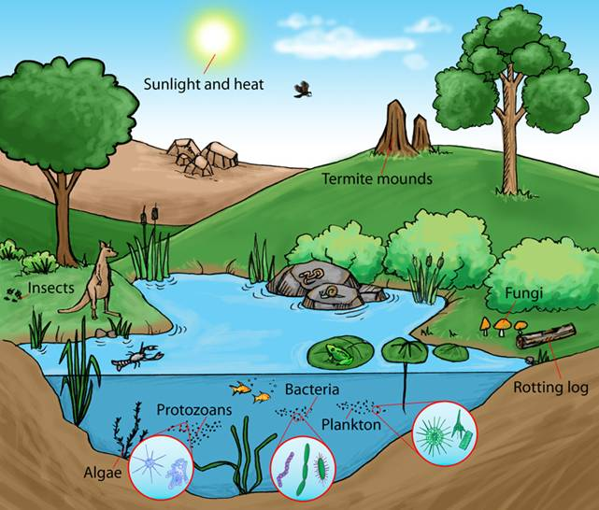
Ecosystem

Slide 9
Structure of an Ecosystem
Eco System
Biotic Components
Abiotic Component
Climate Factor
Rain
Light
Wind
Temperatures
Chemical Factor
Soil
pH
Minerals
Producer
Consumer
Primary
Secondary
Tertiary
Decomposer

Slide 10
Aboitic Components
Non Living Things
Climatic Factors [Helps for growth of biotic community]
Rain
Temperature
Light
Wind
Humidity
Solar Energy
Snow

Slide 11
Aboitic Components
Chemical Factors
pH
Essential Nutrients
Carbon
Nitrogen
Phosphors
Potassium
Hydrogen
Oxygen
Sulphur
Toxic substances
Organic substances

Slide 12
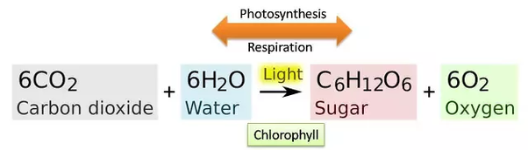
Biotic Components
Living Things
Producers
Manufacturer of food.
Photosynthesis

Slide 13
Biotic Components
Living Things
Consumers
It eats other livings things for food.
It directly or indirectly depends on producers.
Primary
Secondary
Tertiary

Slide 14
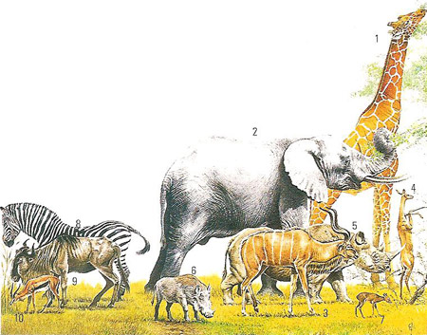
Biotic Components
Primary Consumers
Directly depends on Plants
Herbivores

Slide 15
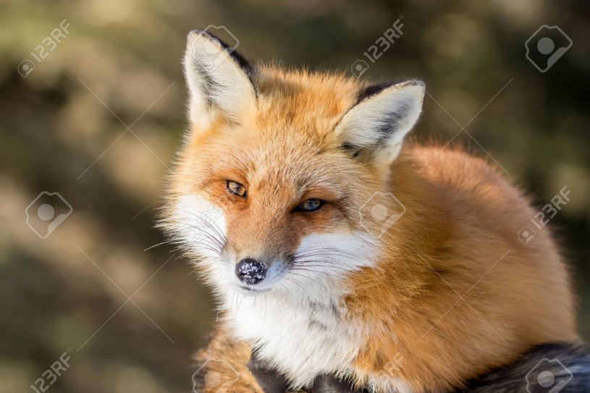
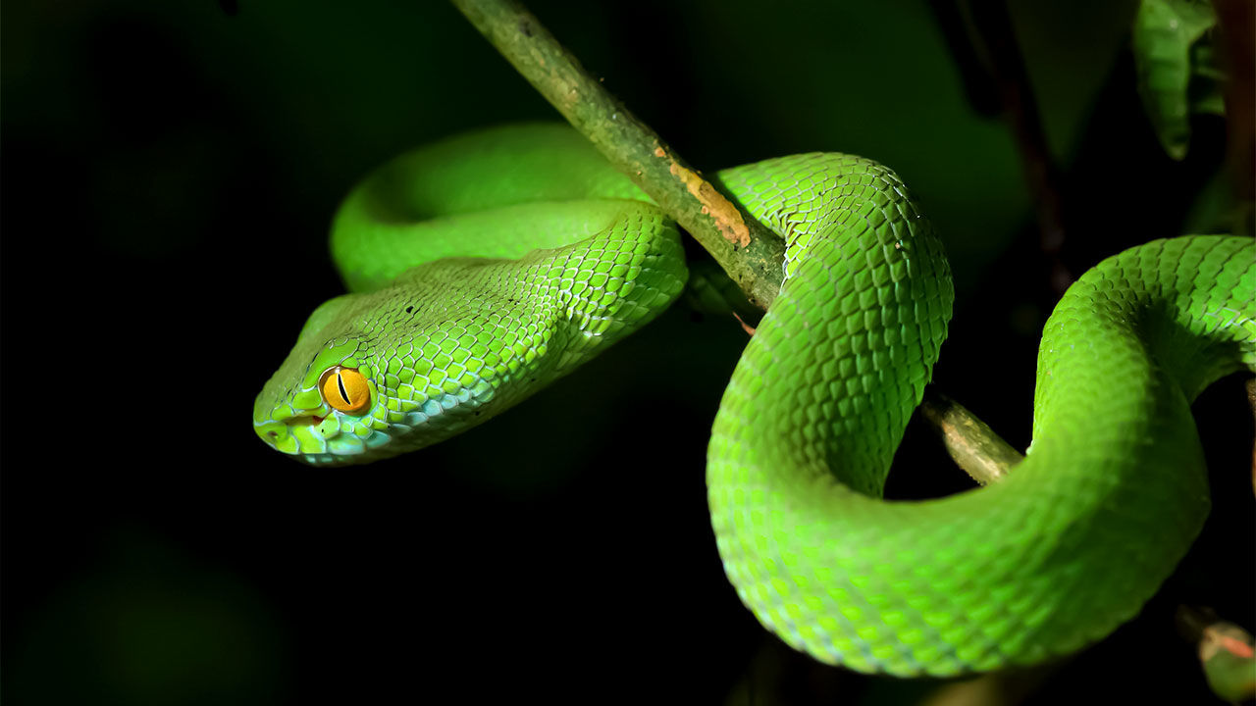
Biotic Components
Secondary Consumers
Directly depends on Herbivores
Also know as primary carnivores

Slide 16
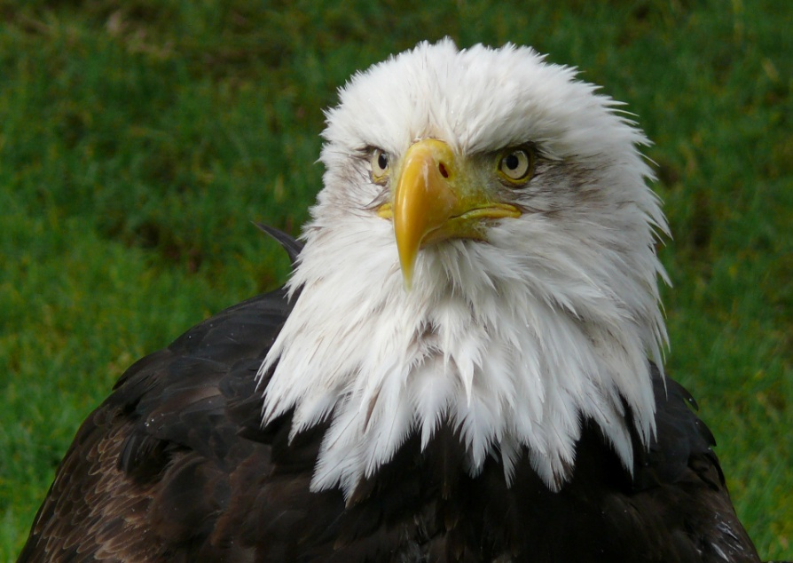
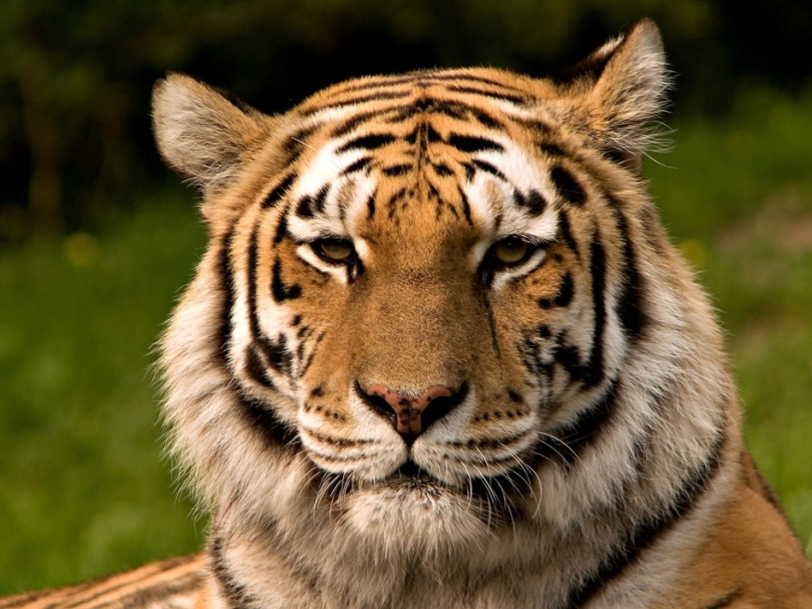
Biotic Components
Secondary Consumers
Directly depends on primary carnivores
Also know as large carnivores

Slide 17
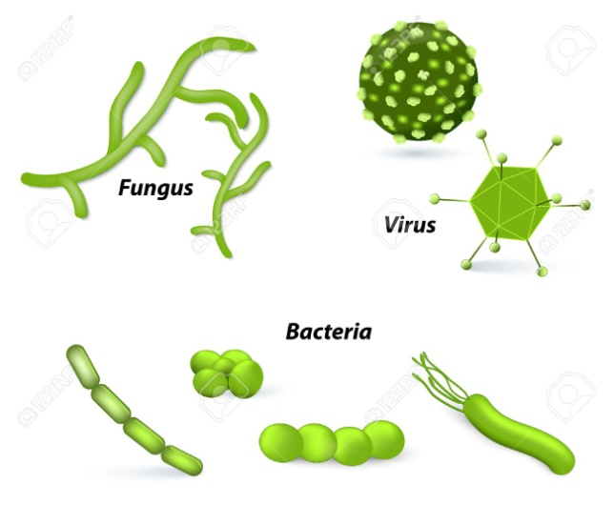
Biotic Components
Decomposers
It is microorganisms.
Bacteria and Fungi
Attacks the dead (producers and consumers) and decomposes into simple components.
It is used by producers to synthesis own food.
Also known as
Saprottrophs
Microconsumers
Osmotrophs

Slide 18
Function of Ecosystem
Three major functions
Production and respiration rates of the organisms.
Rates of material and nutrient cycle.
Biological or ecological regulation.
Rate of organic mater or biomass production is known as productivity

Slide 19
Primary Production
Rate of solar energy captured and converted into food through photosynthesis is known as primary productivity.
How sunlight is utilized.

Slide 20
Secondary Production
Rate of increase in the biomass of consumer per unit of time is called secondary productivity.
Ability to distribute or store the energy by consumer.

Slide 21
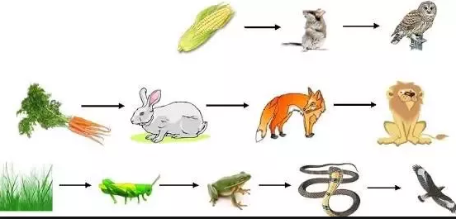
Food Chain
It is known as the transfer of food energy from plants through a series of organism is referred as food chain.

Slide 22
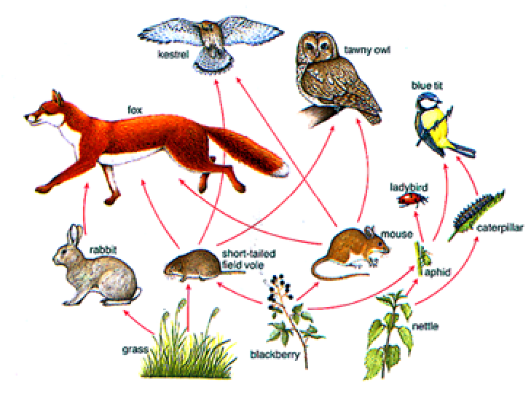
Food Webs
Interlinking pattern of various food chains in an ecosystem is called food web.

Slide 23
Food Webs
Need of complex of food web.
It stabilizes the ecosystem.
Linear food chains are vulnerable.
It helps tropic level species to survive in tough times like brake in food chains.

Slide 24
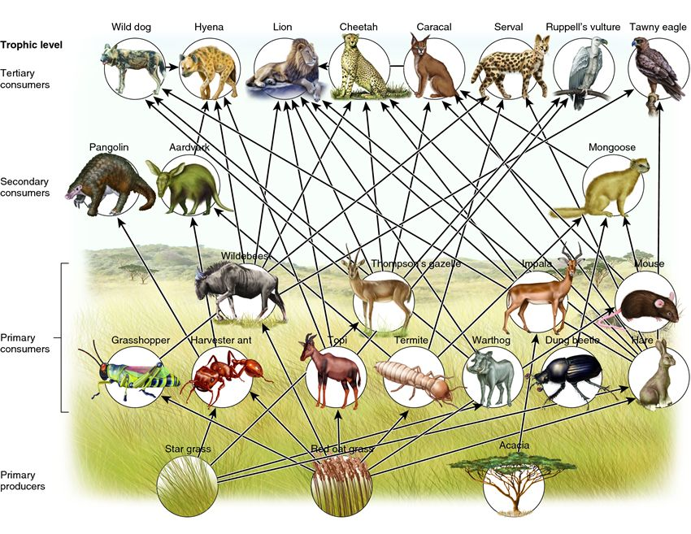
Complex Food Web

Slide 25
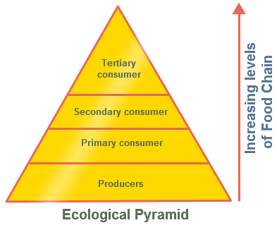
Ecological Pyramid
The graphical representation of structure and function of each tropic level of an ecosystems are referred as ecological pyramid.

Slide 26
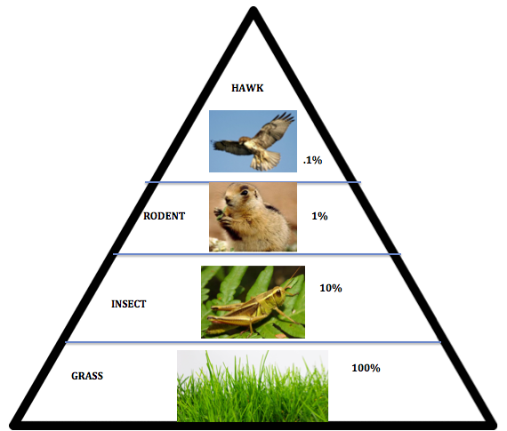
Energy Level Pyramid

Slide 27
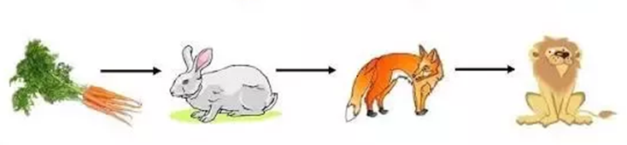
Energy Flow in Ecosystem
Energy entered as radiation in ecosystem and converted in to chemical energy by producers.
Energy transfer to tropic level through food chain.

Slide 28


Energy Flow in Ecosystem
Producers
(Metabolism)
Chemical Energy
Consumer
Sun
Chemical Energy
Decomposers
(Metabolism)
Heat

Slide 29
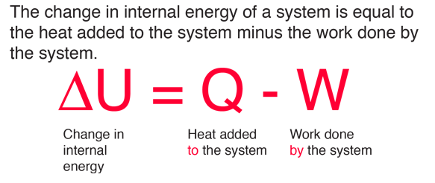
Energy Flow in Ecosystem
First Law of Thermodynamics
Energy can neither be created nor destroyed.
One form of energy is converted into another form
plants

Slide 30
Energy Flow in Ecosystem
Second Law of Thermodynamics
Whenever energy is transferred there is a loss of energy through the release of heat.
100 % energy transfer is not possible.
Part of energy captured is used for gross production.
The gross primary production (GPP) is used for maintenance (respiration) and providing food for herbivores.
Unused net primary production (NPP) serves as energy sources for decomposers.

Slide 31
Energy Flow in Ecosystem
Pg = Pn + R
Pg = Gross productivity (or) energy input.
Pn = Net productivity (or) energy stored.
R = Respiration (or) energy used to do work.

Slide 32
Ecological Succession
The progressive replacement of plants and animals communities by another in given area, till the establishment of stable or climax community is called as ecological succession.
The establishment of community.

Slide 33
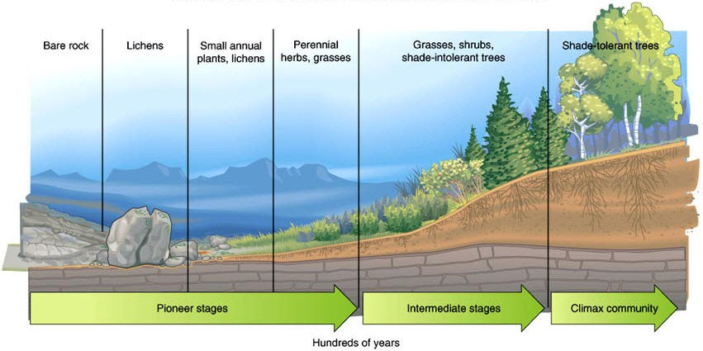
Ecological Succession

Slide 34
Ecological Succession
Ecological Succession
Secondary Succession
Primary Succession

Slide 35
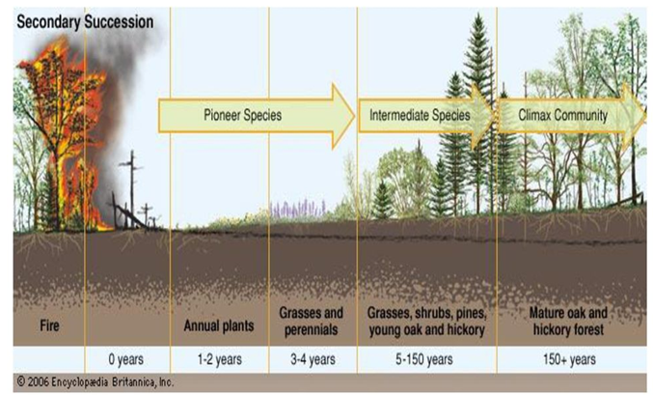
Ecological Succession

Slide 36
Ecological Succession
Primary Succession
It involves the gradual establishment of biotic community on a nearly lifeless ground.
This process start from wet or dry area.
Secondary Succession
It involves the establishment of biotic communities in an area where some type of biotic community is already present.

Slide 37
Ecological Succession (Process Involved)
Nudation
Migration
Establishment
Aggregation
Invasion
Competition and co-action
Reaction
Stabilisations

Slide 38
Ecological Succession (Process Involved)
Nudation
It is development of base area due to landslides, erosion, clearing of forest like any kind of catastrophes.
Migration (or) Dispersal
Seeds are spores reaching base area in known as migration.
It is done by air, water, animal, man.
First arrives are called as pioneers.

Slide 39
Ecological Succession (Process Involved)
Establishment
After migration when it started to grow and reproduce is known as establishment.
An individual species are established in the area is called pioneer community.
Aggregation
After establishment increment in number of individuals is known as aggregation.

Slide 40
Ecological Succession (Process Involved)
Invasion
From time to time pioneers of new species continue to reach the bare area under colonisation.
The new species is known as invaders.
Competitions and co-action
After aggregation of large number of species in a limited place, there is a competition between the colonisers and invaders for water and nutrition's.
Both the species affects others life in many ways.
It is known as co-action.

Slide 41
Ecological Succession (Process Involved)
Reaction
It is a changes brought out by colonisers.
Changes in soil, water, light conditions, temperatures due to their growth.
Modification is unstable for existing species and they are replaced by another suitable community.

Slide 42
Ecological Succession (Process Involved)
Stabilisations
Continues competition, invasion and reaction which gives continues changes in the environment and in the structure of vegetation.
After long interval stable community formed.
No further changes will occur in vegetation it is known as climax and community known as climax community.

Slide 43
Types of Ecosystem
Ecosystem
Artificial
Natural
Terrestrial Ecosystem
Grassland
Forest
Desert
Aquatic Ecosystem
Marine Ecosystem
Fresh Water Ecosystem
Running Water [Lotic]
Standing Water [Lentic]
Dams, Industries, Labs

Slide 44
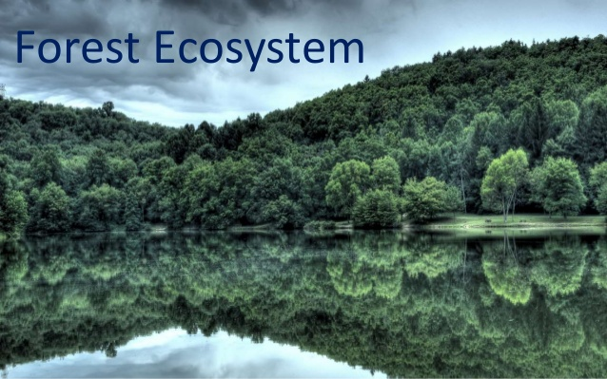

Slide 45
Forest Ecosystem
It contains tall tress [12 to 30m] and dense herbs support for animals and birds.
Development of forest based on
Rainfall
Humidity
Temperature
40 % land covered in world.
19 % in india.

Slide 46
Forest Ecosystem
Characteristics of forests
Adequate rainfall forms number of ponds, lakes
Tall trees supports many wild animals in ecosystem.
Penetration of light is poor so conversion of organic matter to nutrient is fast.
Soil is rich is organic maters and nutrients
Occupies more space in land compare to other ecosystem.
Maintains uniform temperature throughout the season

Slide 47
Structure of Forest Ecosystem
Abiotic Components
Chemical
Organic mater
Atmosphere
Climate
Warm temperature
Poor light
heavy rainfall

Slide 48
Structure of Forest Ecosystem
Biotic Components
Producers
Trees and Shrubs
Consumer
Primary
Ant’s, Flies, Insects, mice, deer
Secondary
Snakes, Birds, Foxes, etc.,
Tertiary
Lions, Tigers, Eagles

Slide 49
Structure of Forest Ecosystem
Biotic Components
Decomposers
Microorganisms
Fungi
Bacteria

Slide 50
Food Chain of Forest Ecosystem
Food Chain
Plants → Deer →Tiger
Plants → Rabbits →Snakes →Eagles
Examples
Western Ghats in india

Slide 51
Function of Forest Ecosystem
It maintains climate and rainfall.
It provides biodiversity.
It provides the wood materials.

Slide 52
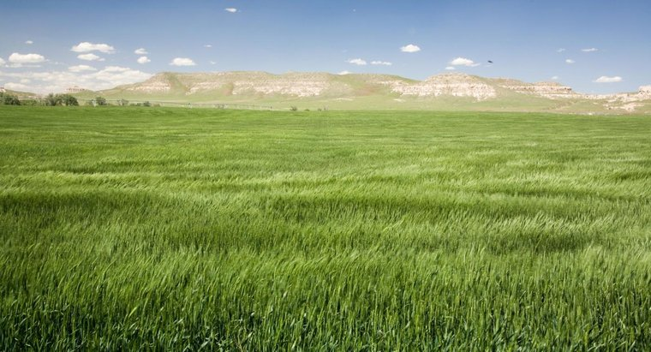
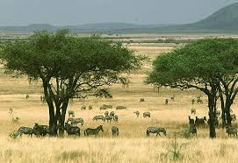
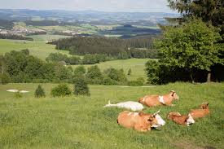
Grassland Ecosystem

Slide 53
Grassland Ecosystem
It is a plain land occupied by grasses.
Climate is cool or cold in winters and hot in summers.
It occupies 20 % of earth surface.
It forms where rainfall is 25 – 75 cm per year.
Mostly found in Europe, Asia and North America

Slide 54
Grassland Ecosystem
Characteristics of forests
Rainfall is low or uneven
Periodic drought
Flat or slightly rolling surface.
Soil is rich in organic matters and nutrients.
Moderate tall grass support for grazing animals

Slide 55
Structure of Grassland Ecosystem
Abiotic Components
Nutrients in soil
C, H, N, P, S, H2O, CO2
Nitrate, Phosphates, Sulphates

Slide 56
Structure of Grassland Ecosystem
Biotic Components
Producers
Grass , Shrubs and few trees.
Consumer
Primary
Cows, Rabbits, Sheep, Deer
Secondary
Snakes, Birds, Forges, Foxes, etc.,
Tertiary
Eagles, Hawks

Slide 57
Structure of Grassland Ecosystem
Biotic Components
Decomposers
Bacteria
Fungi

Slide 58
Food Chain of Grassland Ecosystem
Food Chain
Grasses→ Grasshoppers →Lizards →Eagles
Grasses → Rabbits →Hawk

Slide 59
Function of Grassland Ecosystem
Grass traps solar energy and biomass is consumed by herbivores
Ideal place for grazing animals
Grass prevent soil erosion.

Slide 60
Desert Ecosystem
It occupies 17 % of area in the world
It has extreme low rainfall.
The region receives less than 25 cm rainfall in a year is classified as desert.
Example
Sahara – Africa
Thar – India
Gobi - China

Slide 61
Desert Ecosystem
Characteristics
Dry and climate is hot
Very large variations in diurnal (Daily variations) temperatures 5 to 10 digress.
Soil contain poor organic mater
Very less vegetation.
Annual rainfall is less than 25 cm.

Slide 62
Structure of Desert Ecosystem
Abiotic Components
Dry soil
Low rainfall
High temperature
Biotic Components
Producers
Some grasses
Some shrubs
Bushes and very few trees.

Slide 63
Structure of Desert Ecosystem
Biotic Components
Consumers
Primary
Insects, Mice, Rabbits, Reptile
Secondary
Lizards, Darkling Beetle
Tertiary
Eagles, Owls, Agaves
Decomposers
Bacteria and Fungi

Slide 64
Desert Ecosystem
Food Chain
Shrubs or grass or trees →Insects →Lizards →Eagles
Functions
Desert land is low in nutrients so not many plant lives.
Soil has micro and macronutrients
Deserts are less in water hence cannot be easily accessible for over exploitation.

Slide 65
Aquatic Ecosystem
It occupies 70 % of world.
It helps cycling of chemical substances and influences the growth and activities of terrestrial ecosystem.
Pond Ecosystem
Lake Ecosystem
River Ecosystem
Ocean Ecosystem
Estuarine Ecosystem

Slide 66
Pond Ecosystem
It is a fresh water ecosystem.
It receives enough water during rainy season.
Characteristics
Stagnant fresh water.
Temporary or only seasonal.

Slide 67
Pond Ecosystem
Abiotic Components
Temperature
pH
Light
Organic and Inorganic compounds
Portions and Lipids
Turbidity

Slide 68
Pond Ecosystem
Biotic Components
Producers
Rooted plants
Floating and suspended lower plants
Phytoplankton
Algae, Flagellies, Volvox
Microphytes
Hydrilla, Demna

Slide 69
Pond Ecosystem
Biotic Components
Consumers
Primary
Zooplankton
Protozoan's, ciliates
Secondary
Insects like water beetles
Small fish
Tertiary
Large fishes
Decomposers
Bacteria, Fungi, Actinomycetes

Slide 70
Pond Ecosystem
Functions of pond ecosystem
It is resources for small water requirements and village forming.
It contains more algae, plants, animals and self sufficient ecosystem.

Slide 71
Lake Ecosystem
Lakes are large natural shallow water bodies.
Lakes are used for many purpose.
Lakes are supplied with water from rainfall, melting snow and streams.

Slide 72
Types of Lakes
Oligotrophic lakes
Low nutrient concentrations.
Eutrophic lakes
They are over nourished by nutrients like N and P.
Dystrophic lakes
They have low pH, high humic acid content and brown waters

Slide 73
Types of Lakes
Volcanic lakes
They receive water from magma after volcanic eruptions.
Meromictic lakes
They are rich in salts.
Artificial Lakes
They are created due to construction of dams.

Slide 74
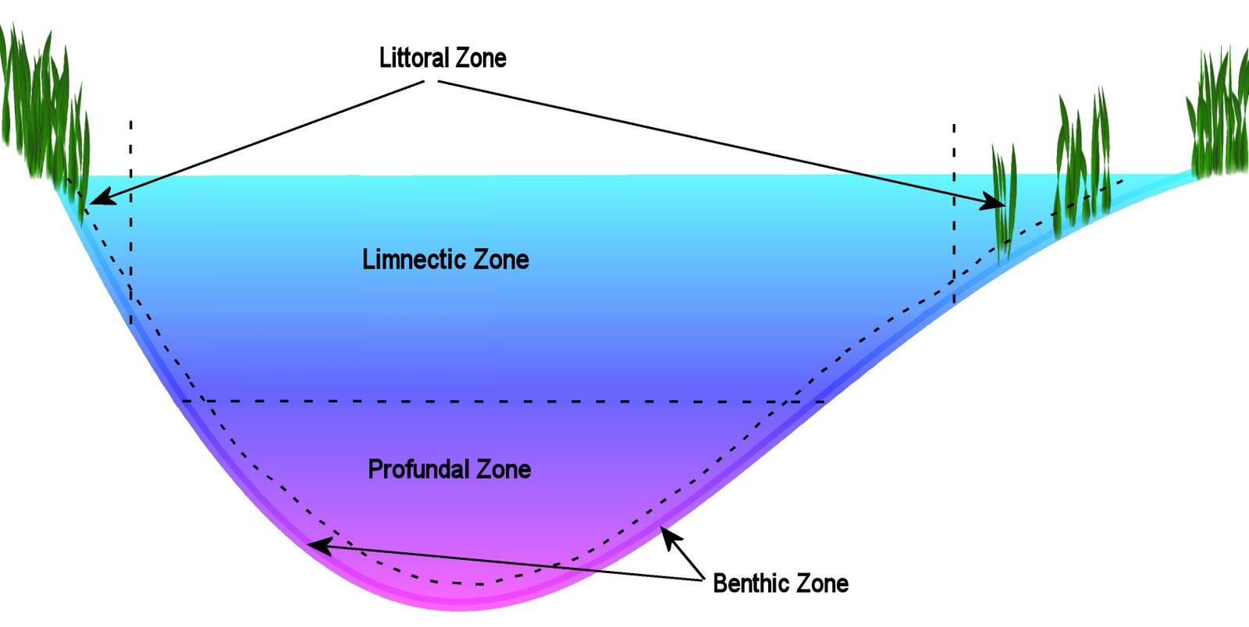
Zones of Lake

Slide 75
Zones of Lake
Littoral Zone
adjoins the shore (and is thus the home of rooted plants) and extends down to a point called the light compensation level, or the depth at which the rate of photosynthesis equals the rate of respiration.
It has the shallow water.

Slide 76
Zones of Lake
Limnetic zone:
Effective penetration of sunlight.
derives its oxygen content from the photosynthetic activity and atmosphere.
Pro-fundal zone
The bottom and deep water area of a lake, which is beyond the depth of effective light penetration is called the pro-fundal zone.

Slide 77
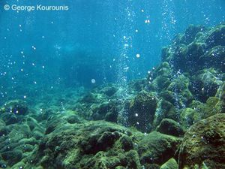
Zones of Lake
Benthic zone
Almost zero percent in light penetration.
Creature must adapt for this situation.
Water pressure is high.
Lake sediment is there.

Slide 78
Lake Ecosystem
Characteristics
Shallow fresh water body
Permanent water body with large resources.
Helps in irrigation and drinking.

Slide 79
Lake Ecosystem
Abiotic Components
Temperature
Light
Proteins and lipids
Turbidity
O2 and CO2

Slide 80
Lake Ecosystem
Biotic Components
They are green plants submerged, floating plants
Phytoplankton
Algae
Flagellates
Consumers
Primary
Cilictes, protozoans

Slide 81
Lake Ecosystem
Biotic Components
Consumers
Secondary
Insects and small fishes
Tertiary
Large fishes
Decomposers
Bacteria
Fungi
Actinomycetes

Slide 82
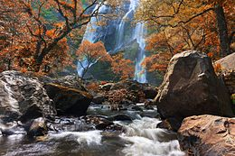
River (Stream) Ecosystem
The running water of stream or river is usually well oxygenated, because it absorbs oxygen from the air.
The number of animals in river is low in stream

Slide 83
River (Stream) Ecosystem
Characteristics
Fresh water
Free flowing water
Due to running dissolved oxygen is high
River deposits large amount of nutrients

Slide 84
River (Stream) Ecosystem
Abiotic Components
Temperature
Light
pH
Nutrients
Organic and inorganic components

Slide 85
River (Stream) Ecosystem
Biotic Components
Producers
Phytoplankton
Algae
Water grasses
Aquatic masses
Consumers
Primary
Water insects, snails, fishes

Slide 86
River (Stream) Ecosystem
Biotic Components
Consumers
Secondary
Birds and mammals
Decomposers
Bacteria
Fungi

Slide 87
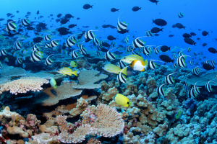
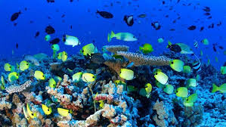
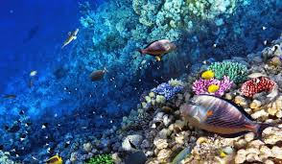
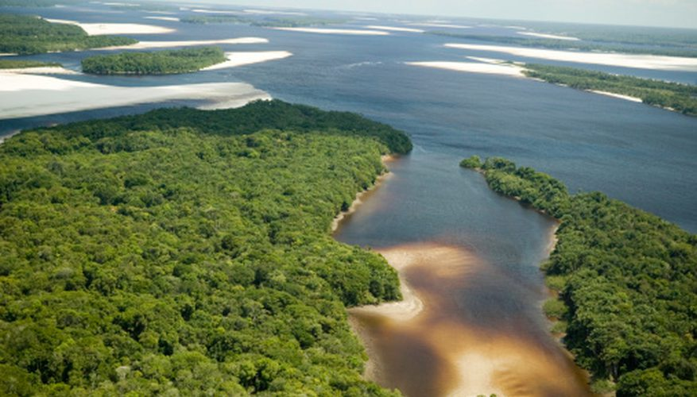
Marine Ecosystem (Saltwater Ecosystem)

Slide 88
Ocean Ecosystem
It covers two third of earth surface
It is characterized by high concentration of salt and minerals.
It supports huge variety of sea-products and drugs.
It supports large variety of animals and plants
It provides iron, magnesium, phosphorus, natural gas.

Slide 89
Zones of Ocean
Coastal zone
It is relatively warm
Nutrient rich
Shallow water
It is high is primary productivity

Slide 90
Zones of Ocean
Open sea
Deeper part of the ocean
Divided into three regions
Euphotic zone
Revives good light
High photosynthetic activity
Bathyal zone
Receives dim light
Geologically active
Abyssal zone
It is dark zone very deep (2000 to 5000 m)

Slide 91
Values of Biodiversity
Evaluation of biodiversity
Two Types
Direct Values
Indirect Values

Slide 92
Values of Biodiversity
Direct Values
Direct use of medicinal and agricultural values
Harvest and consumption
Types
Consumptive use values
Productive use values

Slide 93
Values of Biodiversity
Consumptive use values
It is where the natural products are consumed directly without passing through market.
Eg:
Food
Wild plats, Wild animals
Drugs and medicine
70% of Morden medicine derived from plant and extracts.
20000 species are used is Ayurveda, Sidha and Unani
Fuel
Coal, Petroleum, Natural gas, Firewood

Slide 94
Values of Biodiversity
Productive Values
It is commercial value of natural products.
It is marketed and sold.
Eg:
Silk (silk worm)
Wool (sheep)
Mush (Musk deer)
Tusk (Elephants)
Leather (all animals)
Food (Fish and animals)

Slide 95
Values of Biodiversity
Indirect Values
It involves in the functions performed by biodiversity which are not of any direct use.
It has economic benefits without consumption.
Types
Social Values
Ethical Values
Aesthetic values

Slide 96
Values of Biodiversity
Ethical Values
In this species may or may not use but the existence of these will give us pleasure.
It involves issues like “All life must be preserved”.
Eg:
River ganga worship
Vembu, Tulsi worship
Wild life existence

Slide 97
Values of Biodiversity
Aesthetic Values
Admiring beauty of the nature and protect it.
By protecting this aesthetic value it gives the indirect economic growth.
Eg:
Eco- Tourism
Enjoying wild life
Camping and Living
Option Value
Unknown values of biodiversity

Slide 98
Bio Diversity at Global Level
1.75 million species are discovered.
Kingdom | Described Species | Estimated Total
Bacteria | 4000 | 1000000
Algae and protozoa | 80000 | 600000
Fungi | 70000 | 10500000
Animals | 1320000 | 10000000
Planets | 270000 | 3000000
Total | 1744000 | 14000000

Slide 99
Bio Diversity at Global Level
1.75 million species are discovered.
71 % of earth is covered by water.
2.3 % is non saline water.
2/3 is locked in ice
1/3 is ground water
40 % fish in fresh water
29 % covered by human

Slide 100
Biodiversity National Level
India is 2nd largest country conations 5% of worlds biodiversity and 2% of earth surface.
Rank of India
10th in plant rich countries.
11th in endemic species of higher vertebrates.
6th in centres of biodiversity and origin of agricultural crops.
10th rank in diversity of mammals.

Slide 101
India as a Mega Diversity Nation
It is 12 mega countries in the world.
Rare species
Bengal Tiger
Indian Elephant
Asian lion of Gir
50,000 species of insects.
13,000 butterflies and moths.
18% plants of endemic
50% of lizard are endemic

Slide 102
India as a Mega Diversity Nation
India has
5 world heritage sites
12 biosphere reserves
6 ramsar wetlands
27 indigenous breeds of cattle
40 breeds of sheep
22 breeds of goats
8 breeds of buffaloes
89 national parks
497 sanctuaries

Slide 103
Hot spots of Biodiversity
Endemic Species
Endemic species are plants and animals that exist only in one geographic region.
Hotspot
Hot spots are the geographic area which has high endemic species.

Slide 104
Criteria for recognising hot spots
Rich in endemic spices.
Significant percentage of specialised species.
The site under threat.
Contain gene pools of plants of potentially useful plants.

Slide 105
Hotspots in India
Eastern Himalayas (Indo-Burma region)
9000 types of plants
3500 endemic species
55 endemic flowers are recognized as rare.
Recognized as “cradle of speciation”.
Rich in wild relatives of plants of economic significance(rice, banana, citrus…).
Centre of origin and diversification of five palms
Tea is cultivated for last 4000 years

Slide 106
Hotspots in India
Western Ghats
It has 315 types of vertebrates.
12 mammal
13 birds
89 retails
87 amphibians
104 fish
235 species of endemic flowering plants
1500 endemic species of plants

Slide 107
Threats to Biodiversity
Any disturbance in the ecosystem that causes of reduction of biodiversity is known as threat.
Known Threats
Habitat loss
Over-exploitation
Pollution
Species Introduction
Natural Climates
Drought, Disease, Cyclone, Floods

Slide 108
Thank You
Rajasekaran S
Assistant Professor,
Department of Information Technology,
KGiSL Institute of Technology,
email: proffraja@gmail.com
Github:www.github.com/rajasekaranap

