Slide 1
GE8291 Environmental Science and Engineering
Rajasekaran S
Assistant Professor,
Department of Information Technology,
KGiSL Institute of Technology,
email: proffraja@gmail.com
Github:www.github.com/rajasekaranap

Slide 2
Units
UNIT​ ​I​ ​
ENVIRONMENT, ECOSYSTEMS AND BIODIVERSITY
UNIT II
ENVIRONMENTAL POLLUTION
UNIT​ ​III​
​NATURAL RESOURCES
UNIT​ ​IV​
​SOCIAL ISSUES AND THE ENVIRONMENT
UNIT​ ​V​
​HUMAN POPULATION AND THE ENVIRONMENT

Slide 3
Definitions
Environmental Science
It is a study about the interrelationship of biotic (living) and abiotic (non - living) components present in the environment.
Environmental Engineering
It is the study of technical process which are used to minimize the pollution, asses the impact of human activities on environment and improve the quality of the environment,
Environmental Studies:
It is a process of imparting knowledge to the people for maintain healthy environment.

Slide 4
Importance of Environmental Studies
It provides information about the condition of environment that helps for planning and designing the projects.
Provides knowledge about eco system.
Provides information about biodiversity.
Helps to solve environmental problems.

Slide 5
Scope of Environmental Studies
To get an awareness and sensitivity of environmental problems.
To motivate active participation in improvement and protection of environment.
To develop the skills to solve environmental problems
To know the importance of conservation of natural resources.
To conduct environmental programs in terms of social, economic, ecological and ascetic factors

Slide 6
Need for Public Awareness
Increasing Population, Urbanisation and poverty it leads to degradation of natural resources.
It leads to public participations.
Types of participation
Pressure Group
Watch Dog
Advisory Council
Enforcing environmental laws

Slide 7
Concept of Ecosystem
Eco System
A stable self supporting system formed by the interaction of living and non living component present in the environment is called eco system.
It is basic functional unit of ecology.
Examples
Pond
Lake
Desert
Grassland
Forest
Marine
Ecosystem
Natural
Artificial

Slide 8
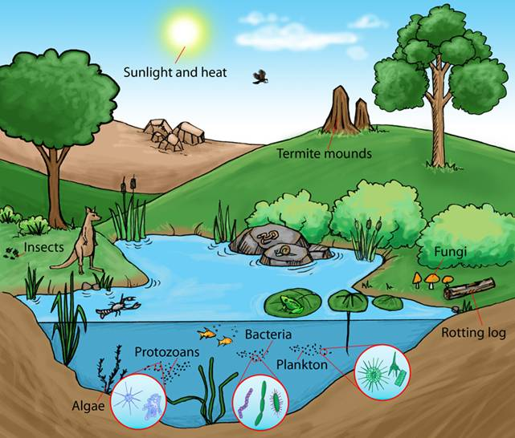
Ecosystem

Slide 9
Thank You
Rajasekaran S
Assistant Professor,
Department of Information Technology,
KGiSL Institute of Technology,
email: proffraja@gmail.com
Github:www.github.com/rajasekaranap

