Slide 1
IT6601 Mobile Computing
Rajasekaran S
Assistant Professor,
Department of Information Technology,
KGiSL Institute of Technology,
email: proffraja@gmail.com
Github:www.github.com/rajasekaranap

Slide 2
Units
UNIT​ ​I​ ​
INTRODUCTION
UNIT II
MOBILE INTERNET PROTOCOL AND TRANSPORT LAYER
UNIT​ ​III​
​MOBILE TELECOMMUNICATION SYSTEM
UNIT​ ​IV​
​MOBILE AD-HOC NETWORKS
UNIT​ ​V​
​MOBILE PLATFORMS AND APPLICATIONS

Slide 3
Introduction
Mobile Computing
Ability to compute remotely on the move.
People can access the information from anywhere and anytime in the world.
It is also known as
Ubiquitous computing.
Nomadic computing
Mobile Computing
Mobile Communication

Slide 4
Deference
Mobile Computing
Capability to automatically carry out certain processing related to service invocations on a remote computers.
Mobile Communication
Capability to change the location while communicating to invoke computing services at some remote computers.

Slide 5
Wireless Networking
Wireless networks are computer networks that are not connected by cables of any kind.
It help us to reduce physical cable costs.
Mobile Computing
Mobile Communication
Wireless Networking
Wired Networking

Slide 6
Mobile Computing vs Wireless Networking
Wireless networking is essential for mobile computing.
It provides a basic structure for communicating.
Mobile computing is about accessing services from remote computers.
Mobile computing involves software development on serversides.

Slide 7
Types of Wireless Networks
Wireless Networks
Fixed
Infrastructure Based
No Fixed
Infrastructure Less

Slide 8
Fixed Infrastructure Based
It uses the fixed Infrastructure.
Simply the extension of wired network.
Single Hop Communication or Two Hop Communication.
Wireless LAN (WLAN).
Expertise in setting up is not required.

Slide 9
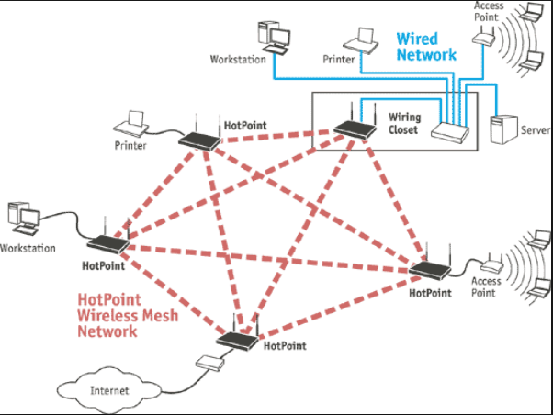
Fixed Infrastructure Based

Slide 10
No Fixed Infrastructure
It is also called as Ad-hoc Networks.
Data channels through multiple hops.
Stable Infrastructure is not necessary.
PAN ( Personal Area Network - Created by Bluetooth Devices ) are best examples.
It requires the expertise knowledge.
Less reliable than Infrastructure based wireless networks.

Slide 11
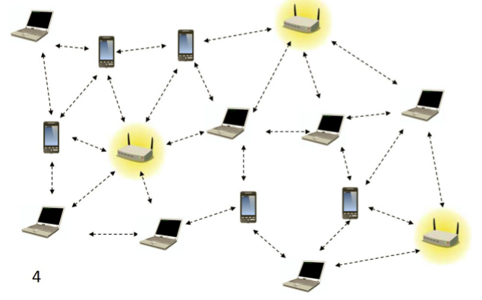
No Fixed Infrastructure

Slide 12
Characteristics of Mobile Computing
Ubiquity.
Location Awareness.
Adaptation.
Broadcast.
Personalization.

Slide 13
Ubiquity
Present every where.
Ability to perform computation anywhere any time.
Very essential for business people.

Slide 14
Location Awareness
GPS System ( Handheld devices are now equipped with this ).
It is useful provide personalized services.
Services
Maps
Traffic Control
Emergency Services.
Fleet Management. ( Managing vehicles under one command )

Slide 15
Adaptation
Adaptation in mobile computing context that adjusting with bandwidth fluctuations without inconveniencing the customers.
It is very crucial for problems we have in mobile technologies,
Handoffs.
Obstacles.
Environmental noises.

Slide 16
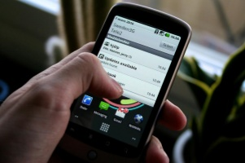
Broadcast
Effective data transmission for more than one node in the network.
Advertising services based on the locations of the users.
Location based deals.

Slide 17
Personalization
Mobile should be personalized according to the user profiles.
We can personalize the information source for correct information source.
Subscribing for specific news channels or news topics and get the valid information.

Slide 18
Thank You
Rajasekaran S
Assistant Professor,
Department of Information Technology,
KGiSL Institute of Technology,
email: proffraja@gmail.com
Github:www.github.com/rajasekaranap

