Slide 1
Genomics Files Formats

Slide 2
Overview
Fasta and FastQ (unaligned sequences)
SAM/BAM (aligned sequences)
Summarized genomic features
BED (genomic intervals)
GFF/GTF (gene annotation)
BEDgraphs (genomic scores)

Slide 3
FastA Format:
FastA format is the most basic sequence format and is accepted by almost all sequence analysis program.
FastA format sequence consists of two lines:
The first is the sequence header, which always starts with a ‘>’
First line begins with ‘>’ to the first whitespace is considered the sequence identifier. Everything after that is considered the sequence description (this can be metadata, machine serial number, read orientation, etc.)
The sequence itself
Note that the sequence can span multiple lines, depending on the length of the sequence.

Slide 4
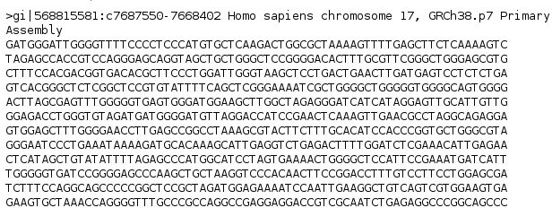
FastA Format

Slide 5
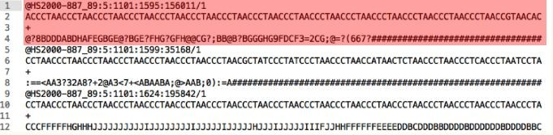
FastQ
FastQ: FASTA with quality
This format is similar to fasta though there are differences in syntax as well as integration of quality scores. Each sequence requires at least 4 lines:
The first line is the sequence header which starts with an ‘@’.
Everything from the leading ‘@’ to the first whitespace character is considered the sequence identifier.
Everything after the first space is considered the sequence description
The second line is the sequence.
The third line starts with ‘+’ and can have the same sequence identifier appended (but usually doesn’t anymore).
The fourth line are the quality scores encodes as ASCI

Slide 6
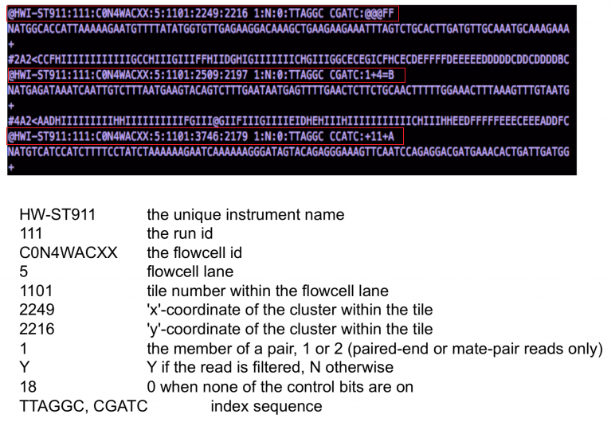
FastQ header

Slide 7
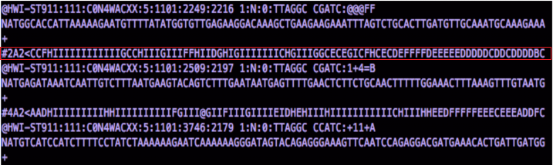
FastQ qualities
Qualities come after the "+" line
-log10 probability of sequence base being wrong
Encoded in ASCII to save space
Used in quality assessment and downstream analysis

Slide 8
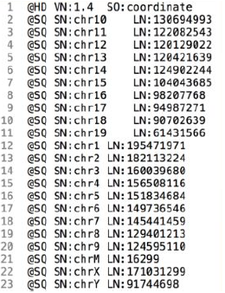
SAM Format
SAM - Sequence Alignment Map
Along with the alignment it retains the associated quality scores, the original read itself, paired-end information, sample information, and many more features.
Standard human readable format of sequence data
Recognised by majority of software and browsers
It consists of a header, a row for every read in your dataset, and 11 tab-delimited fields describing that read.
SAM header
SAM header contains information on alignment and contigs used
@HD - Version number and sorting information
@SQ - Contig/Chromosome name and length of sequence

Slide 9
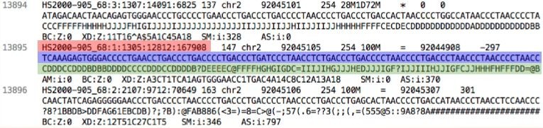
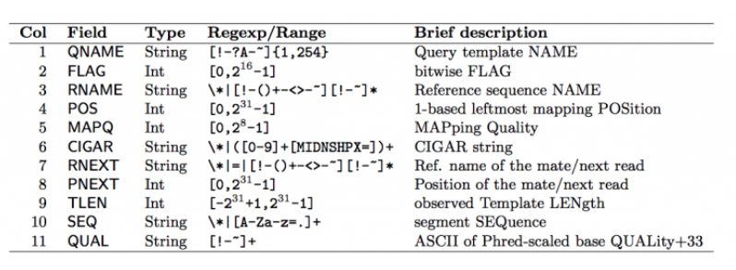
SAM Format
Field Descriptions
Each row contains 11 mandatory fields, which Contains read and alignment information and location
Read name
Sequence of read
Encoded sequence quality

Slide 10
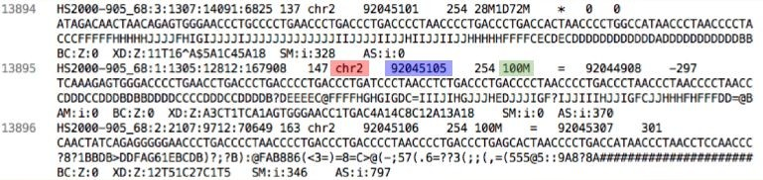
SAM Format
Chromosome to which the read aligns
Position in chromosome to which 5' end of the read aligns
Alignment information - "Cigar string"
This is a shorthand way to encode an entire alignment. Instead of writing the whole alignment out, operators have been defined and are used in combination with numbers to explain which part of the sequence aligns, which doesn’t, and everything in between.

Slide 11
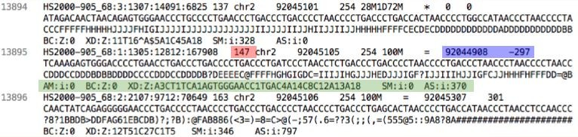
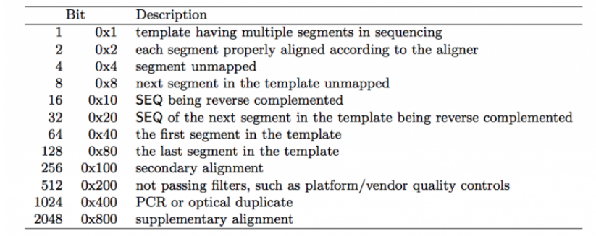
SAM Format
Bit flag - TRUE/FALSE for pre-defined read criteria, like: is it paired? duplicate?
Paired read position and insert size
User defined flags

Slide 12
BAM Format
This is the same format except that it encoded in binary which means that it is significantly smaller than the SAM files and significantly faster to read, though it is not human legible and needs to be converted to another format (i.e. SAM) in order to make sense to us.
Some special tools are needed in order to make sense of BAM, such as Samtools, Picard Tools, and IGV which will be discussed in some of the latter sections.
.bai Format
A bai file is a companion to your bam file that contains the index of your bam file.
BAM files is sorted by position and indexed, a BAM index file should be named by appending .BAI to the bam file name. A SAM index filename is created by appending .SAI.
The index files must have the same base file name and must reside in the same directory as the file that it indexes.
For example, the index file for test-xyz.bam would be named test-xyz.bam.bai or test-xyz.bai.

Slide 13
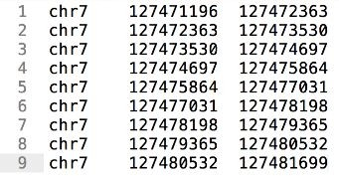
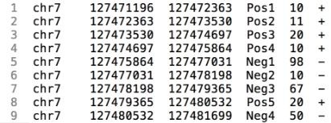
BED format
BED format is a simple way to define basic sequence features to a sequence. It consists of one line per feature, each containing 3-12 columns of data, plus optional track definition lines. These are generally used for user defined sequence features as well as graphical representations of features.
BED3 - 3 tab separated columns
Chromosome
Start
End
Simplest format
BED6 - 6 tab separated columns
Chromosome, start, end
Identifier
Score
Strand ("." stands for strandless)

Slide 14
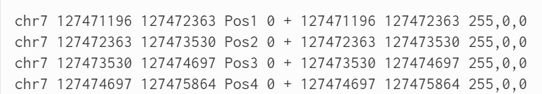
BED File : Optional fields
Nine additional fields are optional. Note that columns cannot be empty – lower-numbered fields must always be populated if higher-numbered ones are used.
Name - Label to be displayed under the feature, if turned on in “Configure this page”.
Score - A score between 0 and 1000.
Strand - defined as + \(forward\) or – \(reverse\).
thickStart - coordinate at which to start drawing the feature as a solid rectangle
thickEnd - coordinate at which to stop drawing the feature as a solid rectangle
itemRgb - an RGB colour value \(e.g. 0,0,255\). Only used if there is a track line with the value of itemRgb set to “on” \(case-insensitive\).
blockCount - the number of sub-elements \(e.g. exons\) within the feature
blockSizes - the size of these sub-elements
blockStarts - the start coordinate of each sub-element

Slide 15
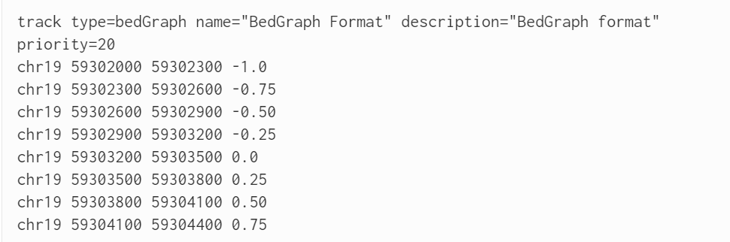
bedGraph format
BED-like format
Starts as a 3 column BED file (chromosome, start, end)
4th column: score value The score is placed in column 4, not column 5
Track lines are compulsory, and must include type=bedGraph

Slide 16
GFF - genomic annotation
General Feature Format (GFF) is a tab-delimited text file that holds information on all the feature that can be applied to a nucleic acid or protein sequence.
There have been many variations of the original GFF format. The latest accepted format (GFF3) has attempted to address many of the issues that were missing from previous versions.
GFF3 has 9 required fields.
Sequence ID
Source - Describes the algorithm or the procedure that generated this feature.
Feature Type - Describes what the feature is (mRNA, domain, exon, etc.).
Feature Start
Feature End
Score - Typically E-values for sequence similarity and P-values for predictions.
Strand
Phase - The phase is one of the integers 0, 1, or 2, indicating the number of bases that should be removed from the beginning of this feature to reach the first base of the next codon.
Attributes - A semicolon-separated list of tag-value pairs, providing additional information about each feature. Some of these tags are predefined, e.g. ID, Name, Alias, Parent .

Slide 17
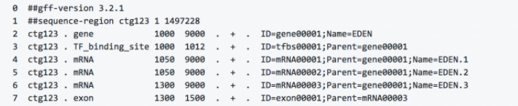

GFF - genomic annotation
Columns:
Chromosome
Source
Feature type
Start position
End position
Score
Strand
Frame - 0, 1 or 2 indicating which base of the feature is the first base of the codon
Semicolon separated attribute: ID (feature name);PARENT (meta-feature name)

Slide 18
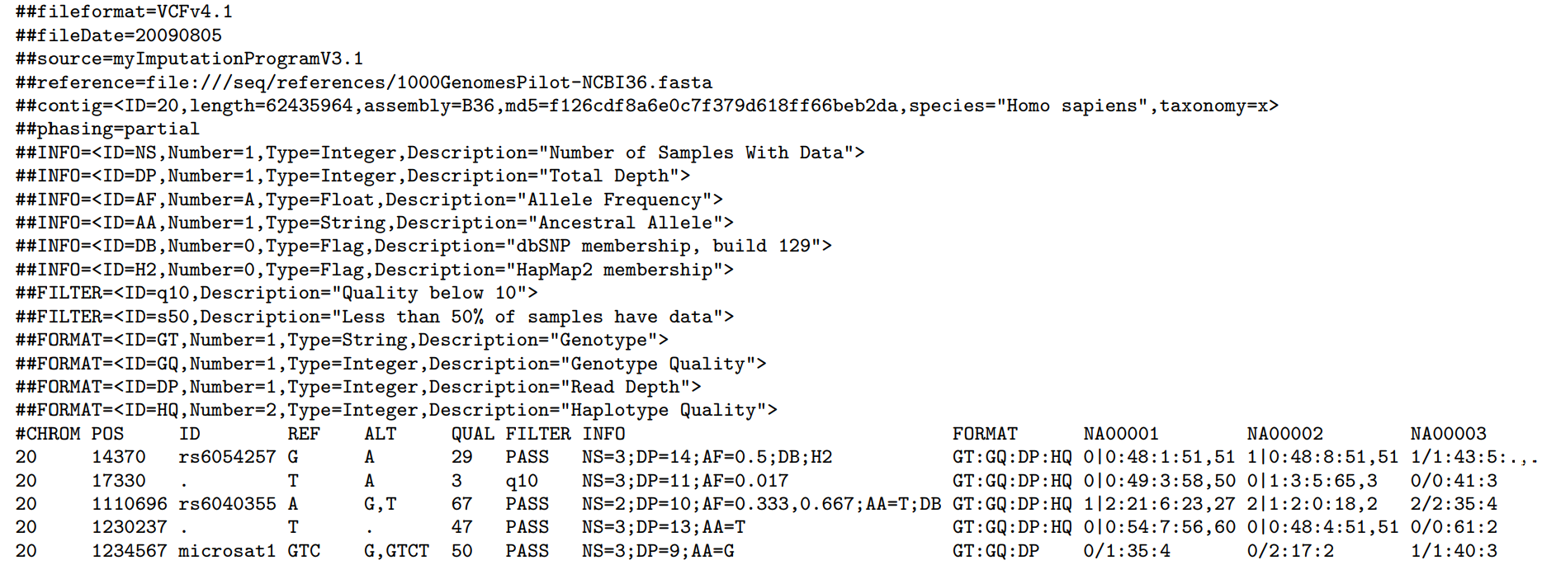
VCF
VCF is a tab- delimited text file format.
It contains meta-information lines, a header line, and then data lines each containing information about a position in the genome.
The format also has the ability to contain genotype information on samples for each position.

Slide 19
## Denotes a Meta-information Line
These lines can define the FILTER, INFO, and FORMAT terms, depending on what program created the vcf file (so not all vcf files are exactly the same!). The first line will always specify which VCF version a file is.
Metadata - file-format
A single ‘file-format’ field is always required, must be the first line in the file, and details the VCF format version number. For example, for VCF version 4.2, this line should read:
##fileformat=VCFv4.2
Or
##fileformat=VCFv4.1,
##fileformat=VCFv4.0 etc

Slide 20
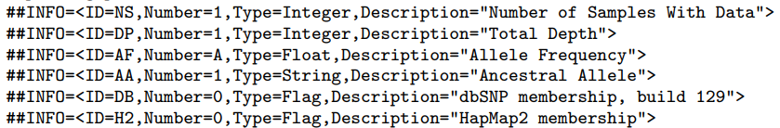

Metadata - INFO
INFO fields should be described as follows (first four keys are required, source and version are recommended):
##INFO=<ID=ID,Number=number,Type=type,Description="description",Source="source",Version="version">

Slide 21
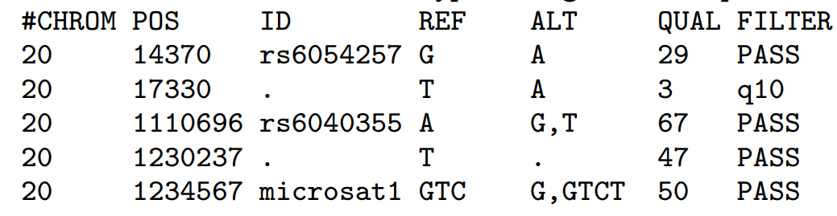
Metadata - FILTERs
FILTERs that have been applied to the data should be described as follows:

Slide 22
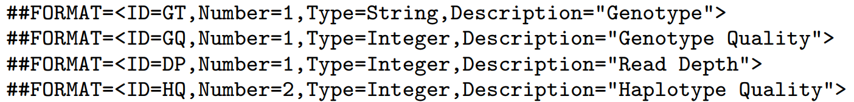
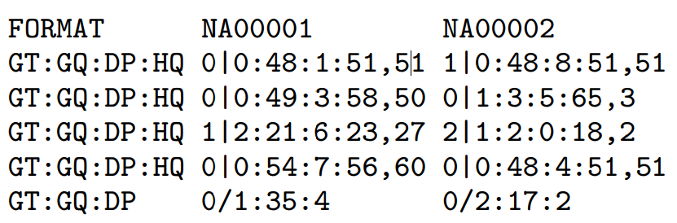
Metadata - FORMAT
Genotype fields specified in the FORMAT field should be described as follows:
##FORMAT= Possible Types for FORMAT fields are: Integer, Float, Character,
and String (this field is otherwise defined precisely as the INFO field).

Slide 23
# Denotes the Header line
The first NINE columns should always be the same for every VCF. Then, there will be one column for every individual in your sample (i.e. these columns will change for each data set). The names for these columns are usually taken from your input file names. Meta-information typically gives you things like the definition of each term in the “Format” field, and will do the same for the “info” field if it is used. Filter information will tell you what filters (if any) were applied to the vcf (for instance using a tool like GatK or VCFtools).
The remaining rows have the information about each SNP position, with 1 row per VARIANT site.

Slide 24
Header line syntax
The header line names the 8 fixed, mandatory columns. These columns are as follows:
#CHROM
POS
ID
REF
ALT
QUAL
FILTER
INFO

Slide 25
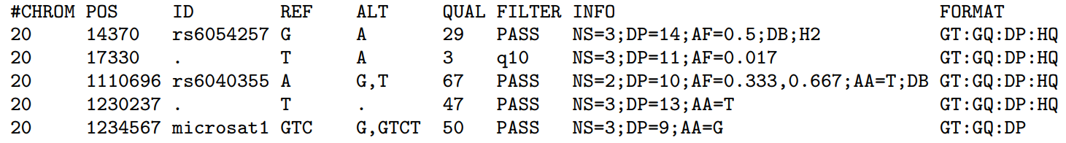
CHROM
CHROM - chromosome: An identifier from the reference genome or an angle-bracketed ID String (“”) pointing to a contig in the assembly file (cf. the ##assembly line in the header). All entries for a specific CHROM should form a contiguous block within the VCF file. (String, no white-space permitted, Required).

Slide 26
2. POS
POS - position: The reference position, with the 1st base having position 1. Positions are sorted numerically, in increasing order, within each reference sequence CHROM. It is permitted to have multiple records with the same POS. Telomeres are indicated by using positions 0 or N+1, where N is the length of the corresponding chromosome or contig. (Integer, Required)

Slide 27
3. ID
ID - identifier: Semi-colon separated list of unique identifiers where available. If this is a dbSNP variant it is encouraged to use the rs number(s).
No identifier should be present in more than one data record.
If there is no identifier available, then the missing value should be used. (String, no white-space or semi-colons permitted)
Notes:
https://www.ncbi.nlm.nih.gov/snp/rs6054257

Slide 28
4. REF
REF - reference base(s): Each base must be one of A,C,G,T,N (case insensitive). Multiple bases are permitted. The value in the POS field refers to the position of the first base in the String. For simple insertions and deletions in which either the REF or one of the ALT alleles would otherwise be null/empty, the REF and ALT Strings must include the base before the event (which must be reflected in the POS field), unless the event occurs at position 1 on the contig in which case it must include the base after the event; this padding base is not required (although it is permitted) for e.g. complex substitutions or other events where all alleles have at least one base represented in their Strings. If any of the ALT alleles is a symbolic allele (an angle-bracketed ID String “”) then the padding base is required and POS denotes the coordinate of the base preceding the polymorphism. Tools processing VCF files are not required to preserve case in the allele Strings. (String, Required).

Slide 29
5. ALT
ALT - alternate base(s): Comma separated list of alternate non-reference alleles. These alleles do not have to be called in any of the samples. Options are base Strings made up of the bases A,C,G,T,N,*, (case insensitive) or an angle-bracketed ID String (“”) or a breakend replacement string as described in the section on breakends.

Slide 30
6. QUAL
QUAL - quality: Phred-scaled quality score for the assertion made in ALT. i.e. −10log10 prob(call in ALT is wrong). If ALT is ‘.’ (no variant) then this is −10log10 prob(variant), and if ALT is not ‘.’ this is −10log10 prob(no variant). If unknown, the missing value should be specified. (Numeric)

Slide 31
7. FILTER
FILTER - filter status: PASS if this position has passed all filters, i.e., a call is made at this position. Otherwise, if the site has not passed all filters, a semicolon-separated list of codes for filters that fail. e.g. “q10;s50” might indicate that at this site the quality is below 10 and the number of samples with data is below 50% of the total number of samples. ‘0’ is reserved and should not be used as a filter String. If filters have not been applied, then this field should be set to the missing value. (String, no white-space or semi-colons permitted)

Slide 32
8. INFO
INFO - additional information: (String, no white-space, semi-colons, or equals-signs permitted; commas are permitted only as delimiters for lists of values) INFO fields are encoded as a semicolon-separated series of short keys with optional values in the format: =[,data]. Arbitrary keys are permitted, although the following sub-fields are reserved (albeit optional):

Slide 33
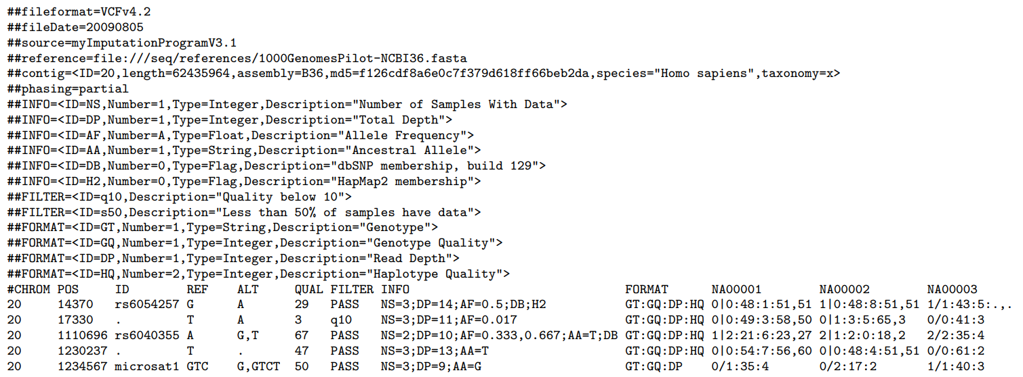
Example of VCF file
Notes:
https://samtools.github.io/hts-specs/VCFv4.2.pdf

Slide 34
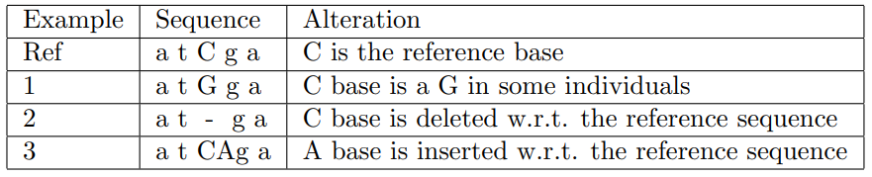
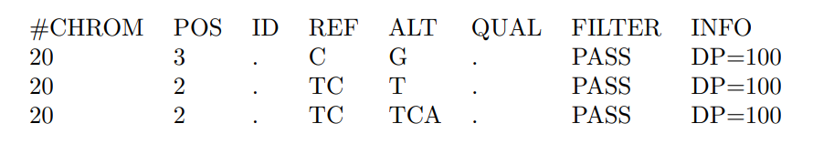
Example 1 (Small insertion)

Slide 35
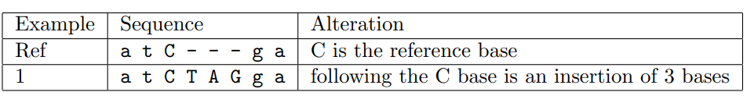
Example 2 (Small insertion)

Slide 36
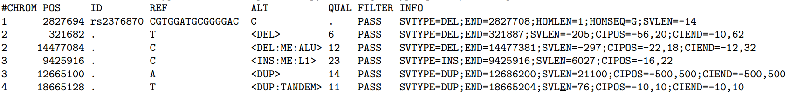
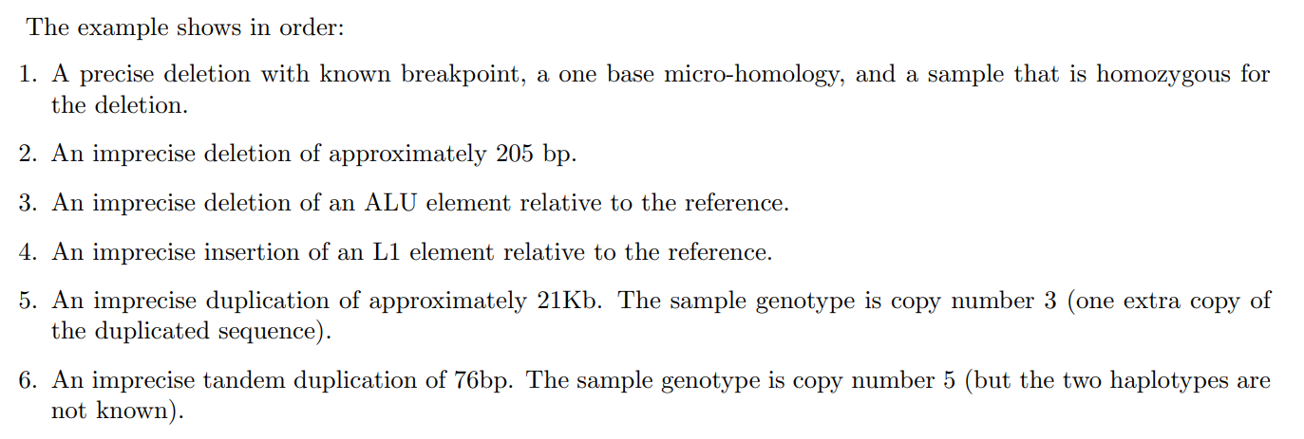
Example 3

Slide 37
Example 3

Slide 38
Example 3

Slide 39
Example 3

Slide 40
Example 3

Slide 41
Example 3

Slide 42
“SYTYPE=BND”
There is one line of VCF (i.e. one record) for each of the two breakends in a novel adjacency. A breakend record is identified with the tag “SYTYPE=BND” in the INFO field. The REF field of a breakend record indicates a base or sequence s of bases beginning at position POS, as in all VCF records. The ALT field of a breakend record indicates a replacement for s. This “breakend replacement” has three parts:
The string t that replaces places s. The string t may be an extended version of s if some novel bases are inserted during the formation of the novel adjacency.
The position p of the mate breakend, indicated by a string of the form “chr:pos”. This is the location of the first mapped base in the piece being joined at this novel adjacency.
The direction that the joined sequence continues in, starting from p. This is indicated by the orientation of square brackets surrounding p.

Slide 43
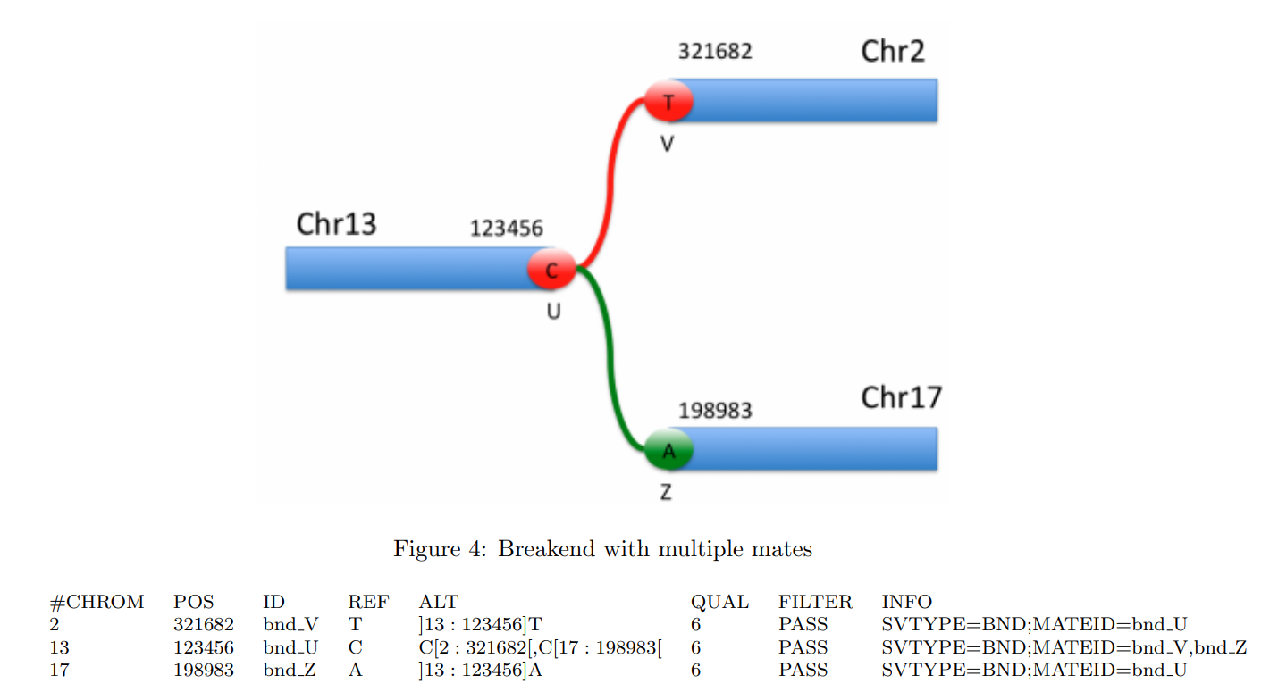
Example 4: Multiple mates

Slide 44
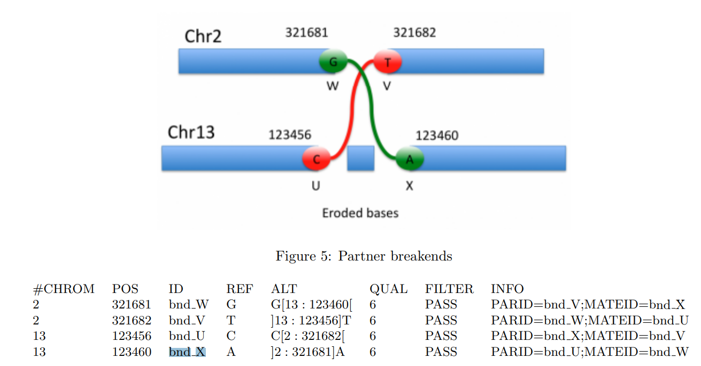
Example 5: Explicit Partners

Slide 45
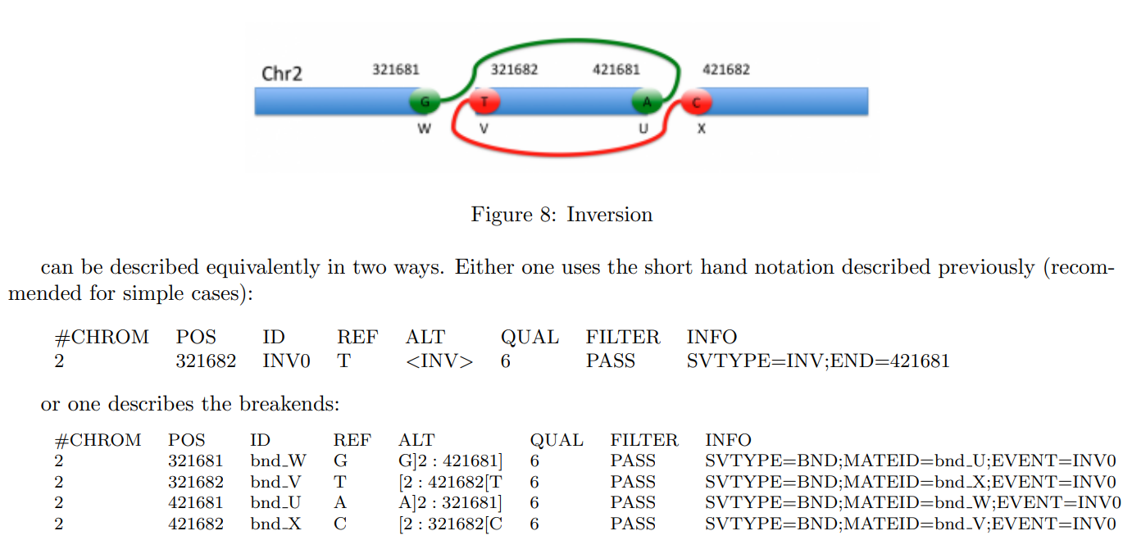
Example 6: Inversion

Slide 46
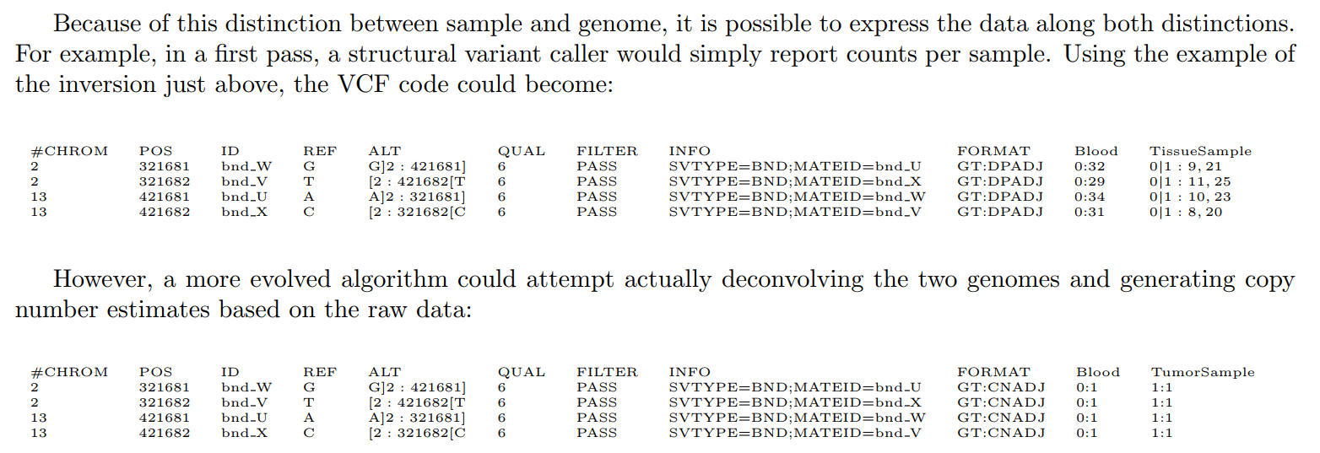
Example 6: Multi:Sample
IDX FILES
IDX format is the index format used for indexing of VCF files. The purpose of IDX files is to allow tools to have indexed random access to VCF files. VCF index (IDX) files have the .idx extension which is appended to the name of the corresponding VCF file (a file named sample.vcf would have an index file named sample.vcf.idx).
IDX FILES
IDX format is the index format used for indexing of VCF files. The purpose of IDX files is to allow tools to have indexed random access to VCF files. VCF index (IDX) files have the .idx extension which is appended to the name of the corresponding VCF file (a file named sample.vcf would have an index file named sample.vcf.idx).

Slide 47
Getting help and more information
UCSC file formats
https://genome.ucsc.edu/FAQ/FAQformat.html
IGV file formats
http://software.broadinstitute.org/software/igv/FileFormats
Sanger file formats
http://gmod.org/wiki/GFF3
VCF
https://samtools.github.io/hts-specs/VCFv4.2.pdf

Slide 48
Acknowledgement
http://mrccsc.github.io/genomic_formats/genomicFileFormats.html#/
https://learn.gencore.bio.nyu.edu/ngs-file-formats
https://samtools.github.io/hts-specs/VCFv4.2.pdf

