Slide 1
AI-Powered Assistive System for the Visually Impaired

Slide 2
Abstract (existing)
Traditional assistive technologies for visually impaired individuals primarily focus on navigation aids, screen readers, and text-to-speech systems. These systems lack centralized control and require multiple independent devices for different functionalities. Existing solutions often rely on manual input rather than real-time, automated assistance. While some advancements in object recognition and emergency alert systems exist, they are not integrated into a single, unified system. Moreover, most assistive technologies do not leverage voice commands for seamless operation, limiting their accessibility for users with mobility constraints. The absence of a centralized server-based architecture further restricts the scalability and efficiency of these systems in providing real-time assistance.

Slide 3
Introduction
Visually impaired individuals face challenges in navigating their surroundings and accessing digital content. Traditional assistive devices provide limited functionality and require manual operation. This project leverages IoT and AI to create an interactive and voice-controlled assistive system, providing real-time sensory feedback and emergency support.

Slide 4
Objective
To develop an AI-powered assistive system that enhances spatial awareness and accessibility.
To integrate a centralized server managing multiple assistive features.
To enable voice-triggered commands for hands-free operation.
To provide real-time object recognition, screen description, and SOS alerts.
Use ultrasonic sensors for distance estimation and obstacle detection.

Slide 5
Domain
Internet of Things (IoT): Enables real-time data processing and communication.
Embedded Systems: Uses ESP32 and ESP32-CAM for automation and vision-based analysis.
Artificial Intelligence: Enhances object recognition, facial emotion detection, and OCR.

Slide 6
Existing Work
A prototype of a Blind Walking Stick has been developed to assist visually impaired individuals with safe and independent navigation. It features ultrasonic sensors for obstacle detection, offering a quick response time, low cost, and high reliability. The system is lightweight and portable despite being equipped with various sensors. Enhancing it with wireless connectivity can improve obstacle detection range and calculate approaching object speed. This solution aims to empower blind individuals, particularly in developing nations, by providing an accessible and efficient mobility aid.

Slide 7
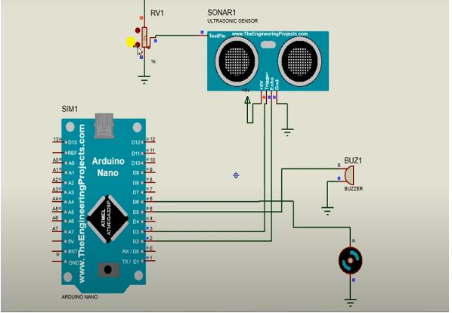
Block diagram existing

Slide 8
Disadvantage of existing
Limited Obstacle Detection Range: Ultrasonic sensors may not detect obstacles beyond a certain distance.
Difficulty in Identifying Object Type: The system can detect objects but cannot distinguish between them.
No Real-Time Communication: Lack of IoT integration limits remote assistance and advanced navigation.
Limited Automation: Relies on physical input rather than voice commands.
No Centralized Management: Independent functionalities require separate devices.
Lack of Emergency Response: No real-time SOS alert with location tracking.

Slide 9
Abstract proposed
The proposed system is an advanced assistive device for visually impaired individuals, integrating ultrasonic sensors for obstacle detection, ESP32-CAM for real-time image processing, and a voice-controlled interface for seamless interaction. It includes Optical Character Recognition (OCR) for reading text, a Sensory Search Module for spatial awareness, and Facial Emotion Detection to assist in social interactions. An SOS alert system ensures emergency communication by sending the user’s location to predefined contacts. All components are connected to a centralized server for real-time data processing, making the system efficient, lightweight, and cost-effective, ultimately enhancing mobility, independence, and safety.

Slide 10
Proposed System
Sensory Search Module: Identifies and retrieves environmental information for spatial awareness.
Screen Description: Provides auditory feedback of on-screen content for accessibility.
SOS Alert System: Sends emergency notifications with real-time location tracking.
Optical Character Recognition (OCR): Converts text in images into digital formats.
Facial Emotion Detection: Recognizes emotions from facial expressions for social interaction.
Ultrasonic Distance Estimation: Measures distances to obstacles for safer navigation.

Slide 11
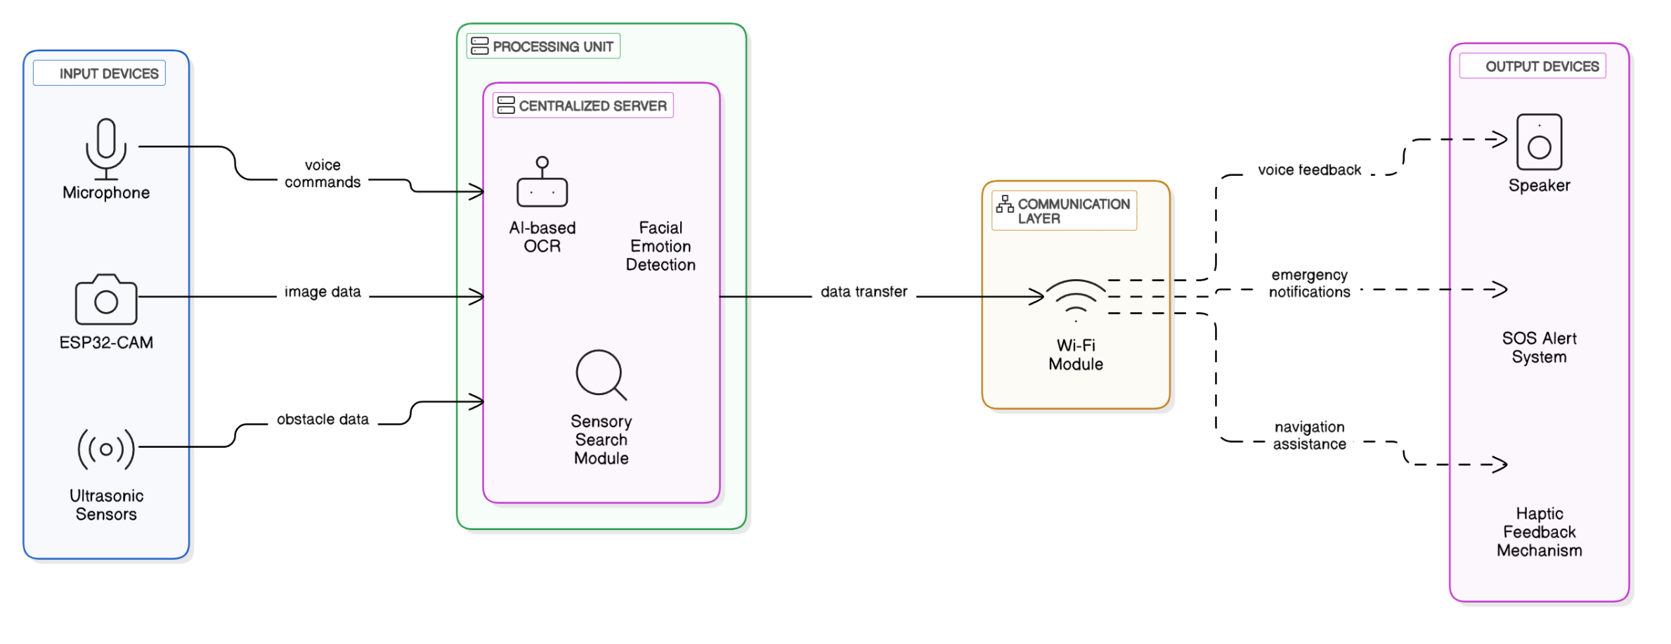
Proposed block diagram

Slide 12
Advantages of Proposed System
Enhanced Obstacle Detection: Ultrasonic sensors ensure safer navigation.
Real-Time Image Processing: ESP32-CAM enables OCR and facial emotion detection.
Voice-Controlled Interface: Hands-free operation for better accessibility.
Sensory Search Module: Assists in spatial awareness and movement.
SOS Alert System: Sends emergency location to predefined contacts.
Centralized Server: Efficient AI processing and real-time updates.
Cost-Effective & Scalable: Lightweight, affordable, and easy to expand.

Slide 13
Hardware and Software Requirements
Hardware:
Software:
Arduino IDE – Programming ESP32 and ESP32-CAM.
Python & OpenCV – For AI-based image processing (OCR & Facial Detection)
Text-to-Speech & Speech Recognition API – Converts text to speech and processes voice commands.
ESP32 – Main microcontroller for processing and communication.
ESP32-CAM – For real-time image capture and processing.
Ultrasonic Sensor – For obstacle detection and distance estimation.
System’s Microphone & Speaker – Used for voice commands and auditory feedback.
Servo Motors – Assists in movement and object interaction.
Battery Pack – Portable power supply for continuous operation.

Slide 14
(a) Proposed Module Description and Design
The proposed system consists of multiple assistive modules working together under a centralized server, allowing seamless interaction through voice commands. The main modules are:
1. Sensory Search & Scene Description – Uses LLM (Gemini) to describe the surroundings based on ESP32-CAM input, helping visually impaired users understand their environment.
2. Face Recognition – Uses face_recognition & OpenCV (cv2) to identify known individuals and provide auditory feedback about their identity.
3. Emotion Detection – Uses a pretrained Haar Cascade model (custom XML) with OpenCV to analyze facial expressions and interpret emotions for social interaction.
4. Obstacle Detection – Uses ultrasonic sensors to measure the distance of nearby objects, ensuring safe navigation.
5. OCR (Optical Character Recognition) – Captures and reads text from images using OpenCV & Tesseract OCR, converting printed text into speech.
6. SOS Alert System – Enables emergency notifications via Twilio's cloud-based communication services, sending alerts to predefined contacts.
7. Voice-Controlled Interface – Uses speech recognition models to trigger different functions based on keyword detection.

Slide 15
(b) Justification of the Algorithms Used for the Proposed System
LLM (Gemini) for Sensory Search & Scene Description
Justification: Capable of understanding complex scenes and providing natural language descriptions for better accessibility.
face_recognition & OpenCV for Face Recognition
Justification: A lightweight, highly accurate face recognition library optimized for real-time execution on edge devices.
Haar Cascade (Custom XML) for Emotion Detection
Justification: A pretrained model with fast execution, effective for detecting facial emotions in real-time.
Ultrasonic Sensors for Obstacle Detection
Justification: Reliable distance measurement for detecting obstacles, ensuring safe mobility.
Tesseract OCR for Text Recognition
Justification: Open-source, highly efficient text recognition engine that converts images into readable text.
Speech Recognition for Voice Commands
Justification: Allows hands-free natural interaction, improving accessibility for visually impaired users.

Slide 16
(c) Description of Datasets Used in the Proposed Work
Face Recognition Dataset
Pre-collected images of individuals for training the face_recognition model.
Emotion Detection Dataset
FER-2013 dataset (or custom dataset) used to train the Haar Cascade XML for recognizing emotions.
Text Recognition Dataset
Synthetic and real-world images used for training the OCR model to extract text from different fonts and surfaces.
Scene Description Dataset
Real-world image datasets used for training LLM-based models to generate scene descriptions.
Obstacle Detection Dataset
Collected ultrasonic sensor readings for different environments to improve distance estimation accuracy.

Slide 17
(d) Parameters Used for Testing
Face Recognition Accuracy (%) – Evaluates the correctness of detected faces.
Emotion Detection Accuracy (%) – Measures the precision of facial emotion classification.
OCR Text Recognition Accuracy (%) – Determines the percentage of correctly extracted text.
Scene Description Coherence Score – Assesses the relevance and clarity of LLM-generated descriptions.
Obstacle Detection Distance Error (cm) – Compares estimated vs. actual obstacle distance.
Voice Command Response Time (ms) – Measures system responsiveness to voice triggers.
SOS Alert Trigger Success Rate (%) – Verifies successful emergency alert transmissions.

Slide 18
Problem Statement
Visually impaired individuals require assistance in navigating environments, reading text, and accessing information. Existing solutions lack integration, hands-free control, and emergency response mechanisms. This project proposes a unified, AI-powered system that addresses these challenges using real-time IoT-based assistance.

Slide 19
Literature Survey 1
Seeing AI – AI-Based Assistive App for the Blind Author: Microsoft Research Year: 2017 Description: This study introduces Seeing AI, a mobile application that helps visually impaired individuals by reading text, recognizing faces, and identifying objects using AI-based image processing and text-to-speech conversion.

Slide 20
Literature Survey 2
OrCam MyEye – Wearable Assistive Technology Author: OrCam Technologies Year: 2018 Description: This research presents a wearable AI-powered device that converts visual information into real-time auditory feedback, allowing blind users to read printed text and recognize faces.

Slide 21
Literature Survey 3
Smart Cane for the Visually Impaired Author: R. Kumar, S. Verma Year: 2019 Description: A smart cane equipped with ultrasonic sensors and haptic feedback to help visually impaired individuals navigate safely by detecting nearby obstacles and providing alerts.

Slide 22
Literature Survey 4
AI-Based Object Detection for the Blind Author: M. Hossain, L. Zaman Year: 2020 Description: This study focuses on using deep learning models for real-time object recognition, enabling visually impaired individuals to identify objects in their environment through auditory feedback.

Slide 23
Literature Survey 5
OCR-Based Text-to-Speech Systems Author: T. Karthik, P. Rajesh Year: 2020 Description: A review of Optical Character Recognition (OCR) technology used in assistive devices to convert printed text into speech, improving accessibility for blind users.

Slide 24
Literature Survey 6
Emotion Recognition for Social Interaction Author: B. Singh, A. Patel Year: 2021 Description: A study on AI-powered facial emotion detection that helps visually impaired users interpret social interactions by analyzing facial expressions and providing verbal cues.

Slide 25
Literature Survey 7
Ultrasonic Sensor-Based Navigation System Author: J. Park, S. Lee Year: 2021 Description: Research on integrating ultrasonic sensors to measure distances and detect obstacles, enhancing navigation safety for visually impaired individuals.

Slide 26
Literature Survey 8
IoT-Based Assistive Technologies for the Visually Impaired Author: N. Williams, T. Johnson Year: 2022 Description: A study on using IoT and cloud-based AI systems for real-time assistance, enabling voice-controlled operation and remote monitoring for blind individuals.

Slide 27
Literature Survey 9
Voice-Controlled Assistive Devices Author: C. Wang, M. Zhang Year: 2022 Description: This paper explores speech recognition technology integrated into assistive systems, allowing hands-free operation for visually impaired users.

Slide 28
Literature Survey 10
Real-Time Audio Feedback Systems for the Blind Author: L. Fernandez, R. K. Singh Year: 2023 Description: A study on converting environmental data into auditory sign

Slide 29
Literature Survey Summary Table
S.No | Topic | Author(s) | Year | Description
1 | Seeing AI – AI-Based Assistive App for the Blind | Microsoft Research | 2017 | Mobile app that reads text, recognizes faces, and identifies objects using AI.
2 | OrCam MyEye – Wearable Assistive Technology | OrCam Technologies | 2018 | Wearable AI-powered device that converts visual information into auditory feedback.
3 | Smart Cane for the Visually Impaired | R. Kumar, S. Verma | 2019 | Smart cane with ultrasonic sensors and haptic feedback for obstacle detection.
4 | AI-Based Object Detection for the Blind | M. Hossain, L. Zaman | 2020 | Deep learning model for real-time object recognition with auditory feedback.

Slide 30
5 | OCR-Based Text-to-Speech Systems | T. Karthik, P. Rajesh | 2020 | Converts printed text into speech using OCR technology for accessibility.
6 | Emotion Recognition for Social Interaction | B. Singh, A. Patel | 2021 | AI-powered facial emotion detection to help blind users interpret expressions.
7 | Ultrasonic Sensor-Based Navigation System | J. Park, S. Lee | 2021 | Uses ultrasonic sensors to measure distances and detect obstacles for navigation.
8 | IoT-Based Assistive Technologies for the Visually Impaired | N. Williams, T. Johnson | 2022 | IoT-powered assistive system for voice-controlled operation and remote monitoring.
9 | Voice-Controlled Assistive Devices | C. Wang, M. Zhang | 2022 | Speech recognition technology for hands-free operation of assistive devices.
10 | Real-Time Audio Feedback Systems for the Blind | L. Fernandez, R. K. Singh | 2023 | AI-based system converting environmental data into auditory signals for awareness.

Slide 31
Conclusion
The proposed assistive system aims to enhance the mobility, accessibility, and safety of visually impaired individuals by integrating advanced technologies such as ultrasonic sensors, ESP32-CAM for real-time image processing, OCR for text recognition, and AI-based facial emotion detection. Unlike existing systems that operate independently, this solution provides a centralized, voice-controlled platform for seamless interaction and navigation. The inclusion of a sensory search module, real-time auditory feedback, and an SOS alert system ensures a more intuitive and reliable experience. With its cost-effectiveness, portability, and real-time processing capabilities, the system empowers visually impaired individuals with greater independence, enabling them to navigate their surroundings confidently and safely.

Slide 32
References
M. Hossain and L. Zaman, "AI-Based Object Detection for the Blind," International Journal of Artificial Intelligence & Vision, vol. 15, no. 4, pp. 210-225, 2020.
B. Singh and A. Patel, "Emotion Recognition for Social Interaction in Assistive Technology," Journal of Assistive Technologies & AI, vol. 12, no. 3, pp. 98-112, 2021.C.
Wang and M. Zhang, "Voice-Controlled Assistive Devices for Visually Impaired Users," IEEE Transactions on Human-Computer Interaction, vol. 18, no. 1, pp. 45-60, 2022.
T. Karthik and P. Rajesh, "OCR-Based Text-to-Speech Conversion for Blind Users," International Journal of Embedded Systems & AI, vol. 11, no. 5, pp. 332-347, 2020.
L. Fernandez and R. K. Singh, "Real-Time Audio Feedback Systems for the Blind," IEEE Transactions on Assistive Technologies, vol. 20, no. 2, pp. 120-135, 2023.

