Slide 1



Data Validation Option
Rajasekhar . B

Slide 2

OVERVIEW
Data validation is the process of verifying the accuracy and completeness of data after a data migration, replication, integration or other similar movement or transformation exercise.
Data Validation Option automates data validation and makes tests repeatable.
Can compare data in the source and target by running table pair tests.

Slide 3
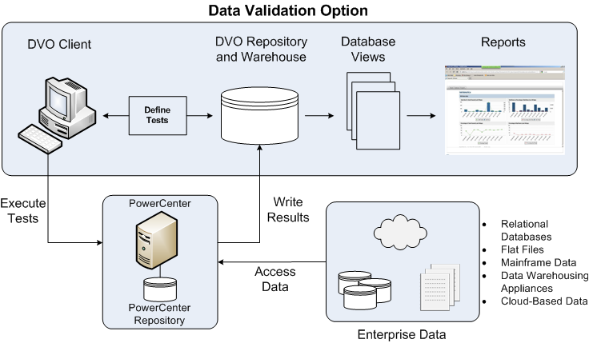
ARCHITECTURE

Slide 4
Data Validation Option uses PowerCenter connections to connect to a PowerCenter repository, and it imports source and target definitions from it.
DVO uses the data processing capabilities of PowerCenter to run tests.
When a test runs, Data Validation Option communicates with PowerCenter through an API to create and run mappings, sessions, and workflows.
After the test runs, PowerCenter stores the results in the Data Validation Option repository.
The Data Validation Option Client displays the results.

Slide 5
TABLE PAIRS
A table pair is a pair of tables on which we can create and run data validation tests.
Each table in the table pair must be a PowerCenter source or target, join view, lookup view, or SQL view.
Single table pair or Multiple table pairs can be generated.
When we create a table pair, Table A and Table B should be specified.
Data Validation Option considers Table A as the master table and Table B as the detail table.

Slide 6
ADDING A TABLE PAIR
Table pair can be created from the file menu or from the shortcut in the menu bar.
1. Select the folder to which you want to add the table pair.
2. Right-click the folder and select Add Table Pair. The Table Pair Editor window appears.
3. On the Basic tab, enter the basic properties of the table pair.
The following figure shows the Basic tab for a relational connection:

Slide 7
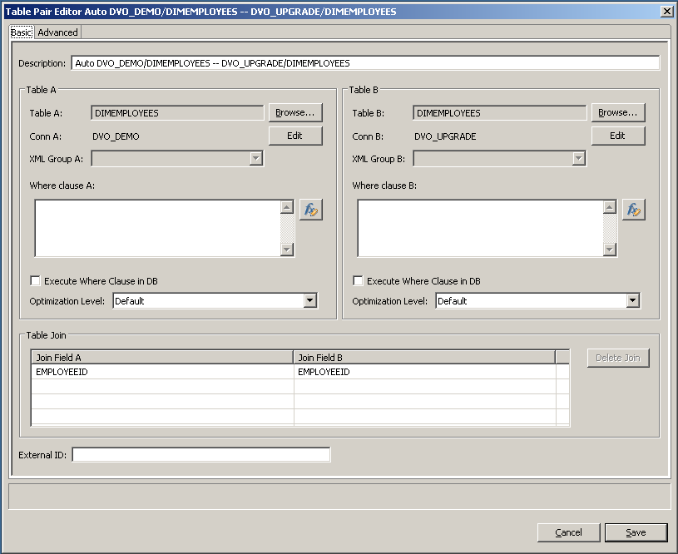

Slide 8
4. Enter values for the basic properties on the Basic tab.
5. Click Edit to configure the connection properties for a table.
6. If you have the enterprise license, click the Advanced tab and enter values for the advanced properties.
7. Click Save to save the table pair.

Slide 9
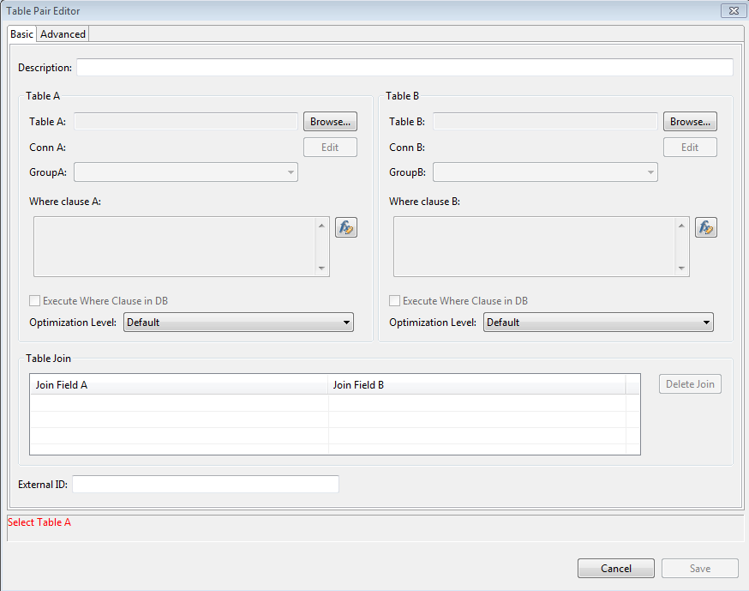
PROPERTIES OF TABLE PAIR

Slide 10
BASIC PROPERTIES
Description
Table pair description. By default, Data Validation Option uses "Joined <Table A>-<Table B>" for joined table pairs.
Table A/B
Table A/B
Conn A/B
XML Group A
Where Clause A/B
Execute Where clause in DB
Optimization Level

Slide 11
Table Join
External ID
Join Field A/B

Slide 12
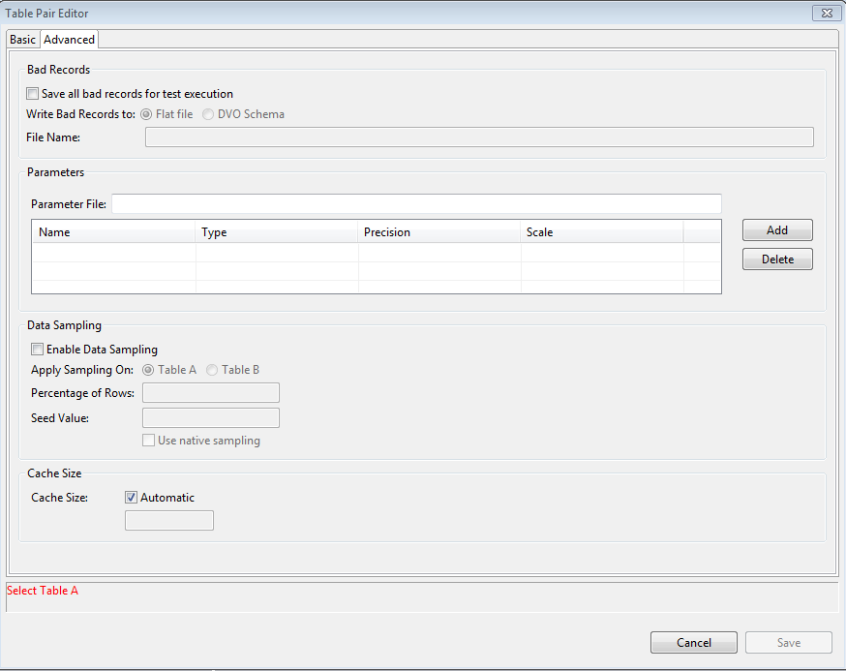
ADVANCED PROPERTIES

Slide 13
Bad Records
Following properties can be configured for bad records:
Save All Bad Records for Test Execution
Write Bad Records to:
File Name
Parameters
Name of the parameter file. Click Add to add a parameter file. Click Delete to delete the selected parameter file.

Slide 14
Data Sampling
Following properties can be configured for data sampling:
Enable Data Sampling
Apply Sampling on:
The table on which you want to apply sampling.
Percentage of Rows
Seed Value
Use Native Sampling

Slide 15
Cache Size
Total cache used to run a PowerCenter session associated with the table pair. Select Automatic to enable PowerCenter to compute the cache size.

Slide 16
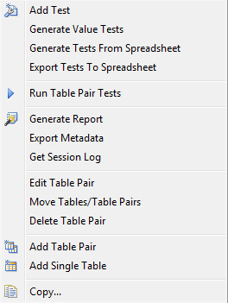
TESTS GENERATED FROM TABLE PAIR COMPARISONS
To generate table pair tests, right click the table pair.
The following dialog box will appear.

Slide 17
Now select the Generate Value Tests option
A dialog box will appear.
Need to configure whether to match columns based on the column name or column position.
If column name is selected, the following window will appear.

Slide 18
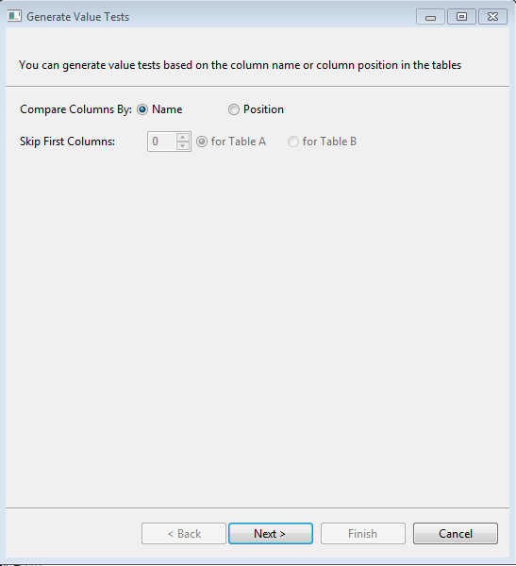

Slide 19
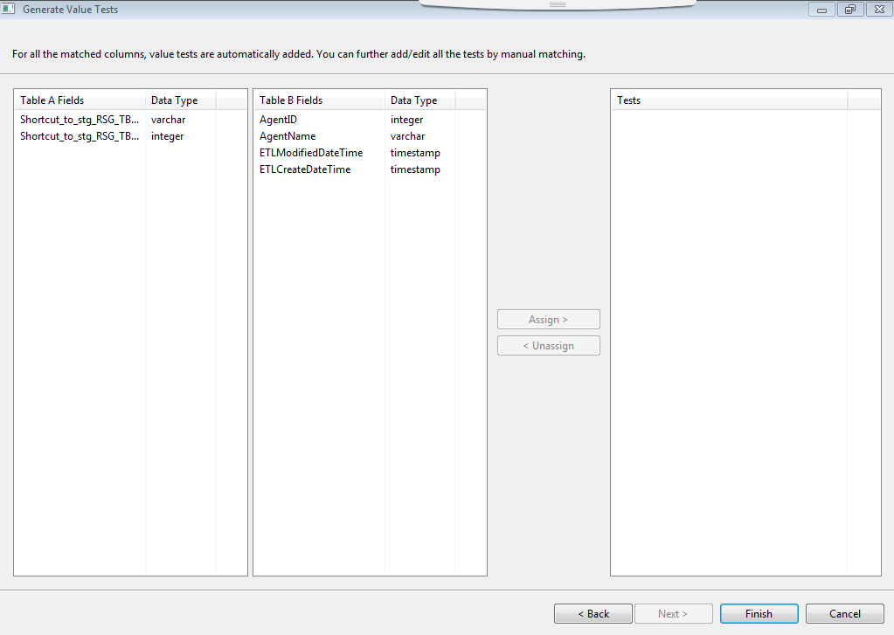

Slide 20
Columns from Table A should be matched with Table B to form a test.
By default, when table comparison is run, DVO generates OUTER_VALUE, VALUE, and COUNT_ROWS tests.
Once the tests are created, click Finish

Slide 21
RUNNING A TABLE PAIR
To run a table pair, right click the table pair.

Slide 22
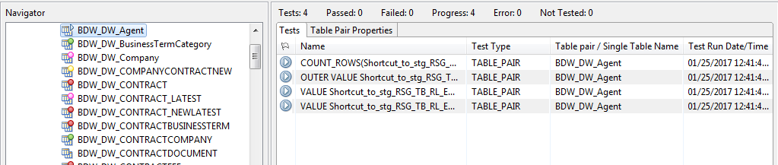
Now select Run Table Pair Tests option.
Table pair tests will start running as shown below.

Slide 23
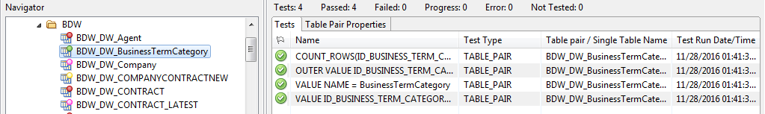
Test result will be obtained as below.
Based on the test result, the table pair will be marked with a color.

Slide 24
TEST RESULTS - COLOUR CODES
All the tests are succeeded
One or many or all the tests are failed
Internal Error / Privilege Issue
No data in either one of the tables or both the tables

Slide 25
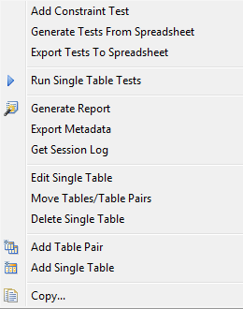
SINGLE TABLE PAIR
Single-table constraint can be used to run tests on a single table.
Adding single table is similar to that of adding table pair. Following dialog box will appear when we right click the single table.

Slide 26
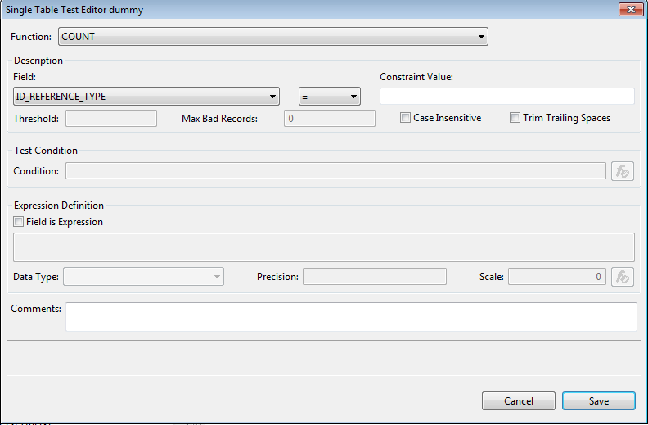
PROPERTIES OF SINGLE TABLE

Slide 27
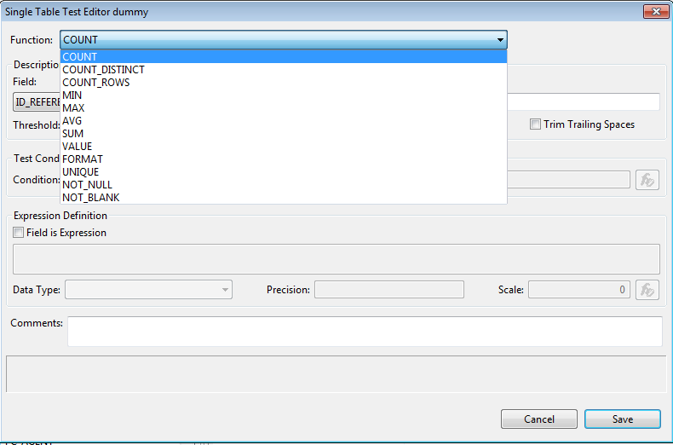

Slide 28
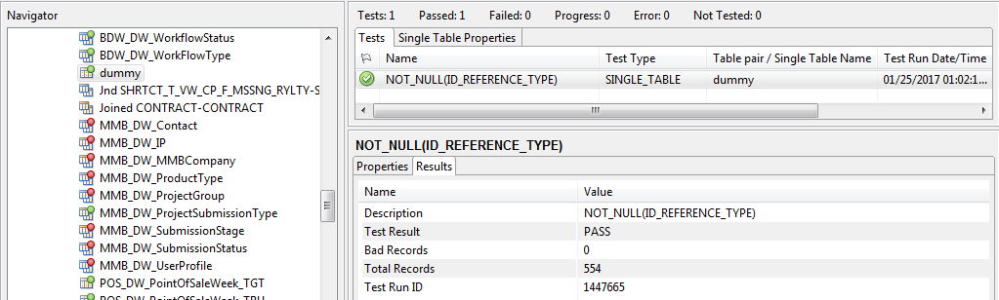
RUNNING A SINGLE TABLE
Following is the test result of a sample single-table test.

Slide 29
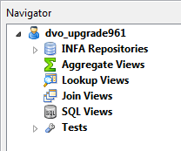
VIEWS IN DVO
Four types of view are commonly used in DVO.
They are,
SQL View
Join View
Lookup View
Aggregate View

Slide 30
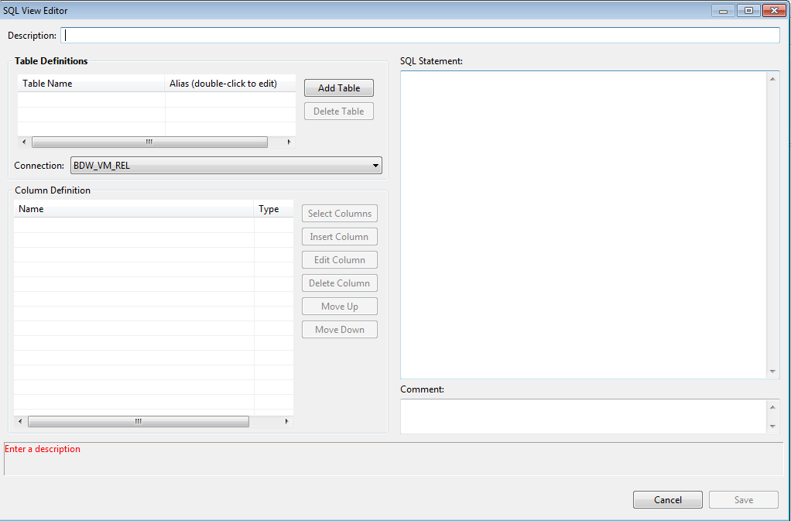
SQL VIEWS

Slide 31
PROPERTIES OF SQL VIEWS
Description SQL view description.
Table Name Name of the table included in the SQL view. All tables you use in the SQL view must exist in the same database.
Alias Alias name for the table.
Connection PowerCenter connection for the tables.
Column Definition The columns that make up the SQL view. Data Validation Option imports all columns from the tables you select. You can create, delete, and rearrange columns.
SQL Statement SQL statement you run against the database to retrieve data for the SQL view.
Comment Information about an SQL view. Data Validation Option displays the comment when you view the SQL view in the Properties area.

Slide 32
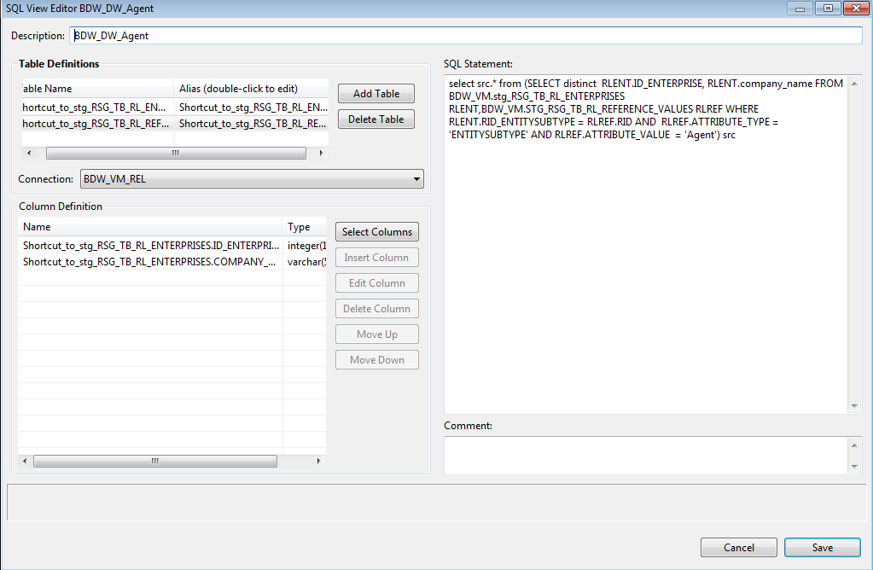
SAMPLE SQL VIEW

Slide 33
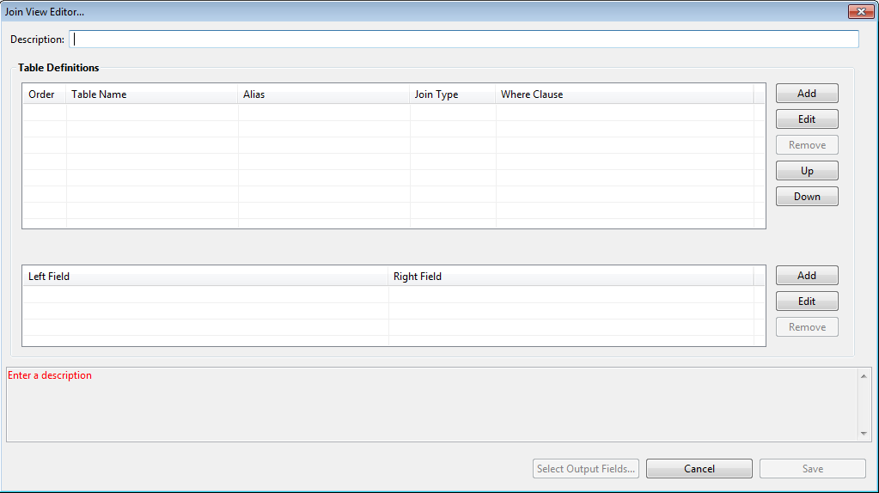
JOIN VIEWS

Slide 34
PROPERTIES OF JOIN VIEWS
Description Description of the join view.
Order Sequence of data sources in the join view. You can join a data source with any of the preceding data sources.
Table Name Data source that you add in the join view.
Alias Alias name for the table.
Join type Type of join used to join the data sources.
Where Clause The WHERE clause to filter rows in the data source.
Left field Left field of the join condition. Left field is the key column of the data source to which you create the join.
Right field Right field of the join condition. Right field is the key column of the data source for which you create the join.

Slide 35
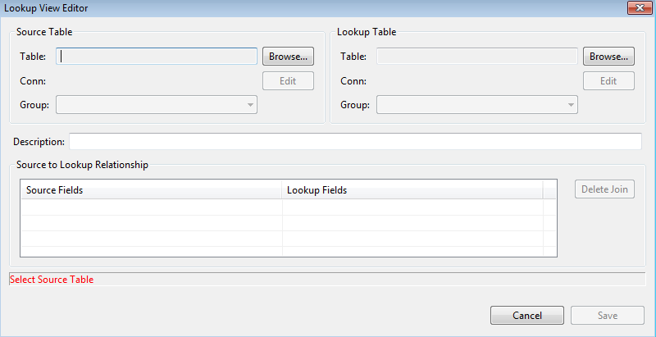
LOOKUP VIEWS

Slide 36
PROPERTIES OF LOOKUP VIEWS
Table Name of source table or lookup table. For a source table, you can use a table from any type of data source, except Salesforce, SAP, and SAS. For a lookup table, you can use a table from any type of data source, except Salesforce, SAP, SAS, and XML.
Conn PowerCenter connection for the source table or lookup table.
Override Owner Name Override for the owner or name of the source table.
XML Group XML group name for an XML data source. An XML group is the parent element of one or more child elements in an XML file. Only child elements of the XML group are available to use as lookup view columns.
Description Lookup view description.
Source Fields
Source field on which to join the source table and the lookup table.
Lookup Fields Lookup field on which to join the source table and the lookup table.

Slide 37
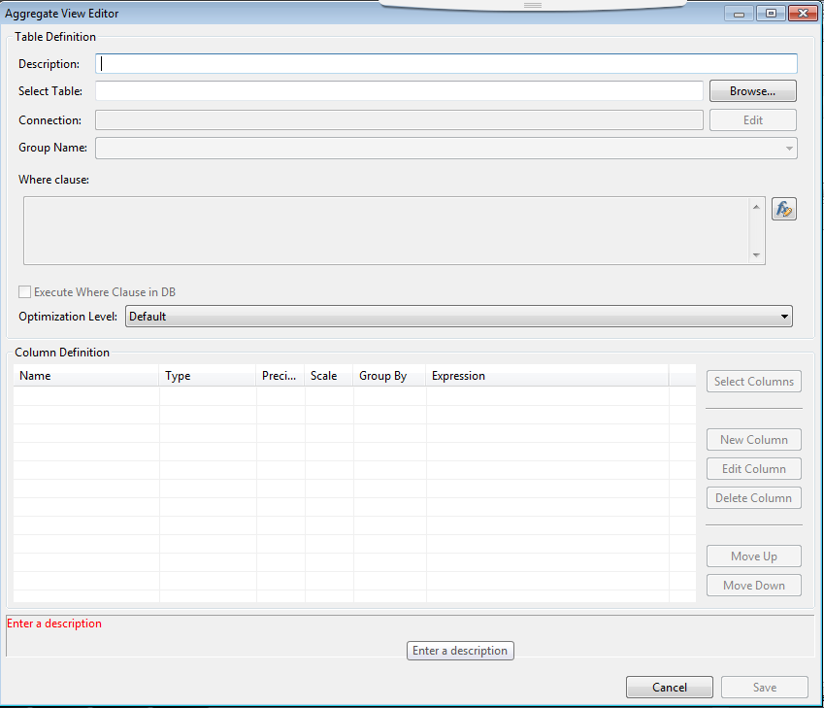
AGGREGATE VIEWS

Slide 38
PROPERTIES OF AGGREGATE VIEWS
Description Description of aggregate view.
Select Table Name of the table included in the aggregate view.
Provide Data Validation Option with information to create an aggregate view. Specify the tables that you want to include in the aggregate view.
Connection PowerCenter connection to the source tables, target tables, or views.
Group Name Name of the group if you use an XML, a PowerExchange for IMS, COBOL, or VSAM data source.
WHERE Clause The WHERE clause filters the records that are read from the data source. Enter a valid PowerCenter expression.

Slide 39
Execute Where Clause in DB Indicator that specifies that the data source must use the WHERE clause. If the data source is relational, Salesforce, SAP, or SAS, select Execute Where Clause in DB if you want the data source to process the WHERE clause.
If you do not select this option, the aggregate view filters the data before performing aggregations.
Optimization Level The optimization level controls the test logic processed the data source. Select one of the following options:
-Default. Sorts the source data before performing aggregations.
-Already Sorted Input. Indicates that the records in the data source are already sorted. If the records in the data source are not sorted, tests might fail.
Columns The columns that you want to include in the aggregate view. Data Validation Option imports all tables that you select. You can create, edit, delete, and rearrange columns.

Slide 40


