Slide 1

Data Quality
- Rajasekhar

Slide 2
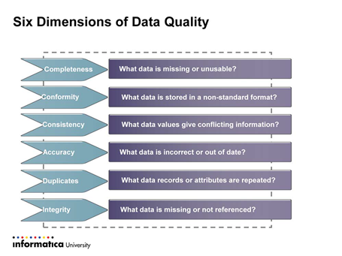
What is Data Quality
Data quality is a complex measure of data properties from various dimensions. It gives us a picture of the extent to which the data are appropriate for their purpose.
Main Dimensions of Data Quality:
Completeness
Accuracy
Consistency
Conformity

Slide 3
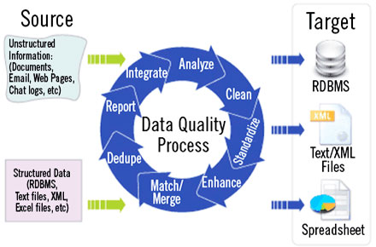
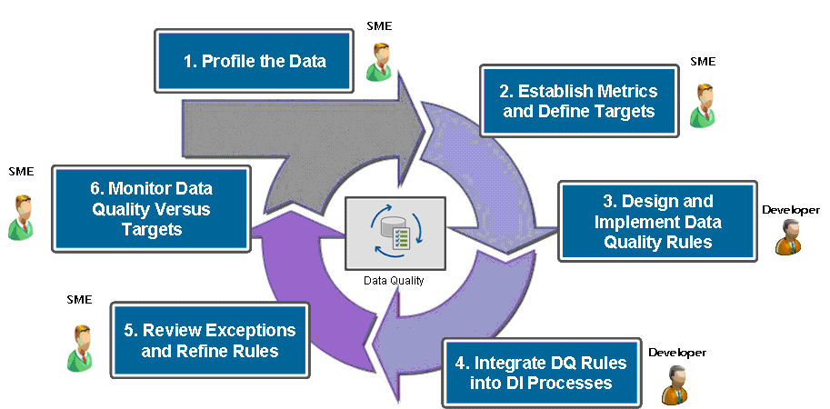
Data Quality Process/Flow
Data Quality Process
Data Quality Process in Detail

Slide 4
Data Profiling
Why Data Profiling?
It is an process through which we can identify how accurate and consistent the data is
Through Data Profiling we can identity Nulls values, Unique values and patterns in an Source Data
Data Profiling
Different types of Data Profiling.
1) Auto Profile
2) Referential Integrity Profile

Slide 5
Thank You

