Slide 1

Informatica Data Quality
- Rajasekhar

Slide 2
Contents
Introduction
What is Data Quality
Purpose/Need for Data Quality
Data Quality Architecture/Process
Data Profiling
→ Analyst Tool
→ Data Profiling in Analyst Tool
→ Data Profiling in Informatica Power Center
→ Data Profiling in Informatica Developer
→ Scorecards in Analyst Tool
Developer Tool Overview

Slide 3
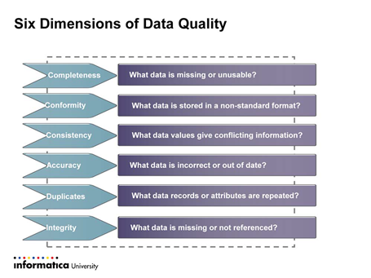
What is Data Quality
Data quality is a complex measure of data properties from various dimensions. It gives us a picture of the extent to which the data are appropriate for their purpose.
Main Dimensions of Data Quality:
Completeness
Accuracy
Consistency
Conformity

Slide 4
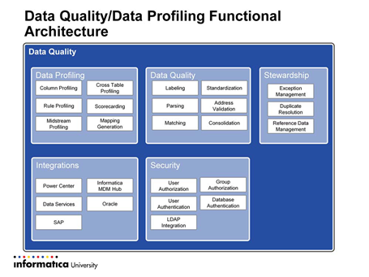
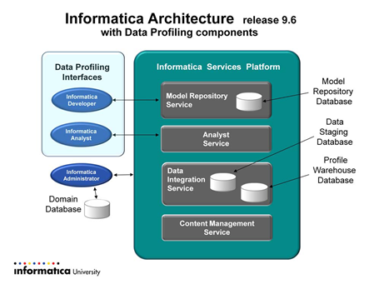
Informatica IDQ Architecture

Slide 5
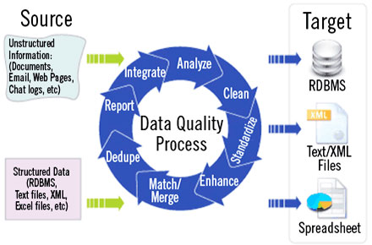
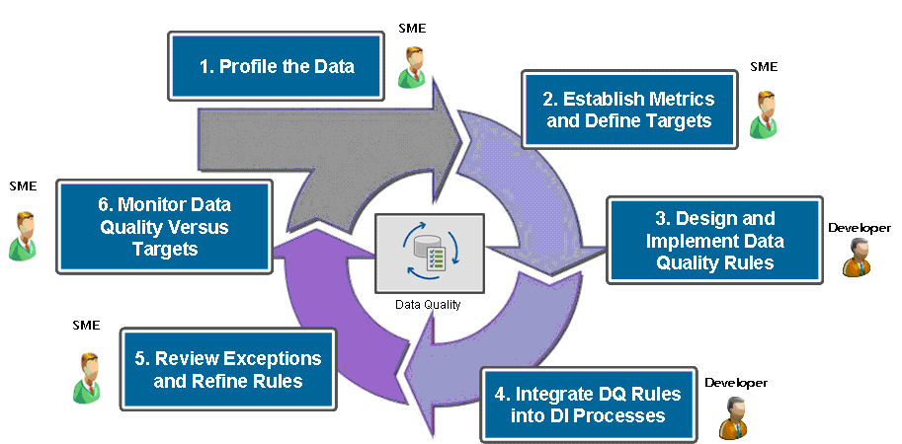
Data Quality Process/Flow
Data Quality Process
Data Quality Process in Detail

Slide 6
Data Profiling
Why Data Profiling?
It is an process through which we can identify how accurate and consistent the data is
Through Data Profiling we can identity Nulls values, Unique values and patterns in an Source Data
Data Profiling
Data Profiling can be done in three different tools in Informatica which are listed below.
1) Informatica Analyst
2) Informatica Developer
3) Informatica Power Center

Slide 7
Thank You

