Slide 1
Project-5-1
File created on: 12/6/2024 9:11:27 AM

Slide 2
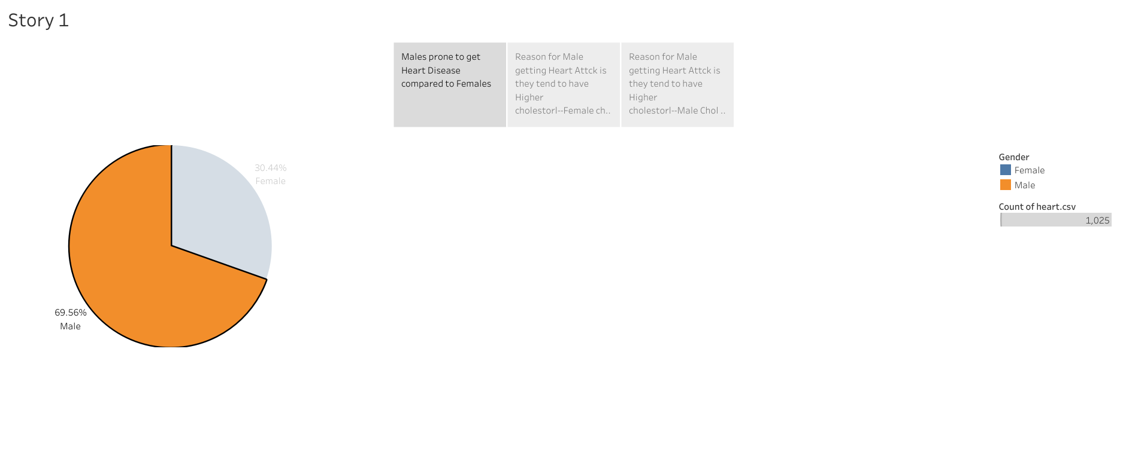

Slide 3
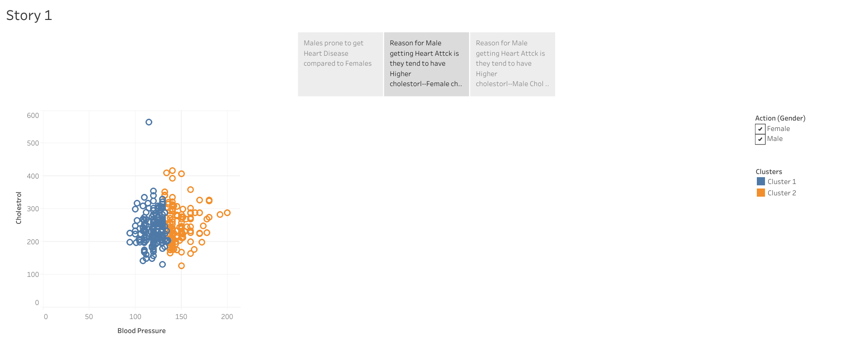

Slide 4
