Slide 1
7-story
File created on: 12/6/2024 9:58:55 AM

Slide 2
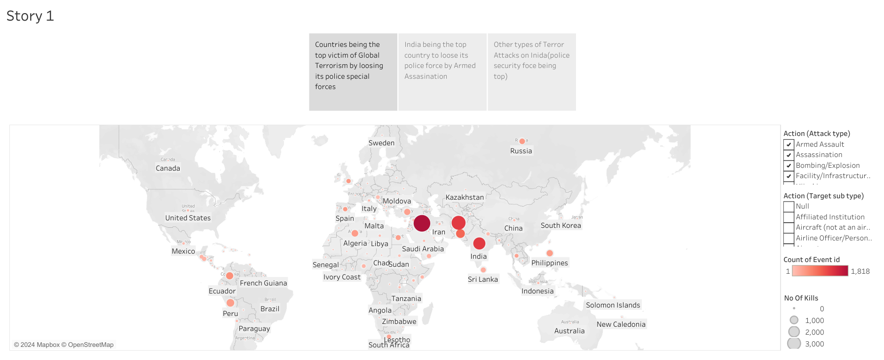

Slide 3
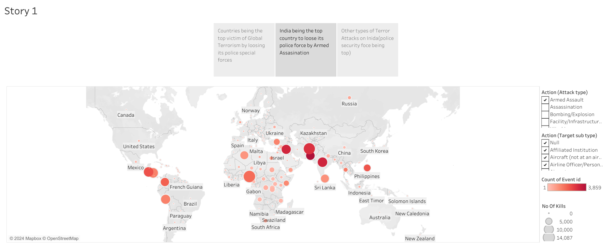

Slide 4
