Slide 1
task-1_7_13
File created on: 11/19/2024 12:48:30 AM

Slide 2
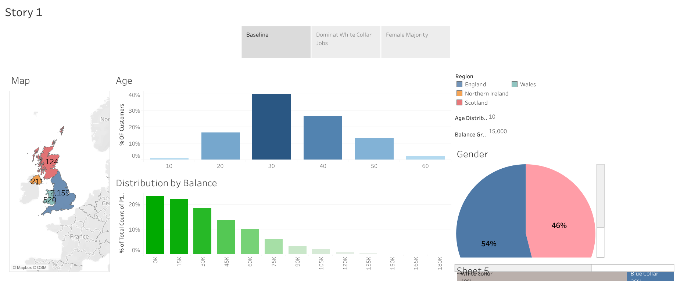

Slide 3


Slide 4
