Slide 1



DEPARTMENT OF COMPUTER SCIENCE & ENGINEERING
SCHOOL OF COMPUTING
10214CS602 MINOR PROJECT -2
WINTER SEMESTER(2023-2024)
INITIAL REVIEW
“COURSE RECOMMENDATION SYSTEM”
SUPERVISED BY
PRESENTED BY
Mr. Sankar Ganesh. K,ME
1.P Rajasekhar Reddy (VTU19381)(REG NO. 21UECS0466)
2.P Devendar Reddy (VTU19934)(REG NO. 21UECS0477)
3.S Harshavardhan Reddy (VTU20580)(REG NO. 21UECS0553)

Slide 2
OBJECTIVES
AIM OF THE PROJECT:
The primary aim of the Course Recommendation System is to simplify and enhance the process of selecting educational courses for individuals. By utilizing advanced algorithms and personalized data, the system strives to provide tailored course recommendations.
The ultimate goal is to empower users to make well-informed decisions that align with their interests, academic background, and future aspirations, thereby optimizing their learning experience and educational outcomes.
SCOPE OF THE PROJECT:
The scope of the Course Recommendation System encompasses a user-centric approach to guide individuals in choosing courses aligned with their preferences and goals. It involves the development of a user-friendly platform that integrates advanced algorithms to analyze user input, including academic background and career aspirations.
The system aims to cover a diverse range of courses, considering various disciplines and difficulty levels. Additionally, it provides flexibility to adapt to changing user preferences over time. The scope extends to fostering a continuous feedback loop for system improvement, ensuring relevance and effectiveness.
Ultimately, the Course Recommendation System seeks to be a comprehensive and dynamic tool, catering to the evolving needs of users within the educational landscape.

Slide 3
TOOLS TO BE USED IN THE PROJECT
1.ML Libraries : scikit-learn, TF-IDF Vectorizer
2. Web-Development Libraries: flask, CORS
3.UI : HTML , CSS, Java Script
4.ORACLE
5.Backend Language : Python

Slide 4
SOCIETAL IMPORTANCE OF THE PROJECT
Enhancing Education Access: Many people face challenges in accessing quality education due to various barriers like geographical location, financial constraints, or lack of information about available courses. A recommendation system can help bridge this gap by suggesting relevant courses based on users' interests, background, and goals, thereby improving access to education for a wider demographic.
Personalized Learning Experience: Every individual has unique learning preferences, abilities, and goals. A course recommendation system can provide personalized learning pathways tailored to each user's needs. By catering to individual interests and learning styles, such systems can improve learning outcomes and foster a deeper engagement with educational content.
Addressing Skill Gaps: In today's rapidly evolving job market, there is a growing demand for individuals with specific skills and knowledge. A recommendation system can identify skill gaps and suggest relevant courses or learning materials to help individuals acquire the competencies needed to stay competitive in their fields or transition to new careers.
Promoting Lifelong Learning: Continuous learning is essential for personal and professional development in a rapidly changing world. By recommending a diverse range of courses across various subjects and difficulty levels, a recommendation system can encourage users to engage in lifelong learning and pursue continuous self-improvement.
Reducing Information Overload: With the proliferation of online learning platforms and an abundance of course options available, users often face the challenge of navigating through vast amounts of information to find courses that meet their needs. A recommendation system can alleviate this burden by filtering and presenting relevant courses tailored to users' preferences, thereby simplifying the course discovery process.

Slide 5
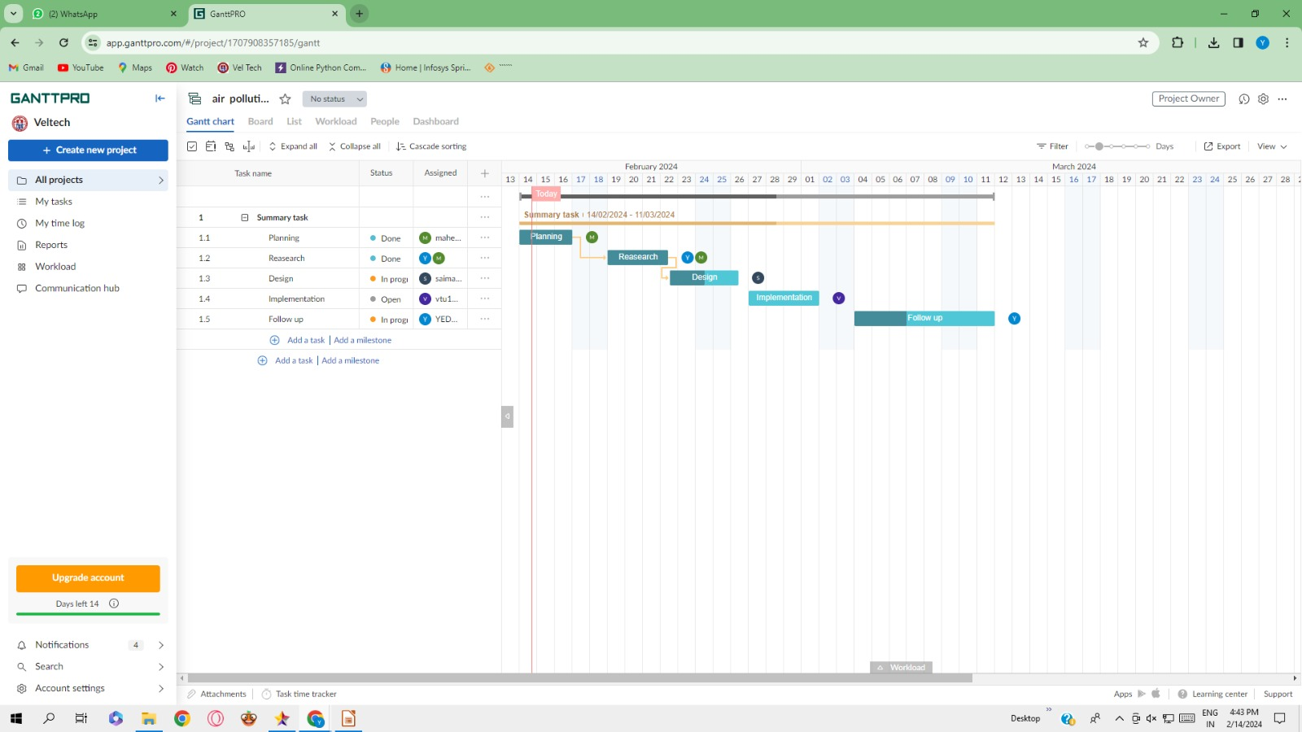
TIMELINE OF THE PROJECT
.

Slide 6

THANK YOU

