Slide 1



DEPARTMENT OF COMPUTER SCIENCE & ENGINEERING
SCHOOL OF COMPUTING
10214CS602 MINOR PROJECT -2
WINTER SEMESTER(2023-2024)
REVIEW-II
“COURSE RECOMMENDATION SYSTEM”
SUPERVISED BY
PRESENTED BY
Mr. Sankar Ganesh K, ME
1.P.Rajasekhar Reddy (VTU19381)(REG NO:21UECS0466)
2.P.Devendar Reddy (VTU19934)(REG NO:21UECS0477)
3.S.Harshavardhan Reddy (VTU20580)(REG NO:21UECS0553)

Slide 2
OVERVIEW
ABSTRACT
OBJECTIVE
INTRODUCTION
LITERATURE REVIEW (SOFT COPY OF PAPERS TO BE LINKED AS HYPERLINK)
DESIGN AND METHODOLOGIES
IMPLEMENTATION
TESTING
INPUT AND OUTPUT
INCLUDE DEMO VIDEO-1 (Till REVEW-1)
INCLUDE DEMO VIDEO-2(Complete Implementation of Project)
CONCLUSION
WEB REFERENCES LINK (TILL REVIEW DATE ALL LINKS TO BE INCLUDED DAY WISE)
PLAGIARISM REPORT OF PPT
REFERENCES

Slide 3
ABSTRACT
In today's world, there are so many courses available, and picking the right one can be tricky. This project introduces a Course Recommendation System (CRS) to help with that. The CRS uses smart technology to suggest personalized courses based on what people like and what they want to achieve.
The main goal of the Course Recommendation System is to make it easier for people to choose the right courses. It looks at what people prefer, their school background, and what they want to do in the future. By using special computer programs, the system aims to improve people's satisfaction with their chosen courses and help them succeed.
To make the Course Recommendation System work, we first ask people about their favorite subjects and how they like to learn. This information helps us create a smart system that understands what courses would be best for each person. We use special math and computer techniques to figure this out.
The end result is a working Course Recommendation System prototype/application. It takes the information we gathered from people's preferences and turns it into a helpful tool. This tool suggests courses that fit each person well. We keep improving the system by listening to what people say and testing it to make sure it stays useful for everyone in the community.

Slide 4
OBJECTIVE
AIM OF THE PROJECT:
The primary aim of the Course Recommendation System is to simplify and enhance the process of selecting educational courses for individuals. By utilizing advanced algorithms and personalized data, the system strives to provide tailored course recommendations.
The ultimate goal is to empower users to make well-informed decisions that align with their interests, academic background, and future aspirations, thereby optimizing their learning experience and educational outcomes.
SCOPE OF THE PROJECT:
The scope of the Course Recommendation System encompasses a user-centric approach to guide individuals in choosing courses aligned with their preferences and goals. It involves the development of a user-friendly platform that integrates advanced algorithms to analyze user input, including academic background and career aspirations.
The system aims to cover a diverse range of courses, considering various disciplines and difficulty levels. Additionally, it provides flexibility to adapt to changing user preferences over time. The scope extends to fostering a continuous feedback loop for system improvement, ensuring relevance and effectiveness.
Ultimately, the Course Recommendation System seeks to be a comprehensive and dynamic tool, catering to the evolving needs of users within the educational landscape.

Slide 5
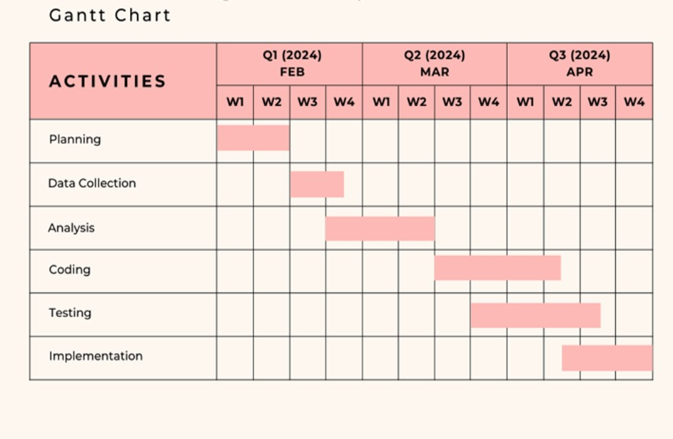
TIMELINE OF THE PROJECT
COURSE RECOMMENDATION SYSTEM

Slide 6
INTRODUCTION
"Ever felt overwhelmed by the countless educational courses available? Imagine a world where choosing the perfect course is as easy as a personalized recommendation.“
This project revolves around the development of a Course Recommendation System (CRS) to revolutionize the course selection process. Harnessing the power of advanced algorithms and user input, the CRS aims to tailor course suggestions based on individual preferences and career aspirations.
The project recognizes the challenge of navigating a vast educational landscape and seeks to simplify this journey for users. With a user-centric approach, the CRS endeavors to enhance satisfaction and success by providing a dynamic, personalized, and efficient course recommendation platform.
The following outlines the key aspects of the project, from its purpose to the methodologies employed in creating a system that adapts to the ever-changing educational needs of the community.

Slide 7
LITERATURE REVIEW
Author’s Name | Paper name and publication details | Year of publication | Main content of the paper
P. Mishra and V. Jain | “Course recommendation system using Content-based filtering” 2023 7th International Conference on trends in Electronics and Informatics(ICOEI) | 2023 | This study has attempted to implement a recommender system based on content based filtering and Machine Learning algorithm to filter skills and courses available digitally based on user's input information.
M. M. Rahman, M. S. Islam, R. R. Richi and A. Chakraborty | “Course Recommendation System for Students using K-Means and Association Rule Mining” | 2022 | The K-Means clustering method has been used to find students' most and least demand courses.

Slide 8
Author’s Name | Paper name and publication details | Year of publication | Main content of the paper
S. Lazarevic, T. Zuvela, S. Djordjevic, S. Sladojevic and M. Arsenovic | “Machine learning driven course recommendation system” | 2022 | This paper presents a machine learning-driven course recommendation system based on similarities between courses. The proposed system employs various data mining techniques to mentioned similarities between courses.

Slide 9
DESIGN AND METHODOLOGIES
MODULE 1: DATA COLLECTION AND MANIPULATION
MODULE 2: VECTORIZATION (CountVectorizer)
MODULE 3: KNN Algorithm

Slide 10
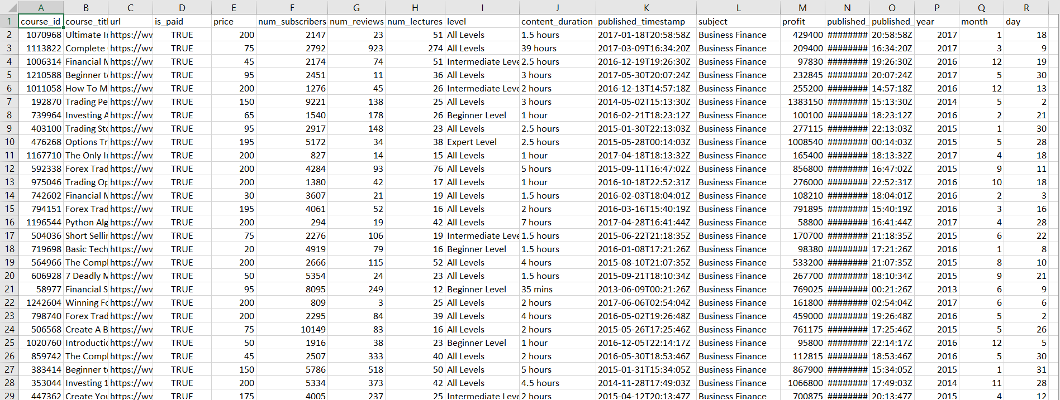
MODULE 1: DATA COLLECTION AND MANIPULATION
Step:1 Collection of data
This is a standard dataset that contains the attributes of a course such as paid-course, price, difficulty of the course, subject and the published date.

Slide 11
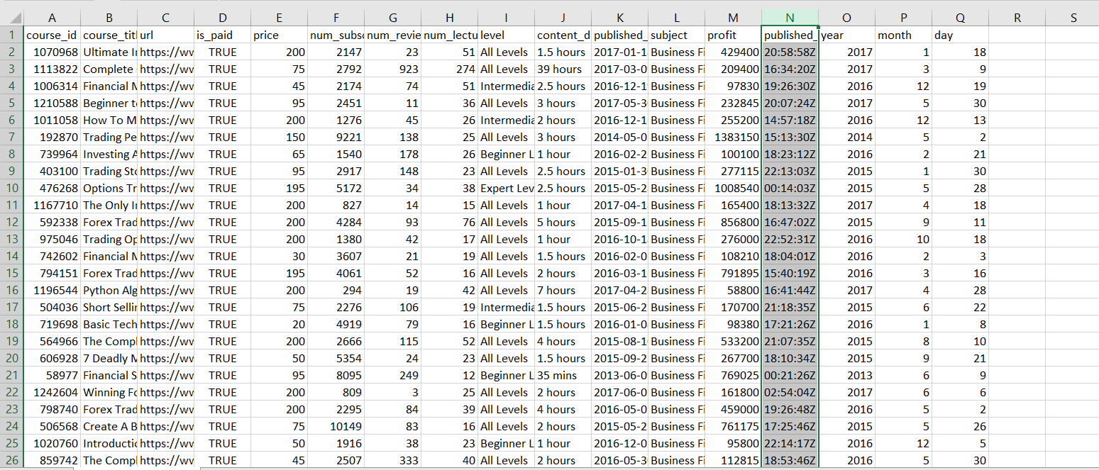
Step 2: Processing the data
Processing of data includes data visualization, removing unwanted rows, columns and the training of the model using the algorithm.

Slide 12
Module 2- VECTORIZATION (TF-IDF Vectorizer)
Vectorization is the process of converting textual data into numerical vectors and is a process that is usually applied once the text is cleaned. It can help improve the execution speed and reduce the training time of your code. In this article, we will discuss some of the best techniques to perform vectorization.
The TF-IDF (Term Frequency-Inverse Document Frequency) vectorizer is a common tool used in machine learning (ML) to convert textual data into a matrix of TF-IDF features.
The break down of what TF-IDF does:
Term Frequency (TF) measures the frequency of a term (word) in a document. It’s calculated as the number of times a term appears in a document divided by the total number of terms in the document.
Inverse Document Frequency (IDF) measures how important a term is across a collection of documents. Terms that occur frequently across many documents are considered less important. IDF is calculated as the logarithm of the total number of documents divided by the number of documents containing the term.
Finally, a sparse matrix is created containing the frequency of words, where each row represents different sentences and each column represents unique words.

Slide 13

Step 3: Using Vectorization

Slide 14
Module 3- KNN Algorithm
The K-Nearest Neighbor (KNN) algorithm is a popular machine learning technique used for classification and regression tasks. It relies on the idea that similar data points tend to have similar labels or values.
K-NN algorithm assumes the similarity between the new case/data and available cases and put the new case into the category that is most similar to the available categories.
During the training phase, the KNN algorithm stores the entire training dataset as a reference. When making predictions, it calculates the distance between the input data point and all the training examples, using a chosen distance metric such as Euclidean distance.
KNN is a reasonably simple classification technique that identifies the class in which a sample belongs by measuring its similarity with other nearby points. Though it is elementary to understand, it is a powerful technique for identifying the class of an unknown sample point.

Slide 15

Step 4: Using KNN Algorithm

Slide 16
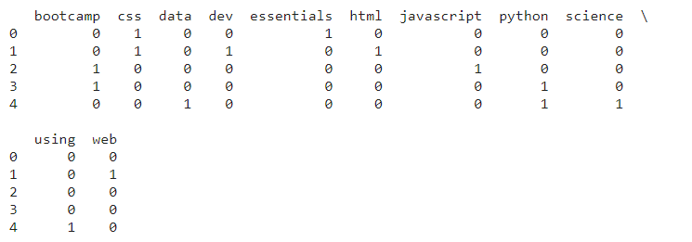
Step 5 : The output
Similarity Matrix

Slide 17
IMPLEMENTATION
Architecture Diagram
Data –Flow Diagram
Use Case Diagram
Class Diagram
Activity Diagram
Sequence Diagram
Collaboration Diagram(If applicable)
E-R Diagram

Slide 18
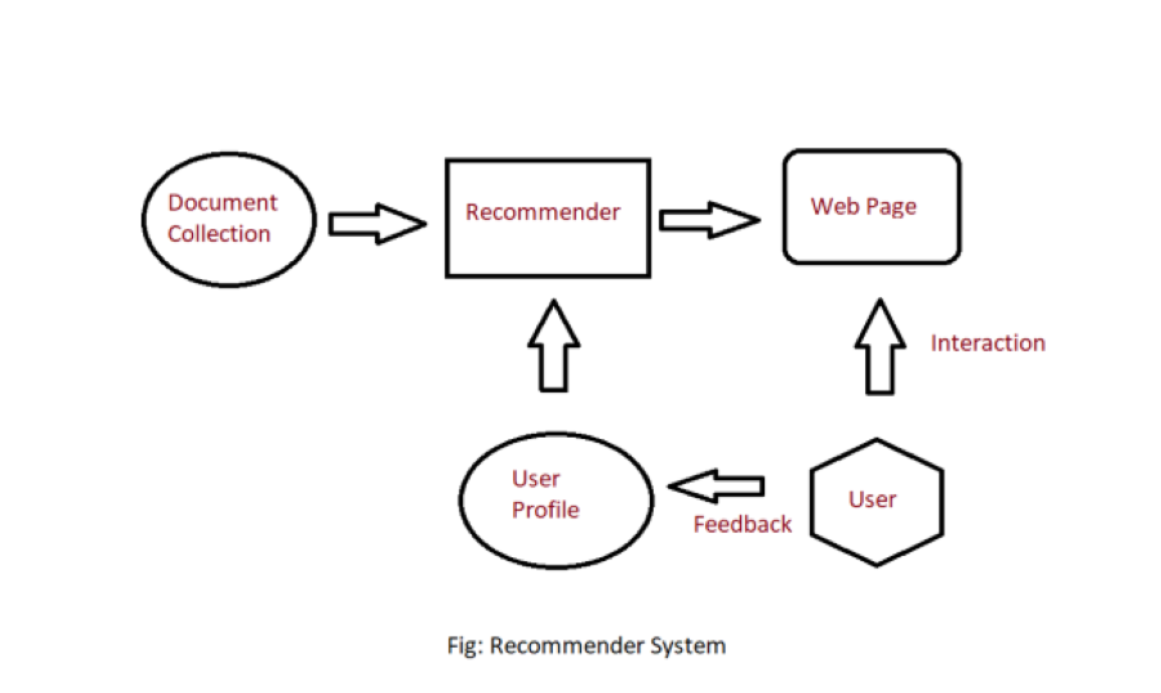
Architecture Diagram
The architecture diagram for the course recommendation system project comprises several key components.
The document collection module gathers information on available courses, while the recommender utilizes this data to generate personalized recommendations based on user preferences.
The webpage component serves as the user interface, presenting recommended courses and enabling user interactions.
User profiles store individual preferences and feedback, facilitating a dynamic and personalized learning experience within the
course recommendation system.

Slide 19
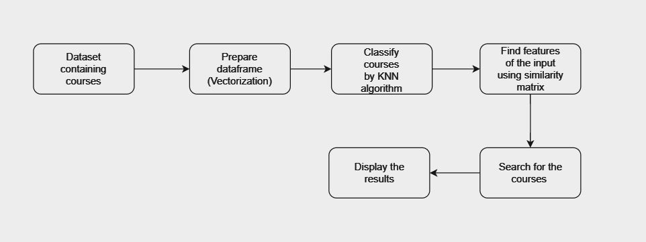
Data –Flow Diagram

Slide 20
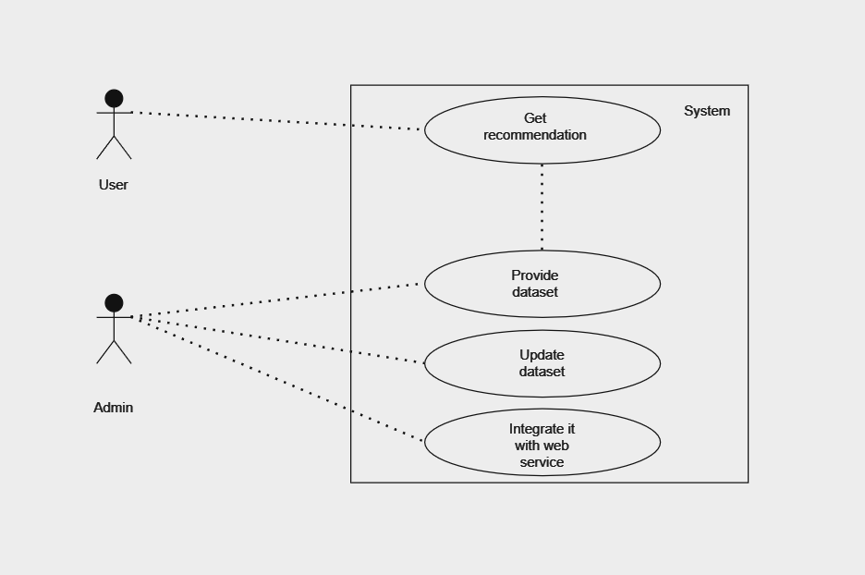
Use Case Diagram

Slide 21
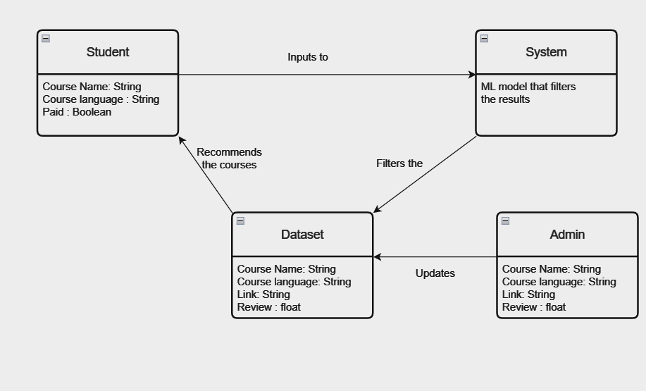
Class Diagram

Slide 22
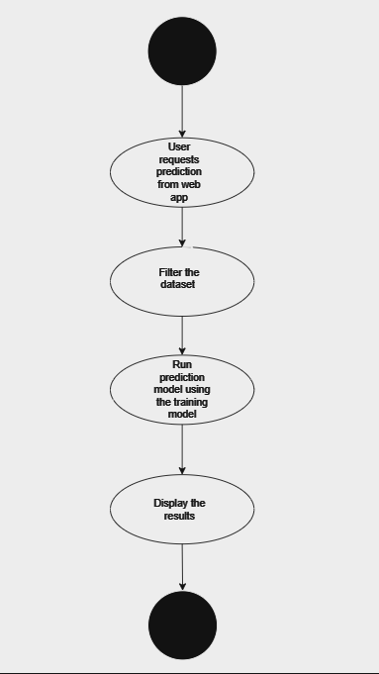
Activity Diagram

Slide 23
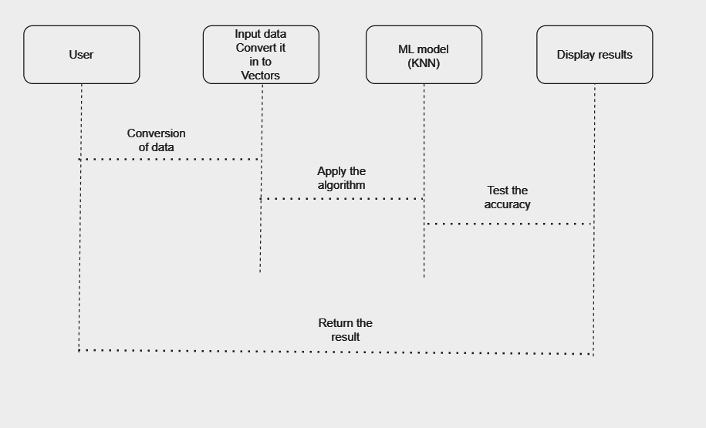
Sequence Diagram

Slide 24
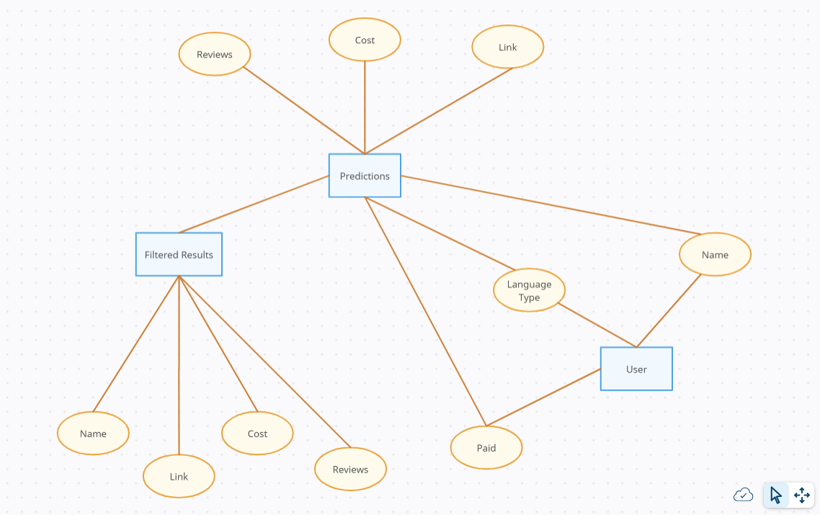
E-R Diagram

Slide 25
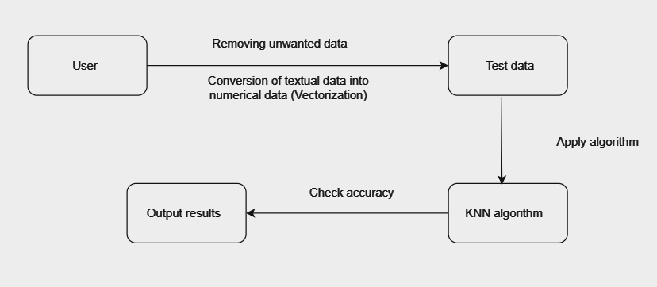
Collaboration Diagram

Slide 26
TESTING
UNIT TESTING
INTEGRATION TESTING
FUNCTIONAL TESTING
WHITE BOX TESTING
BLACK BOX TESTING

Slide 27
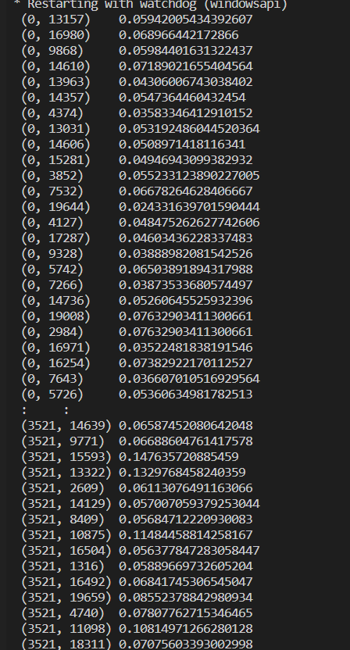
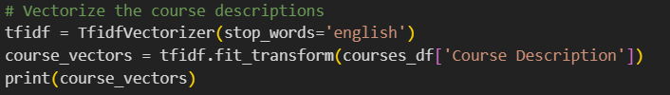
UNIT TESTING
Unit testing involves testing individual components of the software program or application. The main purpose behind this is to check that all the individual parts are working as intended. A unit is known as the smallest possible component of software that can be tested.
Testing the TF-IDF vectorizer unit.

Slide 28
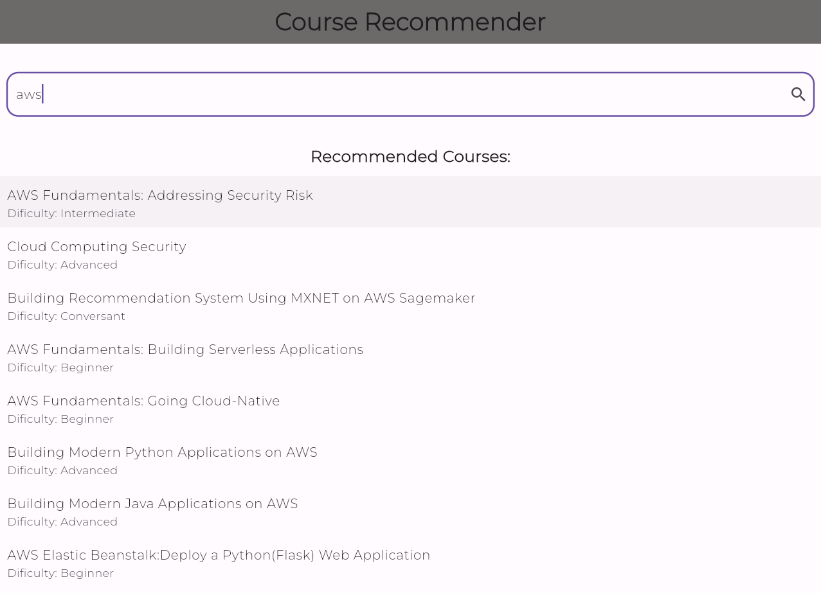
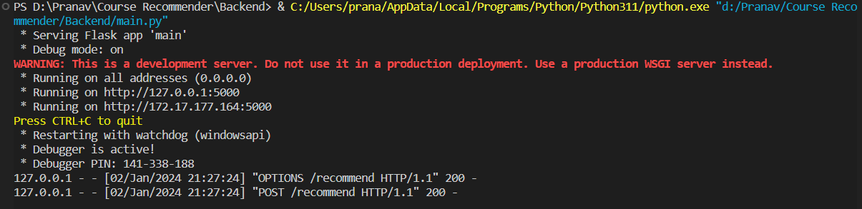
INTEGRATION TESTING
Software components are gradually merged and then tested as a cohesive group in an approach known as integration testing.
Integration testing for our project includes the testing of the server endpoints to check if the server is up and running and accepting the requests generarted from the UI.

Slide 29
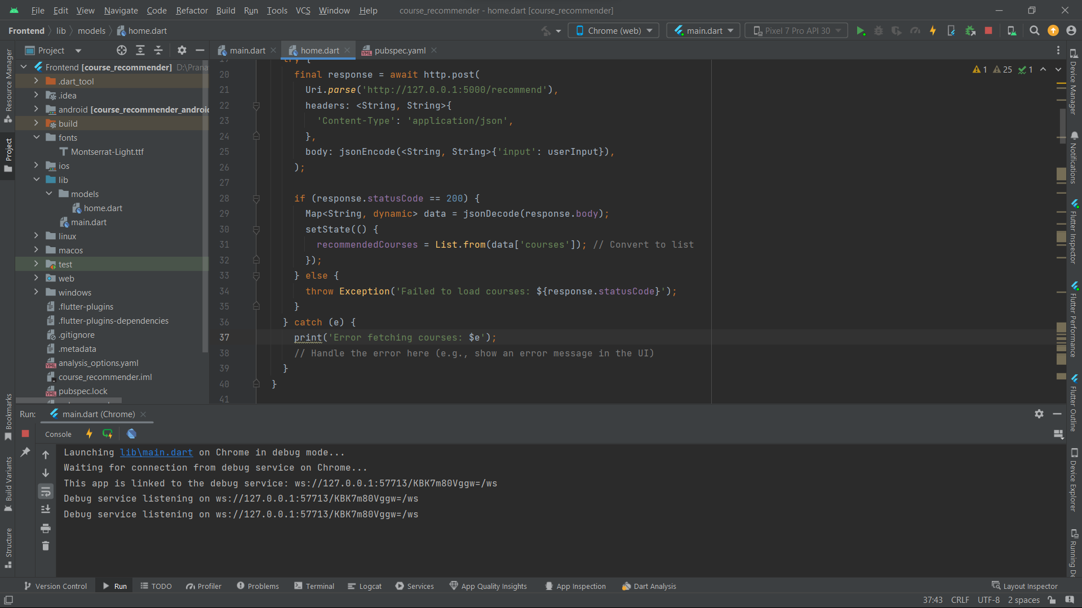
SYSTEM TESTING
Testing an entire, fully integrated software product is known as system testing.
The goal of system testing is to ensure that all components of a software application work together seamlessly to achieve the specified requirements and functionality. All the modules present in this project are tested together.

Slide 30

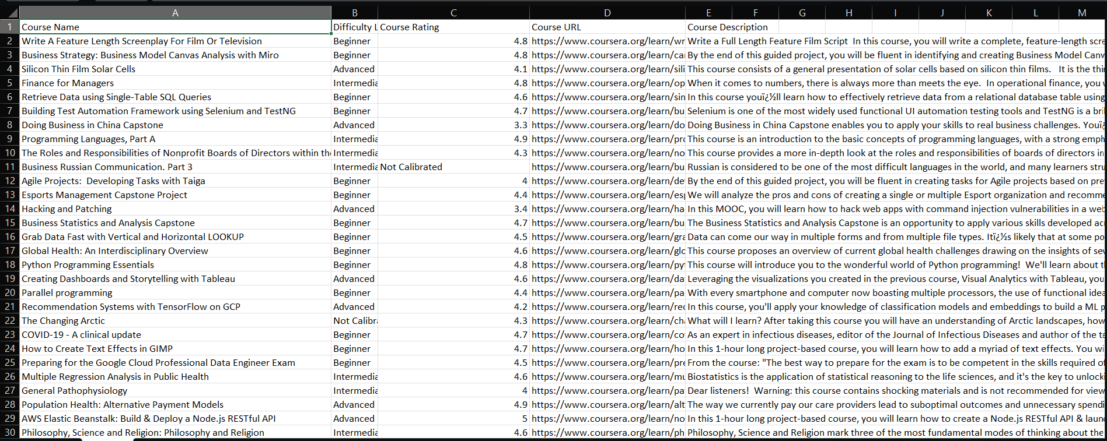
INPUT AND OUTPUT

Slide 31
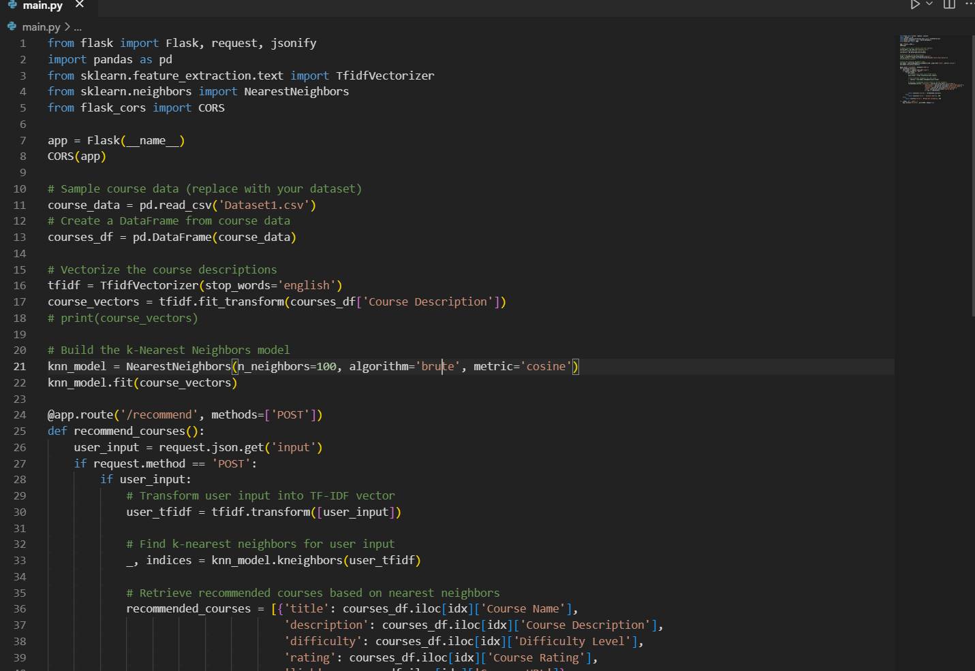
SOURCE CODE

Slide 32
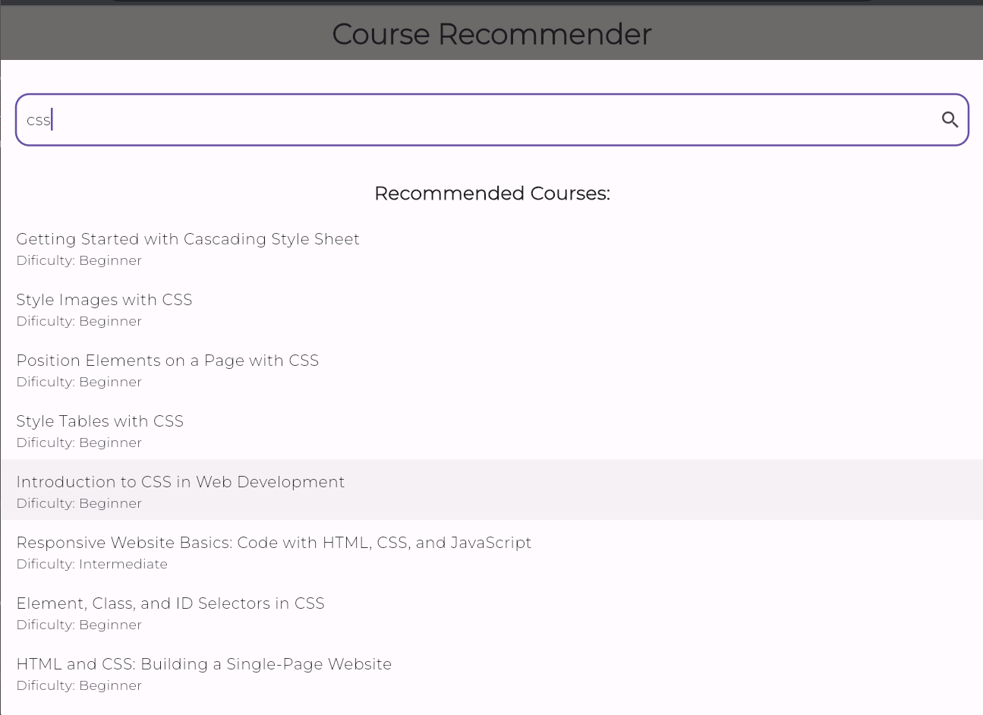
OUTPUT

Slide 33
CONCLUSION
Our course recommendation project acts like a knowledgeable assistant guiding users to discover courses aligned with their interests. It’s akin to a savvy companion who comprehends your preferences and offers suggestions based on that understanding.
Using diverse technologies, we crafted a smart backend responsible for understanding your preferences, while the frontend, the part you see and interact with on your device, presents these recommendations in a user-friendly manner.
Behind the scenes, the backend employs complex methods to analyze your input and find relevant courses. The frontend, on the other hand, is designed to be intuitive and easy to use, displaying these tailored suggestions seamlessly.
The aim is to simplify the process of discovering courses that resonate with your interests, making the journey of exploring educational opportunities more engaging and personalized, akin to having a knowledgeable guide at your fingertips.

Slide 34
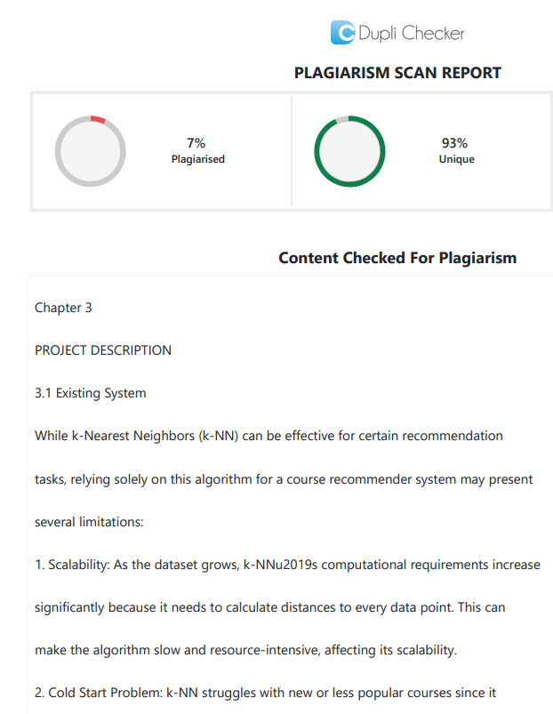
Plagiarism Report of PPT

Slide 35
Web references/video links
Flutter Documentation: https://docs.flutter.dev/
TF-IDF Vectorization: https://www.geeksforgeeks.org/understanding-tf-idf-term-frequency-inverse-document-frequency/
Flask Documentation: https://flask.palletsprojects.com/en/3.0.x/
Recommender Systems: https://www.youtube.com/watch?v=BthUPVwA59s

Slide 36
REFERENCES
S. Lazarevic, T. Zuvela, S. Djordjevic, S. Sladojevic and M. Arsenovic, "Machine learning driven course recommendation system," 2022 21st International Symposium INFOTEH-JAHORINA (INFOTEH), East Sarajevo, Bosnia and Herzegovina, 2022, pp. 1-5, doi: 10.1109/INFOTEH53737.2022.9751282.
M. M. Rahman, M. S. Islam, R. R. Richi and A. Chakraborty, "Course Recommendation System for Students Using K-Means and Association Rule Mining," 2022 International Symposium on Multidisciplinary Studies and Innovative Technologies (ISMSIT), Ankara, Turkey, 2022, pp. 641-646, doi: 10.1109/ISMSIT56059.2022.9932747.
K. Dahdouh, L. Oughdir, A. Dakkak and A. Ibriz, "Smart Courses Recommender System for Online Learning Platform," 2018 IEEE 5th International Congress on Information Science and Technology (CiSt), Marrakech, Morocco, 2018, pp. 328-333, doi: 10.1109/CIST.2018.8596516.

Slide 37
THANK YOU

