Slide 1
Behavior-Driven Development
Prasad SVS

Slide 2

Behavior Driven Development is about
understanding , documenting and
verifying business requirements
through illustrative examples

Slide 3
Behavior-Driven Development
Behavior-Driven Development (BDD) is a collaborative approach to software development that bridges the communication gap between business and IT
BDD helps teams communicate requirements with more precision, discover defects early and produce software that remains maintainable over time.

Slide 4
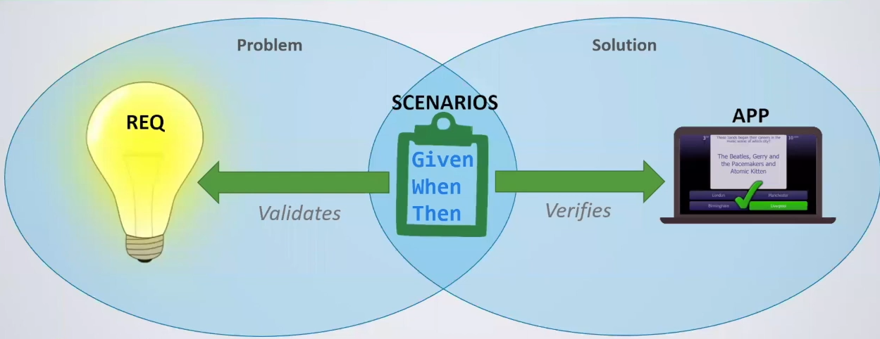

Slide 5
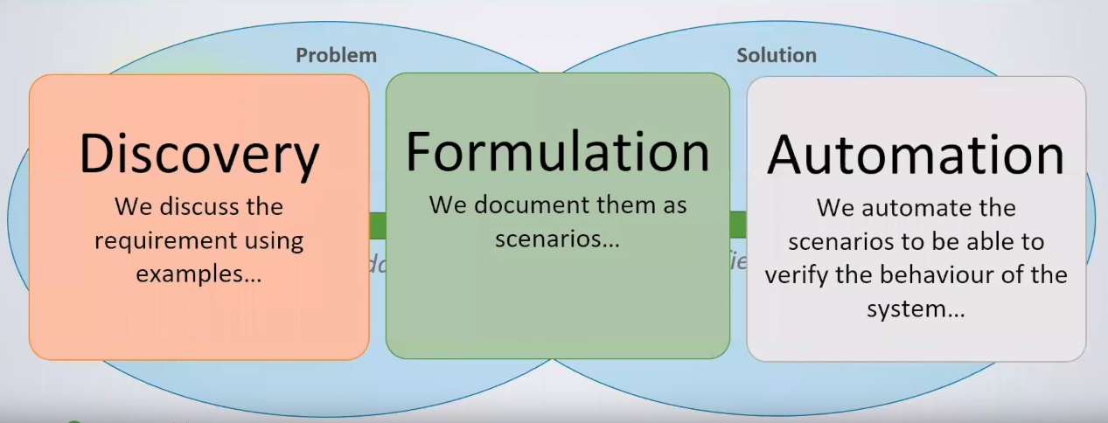

Slide 6
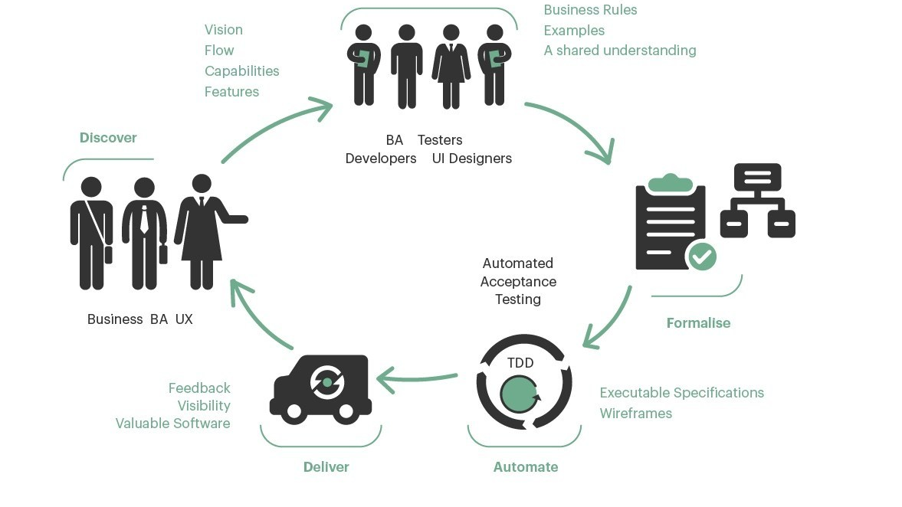

Slide 7
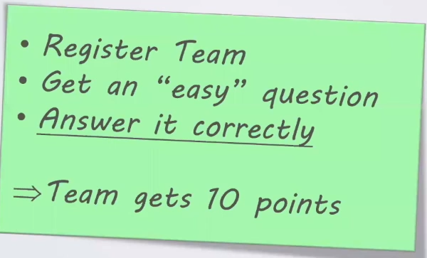
Example

Slide 8
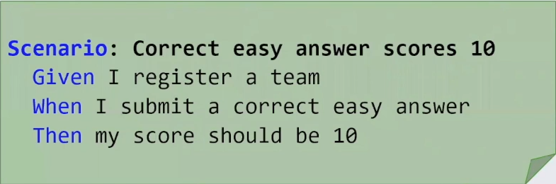
BDD Scenario

Slide 9

6 Principles for Good Scenarios

Slide 10
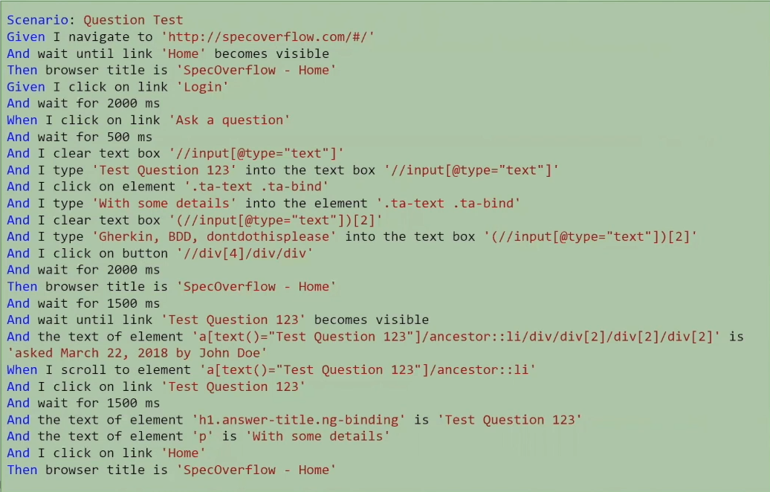
Bad Scenario

Slide 11
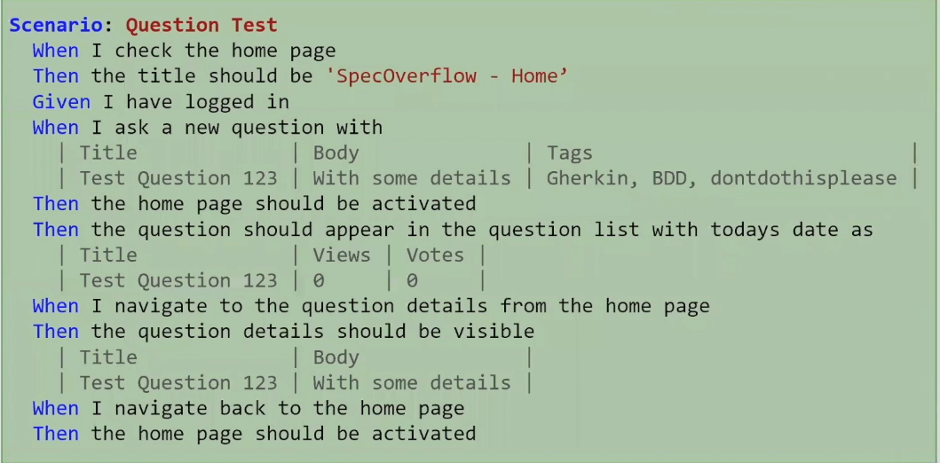
Business Language
Scenario should be using the Business or Domain language
Business will not be able to give feedback if we are using mechanics ( Even if the understand Click , Fill , Populate)

Slide 12
Intension Revealing
Scenario should reveal the intent of what the actors in the scenario are trying to achieve, rather than describing the mechanics on how you will achieve it
More details do not necessarily mean more clarity.
Unnecessary, Unimportant, irrelevant and incidental details might cause confusion (Also bad for maintainability)

Slide 13
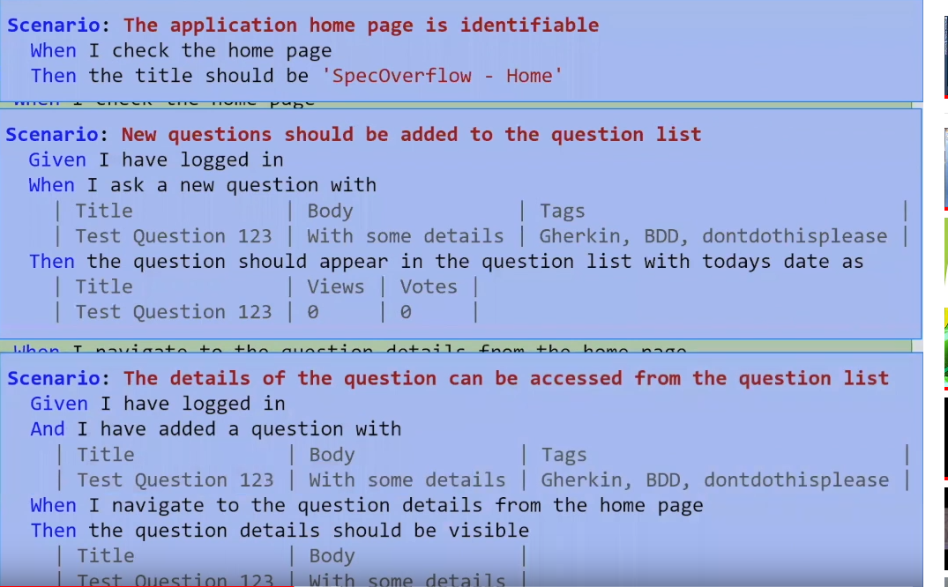
Focus
Multi rule , multi purpose scenarios cause bottleneck in the development process
Small and much focused are much better

Slide 14
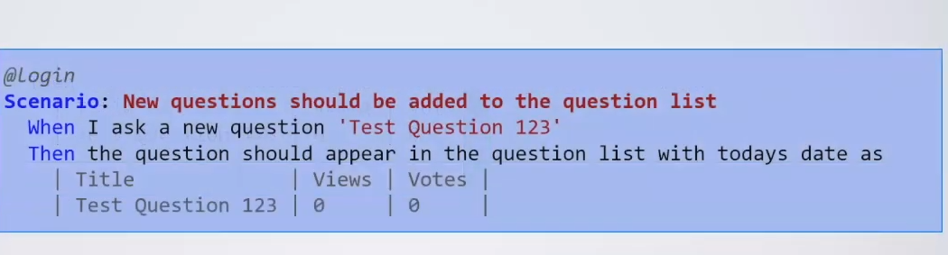
Essential
The purpose of the scenario is to illustrate how a rule should behave.
Any parts of a scenario that don’t directly contribute to this purpose are incidental and should be removed

Slide 15
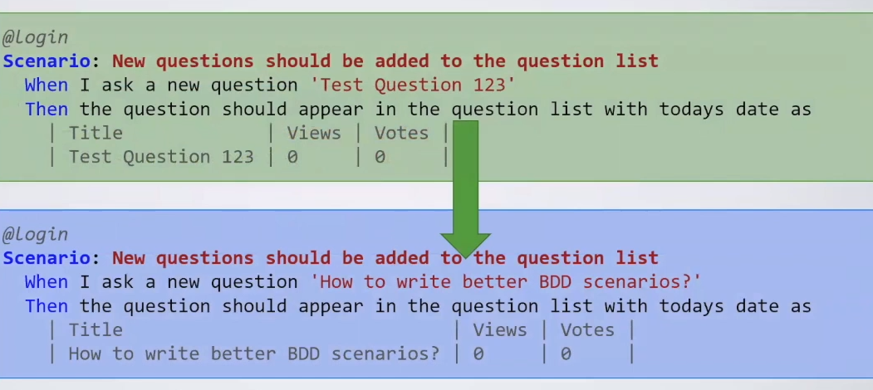
Real Data
Examples should use concrete, real data
This helps expose boundary conditions and underlying assumptions early in the development process

Slide 16
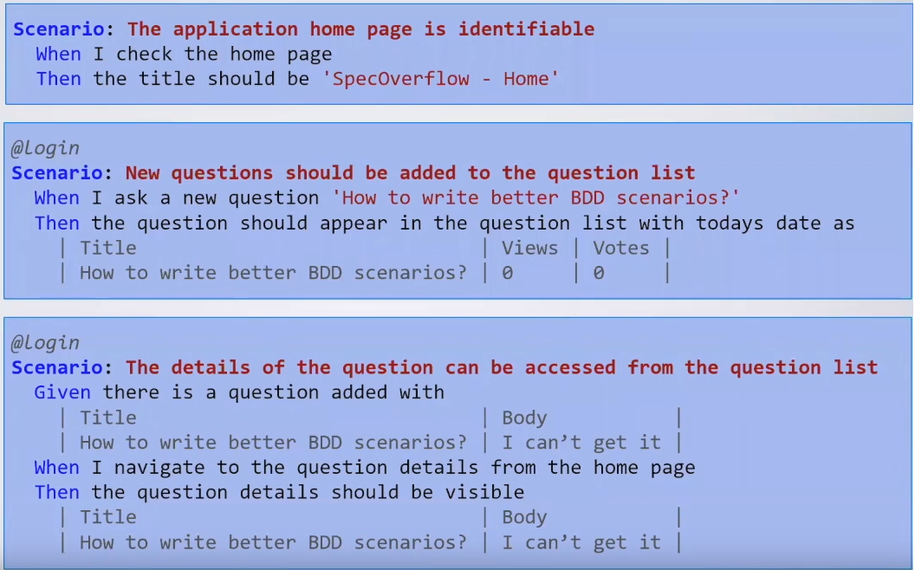
BRIEF

