Slide 1

A
MAJOR PROJECT REVIEW
ON
SMART BI-DIRECTIONAL DOUBLE-POLE (SIC) SOLID STATE CIRCUIT BREAKER (SSCB) WITH STM 32 & ESP 32
UNDER THE GUIDANCE OF,
Mrs. Sagupha Parween B.Tech., M.Tech.
Dept of ECE,
JBREC,HYDERABAD.
BY,
M. SHAILUSHA (23J21A0424)
T. RAJA SHEKAR (24J25A0424)
G.KRITHIN (24J25A0407)
DEPARTMENT OF ELECTRONICS & COMMUNICATION ENGINEERING
JOGINPALLY B.R. ENGINEERING COLLEGE
2026-27

Slide 2


Slide 3
PROJECT INTRODUCTION
The Core Problem: Traditional mechanical circuit breakers suffer from slow switching speeds, contact arcing, and single-pole limitations that leave neutral lines active during fault conditions.
The Solution: A next-generation Solid-State Circuit Breaker (SSCB) utilizing Wide-Bandgap Silicon Carbide (SiC) technology to achieve ultra-fast, arc-free power interruption.
Key Innovations:
Sub-Microsecond Protection: Achieves fault isolation in under using hardware-level analog watchdog monitoring.
Total Dual-Pole Safety: Simultaneous physical interruption of both Phase and Neutral lines.
Smart Integration: Combines real-time STM32 control with an ESP32 IoT co-processor for cloud-based telemetry and power analytics, and Power Factor).

Slide 4
Advanced Solid-State Breaker System with IoT and PFC
230V AC HIGH VOLTAGE POWER PATH
AC MAINS
(230V L, N)
FUSE / MOV
PROTECTION
(16A / 275V)
ISOLATED CURRENT
SENSOR
(ACS758 Hall Effect
±50A / 120kHz)
ISOLATED VOLTAGE
SENSOR
(AMC1301 Diff Amp
4.8kV Isolation)
MAIN SOLID-STATE
SWITCH
(2x Back-to-Back SiC
Wolfspeed 1200V/21mΩ)
SNUBBER &
CLAMP
(UltraMOV 150J
+ RC 10nF/47Ω)
AC LOAD /
CIRCUIT OUTLET
(230V / 16A)
SIGNAL CONDITIONING
(OPA2340 Active Filter)
ISOLATED GATE DRIVER
(Si827x >200V/ns)
ACTIVE PFC STAGE
TRIAC + Cap Bank (15µF)
Analog Sense
PWM / Fast Trip
PFC Trigger Control
STM32 HARD-REAL-TIME CONTROL PLANE
STM32 MICROCONTROLLER (STM32G431KB - 170MHz Cortex-M4F)
ESP32 IOT PLANE (COMPACT)
ADC (SENSING) — Dual 12-Bit 4 MSPS (PA1 Phase, PA2 Neutral, PA3 Voltage)
ESP32 (240MHz)
• 2.4GHz Wi-Fi (802.11 b/g/n)
DSP / FFT (AC ANALYSIS) — DMA True-RMS V & I (128 samples/cycle)
OPTO-
ISOLATORS
(UART ISO
PC817)
• MQTT Client & Telemetry Publisher
• Remote Trip / Reset Command Relay
POWER FACTOR CALC & PFC CONTROLLER (PB6/TIM4) -> Direct Gate Trigger to PFC Stage
MQTT
BROKER
(HiveMQ
Cloud)
USER APP
Web & Mobile
Dashboard
ANALOG WATCHDOG & FAST TRIP LOGIC (<500ns) -> Direct Gate Driver Shutoff (TIM1_BKIN)
HV | LV SIDE
GALVANIC ISOLATION
BARRIER

Slide 5
Operational Process Flow
01
02
03
01
AC MAINS & SURGE INTAKE
02
DUAL GALVANIC SENSING
03
STM32 ULTRA-FAST TRIP
• 230V AC (16A / 50Hz) enters via Line & Neutral.
• 16A ceramic fuse isolates catastrophic shorts.
• ACS758 Hall sensor reads ±50A AC current.
• AMC1301 diff amp reads AC voltage 4.8kV.
• active filter buffers clean ADC signals.
• STM32G431KB executes Dual 12-bit ADC.
• Hardware detects short-circuits in < 500 ns.
• Hardware TIM1 instantly cuts gate driver PWM
04
05
06
04
SiC POWER BREAK & CLAMP
05
DYNAMIC POWER FACTOR
06
ISOLATED CLOUD IOT
• Si827x isolated gate drivers execute < 30ns turn-off.
• 2x back-to-back Wolfspeed SiC MOSFETs open arc-free.
• RC snubber (10nF/47Ω) + UltraMOV clamps kickback.
• STM32 DSP computes real-time power factor cos(φ).
• When PF < 0.95, STM32 PB6 fires Active PFC TRIAC.
• Connects 15µF capacitor bank to restore unity PF.
• PC817 optocouplers isolate UART across 5kV barrier.
• ESP32 publishes V, I, PF & Energy to HiveMQ MQTT.
• Web/Mobile Dashboards stream live telemetry & trip control.

Slide 6
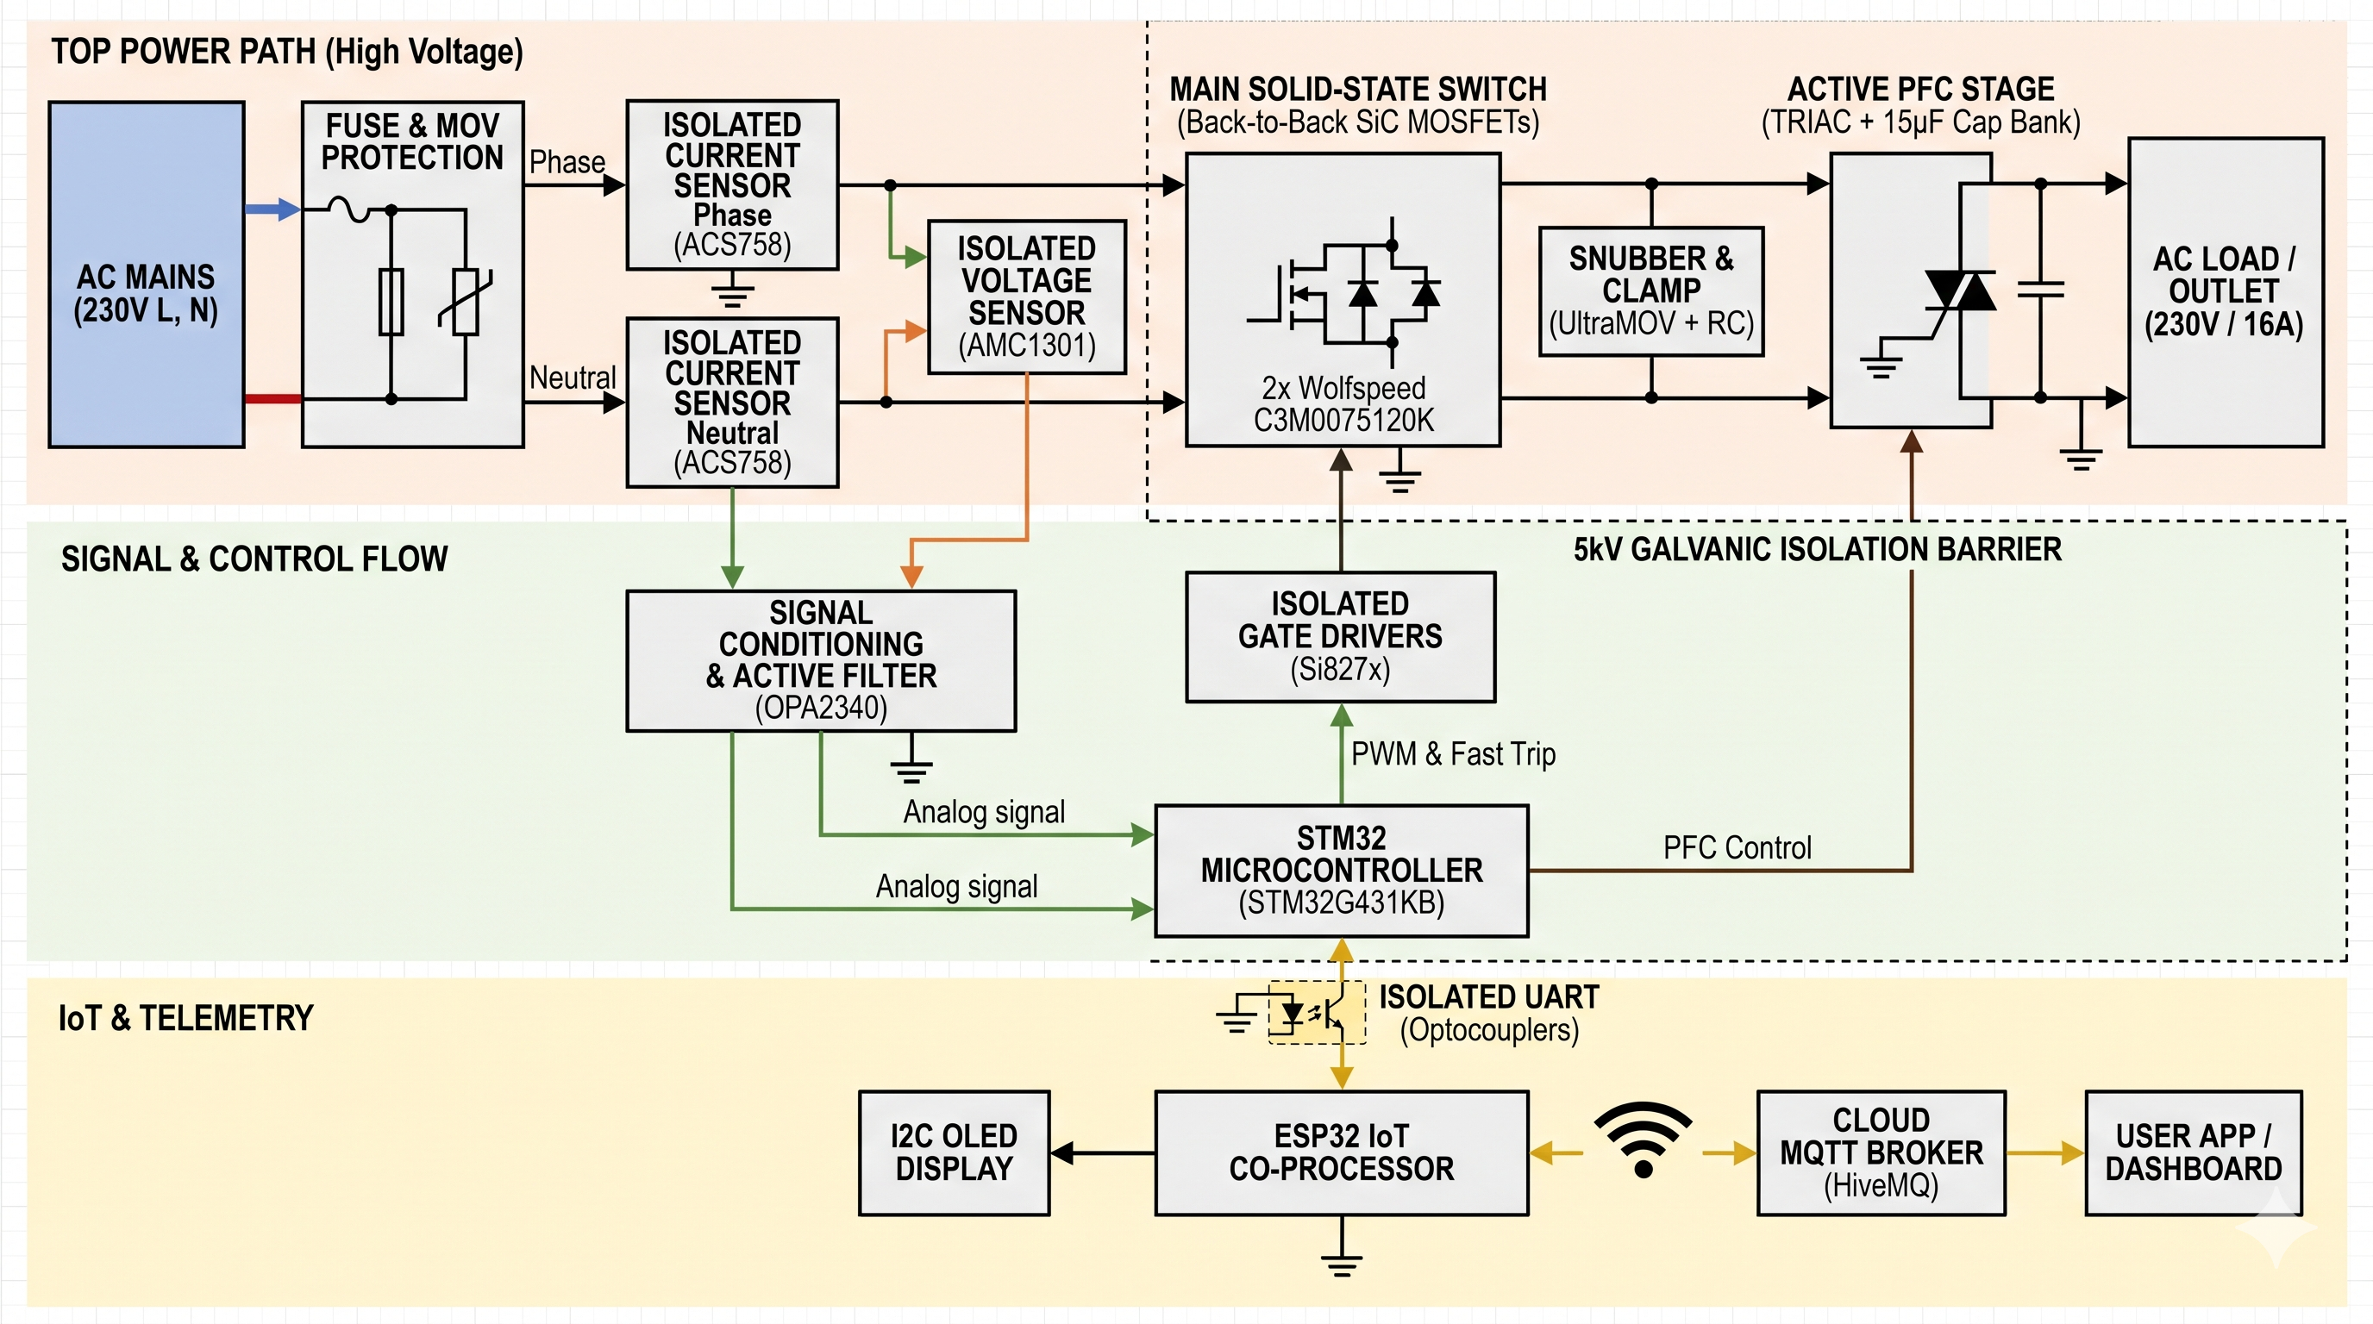

Slide 7
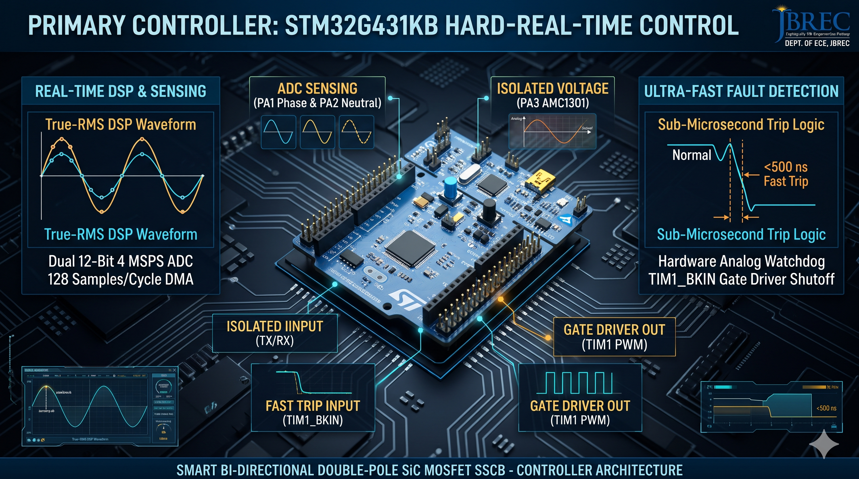

Slide 8
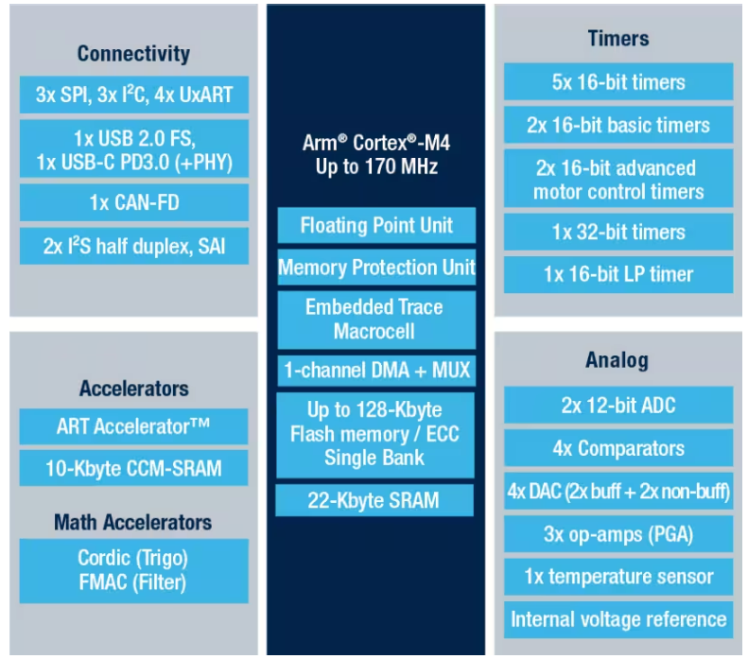
INDIVIDUAL BLOCKS :PRIMARY DSP CONTROLLER STM 32
OFFICIAL ARCHITECTURE BLOCK DIAGRAM (STMicroelectronics)
TECHNICAL SPECIFICATIONS (STMicroelectronics)
• CPU: Arm Cortex-M4F @ 170MHz
• ADCs: Dual 12-Bit, 4.0 MSPS
• ADC Latency: 0.25 µs Fast Conv.
• Watchdogs: 3x Analog AWD
• Fast Trip: < 50 ns (TIM1_BKIN)
• Total Cutoff: < 500 ns Safe Shut
• Flash Memory: 128 KB ECC
• SRAM: 32 KB Parity Check
• Math Accel: CORDIC + FMAC
• True-RMS: 128 Pts/Cycle DMA
• Supply Range: 1.71V to 3.6V
FUNCTIONAL DESCRIPTION & SYSTEM OPERATION
Hardware Analog Watchdogs continuously monitor current levels and trigger TIM1_BKIN to shut off SiC gate drive in < 50 ns without CPU latency.
DMA circular buffers compute 128 samples/cycle True-RMS metrics (V, I, P, Q, PF) with zero CPU overhead and stream telemetry to ESP32 via UART DMA.
STMicroelectronics STM32G431KB Product Architecture • Source: st.com

Slide 9
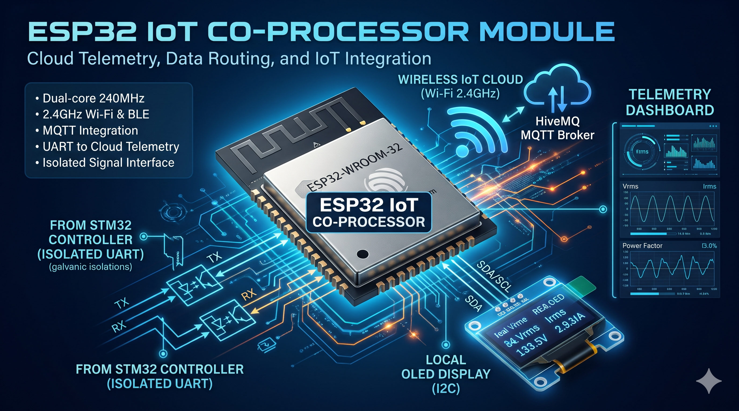

Slide 10
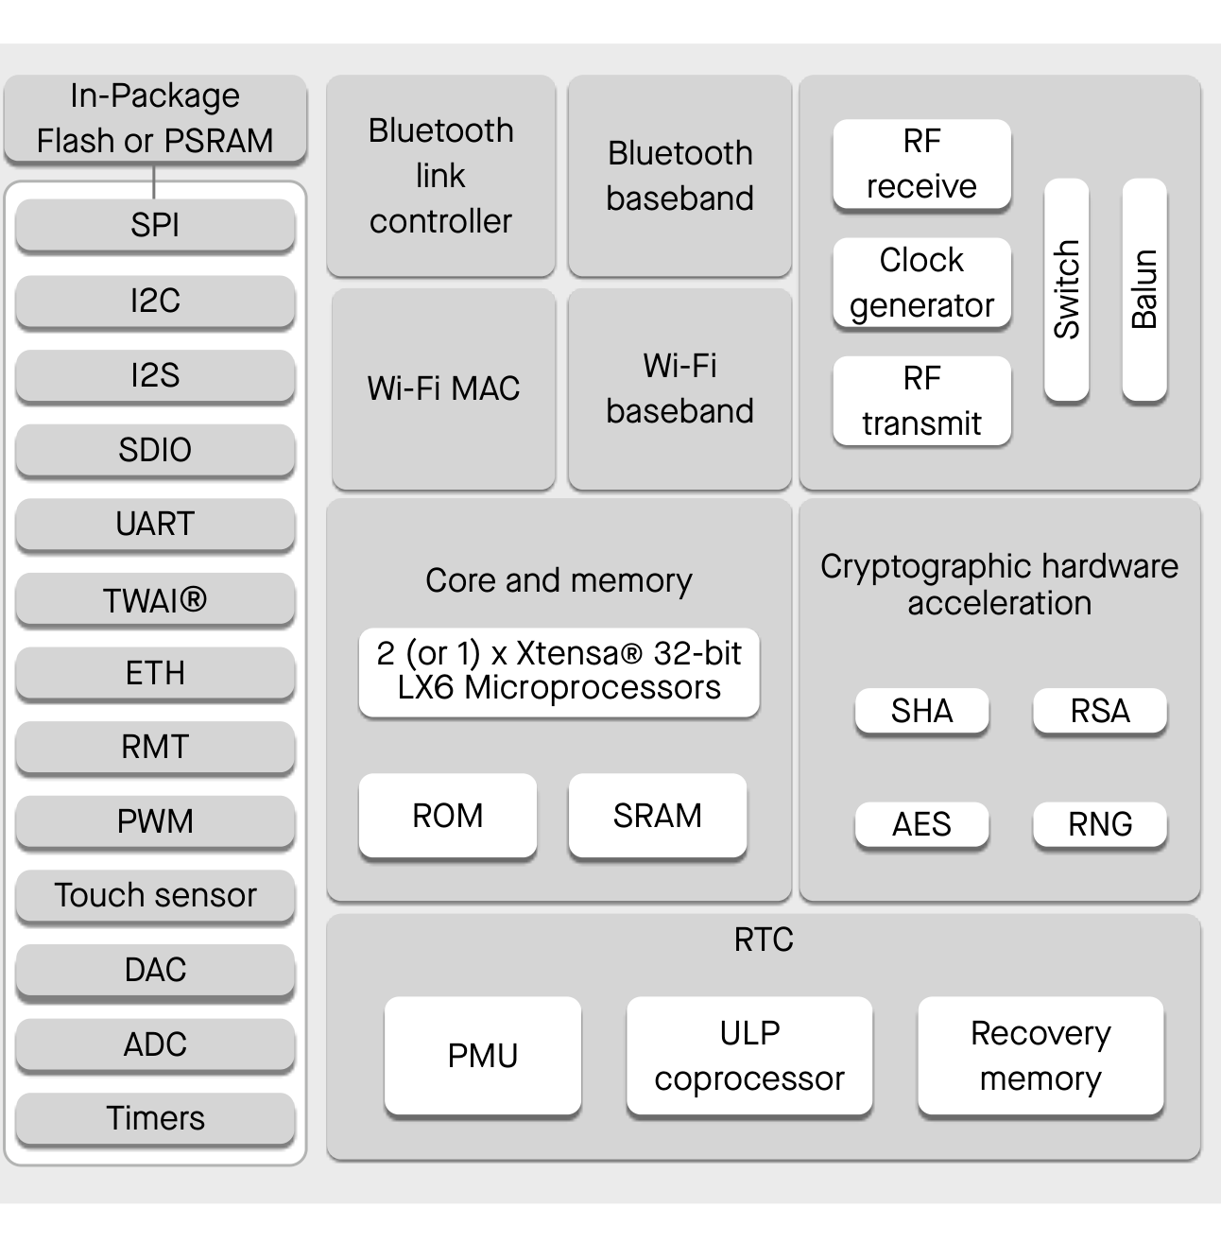
INDIVIDUAL BLOCKS : ESP 32 WROOM
OFFICIAL ARCHITECTURE BLOCK DIAGRAM (Espressif Systems)
TECHNICAL SPECIFICATIONS (Espressif Systems)
• CPU: Dual Xtensa @ 240 MHz
• Wireless: Wi-Fi 4 + BLE 4.2
• RAM: 520 KB Internal SRAM
• Flash: 4 MB Quad-SPI (80MHz)
• I/O: 3x UART, 2x I2C, 3x SPI
• Mixed-Signal: 18x ADC, 2x DAC
• Bus Link: UART2 (921.6k) + DMA
• Cloud IoT: MQTT, WS & Blynk
• Power: 80 mA (Deep Sleep 10 µA)
• Operating Temp: -40°C to +125°C
FUNCTIONAL DESCRIPTION & SYSTEM OPERATION
Receives continuous True-RMS voltage, current, power, and fault telemetry packets from STM32 over isolated high-speed UART2 and broadcasts to MQTT cloud brokers.
Provides real-time user visualization on a local I2C OLED display and receives secure mobile app remote trip/reset commands to actuate the circuit breaker.
Espressif Systems ESP32 Series Functional Block Diagram • Source: espressif.com

Slide 11
INDIVIDUAL BLOCKS : ISOLATED CURRENT SENSING
ACS758LCB-100B: CB-PFF PACKAGE & INTERNAL DIE STRUCTURE
TECHNICAL SPECIFICATIONS (Allegro MicroSystems)
IP+ (Line In)
IP- (Line Out)
• Sensor Model: ACS758LCB-100B
• Primary Current: ±100 A Bidirectional
• Sensitivity: 20 mV / A @ 5V VCC
• Quiescent Output: 2.5 V (Zero Amps)
• Galvanic Isolation: 4.8 kV RMS (60s)
• Conductor Resistance: 100 µΩ (Ultra-Low)
• Bandwidth: 120 kHz Typical
• Response Time: 3.0 µs Step Response
ALLEGRO ACS758LCB-100B • CB-PFF PACKAGE INTERNAL DIE STRUCTURE
100 µΩ Primary Conductor Loop (Continuous 16A / 100A Fault Path)
⚡ 4.8 kV RMS Galvanic Isolation Dielectric Barrier
Hall Plate Sensor
(VH ∝ Primary I)
Offset Cancellation
(2 MHz Chopper)
FUNCTIONAL DESCRIPTION & SYSTEM OPERATION
Diff Preamplifier
& Temp Trim Matrix
Output Buffer & Filter
(20 mV/A Linear VIOUT)
Hall-effect sensing isolates AC mains current and outputs a linear 20 mV/A analog voltage centered at 2.5V directly to STM32 ADC pins PA0 and PA1.
Simultaneous Line and Neutral dual-sensor acquisition enables instant overcurrent protection (< 500 ns) and differential earth leakage detection (Idiff > 30 mA).
Pin 1: VCC (+5V Power)
Pin 2: GND (0V Ref)
Pin 3: VIOUT (PA0/PA1)

Slide 12
INDIVIDUAL BLOCKS : ISOLATED VOLTAGE SENSING
TI AMC1301: SOIC-8 PACKAGE & INTERNAL ISOLATED ARCHITECTURE
TECHNICAL SPECIFICATIONS (Texas Instruments)
• Amplifier Model: Texas Instruments AMC1301
• Linear Input Range: ±250 mV Differential
• Voltage Gain: 8.2x Fixed Differential Gain
• Galvanic Isolation: 5.0 kV RMS (7071 Vpk)
• Common-Mode Transient: 15 kV/µs CMTI
• Nonlinearity: 0.03% (High Precision)
• Signal Bandwidth: 210 kHz Typical
• Propagation Delay: 2.8 µs Latency
TI AMC1301: SOIC-8 DWV PACKAGE & INTERNAL ARCHITECTURE
Diff Input Buffer
(±250 mV Range)
5.0 kV RMS SiO2 BARRIER
Diff Capacitive RX
(Barrier Recovery)
VDD1 (5V)
VDD2 (3.3V)
VINP (+)
2nd-Order ΔΣ Mod
(21 MHz Bitstream)
Digital Demodulator
& Sinc3 Filter
VOUTP (+)
FUNCTIONAL DESCRIPTION & SYSTEM OPERATION
VINN (-)
Diff Capacitive TX
(Isolated Driver)
Diff Output Buffer
(8.2x Gain VOUTP/N)
VOUTN (-)
Precision resistor divider attenuates 230V AC mains to ±250 mV, which AMC1301 transmits across a 5 kV silicon-dioxide barrier to the OPA2340 op-amp.
The OPA2340 active filter converts the differential signal into a single-ended 0-3.3V waveform centered at 1.65V for STM32 ADC sampling and zero-crossing sync.
GND1
VDD1 / GND1 Supply
(Mains Ground Ref)
VDD2 / GND2 Power
(+3.3V System Ref)
GND2 (0V)

Slide 13
INDIVIDUAL BLOCKS : SOLID-STATE SiC POWER SWITCH
C3M0075120K: TO-247-4L PACKAGE & INTERNAL DIE ARCHITECTURE
TECHNICAL SPECIFICATIONS (Wolfspeed Inc.)
Isolated Heatsink Tab (Direct Drain Metallization)
• Device Model: Wolfspeed C3M0075120K
• Drain-Source Voltage (Vds): 1200 V Max
• Continuous Current (Id): 30 A @ 25°C
• On-State Resistance (Rds_on): 75 mΩ Typ
• Gate-Source Voltage: -4V to +15V Rec.
• Total Gate Charge (Qg): 51 nC (Fast)
• Switching Energy (Eon+Eoff): 0.58 mJ
• Turn-Off Delay (td_off): 22 ns Latency
WOLFSPEED C3M0075120K • TO-247-4L INTERNAL DIE
1200V / 30A SiC Channel
• RDS(on) = 75 mΩ Typ.
• Planar MOSFET Technology
Intrinsic Body Diode
• Zero Reverse Recovery
Dedicated 4th Lead Kelvin Source (KS) Internal Bond Wire Split
• (Pin 2): Carries 16A AC Load Current
• (Pin 3): Dedicated Gate Loop Return
FUNCTIONAL DESCRIPTION & SYSTEM OPERATION
Two SiC MOSFETs connected in back-to-back common-source topology block bidirectional AC voltage without requiring mechanical moving contacts.
The dedicated Kelvin driver source lead bypasses high-current source inductance, enabling ultra-fast clean turn-off in under 500 ns without gate bounce.
P1: Drain
(Mains)
P2: Source
(Load 16A)
P3: Kelvin S
(Drive Ref)
P4: Gate
(TIM1 PWM)

Slide 14
INDIVIDUAL BLOCKS : ISOLATED GATE DRIVER
Si8274AB: SOIC-16 PACKAGE & INTERNAL ISOLATED ARCHITECTURE
TECHNICAL SPECIFICATIONS (Silicon Labs)
• Driver Model: Silicon Labs Si8274AB
• Peak Drive Current: 4.0 A Source / Sink
• CMTI Immunity: 200 kV / µs (Ultra-High)
• Propagation Delay: 30 ns Maximum
• Galvanic Isolation: 2.5 kV RMS Barrier
• Input Logic: 3.3V CMOS Compatible
• Asymmetric Bias: +15V ON / -4V OFF
• Fast Disable: < 50 ns (TIM1_BKIN Link)
SILICON LABS Si8274AB1 • SOIC-16 INTERNAL DRIVER ARCHITECTURE
3.3V CMOS Input
(Schmitt Trigger)
2.5 kV RMS 200 kV/µs CMTI
RF Demodulator
& Pulse Receiver
VDDI (3.3V)
VDDB (+15V)
PWM (PA8)
Fast Disable Latch
(< 50 ns TIM1_BKIN)
Dual UVLO Monitor
(+15V / -4V Rails)
VEE (-4V)
DIS (PA6)
Dead-Time Unit
(Anti-Cross Conduction)
4.0A Push-Pull Driver
(Rail-to-Rail VOUT)
VOUT (Gate)
FUNCTIONAL DESCRIPTION & SYSTEM OPERATION
Asymmetric +15V/-4V gate bias guarantees minimum conduction losses when ON and actively prevents parasitic dV/dt false turn-on during fast turn-off.
200 kV/µs CMTI capacitive isolation withstands extreme SiC switching slews without faulting, while a dedicated disable line cuts gate drive in < 50 ns.
GNDI (0V)
RF Modulator TX
(Differential Output)
+15V ON / -4V OFF
Active Miller Clamp
GNDB (KS)

Slide 15
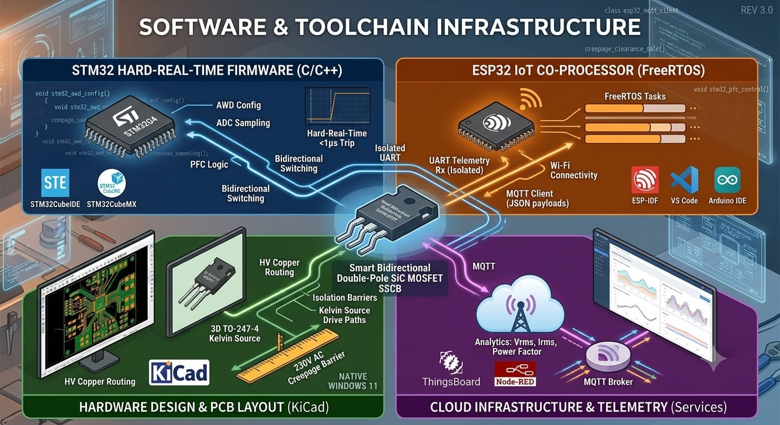

Slide 16
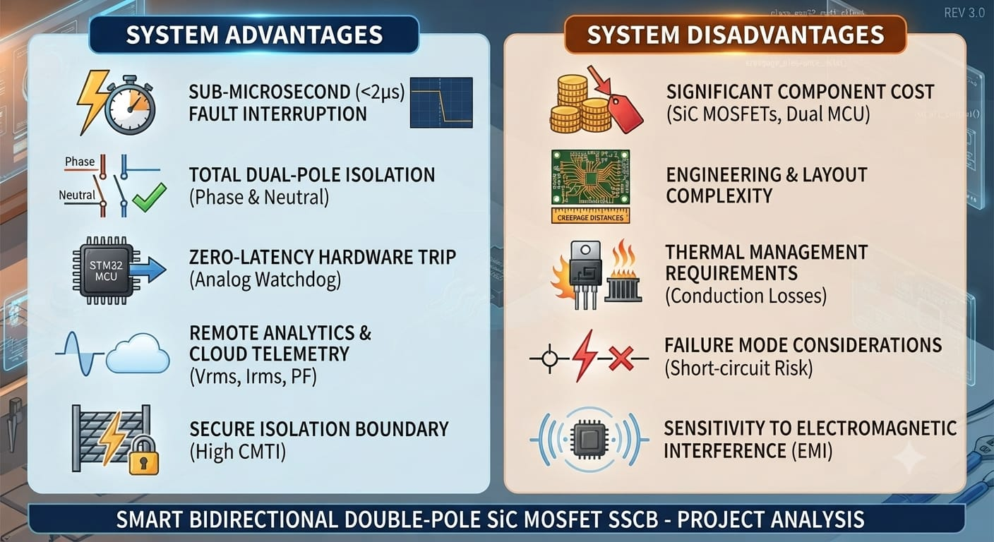

Slide 17


Slide 18
PROJECT CONCLUSION & FUTURE SCOPE
KEY TECHNICAL ACHIEVEMENTS
FUTURE SCOPE
Hardware Analog Watchdog (AWD) achieves autonomous trip in <500 ns with 0 software latency.
Clears bolted short-circuits >30,000× faster than mechanical breakers (20 ms), preventing equipment damage.
Four Wolfspeed 1200V/21mΩ SiC MOSFETs isolate Phase & Neutral paths simultaneously.
Eliminates neutral floating, dangerous reverse currents, and contact wear seen in mechanical relays.
Zero-crossing TRIAC capacitor switching maintains dynamic power factor >0.95 under reactive loads.
Isolated UART streams real-time Vrms, Irms, and PF telemetry to MQTT cloud dashboard via ESP32.
Upgrade switching stage to E-mode GaN FETs for sub-100 ns clearing and lower on-state conduction loss.
Deploy active Miller clamping drivers to suppress parasitic turn-on under extreme dv/dt (>150 V/ns).
Embed TinyML neural models on STM32 Cortex-M4 DSP for continuous load signature analytics (NILM).
Detect arcing signatures, insulation degradation, and motor winding failures before full short-circuit occurs.
Develop 2-Pole 36 mm standard DIN-rail modular enclosure with integrated isolated heatsink channels.
Establish full compliance testing with IEC 60947-2 circuit breaker standards and UL 489 industrial codes.

