Slide 1
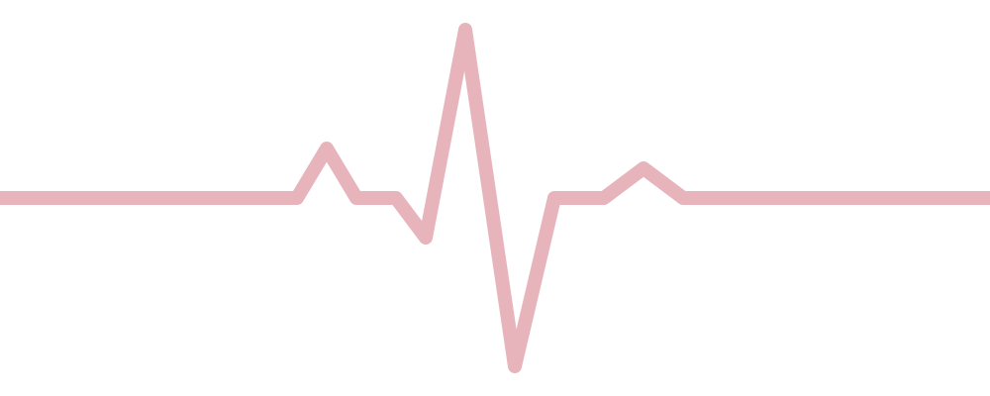
Heart Disease Prediction
Classifying heart-disease risk from routine clinical measurements
Rajashree Guduru | M.S. Business Analytics, Sacred Heart University
Notes:
Heart Disease Prediction. Classifying heart-disease risk from routine clinical measurements.

Slide 2
The question
Can routine clinical measurements predict whether a patient has heart disease, and which factors matter most?
0.85
Test accuracy
0.91
ROC-AUC
Heart disease is a leading cause of death worldwide. A simple, interpretable screening model can help clinicians prioritise patients for further testing.
0.52
Baseline accuracy

Slide 3
Data and approach
1
Exploratory analysis: distributions, disease rate by chest-pain type, correlation matrix
Data
UCI Cleveland Heart Disease dataset: 303 patients, 13 clinical features, binary target (165 with disease, 138 without)
Features: age, sex, chest pain type, resting blood pressure, cholesterol, fasting blood sugar, resting ECG, maximum heart rate, exercise-induced angina, ST depression, ST slope, number of major vessels, thal
No missing values; one duplicate row; mean patient age 54.4
2
70/30 train-test split plus 10-fold stratified cross-validation
3
Models: majority-class baseline, decision tree, logistic regression (raw features), random forest, logistic regression with scaling and one-hot encoding
4
Metrics: accuracy, ROC-AUC, precision, recall, F1; ROC curves; model coefficients for interpretation
5
Generative AI extension (RAG): a 23-passage knowledge base is embedded with the all-MiniLM-L6-v2 sentence-transformer; each patient's top-3 factors drive retrieval; facts come from a template, definitions are quoted from the retrieved passages, and a local LLM (Qwen2.5-1.5B-Instruct via Hugging Face) answers follow-up questions in a Gradio chat app; five designs were evaluated

Slide 4
Data dictionary
Feature | Description | Type
age | Patient age in years | Numerical
sex | Sex (1 = male, 0 = female) | Categorical
cp | Chest pain type (0-3) | Categorical
trestbps | Resting blood pressure (mm Hg) | Numerical
chol | Serum cholesterol (mg/dl) | Numerical
fbs | Fasting blood sugar > 120 mg/dl | Categorical
restecg | Resting ECG result (0-2) | Categorical
Feature | Description | Type
thalach | Maximum heart rate in stress test | Numerical
exang | Exercise-induced angina (1 = yes) | Categorical
oldpeak | ST depression induced by exercise | Numerical
slope | Slope of peak exercise ST segment (0-2) | Categorical
ca | Major vessels coloured by fluoroscopy (0-4) | Numerical
thal | Thalassemia test result (coded 0-3) | Categorical
target | Heart disease present (1 = yes) | Target

Slide 5
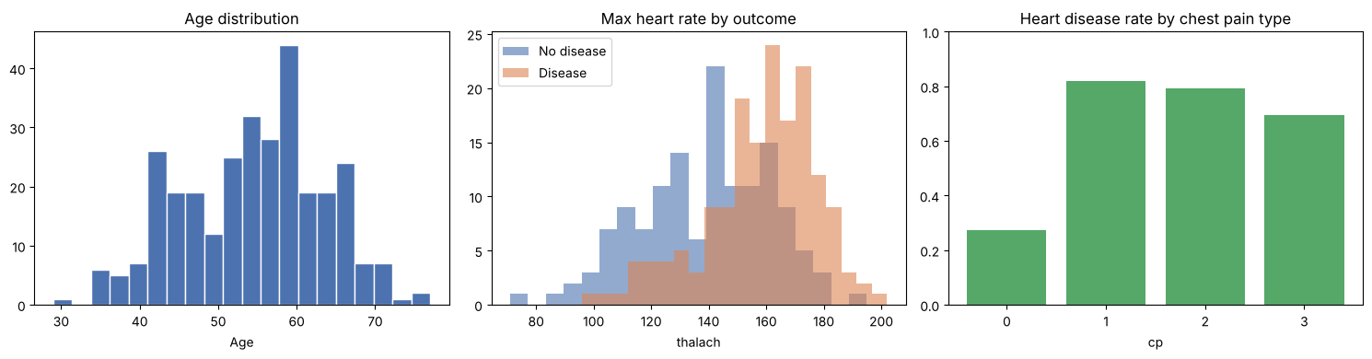
What the data shows
Age distribution, maximum heart rate by outcome, and disease rate by chest-pain type

Slide 6
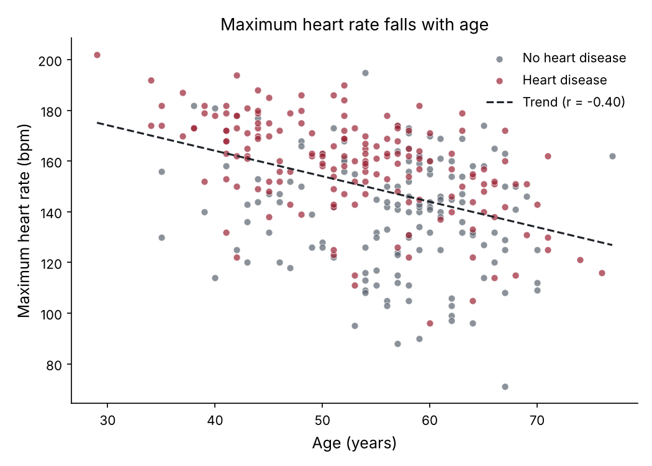
Clinical insights from exploration
50%
of patients have cholesterol above 240 mg/dl, the high-risk threshold (151 of 303)
-0.40
correlation between age and maximum heart rate: heart-rate capacity declines with age
261 vs 239
average cholesterol (mg/dl) for women vs. men in this dataset

Slide 7
Model results
Model | Accuracy | ROC-AUC | Recall | 10-fold CV acc.
Majority-class baseline | 0.52 | 0.50 | 1.00 | 0.55
Decision Tree | 0.75 | 0.75 | 0.74 | 0.75
Logistic Regression (raw) | 0.81 | 0.89 | 0.89 | 0.82
Random Forest | 0.84 | 0.91 | 0.91 | 0.83
Logistic Regression (scaled + one-hot) | 0.85 | 0.91 | 0.89 | 0.85

Slide 8
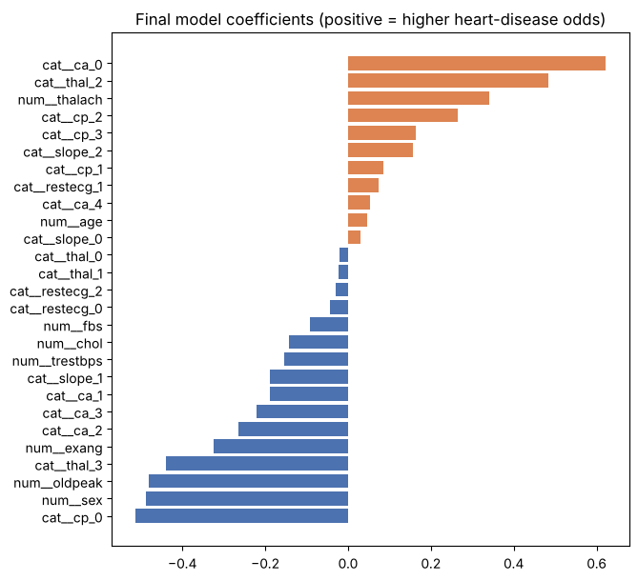
What predicts heart disease
Final model coefficients: positive values raise the odds of heart disease
Strongest signals: number of major vessels, chest pain type, thal result, sex, ST depression and maximum heart rate.
Recall of 0.89: only 5 of 47 heart-disease patients in the test set were missed, which matters most for screening.

Slide 9
Generative AI: RAG explainer and chat
Predict
Attribute
Retrieve
Explain
Chat
Logistic regression scores the patient's risk
›
Top 3 factors: coefficient x deviation from average
›
MiniLM embeddings find matching knowledge-base passages
›
Template states facts; definitions quoted from passages
›
Local LLM (Qwen2.5-1.5B) answers follow-ups, labelled
92.7%
5/5
5
Letting the 1.5B LLM write explanations (v1-v4) produced fluent text with invented numbers and details, e.g. calling a female patient 'male'.
Final design keeps the LLM away from facts: code states risk and directions, definitions are quoted, and the LLM only answers follow-ups.
retrieval hit rate (top factors)
chat answers with no invented numbers
designs evaluated

Slide 10
Key findings
1
Logistic regression improved accuracy from a 0.52 baseline to 0.85, with 0.91 ROC-AUC; 10-fold cross-validation (0.85 accuracy, 0.91 AUC) confirms it is not a lucky split.
2
One-hot encoding the categorical clinical codes added about 3 points of accuracy over raw features, and beat the decision tree by 10 points.
3
Recall of 0.89: only 5 of 47 heart-disease patients in the test set were missed, which matters most for screening.
4
Strongest signals: number of major vessels, chest pain type, thal result, sex, ST depression and maximum heart rate.

Slide 11
How the model could be used
1
2
3
Early detection
Decision support
Targeted prevention
Flag at-risk patients from routine measurements so they can be referred for further testing sooner.
Give clinicians a second opinion with an explainable score: each coefficient shows which factors raised the risk.
Focus lifestyle and monitoring programmes on the patients the model ranks as highest risk.
A screening aid, not a diagnosis: the model would need validation on other hospitals before clinical use.

