Slide 1
Online News Popularity
What drives article shares, and can virality be predicted?
Rajashree Guduru | M.S. Business Analytics, Sacred Heart University
Notes:
Online News Popularity. What drives article shares, and can virality be predicted?.

Slide 2
The question
Which article characteristics are associated with more shares, can we predict whether an article will be popular, and does headline text add signal?
0.73
ROC-AUC (gradient boosting)
0.66
Test accuracy
Publishers decide every day what to write, when to publish and how to tag content. Knowing which levers are linked to shares helps prioritise editorial effort.
0.529
AUC from headline embeddings alone

Slide 3
Data and approach
1
Exploratory analysis of share distribution, channel and weekday effects
Data
UCI Online News Popularity dataset: 39,644 Mashable articles (2013-2014)
58 predictive features: content length, links, images and videos, keyword statistics, publishing day, channel, LDA topic scores, sentiment and subjectivity
Target: shares (median 1,400, heavily right-skewed: skewness 34); popular = more than 1,400 shares (49% of articles)
2
Driver analysis: OLS regression with controls on log(1 + shares), standardised features, redundant dummies removed to avoid collinearity
3
Prediction: majority baseline, logistic regression, gradient boosting on a stratified 80/20 split
4
Text experiment: headlines extracted from URL slugs and embedded with TF-IDF (unigrams + bigrams), tested alone, combined with numeric features, and as an out-of-fold score in gradient boosting
5
LLM embeddings: each headline embedded with the all-MiniLM-L6-v2 sentence-transformer (384 dimensions), tested alone and as an out-of-fold score in gradient boosting; K-means on the embeddings grouped headlines into 12 topic clusters

Slide 4
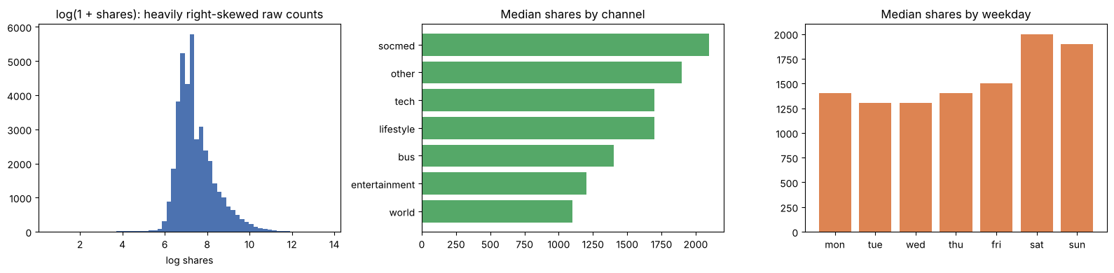
What the data shows
Share distribution (log scale), median shares by channel and by weekday

Slide 5
Model results
Model | Accuracy | ROC-AUC
Majority-class baseline | 0.507 | 0.500
Logistic Regression (numeric) | 0.651 | 0.701
Gradient Boosting (numeric) | 0.664 | 0.728
Headline TF-IDF only | 0.519 | 0.526
Headline LLM embeddings only (MiniLM) | 0.522 | 0.529
Gradient Boosting + headline TF-IDF score | 0.667 | 0.728
Gradient Boosting + LLM embedding score | 0.668 | 0.728

Slide 6
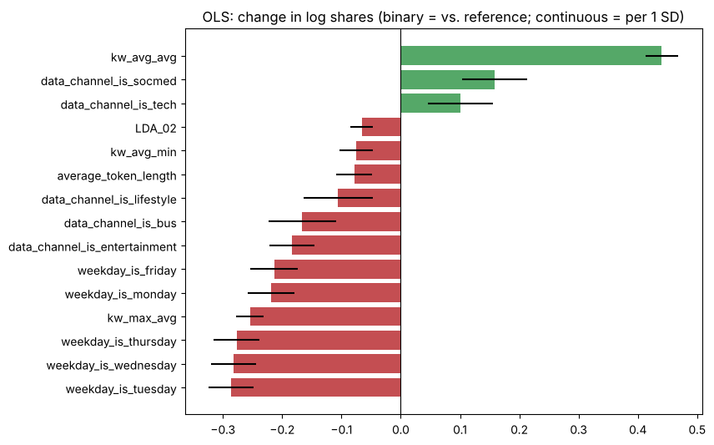
What drives shares
OLS with controls: strongest associations with log shares (95% intervals)
Keyword strength is the largest driver: articles whose keywords historically earn more shares get substantially more shares.
Weekend publishing helps: Monday-Friday articles get about 20-25% fewer shares than Sunday articles (median 1,300-1,500 vs. 1,900-2,000 on weekends).
Social Media and Tech channels outperform; Entertainment, Business and World underperform.

Slide 7
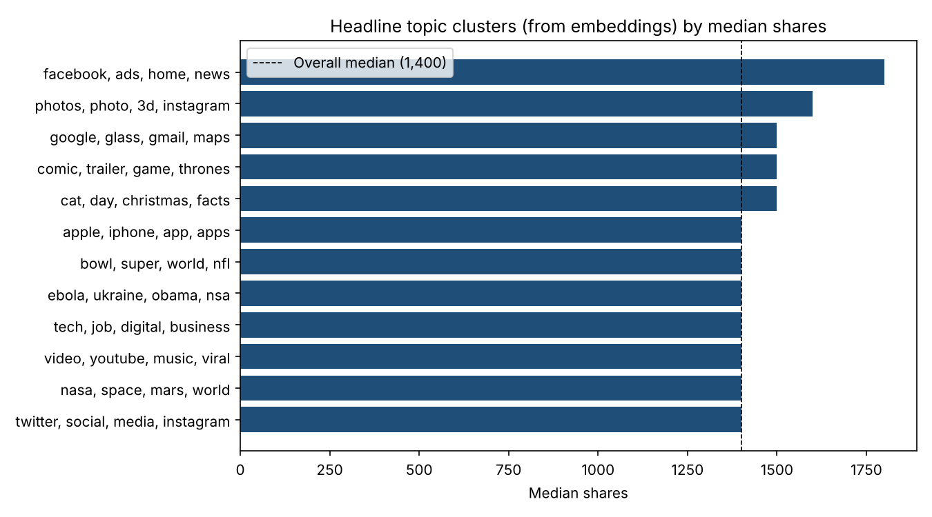
LLM embeddings: meaning, not wording
Embedded all 39,644 headlines with the all-MiniLM-L6-v2 sentence-transformer (78 seconds on CPU); nearest neighbours match paraphrases, e.g. 'celeb mean tweets' and 'celebrities mean tweets'.
Embeddings did not improve prediction (AUC 0.529 alone; 0.728 with or without them), confirming the TF-IDF result.
They are useful for organising content: Facebook / social and photo stories beat the 1,400 median; hard news and sports trail.

Slide 8
Key findings
1
Gradient boosting lifted ROC-AUC from 0.50 to 0.73 and accuracy from 0.51 to 0.66, beating logistic regression by capturing non-linear effects.
2
Headline text added no signal with either representation: TF-IDF (AUC 0.526) or LLM sentence embeddings (0.529). Adding the embedding score left gradient boosting at 0.728.
3
Keyword strength is the largest driver: articles whose keywords historically earn more shares get substantially more shares.
4
Weekend publishing helps: Monday-Friday articles get about 20-25% fewer shares than Sunday articles (median 1,300-1,500 vs. 1,900-2,000 on weekends).

