Slide 1
University Clustering and Imputation App
K-means segments of 1,302 U.S. universities, served through a Flask web app
Rajashree Guduru | M.S. Business Analytics, Sacred Heart University
Notes:
University Clustering and Imputation App. K-means segments of 1,302 U.S. universities, served through a Flask web app.

Slide 2
The question
What natural groups of U.S. universities exist, and can those groups fill in a university's missing data?
4
university segments
93%
cluster-sector agreement
64% of universities in the dataset are missing at least one value. Filling gaps with the overall average ignores what we know about each school; using its peer group should do better.
34%
lower tuition-imputation error vs. mean

Slide 3
Data and approach
1
Mean-impute for fitting, standardise all 17 measures, K-means with k from 2 to 10 compared by elbow and silhouette; k = 4 chosen for interpretability
Data
1,302 U.S. colleges and universities, 17 numeric measures: applications, acceptances, enrolment, student quality, tuition and costs, faculty, graduation rate
Name, state and public/private kept aside to check the clusters
831 universities (64%) have at least one missing value; board, room and fees are missing most often
2
Cluster profiles in original units; clusters named from their profiles (sector, size, selectivity)
3
Validation against sector and state, which were not used in clustering
4
Imputation: distance to each cluster centre using only the values a university has, in standardised units; gaps filled with the nearest centre's averages; accuracy tested by hiding 150 known values per field
5
Flask web app with sign-up, hashed-password login and a JSON imputation endpoint; pytest tests for login and imputation

Slide 4
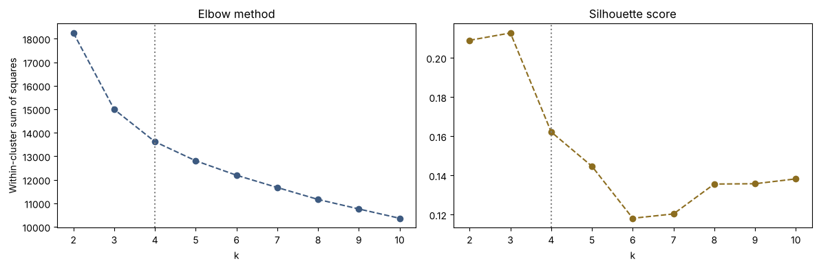
What the data shows
Choosing k: elbow (left) and silhouette score (right)

Slide 5
Model results
Field (150 hidden values) | Cluster MAE | Mean-fill MAE | Improvement
Graduation rate (%) | 12.5 | 16.5 | 24%
% new students from top 10% | 12.7 | 14.5 | 13%
Out-of-state tuition ($) | 2,308 | 3,485 | 34%

Slide 6
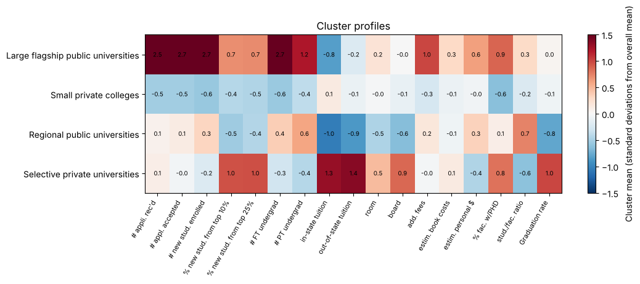
What defines each cluster
Four segments: large flagship public universities (96; ~16,000 undergraduates, selective), regional public universities (363; lowest tuition and 46% graduation), small private colleges (557; ~1,200 students) and selective private universities (286; 79% graduation, highest tuition).
Sector was never used in clustering, yet 93% of universities fall in a cluster matching their sector; selective private universities concentrate in NY, PA, MA and CA.

Slide 7
Key findings
1
Four segments: large flagship public universities (96; ~16,000 undergraduates, selective), regional public universities (363; lowest tuition and 46% graduation), small private colleges (557; ~1,200 students) and selective private universities (286; 79% graduation, highest tuition).
2
Sector was never used in clustering, yet 93% of universities fall in a cluster matching their sector; selective private universities concentrate in NY, PA, MA and CA.
3
Cluster-based imputation beat mean-filling on every field tested: 24% lower error for graduation rate and 34% for out-of-state tuition.
4
Fixed four bugs in the original app: login never checked passwords, the app clustered unstandardised data with 3 clusters while the analysis used 4 standardised ones, broken redirects, and a hard-coded secret key.

