Slide 1
USA Housing Rental Price Analysis
Rental price drivers and where a pricing model misses
Rajashree Guduru | M.S. Business Analytics, Sacred Heart University
Notes:
USA Housing Rental Price Analysis. Rental price drivers and where a pricing model misses.

Slide 2
The question
What drives rental prices, and where does a pricing model systematically under- or over-estimate rent?
0.76
R-squared (random forest)
$176
Typical error per month
Property owners need to price competitively, reduce vacancy and invest in the amenities tenants actually pay for.
0.00
R-squared before cleaning

Slide 3
Data and approach
1
Reproduced the original course model (linear regression of price on size, beds and baths, raw data) as the starting point
Data
USA Housing Listings (Kaggle): 384,977 Craigslist rental listings across 51 states and 404 regions, 22 columns, from the original team capstone (BUAN-685, Sacred Heart University, Nov 2024)
Variables: price, square feet, beds, baths, property type, pet/smoking/wheelchair/EV/furnished flags, laundry, parking, region, state, coordinates
Raw data quality problems: half the listings were duplicate reposts, and prices ranged from $0 to $2.8 billion
2
Cleaning: removed 191,384 duplicates, 2,710 impossible values and 127 listings in tiny regions, leaving 190,756 listings
3
Exploratory analysis: price distribution, price vs. size by type, boxplots, correlations, amenity premiums
4
Models: mean-rent baseline, linear regression, random forest, gradient boosting; 75/25 split plus cross-validation; R-squared and MAE
5
Error analysis: mean residual by property type and state to find systematic under- and over-pricing

Slide 4
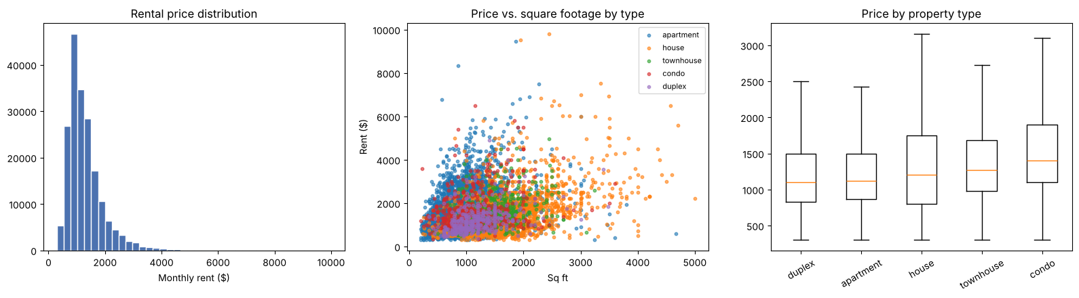
What the data shows
Rent distribution, rent vs. square footage by type (20K-listing sample), and rent by property type

Slide 5
Model results
Model | Test R-sq. | MAE | CV R-sq.
Original course model (raw data) | 0.00 | RMSE ~$10M | n/a
Baseline (mean rent) | 0.00 | $467 | 0.00
Linear Regression | 0.48 | $303 | 0.49
Random Forest | 0.76 | $176 | 0.71
Gradient Boosting | 0.74 | $207 | 0.73

Slide 6
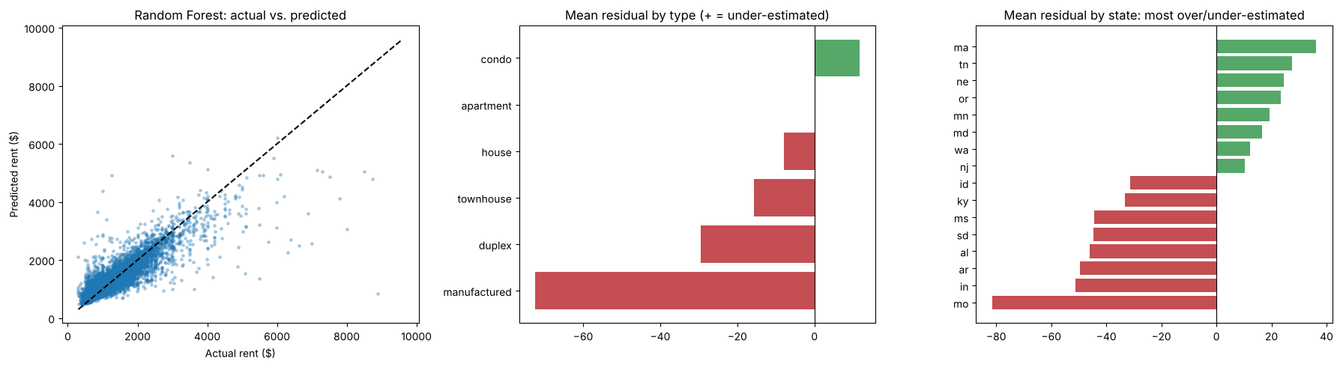
Where the model misses
The model over-estimates low-cost states (Missouri by about $82; Indiana, Arkansas, Alabama by $45-50) and under-estimates high-cost states (Massachusetts, Oregon, Maryland, Washington, New Jersey).
Manufactured homes are over-estimated by about $72 and duplexes by about $30; apartments are nearly unbiased. The model pulls prices toward the national average.

Slide 7
Key findings
1
Cleaning turned an unusable model into a useful one: R-squared rose from 0.00 on the raw data to 0.76 with random forest, and typical error fell from $467 to $176 a month.
2
Location matters as much as size: square footage, longitude, latitude and being in California are the top four features.
3
In-unit washer/dryer is the most valuable common amenity: median rent about $1,370 vs. about $950 with shared laundry. Pet-friendly policies show no premium, matching the team's t-test (p = 0.32).
4
The model over-estimates low-cost states (Missouri by about $82; Indiana, Arkansas, Alabama by $45-50) and under-estimates high-cost states (Massachusetts, Oregon, Maryland, Washington, New Jersey).

