Slide 1
Email Archiving with
Enterprise Vault
ISS Training Unit
Notes:
Welcome
Introduce – Self, Project Team Member
Purpose of the session: introduce you to the new Email Archiving system using ”Enterprise Vault”
Consists of :-
Short presentation
Demonstration
Questions and Answer Session

Slide 2
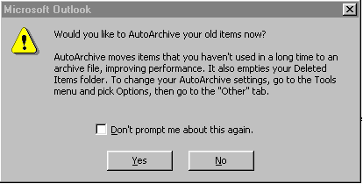
Information Systems Services
What do you do when you see this message in Outlook?
Notes:
PANIC!!! Or IGNORE it

Slide 3
Information Systems Services
What is email archiving?
    Process of moving old email messages from your Outlook Exchange Mailbox to a secondary storage location
What is Enterprise Vault?
    Software that controls the archiving procedures developed by Symantec
What are the benefits of using Enterprise Vault?
  Less likely to run out of space in your Inbox
  Easy to retrieve archived messages
  No need for PST files or manual archives
  Improved general performance of Exchange
Notes:
Email Archive –
What happens if you don’t archive items – inbox becomes full
Archiving is the process of moving old messages that you want to keep, into a different location
Enterprise Vault –
This is the program that is going to automate the archiving process – so no more messages popping up, it will just happen
Benefits –
Less likely to run out of space in your inbox
Once you have archived a message it is really easy to retrieve it
If you AutoArchive at the moment, you probably store the file on your M Drive and archive files can be quite big
You may also have multiple archive or PST files – how do you know which one to look in
If you store your archive file on the Shared network area, then anyone can get access to your archived emails
Enterprise Vault is a secure way of archiving messages

Slide 4
Information Systems Services
How does it work?
    Enterprise Vault automatically archives email messages older than 3 months from:-
        Inbox
        User Defined Folders
        Sent Items
    Enterprise Vault does NOT automatically archive these items:-
        Unread messages
        Deleted Items
        Public Folders
        Calendars
        Notes
        Tasks
Notes:
EV does not archive Calendar, notes and task items – Why?
What size is an average calendar item? 1KB or 2KB
What size is an average email? With attachments they can be anything from 1kb +
Therefore it isn’t worth archiving such small items

Slide 5
Information Systems Services
What happens when Outlook is archive enabled?
  You will receive a welcome email message
  The Enterprise Vault Toolbar will have been added to Outlook
How can you tell which are archived messages?
  They appear with a shortcut icon
What will happen to messages you have already archived?
  Do Not Delete any archive files
  PST files will be dealt with at the end of the rollout
Notes:
What Happens –
The first thing you receive is a welcome message explaining how it all works
The Enterprise Vault Toolbar will sit at the top right with four buttons on it
Archived Messages –
Anything older that 3 months is automatically archived and will appear with a shortcut icon
You still see the message in your Inbox
You can Read it, reply to it, open attachments
Still treated like an ordinary message – it’s just stored somewhere else
PST File –
Don’t worry if you already archive and have a PST file, these will be dealt with later in the rollout
DO NOT DELETE or try to RESTORE archive files

Slide 6
Information Systems Services
Who will be affected?
  Staff, Research Post Graduates & Project Mailboxes > 30MB
When will it happen?
  Faculty by Faculty
  Phase 1- Rollout archiving by end June (Central Admin – early July)
  Phase 2 – PST Files
How will it affect Outlook Web Access?
  Enterprise Vault works in a similar manner whether you are using OWA or MS Outlook
  RMAS (Citrix) works exactly the same
Notes:
Who –
mailboxes who have a capacity of 30 MB and over will be archive enabled
When –

Slide 7
Information Systems Services
Deleting Archive Items
  Use the correct delete button when dealing with Enterprise Vault
  DO use Delete from vault
  to permanently delete an item
  DON’T use the standard outlook delete button
  this will only delete the shortcut and
  not the actual message
Notes:
The Delete from vault button will definitely delete the archived item
Using the standard delete button in outlook will only delete the shortcut and not the associated archived message.

Slide 8
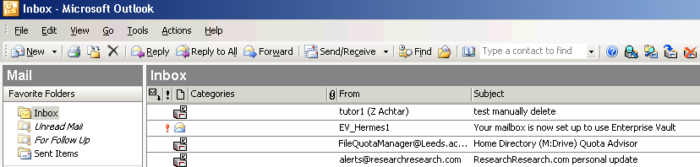
Outlook 2003:-

Slide 9
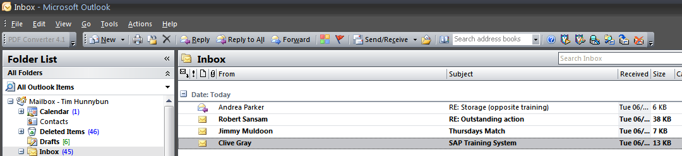
Outlook 2007:-

Slide 10
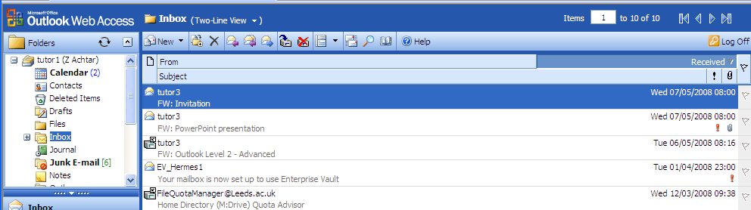
OWA:-

Slide 11
Demonstration
  Outlook client experience (Outlook 2002, 2003 and 2007)
    Retrieving an archived item
    Searching for an archived item
    Deleting an archived item
    Manually archiving items
    Delegate access
    OWA experience

Slide 12
Where can I get more information?
    http://www.leeds.ac.uk/iss/training/
    http://www.leeds.ac.uk/iss/projects/emailarchiving/index.html

Slide 13
    Any Questions?

