Slide 1
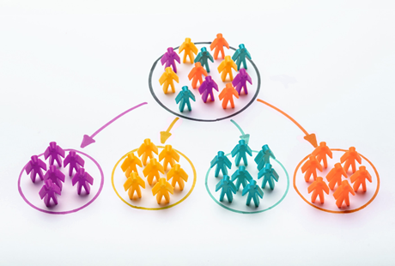
Customer segmentation in Ecommerce : Mini Project
Done by:
Rajashri Chitti

Slide 2

Problem Statement
To analyze the content of Ecommerce dataset that lists purchases made by ~4000 customers over a period of one year (from 2010/12/01 to 2011/12/09).
Based on this analysis, we developed a model that allows to anticipate the purchases that will be made by a new customer, during the following year and this, from its first purchase.

Slide 3
Introduction
Customer segmentation is the practice of dividing a company’s customers into groups that reflect similarity among customers in each group.
The goal of segmenting customers is to decide how to relate to customers in each segment in order to maximize the value of each customer to the business.

Slide 4
Importance of Customer Segmentation
Customer segmentation has the potential to allow marketers to address each customer in the most effective way. Using the large amount of data available on customers (and potential customers), a customer segmentation analysis allows marketers to identify discrete groups of customers with a high degree of accuracy based on demographic, behavioral and other indicators.
Since the marketer’s goal is usually to maximize the value (revenue and/or profit) from each customer, it is critical to know in advance how any particular marketing action will influence the customer.

Slide 5
Dataset Description
Data frame Dimensions: (406829,8)
InvoiceNo: Invoice number. Nominal, a 6-digit integral number uniquely assigned to each transaction.
StockCode: Product (item) code. Nominal, a 5-digit integral number uniquely assigned to each distinct product.
Description: Product (item) name. Nominal.
Quantity: The quantities of each product (item) per transaction. Numeric.
InvoiceDate: Invice Date and time. Numeric, the day and time when each transaction was generated.
UnitPrice: Unit price. Numeric, Product price per unit in sterling.
CustomerID: Customer number. Nominal, a 5-digit integral number uniquely assigned to each customer.
Country: Country name. Nominal, the name of the country where each customer resides.

Slide 6
Flow of the Project
Data Preparation
Data Exploration
Clustering based on products using Kmeans
Categorizing the customers clusters
Classifying the customers
Testing the predictions
Conclusions

Slide 7
Literature Survey
Title | Year of Publication | Authors | Methods | Conclusion
A Predictive Analysis model of Customer Behavior Using Modified Random Forest Algorithm in Cloud environment | 2020 | Soumi Ghosh; Chandan Banerjee | Prediction analysis of customer purchase behavior is an interesting and challenging task in modern-day life. Their objective is to introduce the concept of machine learning using a random forest algorithm in depth. In this paper, a model has been proposed for predicting which cloud services have been purchased on a number of factors. A random forest model is built using different parameters such as advertisement click sequence, previously purchased cloud services, etc. and training our model. | As an outcome, for a customer, this proposed model is providing high accuracy in prediction. Five factors have been considered which affect purchasing decision-making of customers in cloud services, such as previous purchasing habits, a sequence of advertisements viewed, customer location, etc..
Benefit Segmentation of Online Customer reviews using Random Forest | 2018 | K.Torizuka, H. Oi; F. Saitoh; S. Ishizu | In this research, they use the random forest algorithm for benefit segmentation, as this algorithm identifies training data with high accuracy even if noise and outliers exist, and it is widely used for analysis of text data. In the experiment, they analyzed customer reviews for hotels. They treated the reason for using hotels as the benefit, and analyzed topics based on word frequency in the text data as explanatory variables. They extracted factors that influenced each benefit to determine customer needs. | Analyzed the customer reviews of hotels

Slide 8
Literature Survey
Title | Year of Publication | Authors | Methods | Conclusion
Prediction of Consumer Behavior using Random Forest Algorithm | 2018 | Harsh Valecha, Aparna Varma, Ishita Khare, Aakash Sachdeva, Mukta Goyal | The aim of this research paper is to examine the relation between consumer behavior parameters and willingness to buy. First, they investigate to find relationship between consumer behavior to buy products on changing parameters such as environmental factor, organizational factor, individual factor and interpersonal factor. Thus, this paper proposes time-evolving random forest classifier that leverages unique feature engineering to predict the behavior of consumer that affect the choice of purchasing the product significantly. | The behavior of the customer is depended on so many factors such as environmental factor, organizational factor, individual factor and interpersonal factor. Moreover, according to their use, the behavior of the customer is changed time to time. Machine learning techniques are used to predict the behavior of the customer which give good accuracy. This paper used random forest algorithm, has given 94% accuracy.
Machine Learning Techniques for customer retention: A Comparative Study | 2018 | Sahar F. Sabbeh | This paper tries to compare and analyze the performance of different machine-learning techniques that are used for churn prediction problem. Ten analytical techniques that belong to different categories of learning are chosen for this study. The chosen techniques include Discriminant Analysis, Decision Trees (CART), instance-based learning (k-nearest neighbors), Support Vector Machines, Logistic Regression, ensemble–based learning techniques (Random Forest, Ada Boosting trees and Stochastic Gradient Boosting), Naïve Bayesian, and Multi-layer perceptron. | Results show that both random forest and ADA boost outperform all other techniques with almost the same accuracy 96%. Both Multi-layer perceptron and Support vector machine can be recommended as well with 94% accuracy. Decision tree achieved 90%, naïve Bayesian 88% and finally logistic regression and Linear Discriminant Analysis (LDA) with accuracy 86.7%.

Slide 9
Literature Survey
Comparison of Naïve Bayes, Random Forest, Decision Tree, SVM, Logistic Regression Classifiers for Text Reviews Classification | 2017 | Tomas PRANCKEVIČIUS, Virginijus MARCINKEVIČIUS | One of these is text classification with some issues recently investigated by many data scientists. The authors of this paper investigate Naïve Bayes, Random Forest, Decision Tree, Support Vector Machines, and Logistic Regression classifiers implemented in Apache Spark, i.e. the in-memory intensive computing platform. The focus of the paper is on comparing these classifiers by evaluating the classification accuracy, based on the size of training data sets, and the number of n-grams. In experiments, short texts for product-review data from Amazon were analyzed. | The findings indicate that the Logistic Regression multi-class classification method for product-reviews has achieved the highest (min 32.43%, max 58.50%) classification accuracy in comparison with Naïve Bayes, Random Forest, Decision Tree, and Support Vector Machines classification methods. On the contrary, Decision Tree has got the lowest average accuracy values (min in trigram: 24.10%, max in uni/bi/tri-gram: 34.58%).
A customer classification model based on machine learning techniques | 2015 | T.K.Das | In this paper, they have built a prediction model to identify the customers who would most likely respond to the prospective offerings of the company basing on their past purchasing trends. Experiments have been conducted using the well-known classifiers, viz., Naïve Bayes, KNN and SVM to classify a bank customer data. | Among all the classifiers, experimental results show that Naïve Bayesian Classification achieves the highest accuracy and specificity. However, the worst classification was performed by Support Vector Machine technique as SVM technique achieves lowest sensitivity, accuracy and specificity. Additionally, SVM achieves the highest error rate with a large number of false positive and false negative cases when compared to their peers. They conclude that enterprise can plan effective marketing of its products/services by selecting the target customers

Slide 10
Implementation

Slide 11
Data Preparation
Loading of dataset.
Finding missing values if any
Finding duplicate values if any
Removal of duplicate values

Slide 12
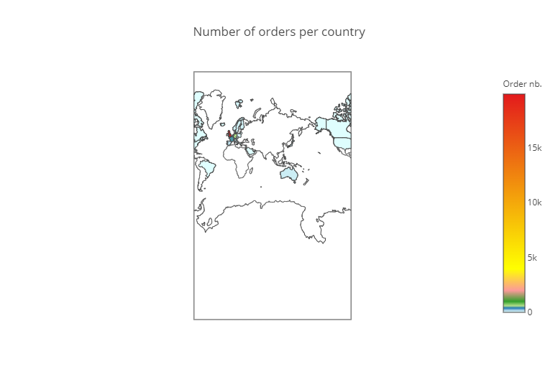
Data Exploration
Orders are largely dominated by UK

Slide 13
Number of Products in dataset: 3684
Number of customers in dataset: 4372
Number of transactions in dataset: 22190
Number of cancelled orders: 3654 (16.47%)

Slide 14
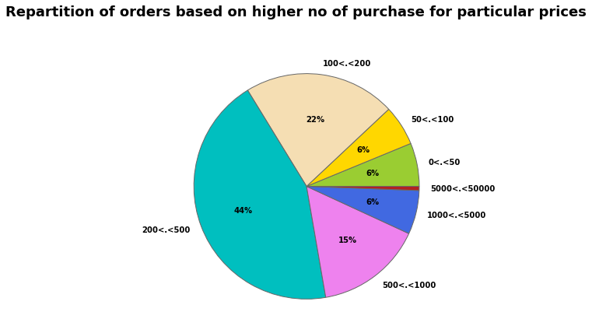
It can be seen that the vast majority of orders concern relatively large purchases given that ∼ 65% of purchases give prizes in excess of £ 200.

Slide 15
Clustering based on products
Creating clusters based on products (using Kmeans)
In order to define (approximately) the number of clusters that best represents the data, we use the silhouette score.
We found that with best average silhouette score is number of clusters =5.
So, we divided into 5 clusters based on products.

Slide 16
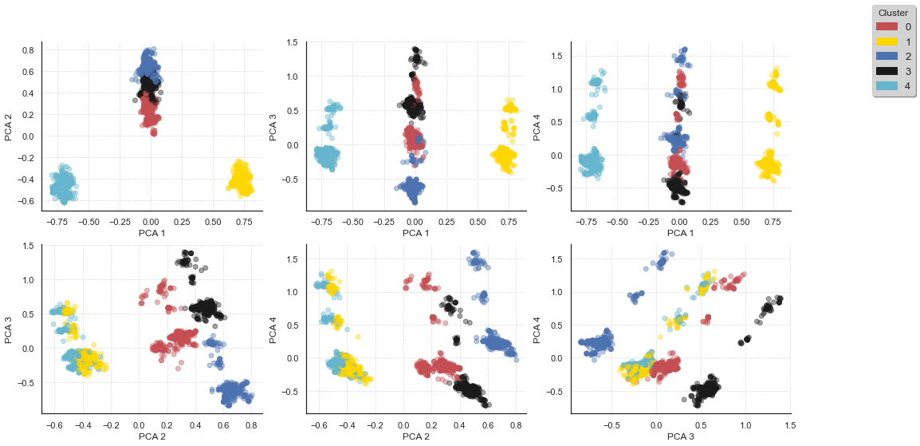
PCA

Slide 17
Customer categorizing
we create the categorical variable categ_product where I indicate the cluster of each product.
Next, we create the categ_N variables (with N∈[0:4] ) that contains the amount spent in each product category.
Collected all the information of a particular order, and put into a single entry.
we then create a new dataframe that contains, for each order, the amount of the basket, as well as the way it is distributed over the 5 categories of products.
Separation of data over time

Slide 18
The dataframe basket_price contains information for a period of 12 months
In order to be able to test the model in a realistic way, we split the data set by retaining the first 10 months to develop the model and the following two months to test it
In a next step, we group together the different entries that correspond to the same user. we thus determine the number of purchases made by the user, as well as the minimum, maximum, average amounts and the total amount spent during all the visits.

Slide 19
Creating clusters of customers
We again use the Kmeans method for clustering the customers.
For defining the number of clusters we used silhouette score and found that the best case is with 11 clusters.
Number of customers/clients in each clusters.
 | 1 | 6 | 9 | 8 | 3 | 7 | 5 | 0 | 4 | 10 | 2
no. of clients | 1450 | 495 | 453 | 310 | 302 | 231 | 185 | 154 | 13 | 8 | 7

Slide 20
Finally, we re-organize the content of the dataframe by ordering the different clusters: first, in relation to the amount spent in each product category and then, according to the total amount spent
 | Cluster | Count | Min | Max | Mean | Sum | Categ_0 | Categ_1 | Categ_2 | Categ_3 | Categ_4 | Size
0 | 6.0 | 2.646465 | 196.388851 | 344.409859 | 259.806342 | 715.732830 | 62.823209 | 10.805295 | 10.849368 | 10.781120 | 4.752409 | 495
1 | 9.0 | 2.417219 | 214.804636 | 324.743468 | 267.189105 | 658.573291 | 9.303342 | 57.454679 | 12.824589 | 7.604795 | 12.815882 | 453
2 | 3.0 | 2.619205 | 205.662185 | 376.898775 | 287.326586 | 818.948444 | 10.457826 | 15.205131 | 60.151829 | 7.228994 | 6.956220 | 302
3 | 8.0 | 2.125806 | 206.340452 | 337.455290 | 265.874749 | 654.209129 | 15.956163 | 13.448154 | 14.027147 | 50.279925 | 6.338576 | 310
4 | 7.0 | 2.207792 | 192.505152 | 317.038961 | 245.720651 | 583.229221 | 7.317551 | 18.092222 | 11.018898 | 5.995236 | 57.576093 | 231
5 | 1.0 | 3.251724 | 220.066683 | 457.759125 | 330.445079 | 1084.909221 | 20.872256 | 25.910287 | 21.891773 | 17.268001 | 14.061771 | 1450
6 | 5.0 | 1.702703 | 1050.559514 | 1410.658276 | 1212.850806 | 2191.505032 | 23.060478 | 26.017026 | 21.767292 | 17.112912 | 12.042658 | 185
7 | 4.0 | 1.692308 | 3253.388462 | 4380.010000 | 3794.797051 | 6250.506154 | 28.943716 | 19.704883 | 13.782335 | 15.824545 | 21.744522 | 13
8 | 0.0 | 17.987013 | 86.284545 | 1649.434416 | 582.640620 | 9887.307662 | 22.053610 | 23.976630 | 25.452168 | 16.189417 | 12.348523 | 154
9 | 10.0 | 87.125000 | 20.862500 | 2643.812500 | 456.526689 | 37313.235000 | 24.794942 | 25.165035 | 24.604929 | 13.979829 | 11.477885 | 8
10 | 2.0 | 26.857143 | 510.302857 | 20131.802857 | 5514.816882 | 113654.117143 | 23.354068 | 25.445817 | 25.738996 | 17.587876 | 7.873243 | 7

Slide 21
Classification of Customers
Splitting dataset into train and test with 80:20 ratio.

Slide 22
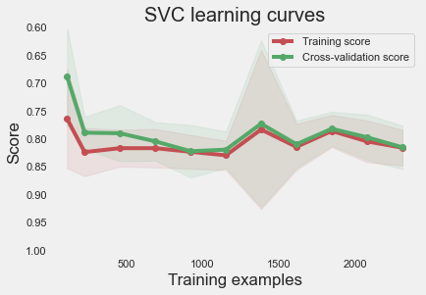
SVM(Support Vector Machine)
Precision:82.13%
On this curve, we can see that the train and cross-validation curves converge towards the same limit when the sample size increases.
This is typical of modeling with low variance and proves that the model does not suffer from overfitting.
Also, we can see that the accuracy of the training curve is correct which is synonymous of a low bias.
Hence the model does not underfit the data.

Slide 23
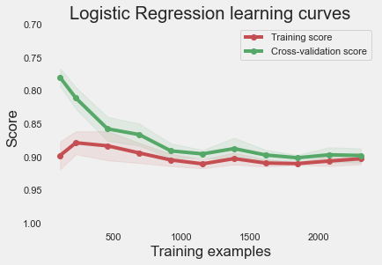
Logistic Regression
Precision: 91.14%

Slide 24
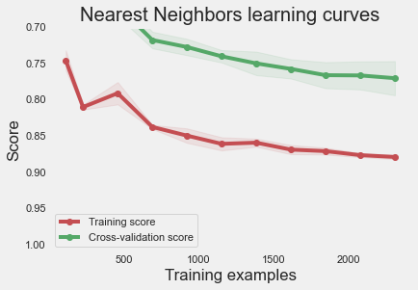
K-nearest neighbor
Precision: 80.19%

Slide 25
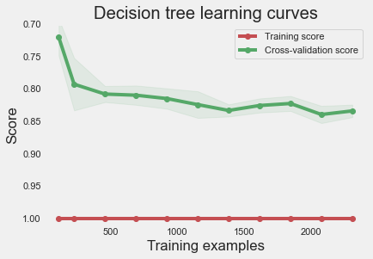
Decision Trees
Precision: 86.29%

Slide 26
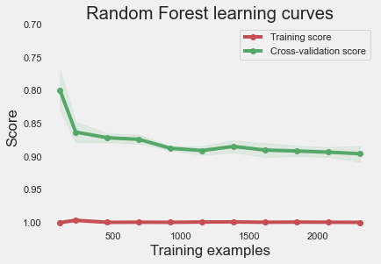
Random Forest
Precision: 91.27%

Slide 27
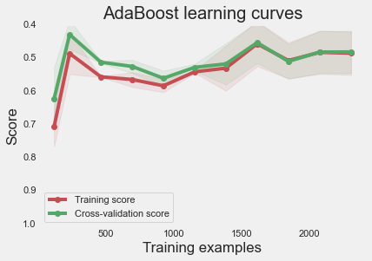
Adaboost Classifier
Precision: 52.91%

Slide 28
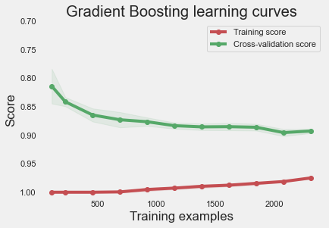
Gradient Boosting Classifier
Precision: 89.47%

Slide 29
Summary
Support Vector Machine Precision: 67.31 % ______________________________ Logistic Regression Precision: 75.42 % ______________________________ k-Nearest Neighbors Precision: 66.88 % ______________________________ Decision Tree Precision: 72.09 % ______________________________ Random Forest Precision: 75.30 % ______________________________ Gradient Boosting Precision: 75.46 %

Slide 30
Conclusion
With given the available information, we developed a classifier that allows to anticipate the type of purchase that a customer will make, as well as the number of visits that he will make during a year, and this from its first visit to the E-commerce site.
The first stage of this work consisted in describing the different products sold by the site, which was the subject of a first classification. There, we grouped the different products into 5 main categories of goods.
In a second step, we performed a classification of the customers by analyzing their consumption habits over a period of 10 months. We have classified clients into 11 major categories based on the type of products they usually buy, the number of visits they make and the amount they spent during the 10 months.
Once these categories established, we finally trained several classifiers whose objective is to be able to classify consumers in one of these 11 categories and this from their first purchase.

Slide 31
Conclusion
For this, the classifier is based on 5 variables which are: mean : amount of the basket of the current purchase categ_N with N∈[0:4] : percentage spent in product category with index N
Finally, the quality of the predictions of the different classifiers was tested over the last two months of the dataset.
The data were then processed in two steps: first, all the data was considered (over the 2 months) to define the category to which each client belongs, and then, the classifier predictions were compared with this category assignment.
We then found that 75% of clients are awarded the right classes. The performance of the classifier therefore seems correct given the potential shortcomings of the current model. In particular, a bias that has not been dealt with concerns the seasonality of purchases and the fact that purchasing habits will potentially depend on the time of year (for example, Christmas ).
In practice, this seasonal effect may cause the categories defined over a 10-month period to be quite different from those extrapolated from the last two months. In order to correct such bias, it would be beneficial to have data that would cover a longer period of time.

Slide 32


