Slide 1


Walmart Sales Data Forecasting
Done by:
Rajashri Chitti
School of Computer Engineering

Slide 2

Problem Statement
To forecast the sales by using historical data and analyze the key factors which affect the sales with good accuracy.

Slide 3
Introduction
Sales forecasting is the process of estimating future revenue by predicting the amount of product or services a sales unit (which can be an individual salesperson, a sales team, or a company) will sell in the next week, month, quarter, or year.
Sales forecast is a projected measure of how a market will respond to a company’s go-to-market efforts.

Slide 4
Why is Sales Forecasting Important?
Forecasts are about the future. Privately-held companies gain confidence in their business when leaders are able to trust forecasts. For publicly-traded companies, accurate forecasts confer credibility in the market.
Production uses sales forecasts to plan their cycles. Forecasts help sales ops with territory and quota planning, supply chain with material purchases and production capacity, and sales strategy with channel and partner strategies.

Slide 5
Benefits of having accurate Sales forecast
An accurate sales forecast process confers many benefits. These include:
Improved decision-making about the future
Reduction of sales pipeline and forecast risks
Alignment of sales quotas and revenue expectations
Reduction of time spent planning territory coverage and setting quota assignments
Benchmarks that can be used to assess trends in the future
Ability to focus a sales team on high-revenue, high-profit sales pipeline opportunities, resulting in improved win rates

Slide 6
Flow of the Project
Data Preprocessing
Data Exploration
Data Normalization
Correlation between features
Feature Importance
Data Splitting to train and test
Fitting the different machine learning models
a. Linear Regression model
b. Random Forest Regressor model
c. K nearest neighbour Regressor model
d. XGBoost model
e. Custom Deep Learning Neural Network model
Comparison of models

Slide 7
Dataset Description
Files: data.csv; stores.csv and features.csv
data.csv dimensions: (421570,5) (Store, department, date, weekly_sales, isHoliday) (5-02-2010 to 1-11-2012)
Stores.csv dimensions: (45,3) (store, type, size)
Features.csv dimensions: (8190,12) (store, data, temperature, Fuel_price,Markdown_1,Markdown_2,Markdown_3,Markdown_4,Markdown_5, CPI,Umemployement, Isholiday)

Slide 8
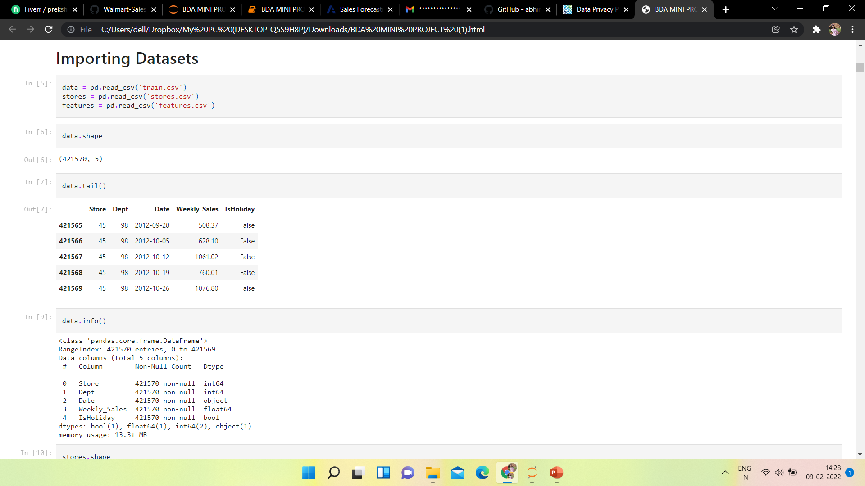
Implementation
Importing Datasets and printing head and tail of all the files.

Slide 9
Data Preprocessing
Finding the missing values (filled all the null and missing values with medians of the respective columns.
Merging of datasets into one final dataset.
Total data rows: 421570 and have 15 attributes in total.
Identification of Outliers and abnormalities
Found the negative weekly sales and removed them.
Final dataset consists of 374247 rows and 20 columns

Slide 10
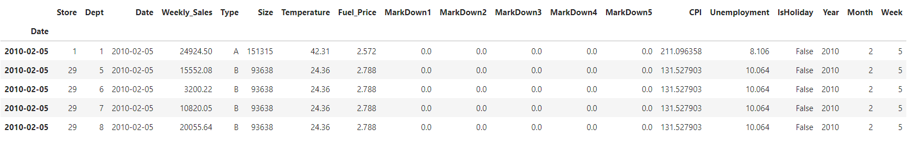

Slide 11
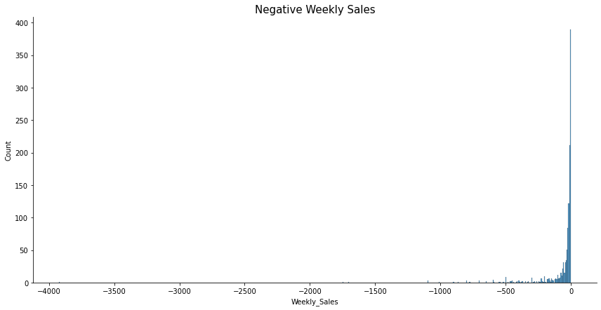

Slide 12
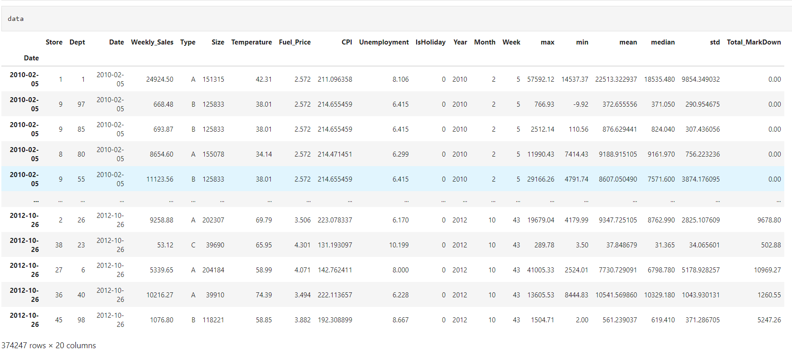
Preprocessed Dataset

Slide 13
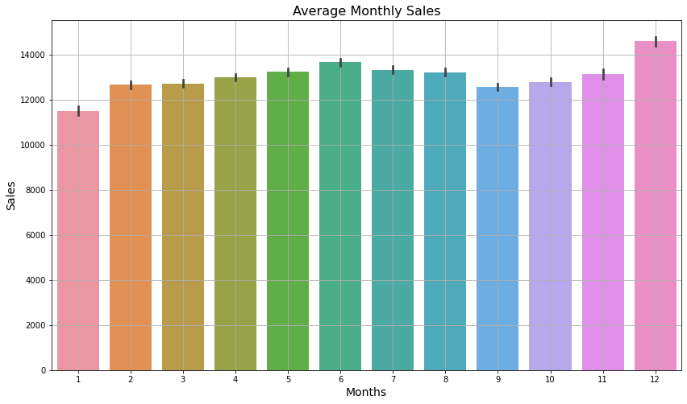
Data Exploration

Slide 14
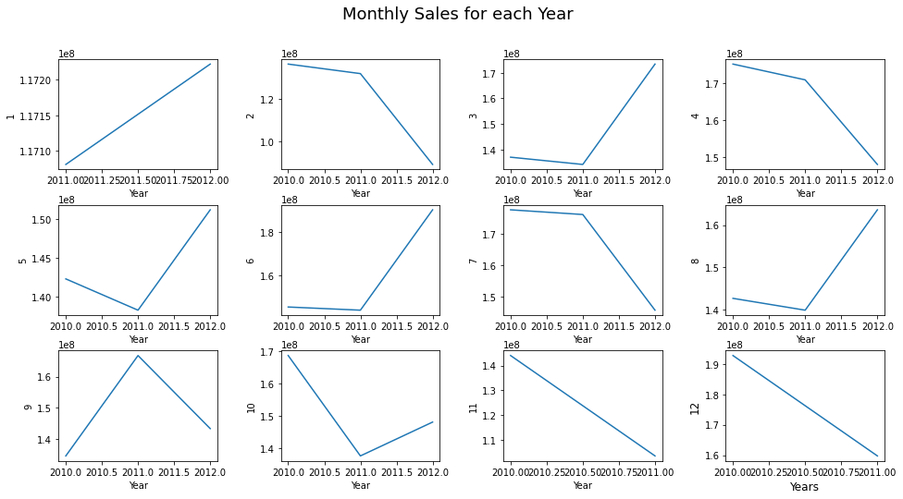

Slide 15
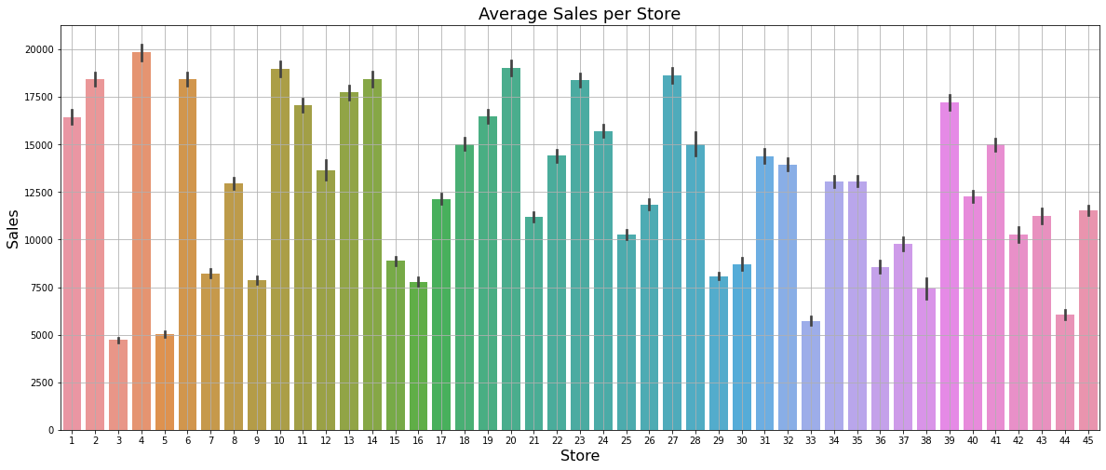

Slide 16
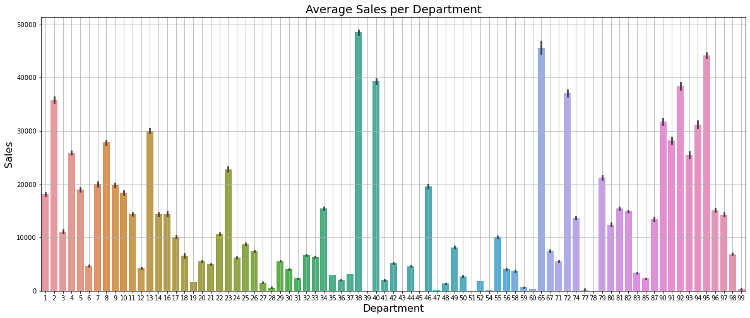

Slide 17
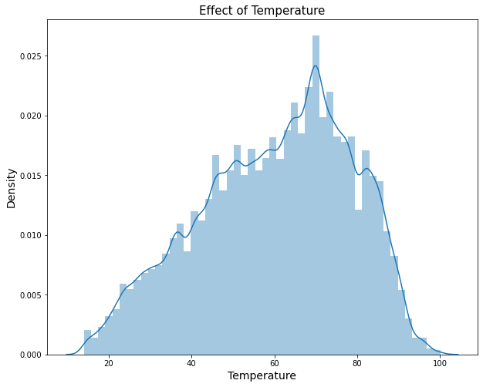

Slide 18
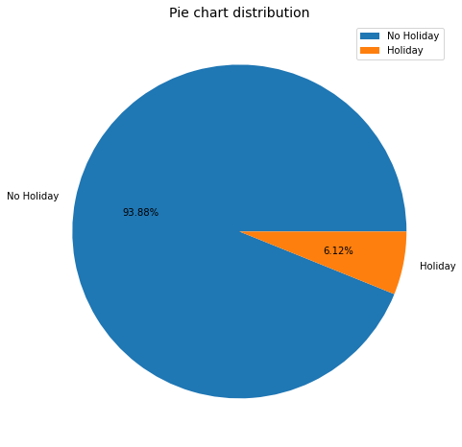

Slide 19
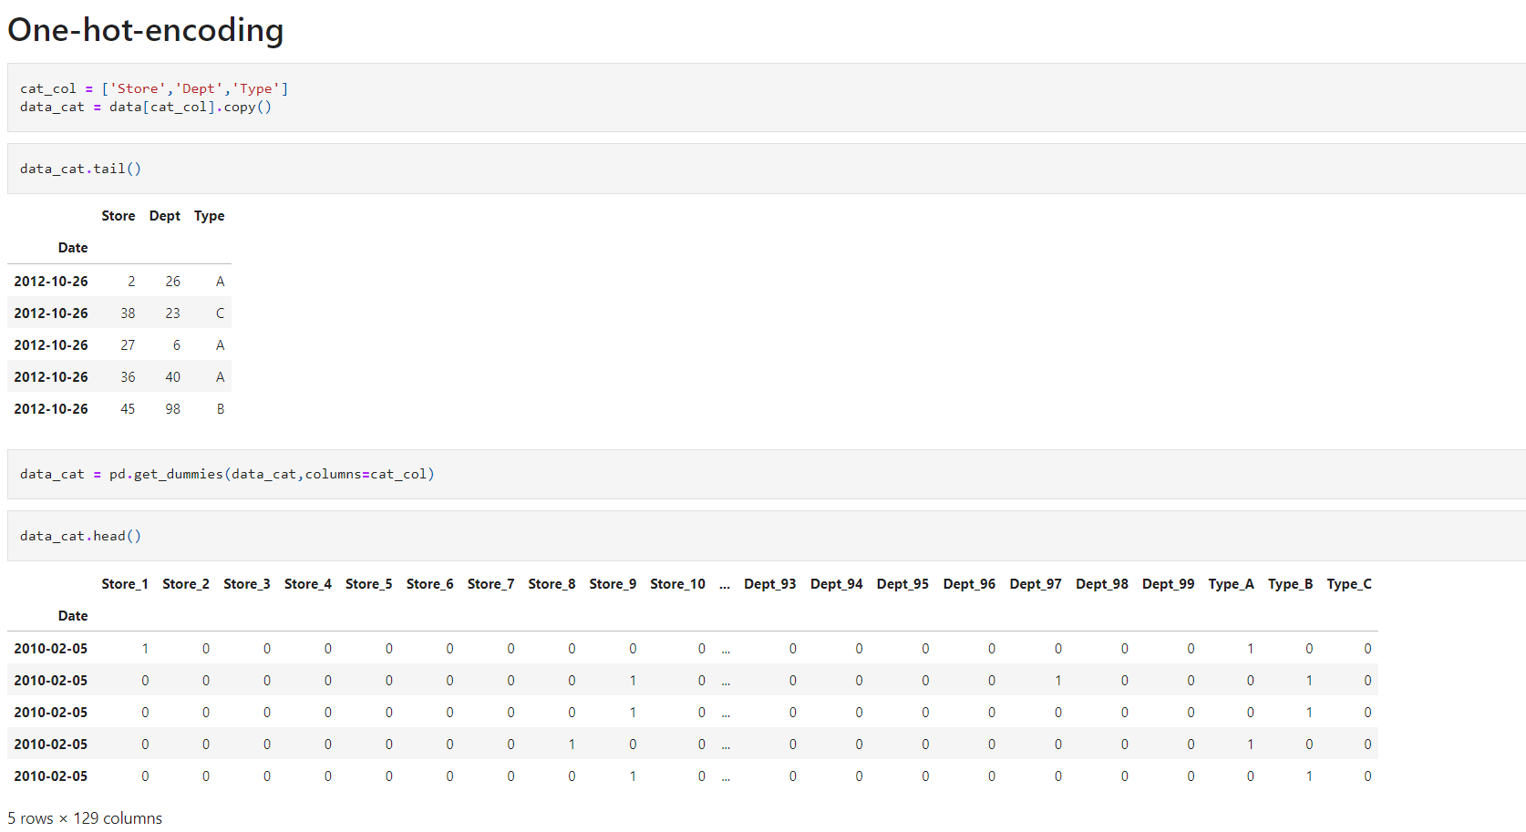
Converting Categorical Variables to Numerical Variables

Slide 20
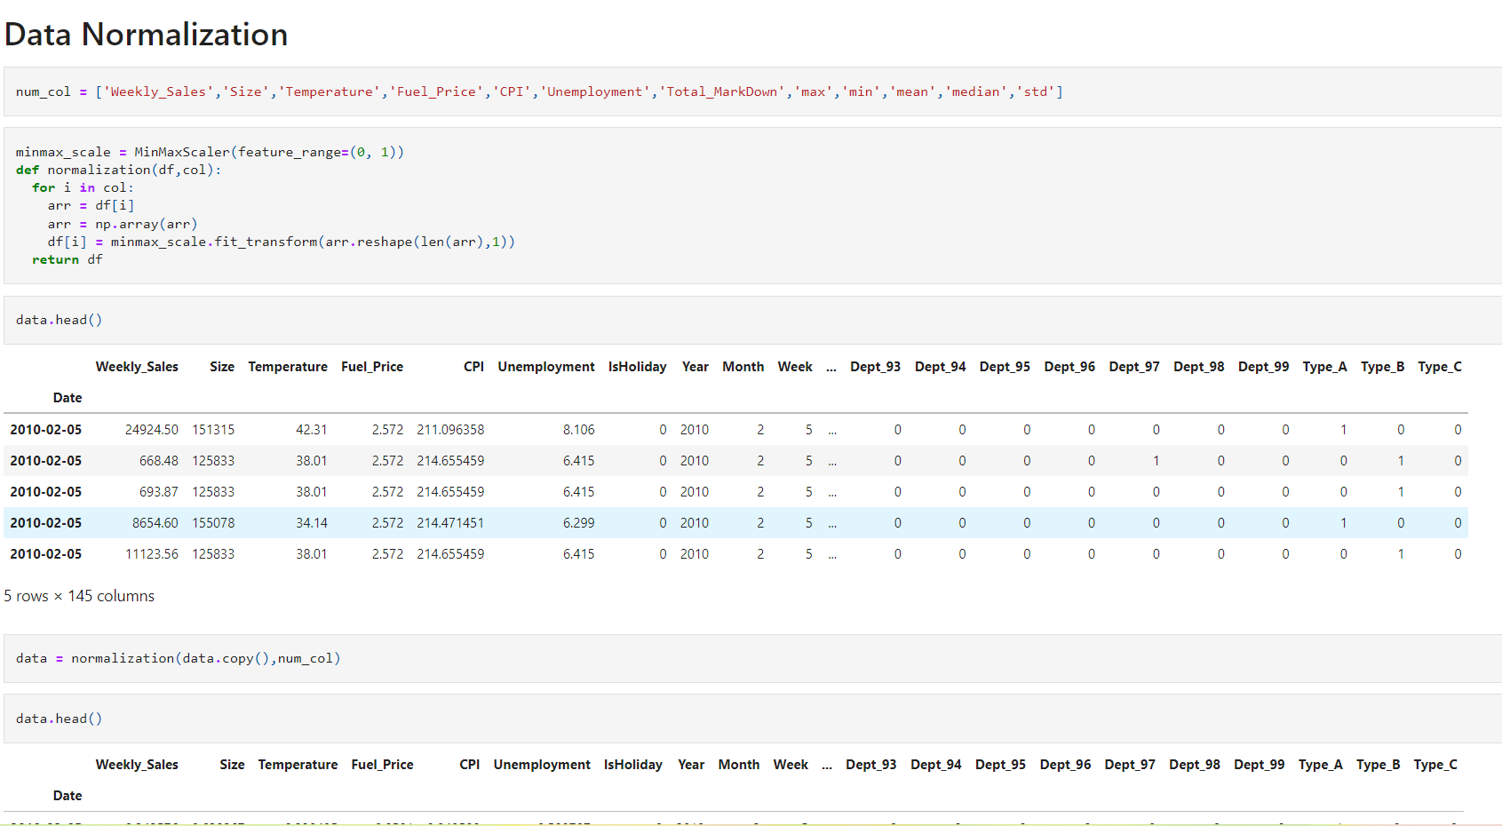
Data Normalization

Slide 21
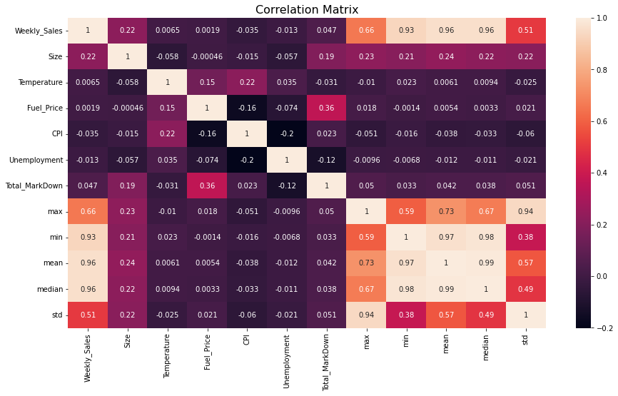
Correlation between the variables

Slide 22
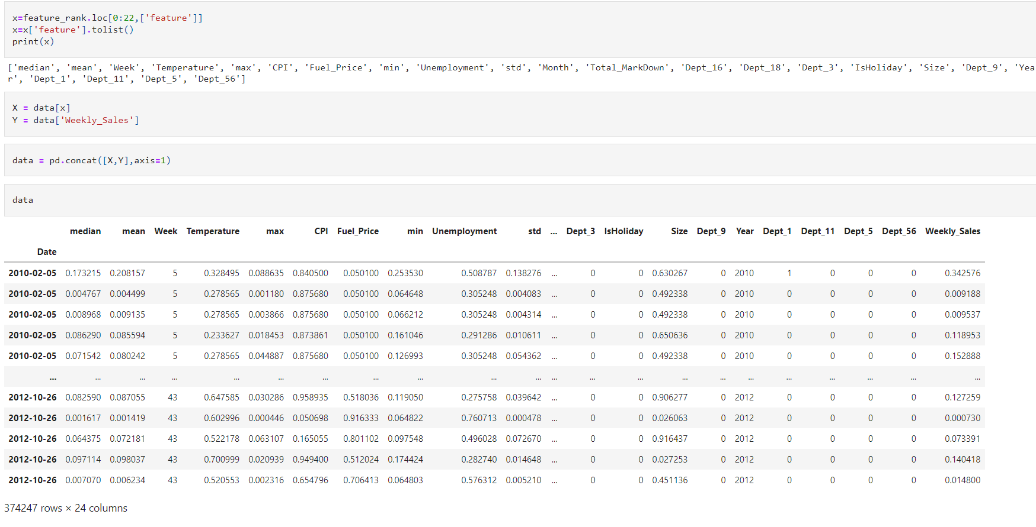
Finding out the feature Importance on the dataset

Slide 23
Splitting the dataset into Training and Testing

Slide 24
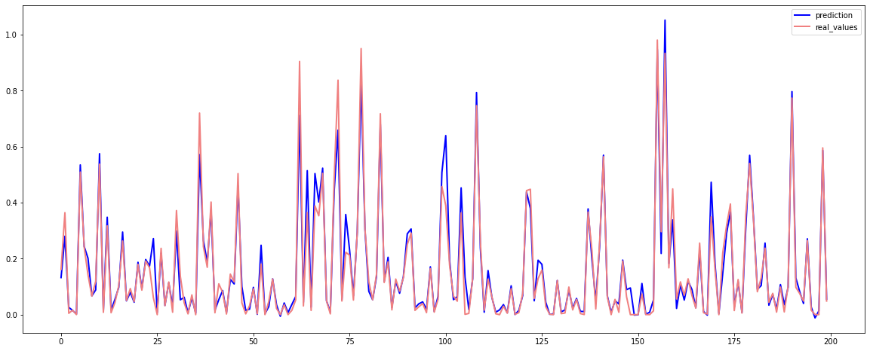
Linear Regression Model
Accuracy : 92.280%

Slide 25
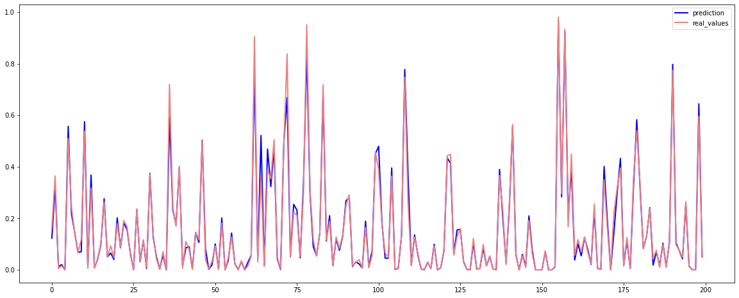
Random Forest Model
Accuracy: 97.890%

Slide 26
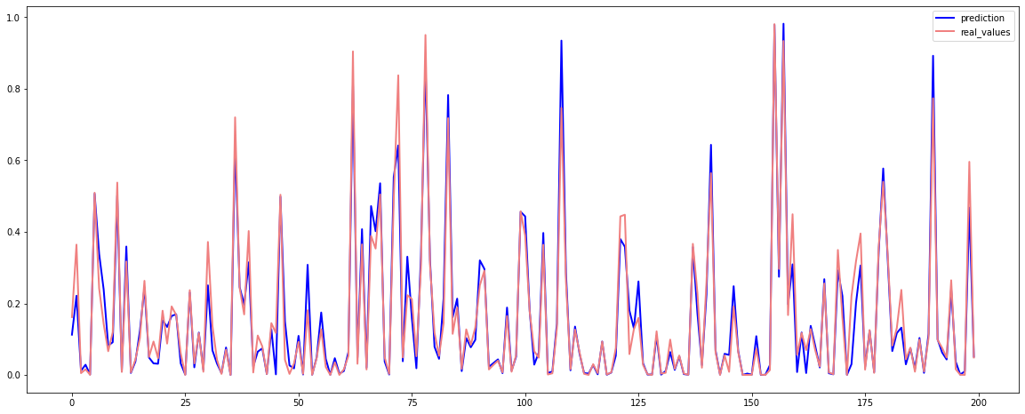
K Nearest Neighbor Model
Accuracy: 91.972%

Slide 27
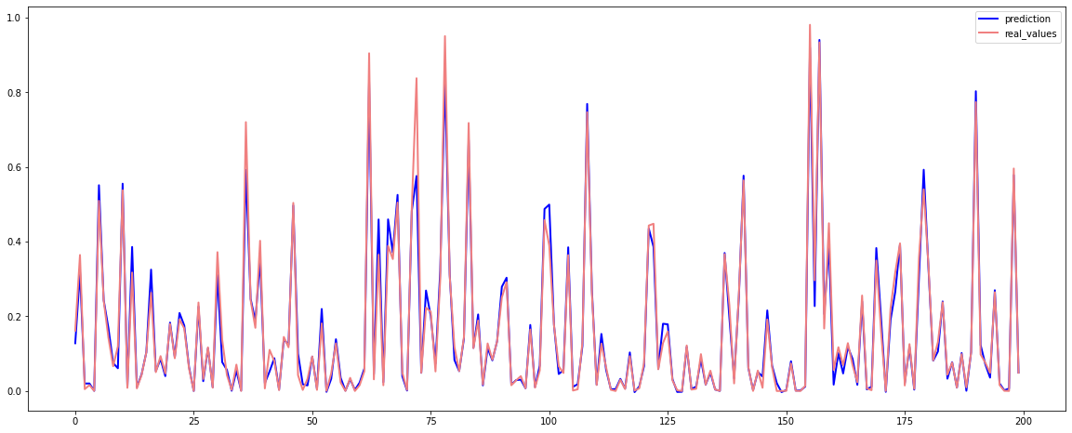
XGBoost Model
Accuracy:97.229%

Slide 28
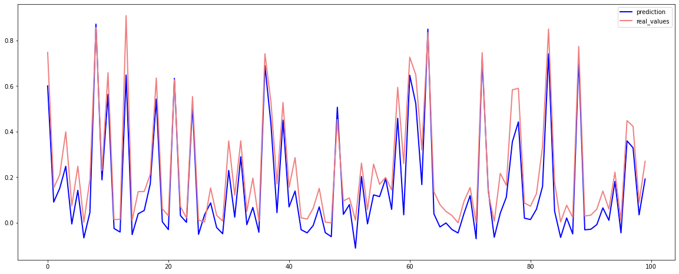
Deep Learning Neural Network
Accuracy:97.120%

Slide 29
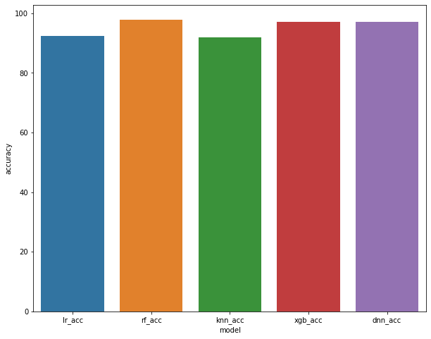
Comparison of Models
model accuracy
lr_acc 92.280797
rf_acc 97.890534
knn_acc 91.972603
xgb_acc 97.229246
dnn_acc 97.120230

Slide 30
Conclusion
Sales forecasts allow you to spot potential issues while there's still time to avoid or mitigate them.
We took a Walmart dataset and performed the sales forecasting on it.
We found that the Random forest Model, performs the best out of all the other models with the accuracy of 97.890%.

Slide 31


