Slide 1
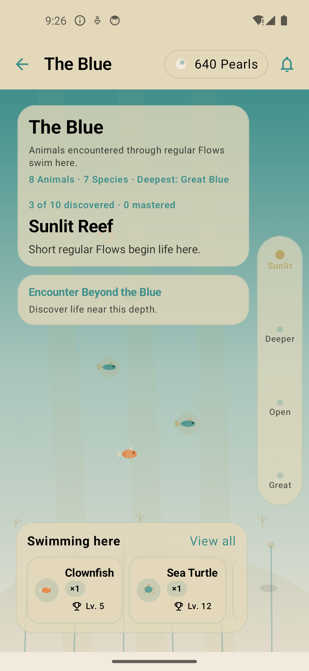

SCYRA
Turn intentional time
into a living story
A complete product walkthrough for investors and stakeholders
Android product demo • August 2026
THE BLUE
Progress becomes a world users can return to.
Notes:
Open with the product promise: Scyra makes focus visible, memorable, and worth returning to.
[Sources]
- Scyra Android app, locally captured on an Android emulator from the Scyra Debug build, 2026-08-19.
[/Sources]

Slide 2
02 / PRODUCT THESIS
The app connects a complete behavior loop
Every action creates context for the next session—and long-term progress beyond it.
01
02
03
04
05
Focus
Capture
Review
Plan
Return
Start a scored Flow or a gentle Soft Flow.
Record a Pulse or multimodal Chronicle.
See time, score, journeys, Sagas, and Chronicles.
Schedule Flows, build Arcs, or launch a suggested Scene.
Grow The Shell, collections, creatures, and badges.
The differentiated value is the continuity between the tools—not any single timer, journal, or reward mechanic.
Notes:
Frame Scyra as a system. The user moves from intention to evidence, then from evidence to a reason to come back.
[Sources]
- Scyra Android app, locally captured on an Android emulator from the Scyra Debug build, 2026-08-19.
[/Sources]

Slide 3
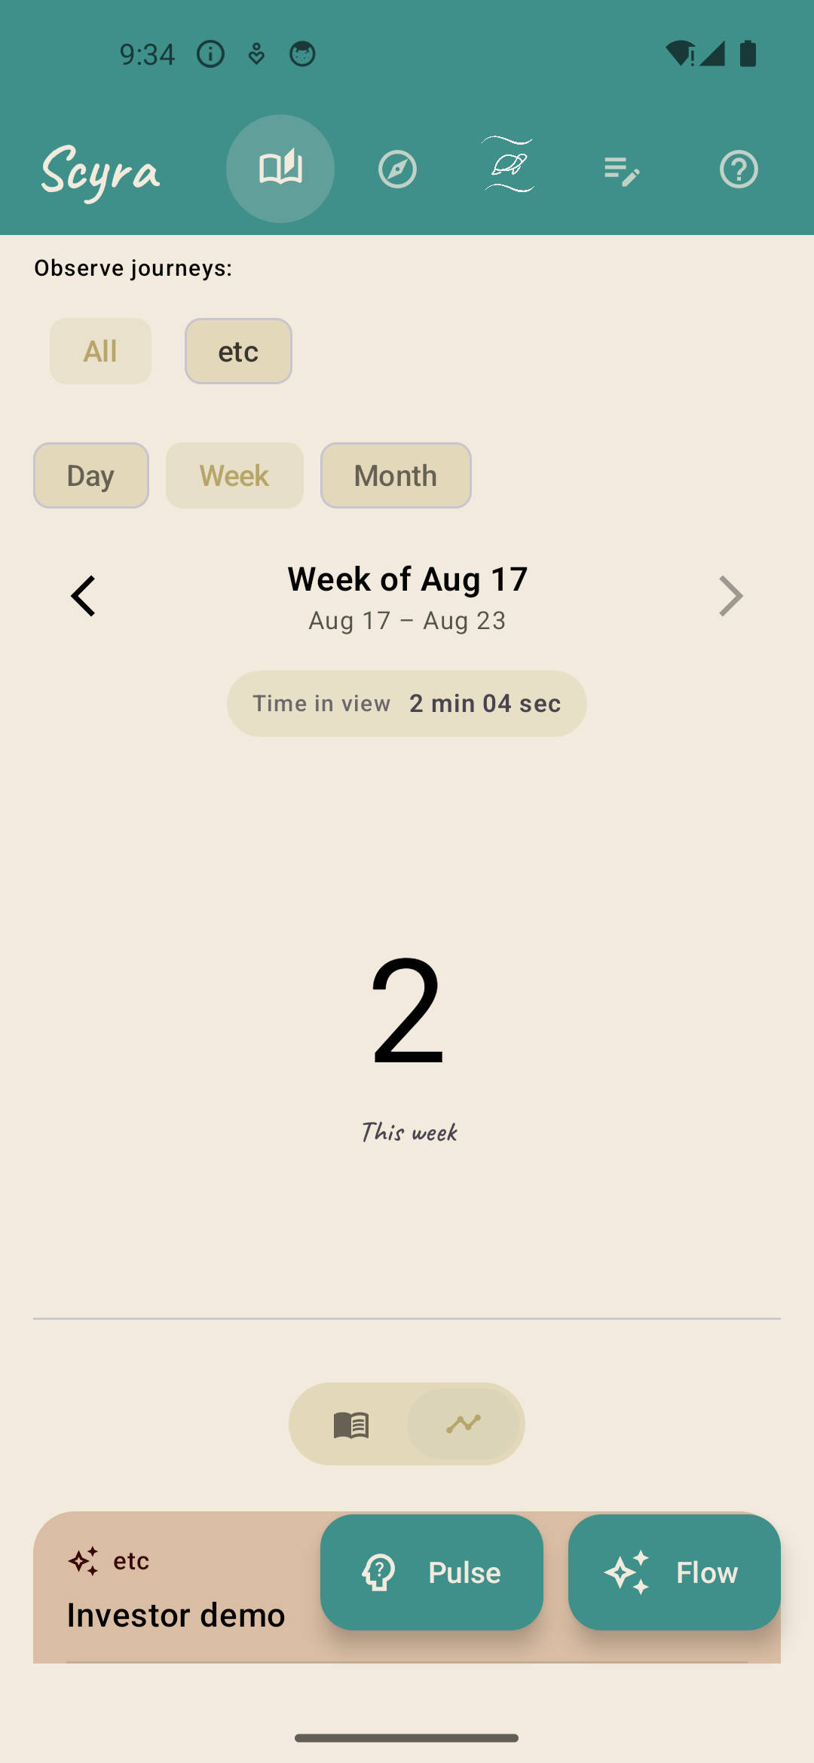
03 / REVIEW
Story turns effort into a navigable record
Users can zoom from one day to a month, filter by journey, and move between narrative and trend views.
ONE HOME
A
Flexible lenses
Time and score in context
Day, Week, Month, previous/next period, and journey filters.
The Story view combines session time, Scyra Score, journey tags, and session cards—without forcing users into a separate analytics product.
B
Two storytelling modes
Sagas organize progress; Chronicles preserve the qualitative record.
C
Action stays close
Start a Flow or capture a Pulse directly from the dashboard.
Story dashboard
Notes:
Use the current-week screenshot to show how quickly a completed session becomes visible and actionable in Story.
[Sources]
- Scyra Android app, locally captured on an Android emulator from the Scyra Debug build, 2026-08-19.
[/Sources]

Slide 4
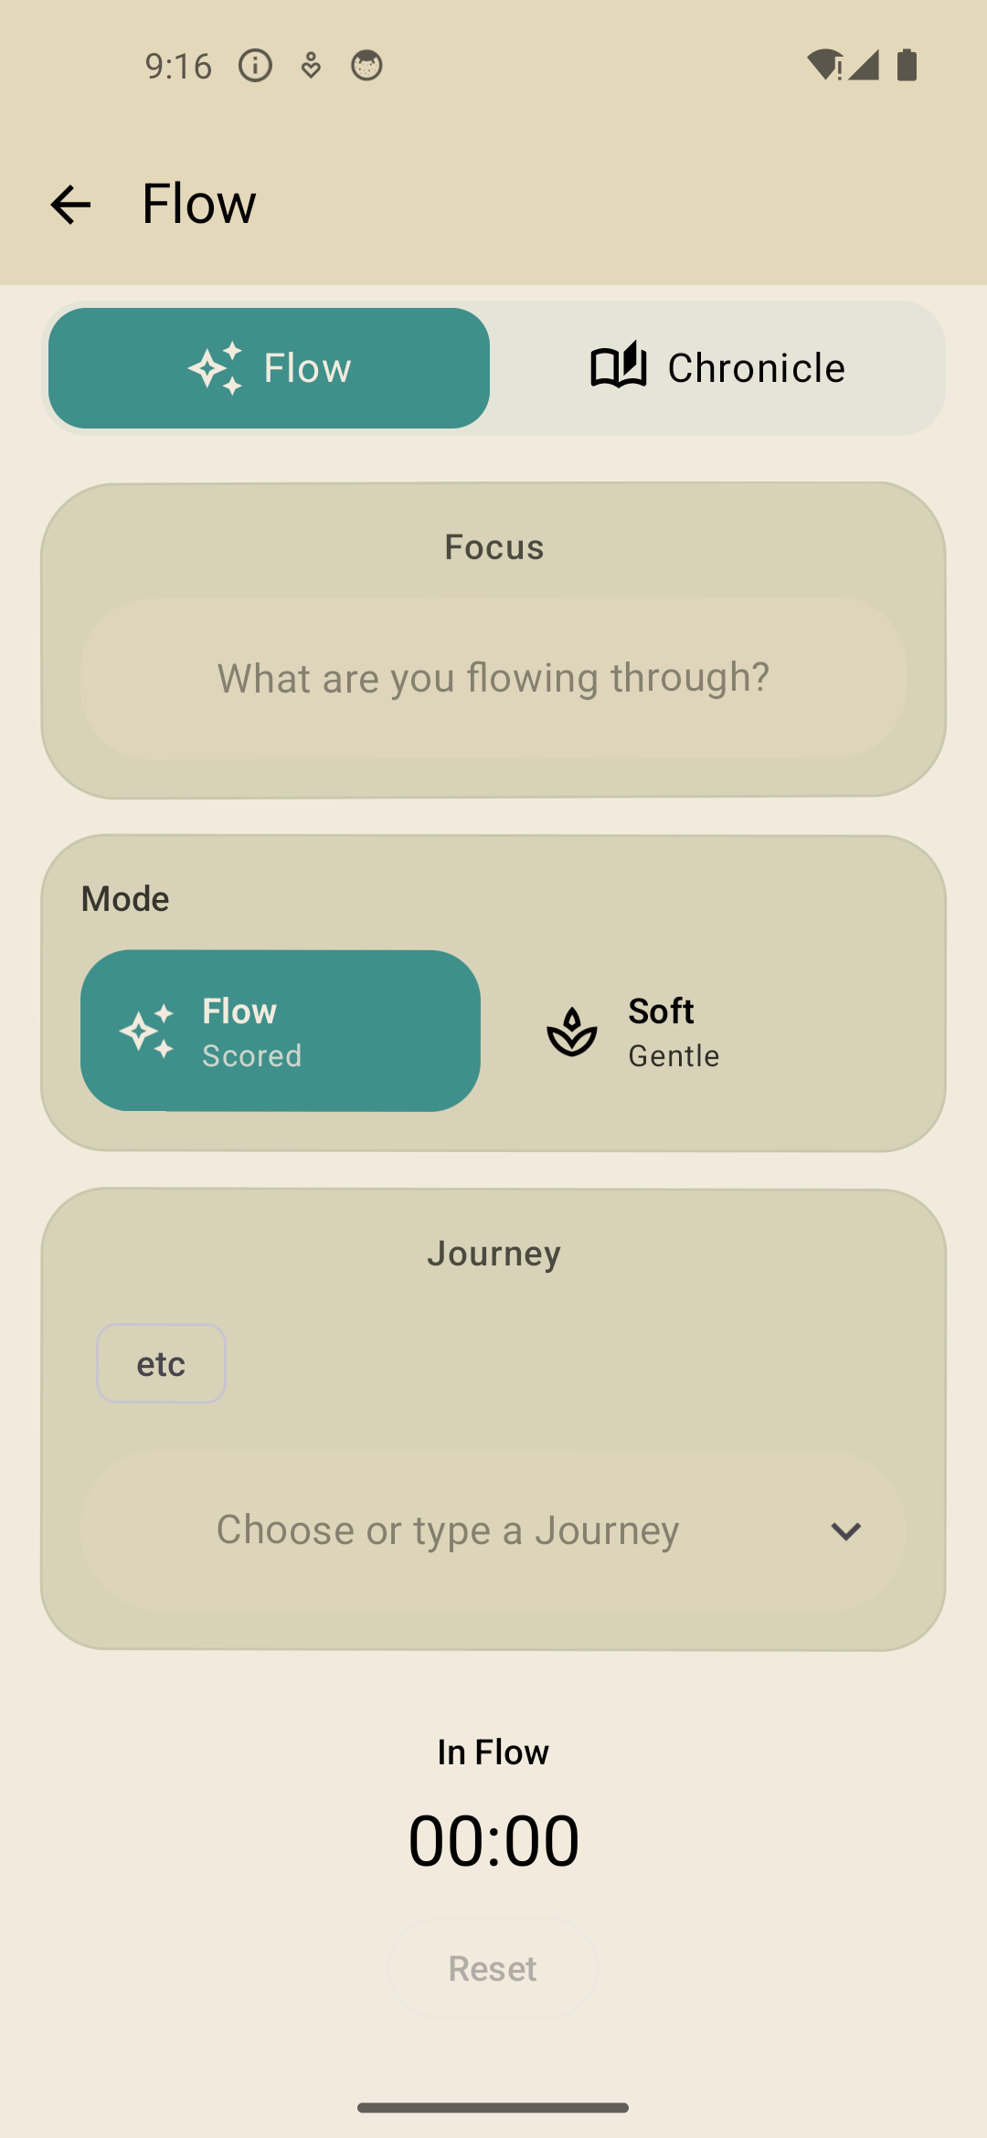
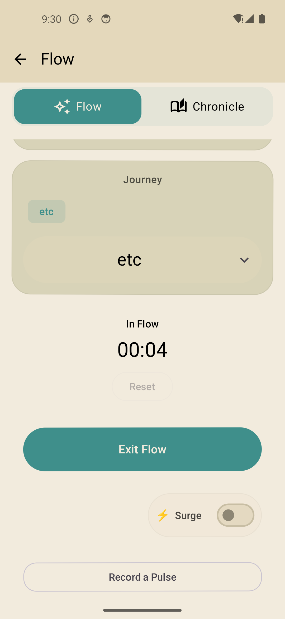
04 / FOCUS
Flow supports intensity without enforcing one mode
A single session surface covers scored focus, gentle work, targets, live runtime, and continuation.
FLEXIBLE SESSION
Flow or Soft Flow
Choose scored focus or a calmer, unscored mode. Add a title and journey, then run the timer in the foreground or background.
01
Surge targets
Arm a timed challenge with milestone feedback and bonus scoring.
02
Stay in the loop
Record a Pulse during the session, reset safely, or continue an Arc step.
Session setup
Live Flow
Notes:
Call out that the timer is only the entry point: Scyra adds mode choice, journey context, Surge targets, reflection, and Arc continuation.
[Sources]
- Scyra Android app, locally captured on an Android emulator from the Scyra Debug build, 2026-08-19.
[/Sources]

Slide 5
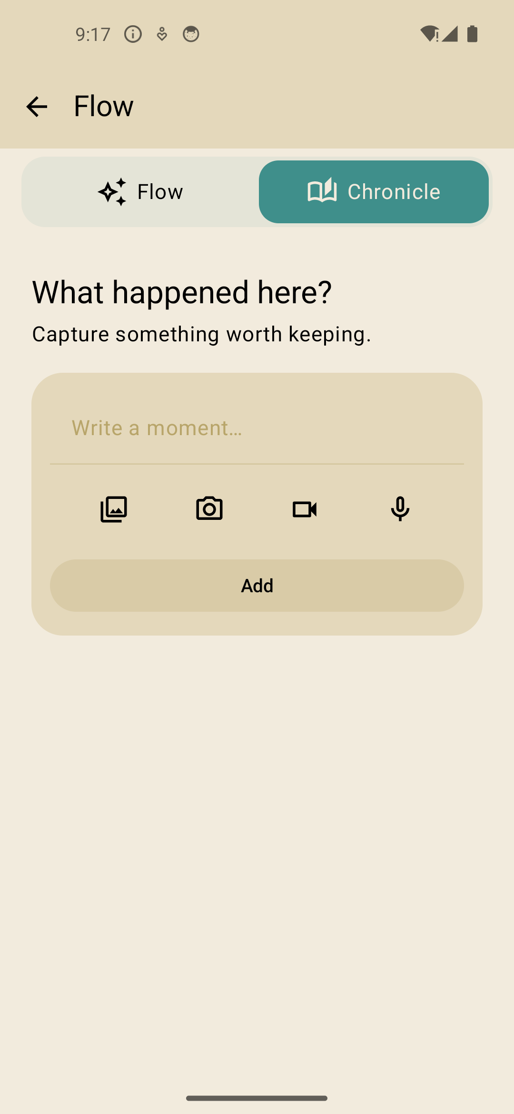
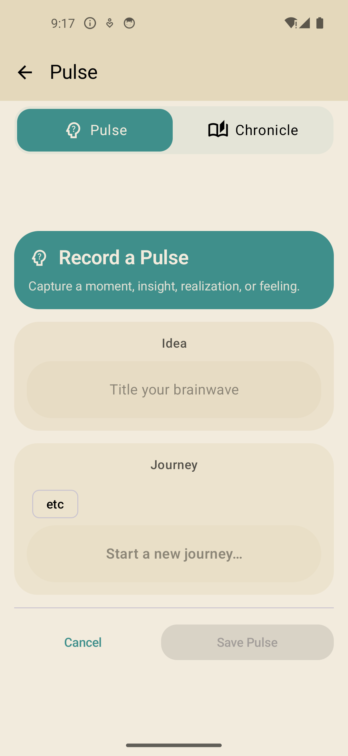
05 / CAPTURE
Reflection meets users in the medium they already have
Quick Pulse capture and rich Chronicle capture share the same journey context.
CHRONICLE
A multimodal memory layer
Capture text, dictated or recorded audio, gallery media, a new photo, or video. Media and transcription stay attached to the user’s story.
PULSE
Low-friction reflection
Tag a thought to a journey, attach it to the active Flow, and later let Idea Grove turn that reflection into something actionable.
Chronicle
Pulse
Notes:
Contrast Chronicle depth with Pulse speed. Both preserve context, while Pulse also feeds the idea workflow.
[Sources]
- Scyra Android app, locally captured on an Android emulator from the Scyra Debug build, 2026-08-19.
[/Sources]

Slide 6
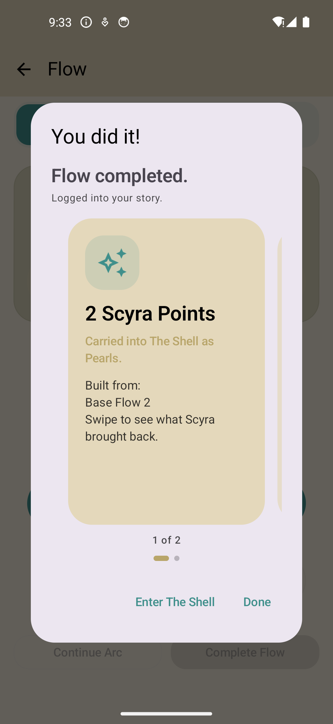
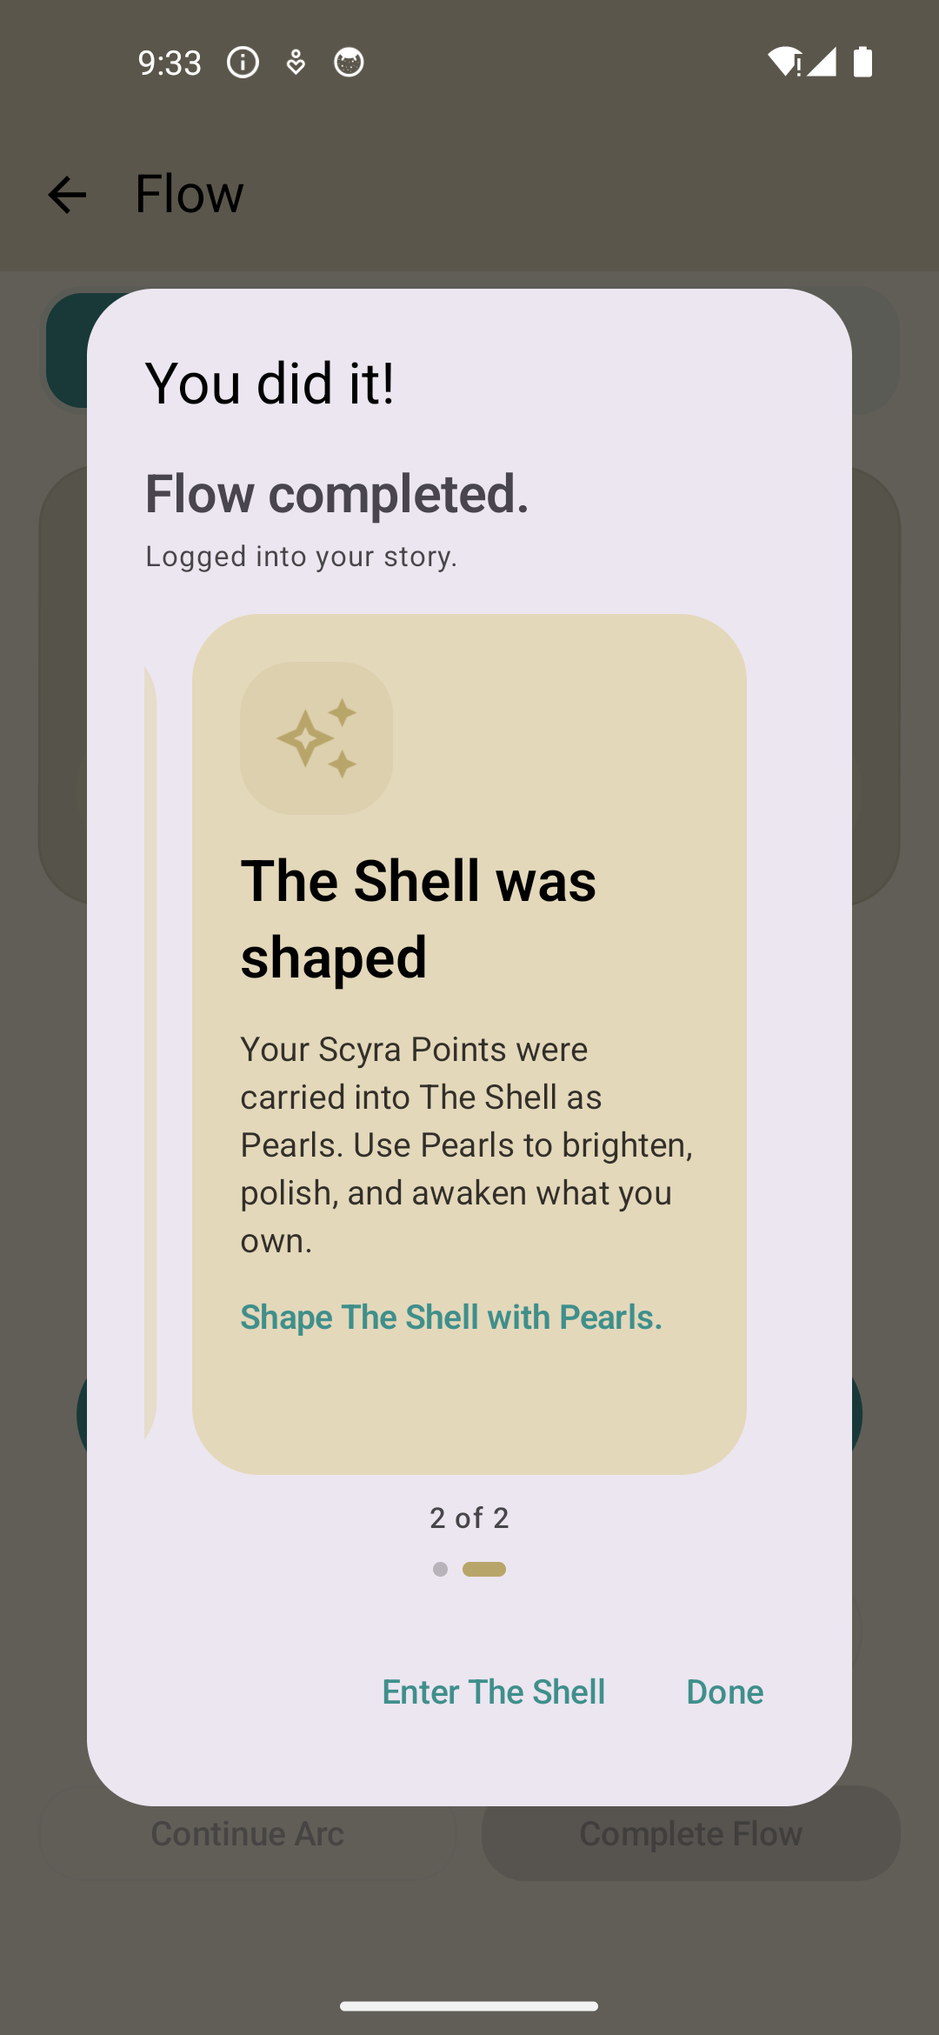
06 / REWARD
Completion closes the loop immediately
The user sees what was logged, what was earned, and how that progress changes The Shell.
REWARD REVEAL
Effort becomes a portable resource
Scyra Points are explained—not just displayed—and carried into The Shell as Pearls. The carousel can also reveal creatures and Arc outcomes.
→
No dead end
Done returns the user to their story; Enter The Shell continues into the retention layer.
Points & Pearls
Shell impact
Notes:
Swipe the live reward carousel during the demo. The investor point is that completion creates both evidence and a next action.
[Sources]
- Scyra Android app, locally captured on an Android emulator from the Scyra Debug build, 2026-08-19.
[/Sources]

Slide 7
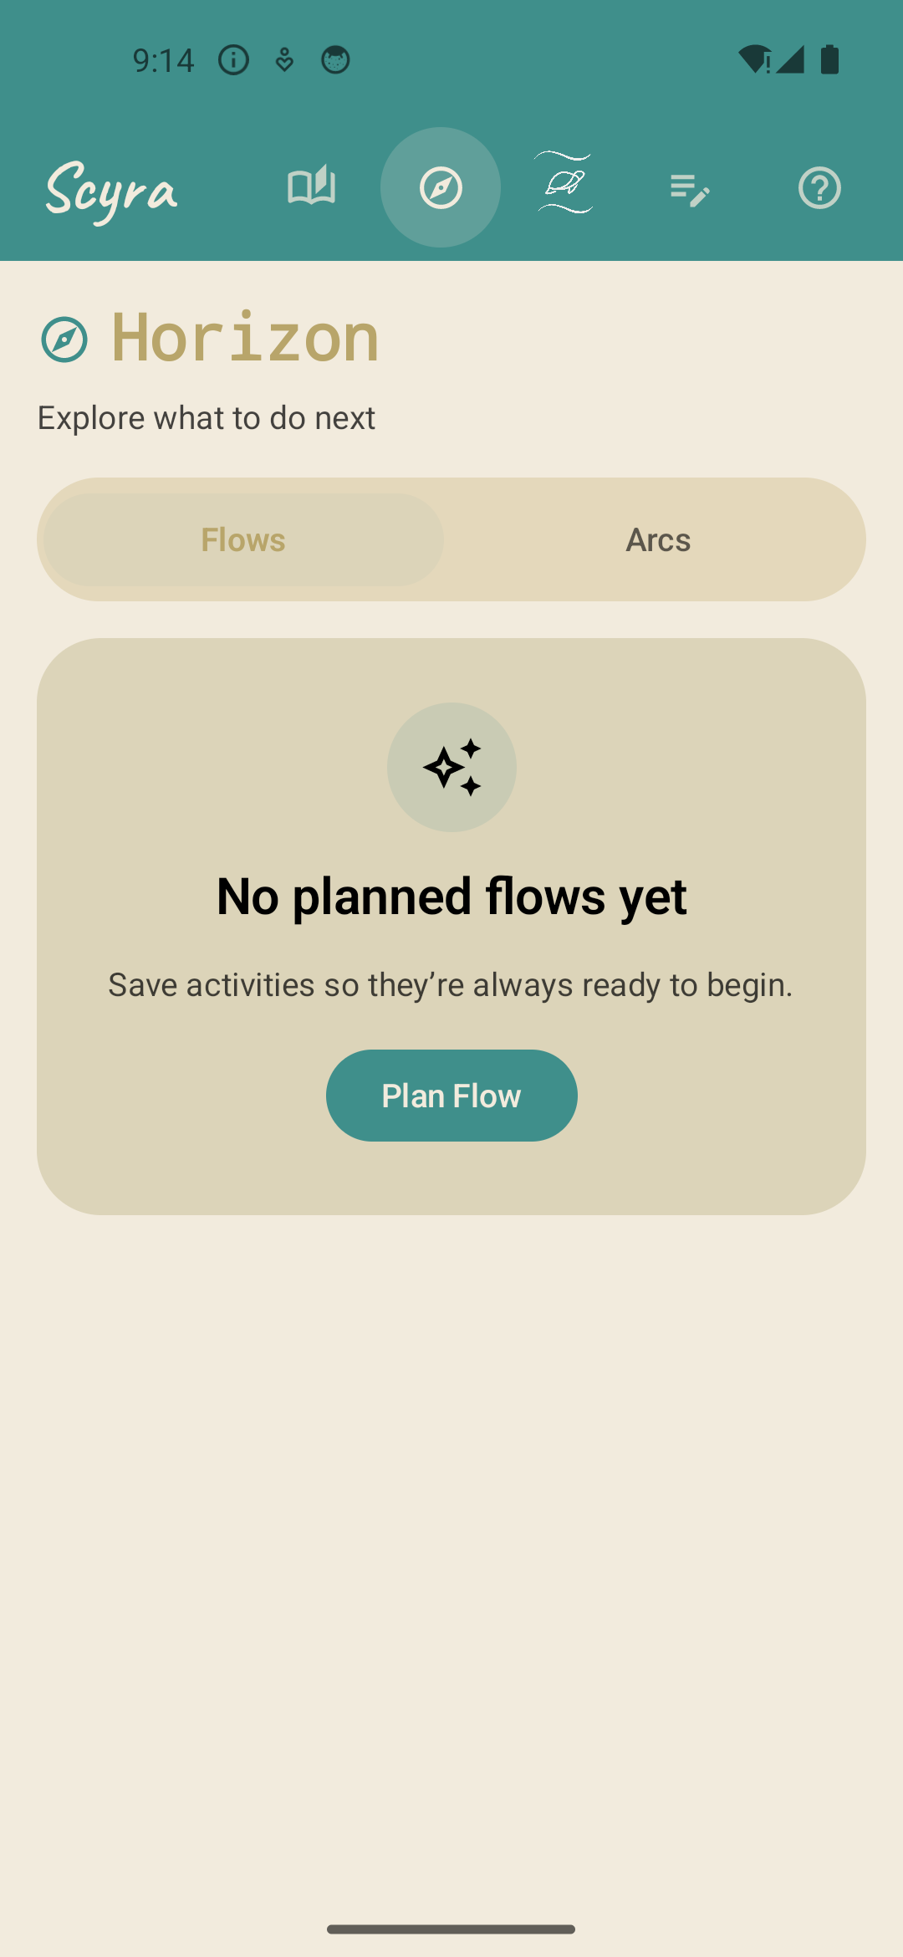
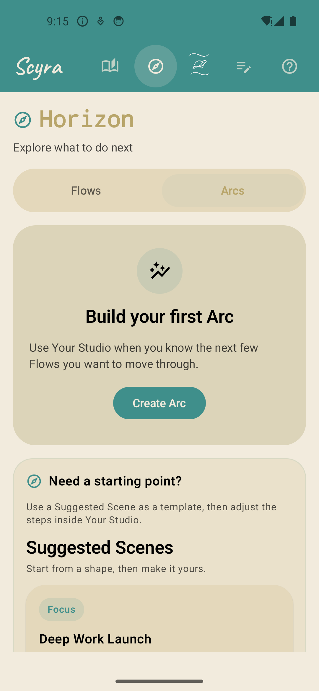
07 / PLAN
Paths turns intention into a visible horizon
Plan a single Flow, organize a multi-step Arc, or begin from a suggested Scene.
HORIZON
Two planning scales
Flows support the next intentional block. Arcs link multiple steps into a reusable route with a clear beginning and continuation state.
01
Create from scratch
Plan a Flow or build an Arc around a goal.
02
Borrow a pattern
Suggested Scenes provide launch-ready structures for common focus modes.
Planned Flows
Arcs
Notes:
Show the Flows and Arcs tabs as the bridge between today’s focus and a repeatable longer-term plan.
[Sources]
- Scyra Android app, locally captured on an Android emulator from the Scyra Debug build, 2026-08-19.
[/Sources]

Slide 8
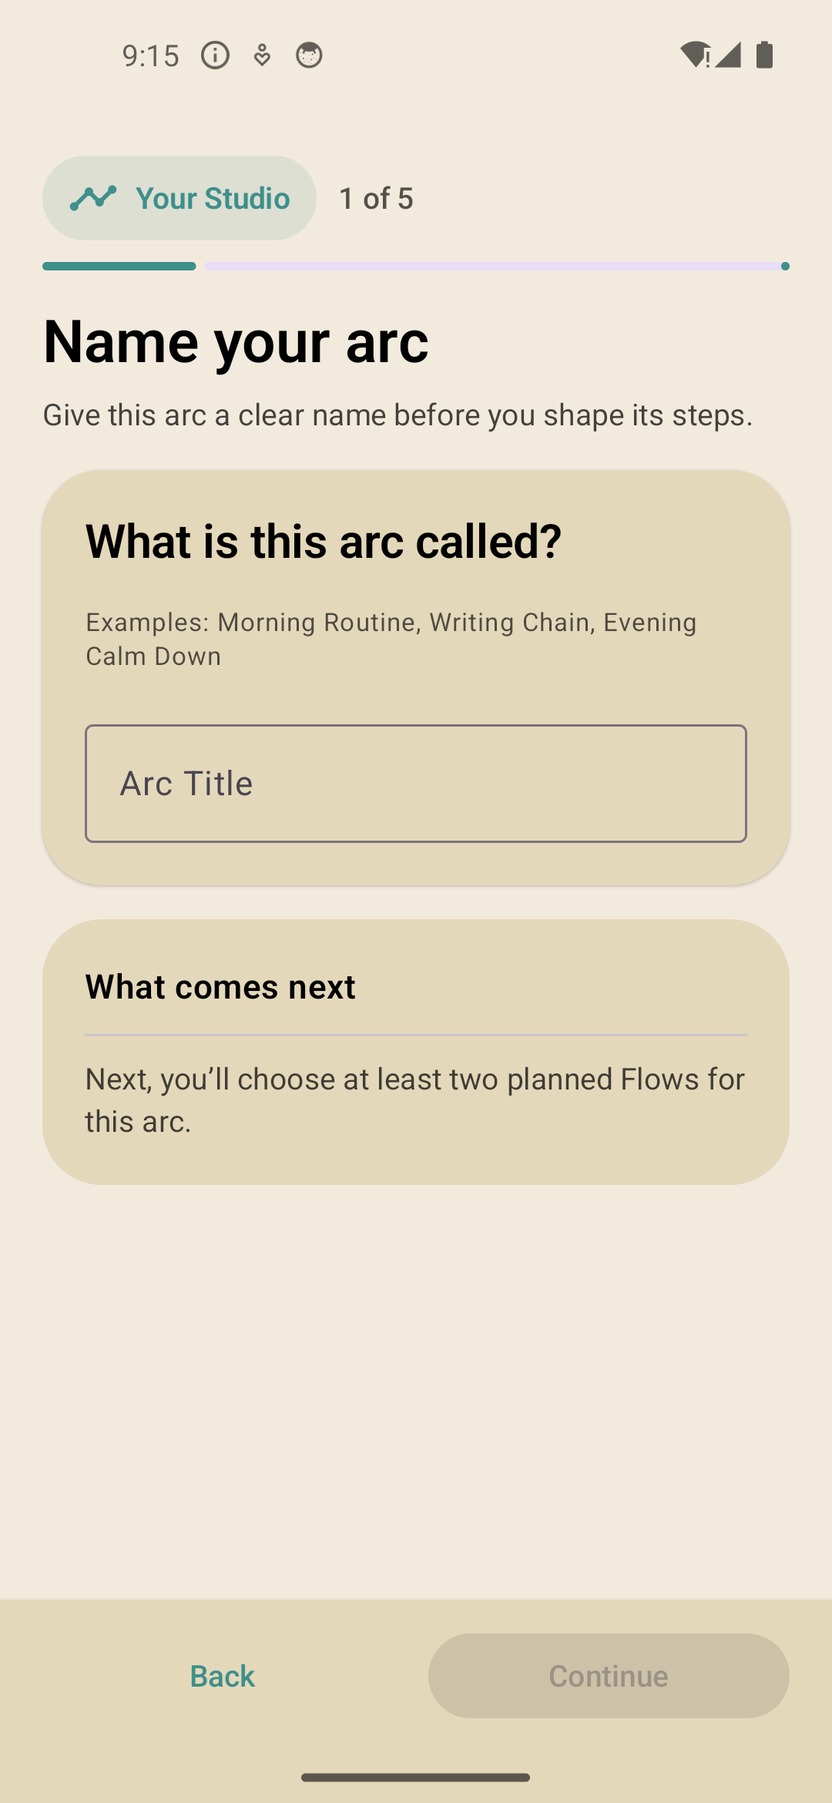
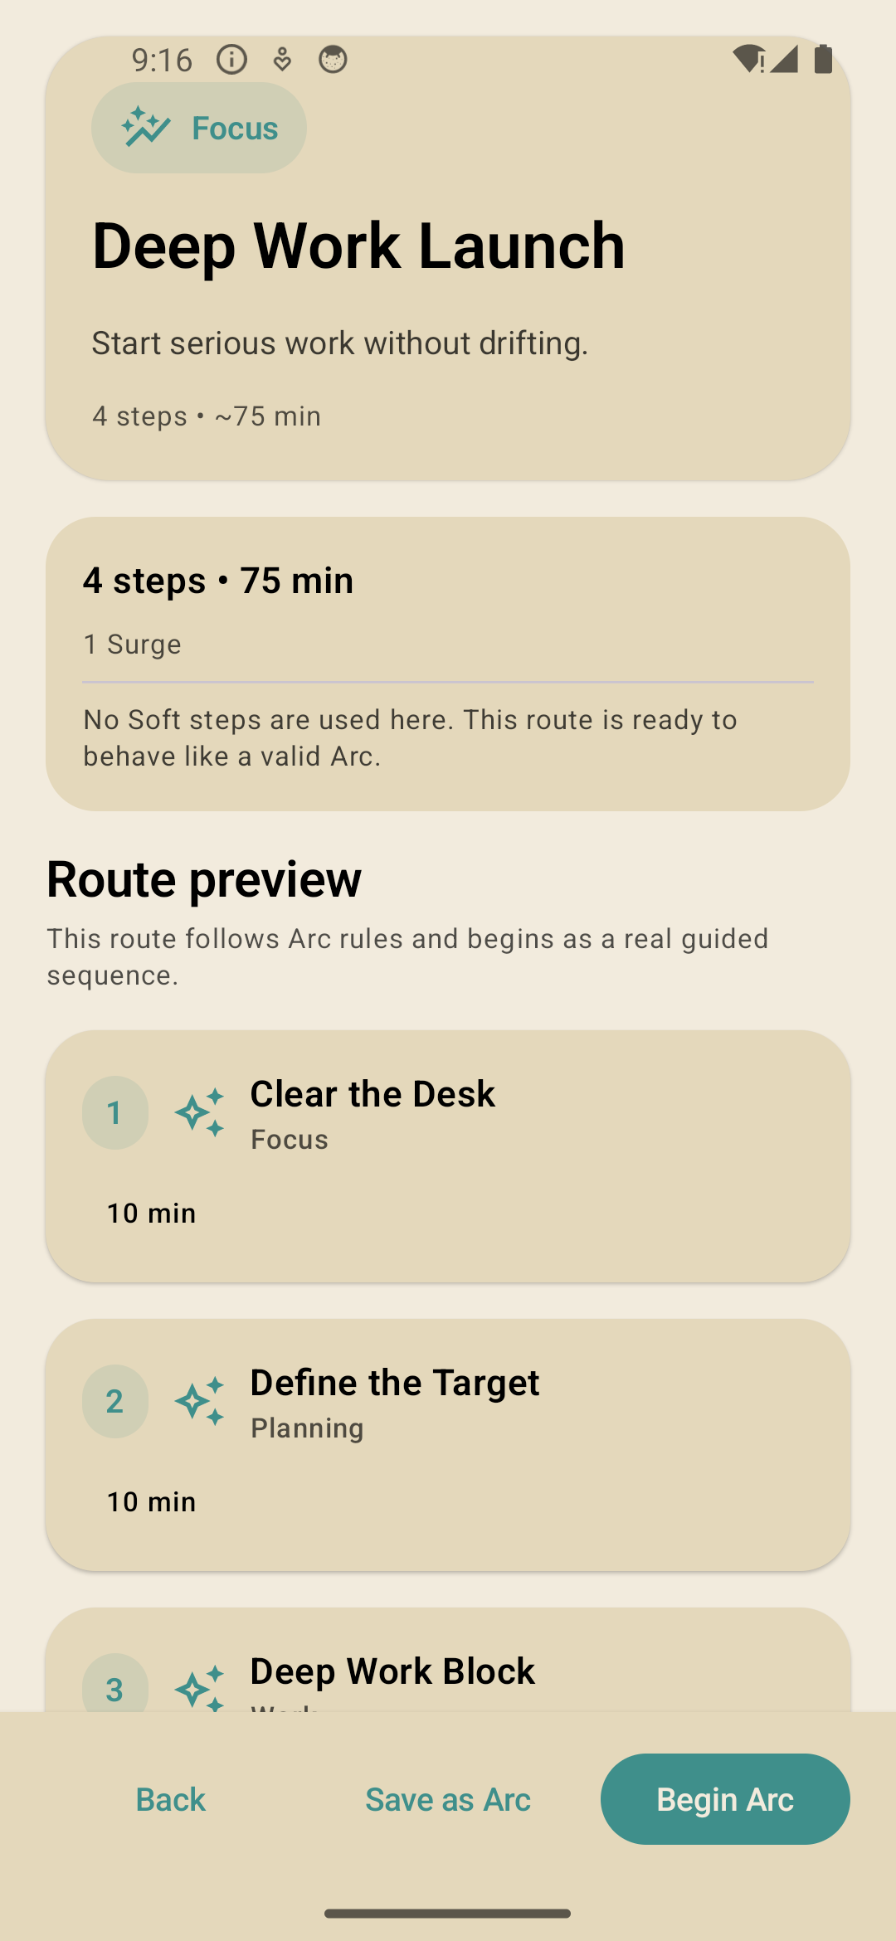
08 / PLAN
The Studio makes multi-step work feel authored
A five-step builder creates an Arc; suggested routes can be saved or launched immediately.
YOUR STUDIO
Name, assemble, and tune the route
The wizard lowers the cost of structuring a sequence while preserving per-step modes, timing, and Surge choices.
SCENES
Templates remain editable
Preview a route such as Deep Work Launch, inspect the steps and estimated duration, then Save as Arc or Begin Arc.
Five-step Studio
Suggested Scene
Notes:
Use this slide to position templates as scaffolding, not locked programs: users can save and adapt the route.
[Sources]
- Scyra Android app, locally captured on an Android emulator from the Scyra Debug build, 2026-08-19.
[/Sources]

Slide 9
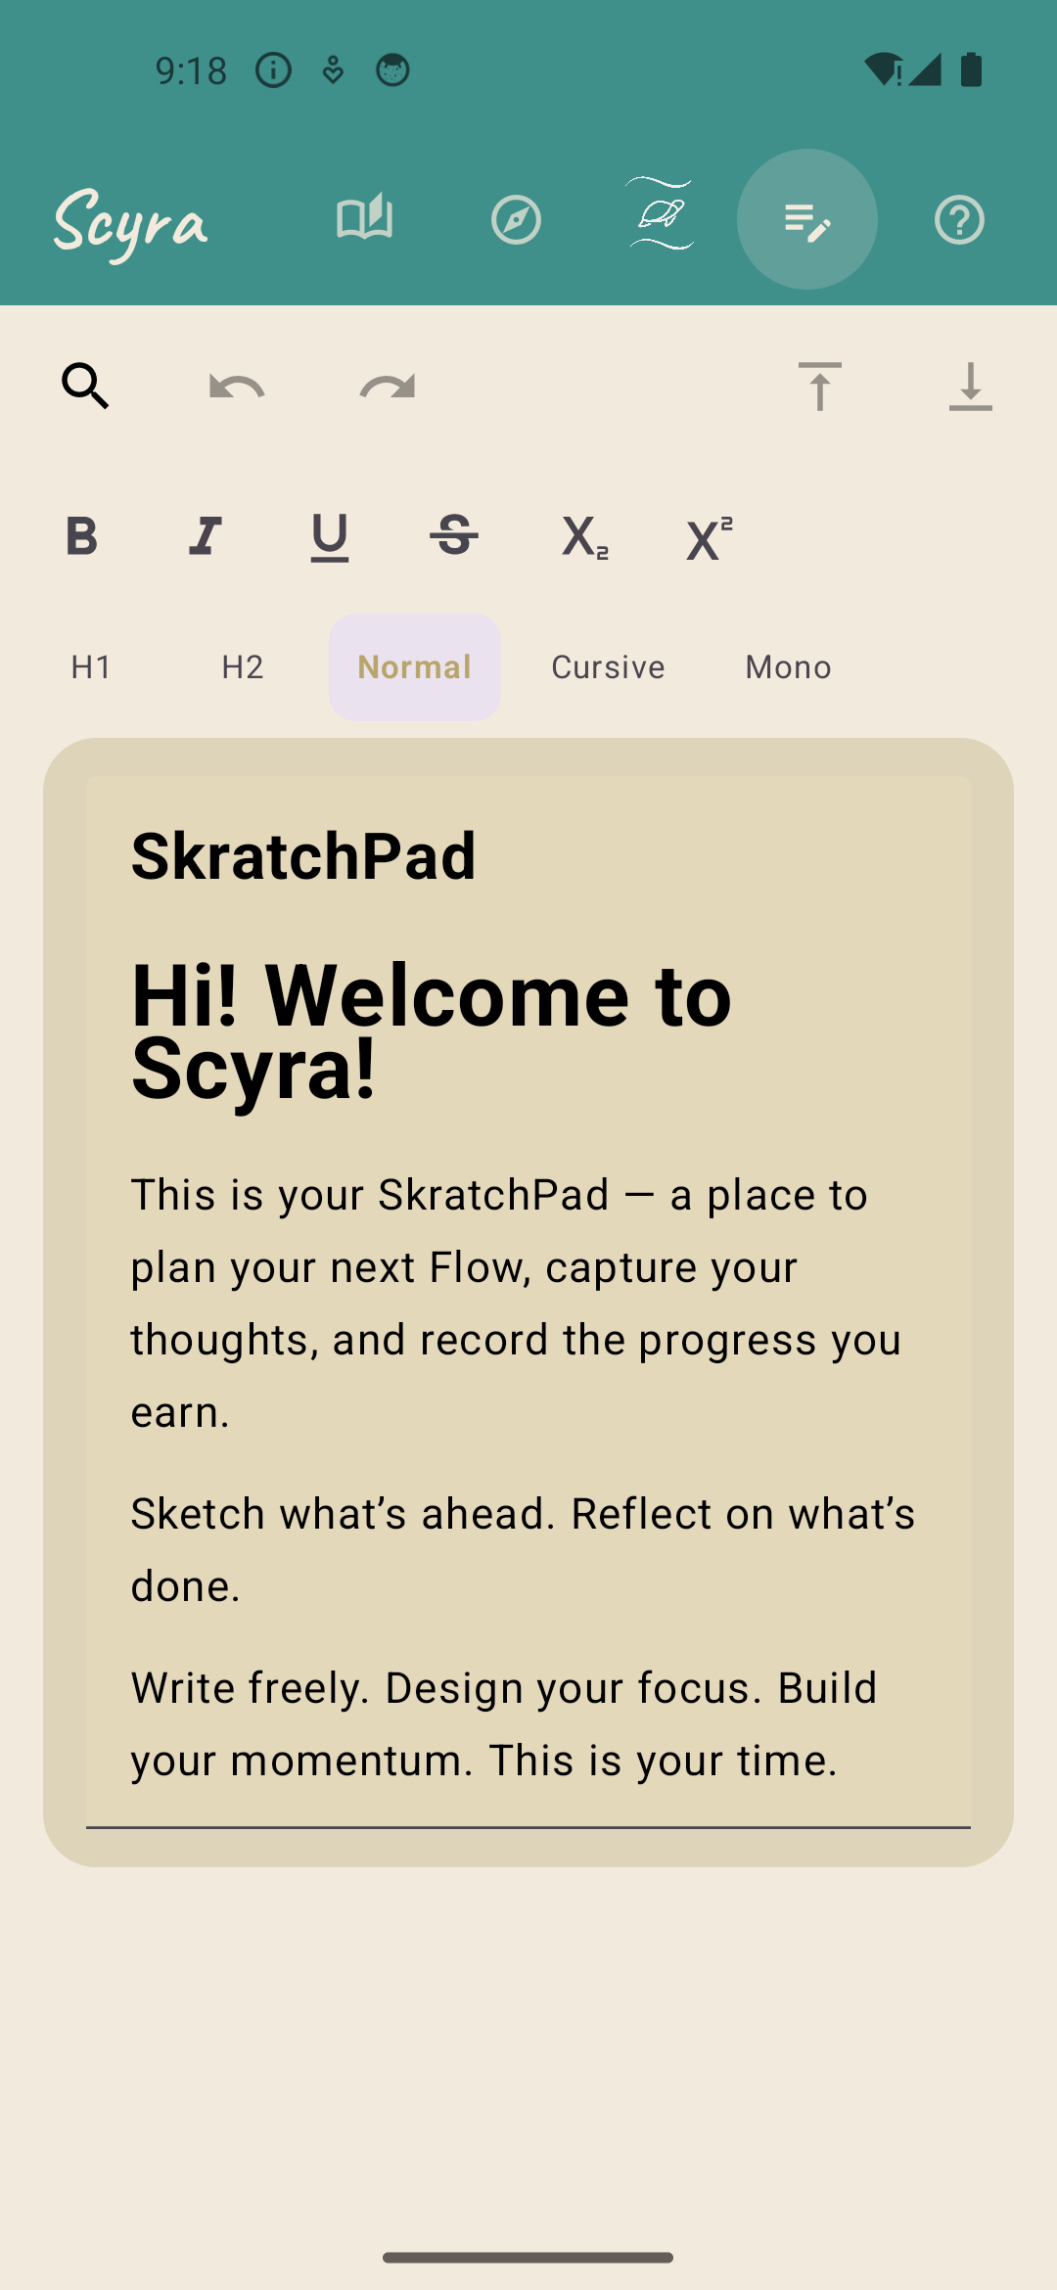
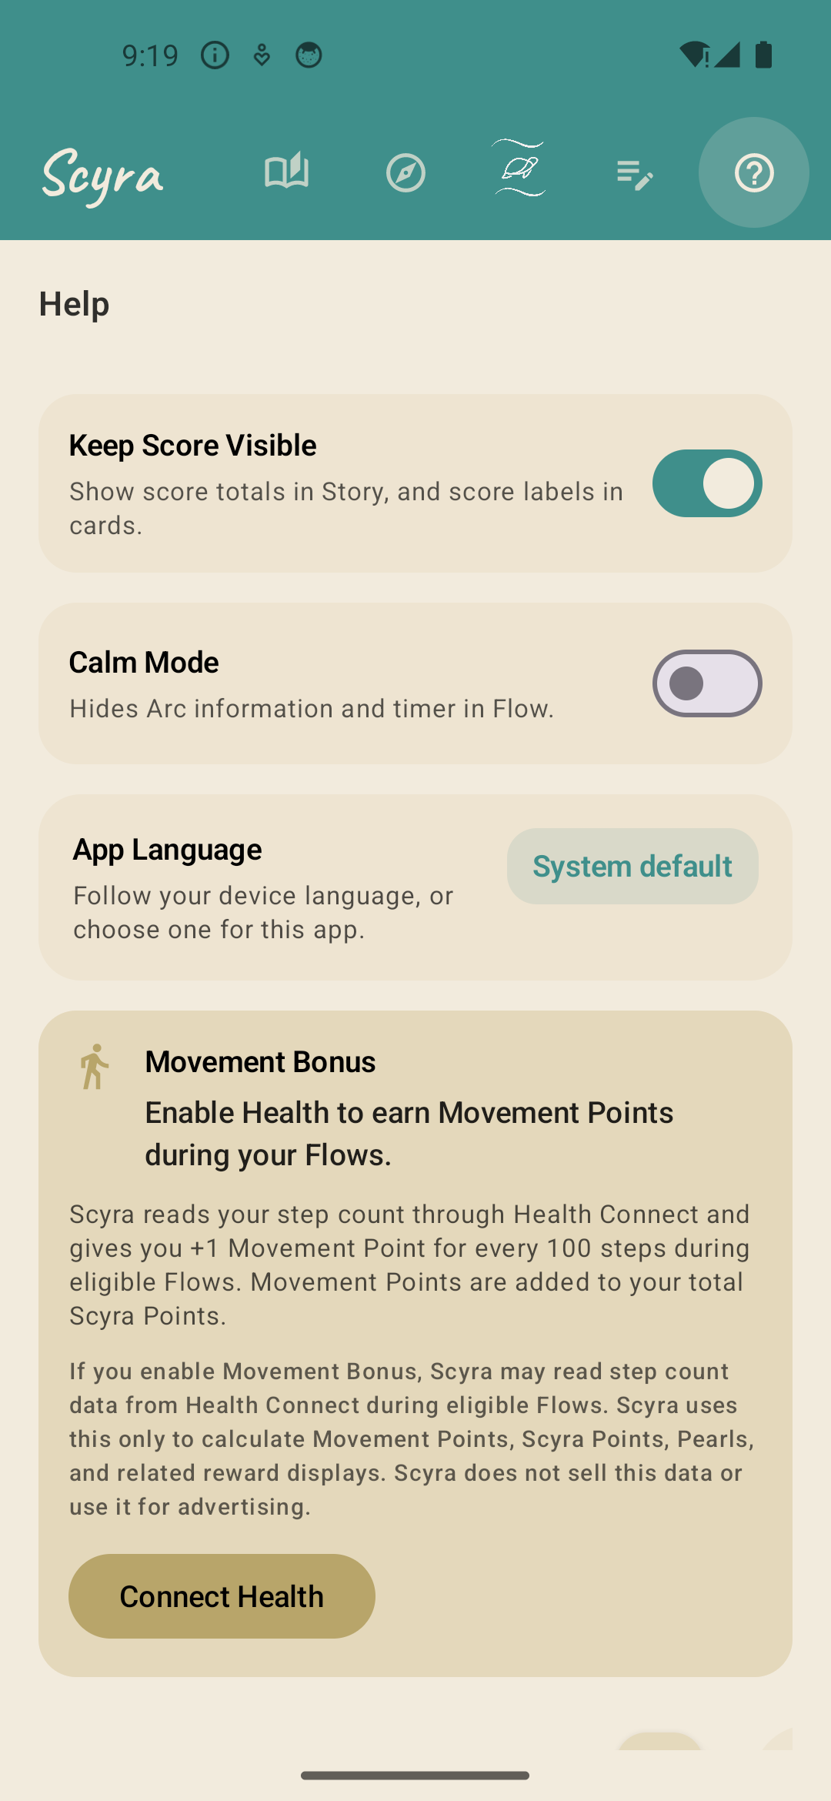
09 / PERSONALIZE
Power tools stay close, but out of the way
ScratchPad supports deep capture; settings tune motivation, calm, language, and movement.
SCRATCHPAD
A real writing surface
Headings, type styles, bold, italic, underline, strike, sub/superscript, search, undo/redo, and top/bottom navigation.
SETTINGS
Motivation can be calibrated
Show or hide score, enable Calm Mode, change language, connect Health Connect, and earn a movement bonus during eligible Flows.
ScratchPad
Help & settings
Notes:
Call out that Scyra can be tuned for users who want numbers and for users who want a calmer experience.
[Sources]
- Scyra Android app, locally captured on an Android emulator from the Scyra Debug build, 2026-08-19.
[/Sources]

Slide 10
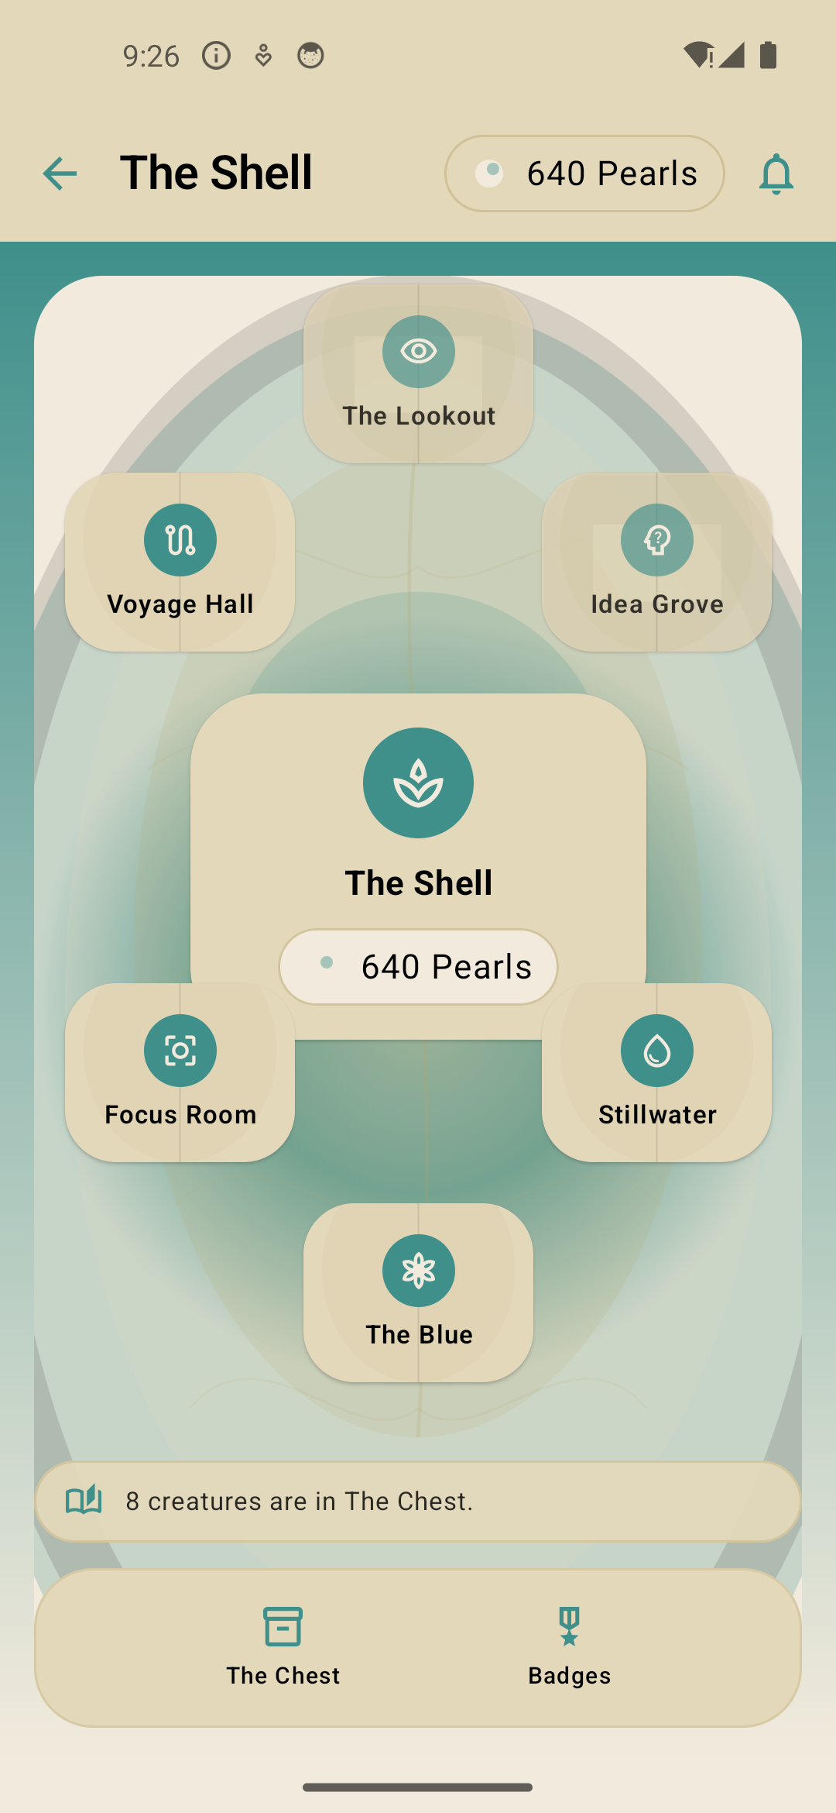
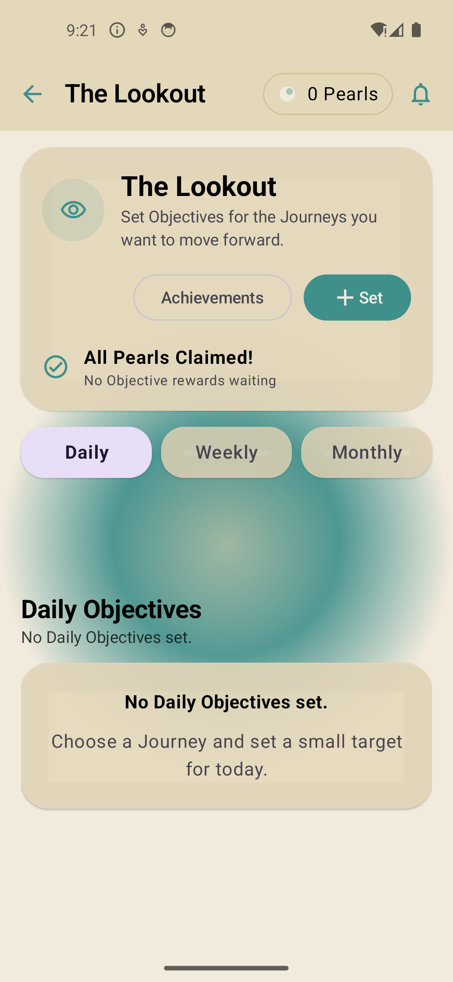
10 / RETURN
The Shell gives every session somewhere to land
A persistent home, Pearl economy, objectives, and notifications turn isolated sessions into continuity.
THE SHELL
The retention hub
Pearls, collections, Heart, The Blue, Chest, badges, and notification inlays live in one navigable place.
THE LOOKOUT
Objectives without streak anxiety
Daily, weekly, and monthly goals create multiple horizons, each with clear Pearl rewards.
The Shell
The Lookout
Notes:
Explain the transition from reward reveal into The Shell, then open The Lookout to show concrete return prompts.
[Sources]
- Scyra Android app, locally captured on an Android emulator from the Scyra Debug build, 2026-08-19.
[/Sources]

Slide 11
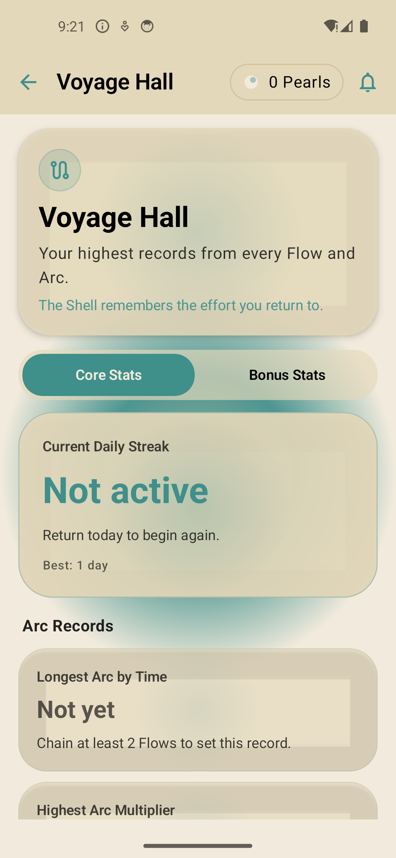
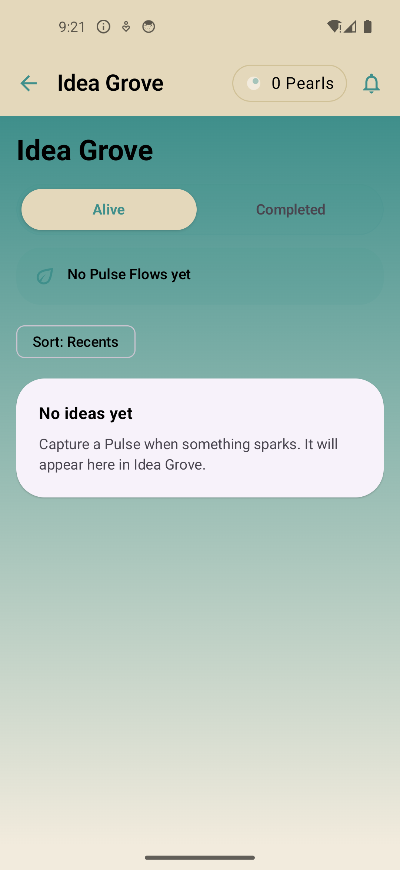
11 / RETURN
Progress can be measured—or turned into the next idea
Voyage Hall serves the analytical user; Idea Grove serves the exploratory user.
VOYAGE HALL
Stats, records, and streaks
Review totals, bests, core progress, bonus contribution, and repeat behavior in a dedicated long-view space.
IDEA GROVE
Thoughts become launch points
Pulse-derived ideas can be alive or completed, then launch a Flow when the user is ready to act.
Voyage Hall
Idea Grove
Notes:
This is a useful investor contrast: the same underlying activity supports analytical and generative motivations.
[Sources]
- Scyra Android app, locally captured on an Android emulator from the Scyra Debug build, 2026-08-19.
[/Sources]

Slide 12
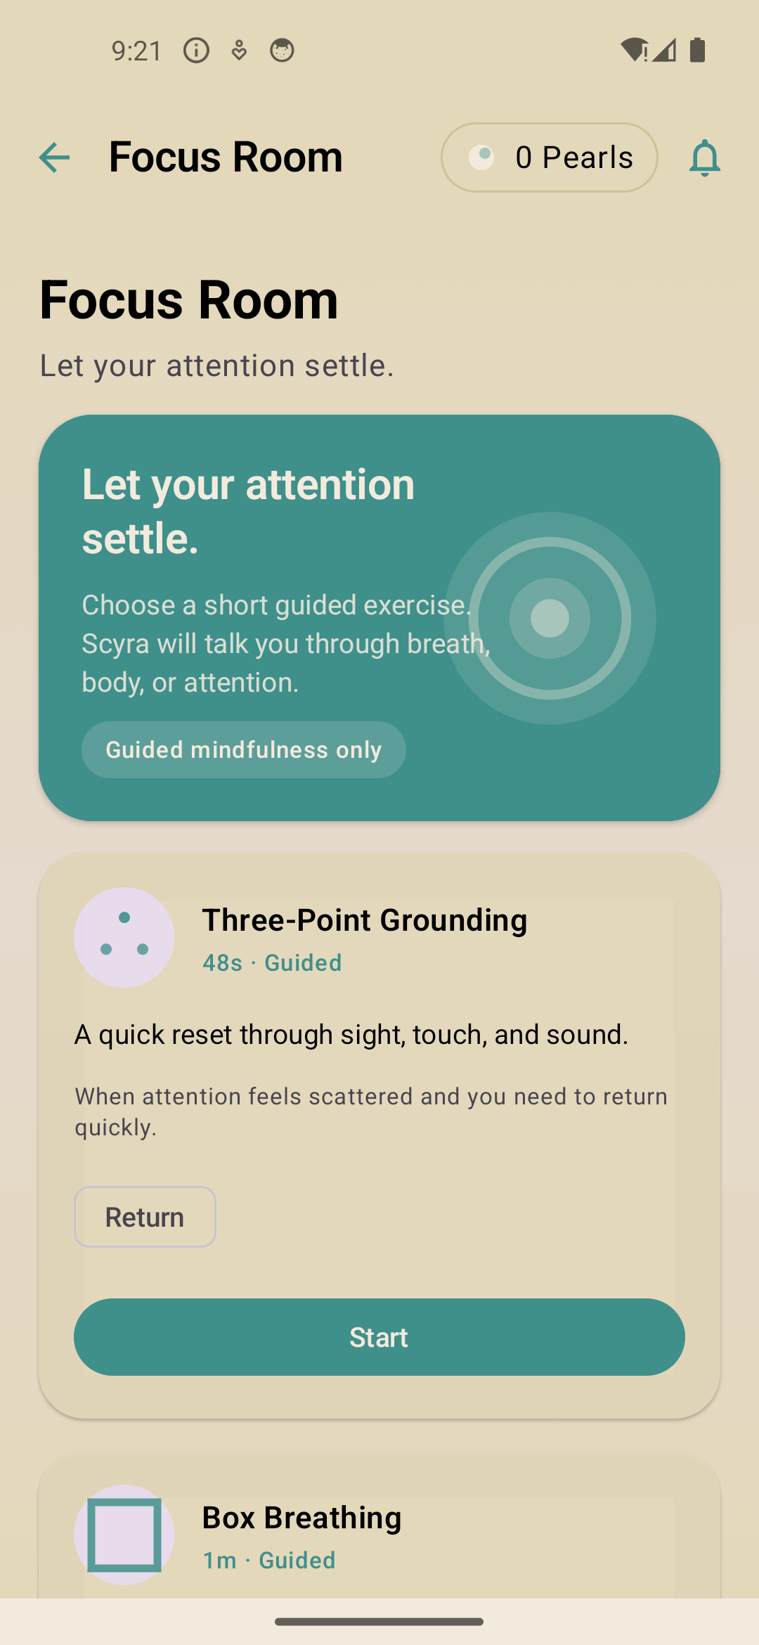
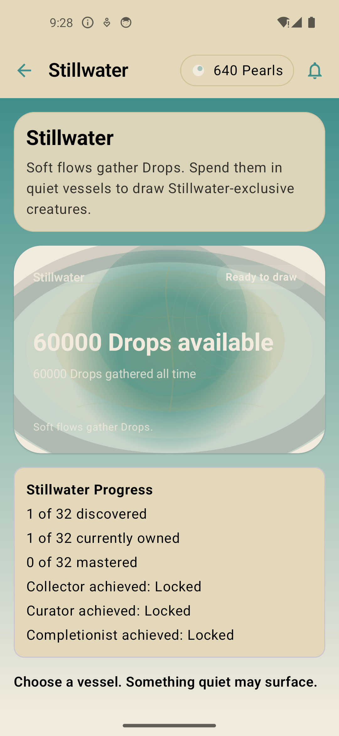
12 / RETURN
The app also rewards recovery and gentler momentum
Guided focus exercises and Soft Flow collection progress make the system broader than high-intensity productivity.
FOCUS ROOM
Guided regulation
Voice-supported exercises include grounding and Box Breathing, giving users a deliberate on-ramp before or between demanding sessions.
STILLWATER
Soft work earns its own ecology
Soft Flow Drops fill vessels and unlock exclusive creatures—recognizing restorative effort without turning it into score competition.
Focus Room
Stillwater
Notes:
Show that Scyra’s motivation system includes recovery and calm, not only more output.
[Sources]
- Scyra Android app, locally captured on an Android emulator from the Scyra Debug build, 2026-08-19.
[/Sources]

Slide 13
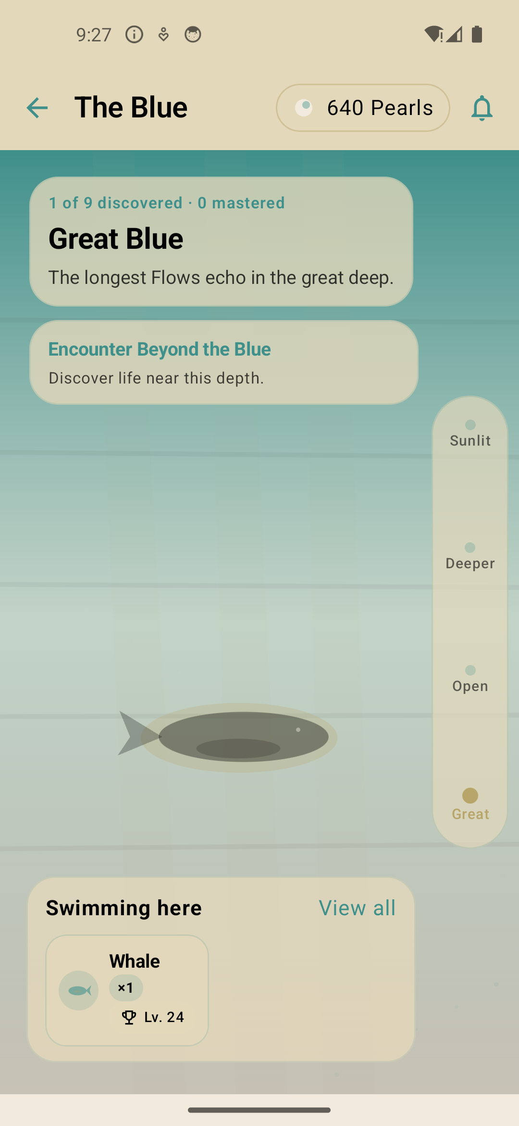
13 / WORLD
The Blue makes accumulated effort feel alive
Creatures inhabit depth zones, collections expand, and the environment changes with continued use.
DEPTH
A world with visible progression
Move from Sunlit Reef into deeper zones, encounter new species, and see collection counts and depth progress in place.
∞
Beyond Blue
Regular Flows can surface encounters; Pearls can grow creatures, and release creates another meaningful outcome.
Sunlit Reef
Great Blue
Notes:
The populated environment is the clearest visual explanation of the long-term return loop. Move between depth zones during the live demo.
[Sources]
- Scyra Android app, locally captured on an Android emulator from the Scyra Debug build, 2026-08-19.
[/Sources]

Slide 14
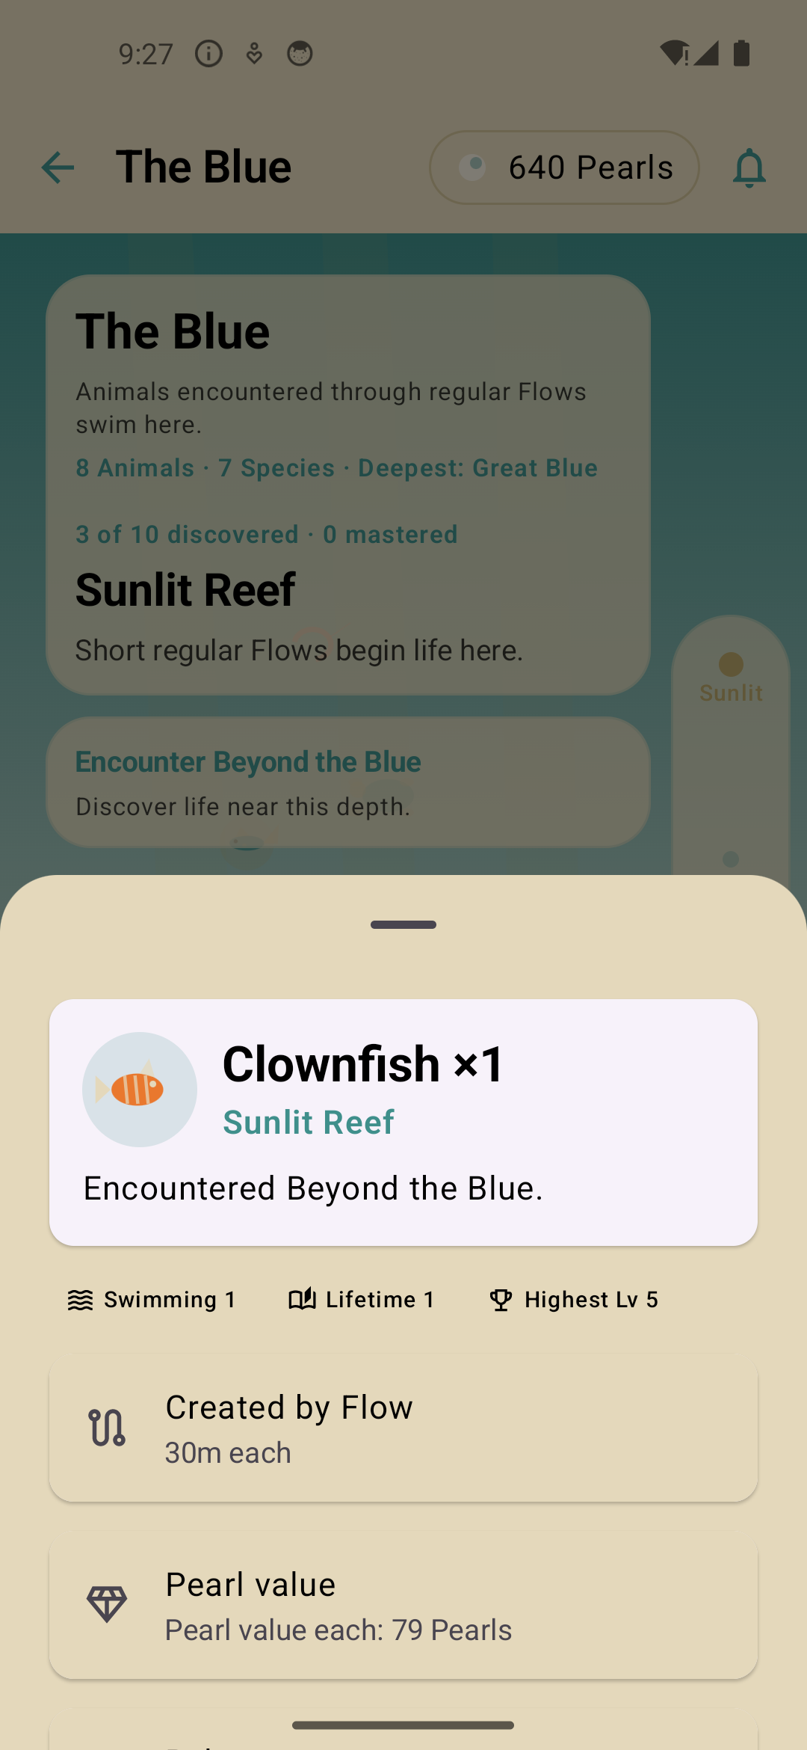
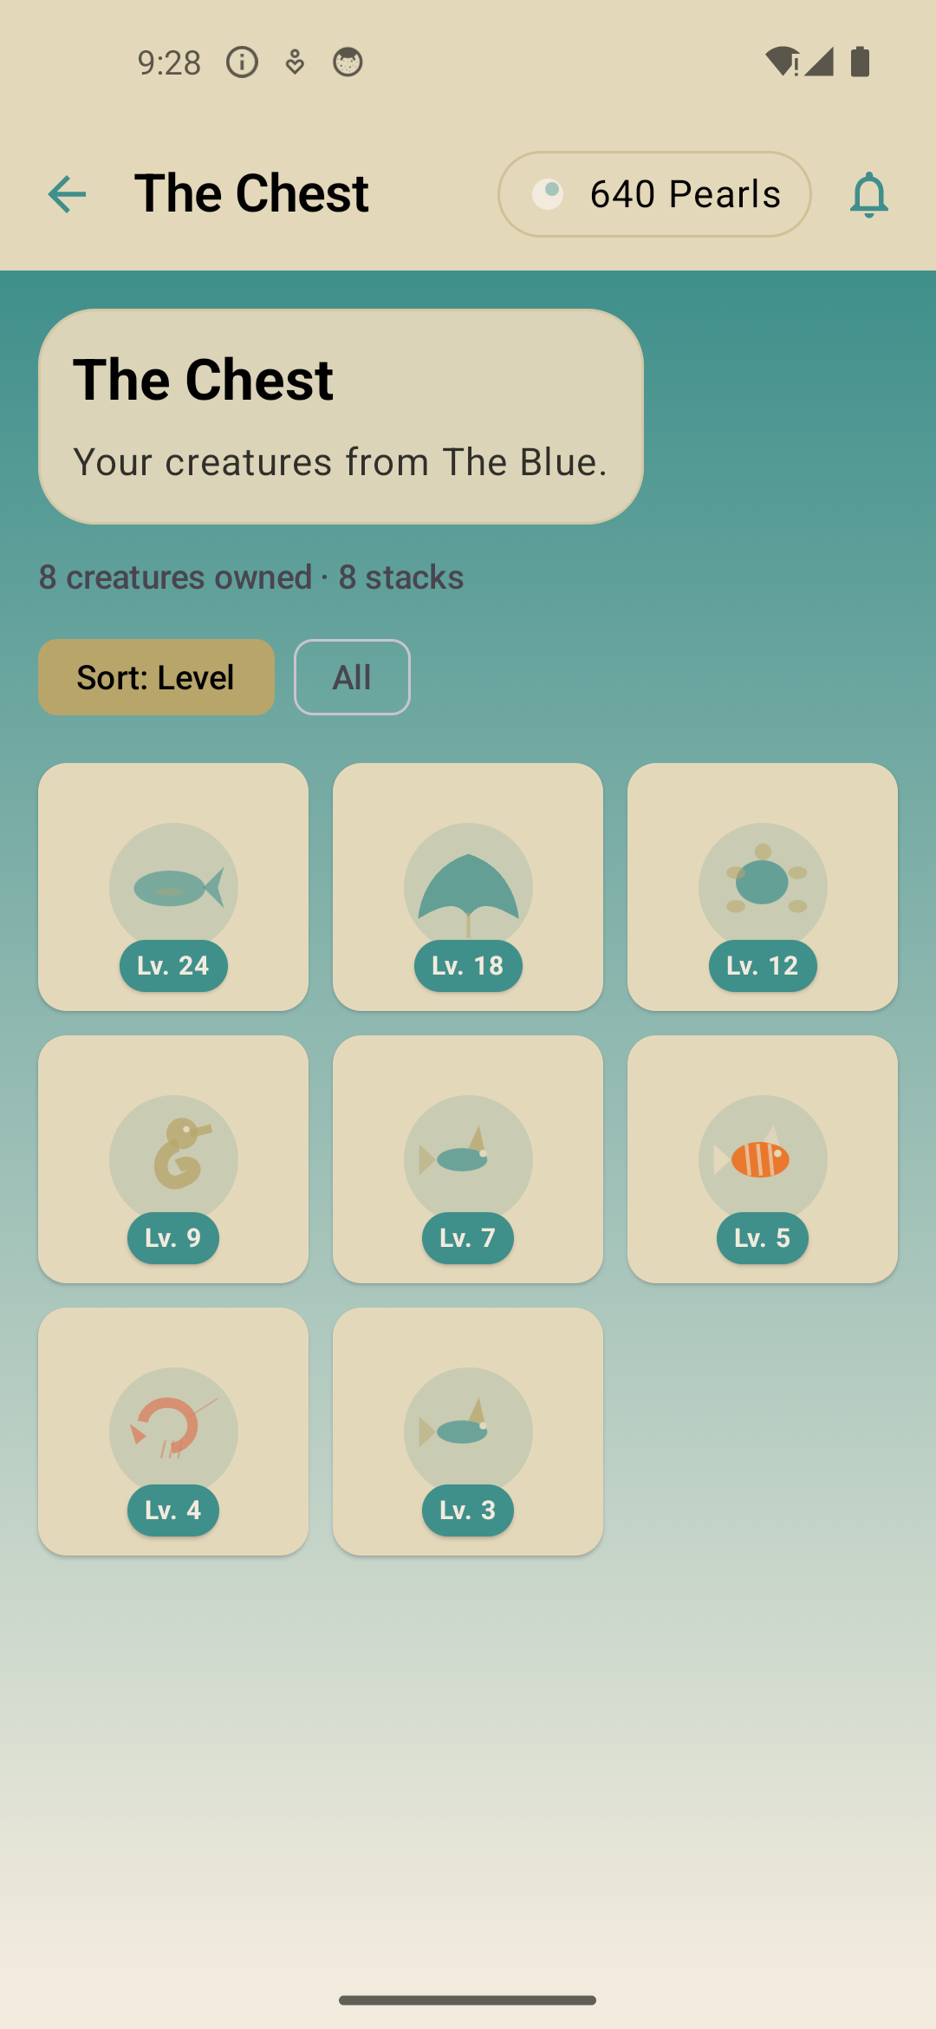
14 / COLLECTION
Every creature retains the story of how it arrived
The Chest makes ownership operational; detail views preserve provenance and growth state.
PROVENANCE
Created by a real Flow
Creature detail connects species, zone, level, age, and Pearl value back to the session that generated it.
INVENTORY
Collect, sort, grow, place, release
The Chest supports filtering and progression actions, giving collection depth beyond a static gallery.
Creature detail
The Chest
Notes:
Open a creature from The Blue or the Chest and emphasize the provenance line linking the reward to a completed Flow.
[Sources]
- Scyra Android app, locally captured on an Android emulator from the Scyra Debug build, 2026-08-19.
[/Sources]

Slide 15
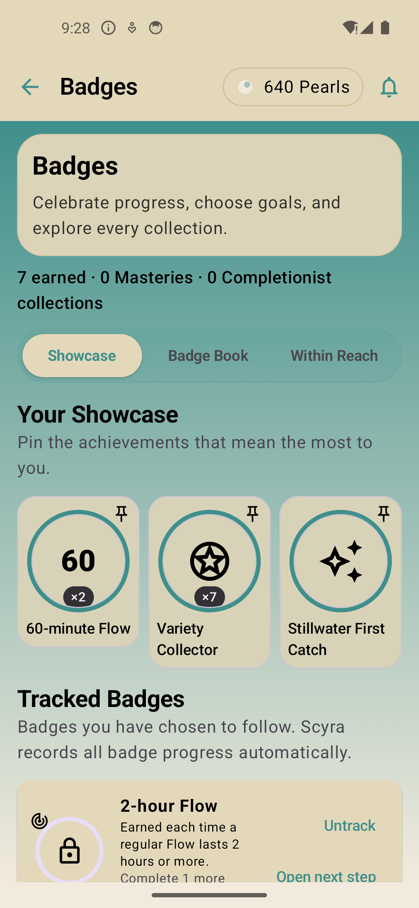
15 / MASTERY
Badges make progress legible before and after mastery
Users can pin, track, showcase, and browse what is within reach.
01
Showcase
Pin earned badges so mastery becomes identity, not just a hidden counter.
02
Track
Choose an in-progress badge such as a two-hour Flow and keep the next milestone visible.
03
Explore
Badge Book, Within Reach, collections, and celebration states create multiple discovery paths.
The system recognizes duration, variety, collection, Stillwater participation, and other forms of engagement.
Badge showcase
Notes:
Badges cover more than streaks. Point out duration, variety, collection, and Stillwater achievements in the populated showcase.
[Sources]
- Scyra Android app, locally captured on an Android emulator from the Scyra Debug build, 2026-08-19.
[/Sources]

Slide 16
16 / SYSTEM
The breadth resolves into four coherent value layers
This is the complete feature map represented in the walkthrough.
01
02
03
04
Act
Remember
Plan
Return
Flow • Soft Flow • Surge
Journey tagging • Live runtime
Pulse during Flow • Arc continuation
Story • Sagas • Chronicles
Text • Audio • Photo • Video
Day/Week/Month analytics
Paths • Planned Flows • Arcs
Five-step Studio • Suggested Scenes
ScratchPad • Idea Grove
Shell • Pearls • Lookout • Voyage
Focus Room • Stillwater • The Blue
Chest • Creatures • Badges
One data spine: sessions, journeys, reflections, plans, rewards, and collection state reinforce each other.
Notes:
Use this as the completeness check. Every named feature in the app belongs to one of four user-facing value layers.
[Sources]
- Scyra Android app, locally captured on an Android emulator from the Scyra Debug build, 2026-08-19.
[/Sources]

Slide 17
17 / LIVE DEMO
A five-minute demo can show the entire product promise
Follow the natural product loop and end in the world that makes progress memorable.
→
→
→
→
1
Start
2
Focus
3
Reflect
4
Reward
5
Return
Open Story, choose a journey, start a Flow.
Show live time, Surge, and Pulse capture.
Open Chronicle and show media choices.
Complete the Flow and swipe the reveal.
Enter The Shell and descend into The Blue.
Optional coda: open Paths to show that the next session is already plan-able.
Notes:
Use this exact route for a concise stakeholder demo. It shows action, reflection, reward, and retention without getting trapped in menus.
[Sources]
- Scyra Android app, locally captured on an Android emulator from the Scyra Debug build, 2026-08-19.
[/Sources]

Slide 18
SCYRA
A productivity system
users can inhabit
Focus creates evidence. Evidence creates meaning. Meaning creates a reason to return.
Decision to advance
Align on the live-demo story, target audience, and next validation milestone.
Notes:
Close by resolving the opening: the product is a continuous system that turns intentional time into a world users can revisit. Invite alignment on the next validation milestone.
[Sources]
- Scyra Android app, locally captured on an Android emulator from the Scyra Debug build, 2026-08-19.
[/Sources]

