Slide 1
Healthy Heart
By Ponni Rajasree.

Slide 2
Introduction
The heart is an organ that pumps blood throughout the body. We keep it in healthy and safely.
The main aim is we must prevent or control the heart diseases.
Based on the dataset the target vector is prediction the class, so heart disease is the target.
The data set having 918 rows and 10 columns.
In heart disease ‘0’ means no heart problem. ‘1’ means having heart problem.
These slides to determine the factors we need to investigate and how we can be able to reduce or recover the disease.
Data is visualized in simpler and easy way to understand.

Slide 3

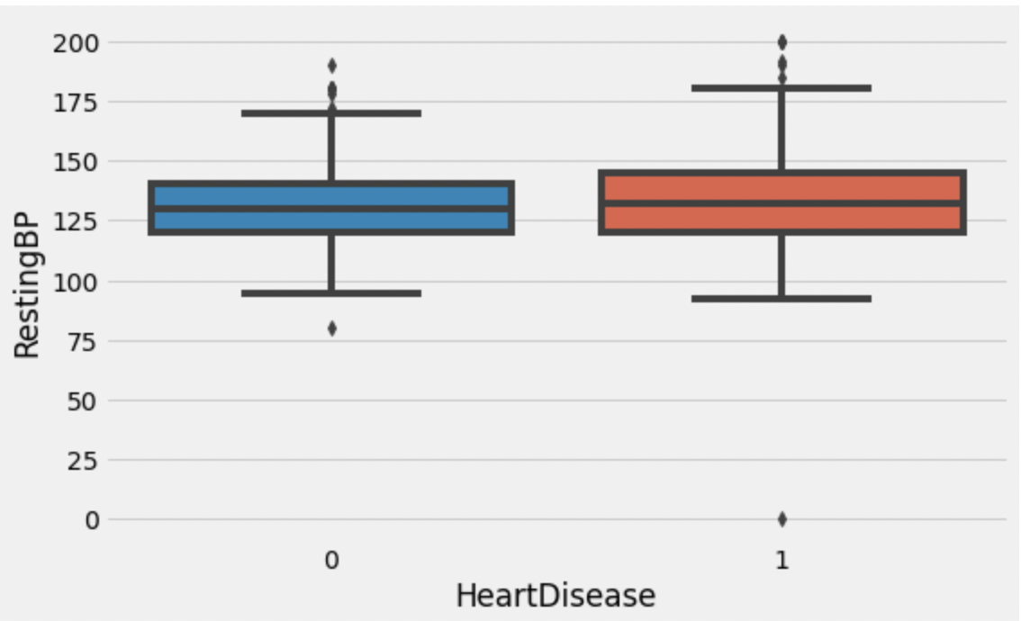
Based on this boxplot people who are having heart disease they are also having BP.
Bp can damage your arteries by making them less elastic, which decreases the flow of blood and oxygen to your heart.

Slide 4


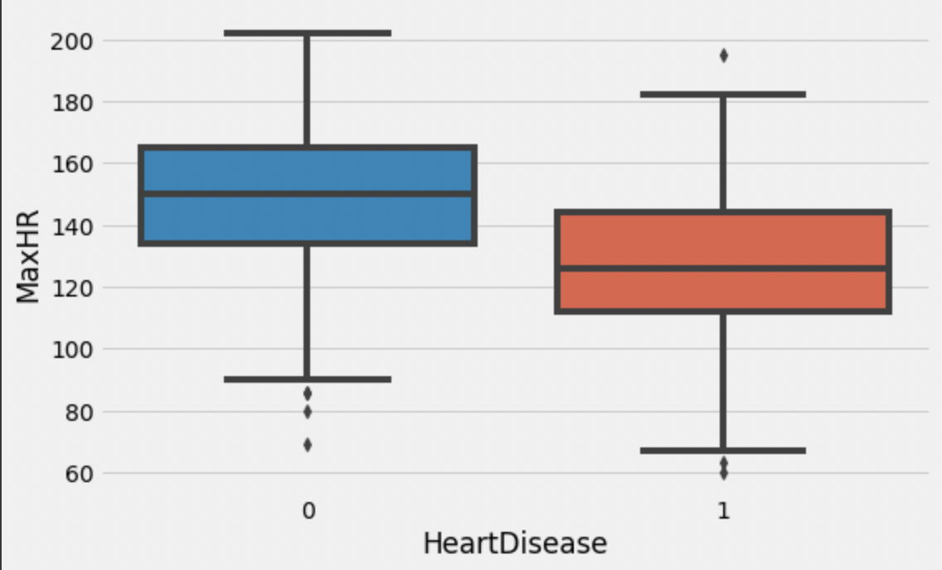

Maximum heart rate based on our ‘Age’. Maximum heart rate is around 220 beats per minute.
In this data, who are having MaxHR rate there are not having heart diseases. Because these are inversely proportional to each other.

Slide 5
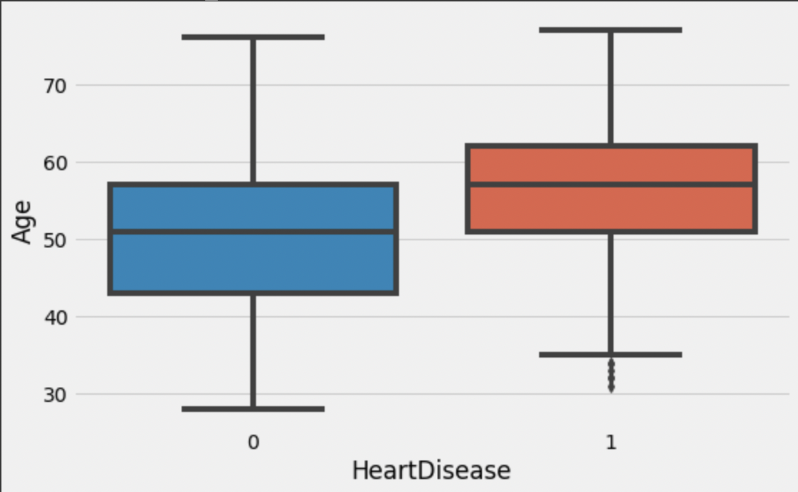
Age plays main key role in any diseases.
We should Know one thing that is who are in above 50 or 55 there are having heart problems.

Slide 6
Models and accuracy
KNN Model: Training Accuracy = 86.9565 ; Testing Accuracy = 89.0988
Logistical Regression Model: Training Accuracy = 86.9565 ; Testing Accuracy = 86.7732
XGB Classifier: Training Accuracy = 93.8953 : Testing Accuracy = 81.7391

Slide 7
Best Model
Based on the dataset I prefer two are the best models
KNN classifier and logistical regression are best models in my view.
Comparatively these two are good at test scores.
These scores are less overfitting, better scores for the test than another algorithm.
I recommended KNN and Logistical Regression for this dataset.

Slide 8
Thank You

