Slide 1
Sales Prediction Data
By Ponni Rajasree.

Slide 2
Trending Figures
Based on the given Sales prediction Data, I have come up with brief slides to show how the current trending of Sales with the Items types and the store types.
These slides to determine the factors we need to look into and how we can be able to improve the total number of sales.
Data is visualized in simpler and easy way to understand.

Slide 3

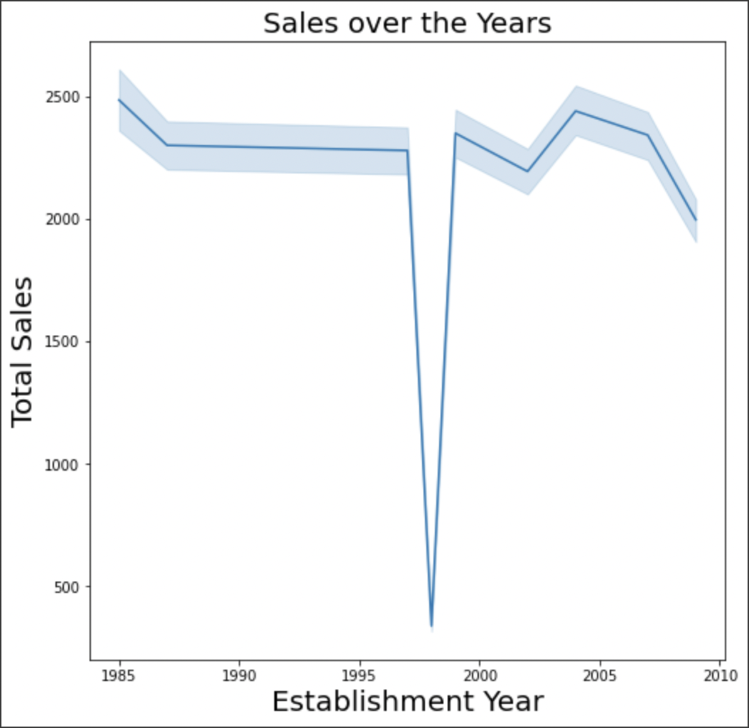
Based on the data the sales between 1995 – 2000 are low.
We may need to investigate this trend and see how this CANNOT happen again.

Slide 4


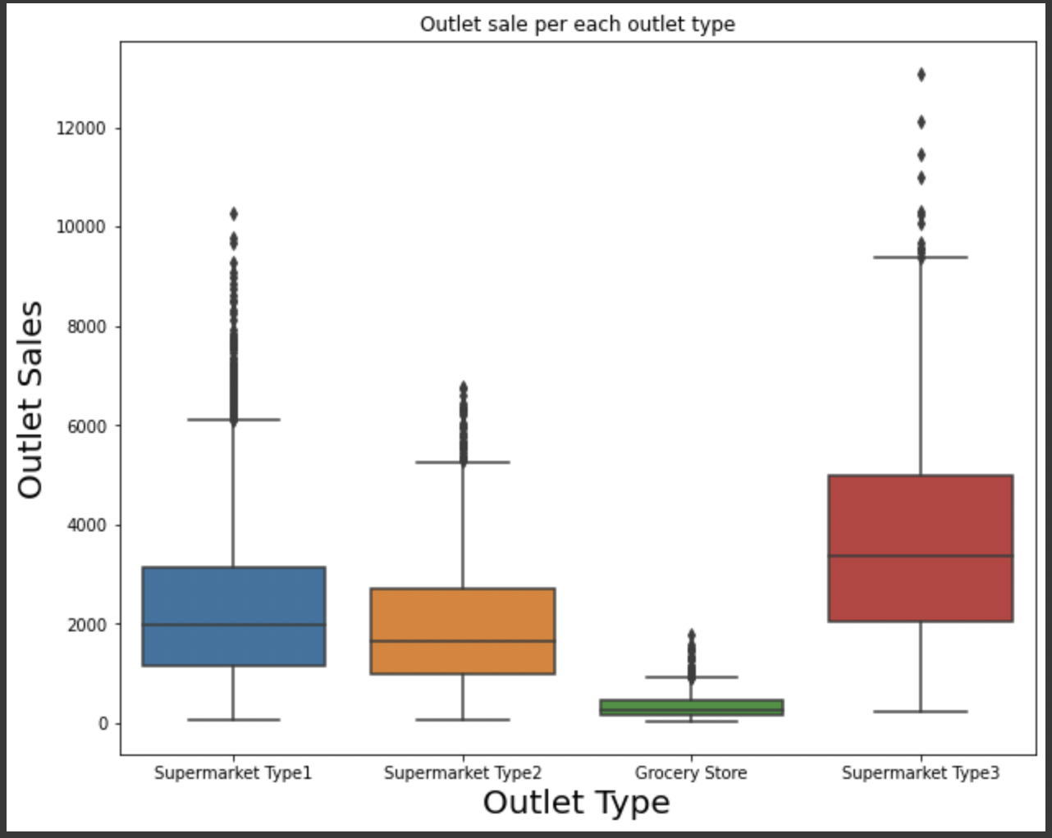

Based on the data the sales for the Grocery Store types are bad and the Supermarket Type 3 types are Good.
We need to focus on the Grocery store types to improve the sales by providing the similar type of resources like the high sales Type.

Slide 5
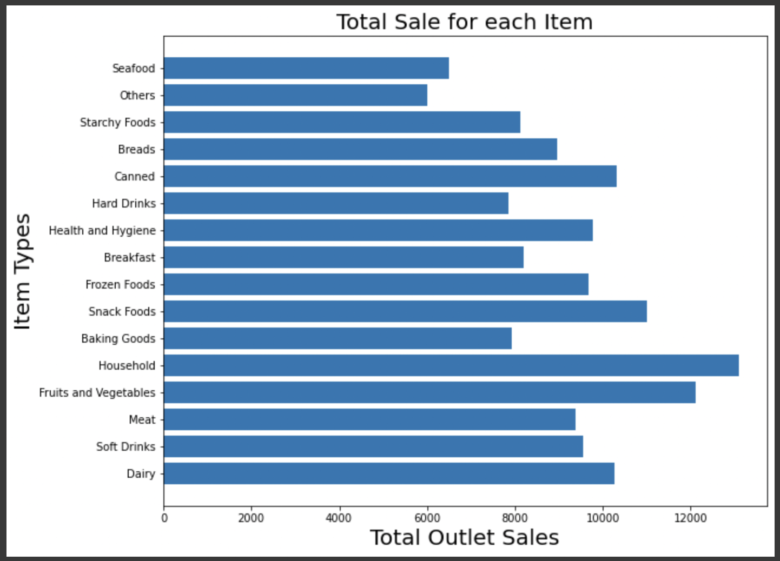
Bases in the given data the Household and Groceries (Fruits and Vegetables) Types are having good number of sales where as the ‘Others’ and ‘Seafood’ types are pretty low in all outlets.
We should reconsider our approach on whether to sell the items that are having low sales on scaling down the number of quantity or stocks and compensate them with a greater number of high sale items.

Slide 6
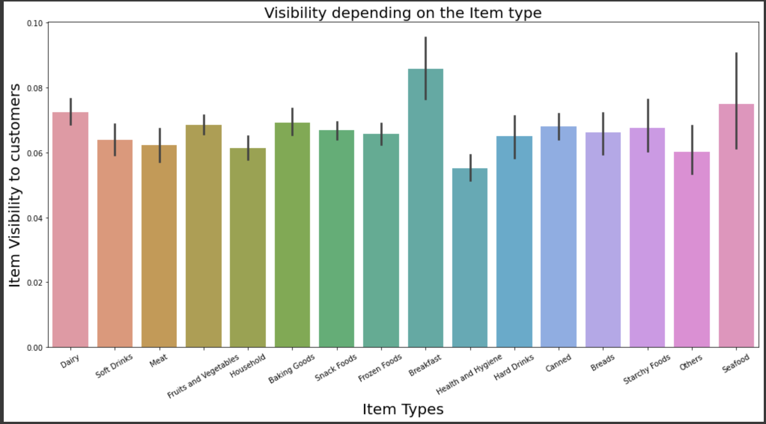
Based on the given data, The overall trend on Employee with high Attrition Data is with the low “Monthly Rate” compared to any other factors.
If we try to increase the ”Monthly Rate” of the employees with the high Attrition rate, those employees might get retain.

Slide 7
Visibility is critical on to increase/balance our sales on each item.
If any item is not marked clearly or not an easy way to locate them, customer may lose patience and skip buying that product or item.
Based on the visibility data, most of Item’s visibility is good, however we should push more on the “Others” item type along with “Health and Hygiene which can improve our sales.
Our sales are also pretty good on ”Household” and “Food and Vegetable” item types, we should consider to have them more visibility to the customers which can bump our sales on these items.

