Slide 1
Operations Notes
A place to keep deployment checks and incident fixes.
Rajasurya J · 24BCS10086

Slide 2
Why I built it
A deployment needs more than a working homepage.
I wanted one small application to practise testing, releasing, monitoring and recovering a service.
The notes make the result visible: create a note, update it and confirm the data stays saved.

Slide 3
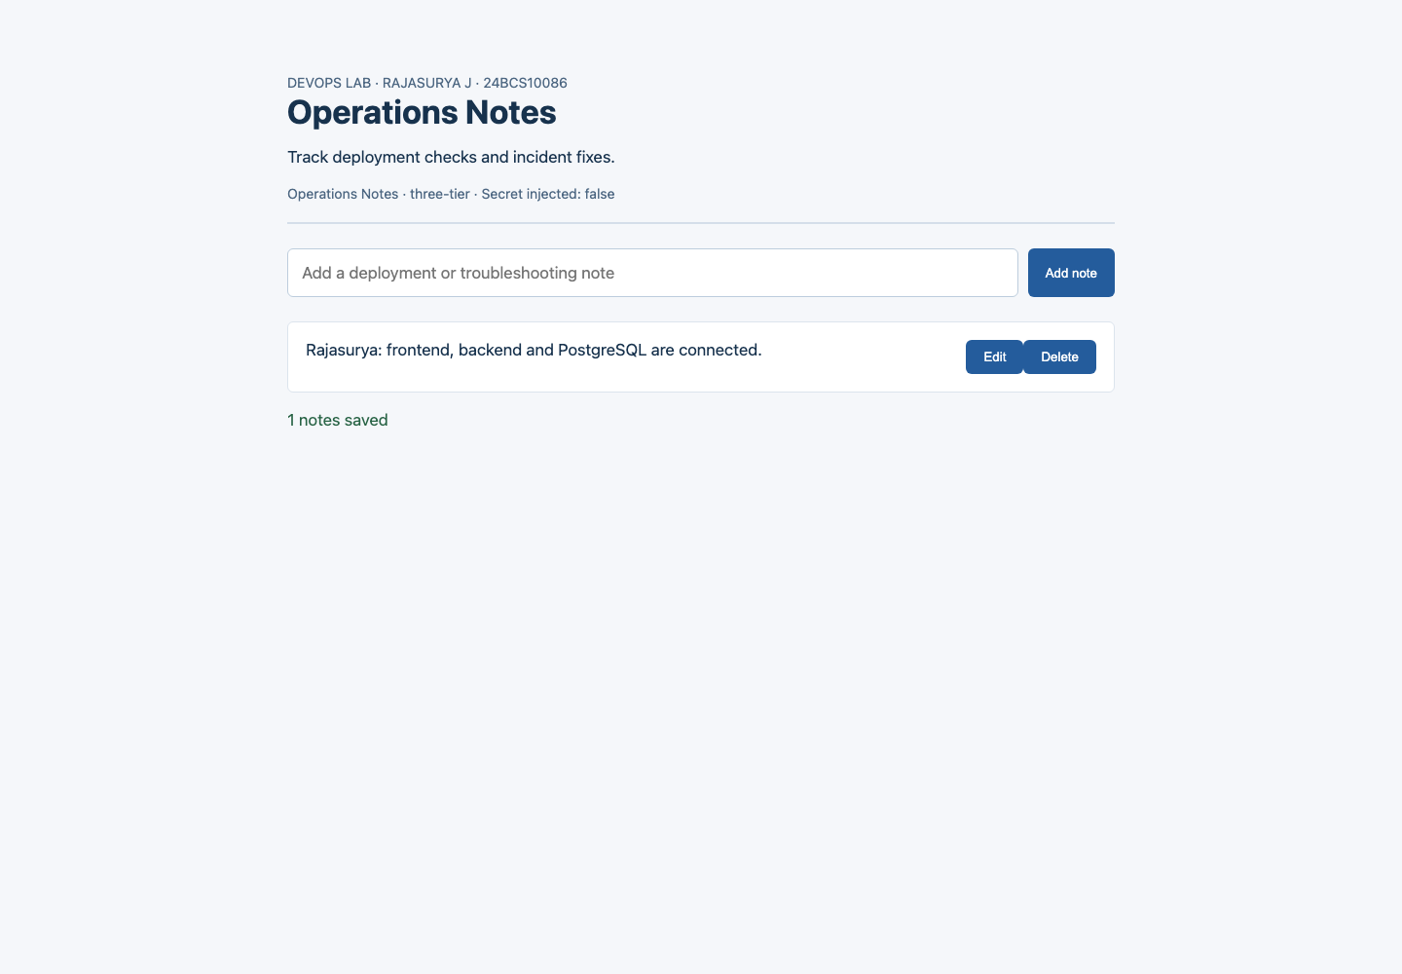
Using the application
Add a deployment note.
Edit it when the status changes.
Remove notes that are no longer needed.

Slide 4
The three application layers
Frontend: the page people use in their browser.
Backend: checks requests and handles adding, editing and deleting notes.
Database: PostgreSQL keeps the notes after the application restarts.
Docker Compose connects these three services on my laptop.

Slide 5
How a release reaches Kubernetes
I commit the code and push it to GitHub.
The pipeline runs backend tests and security checks.
It builds and scans separate frontend and backend images, then publishes them to the registry.
Helm installs the three services in Kubernetes and the pipeline checks the API.

Slide 6
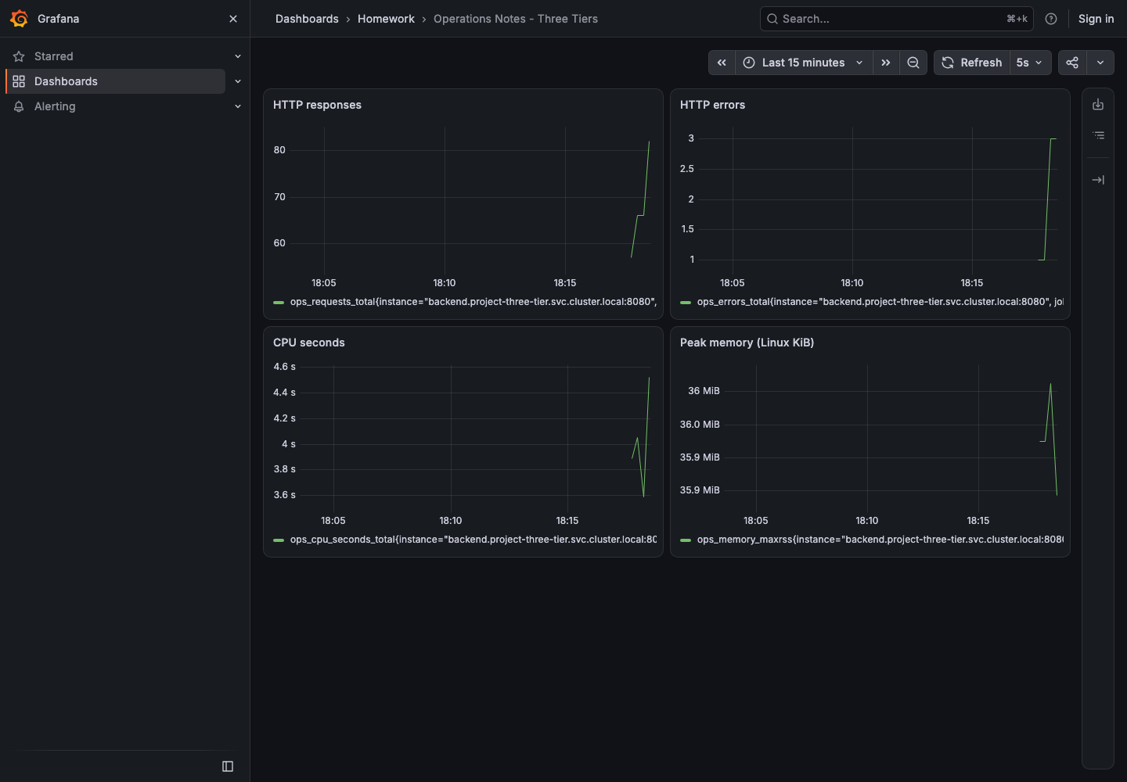
Checking the application
The backend has 13 tests, run with SQLite and PostgreSQL.
Health checks show whether the process and database are available.
Prometheus collects metrics; Grafana makes them easier to inspect.

Slide 7
Finding and fixing problems
A wrong Service selector removed the backend connections. I checked endpoints and restored the selector.
A missing image stopped replacement Pods. I inspected Events and restored the tested image.
A wrong readiness URL kept Pods out of traffic. I corrected the probe and checked HTTP responses.

Slide 8
What I learned
Test the API and the stored data, not just the homepage.
Keep database startup separate from application health.
Use security checks before publishing an image.
Use GitOps to compare the running configuration with Git and repair drift.
The Terraform files describe cloud infrastructure; the current project checklist requires configuration only.

Slide 9
Project deliverables
Code, Dockerfiles, Compose, Helm, tests and pipeline are in devops-heros.
The README explains setup, API endpoints and troubleshooting with screenshots.
This presentation gives the overview; the README contains the technical details.
github.com/rajasurya-rjs/devops-heros

