Slide 1


Effective Malaria Detection using a CNN Model
Department of Electronics and Communication Engineering
Guided By: Dr. Dilip Kumar Choubey
(Assistant Professor, Computer Science and Engineering)
Arju Aman (170102009)
Rajat Deoli (170102035)

Slide 2
Contents
Introduction
Problem Statement
Motivation
Contributions of Research
Literature Survey
Proposed Model
Constraints
Result and Discussion
Conclusion
Future Direction
References

Slide 3
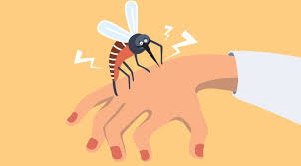
Introduction
Malaria is a serious and a life-threatening disease caused by plasmodium parasites that are transmitted to people through the bites of infected Anopheles mosquitoes. Malaria poses a huge burden on the health of the world, with about 200 million people suffering worldwide and more than 400,000 deaths per year.
It is one of the most common disease in the world. In particular children, pregnant women, patients with other health condition like HIV/AIDS and travelers who have no prior exposure to malaria are more . In addition to biomedical research and political endeavors, modern information technology is also playing an important role in many attempts to fight this disease.
The World Health Organization (WHO) carries out a program to control malaria on a global scale, focusing on health care, early diagnosis of the disease, early treatment, and prevention of disease.

Slide 4
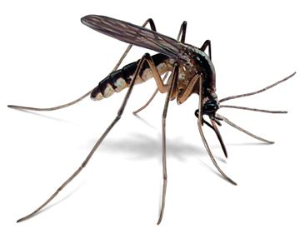
When a Plasmodium infected female mosquito bites a person who has malaria, it drinks the person’s blood, which contains the Plasmodium parasites. When the mosquito bites another person, it injects the parasites into that person and make their way into the bloodstream and head to the liver. From the liver the infection spread to Red blood cells and that's when a human body start showing symptoms. That’s how the disease spreads.
Also, transmission is more in places where the mosquito lifespan is longer than expected as the parasite has time to complete its development inside the mosquito and there they prefer to bite humans rather than other animals.
It also depends on climatic conditions that may affect the number, life span and the survival of mosquitoes, such as rainfall patterns, temperature and humidity.

Slide 5
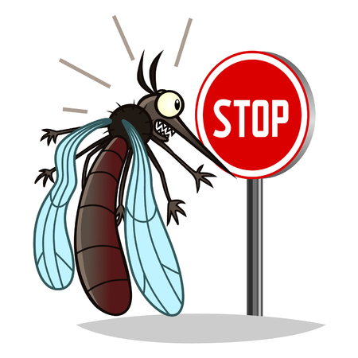
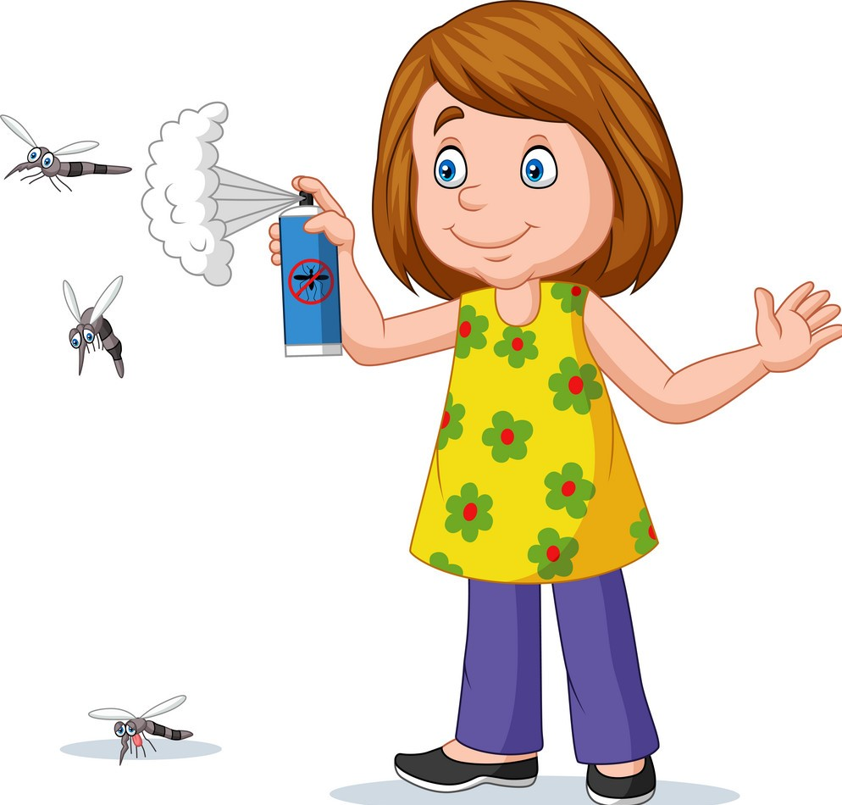
To protect from mosquito bites, one should:
Always cover your body parts. Wear pants and long-sleeved t-shirts and shirts. Try to cover most of your body parts with clothes.
Apply insect repellent to body parts that are not cover. Use only those insect repellents registered with Environmental Protection Agency. Never use a spray directly on your face.
Apply repellent to clothing. Sprays containing permethrin are safe and can be applied to clothing.
Sleep under a mosquito net. In particular, those treated with insecticides help prevent mosquito bites while you are sleeping.
Try to be in an air-conditioned room. If your room isn’t air-conditioned, keep the fan always switched on. Mosquitoes are less active in circulating air.

Slide 6
Problem Statement
The most common method of diagnosing Malaria, which is one of the most serious and life-threatening disease in the world, is to have a qualified technician visually inspect the blood smear under a microscope. Diagnosis by this method relies on experience and knowledge of person conducting the experiment. Through modern deep learning tools, we aim to automate this process as manual processes are time consuming and prone to human error. Our model should be also leave scope for future training with more data and could be also used as an application on smartphones.

Slide 7

Motivation
Malaria poses a huge burden on the health of the world, with about 200 million people suffering worldwide and more than 400,000 deaths per year. While there have been a lot of approaches to minimize the fatalities caused by this disease, early detection is considered the best step towards effective treatment. Classification technique plays a significant role in medical imaging. Most recent research relies on quantitative information, such as size, shape, and the ratio of the affected cells. Computer vision methods are employed to elicit information from medical images, such as the detection of infected cells. This will be very helpful for the society.

Slide 8
Contributions of Research
More affordable treatment: Diagnosis is faster and more accurate with automation. Doctors will be able to recommend the right treatments to patients or intervene appropriately before illnesses aggravate leading to more expensive treatment options.
Safer solutions: More accurate diagnosis means there will be a lower risk of complications associated with patients receiving ineffective or incorrect treatment.
More patients treated: A reduction in the time it takes to complete a diagnostic analyses means laboratories can perform more tests. This will lead to coverage for more patients within shorter duration.

Slide 9
Literature Survey
The performances of LeNet-5 [1], AlexNet [2] and GoogLeNet [3] were evalauted by Dong et al., which are the three most famous Convolutional Neural Networks [4]. They also trained an SVM classifier for comparison purposes and they arrived at the fact that CNN is advantageous over SVM in terms of the capacity of learning image features automatically.
Morphological factors were relied upon by Linder et al[5,6] for feature extraction, and then Principal Component Analysis (PCA) [7] and SVM were used for classification purpose. However, compared with the latest research techniques based on deep learning, the accuracy achieved by these types of models is lower.

Slide 10
Rajaraman et al.[8] used a previously trained CNN-based deep learning model to implement a feature extractor for sorting parasitic and uninfected blood cells to facilitate disease recognition. The research uses experimental methods to identify the best model layer using basic data. The CNN model has two fully connected dense layers and three convolutional layers. Measure the performance to extract characteristics from parasitic and uninfected blood cells with VGG-16, AlexNet, Xception, DenseNet-121 and ResNet-50.
Liang et al. [9] reported that with their 16-layer CNN model, its detection accuracy was 97.37%, and claimed that their model is better than the transfer learning model.
Hung et al.’s model was previously trained in Imagenet [10], but adjusted based on its own data to detect malaria parasites [11].
Quinn et al. [12] showed off the 3D printable design of the adapter to connect the smartphone to the microscope, although all the images in the experiment were taken with a dedicated microscope camera, which provides a higher pixel resolution than their smartphone camera. They proposed a workflow for automatic analysis of thick blood smears, which involves the calculation of morphological and moment features and a tree classifier trained on these features to distinguish normal plaques and normal plaques containing parasites . The performance they report is 97% of the area under the receiver operating characteristic curve.

Slide 11
Proposed Model
Here we take this data set from NIH (national institute of health) that has cell images of malaria. This page hosts a repository of segmented cells from the thin blood smear slide images from the Malaria Screener research activity. The dataset contains a total of 27,558 cell images with equal instances of parasitized and uninfected cells.
The dataset set contain all the images in a directory cell images. These images are categories in 2 parts Parasitized and Uninfected. In this directory there are two more directories Parasitized and Uninfected. Both directories contain 13,780 images according to their category. We have taken 11,024 of each category to train our model (22048 training images) and 2,255 of each category for validation (5510 validating images).That means we split our data set in 80% training and 20% validation.
Here we use artificial neural network to build our model

Slide 12
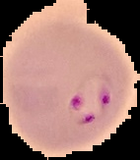
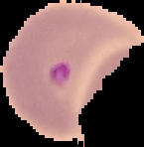


<= Parasitized (Infected) Cell>
Unparasitized Cell =>

Slide 13
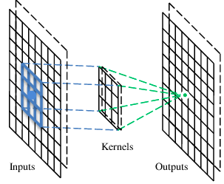
Neural network forms a base of deep learning which is a sub field of deep learning where algorithms are inspired by human brain. Neural network takes in data and train themselves to recognize pattern in the data and predicts the output for a new set of similar data.
Here we build a neural network called convolutional neural network. A CNN is a neural network with some convolutional layers (and some other layers). A convolutional layer has a number of filters that does convolutional operation.
These convolutional layers are able to detect patterns.This pattern detection is what makes CNN so useful for image analysis.

Slide 14
Parasite Images into Train and Validation set
Preprocessing
Feature Engineering
Building the CNN model
Compile and save model
Classify
<= Images are split in a randomized manner in 4:1 ratio for train:test respectively
<= Converted all images into 64x64x3 dimension
<= Tensorflow’s ImageDataGenerator method allows us to rotate, rescale, flip and fill in one go
<= Built the model as shown in the next slide
<= Model is trained for 50 epochs and saved as a pickle file
<= Sigmoid activation function in final layer classifies the cell image as infected or uninfected

Slide 15
Here is what the representation of our model looks like:
Input Image 64x64 x3
Convolution 1 16 Filter (3x3)
Activation function Relu
Batch Normalization ( )
Max Pooling (2x2)
Convolution 2 32 Filter (3x3)
Activation function Relu
Batch Normalization ( )
Max Pooling (2x2)
Activation function Relu
Convolution 3 64 Filter (3x3)
Batch Normalization ( )
Batch Normalization ( )
Max Pooling (2x2)
Convolution 4 128 Filter (3x3)
Activation function Relu
Batch Normalization()
Max Pooling (2x2)
Dropout (0.5)
Fully Connected 1 NM (1024)
Batch Normalization ( )
Dropout (0.5)
Fully Connected 2 NM (512)
Dropout (0.5)
Fully Connected 3 NM (2)
Activation Function Sigmoid
Classifier ()

Slide 16
User will upload image
In background, it’ll be pre-processed into the format on which the model is trained
Model converted into TensorFlow Lite model.
Output shown to user!
We use Tensorflow framework and Keras to create model. We use CNN model to classify images between these 2 category.
We use 4 convolution layer and Max pooling layer using activation function ReLu. In between we use batch normalization and dropout layer to remove random node from the neural network.
Later we compile our model with loss function ‘Binary cross entropy’ with optimizer ‘Adam’.

Slide 17
Constraints
One of the major constraint during the implementation of project was the geographical limitation of images. The images are from Chittagong Medical College Hospital Bangladesh, which might have different climatic condition than any other place. Therefore there is a chance that findings are not geographically independent.

Slide 18
Result and Discussion
Our proposed model has an accuracy of 96.39%
The precision of the model is 95%
The recall is 98%
The F1-score is 96%
The confusion matrix is attached on the next slide:

Slide 19
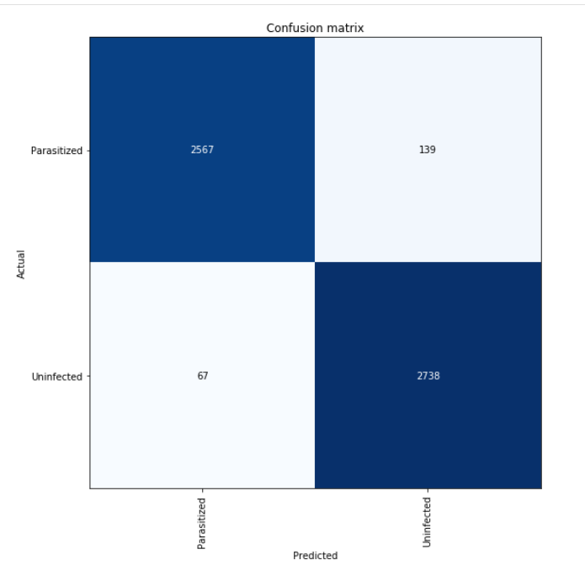
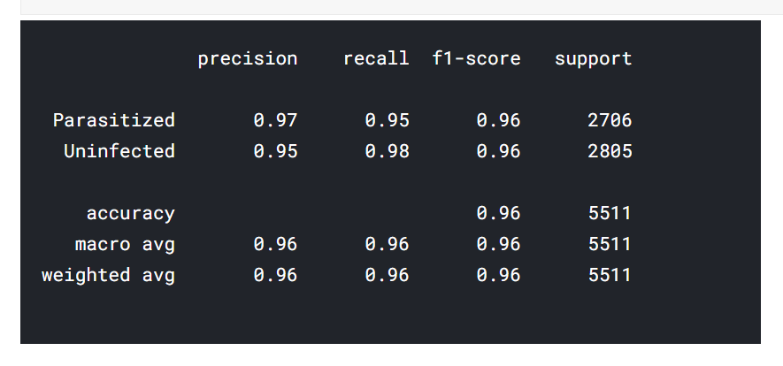

Slide 20
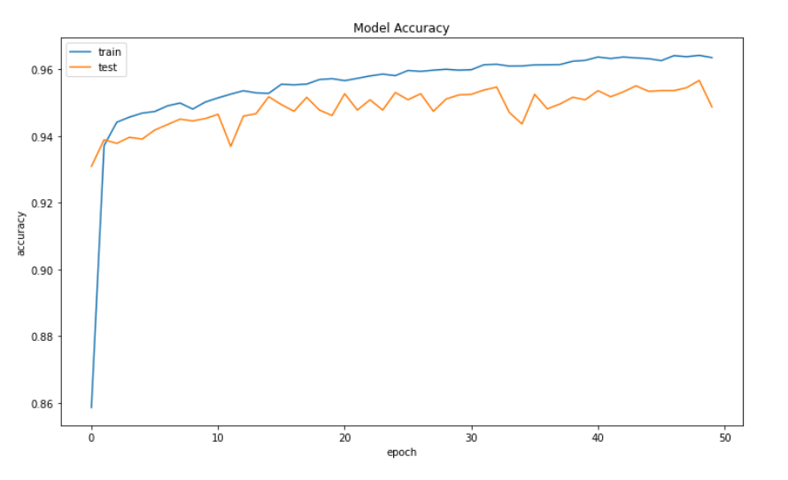
The accuracy can be seen from the following curve:

Slide 21
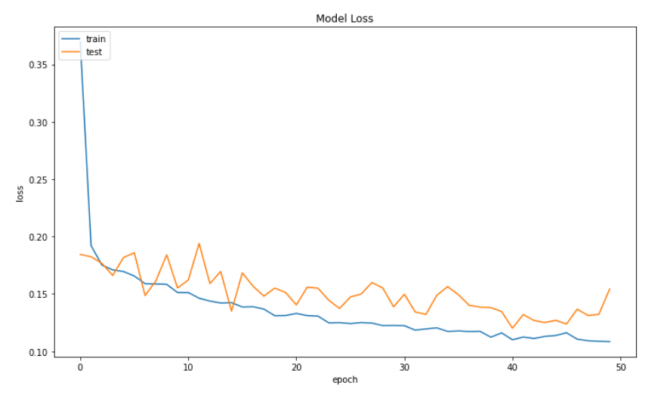
The loss function can be visualized as:

Slide 22
Conclusion
­­­­­­Algorithm | Accuracy | Precision | Recall | F-Score
Proposed Model | 0.9636 | 0.95 | 0.98 | 0.96
Ada Boost | 0.962 | 0.729 | 0.526 | 0.611
Decision Tree | 0.946 | 0.526 | 0.529 | 0.527
KNN | 0.940 | 0.465 | 0.278 | 0.348
Linear Regression | 0.943 | 0.375 | 0.000 | 0.000
Naïve Bayes | 0.858 | 0.271 | 0.873 | 0.414
Random Forest | 0.965 | 0.775 | 0.553 | 0.645
Extra Trees | 0.956 | 0.837 | 0.298 | 0.440
SVM | 0.7889 | - | - | -
When doing the performance measure of our proposed work for malaria detection using classical machine learning algorithms­­, we can see that our model performs superiorly than other classical ones.

Slide 23
Future Direction
There are way too many manual works in medicine. Even for physicians, it is difficult to determine any disease from some raw data, which is why many healthcare industries are turning towards machine learning and deep learning technology to determine disease. With these types of advanced analytics, we can provide physicians with better information while caring for the patient.
Deep learning is going to benefit the practitioner or internist at the bedside. Deep learning can provide objective feedback to improve efficiency, reliability, and accuracy.
Models like the one proposed in our project will serve as tools that medical practitioners will use to improve the ongoing facilities in the malaria detection domain, as well as other similar domains.
Since the dataset is ever increasing in real time, our model can be further trained on large volumes of data and on better systems with high computational powers and thus accuracy and efficiency can be further boosted.

Slide 24
References
1. LeCun Y. Lenet-5, Convolutional Neural Networks. [(accessed on 20 May 2015)]; URL. Available online: http://yann.lecun.com/exdb/lenet.
2. Krizhevsky A., Sutskever I., Hinton G.E. Imagenet classification with deep convolutional neural networks; Proceedings of the Advances in Neural Information Processing Systems; Lake Tahoe, Nevada. 3–6 December 2012; pp. 1097–1105.
3. Szegedy C., Liu W., Jia Y., Sermanet P., Reed S., Anguelov D., Erhan D., Vanhoucke V., Rabinovich A. Going deeper with convolutions; Proceedings of the IEEE Conference on Computer Vision and Pattern Recognition; Boston, MA, USA. 7–12 June 2015; pp. 1–9.
4. Dong Y., Jiang Z., Shen H., Pan W.D., Williams L.A., Reddy V.V., Benjamin W.H., Bryan A.W. Evaluations of deep convolutional neural networks for automatic identification of malaria infected cells; Proceedings of the 2017 IEEE EMBS International Conference on Biomedical & Health Informatics (BHI); Orlando, FL, USA. 16–19 February 2017; pp. 101–104.

Slide 25
5. Linder N., Turkki R., Walliander M., Mårtensson A., Diwan V., Rahtu E., Pietikäinen M., Lundin M., Lundin J. A malaria diagnostic tool based on computer vision screening and visualization of plasmodium falciparum candidate areas in digitized blood smears. PLoS ONE. 2014;9:e104855. [PMC free article] [PubMed]
6. Opoku-Ansah J., Eghan M.J., Anderson B., Boampong J.N. Wavelength markers for malaria (plasmodium falciparum) infected and uninfected red blood cells for ring and trophozoite stages. Appl. Phys. Res. 2014;6:47.
7. Wold S., Esbensen K., Geladi P. Principal component analysis. Chemom. Intell. Lab. Syst. 1987;2:37–52
8. S. Rajaraman, S. K. Antani, M. Poostchi et al., “Pre-trained convolutional neural networks as feature extractors toward improved malaria parasite detection in thin blood smear images,” PeerJ, vol. 6, article e4568, 2018.
9. Liang Z., Powell A., Ersoy I., Poostchi M., Silamut K., Palaniappan K., Guo P., Hossain M.A., Sameer A., Maude R.J., et al. Cnn-based image analysis for malaria diagnosis; Proceedings of the 2016 IEEE International Conference on Bioinformatics and Biomedicine (BIBM); Shenzhen, China. 15–18 December 2016; pp. 493–496.

Slide 26
10. Deng J., Dong W., Socher R., Li L.J., Li K., Fei-Fei L. Imagenet: A large-scale hierarchical image database; Proceedings of the 2009 IEEE Conference on Computer Vision and Pattern Recognition; Miami, FL, USA. 20–25 June 2009; pp. 248–255.
11. Hung J., Carpenter A. Applying faster r-cnn for object detection on malaria images; Proceedings of the IEEE Conference on Computer Vision and Pattern Recognition Workshops; Honolulu, HI, USA. 21–26 July 2017; pp. 56–61.
12. J.A. Quinn, A. Andama, I. Munabi, F.N. Kiwanuka Automated blood smear analysis for mobile malaria diagnosis Mobile Point Care Monitors Diagno Device Design, 31 (2014), p. 115

Slide 27
THANK YOU

