Slide 1
Demo On Query Optimization
By Rajat Gupta

Slide 2
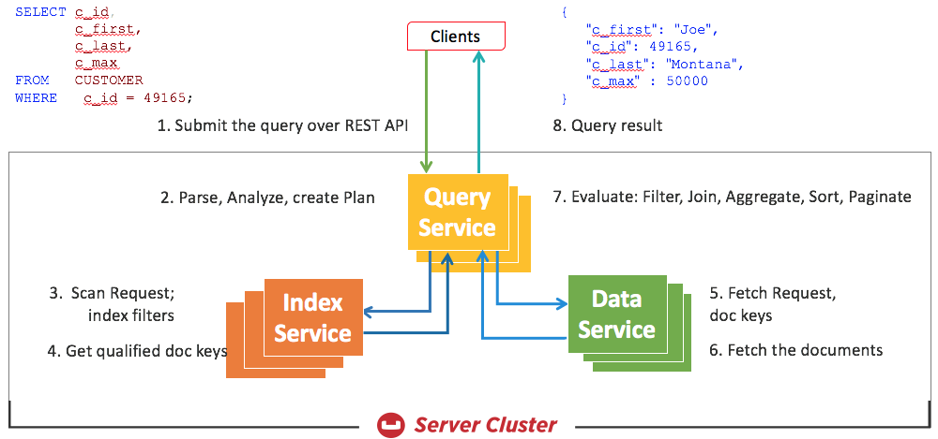
Flow Of Query In Couchbase

Slide 3
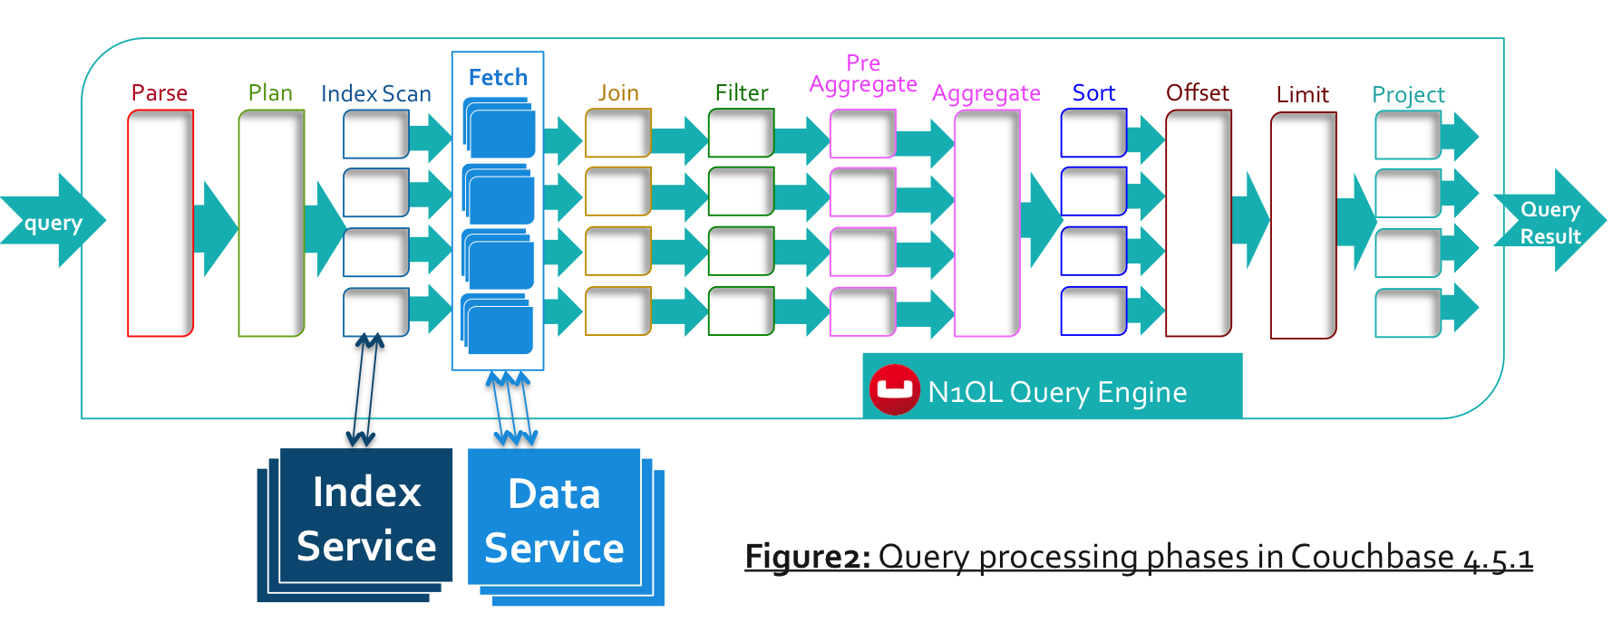
Query Processing In Couchbase

Slide 4
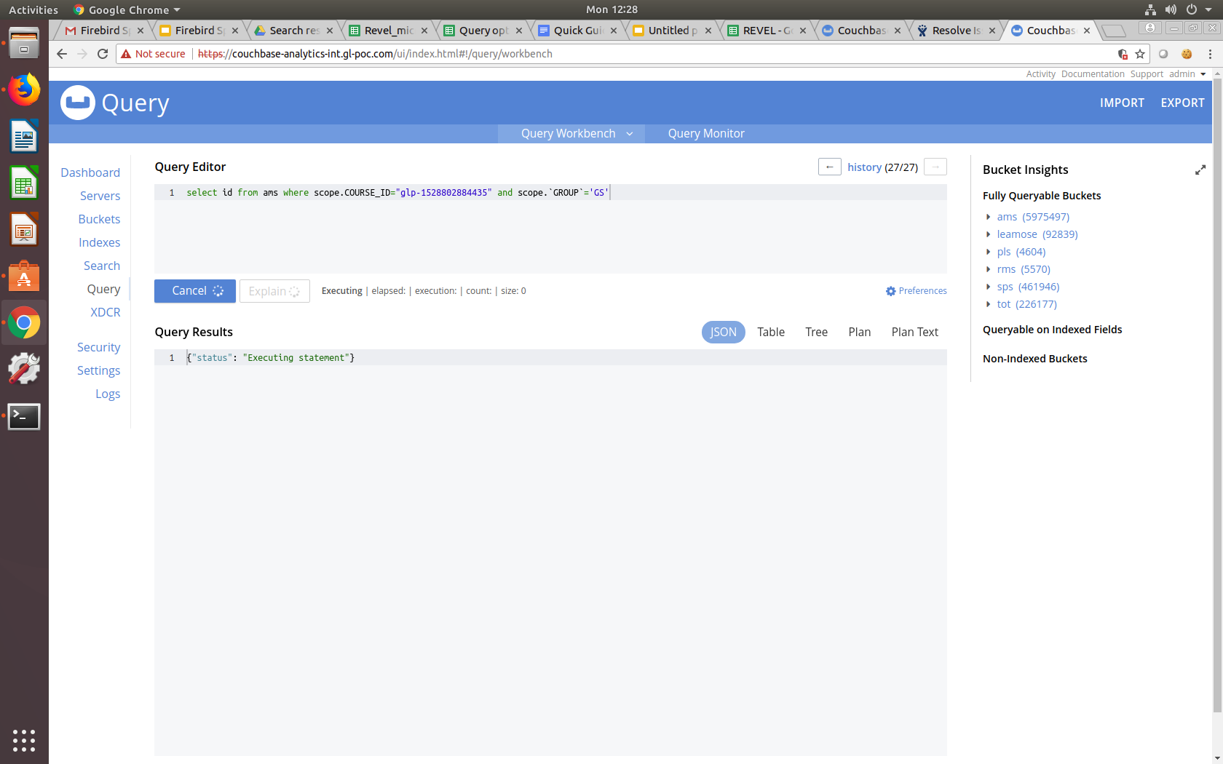
Unoptimized Query
Earlier this query was taking more than 5 minutes to be executed and yet it was being timeout.
Query :
select id from ams where scope.COURSE_ID="glp-1528802884435" and scope.`GROUP`='GS'

Slide 5
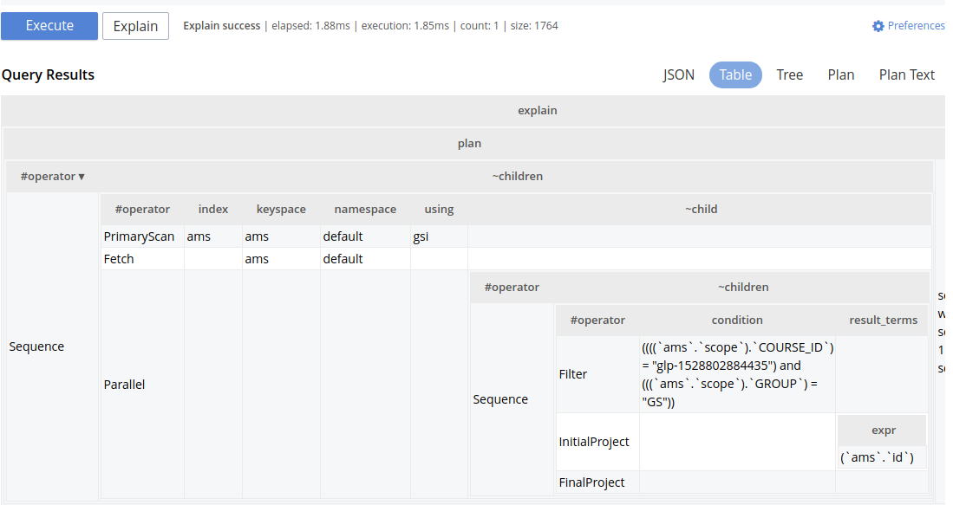
Unoptimized Query
So we analyzed explain plan and came to know that it is using primary index to scan and fetch entire data.

Slide 6
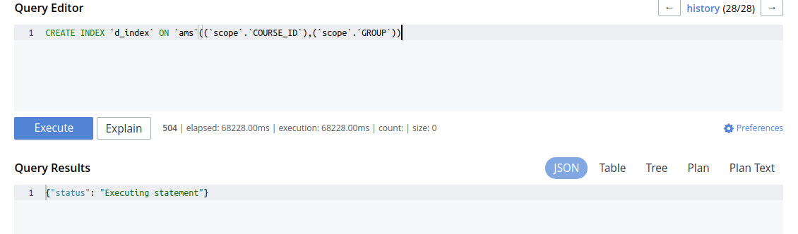
Create INDEX on Keys
CREATE INDEX `d_index` ON `ams`((`scope`.`COURSE_ID`),(`scope`.`GROUP`))
After executing this query an index will be created.

Slide 7
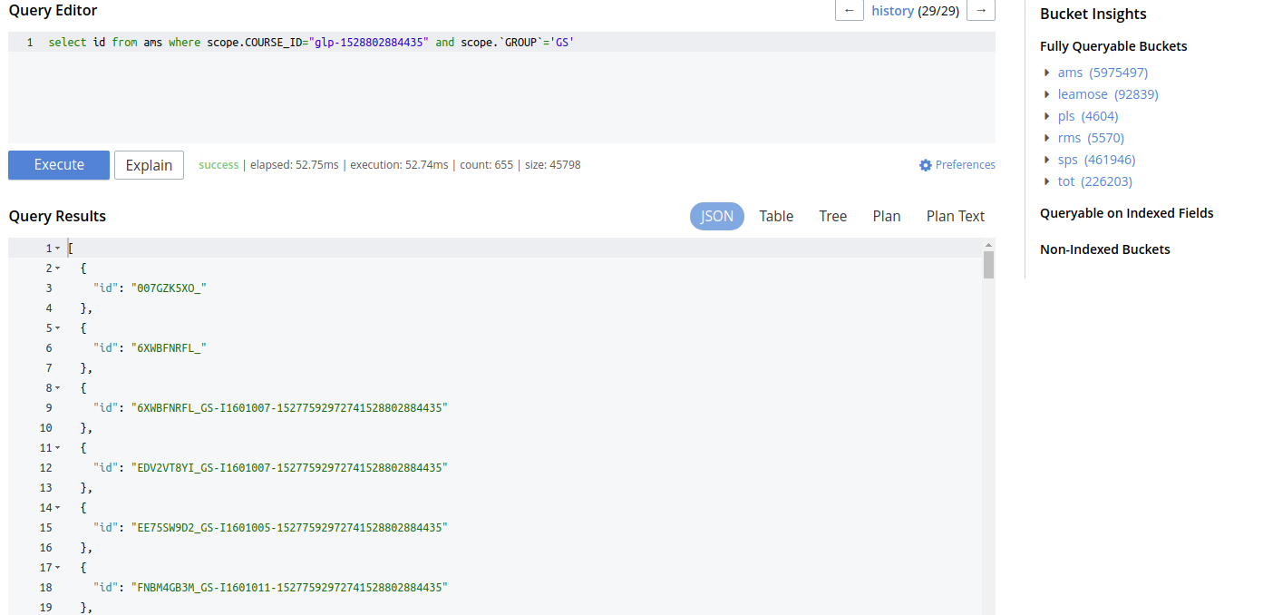
Optimized Query
Now we’ll again run the same query and see the difference.

Slide 8
Query Optimization
Another method to optimize query is to make some logical changes in it and make query more mature.
It depends on your query whether there is any chance to make it more oiptimised or not.

Slide 9
Thanks You

