Slide 1

Overview: AllJoyn
Rajat Rastogi
Notes:
Slide owner: Gavin
This deck answers the following questions:
What is AllJoyn, what is AllSeen?
Why are we investing in AllJoyn?
How are we investing in AllJoyn for Threshold?

Slide 2



AllSeen and AllJoyn
AllJoyn is an open source communication framework that enables apps and devices to communicate regardless of connection specifics and OS platform.
The AllSeen alliance is a non-profit consortium that oversees AllJoyn. Stated focus is to enable the “Internet of Everything” – value is in ecosystem alignment and investment in AllSeen
The AllSeen Alliance is a Linux Foundation Collaborative Project.
Notes:
Slide owner: Gavin

Slide 3
What is AllJoyn?
Short version: AllJoyn is an open-source cross-platform proximal* communication software framework for devices and applications.
*Proximal here assumes devices are on the same local network or in wireless range.
Long version: from https://www.alljoyn.org/about “AllJoyn is an open source project, initially developed by Qualcomm Innovation Center, Inc., and hosted by the AllSeen Alliance, which provides a universal software framework and core set of system services that enable interoperability among connected products and software applications across manufacturers to create dynamic proximal networks.”

Slide 4
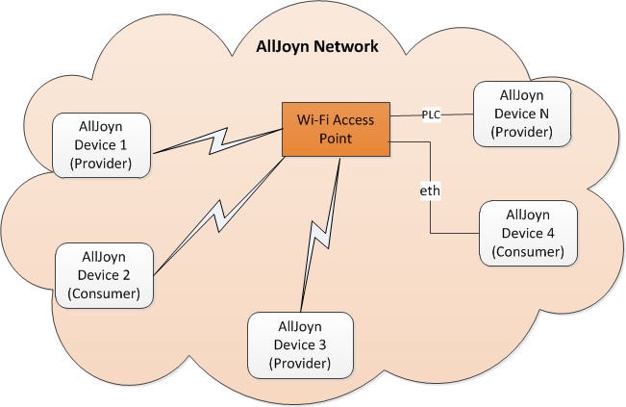
AllJoyn architecture
The figure captures the high-level network architecture for an AllJoyn network with devices connected over Wi-Fi, PLC, and Ethernet transports.

Slide 5
AllJoyn Core Concepts
An AllJoyn-enabled application/device can play the role of a producer, a consumer or both depending upon the service model.
Producer app/device implement services and advertise them over the AllJoyn network.
Consumer app/device interested in these services discover them via the AllJoyn network. Consumer applications then connect to producer applications to make use of these services as desired.

Slide 6
AllJoyn Core Concepts
AllJoyn Router
An AllJoyn Router provides software bus functionality and an app/device connects to this bus to avail core functions of the AllJoyn framework.
Bus Attachment
AllJoyn applications use and interact with the AllJoyn network by instantiating the AllJoyn Bus Attachment object and using that object to connect to the AllJoyn Router.
Advertisement and Discovery
An AllJoyn app/device advertises its services using About announcements. Another app/device discovers this About announcement.
Introspection
Via introspection, one can learn about the remote app/device and communicate with it without needing prior information about that app/device. APIs exist to easily introspect a remote AllJoyn app/device to discover its object paths and objects; its full interface including all methods; and parameters, properties and signals.

Slide 7
AllJoyn in Windows 10
Inbox router service in Windows 10 – ajrouter.
Windows Runtime APIs available for AllJoyn in the Windows 10 SDK. Refer the MSDN documentation.
AllJoyn Studio VS extension for quick and easy AllJoyn app development.
IoT Explorer for AllJoyn – windows store app

Slide 8
Extra References
AllJoyn landing page
AllJoyn universal samples
AllJoyn architecture and concepts

