Slide 1
Big Data
(Introduction & Life Cycle)
C Ranichandra
N C Senthilkumar
SITE, VIT

Slide 2
Overview of Big Data
Big Data
'Big Data' is a term used to describe collection of data that is huge in size and yet growing exponentially with time. Big Data – 1PetaByte= 1000TB 1ExaByte=1000PB
Such a data is so large and complex that none of the traditional data management tools are able to store it or process it efficiently

Slide 3
Data is obtained primarily from the following types of sources:
Internal sources and External Sources
Internal Sources such as organizational or enterprise data
Internal provides structured or organized data that originates from within the enterprise and helps run business.

Slide 4
Internal sources
Eg: Customer relationship management (CRM), Enterprise resource planning (ERP) systems, Customers details, Products and sales data
Application: This data (current data in the operational system) is used to support daily business operations of an organization.

Slide 5
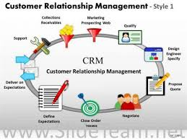

Slide 6
External sources
External sources - such as social data
External Provides unstructured or unorganized data that originates from the external environment of an organization
Eg: Business partners, Syndicate data suppliers, Internet, Government, Market research organizations
Application: This data is often analysed to understand the entities mostly external to the organization such as customers, competitors, market, and environment

Slide 7
Types of Sources of Data
Social Data - various networking sites and online portals ( facebook, Twitter,LinkedIn)
Machine Data: RFID chips, barcode scanners and sensors. (GPS results , climatic information)
Transactional Data: online shopping sites, retailers, Business to Business transactions(B2B) – ebay and Amazon

Slide 8
Types of data:
Social Data :
Refers to the information collected from various social networking sites and online portals
Eg: Facebook, Twitter, and LinkedIn
Machine Data :
Refers to the information generated from Radio Frequency Identification (RFID) chips, bar code scanners and sensors
Eg: Faculty attendance, Library books issue
Transactional Data :
Refers to the information generated from online shopping sites, retailers, and Business to Business (B2B) transactions
Eg: Retail websites like eBay and Amazon.com, Google

Slide 9
On the basis of the structure of data received from the sources, Big Data comprises:
Structured data
Unstructured data
Semi-structured data
Structured data:
defined as the data that has a defined repeating pattern.
This pattern makes it easier for any program to sort, read, and process the data.
Processing structured data is much easier and faster than processing data without any specific repeating patterns

Slide 10
Structured data:
Is organized data in a predefined format
Is the data that resides in fixed fields within a record or file
Is formatted data that has entities and their attributes mapped
Is used to query and report against predetermined data types
Some sources of structured data include:
Relational databases
Flat files in the form of records
Multidimensional databases
Legacy databases

Slide 11
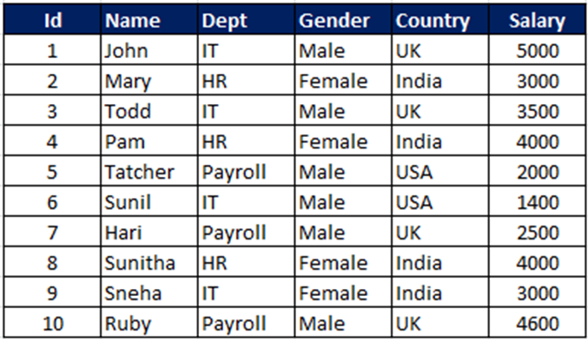
Structured data

Slide 12
Unstructured Data:
Unstructured data is a set of data that might or might not have any logical or repeating patterns.
Consists metadata, i.e. the additional information related to data
Comprises inconsistent data such as data from files and social media websites
Consists of data in different formats such as e-mails, text, audio, video, or images

Slide 13
Some sources of unstructured data include:
Text both internal/external to an organization: Documents, logs, survey results, feedbacks and emails from both within and across the organization
Social media: Data obtained from social networking platforms including YouTube, Facebook, Twitter, LinkedIn, and Flickr
Mobile data: Data such as text messages and location information

Slide 14
Working with unstructured data poses certain challenges like:
Identifying the unstructured data that can be processed
Sorting, organizing, and arranging unstructured data in different sets and formats
Combining and linking unstructured data in a more structured format to derive any logical conclusions out of the available information
Costing in terms of storage space and human resource (data analysts and scientists) needed to deal with the exponential growth of unstructured data

Slide 15
Semi-Structured Data
Semi-structured data, also known as having a schema-less or self-describing structure, refers to a form of structured data that contains tags or markup elements in order to separate elements and generate hierarchies of records and fields in the given data.
Such type of data does not follow the proper structure of data models as in relational databases.
In other words, data is stored inconsistently in rows and columns of a database.
No SQL Databases

Slide 16
Some sources for semi-structured data include:
RDF
Resource Description Framework (RDF) is a family of World Wide Web Consortium (W3C) specifications originally designed as a metadata data model.
File systems like Web data in the form of cookies
Data exchange formats like XML or JavaScript Object Notation (JSON) data

Slide 17
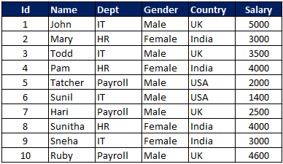
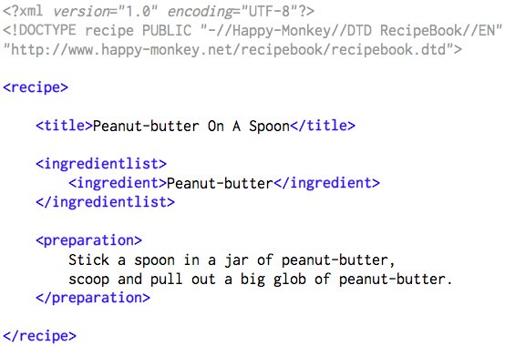

Slide 18
4.242.88.10 - - [07/Mar/2004:16:05:49 -0800] "GET /twiki/bin/edit/Main/Double_bounce_sender?topicparent=Main.ConfigurationVariables HTTP/1.1" 401 12846
64.242.88.10 - - [07/Mar/2004:16:06:51 -0800] "GET /twiki/bin/rdiff/TWiki/NewUserTemplate?rev1=1.3&rev2=1.2 HTTP/1.1" 200 4523
64.242.88.10 - - [07/Mar/2004:16:10:02 -0800] "GET /mailman/listinfo/hsdivision HTTP/1.1" 200 6291
64.242.88.10 - - [07/Mar/2004:16:11:58 -0800] "GET /twiki/bin/view/TWiki/WikiSyntax HTTP/1.1" 200 7352
64.242.88.10 - - [07/Mar/2004:16:20:55 -0800] "GET /twiki/bin/view/Main/DCCAndPostFix HTTP/1.1" 200 5253
64.242.88.10 - - [07/Mar/2004:16:23:12 -0800] "GET /twiki/bin/oops/TWiki/AppendixFileSystem?template=oopsmore¶m1=1.12¶m2=1.12 HTTP/1.1" 200 11382
64.242.88.10 - - [07/Mar/2004:16:24:16 -0800] "GET /twiki/bin/view/Main/PeterThoeny HTTP/1.1" 200 4924
64.242.88.10 - - [07/Mar/2004:16:29:16 -0800] "GET /twiki/bin/edit/Main/Header_checks?topicparent=Main.ConfigurationVariables HTTP/1.1" 401 12851
64.242.88.10 - - [07/Mar/2004:16:30:29 -0800] "GET /twiki/bin/attach/Main/OfficeLocations HTTP/1.1" 401 12851
64.242.88.10 - - [07/Mar/2004:16:31:48 -0800] "GET /twiki/bin/view/TWiki/WebTopicEditTemplate HTTP/1.1" 200 3732
64.242.88.10 - - [07/Mar/2004:16:32:50 -0800] "GET /twiki/bin/view/Main/WebChanges HTTP/1.1" 200 40520
64.242.88.10 - - [07/Mar/2004:16:33:53 -0800] "GET /twiki/bin/edit/Main/Smtpd_etrn_restrictions?topicparent=Main.ConfigurationVariables HTTP/1.1" 401 12851
64.242.88.10 - - [07/Mar/2004:16:35:19 -0800] "GET /mailman/listinfo/business HTTP/1.1" 200 6379
64.242.88.10 - - [07/Mar/2004:16:36:22 -0800] "GET /twiki/bin/rdiff/Main/WebIndex?rev1=1.2&rev2=1.1 HTTP/1.1" 200 46373
64.242.88.10 - - [07/Mar/2004:16:37:27 -0800] "GET /twiki/bin/view/TWiki/DontNotify HTTP/1.1" 200 4140
64.242.88.10 - - [07/Mar/2004:16:39:24 -0800] "GET /twiki/bin/v

Slide 19
Characteristics Of 'Big Data‘ – Four V’s
(i)Volume – The name 'Big Data' itself is related to a size which is enormous.
Size of data plays very crucial role in determining value out of data.
Volume is the amount of data generated by organizations or individuals
2.7 zeta bytes – IBM 571 new websites/minute
672- exabytes , internet traffic -2013 was 43,639 petabytes. Internet traffic
9,00,000 servers owned by Google 1 yotta byte

Slide 20
(ii)Variety –
Variety refers to heterogeneous sources and the nature of data, both structured and unstructured.
Now days, data in the form of emails, photos, videos, monitoring devices, PDFs, audio, etc. is also being considered in the analysis applications.
This variety of unstructured data poses certain issues for storage, mining and analysing data.

Slide 21
iii)Velocity – The term 'velocity' refers to the speed of generation of data.
How fast the data is generated and processed to meet the demands, determines real potential in the data.
eBay – analyses 5 million of data ITDS( fraud identification) from PayPal
Big Data Velocity deals with the speed at which data flows in from sources like business processes, application logs, networks and social media sites, sensors, mobile devices, etc. The flow of data is massive and continuous.

Slide 22
Veracity
iv) Veracity - generally refers to the uncertainty of data, i.e. whether the obtained data is correct or consistent.
Out of the huge amount of data that is generated in almost every process, only the data that is correct and consistent can be used for further analysis.

Slide 23
Questions :
1. Which of the following is not a characteristics of Big data ?
Volume variability
variety velocity
Which of the following is not an example of external data sources?
Data from CRM
Data from web page
Data from government sources
Data from Market surveys

Slide 24
3. Which of the following does not belong to the traditional data?
RDBMS DBMS Flat files NoSQL
4.Some people call this data as “structural but not relational” which data we are talking about?
Structured data unstructured data
Semi Structured data mixed data

Slide 25
5. The data genrated from GPS sattellite and web log is classified as
Structured data UnStructured data
Semi Structured data
both Structured data and semi Structured data
6. The data being captured can be in any form or structure. Then the characteristics of Big Data is ……………….

Slide 26
Data Analytics Life Cycle:
Phase 1—Discovery: In Phase 1, the team learns the business domain, including relevant history such as whether the organization or business unit has attempted similar projects in the past from which they can learn.
The team assesses the resources available to support the project in terms of people, technology, time, and data.
Important activities in this phase include framing the business problem that can be addressed in subsequent phases and formulating initial hypotheses (IHs) to test and begin learning the data.

Slide 27
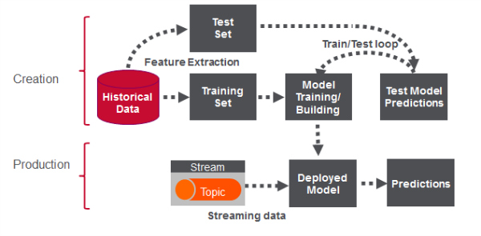
https://www.google.com/search?q=Big+Data+Contributions+to+Banking+Zones+and+Fraud+Detection+phases+life+cycle&client=firefox-b&tbm=isch&source=iu&ictx=1&fir=GFIjcYySOIKOMM%253A%252CV7ULFst3Yyz1-M%252C_&usg=AI4_-kTvafQyy6Dk5HmjC0cKcqS4a6QniQ&sa=X&ved=2ahUKEwiv9eeuu5ffAhUCQH0KHd6UD04Q9QEwCHoECAUQCA&biw=1366&bih=632#imgrc=GFIjcYySOIKOMM:

Slide 28
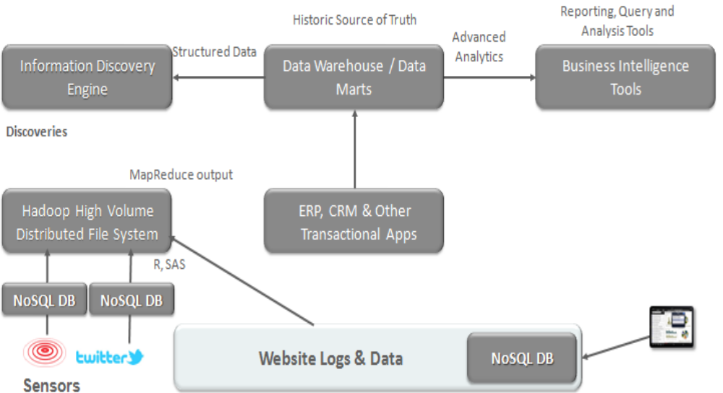
ORACLE ENTERPRISE ARCHITECTURE WHITE PAPER — IMPROVING BANKING AND FINANCIAL SERVICES PERFORMANCE WITH BIG DATA
Hadoop= HDFS + Map Reduce

Slide 29
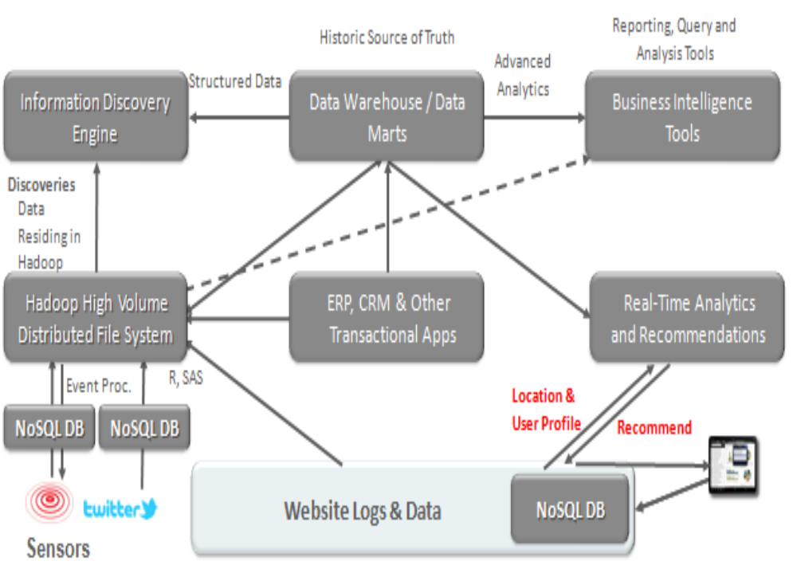

Slide 30
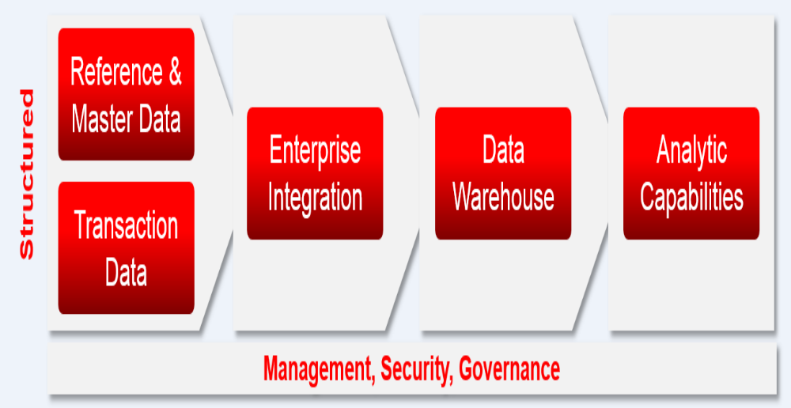

Slide 31
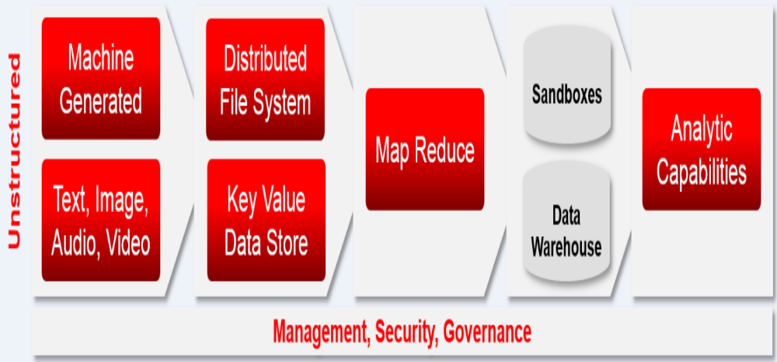

Slide 32
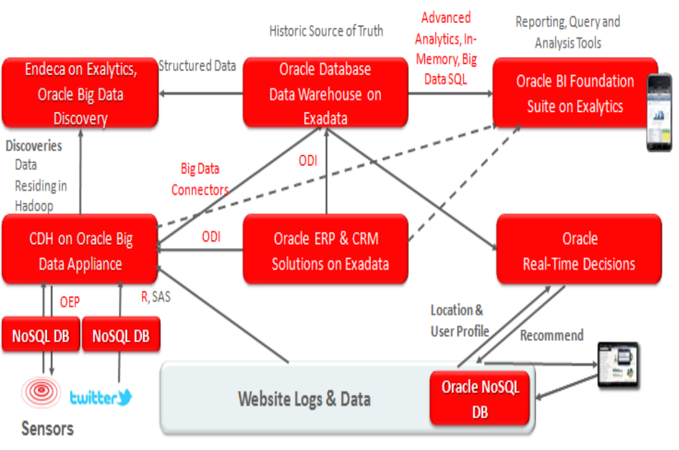
How Key Oracle Products Fit in the Generic Architecture

Slide 33
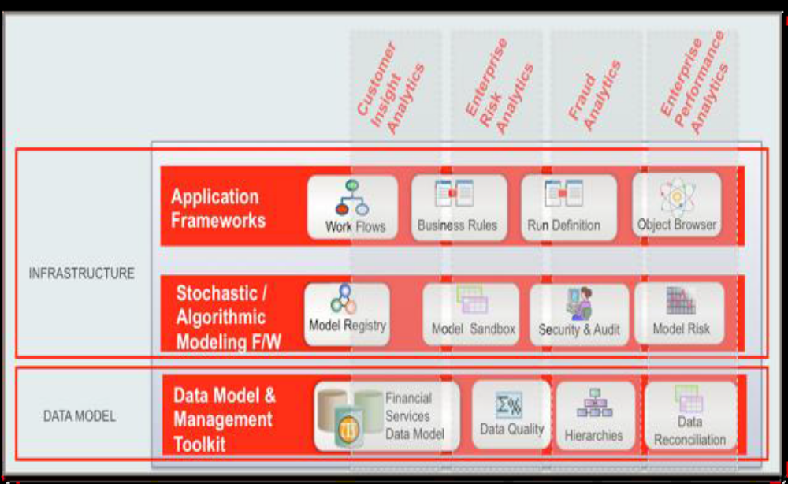
Oracle Financial Services Data Foundation (FSDF), Analytical Applications Infrastructure (AAI)

Slide 34
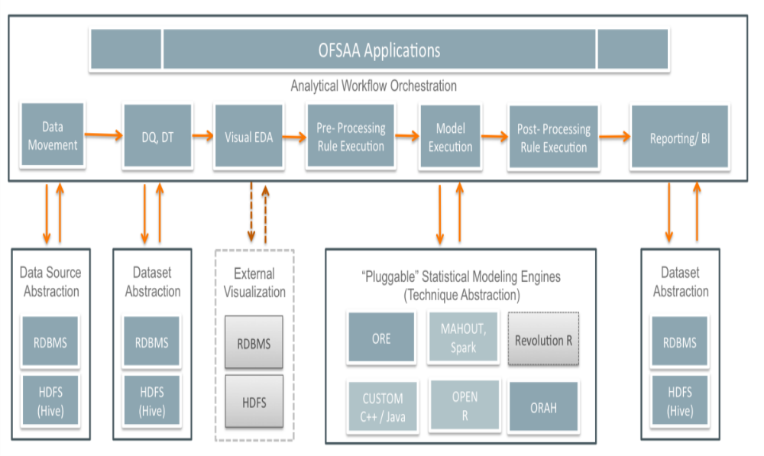
Using AAI as an Enterprise Modeling and Analytics Platform

Slide 35
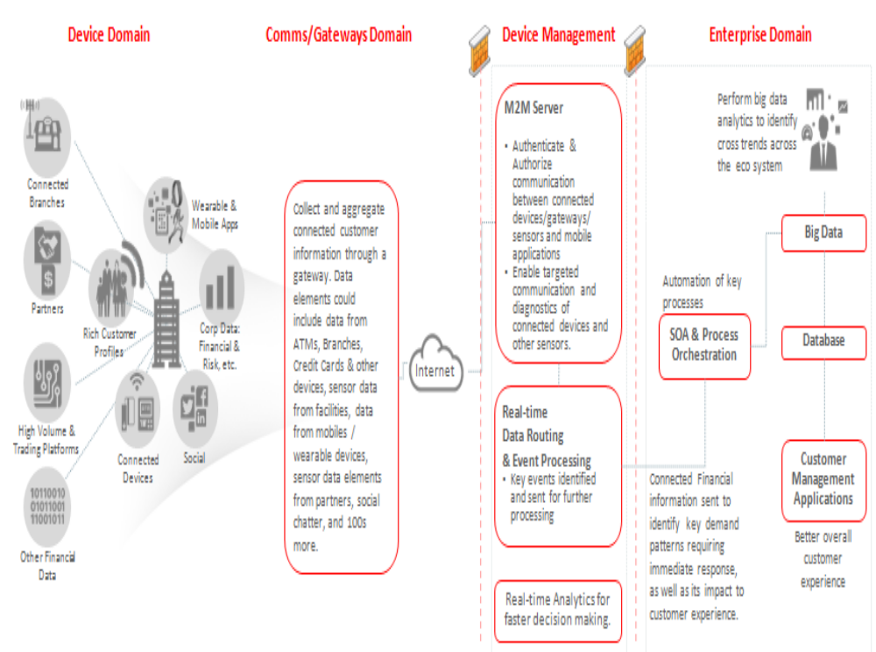

Slide 36
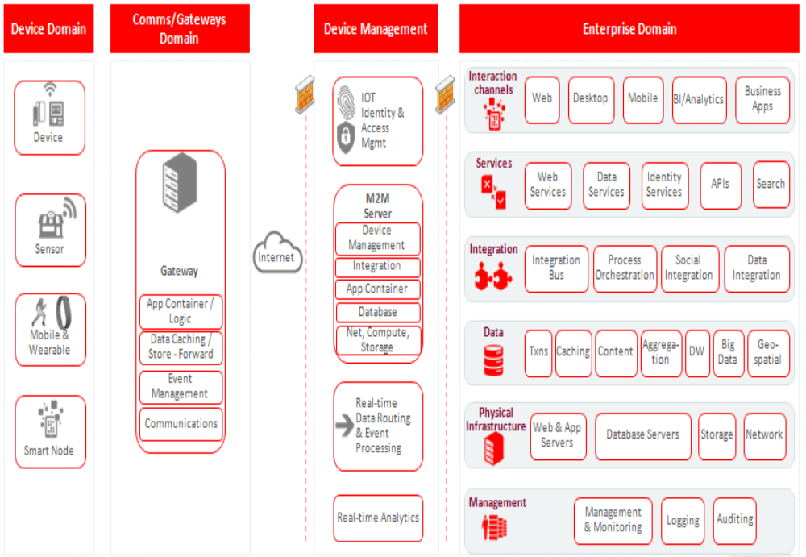

Slide 37
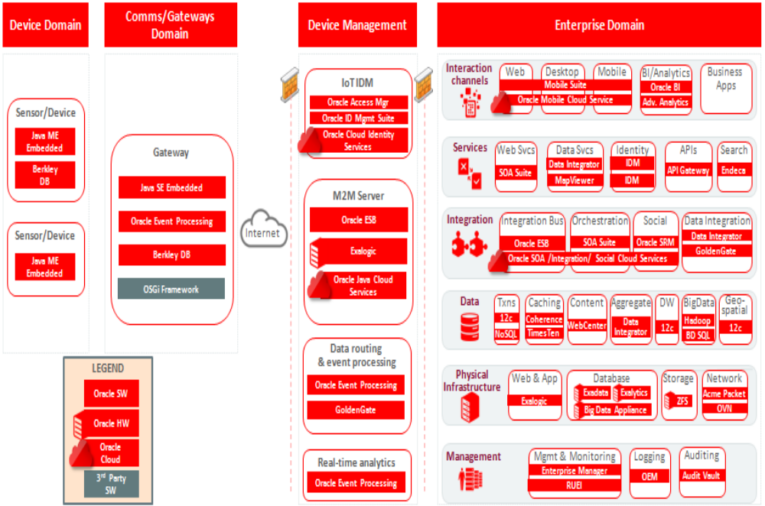

Slide 38
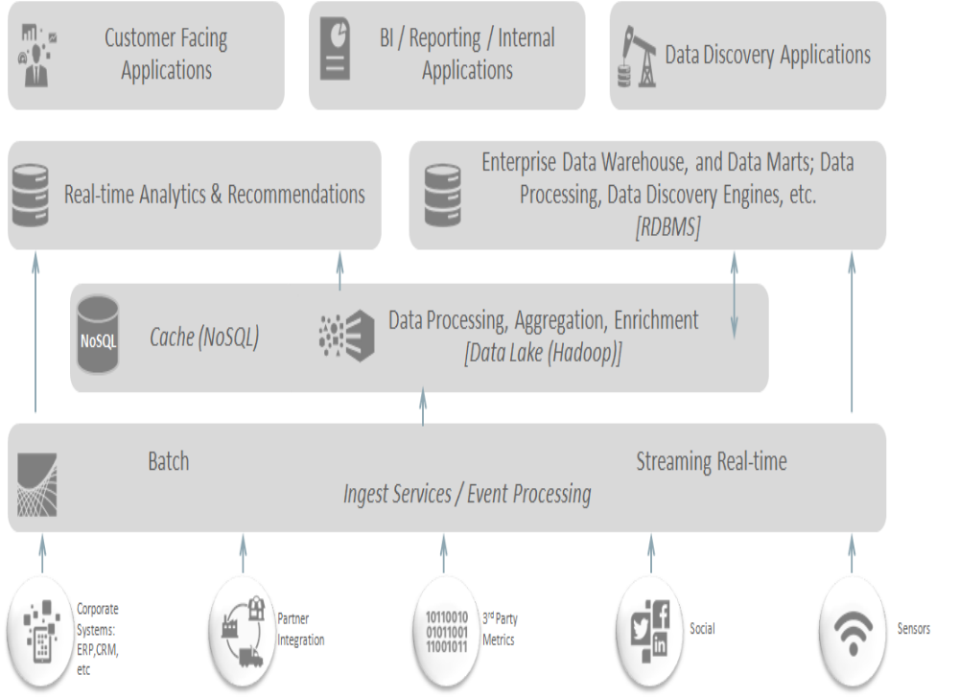
Typical Conceptual Future State Diagram

Slide 39
Phase 2—Data preparation: Phase 2 requires the presence of an analytic sandbox, in which the team can work with data and perform analytics for the duration of the project.
The team needs to execute extract, load, and transform (ELT) or extract, transform and load (ETL) to get data into the sandbox.
Data should be transformed so the team can work with it and analyze it.
In this phase, the team also needs to familiarize itself with the data thoroughly and take steps to condition the data

Slide 40
Phase 3—Model planning: Phase 3 is model planning, where the team determines the methods, techniques, and workflow it intends to follow for the subsequent model building phase.
The team explores the data to learn about the relationships between variables and subsequently selects key variables and the most suitable models.

Slide 41
Phase 4 - Model building: In Phase 4, the team develops datasets for testing, training, and production purposes.
In addition, in this phase the team builds and executes models based on the work done in the model planning phase.
The team also considers whether its existing tools will suffice for running the models, or if it will need a more robust environment for executing models and workflows (for example, fast hardware and parallel processing, if applicable).

Slide 42
Phase 5—Communicate results: In Phase 5, the team, in collaboration with major stakeholders, determines if the results of the project are a success or a failure based on the criteria developed in Phase 1.
The team should identify key findings, quantify the business value, and develop a narrative to summarize and convey findings to stakeholders.
Phase 6—Operationalize: In Phase 6, the team delivers final reports, briefings, code, and technical documents. In addition, the team may run a pilot project to implement the models in a production environment.

Slide 43
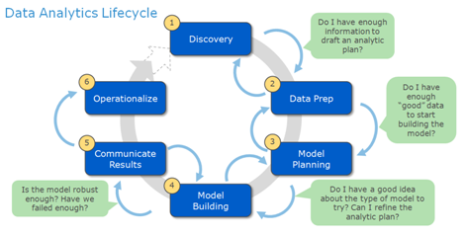

Slide 44
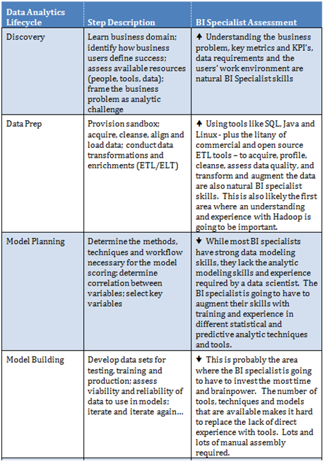

Slide 45
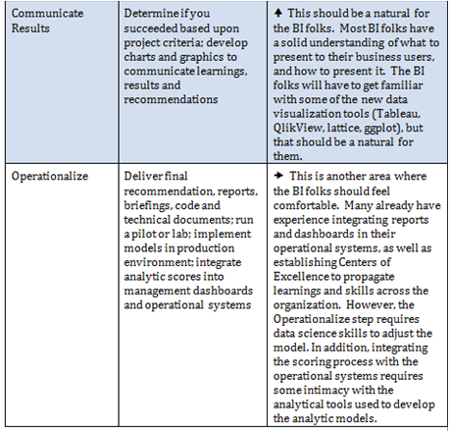

Slide 46
Data Scientist:
The Data Scientist will be responsible for
designing and implementing processes and layouts for complex, large-scale data sets used for modelling, data mining, and research purposes.
business case development, planning, coordination/collaboration with various internal and vendor teams, project managing the lifecycle of an analysis project, and interface with business sponsors to provide periodic updates.
The role will require working on multiple projects simultaneously- super user

Slide 47
Responsibilities:
Develop and plan required analytic projects in response to business needs.
Conduct research and make recommendations on data mining products, services, protocols, and standards in support of procurement and development efforts. intense intellectual curiosity
Work with application developers to extract data relevant for analysis.
Develop new tools or methods for data acquisition and transformation.
In conjunction with data owners and department managers, contribute to the development of data models and protocols for mining production databases.
Contribute to data mining architectures, modelling standards, reporting, and data analysis methodologies.

Slide 48
Collaborate with unit managers, end users, development staff, and other stakeholders to integrate data mining results with existing systems.
Provide and apply quality assurance best practices for data mining/analysis services.
Adhere to change control and testing processes for modifications to analytical models.

Slide 49
The Data Analyst
is the professional whose focus of analysis and problem solving relates to data, types of data, and relationships among data elements within a business system or IT system.
The data analyst role can vary but it can commonly involve the following:
Mapping and tracing data from system to system in order to solve a given business or system problem,
Design and create data reports and reporting tools to help business executives in their decision making,
Documenting the types and structure of the business data (logical modeling),
Analyzing and mining business data to identify patterns and correlations among the various data points,
Perform statistical analysis of business data.
Other common titles for this role are:
Data Modeler, Business Intelligence Analyst, Data Warehouse Analyst,
Systems Analyst, Business Analyst (generic term), etc.
Data Analyst
» Performs logical data modeling
» Identifies patterns in data
» Designs and creates reports

Slide 50
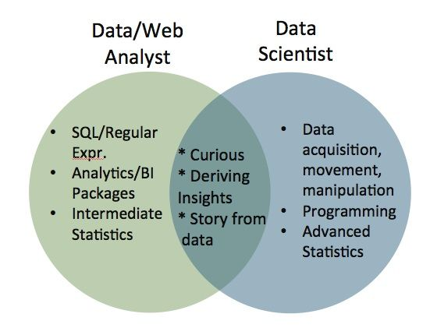

Slide 51
Data Analyst | Data Scientist
Data analysts are generally well versed in Sequel, they know a some Regular Expressions, they can slice and dice data, they can use analytics or BI packages – like Tableau or Pentaho or an in house analytics solution – and they can tell a story from the data. They should also have some level of scientific curiosity. | On the other end of the spectrum, a Data Scientist will have quite a bit of machine learning and engineering or programming skills and will be able to manipulate data to his or her own will.

Slide 52
Data Scientist can also be divided into 4 different roles based on their skill sets.
Data Researcher
Data Developers
Data Creatives
Data Businesspeople

Slide 53
A Data Analyst can also be divided into 4 different roles based on their skill sets.
Data Architects
Database Administrators
Analytics Engineer
Operations

Slide 54
Key Roles in Analytic Project
1. Data Hygienists make sure that data coming into the system is clean and accurate, and stays that way over the entire data lifecycle. For example, are the time values being captured the same? One data set might be measuring calendar days in a year (365), another working days in a year (260), and yet another hours in a year (8765). All the values have to be the same so that comparisons are possible. Or have old data fields been populated with new types of data but under the old field names?
Clean, enhance, standardize , Data integrity management, clustering
2. Data Explorers sift through mountains of data to discover the data you actually need. That can be a significant task because so much data out there was never intended for analytic use and, therefore, is not stored or organized in a way that’s easy to access. Cash register data is a perfect example. Its original function was to allow companies to track revenue not to predict what product a given customer would buy next.
Data Aggregation, Dimensionality reduction

Slide 55
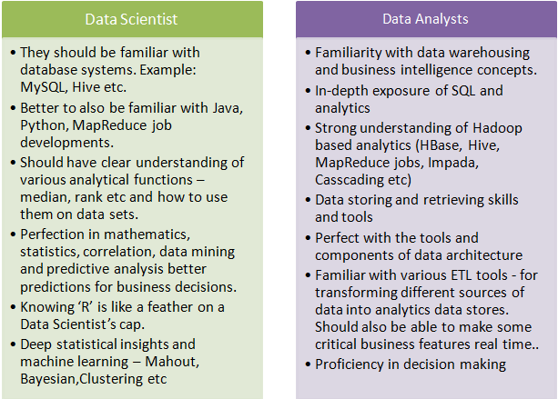

Slide 56
Key Roles in Analytic Project
3. Business Solution Architects put the discovered data together and organize it so that it’s ready to analyze. They structure the data to ensure it can be usefully queried in appropriate timeframes by all users. Some data needs to be accessed by the minute or hour, for example, so that data needs to be updated every minute or hour.
DFS, key value stores
4. Data Scientists take this organized data and create sophisticated analytics models that, for example, help predict customer behaviour and allow advanced customer segmentation and pricing optimization. They ensure each model is updated frequently so it remains relevant for longer.
MapReduce, Mining-Classification, Clustering, Frequent item set
5. Campaign Experts turn the models into results. They have a thorough knowledge of the technical systems that deliver specific marketing campaigns, such as which customer should get what message when. They use what they learn from the models to prioritize channels and sequence the campaigns — for example, based on analysis of an identified segment’s historical behaviour it will be most effective to first send an email then follow it up 48 hours later with a direct mail.
Mails, presentation, video conference

Slide 57
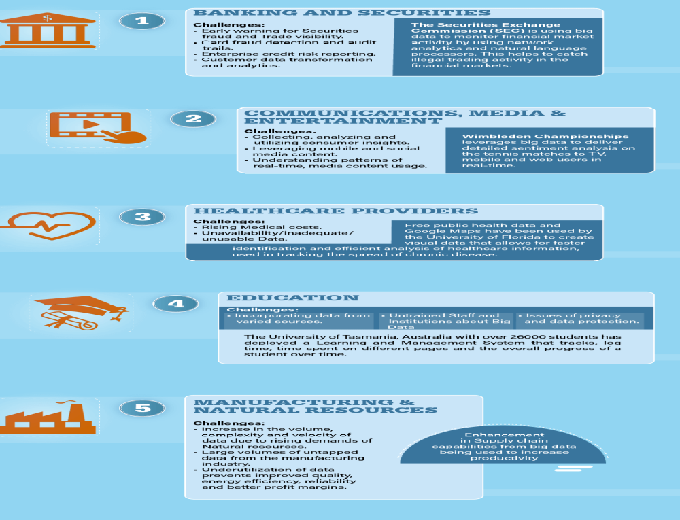

Slide 58
