Slide 1
Module 3: Trees
ITA5002 – Problem Solving with Data Structures and Algorithms

Slide 2
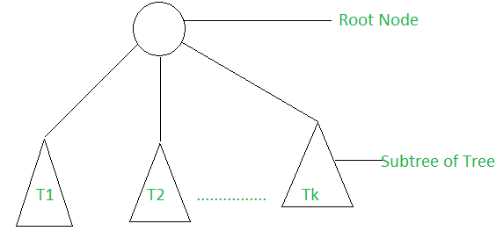
Trees
A tree is a collection of nodes. The collection can be empty; otherwise, a tree consists of a distinguished node, r, called the root, and zero or more nonempty (sub)trees T1, T2, . . . , Tk, each of whose roots are connected by a directed edge from r.
A tree consists of a root, and zero or more subtrees T₁, T₂, … , T_{k} such that there is an edge from the root of the tree to the root of each subtree.

Slide 3
Trees
A tree data structure is a collection of nodes that are linked together to represent hierarchy.
A tree data structure is a non-linear data structure because it does not store in a sequential manner.
In the Tree data structure, the topmost node is known as a root node. Each node contains some data, and data can be of any type.
Each node contains some data and the link or reference of other nodes that can be called children.

Slide 4
Trees – Basic Terminologies
Root : the topmost node in the tree hierarchy
Children : the node is a descendant of any node, then the node is known as a child node
Parent : If the node contains any sub-node, then that node is said to be the parent of that sub-node.
Siblings : The nodes that have the same parent are known as siblings.
Leaf Node: The node with no children is called a leaf node.
Ancestor : An ancestor of a node is any predecessor node on a path from the root to that node.
Descendant : The immediate successor of the given node is known as a descendant of a node.

Slide 5
Trees – Basic Terminologies
Path : A path from node n1 to nk is defined as a sequence of nodes n1, n2, . . . , nk such that ni is the parent of ni+1 for 1 ≤ i < k.
Length : The length of this path is the number of edges on the path, namely, k − 1. There is a path of length zero from every node to itself.
Depth: depth of ni is the length of the unique path from the root to ni
Height: The height of node x can be defined as the longest path from the node x to the leaf node.

Slide 6
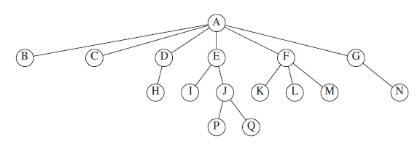
Trees – Basic Terminologies

Slide 7
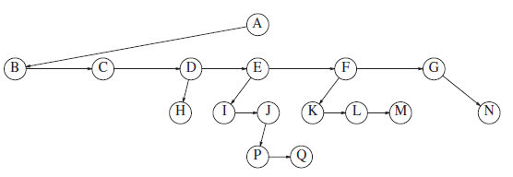
Trees – Implementation
struct TreeNode
{
int data;
TreeNode *firstChild;
TreeNode *nextSibling;
};

Slide 8
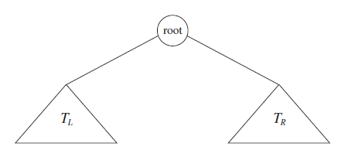
Binary Trees
A binary tree is a tree in which no node can have more than two children.
The Binary tree means that the node can have maximum two children.
Binary name itself suggests that 'two'; therefore, each node can have either 0, 1 or 2 children.
struct Node
{
int data;
struct Node *left_child;
struct Node *right_child;
};

Slide 9
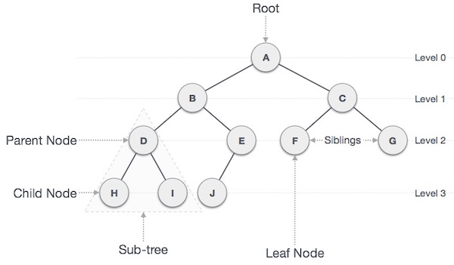
Binary Trees

Slide 10
Binary Trees - Properties
At each level of i, the maximum number of nodes is 2^{i}.
The Maximum number of nodes in a binary tree of height ‘h’ is 2^{h} – 1.
The minimum number of nodes possible at height h is equal to h+1.
If the number of nodes is minimum, then the height of the tree would be maximum.

Slide 11
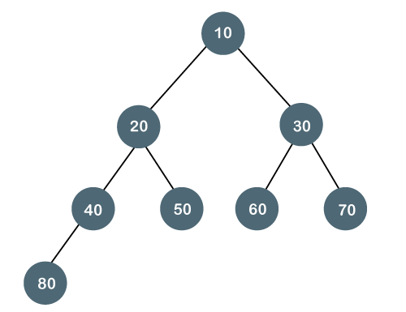
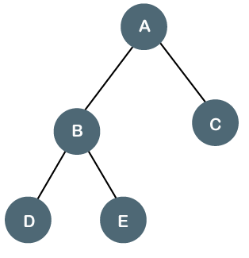
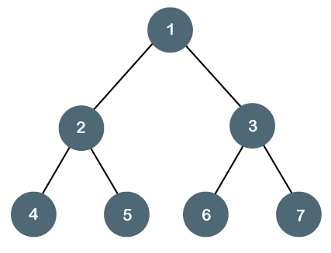
Binary Trees - Types
Full/ proper/ strict Binary tree: A tree in which each node must contain 2 children except the leaf nodes.
Complete Binary tree: A tree in which all the nodes are completely filled except the last level.
Perfect Binary tree: A tree is a perfect binary tree if all the internal nodes have 2 children, and all the leaf nodes are at the same level.

Slide 12
Binary Search Trees
Binary Search Tree(BST) is a binary tree data structure which has the following properties:
The left subtree of a node contains only nodes with keys lesser than the node’s key.
The right subtree of a node contains only nodes with keys greater than the node’s key.
BST divides all its sub-trees into two segments; the left sub-tree and the right sub-tree and can be defined as −
left_subtree (keys) < node (key) ≤ right_subtree (keys)

Slide 13
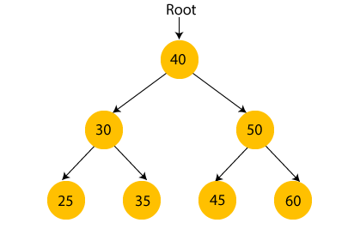
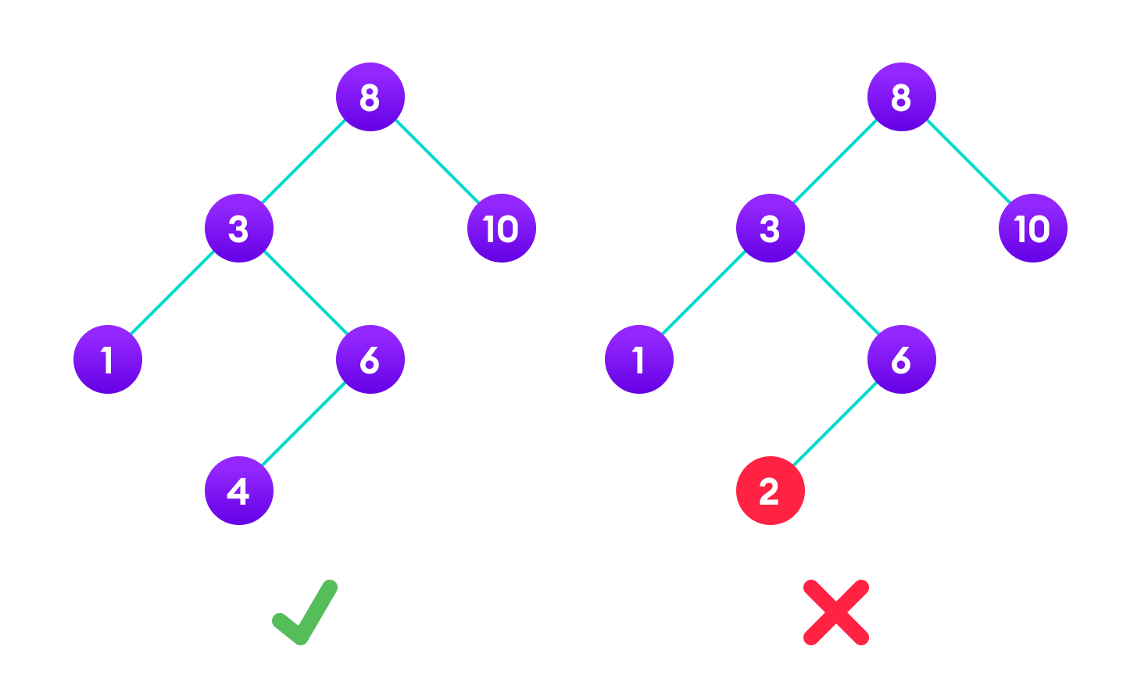
Binary Search Trees

Slide 14
Binary Search Trees - Implementation
Define a node having some data, references to its left and right child nodes.
struct node {
int data;
struct node *leftChild;
struct node *rightChild;
};

Slide 15
Binary Search Trees - Insert
If node == NULL
return createNode(data)
if (data < node->data)
node->left = insert(node->left, data);
else if (data > node->data)
node->right = insert(node->right, data);
return node;
Example: 45, 15, 79, 90, 10, 55, 12, 20, 50

Slide 16
Binary Search Trees - Search
If root == NULL
return NULL;
If number == root->data
return root->data;
If number < root->data
return search(root->left)
If number > root->data
return search(root->right)

Slide 17
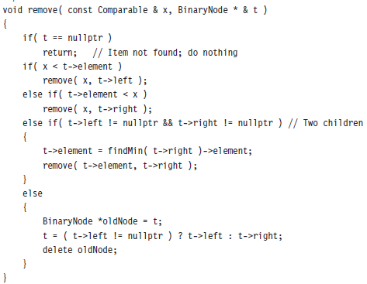
Binary Search Trees - Delete

Slide 18
Binary Tree Traversals
Tree traversal refers to the process of visiting each node in a tree data structure, exactly once.
There are three ways which we use to traverse a tree −
  In-order Traversal
  Pre-order Traversal
  Post-order Traversal
Traverse a tree to search or locate a given item or key in the tree or to print all the values it contains.

Slide 19
Binary Tree Traversals – In-order
In this traversal method, the left subtree is visited first, then the root and later the right sub-tree.
If a binary tree is traversed in-order, the output will produce sorted key values in an ascending order.
Algorithm
Until all nodes are traversed −
Step 1 − Recursively traverse left subtree.
Step 2 − Visit root node.
Step 3 − Recursively traverse right subtree.

Slide 20
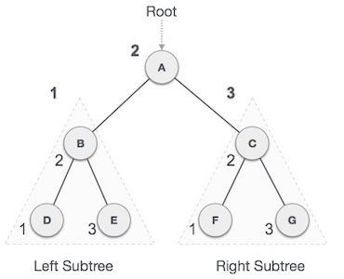
Binary Tree Traversals – In-order
In-order:
D → B → E → A → F → C → G

Slide 21
Binary Tree Traversals – Pre-order
In this traversal method, the root node is visited first, then the left subtree and finally the right subtree.
Algorithm
Until all nodes are traversed −
Step 1 − Visit root node.
Step 2 − Recursively traverse left subtree.
Step 3 − Recursively traverse right subtree.

Slide 22
Binary Tree Traversals – Pre-order
Pre-order:
A → B → D → E → C → F → G

Slide 23
Binary Tree Traversals – Post-order
In this traversal method, the root node is visited last.
First we traverse the left subtree, then the right subtree and finally the root node.
Algorithm
Until all nodes are traversed −
Step 1 − Recursively traverse left subtree.
Step 2 − Recursively traverse right subtree.
Step 3 − Visit root node.

Slide 24
Binary Tree Traversals – Post-order
Post-order:
D → E → B → F → G → C → A

Slide 25
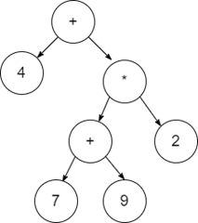
Expression Trees
The expression tree is a binary tree in which each internal node corresponds to the operator and each leaf node corresponds to the operand.
The leaves of an expression tree are operands, such as constants or variable names, and the other nodes contain operators.
4 + ((7 + 9) * 2) will have an expression tree as follows

Slide 26
Expression Trees - Construction
For constructing an expression tree, use a stack.
Take the input expression and do the following for every character.
  If the symbol is an operand, create a one-node tree and push a pointer to it onto a stack.
  If the symbol is an operator, pop (pointers) to two trees T1 and T2 from the stack (T1 is popped first) and form a new tree whose root is the operator and whose left and right children point to T2 and T1, respectively.
  A pointer to this new tree is then pushed onto the stack.

Slide 27
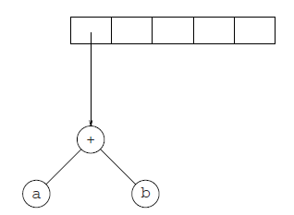
Expression Trees - Construction - Example
a b + c d e + * *
The first two symbols are operands, so we create one-node trees and push pointers to them onto a stack.
Next, a + is read, so two pointers to trees are popped, a new tree is formed, and a pointer to it is pushed onto the stack.

Slide 28
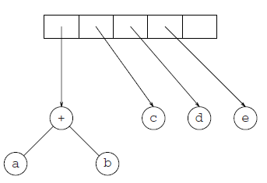
Expression Trees - Construction - Example
Next, c, d, and e are read, and for each a one-node tree is created and a pointer to the corresponding tree is pushed onto the stack.

Slide 29
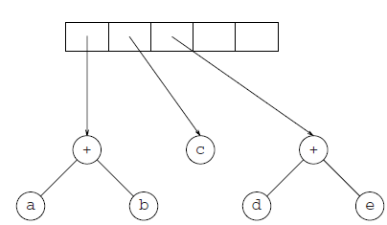
Expression Trees - Construction - Example
Now a + is read, so two trees are merged.

Slide 30
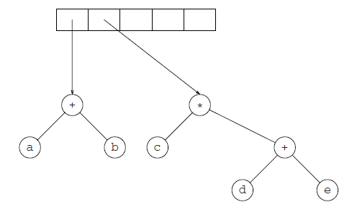
Expression Trees - Construction - Example
Continuing, a * is read, so we pop two tree pointers and form a new tree with a * as root.

Slide 31
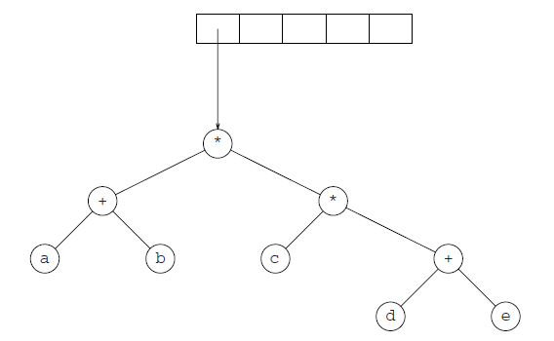
Expression Trees - Construction - Example
Finally, the last symbol is read, two trees are merged, and a pointer to the final tree is left on the stack.

