Slide 1
6LoWPAN

Slide 2
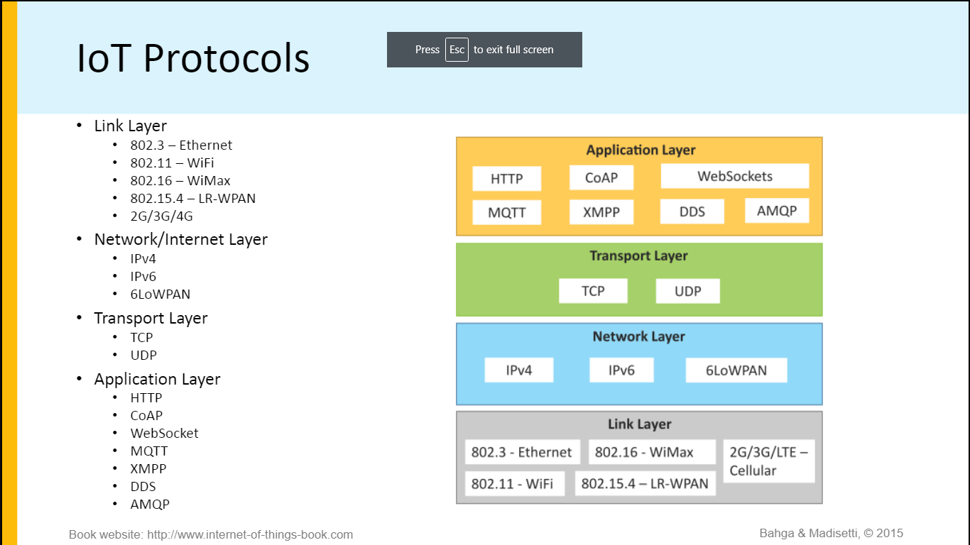
IoT Protocols

Slide 3
6LoWPAN
6LoWPAN (IPv6 over Low power Wireless Personal Area Network)
brings IP protocol to the low-power devices which have limited processing capability.
The motivation behind 6LoWPAN proposal is to define IP over IEEE 802.15.4 stack.
The idea is to leverage the IP networking while taking advantage of low energy operations of MAC and PHY layers of IEEE 802.15.4 standards.
It enriched the application space from all small, handheld battery powered devices to embedded control and monitoring devices including sensor nodes.
It created the space for what is widely known as “Internet of Things” (IoT).

Slide 4
6LoWPAN
6LoWPAN uses IPv6 address space to overcome the problem of scaling in device addressing.
Therefore, it is more appropriate to define 6LoWPAN as IPv6 over Low-Power wireless networks.
It is defined mainly by IETF standards RFC 4919 and 4944 .
Interoperability between IPv6 and LoWPAN network is due to edge routers with 6LoWPAN support.
Within 6LoWPAN network, the routers or the hosts need not work with full IPv6 or UPD header formats.

Slide 5
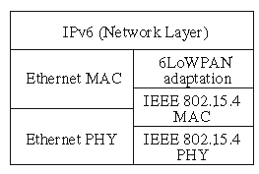
6LoWPAN
The protocol stack at edge router must have support for both conventional IPv6 as well as LoWPAN adaptability as shown in Fig. 2.
Fig. 2 Protocol stack for an IPv6 edge router with 6LoWPAN support

