Slide 1
RPL

Slide 2
Routing Protocol for Low-Power and Lossy Networks (RPL)
Developed by IETF Routing over Low-Power and Lossy Networks (ROLL) working group
Low-Power and Lossy Networks (LLN) Routers have constraints on processing, memory, and energy.
Can’t use OSPF, OLSR, RIP, AODV, DSR, etc
LLN links have high loss rate, low data rates, and instability
expensive bits, dynamically formed topology
Covers both wireless and wired networks. Requires bidirectional links. May be symmetric/asymmetric.
Ideal for n-to-1 (data sink) communications, e.g., meter reading 1-to-n and 1-to-1 possible with some extra work.
Multiple LLN instances on the same physical networks

Slide 3
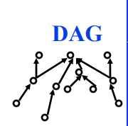
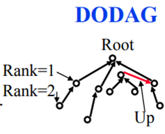
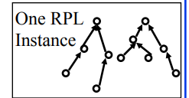
RPL Concepts
Directed Acyclic Graph (DAG): No cycles
Root: No outgoing edge
Destination-Oriented DAG (DODAG): Single root
Up: Towards root
Down: Away from root
Objective Function: Minimize energy, latency, …
Rank: Distance from root using specified objective
RPL Instance: One or more DODAGs. A node may belong to multiple RPL instances.
DODAG ID: IPv6 Adr of the root
DODAG Version: Current version of the DODAG. Every time a new DODAG is computed with the same root, its version

Slide 4
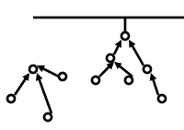
RPL Concepts (Cont)
Goal: Reachability goal, e.g., connected to database
Grounded: Root can satisfy the goal
Floating: Not grounded. Only in-DODAG communication.
Parent: Immediate successor towards the root
Sub-DODAG: Sub tree rooted at this node
Storing: Nodes keep routing tables for subDODAG
Non-Storing: Nodes know only parent. Do not keep a routing table

Slide 5
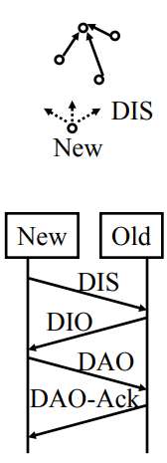
RPL Control Messages
1. DODAG Information Object (DIO):
Downward RPL instance multicasts
Allows other nodes to discover an RPL instance and join it
2. DODAG Information Solicitation (DIS):
Link-Local multicast request for DIO (neighbor discovery).
3. Destination Advertisement Object (DAO):
From child to parents or root.
Can I join you as a child on DODAG #x?
4. DAO Ack: Yes, you can! Or Sorry, you cant!
5. Consistency Check: Challenge/response messages for security

Slide 6
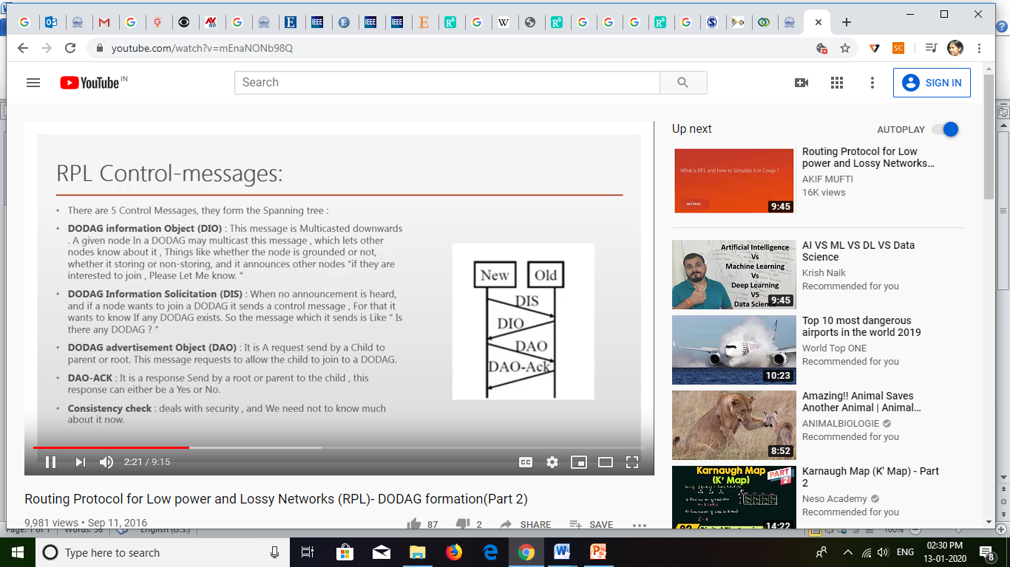

Slide 7
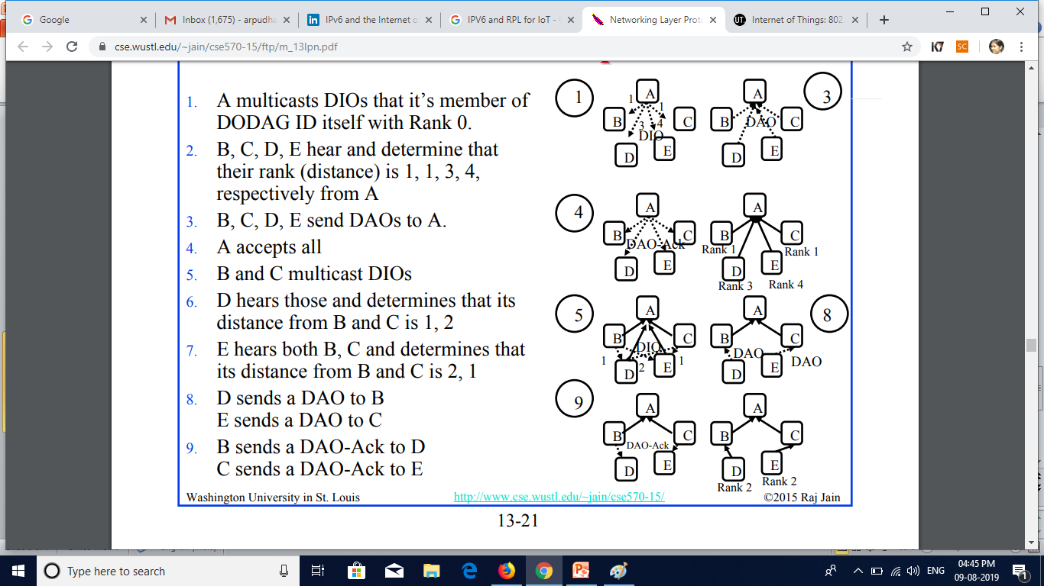
DODAG Formation Example
1. A multicasts DIOs that it’s member of DODAG ID itself with Rank 0.
2. B, C, D, E hear and determine that their rank (distance) is 1, 1, 3, 4, respectively from A
3. B, C, D, E send DAOs to A.
4. A accepts all
5. B and C multicast DIOs
6. D hears those and determines that its distance from B and C is 1, 2
7. E hears both B, C and determines that its distance from B and C is 2, 1
8. D sends a DAO to B E sends a DAO to C
9. B sends a DAO-Ack to D C sends a DAO-Ack to E

Slide 8
RPL Data Forwarding
Case 1: To the root (n-to-1)
Address to root and give to parent
Case 2: A to B
2A: Storing (Everyone keeps a routing table)
Forward up from A to common parent
Forward down from common parent to B
2B: Non-storing (No routing tables except at root)
Forward up from A to root
Root puts a source route and forwards down
Case 2: Broadcast from the root (1-to-n)
2A: Storing (everyone knows their children)
Broadcast to children ➢
2B: Non-Storing (Know only parents but not children)
Root puts a source route for each leaf and forwards

Slide 9
RPL Summary
1. An RPL instance consists of one or more DODAGs
2. DIO are broadcast downward,
DAOs are requests to join upward
DIS are DIO solicitations
DAO-ack are responses to DAO
3. Non-storing nodes do not keep any routing table and send everything upwards toward the root

Slide 10
6LoWPAN vs RPL
1. 6LowPAN is designed for IPv6 over IEEE 802.15.4 . Frame size and address sizes are primary issues Header compression is the key mechanism
2. RPL is designed primarily for data collection No assumption about IEEE 802.15.4 or wireless or frame size Routing is the primary issue Forming a spanning tree like DODAG is the solution

