Slide 1

Software Design
Object Oriented Design
Object oriented design is the result of focusing attention not on the
function performed by the program, but instead on the data that are
to do manipulated by the program. Thus, it is orthogonal to function
oriented design.
Object Oriented Design begins with an examination of the real
world “things” that are part of the problem to be solved. These
things (which we will call objects) are characterized individually in
terms of their attributes and behavior.

Slide 2
Software Design
Basic Concepts
Object Oriented Design is not dependent on any specific
implementation language. Problems are modeled using objects.
Objects have:
Behavior (they do things)
State (which changes when they do things)

Slide 3
Software Design
The various terms related to object design are:
i.
Objects
The word “Object” is used very frequently and conveys different
meaning in different circumstances. Here, meaning is an entity able to
save a state (information) and which offers a number of operations
(behavior) to either examine or affect this state. An object is
characterized by number of operations and a state which remembers
the effect of these operations.

Slide 4
Software Design
ii.
Messages
Objects communicate by message passing. Messages consist of the
identity of the target object, the name of the requested operation and
any other operation needed to perform the function. Message are often
implemented as procedure or function calls.
iii.
Abstraction
In object oriented design, complexity is managed using abstraction.
Abstraction is the elimination of the irrelevant and the amplification of
the essentials.

Slide 5
Software Design
iv. Class
In any system, there shall be number of objects. Some of the objects
may have common characteristics and we can group the objects
according to these characteristics. This type of grouping is known as a
class. Hence, a class is a set of objects that share a common structure
and a common behavior.
We may define a class “car” and each object that represent a car
becomes an instance of this class. In this class “car”, Indica, Santro,
Maruti, Indigo are instances of this class as shown in fig. 20.
Classes are useful because they act as a blueprint for objects. If we
want a new square we may use the square class and simply fill in the
particular details (i.e. colour and position) fig. 21 shows how can we
represent the square class.

Slide 6
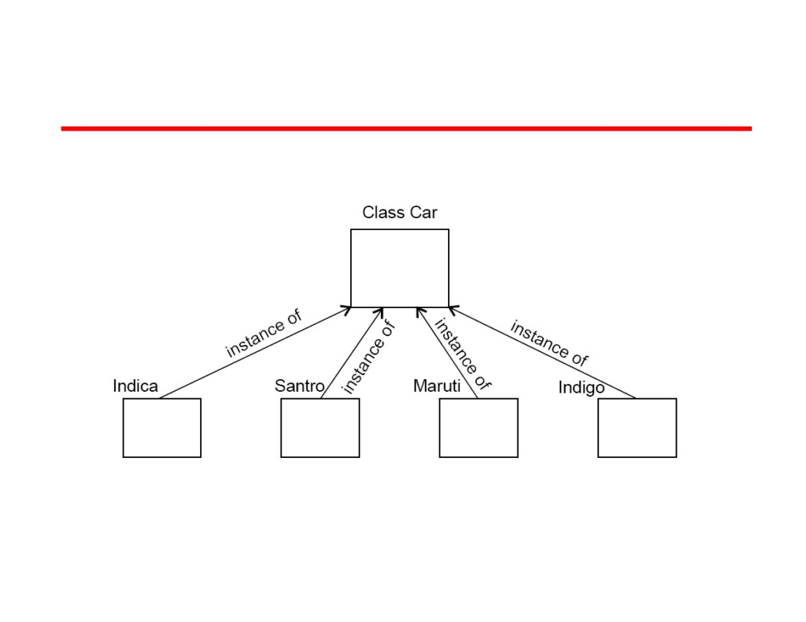
Software Design
Fig.20: Indica, Santro, Maruti, Indigo are all instances of the class “car”

Slide 7
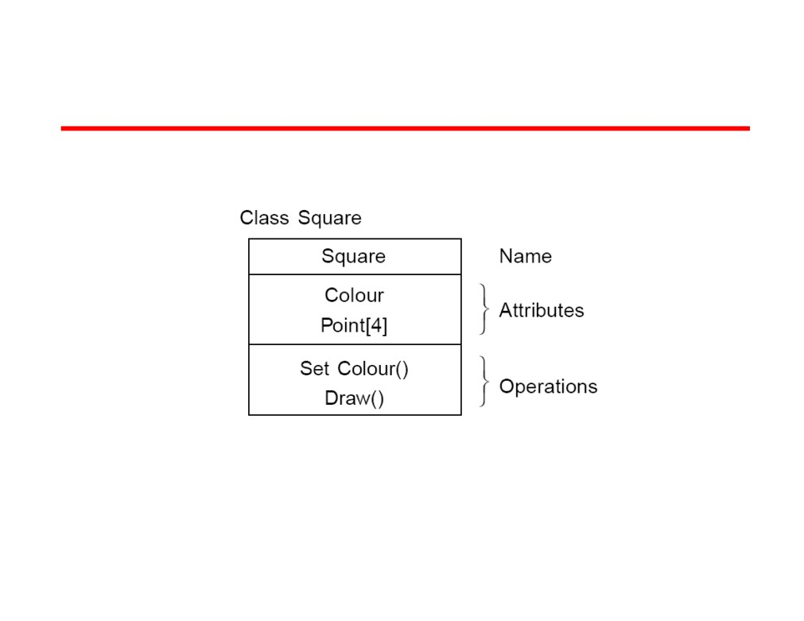
Software Design
Fig. 21: The square class
64

Slide 8
Software Design
v. Attributes
An attributes is a data value held by the objects in a class. The square
class has two attributes: a colour and array of points. Each attributes
has a value for each object instance. The attributes are shown as
second part of the class as shown in fig. 21.
vi. Operations
An operation is a function or transformation that may be applied to or
by objects in a class. In the square class, we have two operations: set
colour() and draw(). All objects in a class share the same operations.
An object “knows” its class, and hence the right implementation of the
operation. Operation are shown in the third part of the class as
indicated in fig. 21.
65

Slide 9
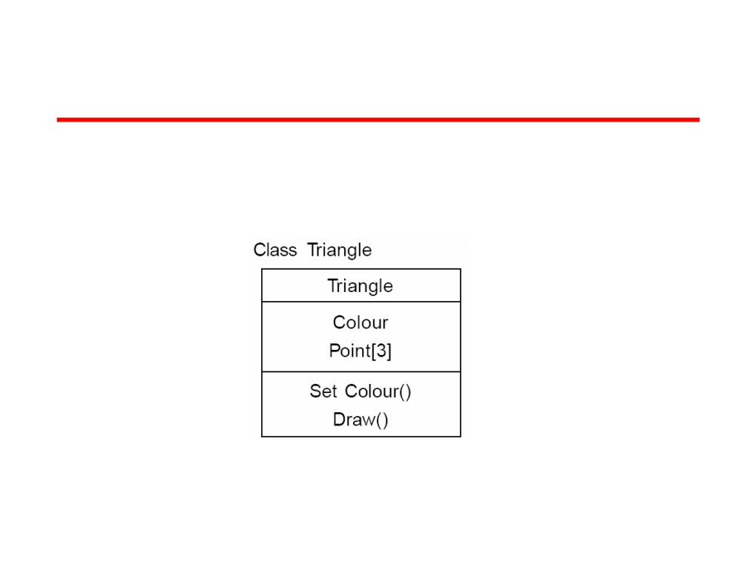
Software Design
vii. Inheritance
Imagine that, as well as squares, we have triangle class. Fig. 22 shows
the class for a triangle.
Fig. 22: The triangle class
66

Slide 10
Software Design
Now, comparing fig. 21 and 22, we can see that there is some
difference between triangle and squares classes.
For example, at a high level of abstraction, we might want to think of a
picture as made up of shapes and to draw the picture, we draw each
shape in turn. We want to eliminate the irrelevant details: we do not
care that one shape is a square and the other is a triangle as long as
both can draw themselves.
To do this, we consider the important parts out of these classes in to a
new class called Shape. Fig. 23 shows the results.
67

Slide 11
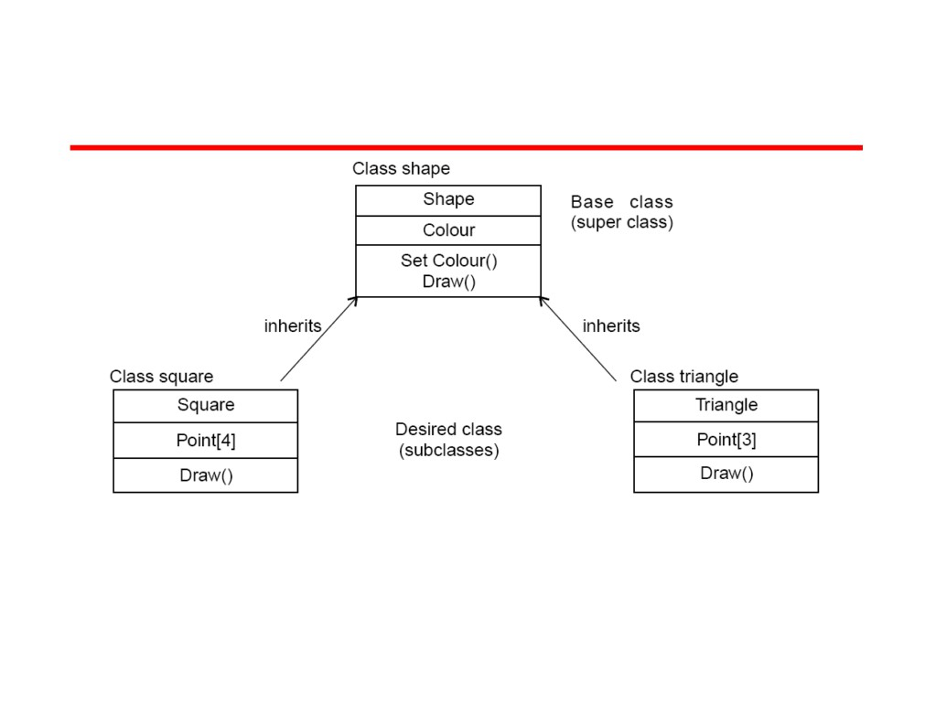
Software Design
Fig. 23: Abstracting common features in a new class
This sort of abstraction is called inheritance. The low level classes
(known as subclasses or derived classes) inherit state and behavior
from this high level class (known as a super class or base class).
68

Slide 12
Software Design
viii. Polymorphism
When we abstract just the interface of an operation and leave the
implementation to subclasses it is called a polymorphic operation and
process is called polymorphism.
ix. Encapsulation (Information Hiding)
Encapsulation is also commonly referred to as “Information Hiding”. It
consists of the separation of the external aspects of an object from the
internal implementation details of the object.
x. Hierarchy
Hierarchy involves organizing something according to some particular
order or rank. It is another mechanism for reducing the complexity of
software by being able to treat and express sub-types in a generic way.
69

Slide 13
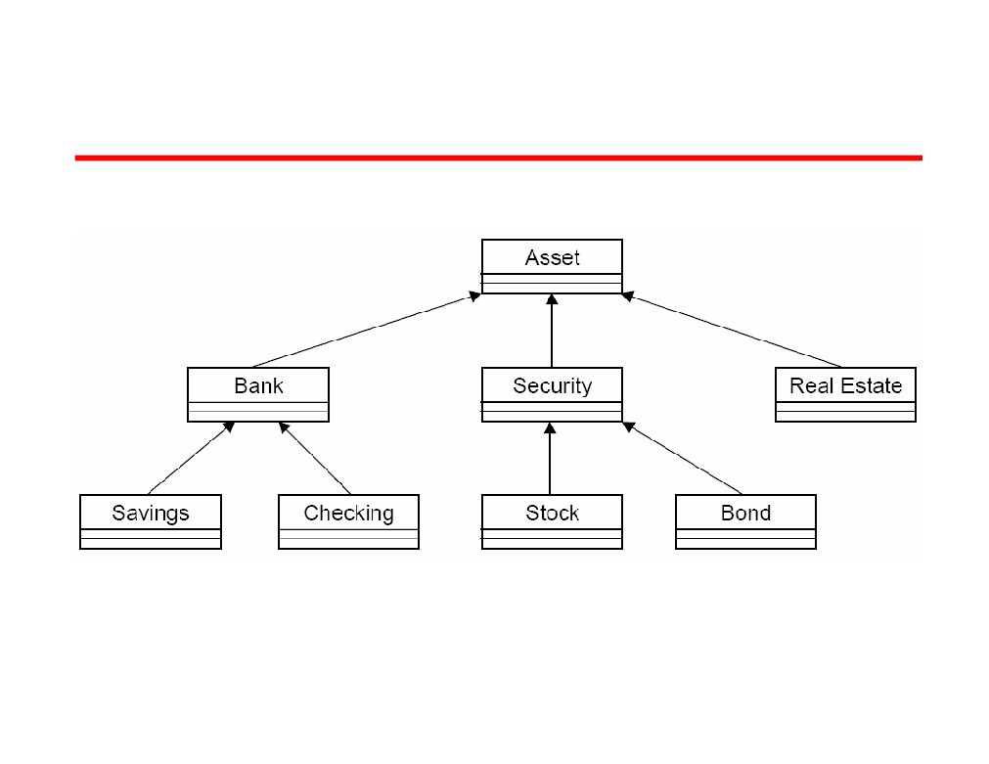
Software Design
Fig. 24: Hierarchy
7

Slide 14
Developing Class Models
Class diagrams used for different purposes during different times in the development life-cycle
  Models that are close to code
  vs.
  Models that support earlier modeling:
    For domain analysis
    For requirements specification
Class diagrams developed iteratively
  Details added over time during lifecycle
  Initially: missing names, multiplicities, other details

Slide 15
Design and Code Level Perspectives
What’s useful at the design level?
Your thoughts here:

Slide 16
Implementation Level Class Diagrams
Implementation
  Direct code implementation of each class in the diagram
  A blue-print for coding
Practical issue: How much detail?
    getters and setters?
    library classes like String?
    Reverse- and round-trip engineering tools
G-<number>
2/14/05

Slide 17
Documenting Your Objects
Need some kind of record of your definitions
  Your white-board?
  A simple glossary
  A data dictionary (perhaps in a CASE tool)
What to define?
  Attributes, operations for each class
  Also relationships between classes
Can you define classes of related objects?
  Inheritance, Java interfaces
G-<number>
2/14/05

Slide 18
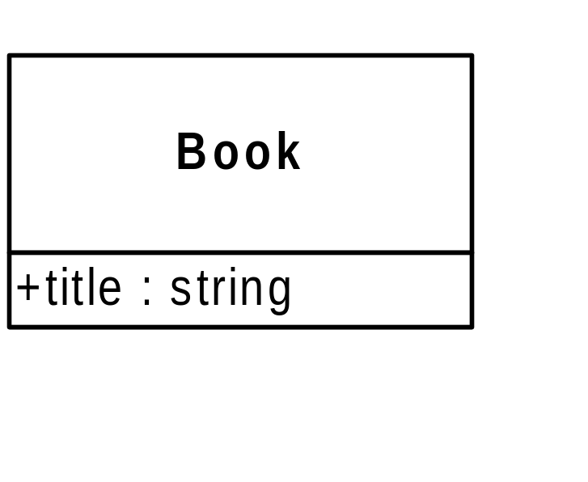
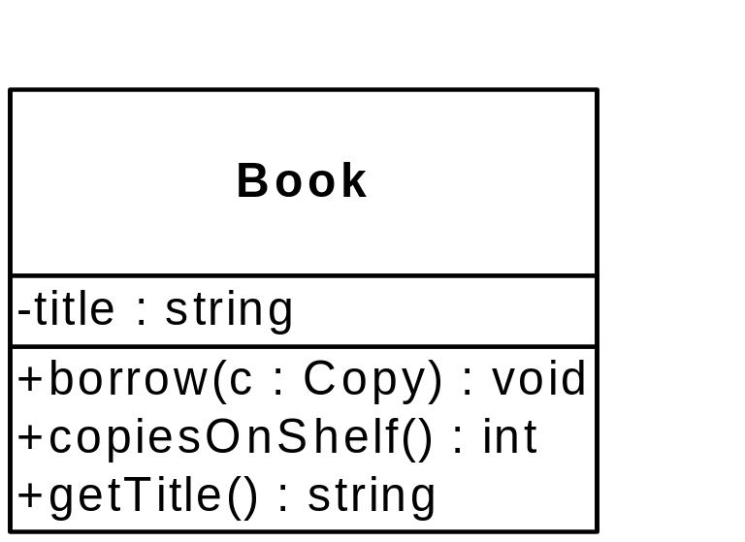
Classes in UML Diagrams
Attributes in middle
Operations at bottom
  Can be suppressed. (What level of abstraction?)
Attribute syntax:
name : type = default
Operation syntax:
name ( params) : return type
Visibility
+ public
- private
# protected etc.
nothing? Java’s default-
package?
G-<number>
2/14/05

Slide 19
Associations
For “real-world objects” is there an association between classes?
Classes A and B are associated if:
  An object of class A sends a message to an object of B
  An object of class A creates an instance of class B
  An object of class A has an attribute of type B or collections of objects of type B
  An object of class A receives a message with an argument that is an instance of B (maybe…)
    Will it “use” that argument?
Does an object of class A need to know about some object of class B?
G-<number>
2/14/05

Slide 20
More on Associations
Associations should model the reality of the domain and allow implementation
Associations are between classes
  A link connects two specific objects
  Links are instances of associations
  Note we could draw an object diagram to show objects and links
    But often interaction diagrams are more useful for modeling objects
Note: In practice, early in modeling, we may not name associations
Note: One may choose to have a dynamic view associations: if at run-time two objects exchange messages, their classes must be associated
G-<number>
2/14/05

Slide 21
Multiplicity
Also known as cardinality
Objects from two classes are linked, but how many?
  An exact number: indicated by the number
  A range: two dots between a pair of numbers
  An arbitrary number: indicated by * symbol
  (Rare) A comma-separated list of ranges
Examples:
1 1..2 0..* 1..* * (same as 0..* but…)
Important: If class A has association X with class B
  The number of B’s for each A is written next to class B
  Or, follow the association past the name and then read the multiplicity
Implementing associations depends on multiplicity
G-<number>
2/14/05

Slide 22
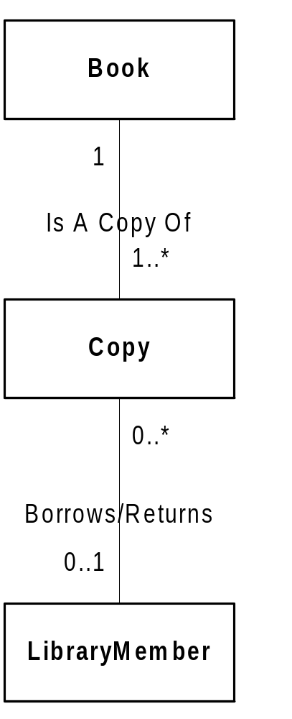
Examples of Associations
From a Library catalog example
One book has 1 or more copies
One copy is linked to exactly one book
Should there be two associations: borrows and returns?
One copy is borrowed by either zero or one LibraryMember
G-<number>
2/14/05

Slide 23
Generalization and Inheritance
You may model “inheritance” early but not implement it
  Generalization represents a relationship at the conceptual level
  Inheritance is an implementation technique
Generalization is just an association between classes
  But so common we put a “triangle” at the superclass
Note this is a relationship between classes
  So no multiplicities are marked. Why not?
Inheritance may not be appropriate when it’s time to implement
  Objects should never change from one subclass to another
  Composition can be used instead
G-<number>
2/14/05

Slide 24
Aggregation and Composition
Again, just a specific kind of association between classes
  An object of class A is part of an object of class B
  A part-whole relationship
Put a diamond on the end of the line next to the “whole”
  Aggregation (hollow diamond): really no semantics about what this means!
  Composition (solid diamond): a stronger relationship
G-<number>
2/14/05

Slide 25
Aggregation and Composition (cont’d)
Composition
  The whole strongly owns the parts
  Parts are copied (deleted, etc.) if the whole is copied (deleted, etc.)
  A part cannot be part of more than one whole
  Mnemonic: the stronger relationship is indicated by the stronger symbol (it’s solid)
Aggregation and composition associations are not named
They do have multiplicities
They can be used too often. If in doubt, use a “plain”, named association.
G-<number>
2/14/05

Slide 26
Example 1: University Courses
Some instructors are professors, while others have job title adjunct
Departments offer many courses, but a course may be offered by >1 department
Courses are taught by instructors, who may teach up to three courses
Instructors are assigned to one (or more) departments
One instructor also serves a department chair
G-<number>
2/14/05

Slide 27
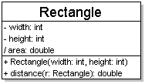
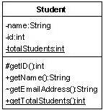
Diagram of one class
class name in top of box
  write <<interface>> on top of interfaces' names
  use italics for an abstract class name
attributes (optional)
  should include all fields of the object
operations / methods (optional)
  may omit trivial (get/set) methods
    but don't omit any methods from an interface!
  should not include inherited methods

Slide 28
Class attributes
attributes (fields, instance variables)
  visibility name : type [count] = default_value
  visibility: + public
  # protected
  - private
  ~ package (default)
  / derived
  underline static attributes
  derived attribute: not stored, but can
  be computed from other attribute values
  attribute example:
  - balance : double = 0.00

Slide 29
Class operations / methods
operations / methods
  visibility name (parameters) : return_type
  visibility: + public
  # protected
  - private
  ~ package (default)
  underline static methods
  parameter types listed as (name: type)
  omit return_type on constructors and
  when return type is void
  method example:
  + distance(p1: Point, p2: Point): double

Slide 30
Relationships btwn. classes
generalization: an inheritance relationship
  inheritance between classes
  interface implementation
association: a usage relationship
  dependency
  aggregation
  composition

Slide 31
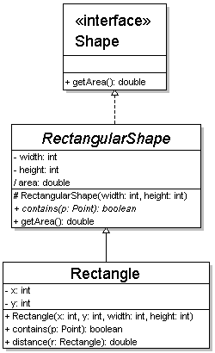
Generalization relationships
generalization (inheritance) relationships
  hierarchies drawn top-down with arrows pointing upward to parent
  line/arrow styles differ, based on whether parent is a(n):
    class:
    solid line, black arrow
    abstract class:
    solid line, white arrow
    interface:
    dashed line, white arrow
  we often don't draw trivial / obvious generalization relationships, such as drawing the Object class as a parent

Slide 32
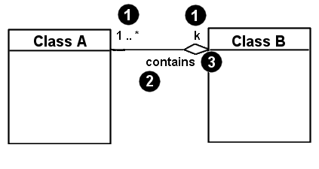
Associational relationships
associational (usage) relationships
  1. multiplicity (how many are used)
    * ⇒ 0, 1, or more
    1 ⇒ 1 exactly
    2..4 ⇒ between 2 and 4, inclusive
    3..* ⇒ 3 or more
  2. name (what relationship the objects have)
  3. navigability (direction)

Slide 33
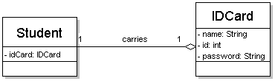
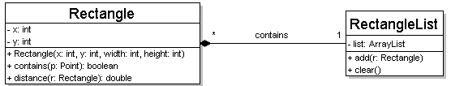
Multiplicity of associations
one-to-one
  each student must carry exactly one ID card
one-to-many
  one rectangle list can contain many rectangles

Slide 34
Association types
Car
1
1
aggregation
aggregation: "is part of"
  symbolized by a clear white diamond
composition: "is entirely made of"
  stronger version of aggregation
  the parts live and die with the whole
  symbolized by a black diamond
dependency: "uses temporarily"
  symbolized by dotted line
  often is an implementation
  detail, not an intrinsic part of
  that object's state
Engine
Book
composition
1
*
Page
dependency
Lottery
Ticket
Random

Slide 35
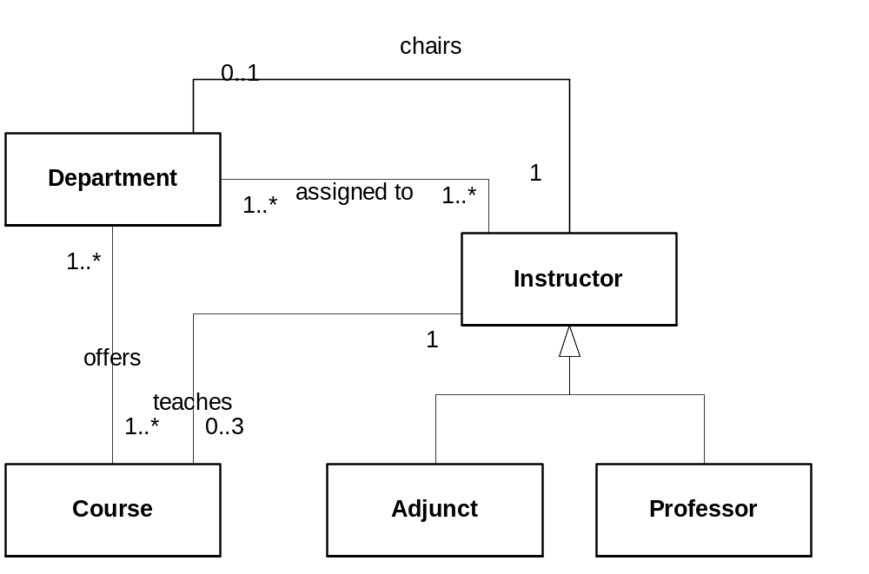
Class Diagram for Univ. Courses
Note this implies adjuncts can be chairs
G-<number>
2/14/05

Slide 36
Example 2: Problem Report Tool
A CASE tool for storing and tracking problem reports
  Each report contains a problem description and a status
  Each problem can be assigned to someone
  Problem reports are made on one of the “artifacts” of a project
  Employees are assigned to a project
  A manager may add new artifacts and assign problem reports to team members
G-<number>
2/14/05

Slide 37
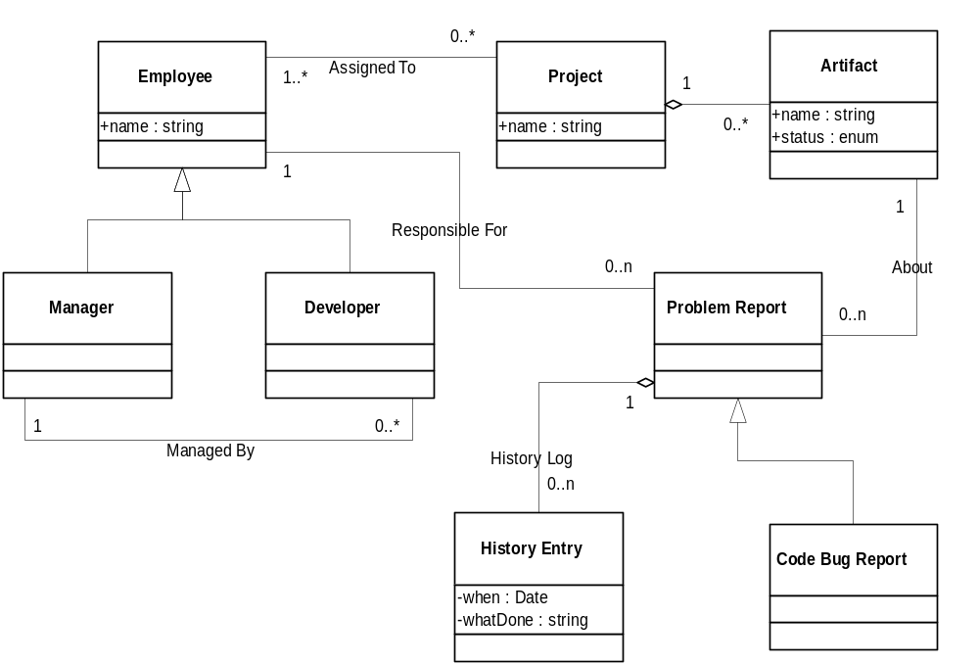
Class Diagram for Prob. Rep. Tool
G-<number>
2/14/05

Slide 38

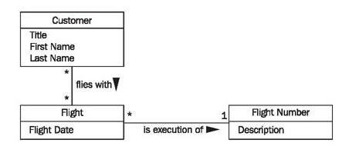
G-<number>
2/14/05

Slide 39
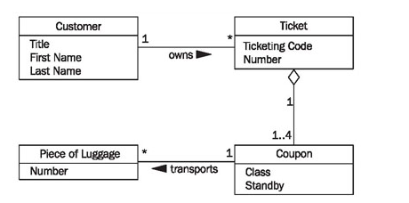
G-<number>
2/14/05

Slide 40
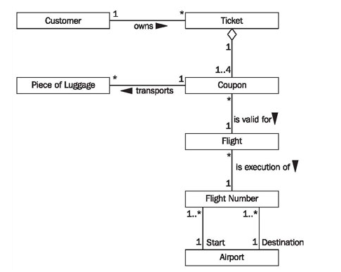
G-<number>
2/14/05

Slide 41
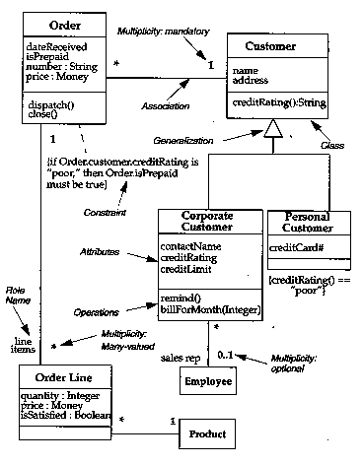
Example from Fowler
G-<number>
2/14/05

Slide 42
More on Associations: Navigability
One reason for having an association between classes:
Messages between objects of those classes
But, often “knowledge” indicated by association is only in one direction
  Example: In a computer system, a User needs access to his/her Password
  From a Password object we should not be able to get back to a User!
Note: Often ignored until design!
G-<number>
2/14/05

Slide 43
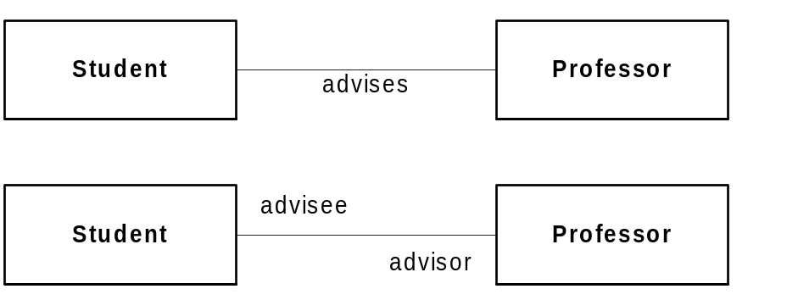
More on Associations: Roles
Review:
  Associations have an optional name
  Name might have a “direction” indicator
But, direction or semantics often easier to understand if we simply but a role name at one or both ends of the line
G-<number>
2/14/05

Slide 44
Dependencies
Dependency: A using relationship between two classes
  A change in the specification of one class may affect the other
  But not necessarily the reverse
Booch says: use dependencies not associations when one class uses another class as an argument in an operation.
Often used for other things in UML: A general relationship between “things” in UML
  Often use a stereotype to give more info
Uses: binding C++ class to template; Java interfaces; a class only instantiates objects (a factory)
G-<number>
2/14/05

Slide 45
Interfaces
Interface: specifies a set of operations that any class implementing or realizing the interface must provide
  More than one class may realize one interface
  One class may realize more than one interface
  No attributes, and no associations
Notation:
  Use <<interface>> with a class; list operations
  “Lollipop” notation
G-<number>
2/14/05

Slide 46
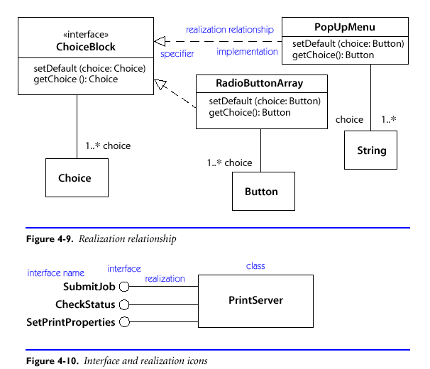
Interface Example Diagram
G-<number>
2/14/05

Slide 47
Classes Realize an Interface
“Realizes” AKA implements, supports, matches, etc.
This means that class provides all the operations in the interface (and more?)
  Remember, no implementation in interface definition
Realization shown with dashed line, hollow arrow
  Like dependency plus generalization
Why have this?
  Just factor out common functionality?
Better “pluggability”, extensibility
G-<number>
2/14/05

Slide 48
Tagged Values, Properties
Every modeling element in UML has its set of properties
  Classes have: name, attributes, operations, etc.
  What if we want to add our own? (e.g. author?)
Just add text in curly-brackets, with name=value, and put below the element name
Note: These tell you something about the model, not about the final system to be built!
  Often used for code generation, version control, etc.
Example: {abstract} classes instead of italics
G-<number>
2/14/05

Slide 49
Abstract Classes
Implementation not provided for one or more operations
  So, a subclass must extend this to provide implementations
How to show this in UML?
  Either italics for class name and operations
  Or, use {abstract} property by name
An abstract class with no attributes and all abstract operations is effectively an interface
  But Java provides a direct implementation
G-<number>
2/14/05

Slide 50
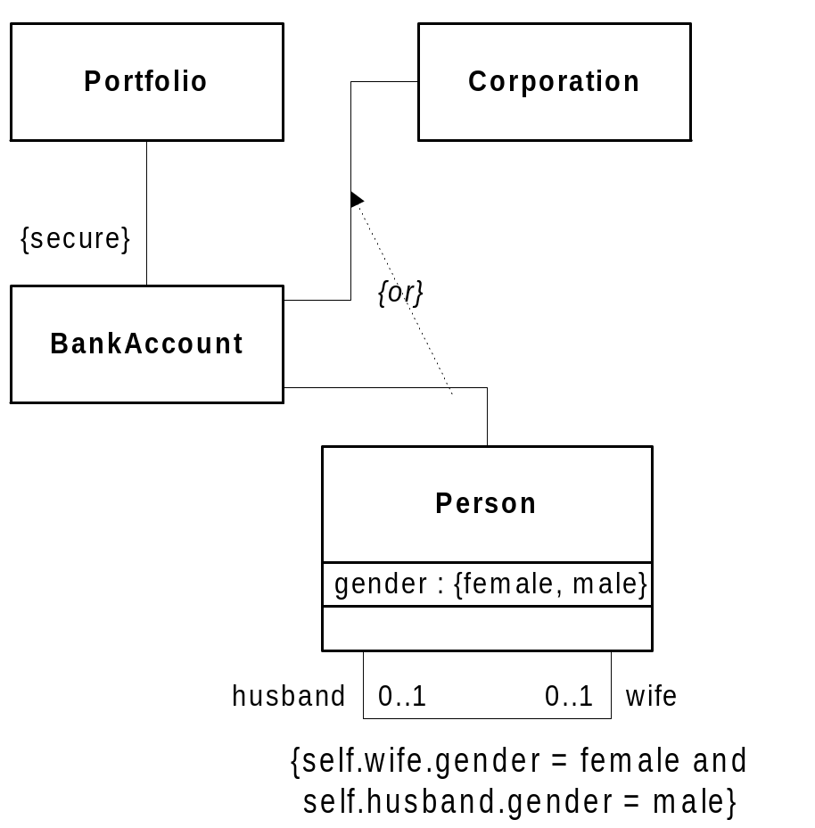
Constraints
Conditions that restrict values, relationships,…
Can be free text or Object Constraint Langauge (OCL)
(see textbook)
Recommendation: Use sparingly!
This example: from UML User Guide, p. 82
G-<number>
2/14/05

Slide 51
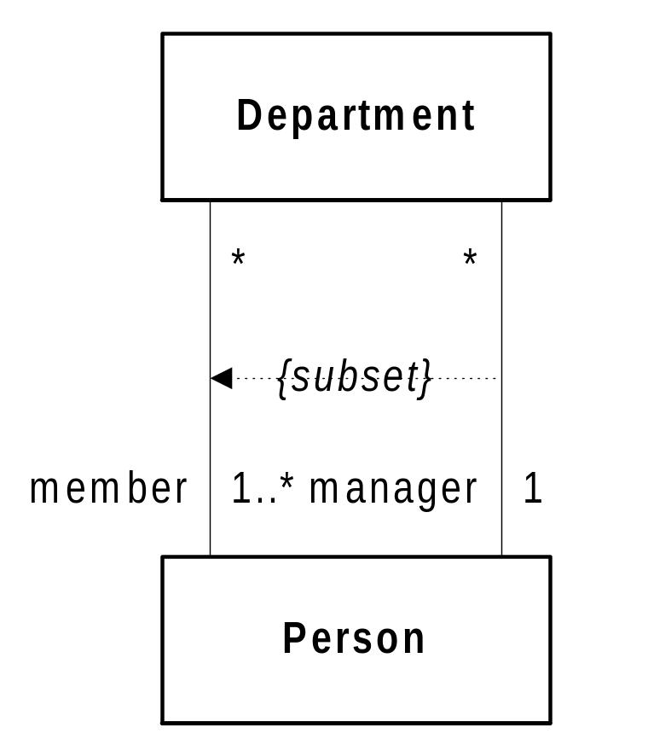
Constraints and Semantics
Example from UML User Guide, p. 88
A dependency and a constraint used
Shows Manager must be one of Members of a Department
One link (say, Jane-to-DeptA) is a subset of all links between Persons and DeptA
G-<number>
2/14/05

Slide 52
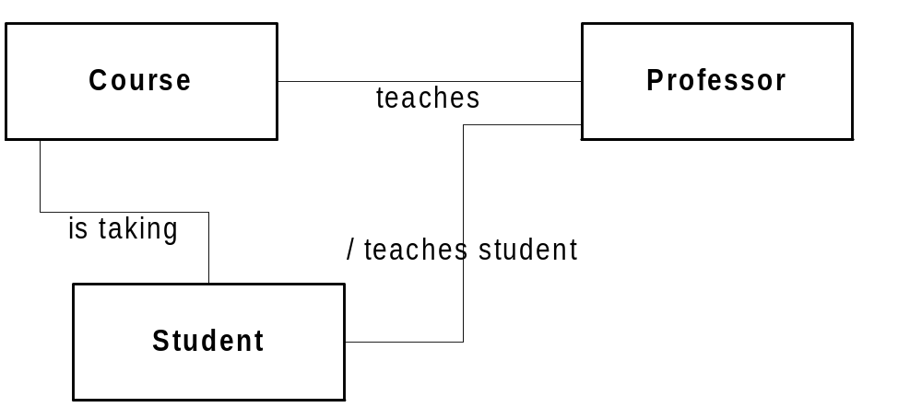
Derived Associations
Often an association in a model be deduced from the existence of one or more other associations
Do we show it? Is it redundant?
Option: Draw it but mark it as derived
  Use a slash symbol / before name
Can use slash in front of class attributes too!
G-<number>
2/14/05

Slide 53
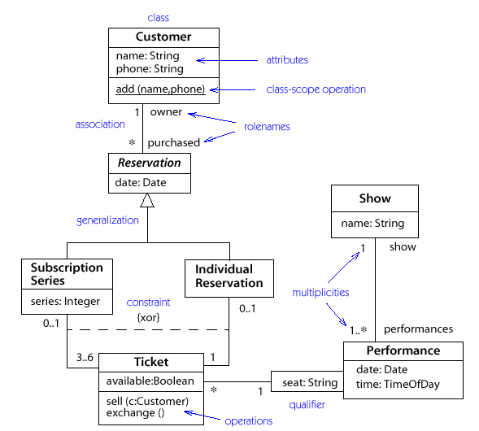
Example: Ticket Sales
G-<number>
2/14/05

Slide 54
Association Classes
Recall that qualified associations really mean that the link between two objects has an attribute
Often associations are “first-class” things
  They have a life-time, state, and maybe operations
  Just like objects!
Association classes
  Same name as the association because...
  They represent the same thing!
G-<number>
2/14/05

Slide 55
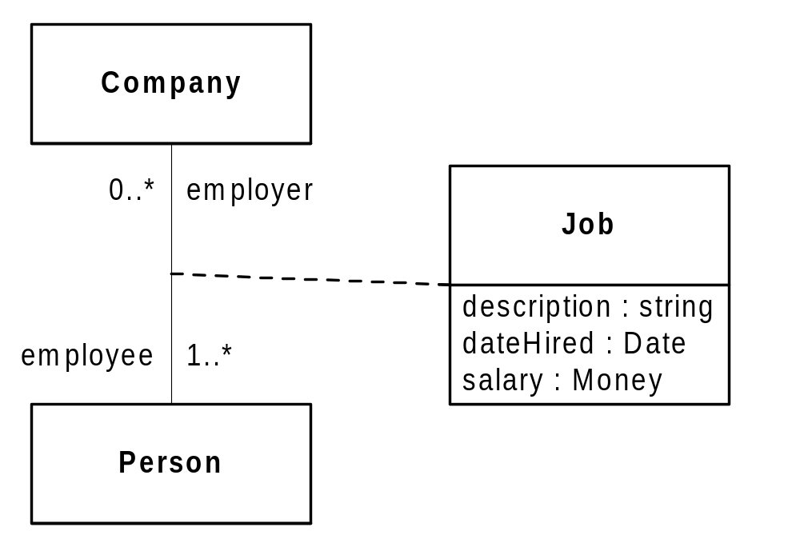
Association Class Example
G-<number>
2/14/05

Slide 56
World Cup Example
We need a system to handle the World Cup. Teams represent countries and are made up of 22 players.
Countries qualify from zones, where each zone is either a country or a group of countries.
Each team plays a given number of games in a specific city. Referees are assigned to games. Hotel reservations are made in the city where the teams play.
G-<number>
2/14/05

Slide 57
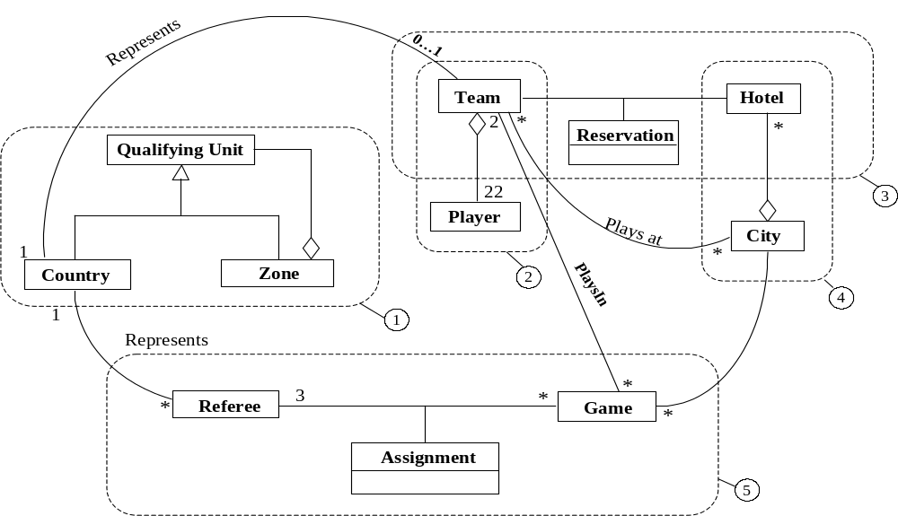
World Cup Problem: Class Model

Slide 58
Qualified Associations
Equivalent to programming language idea of lookup, map, dictionary, associative array, etc.
An object is associated with some number of other objects in a class
  How do we identify which one we want given that association?
The qualifier documents attribute(s) used to identify which object
  The “key” for “lookup”
Formally, these are attributes of the association

Slide 59
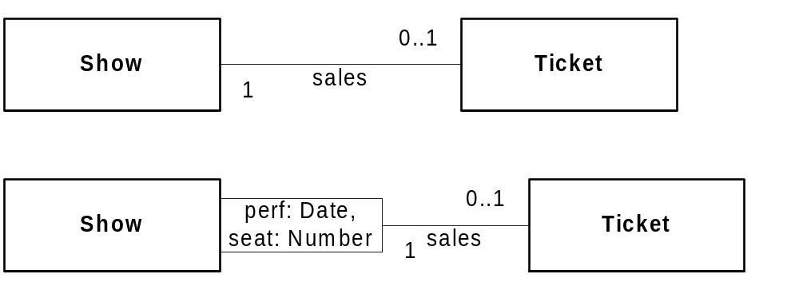
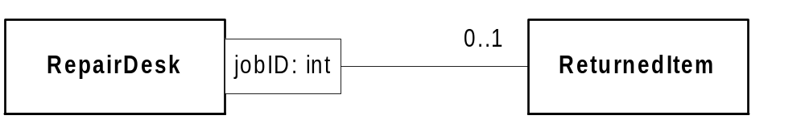
Qualified Association Examples:

Slide 60
Identifying Classes for Requirements
From textual descriptions or requirements or use cases, how do we get classes?
Various techniques, and practice!
  Key Domain Abstractions:
    Real-world entities in your problem domain
  Noun identification
    Not often useful (but easy to describe)
Remember: external view of the system for requirements
  Not system internals, not design components!

Slide 61
Actors and Classes
In some diagrams, actors represented as class boxes
  With special stereotype above class name:
  <<actor>>
UML allows special graphical symbol (e.g. a stick figure) to replace stereotyped classes
  See Richter, p. 53

