Slide 1
Object-Oriented Software Engineering
Practical Software Development using UML and Java
Chapter 2:
Review of Object Orientation

Slide 2
2.1 What is Object Orientation?
Procedural paradigm:
  Software is organized around the notion of procedures
  Procedural abstraction
    Works as long as the data is simple
  Adding data abstractions
    Groups together the pieces of data that describe some entity
    Helps reduce the system’s complexity.
      Such as Records and structures
Object oriented paradigm:
  Organizing procedural abstractions in the context of data abstractions
© Lethbridge/Laganière 2005
Chapter 2: Review of Object Orientation

Slide 3
Object Oriented paradigm
An approach to the solution of problems in which all computations are performed in the context of objects.
  The objects are instances of classes, which:
    are data abstractions
    contain procedural abstractions that operate on the objects
  A running program can be seen as a collection of objects collaborating to perform a given task
© Lethbridge/Laganière 2005
Chapter 2: Review of Object Orientation

Slide 4
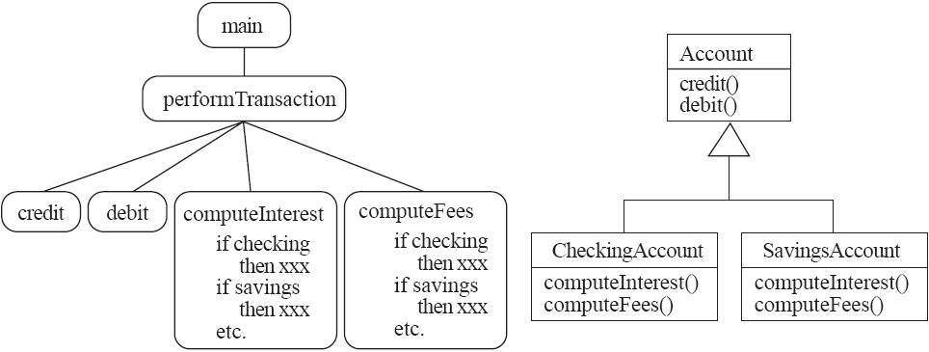
A View of the Two paradigms
See in Umple
© Lethbridge/Laganière 2005
Chapter 2: Review of Object Orientation

Slide 5
2.2 Classes and Objects
Object
  A chunk of structured data in a running software system
  Has properties
    Represent its state
  Has behaviour
    How it acts and reacts
    May simulate the behaviour of an object in the real world
© Lethbridge/Laganière 2005
Chapter 2: Review of Object Orientation

Slide 6
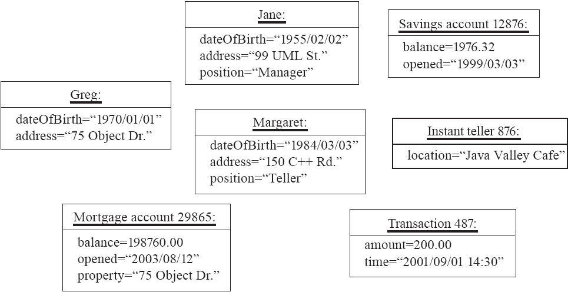
Objects
© Lethbridge/Laganière 2005
Chapter 2: Review of Object Orientation

Slide 7
Classes
A class:
  A unit of abstraction in an object oriented (OO) program
  Represents similar objects
    Its instances
  A kind of software module
    Describes its instances’ structure (properties)
    Contains methods to implement their behaviour
© Lethbridge/Laganière 2005
Chapter 2: Review of Object Orientation

Slide 8
Is Something a Class or an Instance?
  Something should be a class if it could have instances
  Something should be an instance if it is clearly a single member of the set defined by a class
Film
  Class; instances are individual films.
Reel of Film:
  Class; instances are physical reels
Film reel with serial number SW19876
  Instance of ReelOfFilm
Science Fiction
  Instance of the class Genre.
Science Fiction Film
  Class; instances include ‘Star Wars’
Showing of ‘Star Wars’ in the Phoenix Cinema at 7 p.m.:
  Instance of ShowingOfFilm
© Lethbridge/Laganière 2005
Chapter 2: Review of Object Orientation

Slide 9
Naming classes
  Use capital letters
    E.g. BankAccount not bankAccount
  Use singular nouns
  Use the right level of generality
    E.g. Municipality, not City
  Make sure the name has only one meaning
    E.g. ‘bus’ has several meanings
© Lethbridge/Laganière 2005
Chapter 2: Review of Object Orientation

Slide 10
2.3 Instance Variables
Variables defined inside a class corresponding to data present in each instance
  Also called fields or member variables
  Attributes
    Simple data
    E.g. name, dateOfBirth
  Associations
    Relationships to other important classes
    E.g. supervisor, coursesTaken
    More on these in Chapter 5
© Lethbridge/Laganière 2005
Chapter 2: Review of Object Orientation

Slide 11
Variables vs. Objects
A variable
  Refers to an object
  May refer to different objects at different points in time
An object can be referred to by several different variables at the same time
Type of a variable
  Determines what classes of objects it may contain
© Lethbridge/Laganière 2005
Chapter 2: Review of Object Orientation

Slide 12
Class variables
A class variable’s value is shared by all instances of a class.
  Also called a static variable
  If one instance sets the value of a class variable, then all the other instances see the same changed value.
  Class variables are useful for:
    Default or ‘constant’ values (e.g. PI)
    Lookup tables and similar structures
  Caution: do not over-use class variables
© Lethbridge/Laganière 2005
Chapter 2: Review of Object Orientation

Slide 13
2.4 Methods, Operations and Polymorphism
Operation
  A higher-level procedural abstraction that specifies a type of behaviour
  Independent of any code which implements that behaviour
    E.g. calculating area (in general)
© Lethbridge/Laganière 2005
Chapter 2: Review of Object Orientation

Slide 14
Methods, Operations and Polymorphism
Method
  A procedural abstraction used to implement the behaviour of a class
  Several different classes can have methods with the same name
    They implement the same abstract operation in ways suitable to each class
    E.g. calculating area in a rectangle is done differently from in a circle
© Lethbridge/Laganière 2005
Chapter 2: Review of Object Orientation

Slide 15
Polymorphism
A property of object oriented software by which an abstract operation may be performed in different ways in different classes.
  Requires that there be multiple methods of the same name
  The choice of which one to execute depends on the object that is in a variable
  Reduces the need for programmers to code many if-else or switch statements
© Lethbridge/Laganière 2005
Chapter 2: Review of Object Orientation

Slide 16
2.5 Organizing Classes into Inheritance Hierarchies
Superclasses
  Contain features common to a set of subclasses
Inheritance hierarchies
  Show the relationships among superclasses and subclasses
  A triangle shows a generalization
Inheritance
  The implicit possession by all subclasses of features defined in its superclasses
© Lethbridge/Laganière 2005
Chapter 2: Review of Object Orientation

Slide 17
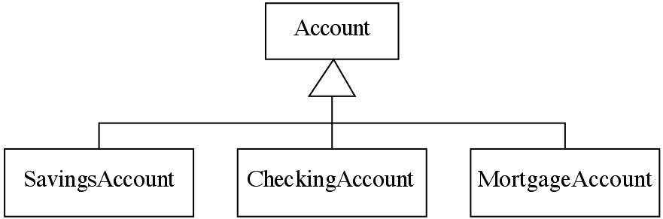
An Example Inheritance Hierarchy
See in Umple
Inheritance
  The implicit possession by all subclasses of features defined in its superclasses
© Lethbridge/Laganière 2005
Chapter 2: Review of Object Orientation

Slide 18
The Isa Rule
Always check generalizations to ensure they obey the isa rule
  “A current account is an account”
  A subclass must retain its distinctiveness throughout its life.
  Eg. Subclass→ OverdrawnAccount
  Is it Valid?
  All the inherited features must make sense in each subclass.
© Lethbridge/Laganière 2005
Chapter 2: Review of Object Orientation

Slide 19
Cont..
Generalizations and their resulting inheritance help to avoid duplication and improve reuse;
Poorly designed generalizations can actually cause more problems than they solve.
© Lethbridge/Laganière 2005
Chapter 2: Review of Object Orientation

Slide 20
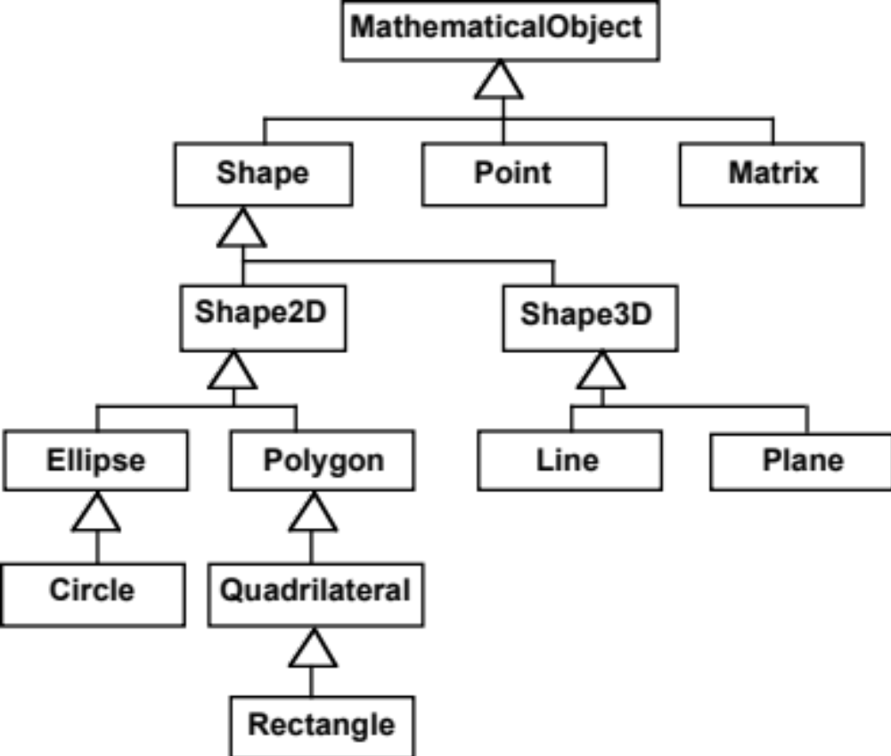
A possible inheritance hierarchy of mathematical objects
© Lethbridge/Laganière 2005
Chapter 2: Review of Object Orientation

Slide 21
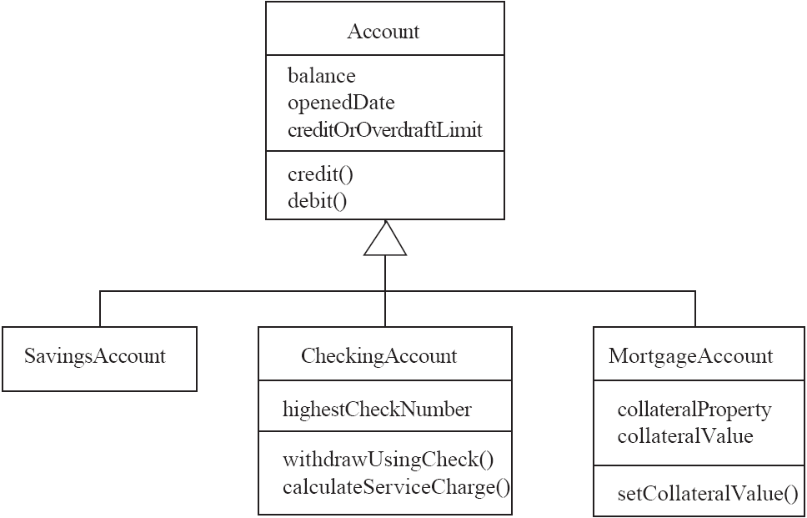
Make Sure all Inherited Features Make Sense in Subclasses
© Lethbridge/Laganière 2005
Chapter 2: Review of Object Orientation

Slide 22
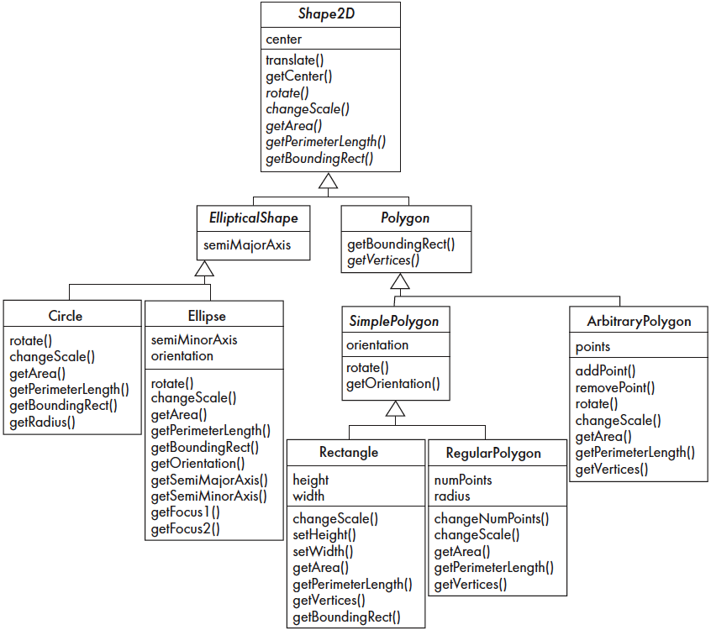
2.6 Inheritance, Polymorphism and Variables
© Lethbridge/Laganière 2005
Chapter 2: Review of Object Orientation

Slide 23
Overriding
If subclass (child class) has the same method as declared in the parent class, it is known as method overriding in Java.
In other words, If a subclass provides the specific implementation of the method that has been declared by one of its parent class, it is known as method overriding.
© Lethbridge/Laganière 2005
Chapter 2: Review of Object Orientation

Slide 24
Cont..
Method overriding is used to provide the specific implementation of a method which is already provided by its superclass.
Method overriding is used for runtime polymorphism
© Lethbridge/Laganière 2005
Chapter 2: Review of Object Orientation

Slide 25
Rules
The method must have the same name as in the parent class.
The method must have the same parameter as in the parent class.
There must be an IS-A relationship (inheritance).
© Lethbridge/Laganière 2005
Chapter 2: Review of Object Orientation

Slide 26
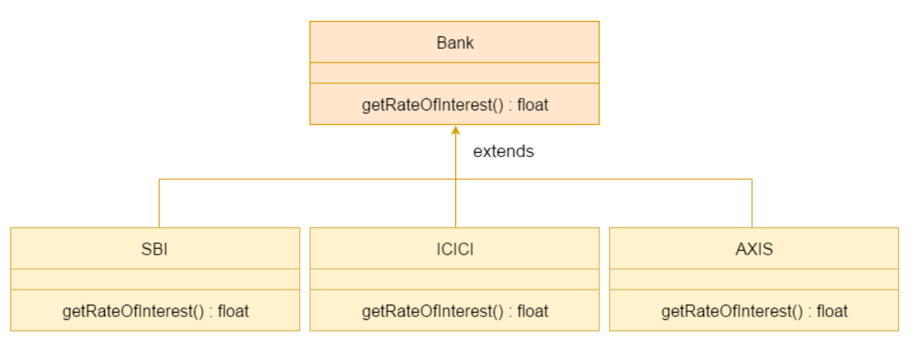
© Lethbridge/Laganière 2005
Chapter 2: Review of Object Orientation

Slide 27
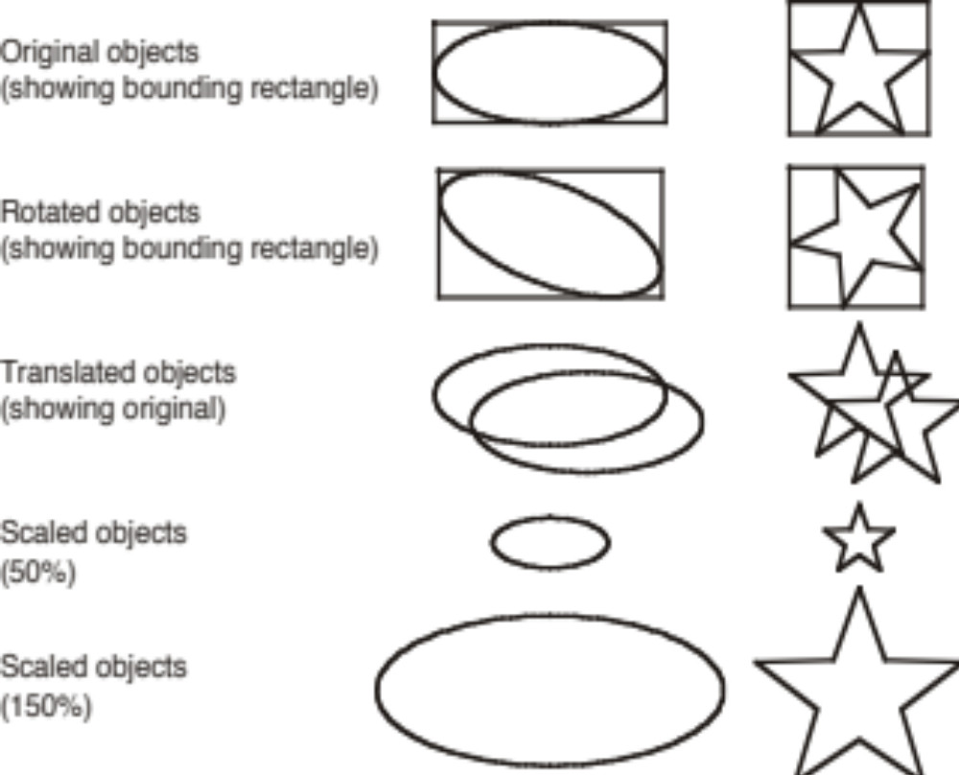
Some Operations in the Shape Example
© Lethbridge/Laganière 2005
Chapter 2: Review of Object Orientation

Slide 28
Abstract Classes and Methods
An operation should be declared to exist at the highest class in the hierarchy where it makes sense
  The operation may be abstract (lacking implementation) at that level
  If so, the class also must be abstract
    No instances can be created
    The opposite of an abstract class is a concrete class
  If a superclass has an abstract operation then its subclasses at some level must have a concrete method for the operation
    Leaf classes must have or inherit concrete methods for all operations
    Leaf classes must be concrete
© Lethbridge/Laganière 2005
Chapter 2: Review of Object Orientation

Slide 29
Overriding
A method would be inherited, but a subclass contains a new version instead
  For restriction
    E.g. scale(x,y) would not work in Circle
  For extension
    E.g. SavingsAccount might charge an extra fee following every debit
  For optimization
    E.g. The getPerimeterLength method in Circle is much simpler than the one in Ellipse
© Lethbridge/Laganière 2005
Chapter 2: Review of Object Orientation

Slide 30
How a decision is made about which method to run
1. If there is a concrete method for the operation in the current class, run that method.
2. Otherwise, check in the immediate superclass to see if there is a method there; if so, run it.
3. Repeat step 2, looking in successively higher superclasses until a concrete method is found and run.
4. If no method is found, then there is an error
  In Java and C++ the program would not have compiled
© Lethbridge/Laganière 2005
Chapter 2: Review of Object Orientation

Slide 31
Dynamic binding
Occurs when decision about which method to run can only be made at run time
  Needed when:
    A variable is declared to have a superclass as its type, and
    There is more than one possible polymorphic method that could be run among the type of the variable and its subclasses
© Lethbridge/Laganière 2005
Chapter 2: Review of Object Orientation

Slide 32
2.7 Concepts that Define Object Orientation
The following are necessary for a system or language to be OO
  Identity
    Each object is distinct from each other object, and can be referred to
    Two objects are distinct even if they have the same data
  Classes
    The code is organized using classes, each of which describes a set of objects
  Inheritance
    The mechanism where features in a hierarchy inherit from superclasses to subclasses
  Polymorphism
    The mechanism by which several methods can have the same name and implement the same abstract operation.
© Lethbridge/Laganière 2005
Chapter 2: Review of Object Orientation

Slide 33
Other Key Concepts
Abstraction
  Object -> something in the world
  Class -> objects
  Superclass -> subclasses
  Operation -> methods
  Attributes and associations -> instance variables
Modularity
  Code can be constructed entirely of classes
Encapsulation
  Details can be hidden in classes
  This gives rise to information hiding:
    Programmers do not need to know all the details of a class
© Lethbridge/Laganière 2005
Chapter 2: Review of Object Orientation

Slide 34
The Basics of Java
History
  The first object oriented programming language was Simula-67
    designed to allow programmers to write simulation programs
  In the early 1980’s, Smalltalk was developed at Xerox PARC
    New syntax, large open-source library of reusable code, bytecode, platform independence, garbage collection.
  late 1980’s, C++ was developed by B. Stroustrup,
    Recognized the advantages of OO but also recognized that there were tremendous numbers of C programmers
  In 1991, engineers at Sun Microsystems started a project to design a language that could be used in consumer ‘smart devices’: Oak
    When the Internet gained popularity, Sun saw an opportunity to exploit the technology.
    The new language, renamed Java, was formally presented in 1995 at the SunWorld ’95 conference.
© Lethbridge/Laganière 2005
Chapter 2: Review of Object Orientation

Slide 35
Java documentation
Looking up classes and methods is an essential skill
  Looking up unknown classes and methods will get you a long way towards understanding code
Java documentation can be automatically generated by a program called Javadoc
  Documentation is generated from the code and its comments
  You should format your comments as shown in some of the book’s examples
    These may include embeded html
© Lethbridge/Laganière 2005
Chapter 2: Review of Object Orientation

Slide 36
Overview of Java
The next few slides will remind you of several key Java features
  Not in the book
  See the book’s web site for
    A more detailed overview of Java
    Pointers to tutorials, books etc.
© Lethbridge/Laganière 2005
Chapter 2: Review of Object Orientation

Slide 37
Characters and Strings
Character is a class representing Unicode characters
  More than a byte each
  Represent any world language
char is a primitive data type containing a Unicode character
String is a class containing collections of characters
  + is the operator used to concatenate strings
© Lethbridge/Laganière 2005
Chapter 2: Review of Object Orientation

Slide 38
Arrays and Collections
Arrays are of fixed size and lack methods to manipulate them
ArrayList is the most widely used class to hold a collection of other objects
  More powerful than arrays, but less efficient
Iterators are used to access members of Vectors
  Enumerations were formally used, but were more complex
    a = new ArrayList();
    Iterator i = a.iterator();
    while(i.hasNext())
    {
    aMethod(i.next());
    }
© Lethbridge/Laganière 2005
Chapter 2: Review of Object Orientation

Slide 39
Casting
Java is very strict about types
  If variable v is declared to have type X, you can only invoke operations on v that are defined in X or its superclasses
    Even though an instance of a subclass of X may be actually stored in the variable
  If you know an instance of a subclass is stored, then you can cast the variable to the subclass
    E.g. if I know a Vector contains instances of String, I can get the next element of its Iterator using:
    (String)i.next();
    To avoid casting you could also have used templates::
    a = ArrayList<String>; i=a.iterator(); i.next()
    using
© Lethbridge/Laganière 2005
Chapter 2: Review of Object Orientation

Slide 40
Exceptions
Anything that can go wrong should result in the raising of an Exception
  Exception is a class with many subclasses for specific things that can go wrong
Use a try - catch block to trap an exception
    try
    {
    // some code
    }
    catch (ArithmeticException e)
    {
    // code to handle division by zero
    }
© Lethbridge/Laganière 2005
Chapter 2: Review of Object Orientation

Slide 41
Interfaces
Like abstract classes, but cannot have executable statements
  Define a set of operations that make sense in several classes
  Abstract Data Types
A class can implement any number of interfaces
  It must have concrete methods for the operations
You can declare the type of a variable to be an interface
  This is just like declaring the type to be an abstract class
Important interfaces in Java’s library include
  Runnable, Collection, Iterator, Comparable, Cloneable
© Lethbridge/Laganière 2005
Chapter 2: Review of Object Orientation

Slide 42
Packages and importing
A package combines related classes into subsystems
  All the classes in a particular directory
Classes in different packages can have the same name
  Although not recommended
Importing a package is done as follows:
  import finance.banking.accounts.*;
© Lethbridge/Laganière 2005
Chapter 2: Review of Object Orientation

Slide 43
Access control
Applies to methods and variables
  public
    Any class can access
  protected
    Only code in the package, or subclasses can access
  (blank)
    Only code in the package can access
  private
    Only code written in the class can access
    Inheritance still occurs!
© Lethbridge/Laganière 2005
Chapter 2: Review of Object Orientation

Slide 44
Threads and concurrency
Thread:
  Sequence of executing statements that can be running concurrently with other threads
To create a thread in Java:
  1. Create a class implementing Runnable or extending Thread
  2. Implement the run method as a loop that does something for a period of time
  3. Create an instance of this class
  4. Invoke the start operation, which calls run
© Lethbridge/Laganière 2005
Chapter 2: Review of Object Orientation

Slide 45
Programming Style Guidelines
Remember that programs are for people to read
  Always choose the simpler alternative
  Reject clever code that is hard to understand
  Shorter code is not necessarily better
Choose good names
  Make them highly descriptive
  Do not worry about using long names
© Lethbridge/Laganière 2005
Chapter 2: Review of Object Orientation

Slide 46
Programming style …
Comment extensively
  Comment whatever is non-obvious
  Do not comment the obvious
  Comments should be 25-50% of the code
Organize class elements consistently
  Variables, constructors, public methods then private methods
Be consistent regarding layout of code
© Lethbridge/Laganière 2005
Chapter 2: Review of Object Orientation

Slide 47
Programming style …
Avoid duplication of code
  Do not ‘clone’ if possible
    Create a new method and call it
    Cloning results in two copies that may both have bugs
      When one copy of the bug is fixed, the other may be forgotten
© Lethbridge/Laganière 2005
Chapter 2: Review of Object Orientation

Slide 48
Programming style ...
Adhere to good object oriented principles
  E.g. the ‘isa rule’
Prefer private as opposed to public
Do not mix user interface code with non-user interface code
  Interact with the user in separate classes
    This makes non-UI classes more reusable
© Lethbridge/Laganière 2005
Chapter 2: Review of Object Orientation

Slide 49
2.10 Difficulties and Risks in Object-Oriented Programming
Language evolution and deprecated features:
  Java is evolving, so some features are ‘deprecated’ at every release
  But the same thing is true of most other languages
Efficiency can be a concern in some object oriented systems
  Java can be less efficient than other languages
    VM-based
    Dynamic binding
© Lethbridge/Laganière 2005
Chapter 2: Review of Object Orientation

