Slide 1
Recovery in Distributed Database
More Complicated than in a centralized system
Failures related to distributed database are:
Loss of message
Failure of site at which sub transaction is running
Failure of communication link
Recovery system must ensure ATOMICITY( All or NONE)

Slide 2
Two Phase Commit Protocol
In Distributed transaction, global transactions along with each of its sub-transactions should follow the property of “ATOMICITY” which will help to maintain consistency.
Two phase commit protocol ensures atomic commitment of distributed transactions.
It checks whether all site invloved in the execution of distributed transaction are ready to commit before their effects are made permanent

Slide 3
Two Modules
Co-ordinator
Participant
Co-ordinator
The process at the site where the transaction originates & which Controls the execution.
Participant
Processes at the other side that participate in executing the Transaction.

Slide 4

Voting Protocol
In this, participating sites vote on whether they are ready to commit the transaction or not
Decision Protocol
In this, the coordinator site decides whether the transaction can be committed or has to be aborted.

Slide 5
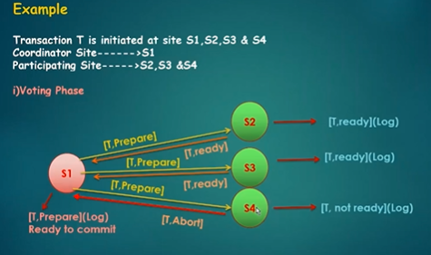

Slide 6
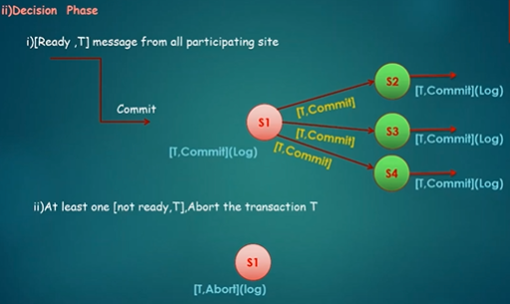

Slide 7
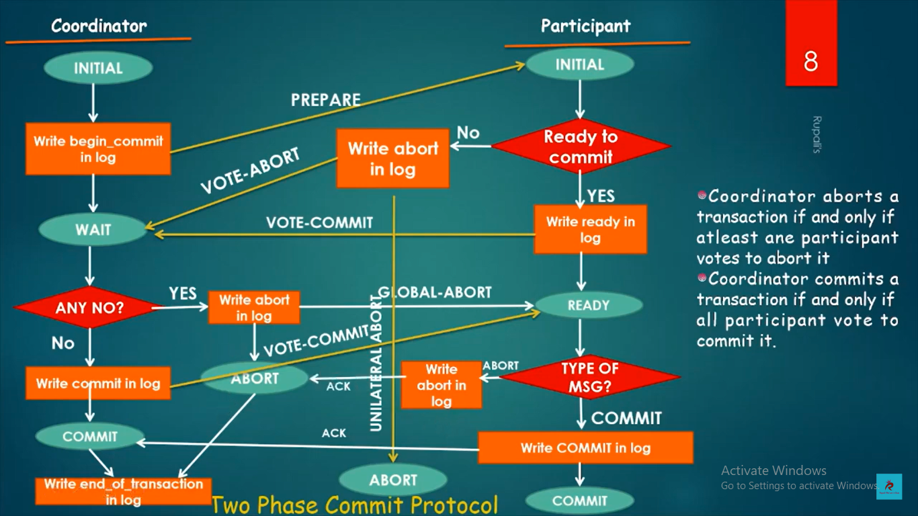

Slide 8
Failure of Participating site
Site fails before sending “ready T” (transaction is aborted)
Site fails after sending “Ready T” (proceeding normal way)
Recovery process when participating site restarts after failure: (log file checked)
LOG --- [T , Commit] Redo T }….Acknowledge [ T, Abort} undo T to coordinator site
LOG--- [T, Ready] --- site contacts the coordinator site to determine whether to commit or Abort T
No such record in LOG----- undo t and abort the transaction

Slide 9
Failure of Coordinators site
All the participating sites communicate with each other to determine status of ‘T’
Any site [t, commit] transaction has to be committed.
[t, abort] transaction has to be abort
2. No [t, ready] in log--- site has not voted for t so abort
3. No case holds--- participating site waits until coordinator site is recovered. Till this decision all participating sites are in blocking stage

Slide 10
Recovery process when coordinator site restarts after failure:
log [t,commit] redo t
[ t, abort] undo t --- share this message to all the participating sites
2. Log --- [t , prepare] --- abort t ---communicate to all the participating site.

Slide 11
Disadvantage
when the coordinator site failure may result in blocking, so a decision either to commit or abort transaction(T) may have to be postponed until coordinator recovers.

Slide 12
Three Phase Commit Protocol
Three Phase Commit Protocol that avoids blocking even if the coordinator site fails during recovery.
Here one or more state is added in between VOTING and DECISION Phase

Slide 13
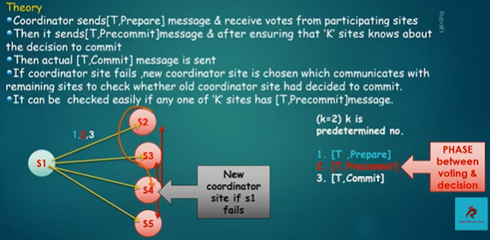

Slide 14
