Slide 1
Parallel Databases

Slide 2
Parallel Databases
Architecture
Data Partitioning Strategy
Interquery and Intraquery Parallelism
Parallel Query Optimization

Slide 3
Measuring Performance of a Database
Throughput
The number of tasks that can be completed in a given time interval
Response Time
The amount of time it takes to complete a single task from the time it is submitted

Slide 4
Single Processor, Single Disk Systems
Data
Main Memory
Data
Throughput and Response Time was not Satisfactory
Processor
Disk

Slide 5
Problems with Single Processor Systems
Growth of the internet lead to Millions of users accessing websites and increased data collection from users
Such huge data running in terabytes are used for data analytics and decision support.
Single processor systems cannot efficiently handle decision support queries on huge data.
Single processor systems cannot efficiently handle large number of concurrent transactions

Slide 6
Parallel Databases

Slide 7
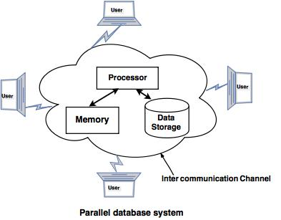

Slide 9
Parallel Databases
Parallel systems improve processing and I/O speeds by using multiple processors and disks in parallel.

Slide 10
Types of Parallel Machines
Coarse Grain Parallel Machine
A coarse-grain parallel machine consists of a small number of powerful processors
All high-end machines today offer some degree of coarse-grain parallelism: at least two or four processors
Fine Grain Parallel Machines
A Fine-grain parallel machine uses thousands of smaller processors.
They support a larger degree of parallelism

Slide 11
Measuring Performance of Parallel Processing Systems
Speedup
Scaleup

Slide 12
Speed up
Task1
Task1
Speedup = T_{S} / T_{L}
Time Taken( T_{L} )
Time Taken( T_{S})
P
P
P
P
D
D
D
D
Output
Output

Slide 13
Example - Speedup
If the original system took 60 seconds to perform the task and the parallel system with 3 parallel processors took 20 seconds to complete the task then
Speedup = 60/20 = 3
Speedup increases with the number of parallel processors.

Slide 14
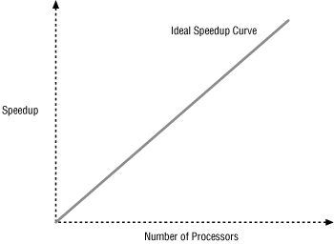
Speedup Curve

Slide 15
Scaleup - Example
Scaleup is the factor that expresses how much more work can be done in the same time period by a system n times larger.
If the original system can process 100 transactions in a given amount of time, and the parallel system can process 300 transactions in this amount of time, then the value of scaleup would be equal to 3. That is, 300/100 = 3

Slide 16
Scaleup
Volume_{S} = 100
Volume_{L} = 300
Task2
Task 100
Task2
Task4
Task1
Task1
Task3
Task300
Volume_{L} / Volume_{S}
P
P
P
Constant Time
P
Constant Time
D
D
D
D
Output
Output

Slide 17
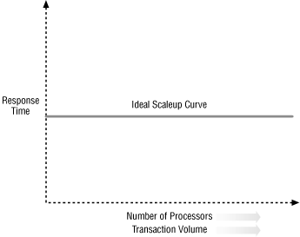
Scaleup Curve

Slide 18
Parallel Database Architecture
Shared Memory
Shared Disk
Shared Nothing

Slide 19
Shared Memory Architecture
Processor1
Processor2
Processor3
Processor4
cache
cache
cache
cache
Interconnection Network
Global Shared Primary Memory
Disk1
Disk2
Disk3
Disk4

Slide 20
Shared Memory
Multiple Processors share secondary disk storage and also share primary memory
In a shared memory system multiple processors are attached to an interconnection network and can access a common region of the main memory.

Slide 21
Advantages of Shared Memory Architecture
Efficient Communication between Processors
A Processor can send messages to another Processor by using Memory Writes

Slide 22
Shared Memory Disadvantages
Architecture is not scalable beyond 64 Processors
Communication Network is a Bottleneck
These Architectures have large memory caches at each processor. Maintaining Cache coherency becomes an increasing overhead.

Slide 23
Shared Disk Architecture
Each Processor has a private main memory and access to all disks using a common interconnection network
Multiple processors share secondary disk storage but each has their own primary memory

Slide 24
Shared Disk Architecture
Main Memory
Main Memory
Main Memory
Main Memory
Processor1
Processor2
Processor3
Processor4
Interconnection Network
Disk1
Disk2
Disk3
Disk4

Slide 25
Advantages/Disadvantages of Shared Disk Architecture
Fault Tolerance – If a Processor fails other processors can take up its task since all processors can access all disks.
Disadvantages – As we scale up the communication network becomes a bottleneck

Slide 26
Problems with Shared Memory and Shared Disk Architecture
As more Processors are added, the existing processors slow down because of increased memory contention and network bandwidth.
A system with 1000 Processors is only 4% percent as effective as a single processor system
Notes:
Memory contention:A situation in which two different programs, or two parts of a program, try to read items in the same block of memory at the same time.

Slide 27
Shared Nothing Architecture
Each processor has a local main memory and disk space.
No two processors can access the same storage area.
All communication between processors happen over a communication network.
There is a homogeneity of nodes in a shared nothing architecture

Slide 28
Shared Nothing Architecture
Disk 1
Disk 2
Disk 3
Disk 4
Main Memory
Main Memory
Main Memory
Main Memory
Processor 1
Processor 2
Processor 3
Processor 4
Interconnection Network

Slide 29
Advantages/Disadvantages of Shared Nothing Architectures
Communication network is used for non local disk access.
Each node functions as a server for the data
Drawback is that non local disk access is costly

Slide 30
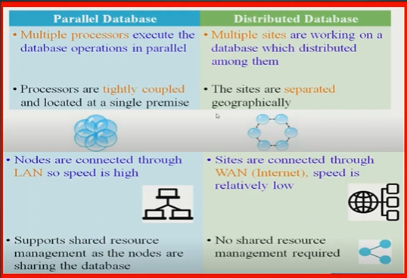

Slide 31
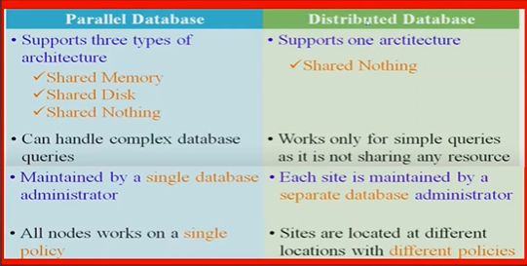

Slide 32
How Parallelism is achieved
Parallelism
I/O Parallelism
Round Robin
List
Interquery Parallelism
Intraquery
Parallelism
Hash
Range Partitioning
Intraoperation Parallelism
Interoperation
Parallelism

Slide 33
I/O Parallelism
I/O parallelism refers to reducing the time required to retrieve relations from disk by partitioning the relations on multiple disks.

Slide 34
Partitioning Example
Id | Name | Branch
1 | Sam | Chennai
2 | Ram | Vellore
3 | Tom | Mumbai
4 | Chris | Mumbai
5 | Jeff | Vellore
6 | Mohan | Vellore
7 | Rahul | Chennai

Slide 35
Horizontal Partitioning
Id | Name | Branch
1 | Sam | Chennai
2 | Ram | Vellore
3 | Tom | Mumbai
4 | Chris | Mumbai
5 | Jeff | Vellore
6 | Mohan | Vellore
7 | Rahul | Chennai
Id | Name | Branch
Id | Name | Branch
Id | Name | Branch
DISK 1
DISK 3
DISK 2

Slide 36
Basic Partitioning Strategies
Round Robin Partitioning
List Partitioning
Hash Partitioning
Range Partitioning

Slide 37
Round Robin Partitioning
This strategy scans the relation in any order and sends the ith tuple to disk number Di mod n.
The round-robin scheme ensures an even distribution of tuples across disks; that is, each disk has approximately the same number of tuples as the others.

Slide 38
Round Robin Partitioning
Id | Name | Branch
1 | Sam | Chennai
2 | Ram | Vellore
3 | Tom | Mumbai
4 | Chris | Mumbai
5 | Jeff | Vellore
6 | Mohan | Vellore
7 | Rahul | Chennai
1 mod 3=1
2 mod 3=2
3 mod 3=0
4 mod 3 =1
5 mod 3 = 2
6 mod 3 = 0
7 mod 3 = 1
i – record number
n – number disks
i mod n is used for splitting records
Id | Name | Branch
3 | Tom | Mumbai
6 | Mohan | Vellore
Id | Name | Branch
2 | Ram | Vellore
5 | Jeff | Vellore
Id | Name | Branch
1 | Sam | Chennai
4 | Chris | Mumbai
7 | Rahul | Chennai
DISK 0
DISK 2
DISK 1

Slide 39
Disadvantages
Only suitable for full table scans
Not suitable for point queries or range queries.
Select * from employee where name=‘sam’;
Select * from employee where id between 3
and 5;

Slide 40
List Partitioning
List partitioning enables you to explicitly control how rows map to partitions by specifying a list of discrete values for the partitioning key in the description for each partition.
For a table with a Branch column as the partitioning key, the Tamilnadu partition might contain values Chennai and Vellore , the Maharashtra partition might contain Mumbai

Slide 41
List Partitioning
Id | Name | Branch
1 | Sam | Chennai
2 | Ram | Vellore
3 | Tom | Mumbai
4 | Chris | Mumbai
5 | Jeff | Vellore
6 | Mohan | Vellore
7 | Rahul | Chennai
Partition Key - Branch
Tamilnadu Partition
Maharashtra Partition
Id | Name | Branch
1 | Sam | Chennai
2 | Ram | Vellore
5 | Jeff | Vellore
7 | Rahul | Chennai
Id | Name | Branch
3 | Tom | Mumbai
4 | Chris | Mumbai
DISK 1
DISK 0

Slide 42
Oracle Implementation
create table employee_branch(
id number,name varchar2(10),
branch varchar2(10), income number)
partition by list(branch)
(
partition Tamilnadu
values('chennai','vellore'),
partition Maharashtra
values('mumbai','pune')
);

Slide 43
Lets insert some Records

Slide 44
What happens when a user inserts a record with a branch that doesn’t match any partition?
insert into employee_branch values(1,'sam','trichy',5000);

Slide 45
Partition Key Error
SQL> insert into employee_branch values(1,'sam','trichy',5000);
insert into employee_branch values(1,'sam','trichy',5000)
*
ERROR at line 1:
ORA-14400: inserted partition key does not map to any partition

Slide 46
Default Partition
The DEFAULT partition enables you to avoid specifying all possible values for a list-partitioned table by using a default partition, so that all rows that do not map to any other partition do not generate an error.

Slide 47
Default Partition Oracle
create table employee_branch1(
id number,
name varchar2(10),
branch varchar2(10),
income number)
partition by list(branch)
(
partition Tamilnadu
values ('vellore','chennai'),
partition Maharashtra
values ('mumbai','pune'),
partition unknown_branch
values (default)
);

Slide 48
Inserting records
SQL> insert into employee_branch1 values(123,'sam','vellore',5000);
1 row created.
SQL> insert into employee_branch1 values(123,'sam','trichy',5000);
1 row created.

Slide 49
Viewing data from a partition
SELECT <column_name_list> FROM <table_name> PARTITION (<partition_name>);
SQL> select * from employee_branch partition (Tamilnadu);
ID NAME BRANCH INCOME
---------- ---------- ---------- ----------
1 sam vellore 5000
2 ram chennai 20000
SQL> select * from employee_branch partition (Maharashtra);
ID NAME BRANCH INCOME
---------- ---------- ---------- ----------
3 rahul mumbai 60000

Slide 50
Hash Partitioning
Hash partitioning maps data to partitions based on a hashing algorithm that applies to the partitioning key that you identify.
The hashing algorithm evenly distributes rows among partitions, giving partitions approximately the same size.

Slide 51
For example, consider the following table;
EMPLOYEE(ENo, EName, DeptNo, Salary, Age)
If we choose DeptNo attribute as the partitioning attribute and if we have 10 disks to distribute the data, then the following would be a hash function;
h(DeptNo) = DeptNo mod 10
If we have 10 departments, then according to the hash function, all the employees of department 1 will go into disk 1, department 2 to disk 2 and so on.
As another example, if we choose the EName of the employees as partitioning attribute, then we could have the following hash function;
h(EName) = (Sum of ASCII value of every character in the name) mod n,
where n is the number of disks/partitions needed.

Slide 52
Sample
Partition 1
Partition key Mod N
Hash function
Partition
Key
Partition 2
Partition 3

Slide 53
Hash Partitioning - oracle
create table employee_branch1(
id number,
name varchar2(10),
branch varchar2(10),
income number)
partition by hash(id)
(
partition p1,
partition p2,
partition p3);

Slide 54
Inserting some records
SQL> insert into employee_branch1 values(1,'sam','vellore',2000);
1 row created.
SQL> insert into employee_branch1 values(2,'ram','chennai',3000);
1 row created.
SQL> insert into employee_branch1 values(3,'tom','mumbai',4000);
1 row created.

Slide 55
Range Partitioning
Range partitioning strategy partitions the data based on the partitioning attributes values.
We need to find set of range vectors on which we are about to partition.
For example, the records with Salary range 100 to 5000 will be in disk 1, 5001 to 10000 in disk 2, and so on.

Slide 56
Range Partitioning
Id | Name | Branch | Salary
1 | Sam | Chennai | 1000
2 | Ram | Vellore | 5000
3 | Tom | Mumbai | 40000
4 | Chris | Mumbai | 20000
5 | Jeff | Vellore | 28000
6 | Mohan | Vellore | 3000
7 | Rahul | Chennai | 38000
Partition Key - Salary
<10000
10000 < 30000
>30000
<10000
>30000
10000 < 30000
Id | Name | Branch | Salary
1 | Sam | Chennai | 1000
2 | Ram | Vellore | 5000
6 | Mohan | Vellore | 3000
Id | Name | Branch | Salary
3 | Tom | Mumbai | 40000
7 | Rahul | Chennai | 38000
Id | Name | Branch | Salary
4 | Chris | Mumbai | 20000
5 | Jeff | Vellore | 28000

Slide 57
Oracle Implementation – Range Partitioning
create table employee_branch2(
id number,
name varchar2(10),
branch varchar2(10),
salary number)
partition by range(salary)
(
partition p0 values less than(10000),
partition p1 values less than(30000),
partition p2 values less than (maxvalue));

Slide 58
Lets Insert some records
SQL> insert into employee_branch2 values(1,'sam','vellore',1000);
1 row created.
SQL> insert into employee_branch2 values(2,'ram','chennai',25000);
1 row created.
SQL> insert into employee_branch2 values(3,'tom','mumbai',35000);
1 row created.

Slide 59
Viewing Records from each partition
SQL> select * from employee_branch2 partition(p0);
ID NAME BRANCH SALARY
---------- ---------- ---------- ----------
1 sam vellore 1000
SQL> select * from employee_branch2 partition(p1);
ID NAME BRANCH SALARY
---------- ---------- ---------- ----------
2 ram chennai 25000

Slide 60
Viewing Records from each partition
SQL> select * From employee_branch2 partition(p2);
ID NAME BRANCH SALARY
---------- ---------- ---------- ----------
3 tom mumbai 35000

Slide 61
Inserting a record into the partition
insert into employee_branch2 partition(p0) values(54,'Jim','US',8000);

Slide 62
Updating a record in a partition
update employee_branch2 partition(p0) set name='waters' where id=1;

Slide 63
Delete a record from a partition
delete from employee_branch2 partition(p0) where id=54;

Slide 64
Viewing Partitions on a table
select table_name,partition_name from user_tab_partitions;

Slide 65
Partitioning Techniques and their Support for different type of access
Round Robin –
Useful for reading entire relations
Point queries and Range Queries should access all n disks and is complicated to process.
Hash Partitioning
Good for point or range queries on the partitioning attribute
Not good for point or range queries on non partitioning attribute

Slide 66
Partitioning Techniques and their Support for different type of access
Range Partitioning–
Well suited for range and point queries on the partitioning attribute

Slide 67
Handling of Skew
Skew – Some partition gets more tuples and some partition gets lesser tuples
Two Types of Skew
Attribute-Skew
Partition Skew

Slide 68
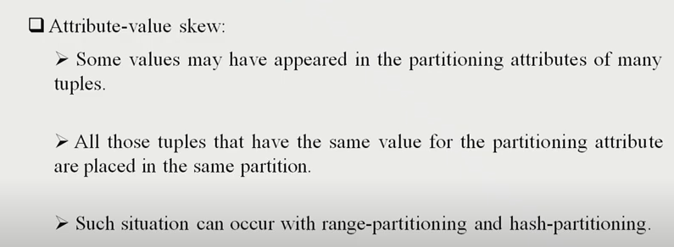

Slide 69
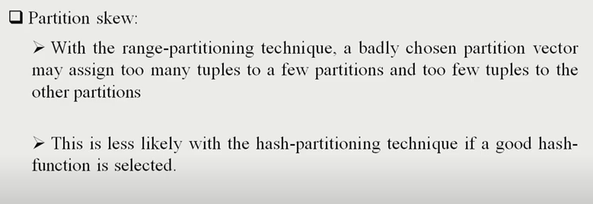

Slide 70
Attribute value Skew
Id | Name | Branch
1 | Sam | Chennai
2 | Ram | Vellore
3 | Tom | Mumbai
4 | Chris | Trichy
5 | Jeff | Vellore
6 | Mohan | Vellore
7 | Rahul | Chennai
Partition Key - Branch
Tamilnadu Partition
Maharashtra Partition
Id | Name | Branch
1 | Sam | Chennai
2 | Ram | Vellore
5 | Jeff | Vellore
7 | Rahul | Chennai
4 | Chris | Trichy
Id | Name | Branch
3 | Tom | Mumbai
DISK 0
DISK 1

Slide 71
Partition Skew
Id | Name | Branch | Salary
1 | Sam | Chennai | 1000
2 | Ram | Vellore | 5000
3 | Tom | Mumbai | 40000
4 | Chris | Mumbai | 20000
5 | Jeff | Vellore | 28000
6 | Mohan | Vellore | 3000
7 | Rahul | Chennai | 38000
Partition Key - Salary
<1000
1001 < 30000
>30000
<1000
>30000
1001 < 30000
Id | Name | Branch | Salary
Id | Name | Branch | Salary
3 | Tom | Mumbai | 40000
7 | Rahul | Chennai | 38000
Id | Name | Branch | Salary
4 | Chris | Mumbai | 20000
5 | Jeff | Vellore | 28000
1 | Sam | Chennai | 1000
2 | Ram | Vellore | 5000
6 | Mohan | Vellore | 3000

