Slide 1
Data Partitions Examples

Slide 2
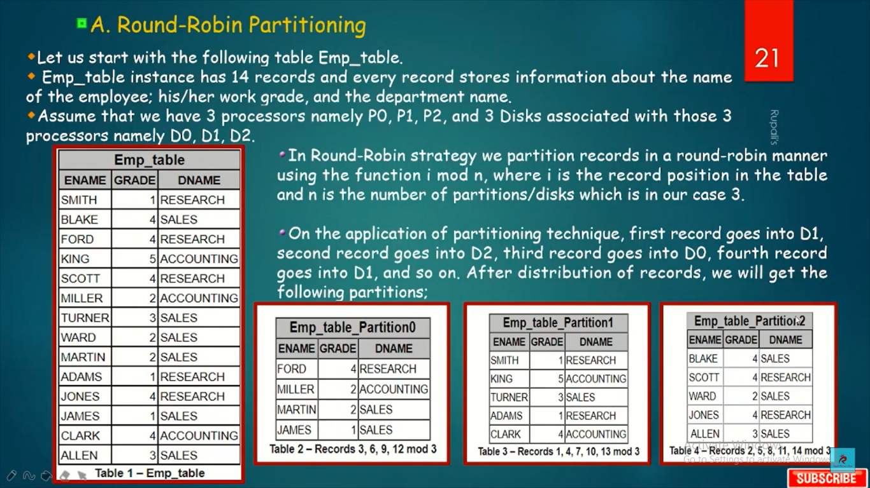

Slide 3
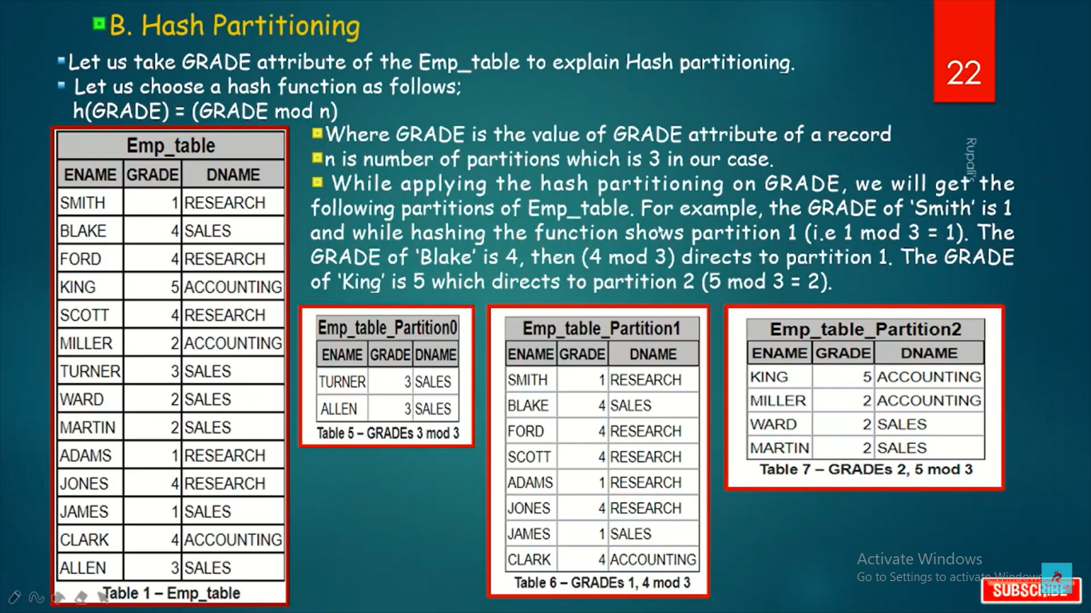

Slide 4
