Slide 1
DATABASE TECHNOLOGIES IT5008
Vinay. M
Asst Prof
SITE School

Slide 2
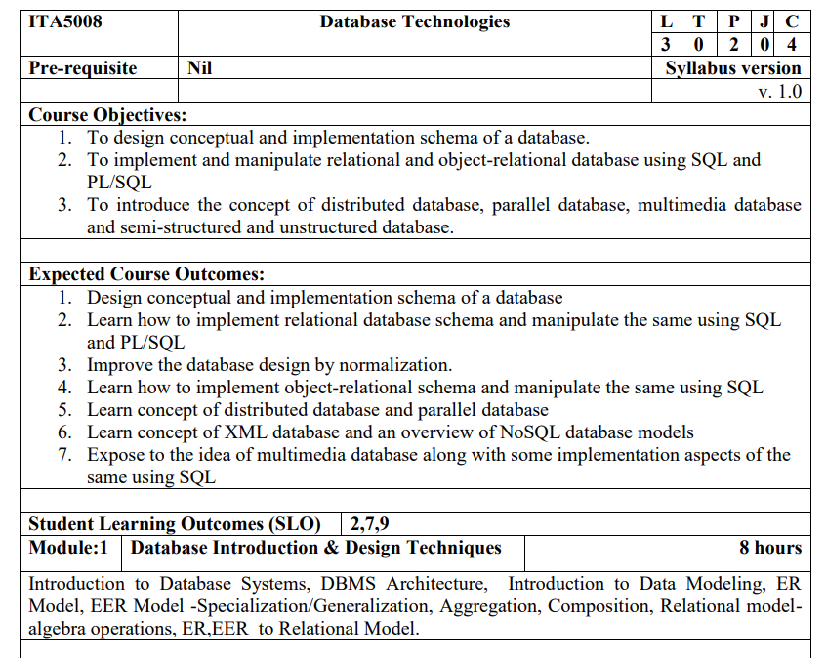

Slide 3
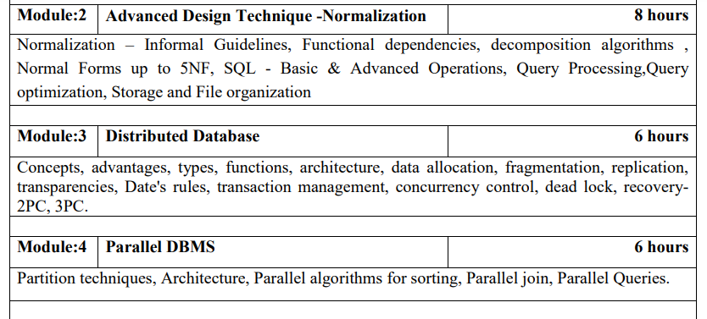

Slide 4
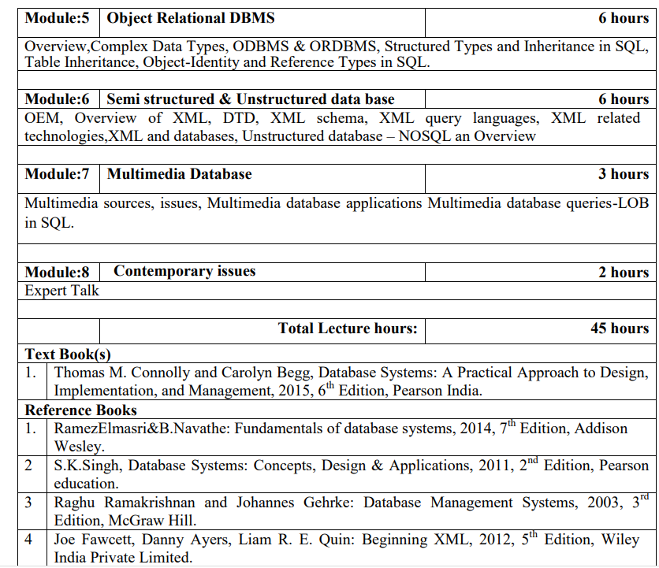

Slide 5
DATA
Data is a collection of a distinct small unit of information.
It can be used in a variety of forms like text, numbers, media, bytes, etc.
It can be stored in pieces of paper or electronic memory

Slide 6
DATABASE
A database is an organized collection of structured information, or data, typically stored electronically in a computer system.
Database example: An VTOP uses a database to store data of people, phone numbers, and other contact details.
Facebook. It needs to store, manipulate, and present data related to members, their friends, member activities, messages, advertisements, and a lot more

Slide 7
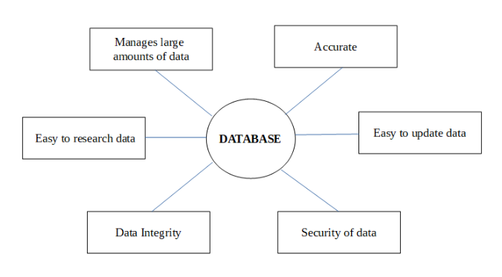
Why do we need a Database?

Slide 8
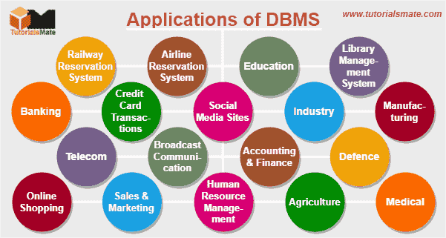

Slide 9
Applications of DBMS
Railway Reservation System − The railway reservation system database plays a very important role by keeping record of ticket booking, train’s departure time and arrival status and also gives information regarding train late to people through the database.
Library Management System − Now-a-days it’s become easy in the Library to track each book and maintain it because of the database. This happens because there are thousands of books in the library. It is very difficult to keep a record of all books in a copy or register. Now DBMS used to maintain all the information related to book issue dates, name of the book, author and availability of the book.
Banking − Banking is one of the main applications of databases. We all know there will be a thousand transactions through banks daily and we are doing this without going to the bank. This is all possible just because of DBMS that manages all the bank transactions.

Slide 10
Universities and colleges − Now-a-days examinations are done online. So, the universities and colleges are maintaining DBMS to store Student’s registrations details, results, courses and grade all the information in the database. For example, telecommunications. Without DBMS there is no telecommunication company. DBMS is most useful to these companies to store the call details and monthly postpaid bills.
Credit card transactions − The purchase of items and transactions of credit cards are made possible only by DBMS. A credit card holder has to know the importance of their information that all are secured through DBMS.
Social Media Sites − By filling the equired details we are able to access social media platforms. Many users sign up daily on social websites such as Facebook, Pinterest and Instagram. All the information related to the users are stored and maintained with the help of DBMS.
Finance − Now-a-days there are lots of things to do with finance like storing sales, holding information and finance statement management etc. these all can be done with database systems.

Slide 11
Military − In military areas the DBMS is playing a vital role. Military keeps records of soldiers and it has so many files that should be kept secure and safe. DBMS provides a high security to military information.
Online Shopping − Now-a-days we all do Online shopping without wasting the time by going shopping with the help of DBMS. The products are added and sold only with the help of DBMS like Purchase information, invoice bills and payment.
Human Resource Management − The management keeps records of each employee’s salary, tax and work through DBMS.
Manufacturing − Manufacturing companies make products and sell them on a daily basis. To keep records of all those details DBMS is used.
Airline Reservation system − Just like the railway reservation system, airlines also need DBMS to keep records of flights arrival, departure and delay status.

