Slide 1
Semistructured Data & XML
Database Systems, Connolly & Begg
Chapter 30
Web resource: https://www.w3schools.com/xml/default.asp

Slide 2
Semistructured data
Data that may be irregular or incomplete and
have a structure that may change rapidly or
unpredictably.

Slide 3
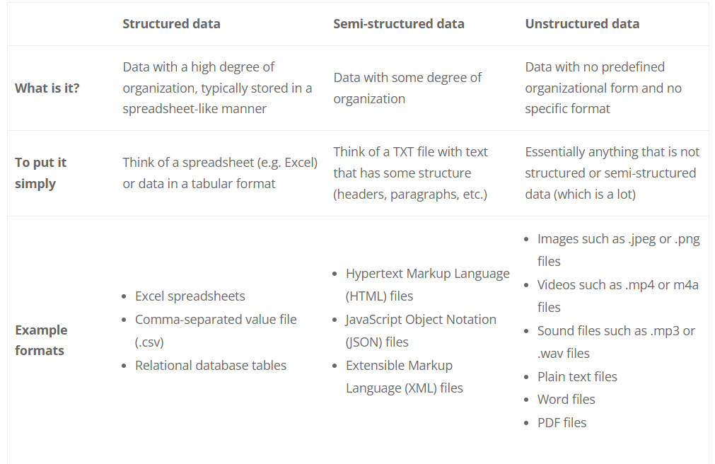

Slide 4
Company(&1)
Department(&2)
dname (&7)"Estate"
Manager &3
empl (&3)
name (&8)
fname (&17) "John"
lname (&18) "Smith"
managerOf &2
empl(&4)
name (&9) "James Borg"
salary (&10) 60000
manages &5
manages &6
project (&5)
pname (&11) "Reorganization"
type (&12) "Inhouse"
monthlyCost (&13) 4000
managedBy &4
project(&6)
pname (&14) "Computerization"
type (&15) 1
annualCost (&16) 40000
managedBy &4
Sample representation of
Semistructured data

Slide 5
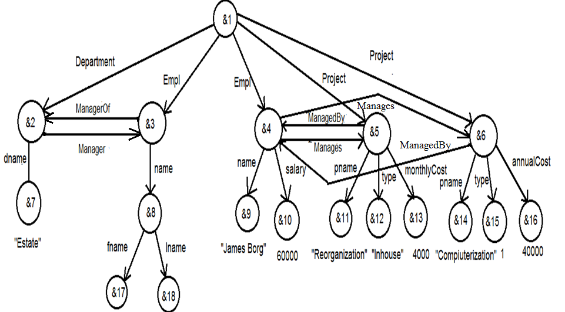
A graphical representation of the data
Graphical representation of semistructured data
Company
“John”
“Smith”

Slide 6
Object Exchange Model (OEM)
One of the proposed models for semistructured data is the
Object Exchange Model (OEM)
OEM is a nested object model
Data in OEM is schema-less and self-describing, and
can be thought of as a labeled directed graph where the
nodes are objects

Slide 7
OEM
An OEM object consists of
a unique object identifier,
a descriptive textual label,
a type and
a value

Slide 8
OEM
Objects are decomposed into atomic and complex.
An atomic object contains a value for a base type.
Examples of OEM objects
{empl, &4, set, {&5, &6}}
{name, &9, string, “James Borg”}
{salary, &10, decimal, 60000}

Slide 9
Lore & Lorel
Lore (Lightweight Object Repository) is a multi-user
DBMS based on OEM
Lore has been modified to handle XML
Lorel (Lore Language) is a query language for Lore.
Lorel supports path expression to answer query
e.g. company.department.dname is a path expression

Slide 10
Lorel
Lorel is similar to SQL
Find all employees with salary higher than 40000
Select company.employee where
company.employee.salary > 40000
Find out name of employees and their department name with salary higher than 40000
Select company.employee.name,
company.department.dname
where company.employee.salary > 40000

Slide 11
XML
XML (eXtensible Markup Language) is a markup language
that allows its designers to create their own tags.
XML is a restricted version of SGML (Standard
generalized markup Language).
XML is less complex than SGML
XML can store and manage semi-structured data.
XML data may or may not have schema.

Slide 12
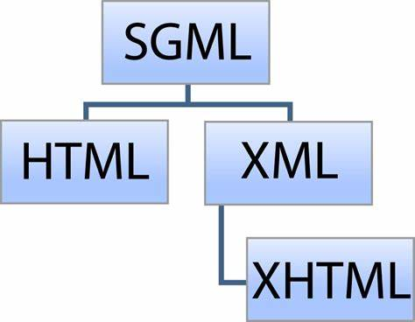

Slide 13
Advantages of XML
Simple
Platform and vendor independent
Extensible
Reuse
Separation of content and presentation
Improved load balancing
Support for integration of data from various sources
Ability to describe data from a variety of applications

Slide 14
Overview of XML
XML declarations
Elements
Attributes
Entity references
Comments
CDATA section & processing instructions
Ordering

Slide 15
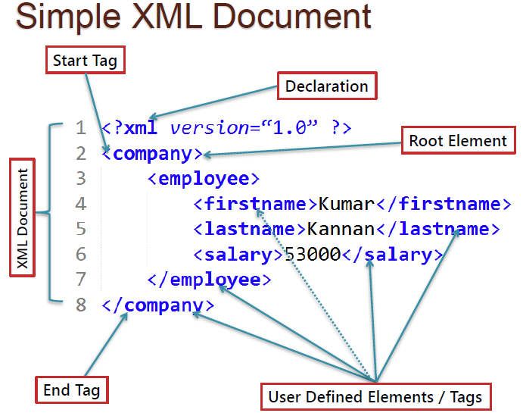

Slide 16
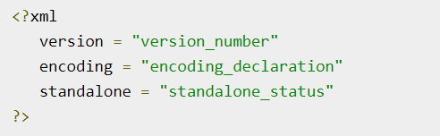
XML Declaration
Parameter | Parameter_value | Parameter_description
Version | 1.0 | Specifies the version of the XML standard used.
Encoding | UTF-8, UTF-16, ISO-10646-UCS-2, ISO-10646-UCS-4, ISO-8859-1 to ISO-8859-9, ISO-2022-JP, Shift_JIS, EUC-JP | It defines the character encoding used in the document. UTF-8 is the default encoding used.
Standalone | yes or no | It informs the parser whether the document relies on the information from an external source, such as external document type definition (DTD), for its content. The default value is set to no. Setting it to yes tells the processor there are no external declarations required for parsing the document.

Slide 17
<?xml version = "1.0" encoding = "UTF-8“ standalone = 'no"?>
<?xml stylesheet type ="text/xsl" href = "empl_list.xsl"?>
<!doctype empllist system "empl_list.dtd">
<empllist>
<empl dno = "5">
<ssn>123456789</ssn>
<name>
<fname> John </fname>
<lname> Smith </lname>
</name>
<dob>01-jan-1990</dob>
<salary>60000</salary>
</empl>
<empl dno = "1">
<ssn>888665555</ssn>
<name>
James Borg
</name>
<salary>80000</salary>
</empl>
</empllist>
An XML document

Slide 18
XML rules
An XML document should start with the XML
declaration; for example,
<?xml version = “1.0”?>;
All elements must be contained within one root
element;
Elements must be nested in a tree structure
without any overlap;
All non-empty elements must have a start-tag
and an end-tag.

Slide 19
Ordering of tags & attributes
<NAME>
<FNAME>John</FNAME> <LNAME>White</LNAME>
</NAME>
<NAME>
<LNAME>White</LNAME> <FNAME>John</FNAME>
</NAME>
<NAME FNAME = "John" LNAME = "White"/>
<NAME LNAME = "White" FNAME = "John"/>

Slide 20
Document Type Definition (DTD)
A DTD defines the valid syntax of an XML document.
A DTD is a schema of an XML document.
But DTD syntax is different from XML syntax.
You may have XML schema for XML document.

Slide 21
XML document
<empllist>
<empl ssn = “123456789">
<name>
<fname> John </fname>
<lname> Smith </lname>
</name>
<dob>01-jan-1990</dob>
<salary>60000</salary>
</empl>
<empl ssn = "333445555">
<name>
<fname> Franklin </fname>
<lname> Wong </lname>
</name>
<salary>70000</salary>
</empl>
</empllist>
<department empl = "123456789 333445555">
<dno>5</dno>
<dname> Estate </dname>
</department>

Slide 22
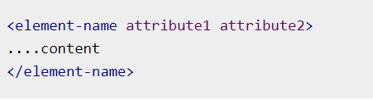
XML Element
XML elements can be defined as building blocks of an XML. Elements can behave as containers to hold text, elements, attributes, media objects or all of these.

Slide 23
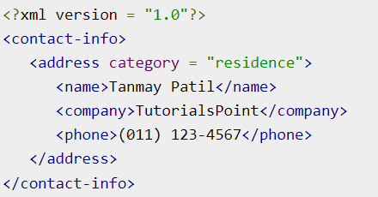

Slide 24
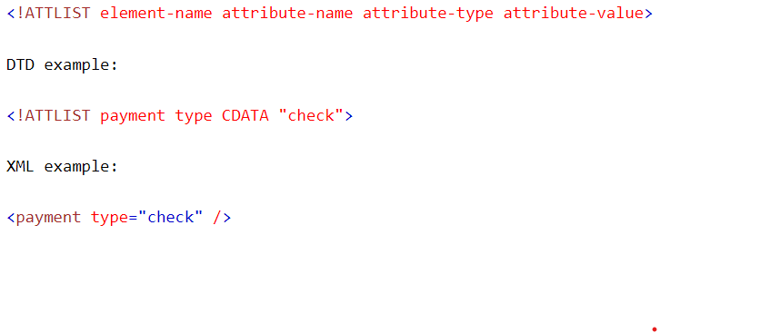
XML Attribute

Slide 25
Attribute types
Type | Description
CDATA | The value is character data
(en1|en2|..) | The value must be one from an enumerated list
ID | The value is a unique id
IDREF | The value is the id of another element
IDREFS | The value is a list of other ids
NMTOKEN | The value is a valid XML name
NMTOKENS | The value is a list of valid XML names
ENTITY | The value is an entity
ENTITIES | The value is a list of entities
NOTATION | The value is a name of a notation

Slide 26
Attribute Value
Value | Explanation
value | The default value of the attribute
#REQUIRED | The attribute is required
#IMPLIED | The attribute is optional
#FIXED value | The attribute value is fixed

Slide 27
DTD
<!element empllist (empl)*>
<!element empl(ssn, name, dob?, salary)>
<!element name(fname, lname)>
<!element ssn #pcdata>
<!element fname #pcdata>
<!element lname #pcdata>
<!element dob #pcdata>
<!element salary #pcdata>
<!element department(dno, dname)>
<!attlist empl ssn id #required>

Slide 28
Well-formed XML document & Valid XML document
An XML document that is written following XML rules
is called Well-formed XML document
An XML document which is well-formed and
conforms to a DTD/XML schema is called a
Valid XML document.

Slide 29
Drawbacks of DTD
It is written in a different (non-XML) syntax
It has no support for namespaces
It only offers extremely limited data typing

Slide 30
XML schema
XML schema defines the structure (content model)
of XML document.
An XML schema is a language for expressing
constraints about XML documents.
XML schema is W3C recommendation
XML schema is written in XML and
hence it can be processed by the same processor as
XML document.
An XML document validated against an XML Schema
is both "Well Formed" and "Valid".

Slide 31
XML schema built-in type
boolean
string
decimal
float
date
time
dateTime
anySimpleType
anyType

Slide 32
An XML document
<?xml version="1.0" encoding="UTF-8"?>
<note>
<to>Students</to>
<from>Instructor</from>
<heading>Reminder</heading>
<body>LAB FAT on April 4, 2019!</body>
</note>

Slide 33
<?xml version="1.0"?>
<xs:schema xmlns:xs="http://www.w3.org/2001/XMLSchema">
<xs:element name="note">
<xs:complexType>
<xs:sequence>
<xs:element name="to" type="xs:string"/>
<xs:element name="from" type="xs:string"/>
<xs:element name="heading" type="xs:string"/>
<xs:element name="body" type="xs:string"/>
</xs:sequence>
</xs:complexType>
</xs:element>
</xs:schema>

Slide 34
Complex element
A complex element is an XML element that contains
other elements and/or attributes.

Slide 35
Complex type
<xs:element name = "STAFFLIST">
<xs:complexType>
<xs:sequence>
<!-- children defined here -->
</xs:sequence>
</xs:complexType>
</xs:element>

Slide 36
Simple element
A simple element is an XML element that contains
only text.
It cannot contain any other elements or attributes.

Slide 37
Simple element
<xs:element name = "STAFFNO" type = "xs:string"/>
<xs:element name = "DOB" type = "xs:date"/>
<xs:element name = "SALARY" type = "xs:decimal"/>

Slide 38
Simple vs. Complex element
Simple elements cannot have attributes.
If an element has attributes, it is considered to be of
a complex type.
But the attribute itself is always declared as a simple
type.
<xs:attribute name="xxx" type="yyy"/>

Slide 39
Converting Relational database schema into XML schema
CUSTOMER(Cus_code, Cus_fname, Cus_lname, Cus_balance)
XML schema ?

Slide 40
XML schema
<?xml version=“1.0” encoding=“UTF-8” ?>
<xsd:schema xmlns:xsd=“http://www.w3.org/2001/XMLSchema”>
<xsd:element name=“customer”>
<xsd:complexType>
<xsd:element name=“customer” type=“Customer” minOccurs=“0” maxOccurs= “unbounded” />
</xsd:complexType>
<xsd:key name =“customerKey”>
<xsd:selector xpath=“customer” />
<xsd:field xpath=“cus_code” />
</xsd:key>

Slide 41
XML schema
<xsd:complexType name=“Customer”>
<xsd:sequence>
<xsd:element name=“cus_code” type=“xsd:string”/>
<xsd:element name=“cus_fname” type=“xsd:string”/>
<xsd:element name=“cus_lname” type=“xsd:string”/>
<xsd:element name=“cus_balance” type=“xsd:unsignedInt”/>
</xsd:sequence>
</xsd:complexType>
</xsd:schema>

Slide 42
Converting Relational database schema into XML schema
CUSTOMER(Cus_code, Cus_fname, Cus_lname, Cus_balance)
INVOICE(Inv_no, Cus_code, Inv_date, Inv_amount).
XML schema?

Slide 43
XML schema
<?xml version=“1.0” encoding=“UTF-8” ?>
<xsd:schema xmlns:xsd=“http://www.w3.org/2001/XMLSchema”>
<xsd:element name=“customer_invoice”>
<xsd:complexType>
<xsd:sequence>
<xsd:element name=“customer” type=“Customer” minOccurs=“0” maxOccurs= “unbounded” />
<xsd:element name=“invoice” type=“Invoice” minOccurs=“0” maxOccurs= “unbounded” />
</xsd:sequence>
</xsd:complexType>
<xsd:key name =“customerKey”>
<xsd:selector xpath=“customer” />
<xsd:field xpath=“cus_code” />
</xsd:key>

Slide 44
XML schema
<xsd:key name=“invoiceKey”>
<xsd:selector xpath=“invoice” />
<xsd:field xpath=“inv_no” />
</xsd:key>
<xsd:keyref name=“cusref” refer=“customerKey”>
<xsd:selector xpath=“invoice” />
<xsd:field xpath=“cus_code” />
</xsd:keyref>
<xsd:complexType name=“Customer”>
<xsd:sequence>
<xsd:element name=“cus_code” type=“xsd:string” />
<xsd:element name=“cus_fname” type=“xsd:string” />
<xsd:element name=“cus_lname” type=“xsd:string” />
<xsd:element name=“cus_balance” type=“xsd:unsignedInt” />
</xsd:sequence>
</xsd:complexType>

Slide 45
XML schema
<xsd:complexType name=“Invoice”>
<xsd:sequence>
<xsd:element name=“inv_no” type=“xsd:string” />
<xsd:element name=“cus_code” type=“xsd:string” />
<xsd:element name=“inv_date” type=“xsd:date” />
<xsd:element name=“inv_amount” type=“xsd:unsignedInt” />
<xsd:sequence>
</xsd:complexType>
</xsd:element>
</xsd:schema>

Slide 46
Technologies related to XML
Technologies related to XML
Document Object Model (DOM) [live DOM Viewer]
Simple API for XML (SAX),
Namespaces,
eXtensible Stylesheet Language for Transformations (XSLT),
XML Path Language (XPath),
XML Pointer Language (XPointer),
XML Linking Language (XLink),
XHTML,
Simple Object Access Protocol (SOAP),
Web Services Description Language (WSDL),
Universal Discovery, Description and Integration (UDDI)

Slide 47
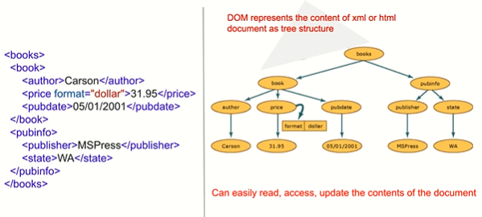

Slide 48
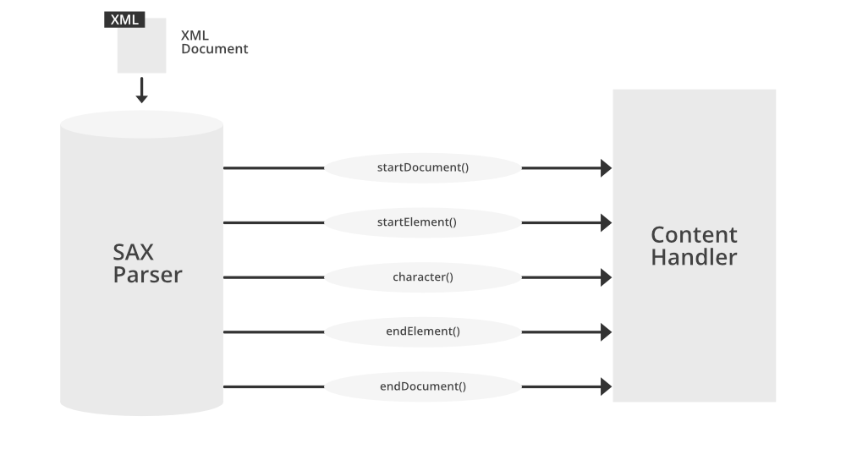
Simple API for XML (SAX),
SAX parsers work on each element of the XML document sequentially, issuing parsing events while passing through the input stream in a single pass. Unlike DOM, SAX does not have a formal specification.

Slide 49
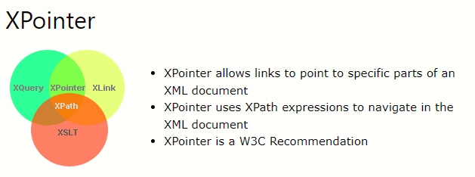
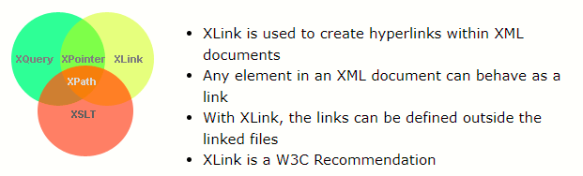

Slide 50
eXtensible Stylesheet Language(XSL)
XSL is a language for expressing XML based style sheet
An XSL file describes how to display an XML document of a given type.
XSL consists of the following:
XSLT is a language for transforming XML documents.
XPath is a language for navigating in XML documents.
XQuery is a language for querying XML documents.

Slide 51
XSLT(Extensible Stylesheet Language for Transformations)
XSLT is a programming language to render XML
document.
It is a language for transforming XML documents into other XML documents.
XSLT transforms an XML document into another XML document, HTML document, or a text document.
XSLT uses Xpath to navogate in XML Documents.
XSLT is a W3C Recommendation
All major browsers support XSLT.

Slide 52
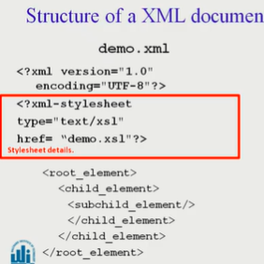
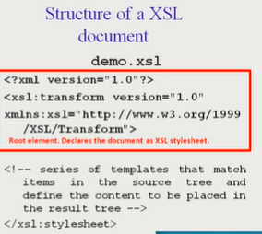

Slide 53
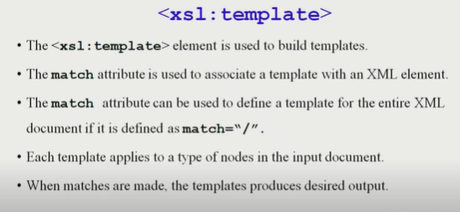

Slide 54
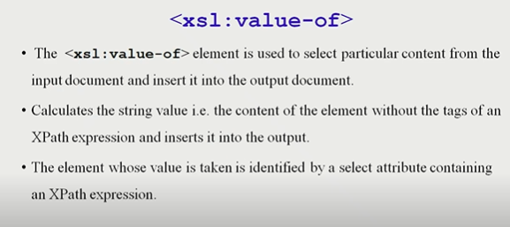

Slide 55
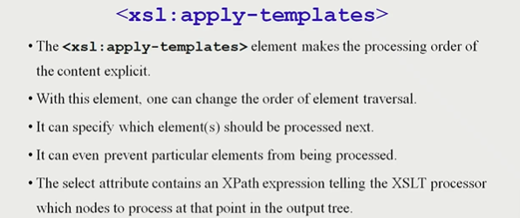

Slide 56
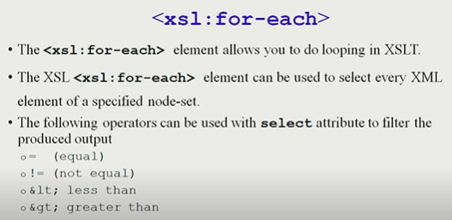

Slide 57
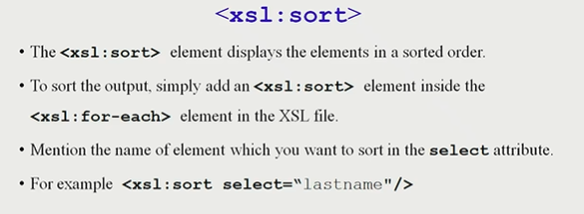

Slide 58
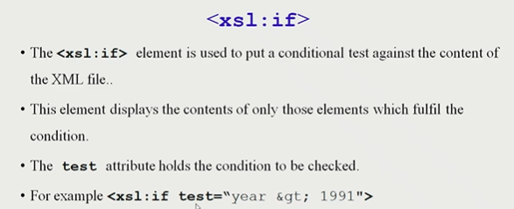

Slide 59
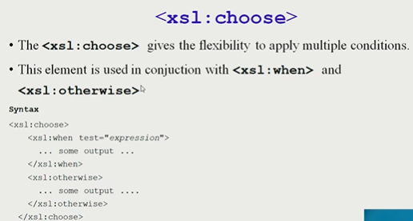

Slide 60
XQuery
XQuery is the language for querying XML data
XQuery for XML is like SQL for databases
XQuery is built on XPath expressions
XQuery is supported by all major databases
XQuery is a W3C Recommendation
FLWOR expressions are used to write XQuery.

Slide 61
FLWOR expression
A FLWOR (pronounced “flower”) expression is
constructed from FOR, LET, WHERE, ORDER BY,
and RETURN clauses. The syntax of a FLWOR
expression is:
FOR $forVar IN inExpression -------------SQL From
LET $letVar := letExpression----------------allows temporary variables, and has no equivalent in SQL
WHERE filterExpression------ SQL Where
ORDER BY orderSpec-------- SQL Order by
RETURN expression--------- SQL Select

Slide 62
XQuery example
for $x in doc("books.xml")/bookstore/book
where $x/price>30
return $x/title
Output:
<title lang="en">XQuery Kick Start</title>
<title lang="en">Learning XML</title>

Slide 63
XQuery example
for $x in doc("books.xml")/bookstore/book/title
order by $x
return $x
Output:
<title lang="en">Everyday Italian</title>
<title lang="en">Harry Potter</title>
<title lang="en">Learning XML</title>
<title lang="en">XQuery Kick Start</title>

Slide 64
XQuery Conditional expression
for $x in doc("books.xml")/bookstore/book
return if ($x/@category="CHILDREN")
then <child>{data($x/title)}</child>
else <adult>{data($x/title)}</adult>
Output
<adult>Everyday Italian</adult>
<child>Harry Potter</child>
<adult>XQuery Kick Start</adult>
<adult>Learning XML</adult>

Slide 65
XQuery expression
for $x at $i in
doc("books.xml")/bookstore/book/title
return <book>{$i}. {data($x)}</book>
<book>1. Everyday Italian</book>
<book>2. Harry Potter</book>
<book>3. XQuery Kick Start</book>
<book>4. Learning XML</book>

Slide 66
XQuery expression
for $x in (10,20), $y in (100,200)
return <test>x={$x} and y={$y}</test>
<test>x=10 and y=100</test>
<test>x=10 and y=200</test>
<test>x=20 and y=100</test>
<test>x=20 and y=200</test>

Slide 67
XQuery expression
LET $d := doc(www.company.com/info.xml)
FOR $x IN $d/company/project[projectNumber = 5]/projectWorker,
$y IN $d/company/employee
WHERE $x/hours gt 20.0 AND $y.ssn = $x.ssn
RETURN
<res>
$y/employeeName/firstName,
$y/employeeName/lastName,
$x/hours
</res>
Refer to Company database

Slide 68
XQuery expression
List all employees, ordered in descending order of ssn.
FOR $S IN doc(“empllist.xml")//empl
ORDER BY $S/ssn DESCENDING
RETURN $S/ssn

Slide 69
XML & Databases
Store, retrieve & query XML document.
Storing XML document
As column of a table
In a shredded form i.e. distribute content of XML
document among tables.

Slide 70
Storing XML document as column of a table
Create table XMLempl(
docno char(4), docDate date, empl_data XMLType
);
Insert into XMLempl values(
‘1234’, ‘3-feb-18’ , XMLType(‘the xml document
content’)
);

Slide 71
Querying XML column
Return the employee salaries that are higher than $30,000.
SELECT
XMLQUERY ('FOR $S IN //empl/SALARY WHERE $S
$SAL AND $S/@dno = "1" RETURN $S'
PASSING '30000' AS SAL, empl_data
RETURNING CONTENT) highSalaries
FROM XMLempl;

Slide 72
XMLTable function
SELECT s.*
FROM XMLempl xs,
XMLTABLE ('FOR $S IN //empl WHERE $S/SALARY > 30000'
PASSING xs.empl_data
COLUMNS
"seqNo" FOR ORDINALITY,
"ssn" CHAR(9) PATH 'ssn',
"fName" VARCHAR(30) PATH 'NAME/FNAME',
"lName" VARCHAR(30) PATH 'NAME/LNAME',
"DOB" DATE PATH 'DOB',
"salary" DECIMAL(7,2) PATH 'SALARY',
"deptNo" CHAR(4) PATH '@dno') AS s;

Slide 73
Publishing relational data in XML format
SELECT XMLELEMENT (NAME "DEPARTMENT",
XMLATTRIBUTES (dno),
XMLAGG (
XMLELEMENT (NAME "empl",
fName || ' ' || lName)
ORDER BY fName || ' ' || lName
)
) AS "deptXMLCol"
FROM employee
GROUP BY dno;

Slide 74
Output
<DEPARTMENT DNO="1"><empl>James Borg</empl></DEPARTMENT>
<DEPARTMENT DNO="4">
<empl>Ahmed Jabbar</empl>
<empl>AliciaZelaya</empl>
<empl>Jen …
</DEPARTMENT>
<DEPARTMENT DNO="5">
<empl>Franklin Wong</empl>
<empl>John Smith</empl>
<empl>Joyac …
</DEPARTMENT>
The output is from Oracle, some parts of it are not visible and are indicated using …

Slide 75
Publishing relational data in XML format
SELECT XMLElement("BDate", bdate) FROM employee;
<Bdate>1985-06-09</Bdate>
<Bdate>1985-12-08</Bdate>
<Bdate>1992-01-19</Bdate>
<Bdate>1982-06-20</Bdate>
<Bdate>1988-09-15</Bdate>
<Bdate>1993-07-31</Bdate>
<Bdate>1993-03-08</Bdate>
<Bdate>1987-11-11</Bdate>

Slide 76
Publishing relational data in XML format
select xmlelement("Empl", xmlelement("Bdate", bdate),
xmlelement("Name", fname||' '||lname) )
from employee;
<Empl><Bdate>1985-06-09</Bdate><Name>John Smith</Name></Empl>
<Empl><Bdate>1985-12-08</Bdate><Name>Franklin Wong</Name></Empl>
<Empl><Bdate>1992-01-19</Bdate><Name>Alicia Zelaya</Name></Empl>
<Empl><Bdate>1982-06-20</Bdate><Name>Jennifer Wallace</Name></Empl>
<Empl><Bdate>1988-09-15</Bdate><Name>Ramesh Narayan</Name></Empl>
<Empl><Bdate>1993-07-31</Bdate><Name>Joyace English</Name></Empl>
<Empl><Bdate>1993-03-08</Bdate><Name>Ahmed Jabbar</Name></Empl>
<Empl><Bdate>1987-11-11</Bdate><Name>James Borg</Name></Empl>

Slide 77
Publishing relational data in XML format
SELECT XMLElement("Emp", XMLAttributes(ssn, fname, lname))
FROM employee;
<Emp SSN="123456789" FNAME="John" LNAME="Smith“></Emp>
<Emp SSN="333445555" FNAME="Franklin" LNAME="Wong"></Emp>
<Emp SSN="999887777" FNAME="Alicia" LNAME="Zelaya"></Emp>
<Emp SSN="987654321" FNAME="Jennifer" LNAME="Wallace"></Emp>
<Emp SSN="666884444" FNAME="Ramesh" LNAME="Narayan"></Emp>
<Emp SSN="453453453" FNAME="Joyace" LNAME="English"></Emp>
<Emp SSN="987987987" FNAME="Ahmed" LNAME="Jabbar"></Emp>
<Emp SSN="888665555" FNAME="James" LNAME="Borg"></Emp>

Slide 78
Publishing relational data in XML format
select xmlelement("Employee", xmlforest(ssn, fname, lname))
from employee;
<Employee>
<SSN>123456789</SSN>
<FNAME>John</FNAME>
<LNAME>Smith</LNAME>
</EMPLOYEE>
<Employee>
<SSN>333445555</SSN>
<FNAME>Franklin</FNAME>
<LNAME>Wong</LNAME>
</EMPLOYEE>
<Employee><SSN>999887777</SSN><FNAME>Alicia</FNAME><LNAME>Zelaya</LNAME></EMPLOYEE>
<Employee><SSN>987654321</SSN><FNAME>Jennifer</FNAME><LNAME>Wallace</LNAME></EMPLOYEE>
<Employee><SSN>666884444</SSN><FNAME>Ramesh</FNAME><LNAME>Narayan</LNAME></EMPLOYEE>
<Employee><SSN>453453453</SSN><FNAME>Joyace</FNAME><LNAME>English</LNAME></EMPLOYEE>
<Employee><SSN>987987987</SSN><FNAME>Ahmed</FNAME><LNAME>Jabbar</LNAME></EMPLOYEE>
<Employee><SSN>888665555</SSN><FNAME>James</FNAME><LNAME>Borg</LNAME></EMPLOYEE>

Slide 79
Questions
1) What are the differences between structured, semistructured, and unstructured data? Under which of the categories do XML documents fall?
2) What is the difference between attributes and elements in XML?
3) List some of the important attributes used to specify elements in XML schema.
4) What is the difference between XML schema and XML DTD?

Slide 80
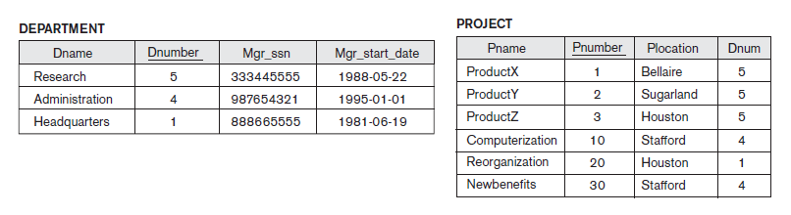
Questions
5) Create an XML instance document to correspond to the data stored in the relational database shown below.
6) Create an XML schema that corresponds to the following relational database schema relating to customer and invoice entity type. The primary keys are underlined and the foreign key is self -explanatory.
CUSTOMER(Cus_code, Cus_fname, Cus_lname, Cus_balance)
INVOICE(Inv_no, Cus_code, Inv_date, Inv_amount).

Slide 81
Questions
7) Consider the following XML document for bibliography. (a) Write down and test an XSLT file for rendering the XML document in a tabular form showing the title and author name of books with price higher than 40.00. (b) Write down and test an XSLT file to demonstrate usage of xsl:choose in rendering
the same XML document.
XML document:
<?xml version="1.0" encoding="UTF-8"?>
<bookstore>
<book category="cooking">
<title lang="en">Everyday Italian</title>
<author>Giada De Laurentiis</author>
<year>2005</year>
<price>30.00</price>
</book>

Slide 82
Questions
<book category="children">
<title lang="en">Harry Potter</title>
<author>J K. Rowling</author>
<year>2005</year>
<price>29.99</price>
</book>
<book category="web">
<title lang="en">XQuery Kick Start</title>
<author>James McGovern</author>
<author>Per Bothner</author>
<author>Kurt Cagle</author>
<author>James Linn</author>
<author>Vaidyanathan Nagarajan</author>
<year>2003</year>
<price>49.99</price>
</book>

Slide 83
Questions
<book category="web" cover="paperback">
<title lang="en">Learning XML</title>
<author>Erik T. Ray</author>
<year>2003</year>
<price>39.95</price>
</book>
</bookstore>
8) Write down the following XQuery on the above instance document.
(a) List all books in descending order of price.
(b) List all books with price no greater than 100.00.
9) Consider the following database schema
CUSTOMER(Cus_code, Cus_fname, Cus_lname, Cus_balance)
INVOICE(Inv_no, Cus_code, Inv_date, Inv_amount).
Show the usage of SQL/XML functions – XMLElement, XMLAttribute, XMLAgg and XMLForest.

