Slide 1
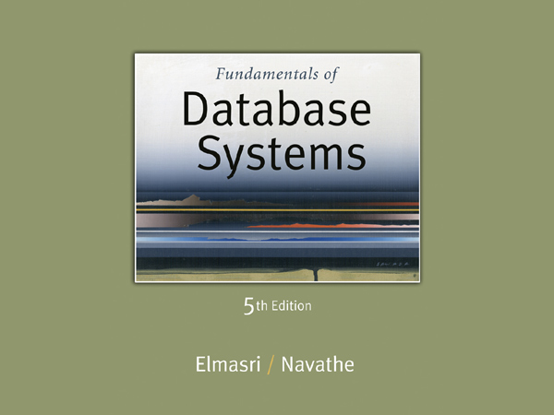

Slide 2
Enhanced Entity-Relationship (EER) Modeling

Slide 3
Chapter Outline
EER stands for Enhanced ER or Extended ER
EER Model Concepts
Includes all modeling concepts of basic ER
Additional concepts:
subclasses/superclasses
specialization/generalization
categories (UNION types)
attribute and relationship inheritance
The additional EER concepts are used to model applications more completely and more accurately
EER includes some object-oriented concepts, such as inheritance

Slide 4
Subclasses and Superclasses (1)
An entity type may have additional meaningful subgroupings of its entities
Example: EMPLOYEE may be further grouped into:
SECRETARY, ENGINEER, TECHNICIAN, …
Based on the EMPLOYEE’s Job
MANAGER
EMPLOYEEs who are managers
SALARIED_EMPLOYEE, HOURLY_EMPLOYEE
Based on the EMPLOYEE’s method of pay
EER diagrams extend ER diagrams to represent these additional subgroupings, called subclasses or subtypes

Slide 5
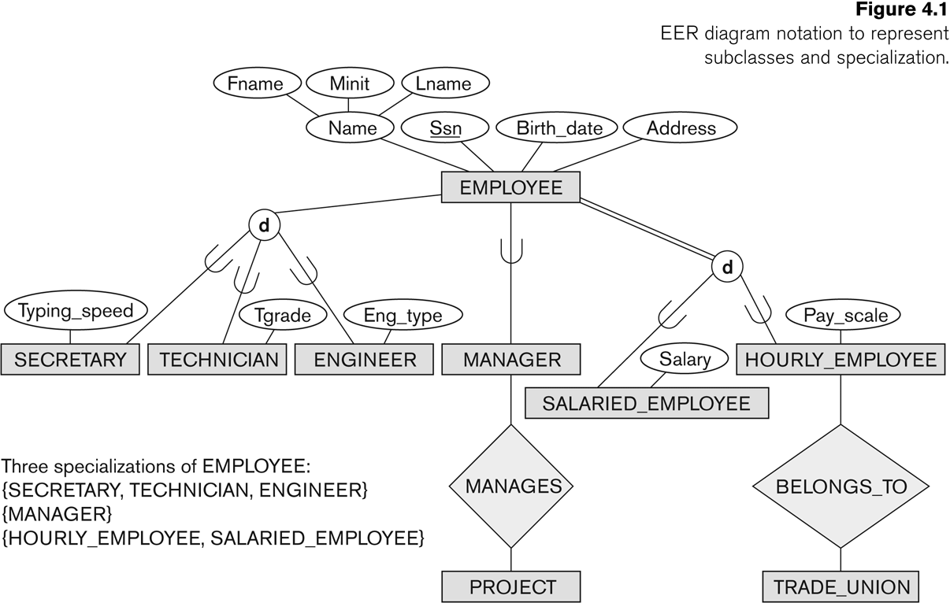

Subclasses and Superclasses

Slide 6
How can you categorize employees at VIT
Professors, Data Entry Operators, Clerks, Gardeners, Drivers (Job Type)
Deans (Only Deans Manage Schools)
Permanent and Contract Employees (Job Agreement)

Slide 7
Subclasses and Superclasses (2)
Each of these subgroupings is a subset of EMPLOYEE entities
Each is called a subclass of EMPLOYEE
EMPLOYEE is the superclass for each of these subclasses
These are called superclass/subclass relationships:
EMPLOYEE/SECRETARY
EMPLOYEE/TECHNICIAN
EMPLOYEE/MANAGER
…

Slide 8
Subclasses and Superclasses (3)
A member of the superclass can be optionally included as a member of any number of its subclasses
Examples:
A salaried employee who is also an engineer belongs to the two subclasses:
ENGINEER, and
SALARIED_EMPLOYEE
A salaried employee who is also an engineering manager belongs to the three subclasses:
MANAGER,
ENGINEER, and
SALARIED_EMPLOYEE
It is not necessary that every entity in a superclass be a member of some subclass

Slide 9
Attribute Inheritance in Superclass / Subclass Relationships
An entity that is member of a subclass inherits
All attributes of the entity as a member of the superclass
All relationships of the entity as a member of the superclass
Example:
In the next slide, SECRETARY (as well as TECHNICIAN and ENGINEER) inherit the attributes Name, SSN, …, from EMPLOYEE
Every SECRETARY entity will have values for the inherited attributes

Slide 10
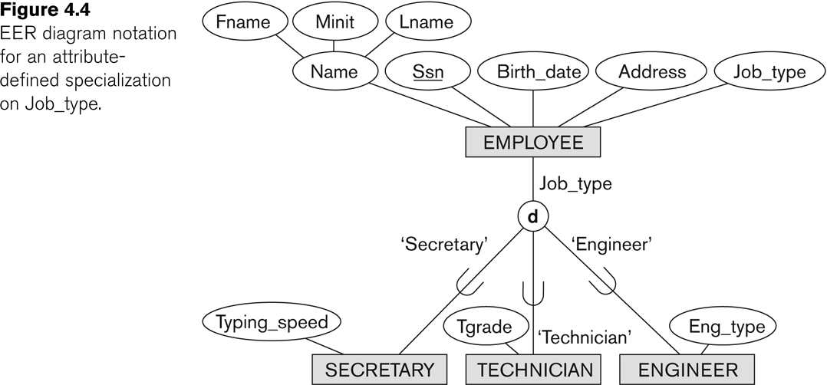
Representing Specialization in EER Diagrams

Slide 11
Specialization (1)
Specialization is the process of defining a set of subclasses of a superclass
The set of subclasses is based upon some distinguishing characteristics of the entities in the superclass
Example: {SECRETARY, ENGINEER, TECHNICIAN} is a specialization of EMPLOYEE based upon job type.
May have several specializations of the same superclass

Slide 12
Specialization (2)
Example: Another specialization of EMPLOYEE based on method of pay is {SALARIED_EMPLOYEE, HOURLY_EMPLOYEE}.
Superclass/subclass relationships and specialization can be diagrammatically represented in EER diagrams
Attributes of a subclass are called specific or local attributes.
For example, the attribute TypingSpeed of SECRETARY
The subclass can also participate in specific relationship types.
For example, a relationship BELONGS_TO of HOURLY_EMPLOYEE

Slide 13
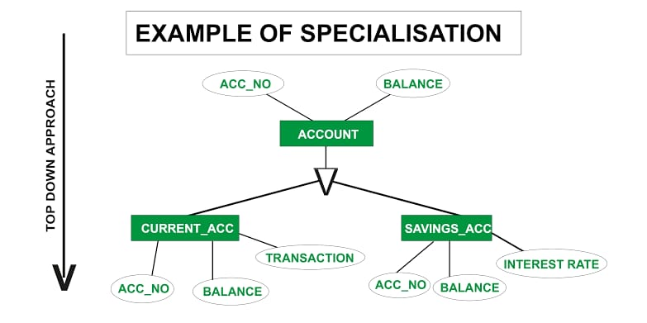

Slide 14
Specialization (3)

Slide 15
Generalization
Generalization is the reverse of the specialization process
Several classes with common features are generalized into a superclass;
original classes become its subclasses
Example: CAR, TRUCK generalized into VEHICLE;
both CAR, TRUCK become subclasses of the superclass VEHICLE.
We can view {CAR, TRUCK} as a specialization of VEHICLE
Alternatively, we can view VEHICLE as a generalization of CAR and TRUCK

Slide 16
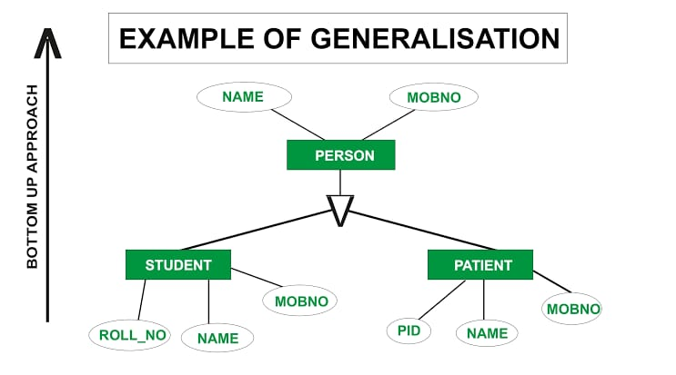

Slide 17
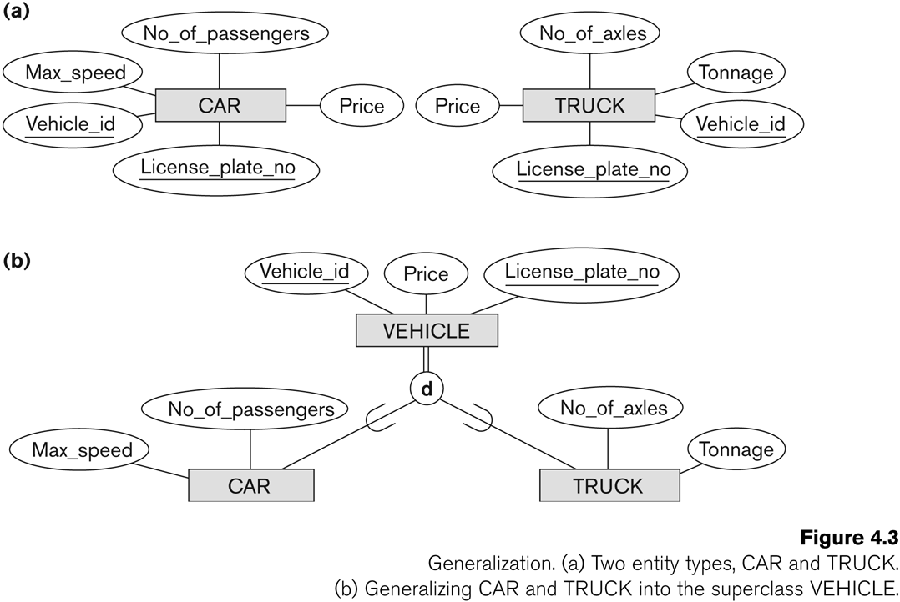
Generalization (2)

Slide 18
Generalization and Specialization (1)
Diagrammatic notation are sometimes used to distinguish between generalization and specialization
Arrow pointing to the generalized superclass represents a generalization
Arrows pointing to the specialized subclasses represent a specialization
We do not use this notation because it is often subjective as to which process is more appropriate for a particular situation
We advocate not drawing any arrows

Slide 19
Predicate Defined Specialization
If we can determine exactly those entities that will become members of each subclass by a condition, the subclasses are called predicate-defined (or condition-defined) subclasses
Condition is a constraint that determines subclass members
Display a predicate-defined subclass by writing the predicate condition next to the line attaching the subclass to its superclass

Slide 20
Attribute-defined and user-defined specialization
If all subclasses in a specialization have membership condition on same attribute of the superclass, specialization is called an attribute-defined specialization
Attribute is called the defining attribute of the specialization
Example: JobType is the defining attribute of the specialization {SECRETARY, TECHNICIAN, ENGINEER} of EMPLOYEE
If no condition determines membership, the subclass is called user-defined
Membership in a subclass is determined by the database users by applying an operation to add an entity to the subclass
Membership in the subclass is specified individually for each entity in the superclass by the user

Slide 21
Displaying an attribute-defined specialization in EER diagrams

Slide 22
Constraints on Specialization and Generalization (3)
Two basic constraints can apply to a specialization/generalization:
Disjointness Constraint:
Completeness Constraint:

Slide 23
Constraints on Specialization and Generalization (4)
Disjointness Constraint:
Specifies that the subclasses of the specialization must be disjoint:
an entity can be a member of at most one of the subclasses of the specialization
Specified by d in EER diagram
If not disjoint, specialization is overlapping:
that is the same entity may be a member of more than one subclass of the specialization
Specified by o in EER diagram

Slide 24
Disjoint Example
An Employee can be either a Secretary or a Professor but not both.
The subclasses Secretary and Professors are disjoint

Slide 25
Overlap Example
An Employee can be Professor as well as a Dean.
A superclass instance is part of two subclass instances
The two subclasses overlap

Slide 26
Constraints on Specialization and Generalization (5)
Completeness Constraint:
Total specifies that every entity in the superclass must be a member of some subclass in the specialization/generalization
Shown in EER diagrams by a double line
Partial allows an entity not to belong to any of the subclasses
Shown in EER diagrams by a single line

Slide 27
Example of Total Completeness Constraint
Every employee should be either a permanent employee or a contract employee.
Every instance of employee Should be present in one the two subclasses permanent or contract.

Slide 28
Example of Partial Completeness Constraint
If cars and trucks are the subclasses of vehicles.
Not all Vehicle instances are cars or trucks.
There are vehicles instances which are not part of the two subclasses. Hence Partial.

Slide 29
Constraints on Specialization and Generalization (6)
Hence, we have four types of specialization/generalization:
Disjoint, total
Disjoint, partial
Overlapping, total
Overlapping, partial
Note: Generalization usually is total because the superclass is derived from the subclasses.

Slide 30
Example of disjoint partial Specialization

Slide 31
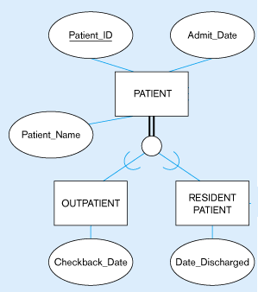
Disjoint Total- Example

Slide 32
Overlap Total - Example
Employee
Total Participation
O
An Employee can be a teaching faculty and a research scholar – This is called overlapping
Teaching Faculty
Research Scholar

Slide 33
Overlap Partial
Employee
Not all Employees are Teaching faculty or research scholars. There are instance of the employee superclass which is not part of the subclass . For instance administrative officers are neither teachers not research scholars
O
Teaching Faculty
Research Scholar

Slide 34
Specialization/Generalization Hierarchies, Lattices & Shared Subclasses (1)
A subclass may itself have further subclasses specified on it
forms a hierarchy or a lattice
Hierarchy has a constraint that every subclass has only one superclass (called single inheritance); this is basically a tree structure
In a lattice, a subclass can be subclass of more than one superclass (called multiple inheritance)

Slide 35
Super Class
Super Class
Super Class
Sub Class
Shared Sub Class
Single Level
Multiple Inheritance

Slide 36
Employee
Professor
Student
Professor
Teaching Assistant
Single Level
Multiple Inheritance

Slide 37
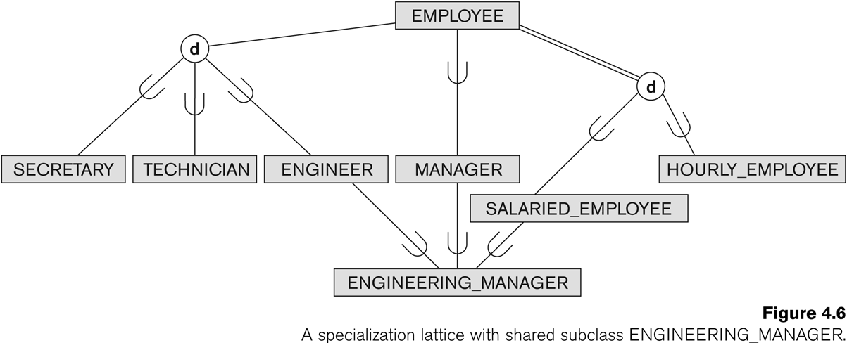
Shared Subclass “Engineering_Manager”

Slide 38
Categories (UNION TYPES) (1)
All of the superclass/subclass relationships we have seen thus far have a single superclass
A shared subclass is a subclass in:
more than one distinct superclass/subclass relationships
each relationships has a single superclass
shared subclass leads to multiple inheritance
In some cases, we need to model a single superclass/subclass relationship with more than one superclass
Superclasses can represent different entity types
Such a subclass is called a category or UNION TYPE

Slide 39
Categories (UNION TYPES) (2)
Example: In a database for vehicle registration, a vehicle owner can be a PERSON, a BANK (holding a lien on a vehicle) or a COMPANY.
A category (UNION type) called OWNER is created to represent a subset of the union of the three superclasses COMPANY, BANK, and PERSON
A category member must exist in at least one of its superclasses

Slide 40
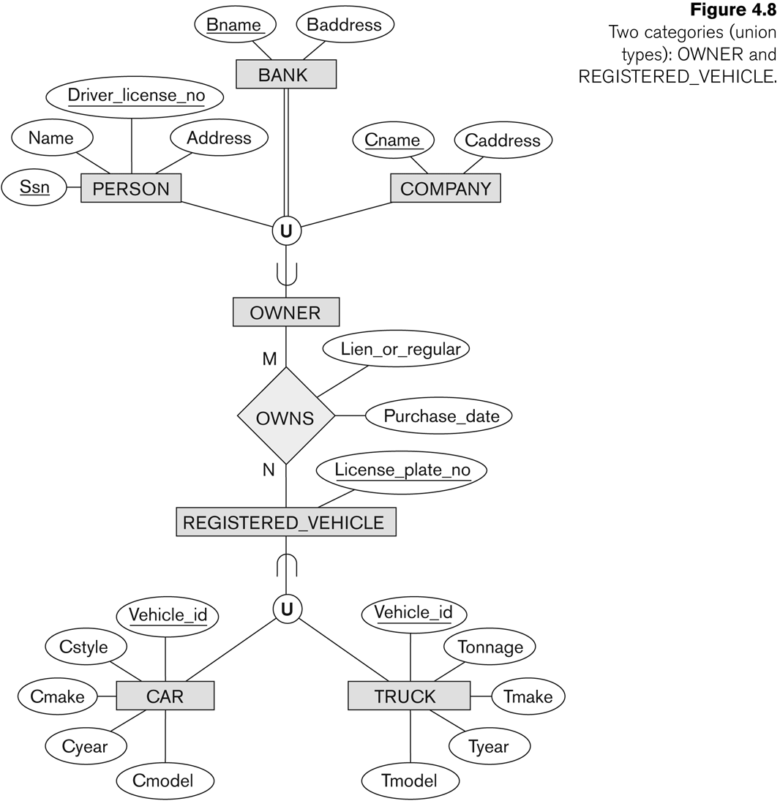
Two categories (UNION types): OWNER, REGISTERED_VEHICLE

Slide 41
EER to Relational MApping

Slide 42
Scenario 1
EMP ID
Name
Multiple relations—superclass and subclasses
For any specialization (total or partial, disjoint or overlapping)
Phone
EMPLOYEE
Employee
EMPID | NAME | Phone
Project Name
TypingSpeed
Professor
EMPID | Project Name
Professor
Secretary
Secretary
EMPID | Typing Speed

Slide 43
Scenario 2
EMP ID
Name
Multiple relations—subclass relations only
Subclasses are total
Specialization has
disjointedness constraint
Phone
EMPLOYEE
d
Professor
Project Name
TypingSpeed
EMPID | Name | Phone | Project Name
Professor
Secretary
Secretary
EMPID | Name | Phone | Typing Speed

Slide 44
Scenario 3
EMP ID
Name
Single relation with one type attribute
Type or discriminating attribute indicates subclass of tuple
Subclasses are disjoint
Potential for generating many NULL values if local attributes exist for subclasses
Phone
EMPLOYEE
d
Project Name
TypingSpeed
Employee
EMPID | Name | Phone | Job Type | Typing Speed | Project Name
1 | Sat | 2333 | Prof |  | DBMS
2 | Ram | 3222 | Secr | 400
Professor
Secretary

Slide 45
Scenario 4
EMP ID
Name
Single relation with multiple type attributes
Subclasses are overlapping
Will also work for a disjoint specialization
Phone
EMPLOYEE
Employee
O
EMP ID | Name | Phone | P flag | R flag | Guide Name | Project Name
1 | Sat | 2333 | 1 | 0 |  | DBMS
2 | Ram | 3222 | 0 | 1 | 400
3 | Tom | 4555 | 1 | 1 | Sat | DBMS
Project Name
Guide Name
Professor
Research
Scholar

Slide 46
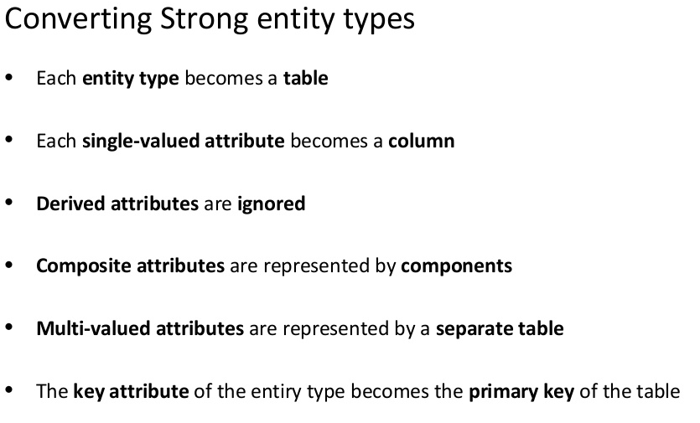
Convert ER to Table

Slide 47
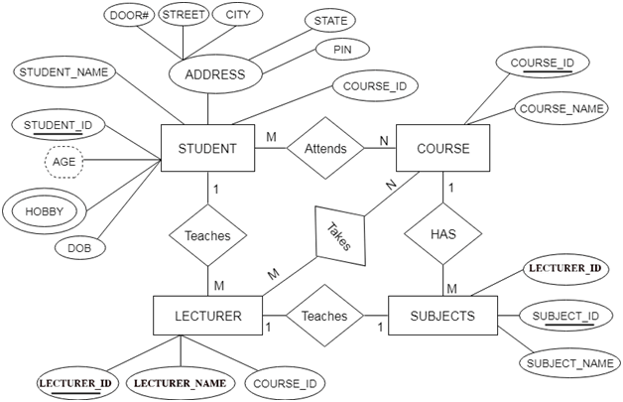

Slide 48
