Slide 1
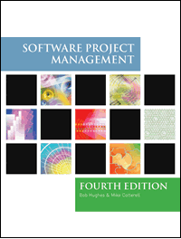
Software Project Management
4th Edition
Chapter 3
Programme management and project evaluation
Notes:
This talk provides an overview of the basic steps needed to produce a project plan. The framework provided should allow students to identify where some of the particular issues discussed in other chapters are applied to the planning process. As the focus is on project planning, techniques to do with project control are not explicitly described. However, in practice, one element of project planning will be to decide what project control procedures need to be in place.

Slide 2
Main topics to be covered
Strategic Assessment
Programme management
Benefits management
Cost benefit analysis
Cash flow forecasting
Project risk evaluation

Slide 3
PROJECT EVALUATION
Project evaluation is normally carried out in step 0 of stepwise
Project evaluation is a step by step process of collecting, recording and organizing information about
  Project results
  short - term outputs (immediate results of activities or project deliverables)
  Long – term outputs (changes in behaviour , practice or policy resulting from the result.

Slide 4
STRATEGIC ASSESSMENT
WHAT IS STRATEGIC PLANNING?
Strategic planning is defined as an organization’s process of defining its strategy , or direction and making decisions on allocating its resources to pursue this strategy, including its capital and people
- it deals with:
- what do we do?
- for whom do we do it?
- how do we excel?

Slide 5
STRATEGIC ASSESSMENT is the first criteria for project evaluation
  For evaluating and managing the projects, the individual projects should be seen as components of a programme. Hence need to do programme management.
Programme management:
D.C. Ferns defined “a programme as a group of projects that are managed in a co-ordinated way to gain benefits that would not be possible were the projects to be managed independently”.
A programme in this context is a “collection of projects that all contribute to the same overall organization goals”.
Effective programme management requires that there is a well defined programme goal and that all the organization’s projects are selected and tuned to contribure to this goal”

Slide 6
Evaluating of project is depends on:
  How it contributes to programme goal.
  It is viability [ capability of developing or useful].
  Timing.
  Resourcing.
For successful strategic assessment, there should be a strategic plan which defines:
  Organization’s objectives.
  Provides context for defining programme
  Provides context for defining programme goals.
  Provide context for accessing individual project.

Slide 7
In large organization, programme management is taken care by programme director and programme executive , rather than, project manager, who will be responsible for the strategic assessment of project.
Any potential software system will form part of the user organization’s overall information system and must be evaluated within the context of existing information system and the organization’s information strategy.
If a well – defined information system does not exist then the system development and the assessment of project proposals will be based on a more “piece meal approach”.
Piece meal approach is one in which each project being individually early in its life cycle.
Notes:
than,

Slide 8
Typical issues and questions to be considered during strategic assessment
Issue – 1: objectives:
  How will the proposed system contribute to the organization’s stated objectives? How, for example, might it contribute to an increase in market share?
Issue – 2: is plan
  How does the proposed system fit in to the IS plan? Which existing system (s) will it replace/interface with? How will it interact with systems proposed for the later development?

Slide 9
Issue – 3: organization structure:
  What effect will the new system have on the existing departmental and organization structure?
  For example, a new sales order processing system overlap existing sales and stock control functions?
Issue – 4: MIS:
  What information will the system provide and at what levels in the organization? In what ways will it complement or enhance existing management information system?
Issue – 5: personnel:
  In what way will the system proposed system affect manning levels and the existing employee skill base? What are the implications for the organization’s overall policy on staff development.
Issue – 6: image:
  What, if any, will be the effect on customer’s attitudes towards the organization? Will the adoption of, say, automated system conflict with the objectives of providing a friendly service?

Slide 10
Programme management
One definition:
‘a group of projects that are managed in a co-ordinated way to gain benefits that would not be possible were the projects to be managed independently’ Ferns
Notes:
The quotation is from a paper that appeared in the International Journal of Project Management August 1991

Slide 11
Programmes may be
Strategic – several projects together can implement a single strategy – Merging of two organizations could involve the creation of unified payroll and accounting applications
Business cycle programmes – collection of projects that an organization undertakes within a particular planning cycle is referred to as a portfoilo – Projects to implement within the budget within the accounting period
Infrastructure programmes – sharing of application between departments
Research and development programmes- risk associated with an innovative projects fluctuate
Notes:
Strategic
Several projects together implement a single strategy. For example, merging two organizations will involve many different activities e.g. physical re-organization of offices, redesigning the corporate image, merging ICT systems etc. Each of these activities could be project within an overarching programme.
Business cycle programmes
A portfolio of project that are to take place within a certain time frame e.g. the next financial year
Infrastructure programmes
In an organization there may be many different ICT-based applications which share the same hardware/software infrastructure
Research and development programmes
In a very innovative environment where new products are being developed, a range of products could be developed some of which are very speculative and high-risk but potentially very profitable and some will have a lower risk but will return a lower profit. Getting the right balance would be key to the organization’s long term success
Innovative partnerships
e.g. pre-competitive co-operation to develop new technologies that could be exploited by a whole range of companies

Slide 12
Programme managers versus project managers
Programme manager
  Many simultaneous projects
  Personal relationship with skilled resources
  Optimization of resource use
  Projects tend to be seen as similar
Project manager
  One project at a time
  Impersonal relationship with resources
  Minimization of demand for resources
  Projects tend to be seen as unique
Notes:
The programme manager may well have a pool of staff upon which to call. He/she will be concerned with ensuring the best use of staff e.g ensuring that staff have regular work with no periods of enforced idleness between project tasks. The project leader would think in terms of ‘I need a Java programmer for four weeks’ without being concerned which specific person it is (beyond obvious concerns that they are fully capable).

Slide 13
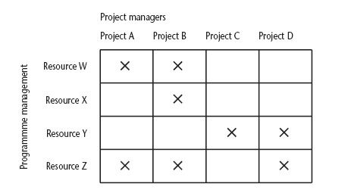
Projects sharing resources
Notes:
During the resource allocation phase of project planning – see chapter/lecture 8 on resource allocation – some project activities could be delayed while waiting for a resource to become available.

Slide 14
Strategic programmes
Based on OGC approach
Initial planning document is the Programme Mandate describing
  The new services/capabilities that the programme should deliver
  How an organization will be improved
  Fit with existing organizational goals
A programme director appointed a champion for the scheme
Notes:
The material here is based on the UK government’s Office of Government Commerce (OGC) approach which is described in detail in their publication Managing successful programmes.
The programme director should be someone who is in a prominent position in the organization so that the seriousness and commitment of the organization to the programme are made clear.
An example of what might be a programme is given in Section 3.4 in the text. It might be found at the IOE company that the customers’ experience of the organization can be very variable and inconsistent. The employee who records the customer’s requirements is different from the people who actually carry out the work and different again from the clerk who deals with accounts. Different maintenance engineers deal with different types of equipment. A business objective might be to present a consistent and uniform interface to the client. This objective might need changes to a number of different systems which until now have been largely self-contained. The work to reorganize each individual area might be treated as separate projects, co-ordinated at a higher level as a programme.

Slide 15
Next stages/documents
The programme brief – equivalent of a feasibility study: emphasis on costs and benefits
The vision statement – explains the new capability that the organization will have
The blueprint – explains the changes to be made to obtain the new capability
Notes:
The programme brief – is it worth it?
The vision statement – the ‘what’
The blueprint – the ‘how’

Slide 16
Technical assessment
  It is the second criteria for evaluating the project.
  Technical assessment of a proposed system evaluates functionality against available:
    Hardware
    Software
Limitations
  Nature of solutions produced by strategic information systems plan
  Cost of solution. Hence undergoes cost-benefit analysis.

Slide 17
Benefits management
developers
users
organization
use
for
the
application
benefits
build
to deliver
Providing an organization with a capability does not guarantee that this will provide benefits envisaged – need for benefits management
This has to be outside the project – project will have been completed
Therefore done at programme level

Slide 18
Benefits management
To carry this out, you must:
Define expected benefits
Analyse balance between costs and benefits
Plan how benefits will be achieved
Allocate responsibilities for their achievement
Monitor achievement of benefits
Notes:
Benefit profiles can be produced that document when and how it is planned that the benefits will be experienced.
As different components of the new capability are developed, a series of tranches of projects (projects grouped in different steps of the programme) may be completed, each with a set of associated benefits.
The achievement of benefits might be made the responsibility of staff who are designated as business change managers.

Slide 19
Benefits
These might include:
Mandatory requirement
Improved quality of service
Increased productivity
More motivated workforce
Internal management benefits
Notes:
You could argue that as you have to comply with a mandatory requirement, the question of benefits is irrelevant in this case. However as failure to comply will a negative outcome (e.g. not being able to trade), avoiding that negative outcome is clearly a benefit which could be costed.
‘Internal management benefits’ includes things like better decision-making. In the case of an insurance company a deeper analysis of insurance claims might help identify types of business that are most risky and allow the company to adjust premiums to cover these.

Slide 20
Benefits - continued
Risk reduction
Economies
Revenue enhancement/acceleration
Strategic fit
Notes:
‘Economies’ refers to cost-cutting e.g. using an automated telephone system to direct calls without human intervention could allow an organization to reduce staff.
Revenue enhancement/acceleration e.g. the sooner that bills reach the customers, the sooner they can pay them.
‘Strategic fit’ A change might not benefit any single group within an organization but might have to be made to obtain a benefit for the organization as a whole.

Slide 21
Quantifying benefits
Benefits can be:
Quantified and valued e.g. a reduction of x staff saving £y
Quantified but not valued e.g. a decrease in customer complaints by x%
Identified but not easily quantified – e.g. public approval for a organization in the locality where it is based

Slide 22
Economic Assessment
Cost benefit analysis (CBA)
You need to:
Identify all the costs which could be:
  Development costs
  Set-up
  Operational costs
Identify the value of benefits
Check benefits are greater than costs
Notes:
Section 3.10 of the text expands this material.
Exercise 3.1 requires students to identify the potential costs and benefits of the Brightmouth College payroll application.

Slide 23
Three types of cost
Development costs: includes salary and other employment cost of staff involved.
Setup costs: includes the cost of implementation of system such as hardware, and also file conversion, recruitment and staff training.
Operational cost: cost require to operate system, after it is installed.

Slide 24
CASH FLOW FORCASTING
It estimate overall cost and benefits of a product with respect to time.
-ive cashflow during development stage.
+ive cashflow during operating life.
During development stage
Staff wages
Borrowing money from bank
Paying interest to bank
Payment of salaries
Amount spent for installation, buying hw and sw
Income is expected by 2 ways.
Payment on completion
Stage payment

Slide 25
Net profit
Year | Cash-flow
0 | -100,000
1 | 10,000
2 | 10,000
3 | 10,000
4 | 20,000
5 | 100,000
Net profit | 50,000
‘Year 0’ represents all the costs before system is operation
‘Cash-flow’ is value of income less outgoing
Net profit value of all the cash-flows for the lifetime of the application
Notes:
See Section 3.12 for further details. Exercise 3.2 is applicable here

Slide 26
Pay back period
This is the time it takes to start generating a surplus of income over outgoings. What would it be below?
Year | Cash-flow | Accumulated
0 | -100,000 | -100,000
1 | 10,000 | -90,000
2 | 10,000 | -80,000
3 | 10,000 | -70,000
4 | 20,000 | -50,000
5 | 100,000 | 50,000
Notes:
The payback period would be about 4.5 years.
Exercise 3.3. in the text is relevant hee.

Slide 27
Return on investment (ROI)
ROI =
Average annual profit
Total investment
X 100
In the previous example
average annual profit = 50,000/5
= 10,000
ROI = 10,000/100,000 X 100 = 10%
Notes:
Exercise 3.4. gives further practice is calculating ROI.

Slide 28
Net present value
Would you rather I gave you Rs. 1,00,000 today or in 12 months time?
If I gave you Rs. 1,00,000 now you could put it in savings account and get interest on it.
If the interest rate was 10% how much would I have to invest now to get Rs. 1,00,000 in a year’s time?
This figure is the net present value of Rs. 1,00,000 in one year’s time
Notes:
If you invested Rs. 91000 now you would get Rs. 9100 in interest which would give you Rs. 1,09,200 in 12 months

Slide 29
Discount factor
Discount factor = 1/(1+r)^{t}
  r is the interest rate (e.g. 10% is 0.10)
  t is the number of years
In the case of 10% rate and one year
Discount factor = 1/(1+0.10) = 0.9091
In the case of 10% rate and two years
Discount factor = 1/(1.10 x 1.10) =0.8294

Slide 30
Applying discount factors
Year | Cash-flow | Discount factor | Discounted cash flow
0 | -100,000 | 1.0000 | -100,000
1 | 10,000 | 0.9091 | 9,091
2 | 10,000 | 0.8264 | 8,264
3 | 10,000 | 0.7513 | 7,513
4 | 20,000 | 0.6830 | 13,660
5 | 100,000 | 0.6209 | 62,090
 |  | NPV | 618
Notes:
NPV is the sum of the discounted cash flows for all the years of the ‘project’ (note that in NPV terms the lifetime of the completed application is included in the ‘project’)
The figure of £618 means that £618 more would be made than if the money were simply invested at 10%. An NPV of £0 would be the same amount of profit would be generated as investing at 10%.

Slide 31
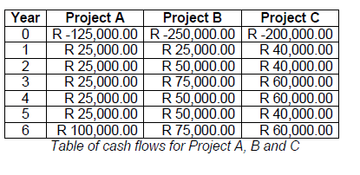
Exercise

Slide 32
Internal rate of return
Internal rate of return (IRR) is the discount rate that would produce an NPV of 0 for the project
Can be used to compare different investment opportunities
There is a Microsoft Excel function which can be used to calculate
Notes:
A quite detailed discussion of IRR features in the text in Section 3.12

Slide 33
IRR (Internal Rate Return)
The IRR compares returns to costs by asking: "What is the discount rate that would give the cash flow stream a net present value of 0?"
Timing | Discount Rate(10%) | CASE A |  | CASE B
 |  | Net Cash Flow | Present Value | Net Cash Flow | Present Value
Now 0 | 1 | – $100.00 | – $100.00 | – $100.00 | – $100.00
Year 1 | 0.9091 | $60.00 | $54.54 | $20.00 | $18.18
Year 2 | 0.8264 | $60.00 | $49.59 | $20.00 | $16.52
Year 3 | 0.7513 | $40.00 | $30.05 | $40.00 | $30.05
Year 4 | 0.6830 | $20.00 | $13.70 | $60.00 | $41.10
Year 5 | 0.6209 | $20.00 | $12.42 | $60.00 | $37.27
Total |  | Net CF_{A} = $100.00 | NPV_{A} = $60.30 | Net CF_{B} = $100.00 | NPV_{B} = $43.12

Slide 34
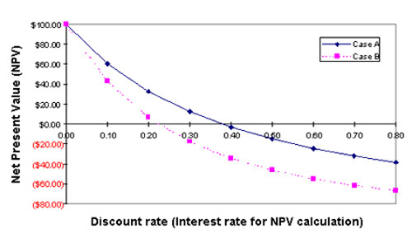
IRR asks a different question of the same two cash flow streams. Instead of proposing a discount rate and finding the NPV of each stream (as with NPV), IRR starts with the net cash flow streams and finds the interest rate (discount rate) that produces an NPV of zero for each. The easiest way to see how this solution is found is with a graphical summary:

Slide 35
These curves are based on the Case A and Case B cash flow figures in the table above. Here, however, we have used nine different interest rates, including 0.0 and 0.10, on up through 0.80.
As you would expect, as the interest rate used for calculating NPV of the cash flow stream increases, the resulting NPV decreases.
For Case A, an interest rate of 0.38 produces NPV = 0, whereas Case B NPV arrives at 0 with an interest rate of 0.22.
Case A therefore has an IRR of 38%, Case B an IRR of 22%.
IRR as the decision criterion, the one with the higher IRR is the better choice.

Slide 36
Risk Evaluation

Slide 37
Risk evaluation
Risk evaluation is meant to decide whether to proceed with the project or not, and whether the project is meeting its objectives.
Risk Occurs:
When the project exceed its original specification
Deviations from achieving it objectives and so on.
Risk Identification and ranking
Risk and Net Present Value
For riskier projects could use higher discount rates
Ex: Can add 2% for a Safe project or 5 % for a fairly risky one.
Cost benefit Analysis
Risk profile analysis
Decision trees

Slide 38
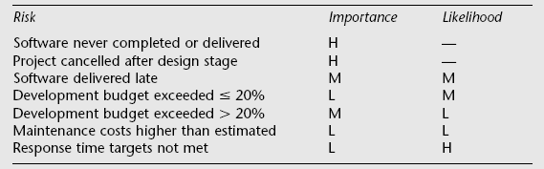
Risk Identification and ranking
Identify the risk and give priority.
Could draw up draw a project risk matrix for each project to assess risks
Project risk matrix used to identify and rank the risk of the project
Example of a project risk matrix
Notes:
In the table ‘Importance’ relates to the cost of the damage if the risk were to materialize and ‘likelihood’ to the probability that the risk will actual occur. ‘H’ indicates ‘High’, ‘M’ indicates ‘medium’ and ‘L’ indicates ‘low’. The issues of risk analysis are explored in much more depth in lecture/chapter 7.

Slide 39
Risk profile analysis
This make use of “risk profiles” using sensitivity analysis.
It compares the sensitivity of each factor of project profiles by varying parameters which affect the project cost benefits.
Eg:
Vary the original estimates of risk plus or minus 5% and re-calculate the expected cost benefits.

Slide 40
Decision trees
Identify over risky projects
Choose best from risk
Take suitable course of action
Decision tree of analysis risks helps us to
Extend the existing system
increase sales
improve the management information
Replace the existing system
Not replacing system leads in loss
Replace it immediately will be expensive.

Slide 41
The NPV of extending the invoicing system is assessed as Rs.75,000 if there is no sudden expansion. If there were a sudden expansion then there would be a loss of Rs.100,000. If the whole system were replaced and there was a large expansion there would be a NPV of Rs.250,000 due to the benefits of being able to handle increased sales. If sales did not increase then the NPV would be –Rs.50,000.
The company estimate the likelihood of the market increasing significantly at 20% and, hence the probability that it will not increase at 80%.
The decision tree shows these possible outcomes and also shows the estimated probability of each outcome.

Slide 42
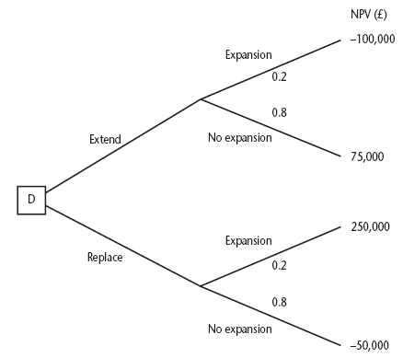
Decision trees
Notes:
The diagram here is figure 3.8 in the text.
This illustrates a scenario relating to the IOE case study. Amanda is responsible for extending the invoicing system. An alternative would be to replace the whole of the system. The decision is influenced by the likelihood of IOE expanding their market. There is a strong rumour that they could benefit from their main competitor going out of business: in this case they could pick up a huge amount of new business, but the invoicing system could not cope. However replacing the system immediately would mean other important projects would have to be delayed.
The NPV of extending the invoicing system is assessed as £75,000 if there is no sudden expansion. If there were a sudden expansion then there would be a loss of £100,000. If the whole system were replaced and there was a large expansion there would be a NPV of £250,000 due to the benefits of being able to handle increased sales. If sales did not increase then the NPV would be -£50,000.
The decision tree shows these possible outcomes and also shows the estimated probability of each outcome.
The value of each outcome is the NPV multiplied by the probability of its occurring. The value of a path that springs from a particular decision is the sum of the values of the possible outcomes from that decision. If it is decided to extend the system the sum of the values of the outcomes is £40,000 (75,000 x 0.8 – 100,000 x 0.2) while for replacement it would be £10,000 (250,000 x 0.2 – 50,000 x 0.80). Extending the system therefore seems to be the best bet (but it is still a bet!).

Slide 43
The value of each outcome is the NPV multiplied by the probability of its occurring. The value of a path that springs from a particular decision is the sum of the values of the possible outcomes from that decision. If it is decided to extend the system the sum of the values of the outcomes is
Rs.40,000 (75,000 x 0.8 – 100,000 x 0.2)
while for replacement it would be
Rs.10,000 (250,000 x 0.2 – 50,000 x 0.8).
Extending the system therefore seems to be the best option.

Slide 44
Ex 1:
NPV (Rs)
Further extension
-100,000
0.5
Extend
80,000
0.5
No extension
D2
Further extension
0.1
0.5
200,000
Extend
Replace
0.5
0.9
No extension
-30,000
D1
Further extension
Replace
0.1
-100,000
0.9
Replace
No extension
75,000
0.2
Further extension
250,000
0.8
No extension
-50,000

