Slide 1
Managing People and organizing teams

Slide 2
Three main concerns
Staff selection
Staff development
Staff motivation
Continued well being of staff during the course of the project
Objectives (step 1)
Control (step 2)
Scope and nature of activities (step 4)
Risks to project success (step 6)
Qualities of individual members (step 7)

Slide 3


Organizational Behaviour: A Background
Frederick Taylor (1856-1915) ‘the father of scientific management’
Focus:
  To select the best people for the job;
  To instruct them in the best methods;
  To give financial incentives in the form of higher wages to the best workers.
One problem: ‘group norms’
SPM (5e) Managing people and organizing teams© The McGraw-Hill Companies, 2009
Notes:
Much of the work of Taylor was in factories and mines, working with manual workers. The ‘instruction in best methods’ involved breaking down a manual task into its component activities, identifying the best way of carrying out those activities and then teaching the workers to copy the approved method. This can be seen as treating the workers as little better than automatons – but it is also the way the sporting coaches often work!
The individual workers were encouraged to maximize output by paying them piece-rates e.g. by the units processed.
One difficulty with this is that workers learn that increasing output can in fact lead to the piece-rate being adjusted in a downward direction. Maximizing output can also be physically and mentally exhausting. Groups of workers therefore tend to converge on an agreed output rate which does not require a constant 100% effort.
See Sections 11.2 and 11.3.

Slide 4
Hawthorne effect
1920’s – series of experiments at the Hawthorne Plant of Western Electric, Chicago
Found that simply showing an interest in a group increased productivity
Theory X: there is a need for coercion, direction, and control of people at work
Theory Y: work is as natural as rest or play
SPM (5e) Managing people and organizing teams© The McGraw-Hill Companies, 2009
Notes:
The Hawthorne experiments investigated the effect of various factors such as improved lightning on productivity. It was found that the productivity of the control group (whose working conditions such as lighting were not changed) increased – the fact that someone singled them out for observation improved their motivation.
Donald McGregor Theory X and Theory Y management approaches.
See Section 11.3 Page 257-8.

Slide 5
Selecting the best people
Belbin distinguishes between eligible (having the right qualifications) and suitable candidates (can do the job).
The danger is employ someone who is eligible but not suitable
The best situation is to employ someone who is suitable but not eligible! For example, these are likely to be cheaper and to stay in the job.
SPM (5e) Managing people and organizing teams© The McGraw-Hill Companies, 2009

Slide 6
Do good software developers have innate characteristics?
1968 study – difference of 1:25 in time taken by different programmers to code program
Other research found experience better than maths skills as a guide to software skills
Some research suggested software developers less sociable than other workers
Later surveys have found no significant social differences between IT workers and others – this could be result of broader role of IT in organizations
SPM (5e) Managing people and organizing teams© The McGraw-Hill Companies, 2009
Notes:
There is some evidence that there is a very wide variation in software development skills – going back many years.
Some research found that computer people had fewer social needs than other professionals. Later research has not found any significant difference – this may be because the ‘ICT profession’ has become broader in scope.

Slide 7
The Recruitment Process
Create a job specification.
  Content includes types of task to be carried out.
Create a job holder profile
  Describes the characteristics of the person who could do the job
Obtain applicants
  Identify the media that potential job holders are likely to consult. Elicit CVs
SPM (5e) Managing people and organizing teams© The McGraw-Hill Companies, 2009

Slide 8
The Recruitment Process - continued
Select potential candidates from CVs.
  Do not waste everybody’s time interviewing people whose CV clearly indicates are unsuitable.
Further selection, including interview
  Selection processes could include aptitude tests, examination of work portfolios. Make sure selection processes map to the job holder profile
Other procedures.
  e.g. taking up references, medical examination, etc
SPM (5e) Managing people and organizing teams© The McGraw-Hill Companies, 2009

Slide 9

Instruction in the best methods
The induction of new staff should be carefully planned – worst case where new recruit is simply ignored and not given any tasks
Good induction leads to new recruit becoming productive more quickly
Need to review staff progress frequently and provide feedback
Need to identify training that could enhance staff effectiveness.
SPM (5e) Managing people and organizing teams© The McGraw-Hill Companies, 2009
Notes:
Section 11.5 Page 261

Slide 10
Motivation
Motivation and application can often make up for shortfalls in innate skills
Taylor’s approach - financial incentives
Abraham Maslow (1908-1970)
  motivations vary from individual to individual
  hierarchy of needs – as lower ones fulfilled, higher ones emerge
  Lowest level – food, shelter
  Highest level – self-actualization
SPM (5e) Managing people and organizing teams© The McGraw-Hill Companies, 2009
Notes:
Maslow’s model implies that people will be motivated by different things at different times. Also that people always feel dissatisfied, but the focus of the dissatisfaction changes over time.
This and other aspects of motivation are discussed in Section 11.6 of the text
Exercises 11.2 and 11.3 are designed to get students to think a little about the implications of the Taylor and Maslow models of motivation.

Slide 11
Herzberg
Herzberg suggested two sets of factors affected job satisfaction
Hygiene or maintenance factors – make you dissatisfied if they are not right e.g. pay, working conditions
Motivators – make you feel the job is worthwhile e.g. a sense of achievement
SPM (5e) Managing people and organizing teams© The McGraw-Hill Companies, 2009
Notes:
Exercise 11.4 illustrates the approach that Herzberg and associates used to gather data about motivational factors.

Slide 12
Expectancy theory - Vroom
Vroom and colleagues identified three influences on motivation
Expectancy – the belief that working harder leads to better performance
Instrumentality – the belief that better performance will be rewarded
Perceived value of the reward
Note: If any of the above factors has a zero value, then motivation will also be zero
Expectancy: - compilation error no matter how hard you tried
Instrumentality – removing fault on the software that is no longer used
Perceived value – 90% get 1st place.
SPM (5e) Managing people and organizing teams© The McGraw-Hill Companies, 2009
Notes:
Note: if any of the factors has a zero value, then motivation will be zero.
Example from the text book: expectancy – trying to use a compiler to compile software code; the code has a bug which causes a compilation error regardless of what you do. In this case motivation will collapse.
Instrumentality – you are working on removing a fault from a software tool used by a client; you find that the client has given up using the tool and has acquired a different one to do the job. Low perceived value of reward: a reward that everyone gets is less highly regarded than one which only outstanding people get. Getting a first is more valuable if only 5% of students get a first compared to where 90% get a first!
Chapter 11a

Slide 13
Oldham-Hackman job characteristics
Identified the following characteristics of a job which make it more ‘meaningful’
Skill variety
Task identity
Task significance
Two other factors contributed to satisfaction:
Autonomy
Feedback
SPM (5e) Managing people and organizing teams© The McGraw-Hill Companies, 2009
Notes:
Skill variety – number of different skills the job holder has the opportunity to exercise
Task identity – the degree to which your work and its results are associated with you
Task significance – the degree to which your job has an influence on others
Two other factors contributed to satisfaction:
Autonomy – the freedom that you have about the way that you do the job;
Feedback – the information you get back about the results of your work.
Software developers will tend to be associated with their code – task identity; analyst programmers will have a to use a wider range of skills than lower level programmers – more skill variety. If you have direct contact with the end-users of your software you are likely to be more aware of the results of your work – task significance, and more likely to get feedback on it.

Slide 14
Methods to Improve Motivation
Set specific goals
Provide feedback on the progress towards meeting those goals
Consider job redesign
  Job enlargement
  Job enrichment
SPM (5e) Managing people and organizing teams© The McGraw-Hill Companies, 2009
Notes:
Job enlargement – widening the range of tasks carried out by a worker
Job enrichment – delegating some management roles to the worker e.g for re-ordering raw materials.
Chapter 11a

Slide 15
Becoming a team
Five basic stages of development:
1) Forming – The members of the group get to know each other and try to set up some ground rules about behaviour.
2) Storming – Conflicts arise as various members of the group try to exert leadership and the group’s methods of operation are being established.
3) Norming – Conflicts are legally settled and a feeling of group identity emerges
4) Performing – The emphasis is now on the tasks at hand
5) Adjourning – The group disbands.
SPM (5e) Managing people and organizing teams© The McGraw-Hill Companies, 2009
Notes:
The members of the group get to know one another and try to set up some ground rules about behaviour
Storming – conflicts arise as various members of the group try to exert leadership and the group’s methods of working are established
Norming – conflicts are largely settled and a feeling of group identity emerges
Performing – the emphasis is now on the tasks at hand
Adjourning – the group disbands
One way of attempting to accelerate this process is through team-building exercises.
This is covered in Section 11.9 of the text book.
Chapter 11a

Slide 16
Balanced teams
Meredith Belbin studied the performance of top executives carrying out group work at the Hendon Management Centre
Tried putting the ‘best’ people together in ‘Apollo’ teams – almost invariably did badly
Identified the need for a balance of skills and management roles in a successful team
The difference between “eligible” and “suitable” candidates
SPM (5e) Managing people and organizing teams© The McGraw-Hill Companies, 2009
Notes:
R. Meredith Belbin Management Teams: Why they succeed or fail (2nd edition) Elsevier 2003 contains a self-assessment questionnaire which identifies the role a person to which a person is best suited.
Chapter 11a

Slide 17
Management team roles
The co-ordinator/chair – good at chairing meetings
The ‘plant’ – an idea generator
The monitor-evaluator – good at evaluating ideas
The shaper – helps direct team’s efforts
The team worker – skilled at creating a good working environment
The resource investigator – adept at finding resources in terms of physical and info.
The completer-finisher – concerned with completing tasks
The company worker – good team player willing to undertake less attractive work if needed for team success
The specialist – the ‘techie’ who likes to acquire knowledge for its own sake
SPM (5e) Managing people and organizing teams© The McGraw-Hill Companies, 2009
Notes:
Chapter 11a

Slide 18
Belbin management roles - continued
To be a good team member you must be able to:
Time your interventions e.g – not overwhelm others
Be flexible
Be restrained
Keep the common goals of the team in mind all the time
SPM (5e) Managing people and organizing teams© The McGraw-Hill Companies, 2009
Notes:
The ‘specialist’ was added by Belbin in 1996.
A person can have elements of more than one of the types, but usually one or two predominate. According to Belbin about 30% cannot be classified under any heading at all.
Problems can occur if, for example, you have two or more shapers and no effective co-ordinator – there are likely to be clashes that are difficult to resolve.
Chapter 11a

Slide 19
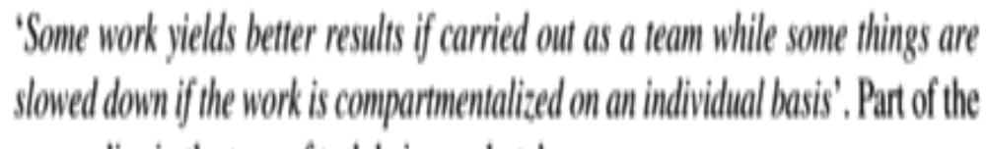
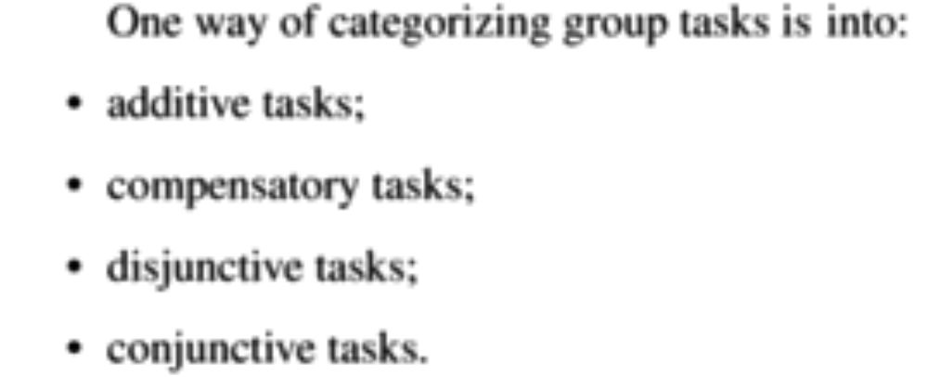
Group Performance
SPM (5e) Managing people and organizing teams© The McGraw-Hill Companies, 2009

Slide 20
‘Social loafing’
Tendency for some team participants to ‘coast’ and let others do the work
Also tendency not to assist other team members who have problems
Suggested counter-measures:
  Make individual contributions identifiable
  Consciously involve group members ( ‘loafer’ could in fact just be shy!)
  Reward ‘team players’
SPM (5e) Managing people and organizing teams© The McGraw-Hill Companies, 2009
Notes:
Chapter 11a

Slide 21
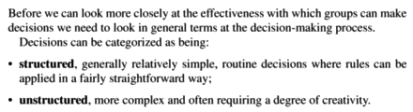
Decision Making
SPM (5e) Managing people and organizing teams© The McGraw-Hill Companies, 2009

Slide 22
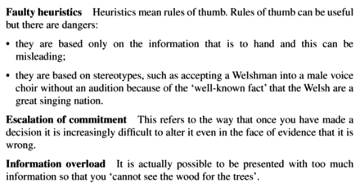
Obstacles in Decision making
SPM (5e) Managing people and organizing teams© The McGraw-Hill Companies, 2009

Slide 23
Barriers to good team decisions
Inter-personal conflicts – see earlier section on team formation
Conflicts tend to be a dampened by emergence of group norms – shared group opinions and attitudes
Risky shift – people in groups are more likely to make risky decisions than they would as individuals
SPM (5e) Managing people and organizing teams© The McGraw-Hill Companies, 2009
Notes:
Chapter 11a

Slide 24
Delphi approach
To avoid dominant personalities intruding the
following approach is adopted
Enlist co-operation of experts
Moderator presents experts with problem
Experts send in their recommendations to the moderator
Recommendations are collated and circulated to all experts
Experts comment on ideas of others and modify their own recommendation if so moved
If moderator detects a consensus, stop; else back to 4
SPM (5e) Managing people and organizing teams© The McGraw-Hill Companies, 2009
Notes:
The Delphi approach was originally developed by the RAND Corporation in the late 1960s. The development of email clearly makes the application of the method much easier to organize.
Chapter 11a

Slide 25
Leadership: Types of authority
Position power
Coercive power – able to threaten punishment
Connection power – have access to those who do have power
Legitimate power – based on a person’s title conferring a special status
Reward power – able to reward those who comply
SPM (5e) Managing people and organizing teams© The McGraw-Hill Companies, 2009
Notes:
Section 11.11 discusses these concepts.
Chapter 11a

Slide 26
Leadership: Types of power
Personal power
Expert power: holder can carry out specialist tasks that are in demand
Information power: holder has access to needed information
Referent power: based on personal attractiveness or charisma
SPM (5e) Managing people and organizing teams© The McGraw-Hill Companies, 2009
Notes:
Exercise 11.7 should help student familiarize themselves with these concepts
Chapter 11a

Slide 27
Leadership styles
Task orientation – focus on the work in hand
People orientation – focus on relationships
Where there is uncertainty about the way job is to be done or staff are inexperienced they welcome task oriented supervision
Uncertainty is reduced – people orientation more important
Risk that with reduction of uncertainty, managers have time on their hands and become more task oriented (interfering)
1. Directive autocrat
2. Permissive autocrat
3. Directive democrat
4.Permissive democrat
SPM (5e) Managing people and organizing teams© The McGraw-Hill Companies, 2009
Notes:
Essentially staff want hands-on management when they need guidance. Once the know the job they want to be left to get on with it!
Chapter 11a

Slide 28
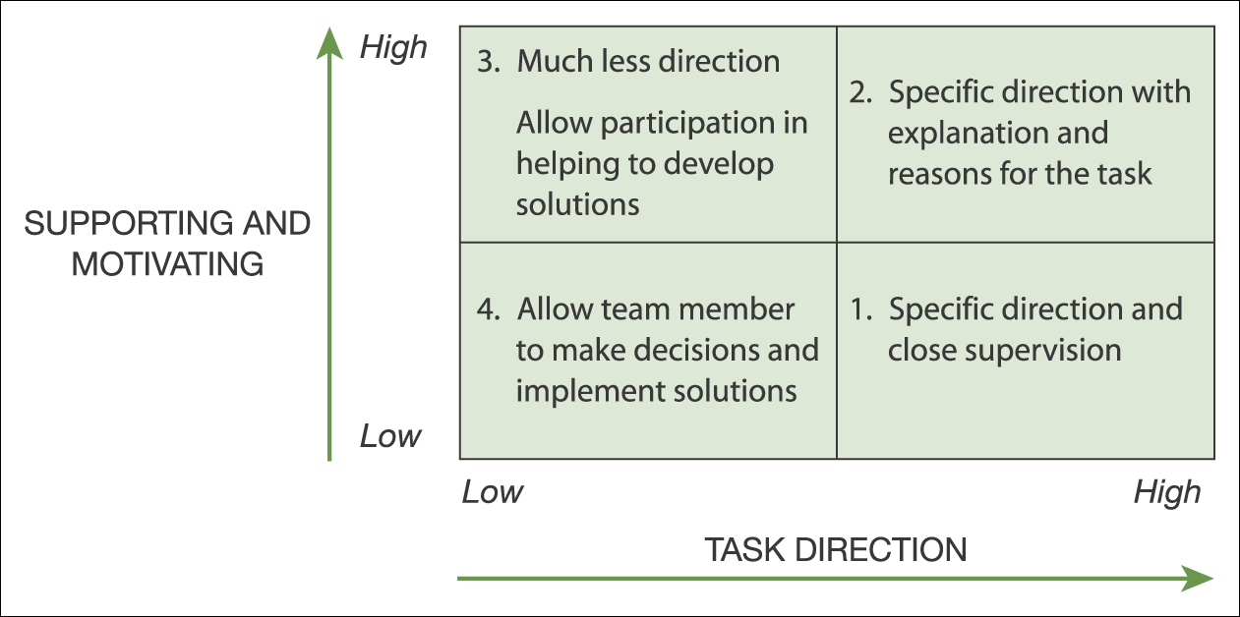
Coaching style matrix
Figure 21.5 Developing team members by matching your supervision to their needs
SPM (5e) Managing people and organizing teams© The McGraw-Hill Companies, 2009

Slide 29
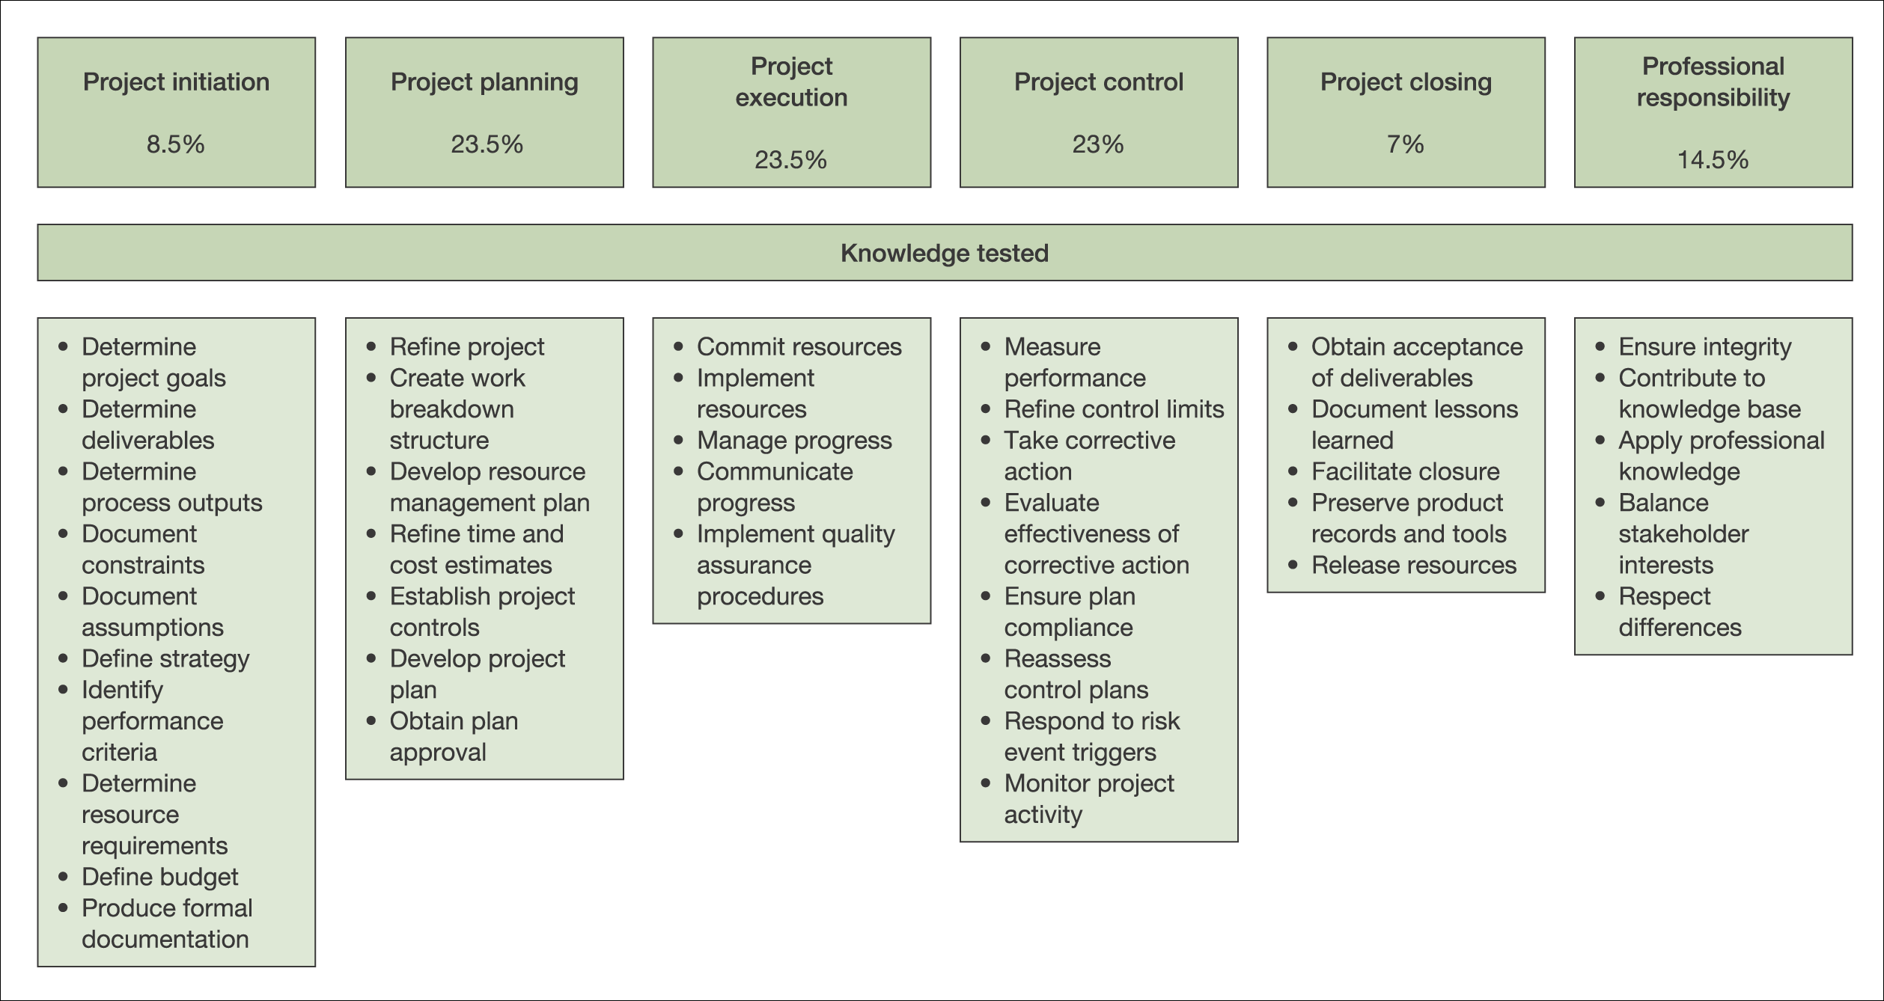
PMI examination content
Figure 24.1 PMI qualification examination content
SPM (5e) Managing people and organizing teams© The McGraw-Hill Companies, 2009

Slide 30
Stress
Edward Yourdon quotes a project manager: ‘Once a project gets rolling, you should be expecting members to be putting in at least 60 hours a week….The project manager must expect to put in as many hours as possible.’
1960 study in US: people under 45 who worked more than 48 hours a week twice the risk of death from coronary heart disease.
XP practice – maximum 40 hour working week
SPM (5e) Managing people and organizing teams© The McGraw-Hill Companies, 2009

Slide 31
Stress can be reduced by good project management
Good project management should lead to:
Reasonable estimates of effort
Good project control leading fewer unexpected crises
Making clear what is expected of each team member – reduces role ambiguity
Reduced role conflict where a person is torn between conflicting responsibilities
Bullying tactics are a symptom of incompetent project management.
SPM (5e) Managing people and organizing teams© The McGraw-Hill Companies, 2009

Slide 32
Health and safety
Apart from stress, health and safety less likely to be an issue compared to other engineering projects.
…but sometimes IT infrastructure may be set up as other building work is going on
UK law lays down that organizations employing over 5 staff should have a written safety policy
Management of safety should be embedded in project management.
SPM (5e) Managing people and organizing teams© The McGraw-Hill Companies, 2009

Slide 33
Health and safety - continued
Top management must be committed to health and safety (H&S) policy
Delegation of responsibilities relating to H&S should be clear
Job descriptions should include H&S related responsibilities
Need to ensure those given H&S responsibilities should understand and accept them
SPM (5e) Managing people and organizing teams© The McGraw-Hill Companies, 2009

Slide 34
Health and safety - continued
There should be a designated safety officer
Staff, particularly knowledgeable technical specialists, should consulted about safety
There should be an adequate H&S budget
SPM (5e) Managing people and organizing teams© The McGraw-Hill Companies, 2009

Slide 35
Ethical and professional concerns
Ethics relates to the moral obligation to respect the rights and interests of others – goes beyond strictly legal responsibilities
Three groups of responsibilities:
Responsibilities that everyone has
Responsibilities that people in organizations have
Responsibilities relating to your profession or calling
SPM (5e) Managing people and organizing teams© The McGraw-Hill Companies, 2009

Slide 36
Organizational ethics
There are some who argue that ethical organizational ethics are limited:
Stockholder theory (e.g. Milton Friedman). An employee’s duty is to the owners of the business (which often means the stakeholders) above all others – although legal requirements must be met.
Competitive relationships between businesses. Competition may cause you to do things that could have a negative impact on the owners or employees of competitive businesses
SPM (5e) Managing people and organizing teams© The McGraw-Hill Companies, 2009
Notes:
Two key documents here are:
Milton Friedman (1970) ‘The social responsibility of business is to increase profits’ The New York Times Magazine 13 September. Available at <http://www.umich.edu/~the core/Friedman.doc>
Alfred Carr (1968) ‘Is business bluffing ethical?’ Harvard Business Review 46(11) 143-53.

Slide 37
Exercise
Identify some of the possible objections and criticisms that can be made of the stockholder business ethics model described above.
SPM (5e) Managing people and organizing teams© The McGraw-Hill Companies, 2009
Notes:
Giving this exercise to students can be an interesting (and sometimes scary) experience. The argument against stockholder theory is that the work of an organization is not purely that of money-making. Banks, for example, have a social and economic role facilitating day to day commerce and business. If the owners of the banks decided to opt out of this role the community at large (through the government) would have to step in to ensure that that role is still carried out. Freidman’s arguments unwittingly support a greater role for state ownership of important organizations.

Slide 38
Professional ethics
Professionals have knowledge about the technical domain that the general public does not
Ethical duty of the expert to warn lay people of the risks involved in a particular course of action
Many professions, or would be professions, have codes of conduct for their members e.g.
<http://www.bcs.org/upload/pdf/cop.pdf>
<http://www.ieee.org/web/aboutus/ethics>
<http://www.apm.org/about/se_code>
SPM (5e) Managing people and organizing teams© The McGraw-Hill Companies, 2009

