Slide 1
What is software?
Software is a set of instructions, data or programs used to operate computers and execute specific tasks.
The product that software professionals build and then support over the long term.
Software encompasses: (1) instructions (computer programs) that when executed provide desired features, function, and performance; (2) data structures that enable the programs to adequately store and manipulate information and (3) documentation that describes the operation and use of the programs.

Slide 2
software Applications
The two main categories of software are application software and system software.
Application software. The most common type of software, application software is a computer software package that performs a specific function for a user, or in some cases, for another application. Examples of modern applications include office suites, graphics software, databases and database management programs, web browsers, word processors, software development tools, image editors and communication platforms.
System software. These software programs are designed to run a computer's application programs and hardware. System software coordinates the activities and functions of the hardware and software. In addition, it controls the operations of the computer hardware and provides an environment or platform for all the other types of software to work in. The OS is the best example of system software; it manages all the other computer programs. Other examples of system software include the firmware, computer language translators and system utilities.

Slide 3
Software Applications
System software: such as compilers, editors, file management utilities.
Application software: stand-alone programs for specific needs.
Engineering/scientific software: Characterized by “number crunching”algorithms. such as automotive stress analysis, molecular biology, orbital dynamics.
Embedded software resides within a product or system. (key pad control of a microwave oven, digital function of dashboard display in a car).
Product-line software focus on a limited marketplace to address mass consumer market. (word processing, graphics, database management).
Web Apps (Web applications) network centric software. As web 2.0 emerges, more sophisticated computing environments is supported integrated with remote database and business applications.
AI software uses non-numerical algorithm to solve complex problem. Robotics, expert system, pattern recognition game playing.

Slide 4
The nature of software
Software is largely intangible.
The mass-production of duplicate pieces of software is trivial.
The software industry is labor intensive.
It is all too easy for an inadequately trained software developer to create a piece of software that is difficult to understand and modify.
Software is physically easy to modify.
Software does not wear out with use like other engineering artifacts, but instead its design deteriorates as it is changed repeatedly.

Slide 5
Types of Software...
Custom
For a specific customer
Generic
Sold on open market
Often called
COTS (Commercial Off The Shelf)
Shrink-wrapped
Embedded
Built into hardware
Hard to change
© Lethbridge/Laganière 2005
Chapter 1: Software and Software Engineering
5

Slide 6
Types of Software
© Lethbridge/Laganière 2005
Chapter 1: Software and Software Engineering
6
Differences among custom, generic and embedded software

Slide 7
Types of Software
© Lethbridge/Laganière 2005
Chapter 1: Software and Software Engineering
7
Real time software
E.g. control and monitoring systems
Must react immediately
Safety often a concern
Data processing software
Used to run businesses
Accuracy and security of data are key
Some software has both aspects

Slide 8
Exercise 1
Classify the following software according to whether it is
likely to be custom, generic or embedded (or some
combination); and whether it is data processing or real-time.
A system to control the reaction rate in a nuclear reactor
A program that runs inside badges worn by nuclear plant workers that monitors radiation exposure
A program used by administrative assistants at the nuclear plant to write letters
A program used to generate annual summaries of the radiation exposure experienced by workers
An educational website containing a Flash animation describing how the nuclear plant works

Slide 9
characteristics | Explanation
Functionality | The functionality of software refers to its ability to perform and function according to design specification.
Usability | The user-friendliness of the software is characterized by its ease of use. In other words, learning how to use the software should require less effort or time. (smooth user Interface)
Efficiency | Essentially, it refers to the software’s ability to utilize human and system resources such as time, effort, CPU, memory, computation power, network bandwidth, files, databases, etc., as effectively and efficiently as possible.
Flexibility | Software Flexibility refers to the ability of the software solution to adapt to potential or future changes in its requirements. When evaluating the flexibility of software, look at how simple it is to add, modify, or remove features without interfering with the current operation.
Reliability | The reliability of a software product describes the likelihood it will operate without failure over a specified period of time under certain conditions.
Maintainability | Maintainability refers to how easily you can repair, improve and comprehend software code. In some ways, maintaining is similar to being flexible.
Portability | Software portability is a critical factor that cannot be ignored. Portability refers to the ability to use software in different environments.
Integrity | There are multiple interpretations of software integrity. Some people tend to associate integrity with security, believing it is resistant to hacks and privacy violations. To others, high integrity means that the software cannot be modified without authorization.

Slide 10
Software Engineering
The IEEE definition:
Software Engineering:The application of a systematic, disciplined, quantifiable approach to the development, operation, and maintenance of software; that is, the application of engineering to software.
software engineering is the process of solving customers’ problems by the systematic development and evolution of large, high-quality software systems within cost, time and other constraints.

Slide 11
Why Software is Important?
The economies of ALL developed nations are dependent on software.
More and more systems are software controlled (transportation, medical, telecommunications, military, industrial, entertainment,)
Software engineering is concerned with theories, methods and tools for professional software development.
Expenditure on software represents a significant fraction of GNP in all developed countries.

Slide 12
Software costs
Software costs often dominate computer system costs. The costs of software on a PC are often greater than the hardware cost.
Software costs more to maintain than it does to develop. For systems with a long life, maintenance costs may be several times development costs.
Software engineering is concerned with cost-effective software development.

Slide 13
Stakeholders in SE
The term Stakeholder refers to, “a person, group or company that is directly or indirectly involved in the project and who may affect or get affected by the outcome of the project”.
Primary Stakeholders
Primary stakeholders have direct contact with the production of software and/or its use:
Users of the software
Customers of the software
Developers of the software
Managers of the hardware systems on which the software runs

Slide 14
Secondary Stakeholders
In addition, there are countless other people who are indirectly affected by software even though they may be unaware of its existence, e.g: Bank customers, because software manages bank accounts
Cancer patients, because software controls radiation treatment machines
Airline passengers, because software is involved with aircraft flight control
These are "secondary" only in the sense that their roles are not directly involved with the production of software and its use.
The software values of these groups are difficult to generalize, but due to the software impact on their lives or property, they must be considered by the primary stakeholders.

Slide 15
Classical Waterfall Model
The classical waterfall model divides the life cycle into a set of phases.
This model considers that one phase can be started after the completion of the previous phase.
That is the output of one phase will be the input to the next phase.
Thus the development process can be considered as a sequential flow in the waterfall. Here the phases do not overlap with each other. The different sequential phases of the classical waterfall model are shown in the below figure:

Slide 16
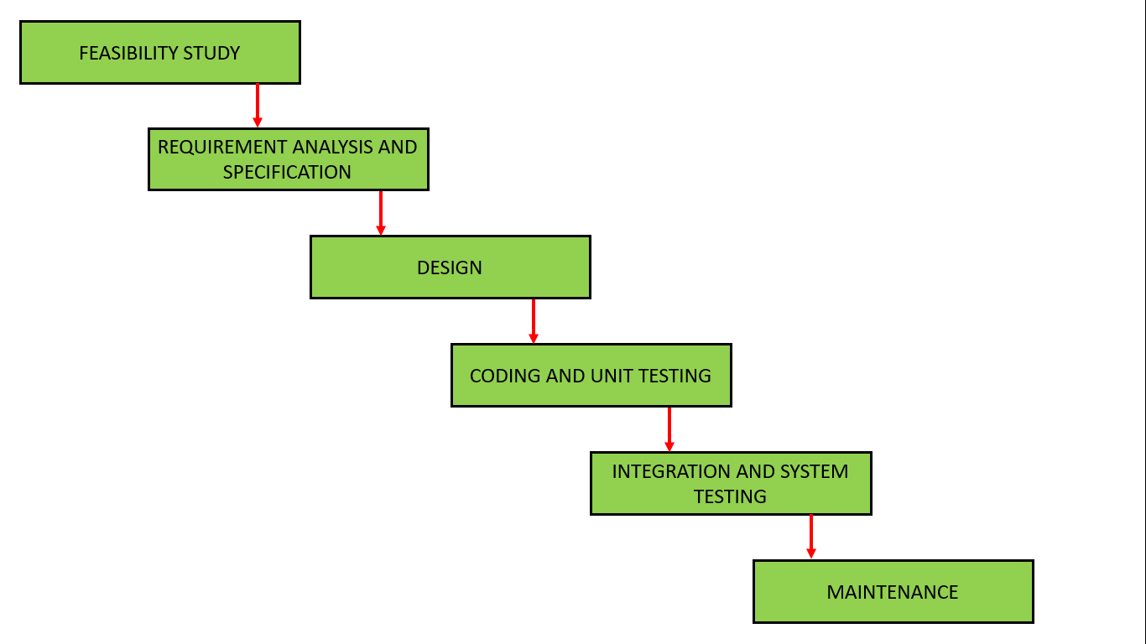
Waterfall Model

Slide 17
Phases of Waterfall Model
Feasibility Study: The main goal of this phase is to determine whether it would be financially and technically feasible to develop the software.
Requirements analysis and specification: The aim of the requirement analysis and specification phase is to understand the exact requirements of the customer and document them properly. This phase consists of two different activities.
1. Requirement gathering and analysis
2. Requirement specification

Slide 18
Phases of Waterfall Model
Design: The goal of this phase is to convert the requirements acquired in the SRS into a format that can be coded in a programming language. It includes high-level and detailed design as well as the overall software architecture. A Software Design Document is used to document all of this effort (SDD).
Coding and Unit testing: In the coding phase software design is translated into source code using any suitable programming language. Thus each designed module is coded. The aim of the unit testing phase is to check whether each module is working properly or not.

Slide 19
Phases of Waterfall Model
Integration and System testing: Integration of different modules are undertaken soon after they have been coded and unit tested. Integration of various modules is carried out incrementally over a number of steps. During each integration step, previously planned modules are added to the partially integrated system and the resultant system is tested. Finally, after all the modules have been successfully integrated and tested, the full working system is obtained and system testing is carried out on this. System testing consists of three different kinds of testing activities as described below :
Alpha testing: Alpha testing is the system testing performed by the development team.
Beta testing: Beta testing is the system testing performed by a friendly set of customers.
Acceptance testing: After the software has been delivered, the customer performed acceptance testing to determine whether to accept the delivered software or reject it.

Slide 20
Phases of Waterfall Model
Maintenance: Maintenance is the most important phase of a software life cycle. The effort spent on maintenance is 60% of the total effort spent to develop a full software. There are basically three types of maintenance :
Corrective Maintenance: This type of maintenance is carried out to correct errors that were not discovered during the product development phase.
Perfective Maintenance: This type of maintenance is carried out to enhance the functionalities of the system based on the customer’s request.
Adaptive Maintenance: Adaptive maintenance is usually required for porting the software to work in a new environment such as working on a new computer platform or with a new operating system.

Slide 21
Advantages of Classical Waterfall Model
This model is very simple and is easy to understand.
Phases in this model are processed one at a time.
Each stage in the model is clearly defined.
This model has very clear and well-understood milestones.
Process, actions and results are very well documented.
Reinforces good habits: define-before- design, design-before-code.
This model works well for smaller projects and projects where requirements are well understood.

Slide 22
Drawbacks of Classical Waterfall Model
No feedback path: In the classical waterfall model evolution of software from one phase to another phase is like a waterfall. It assumes that no error is ever committed by developers during any phase. Therefore, it does not incorporate any mechanism for error correction.
Difficult to accommodate change requests: This model assumes that all the customer requirements can be completely and correctly defined at the beginning of the project, but actually customers’ requirements keep on changing with time. It is difficult to accommodate any change requests after the requirements specification phase is complete.

Slide 23
Drawbacks of Classical Waterfall Model
No overlapping of phases: This model recommends that a new phase can start only after the completion of the previous phase. But in real projects, this can’t be maintained. To increase efficiency and reduce cost, phases may overlap.

Slide 24
When to use the Waterfall Model
Requirements are very well known
Product definition is stable
Technology is understood
New version of an existing product
Porting an existing product to a new platform.

Slide 25
Iterative Waterfall Model
In a practical software development project, the classical waterfall model is hard to use. So, the Iterative waterfall model can be thought of as incorporating the necessary changes to the classical waterfall model to make it usable in practical software development projects. It is almost the same as the classical waterfall model except some changes are made to increase the efficiency of the software development.
The iterative waterfall model provides feedback paths from every phase to its preceding phases, which is the main difference from the classical waterfall model.

Slide 26
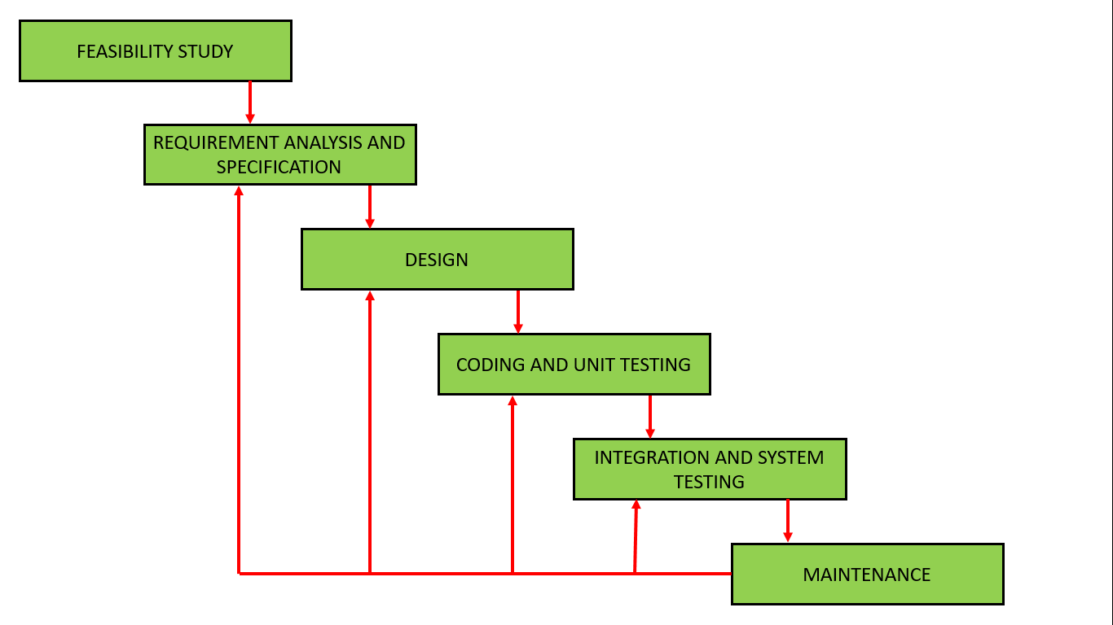
Iterative Waterfall Model

Slide 27
Advantages of Iterative Waterfall Model
Feedback Path
Simple
Cost-Effective
Well-organized

Slide 28
Drawbacks of Iterative Waterfall Model
Difficult to incorporate change requests
Incremental delivery not supported
Overlapping of phases not supported
Risk handling not supported
Limited customer interactions

Slide 29
Rapid application development model (RAD)
The Rapid Application Development Model was first proposed by IBM in the 1980s.
The critical feature of this model is the use of powerful development tools and techniques.
A software project can be implemented using this model if the project can be broken down into small modules wherein each module can be assigned independently to separate teams.
These modules can finally be combined to form the final product. Development of each module involves the various basic steps as in the waterfall model i.e analyzing, designing, coding, and then testing, etc. as shown in the figure. Another striking feature of this model is a short time span i.e the time frame for delivery(time-box) is generally 60-90 days.

Slide 30
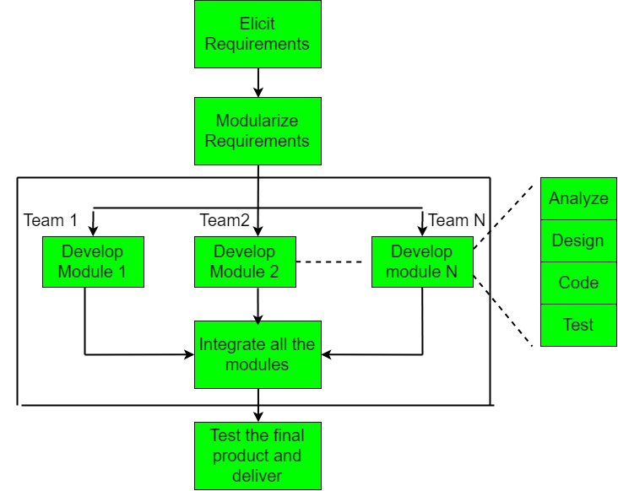
RAD

Slide 31
Phases of RAD
This model consists of 4 basic phases:
Requirements Planning
User Description
Construction
Cutover
The process involves building a rapid prototype, delivering it to the customer, and taking feedback. After validation by the customer, the SRS document is developed and the design is finalized.

Slide 32
When to use RAD Model?
When the customer has well-known requirements, the user is involved throughout the life cycle, the project can be time boxed, the functionality delivered in increments, high performance is not required, low technical risks are involved and the system can be modularized. In these cases, we can use the RAD Model.
Advantages:
The use of reusable components helps to reduce the cycle time of the project.
Feedback from the customer is available at the initial stages.

Slide 33
Advantages
Reduced costs as fewer developers are required.
The use of powerful development tools results in better quality products in comparatively shorter time spans.
The progress and development of the project can be measured through the various stages.
It is easier to accommodate changing requirements due to the short iteration time spans.

Slide 34
Disadvantages:
The use of powerful and efficient tools requires highly skilled professionals.
The absence of reusable components can lead to the failure of the project.
The team leader must work closely with the developers and customers to close the project in time.
The systems which cannot be modularized suitably cannot use this model.
Customer involvement is required throughout the life cycle.
It is not meant for small-scale projects as in such cases, the cost of using automated tools and techniques may exceed the entire budget of the project.

Slide 35
Applications:
This model should be used for a system with known requirements and requiring a short development time.
It is also suitable for projects where requirements can be modularized and reusable components are also available for development.
The model can also be used when already existing system components can be used in developing a new system with minimum changes.
This model can only be used if the teams consist of domain experts. This is because relevant knowledge and the ability to use powerful techniques are a necessity.
The model should be chosen when the budget permits the use of automated tools and techniques required.

Slide 36
Agile methods
Dissatisfaction with the overheads involved in software design methods of the 1980s and 1990s led to the creation of agile methods. These methods:
Focus on the code rather than the design
Are based on an iterative approach to software development
Are intended to deliver working software quickly and evolve this quickly to meet changing requirements.
The aim of agile methods is to reduce overheads in the software process (e.g. by limiting documentation) and to be able to respond quickly to changing requirements without excessive rework.

Slide 37
Agile manifesto
Individuals and Interactions more than processes and tools
Working Software more than comprehensive documentation
Customer Collaboration more than contract negotiation
Responding to Change more than following a plan

Slide 38
The principles of agile methods
Principle | Description
Customer involvement | Customers should be closely involved throughout the development process. Their role is provide and prioritize new system requirements and to evaluate the iterations of the system.
Incremental delivery | The software is developed in increments with the customer specifying the requirements to be included in each increment.
People not process | The skills of the development team should be recognized and exploited. Team members should be left to develop their own ways of working without prescriptive processes.
Embrace change | Expect the system requirements to change and so design the system to accommodate these changes.
Maintain simplicity | Focus on simplicity in both the software being developed and in the development process. Wherever possible, actively work to eliminate complexity from the system.

Slide 39
Agile principles
Customer satisfaction by early and continuous delivery of valuable software
Welcome changing requirements, even in late development
Working software is delivered frequently (weeks rather than months)
Close, daily cooperation between business people and developers
Projects are built around motivated individuals, who should be trusted
Face-to-face conversation is the best form of communication (co-location)

Slide 40
Agile principles
Working software is the primary measure of progress
Sustainable development, able to maintain a constant pace
Continuous attention to technical excellence and good design
Simplicity—the art of maximizing the amount of work not done—is essential
Best architectures, requirements, and designs emerge from self-organizing teams
Regularly, the team reflects on how to become more effective, and adjusts accordingly

Slide 41
Agile SDLC’s
Speed up or bypass one or more life cycle phases
Usually less formal and reduced scope
Used for time-critical applications
Used in organizations that employ disciplined methods

Slide 42
Some Agile Methods
Adaptive Software Development (ASD)
Feature Driven Development (FDD)
Crystal Clear
Dynamic Software Development Method (DSDM)
Rapid Application Development (RAD)
Scrum
Extreme Programming (XP)
Rational Unify Process (RUP)

Slide 43
Extreme Programming - XP
XP is a lightweight, efficient, low-risk, flexible, predictable, scientific, and fun way to develop a software.
eXtreme Programming (XP) was conceived and developed to address the specific needs of software development by small teams in the face of vague and changing requirements.
It provides values and principles to guide the team behaviour. The team is expected to self-organize. Extreme Programming provides specific core practices where −
Each practice is simple and self-complete.
Combination of practices produces more complex and emergent behaviour.

Slide 44
Embrace Change
A key assumption of Extreme Programming is that the cost of changing a program can be held mostly constant over time.
This can be achieved with −
Emphasis on continuous feedback from the customer
Short iterations
Design and redesign
Coding and testing frequently
Eliminating defects early, thus reducing costs
Keeping the customer involved throughout the development
Delivering working product to the customer

Slide 45
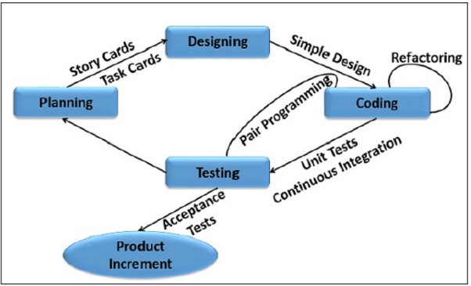

Slide 46
XP Practices (1-6)
Planning game – determine scope of the next release by combining business priorities and technical estimates
Small releases – put a simple system into production, then release new versions in very short cycle
Metaphor – all development is guided by a simple shared story of how the whole system works
Simple design – system is designed as simply as possible (extra complexity removed as soon as found)
Testing – programmers continuously write unit tests; customers write tests for features
Refactoring – programmers continuously restructure the system without changing its behavior to remove duplication and simplify

Slide 47
XP Practices (7 – 12)
Pair-programming -- all production code is written with two programmers at one machine
Collective ownership – anyone can change any code anywhere in the system at any time.
Continuous integration – integrate and build the system many times a day – every time a task is completed.
40-hour week – work no more than 40 hours a week as a rule
On-site customer – a user is on the team and available full-time to answer questions
Coding standards – programmers write all code in accordance with rules emphasizing communication through the code

Slide 48
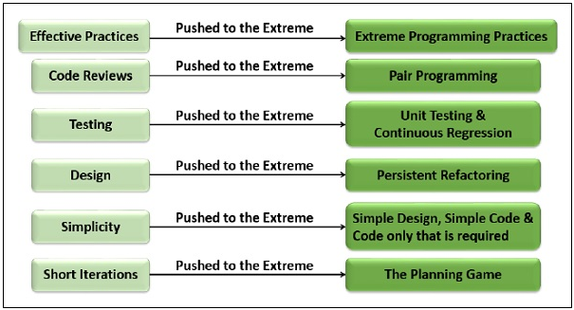
Extreme!

Slide 49
XP is “extreme” because
Commonsense practices taken to extreme levels
If code reviews are good, review code all the time (pair programming)
If testing is good, everybody will test all the time
If simplicity is good, keep the system in the simplest design that supports its current functionality. (simplest thing that works)
If design is good, everybody will design daily (refactoring)
If architecture is important, everybody will work at defining and refining the architecture (metaphor)
If integration testing is important, build and integrate test several times a day (continuous integration)
If short iterations are good, make iterations really, really short (hours rather than weeks)

Slide 50
Dynamic Systems Development Method (DSDM)
Applies a framework for RAD and short time frames
Paradigm is the 80/20 rule
– majority of the requirements can be delivered in a relatively short amount of time.

