Slide 1

Software Project Management
4th Edition
Chapter 1
An Introduction
Robert Hughes and Mike Cotterell

Slide 2
Outline of talk
In this introduction the main questions to be addressed will be:
  What is software project management? Is it really different from ‘ordinary’ project management?
  How do you know when a project has been successful? For example, do the expectations of the customer/client match those of the developers?
Notes:
The two key questions are:
What exactly is software project management?
This is going to be tackled by looking firstly at what is meant by ‘project’. We are then going to examine whether ‘software project management’ is really different from ‘normal’ project management. Is there anything special about software as opposed to other engineered artefacts?
2. How do we define whether a project is a success or not?
The point about studying project management is to be able to have successful projects. So how do we know if we have been successful?

Slide 3
What is a project?
Some dictionary definitions:
“A specific plan or design”
“A planned undertaking”
“A large undertaking e.g. a public works scheme”
Longmans dictionary
Key points above are planning and size of task
Notes:
Here are some definitions of ‘project’. No doubt there are other ones: for example
‘Unique process, consisting of a set of coordinated and controlled activities with start and finish dates, undertaken to achieve an objective conforming to specific requirements, including constraints of time, cost and resources’
BSO ISO 10006: 1997

Slide 4
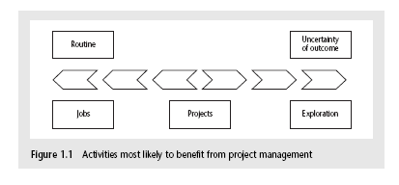
Jobs versus projects
‘Jobs’ – repetition of very well-defined and well understood tasks with very little uncertainty
‘Exploration’ – e.g. finding a cure for cancer: the outcome is very uncertain
‘Projects’ – in the middle!
Notes:
On the one hand there are repetitive jobs a similar task is carried out repeatedly, for example Kwikfit replacing a tyre on a car or a lecturer giving an introductory talk on project management. The task is well-defined and there is very little uncertainty. In some organizations, software development might tend to be like this – in these environments software process management might be more important than software project management
On the other hand some exploratory activities are very uncertain. Some research projects can be like this – we may not be sure what the outcome will be, but we hope that we will learn some things of importance. It may be very difficult to come up with precise plans, although we would probably have some idea of a general approach.
Projects seem to come somewhere between these two extremes. There are usually well-defined hoped-for outcomes but there are risks and uncertainties about achieving those outcomes.

Slide 5
Characteristics of projects
A task is more ‘project-like’ if it is:
Non-routine
Planned
Aiming at a specific target
Work carried out for a customer
Involving several specialisms
Made up of several different phases
Constrained by time and resources
Large and/or complex
Notes:
Exercise 1.1 in the Software Project Management te xt is a good way of introducing this material if you have time. I have found this exercise to be a good ‘ice-breaker’. Get each student to list the example activities in an order which matches the degree to which they merit the description of ‘project’. You can create a grid on a whiteboard with the projects on the vertical axis and the positions 1st, 2nd, 3rd etc on the horizontal axis. You then go through asking how many put ‘producing a newspaper’ first, second, etc. (Avoid making jokes about this being like the Eurovision song contest). This is time-consuming but it does mean that every student participates in building up a general picture of people’s perceptions, and you can discuss disagreements in perceptions as you go along.

Slide 6
Are software projects really different from other projects?
Not really! …but…
Invisibility
Complexity
Conformity
Flexibility
make software more problematic to build than other engineered artefacts.
Notes:
This is based on Fred Brooks’ paper No Silver Bullet: Essence and Accidents of Software Engineering which appeared in IEEE Computer 20(4) pp10-19 April 1987

Slide 7
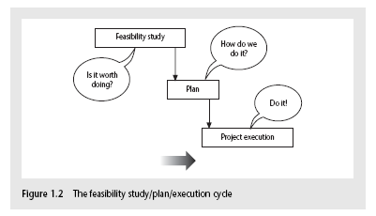
Activities covered by project management
Feasibility study
  Is project technically feasible and worthwhile from a business point of view?
Planning
  Only done if project is feasible
Execution
  Implement plan, but plan may be changed as we go along
Notes:
There are two key points here.
Often you see something like ‘feasibility study’ being put as the first stage of development life cycle, and indeed it might be. However, the outcome of the feasibility study might be not to carry out the proposed project. Planning of the project should therefore take place after the feasibility study (or as a part of the feasibility study perhaps). Clearly the feasibility study itself might need a plan.
All plans are to some extent provisional and subject to change. The key point is that the evolving plan allows us to control the project.

Slide 8
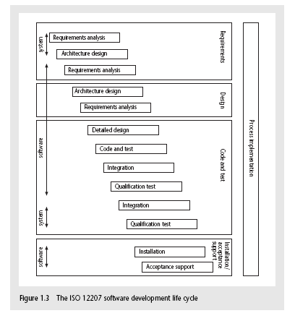
The SDLC (ISO 12207)
Notes:
This section of the lecture discusses the software development life cycle. Note that this is a technical model. It identifies the technical constraints on the order activities are done. This does NOT imply that a ‘waterfall’ approach is the only way to organize projects. The technical model could be implemented as increments or in an evolutionary manner.

Slide 9
ISO 12207 life-cycle
Requirements analysis
  Requirements elicitation: what does the client need?
  Analysis: converting ‘customer-facing’ requirements into equivalents that developers can understand
  Requirements will cover
    Functions
    Quality
    Resource constraints i.e. costs
Notes:
The key point here is that requirement analysis has to face in (at least) two different directions. It needs to communicate and elicit the requirements of the users, speaking in their language. It needs to organize and translate those requirements into a form that developers can understand and relate to.

Slide 10
ISO 12207 life-cycle
Architecture design
  Based on system requirements
  Defines components of system: hardware, software, organizational
  Software requirements will come out of this
Code and test
  Of individual components
Integration
  Putting the components together
Notes:
The software project will almost certainly be part of a larger project which has non-software elements. In a software engineering environment it could be the software will be embedded in hardware product of some kind. Thus there are system requirements for the product as a whole and software requirements for the software element.
In a business information systems environment, the software development could be a relatively minor part of a much larger organizational change project.

Slide 11
ISO12207 continued
Qualification testing
  Testing the system (not just the software)
Installation
  The process of making the system operational
  Includes setting up standing data, setting system parameters, installing on operational hardware platforms, user training etc
Acceptance support
  Including maintenance and enhancement
Notes:
The confusion about what ‘implementation’ really means could be mentioned. Does it mean implementing the design (that is, coding) or implementing the complete system in its user environment? It is best to use ‘installation’ to describe the latter in order to avoid confusion.

Slide 12
Some ways of categorizing projects
Distinguishing different types of project is important as different types of task need different project approaches e.g.
Information systems versus embedded systems
Objective-based versus product-based
Notes:
With objective-based projects, a general objective or problem is defined, and there are several different ways in which that objective could be reached. The project team have freedom to select what appears to be the most appropriate approach.
With product-based projects, the product is already very strictly defined and the development team’s job is to implement the specification with which they have been presented.
Arguably, information systems projects are more likely to be objective-based than is the case with software engineering.
In many cases, an objective-based project could consider a problem and recommend a solution that is then implemented by a product-based project.
Exercise 1.5 in the text is relevant here.

Slide 13
Exercise
Brightmouth college payroll is administrated by a local government authority, and pay slips and other output are produced at the local authority’s computer center. The authority is charging the college for such service. The college management are of an opinion that it will be cheaper to obtain an off the shelf package and do the payroll processing at the college. The project of converting to an independent payroll system, will it be considered product or objective driven??

Slide 14
This project is really Objective driven. If in-house payroll processing turns out not to be cost-effective, then the project should not try to implement such a solution. Other ways of meeting the objectives set could be considered:, for example, it might be possible to give contract to some other organization other than the local authority at a lower cost

Slide 15
What is management?
This involves the following activities:
Planning – deciding what is to be done
Organizing – making arrangements
Staffing – selecting the right people for the job
Directing – giving instructions
continued…
Notes:
This list is based on one that can be found in Introduction to Software Project Management and Quality Assurance by Darrel Ince, Helen Sharp and Mark Woodman, McGraw-Hill, 1993.

Slide 16
What is management?
(continued)
Monitoring – checking on progress
Controlling – taking action to remedy hold-ups
Innovating – coming up with solutions when problems emerge
Representing – liaising with clients, users, developers and other stakeholders
Notes:
Exercise 1.6 (a day in the life of a project manager) is of relevance here.

Slide 17
Problems with software projects
Managers point of view
- poor estimates and plans;
- lack of quality standards and measures;
- lack of guidance about making organizational decisions;
- lack of techniques to make progress visible;
- poor role definition – who does what?
- incorrect success criteria.
Developers point of view
- inadequate specification of work;
- lack of knowledge of application area;

Slide 18
Problems with software projects ..
- Lack of standards;
- Lack of up-to-date documentation;
- preceding activties not completed on time – including late delivery of equipment;
- lack of communication between users and technicians;
- lack of communication leading to duplication of work;
- lack of commitment – especially when a project is tied to one person who then moves;
- Changing software environment
- deadline pressure; lack of quality control;
- remote management; lack of training;

Slide 19
How do we overcome these problems and have a successful software project? (by setting objectives)
Need for a project authority
  Sets the project scope
  Allocates/approves costs
Could be one person - or a group
  Project Board
  Project Management Board
  Steering committee
Notes:
Different people who are involved in a project (Stakeholders) will have different interests in the project and are likely to see different outcomes as being important.
For example, end-users would want a system that is ‘user-friendly’, that is, easy to learn and to use, and a system that helps rather than hinders them from doing their jobs. Their managers may be more interested in whether the new system would allow them to reduce staffing levels.
It is important therefore that a set of clearly defined objectives are identified and published for the project. Some individual or group needs to be pinpointed who acts as the main client for the project.
See Exercise 1.7 in the text.

Slide 20
Both manager and team members must know what will constitute success.
Many groups of people involved in development – need well defined objectives acceptable by all these groups..
Project authority (project steering comittee/project board/project mgmt board – resposible for setting monitoring and modifying objectives.
Project Manager – running project on day-to-day basis – report to pro authority.

Slide 21
Objectives should be SMART
S – specific, that is, concrete and well-defined
M – measurable, that is, satisfaction of the objective can be objectively judged
A – achievable, that is, it is within the power of the individual or group concerned to meet the target
R – relevant, the objective must relevant to the true purpose of the project
T – time constrained: there is defined point in time by which the objective should be achieved
Notes:
I have seen some places where the R is said to stand for ‘resource-constrained’, that is that there is a target cost associated with the achievement of the objective.

Slide 22
Goals/sub-objectives
These are steps along the way to achieving the objective. Informally, these can be defined by completing the sentence…
Objective X will be achieved
IF the following goals are all achieved
A……………
B……………
C…………… etc
Notes:
Scoring a goal in football is a ‘goal’ or sub-objective on the way to achieving the overall objective of winning the match. Sub-objectives and objectives can be nested in a hierarchy, so that the objective of winning the match could itself be a goal or sub-objective on the way to winning the league etc.

Slide 23
Goals/sub-objectives continued
Often a goal can be allocated to an individual.
Individual may have the capability of achieving goal, but not the objective on their own e.g.
Objective – user satisfaction with software product
Analyst goal – accurate requirements
Developer goal – software that is reliable
Notes:
Goals can be formulated in such a way that they represent what an individual or group need to do to contribute to the success of the project’s objectives.
In the example above, the analyst or developer, by themselves, cannot guarantee user satisfaction. However, the analyst can contribute to the achievement of the objective by making sure the users’ requirements are accurately recorded and the developer by making sure that the software is reliable.
See Exercise 1.7 in the text.

Slide 24
Measures of effectiveness
How do we know that the goal or objective has been achieved?
By a practical test, that can be objectively assessed.
e.g. for user satisfaction with software product:
Repeat business – they buy further products from us
Number of complaints – if low etc etc
Notes:
See Exercise 1.8 in the text.

Slide 25
Stakeholders
These are people who have a stake or interest in the project
In general, they could be users/clients or developers/implementers
They could be:
Within the project team
Outside the project team, but within the same organization
Outside both the project team and the organization
Notes:
Each stakeholder will have their own goals and concerns in relation to the project which may be different from those of the project as a whole. For example, a software developer might work to make a living, pay the mortgage, learn new things, solve interesting problems. The main stakeholders need, however, to understand and accept the overall project objectives.

Slide 26
Identify the stakeholders of Brightmouth College payroll project Stakeholders:○
The finance department.
The human resource department – supplying employee details.
Heads of departments - submitting details of hours worked for part time staff.
Staff – concerned that they will be paid correctly.
Site management - will make new arrangements in the office layout.
Software and hardware vendors.

Slide 27
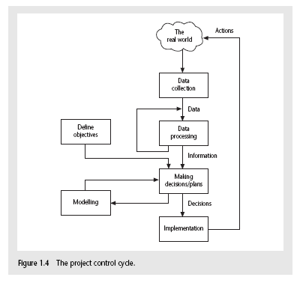
Management control
Notes:
This is explained on the next overhead.

Slide 28
Management control
Data – the raw details
  e.g. ‘6,000 documents processed at location X’
Information – the data is processed to produce something that is meaningful and useful
  e.g. ‘productivity is 100 documents a day’
Comparison with objectives/goals
  e.g. we will not meet target of processing all documents by 31st March
  continued…..
Notes:
This example is expanded in the text.

Slide 29
Management control - continued
Modelling – working out the probable outcomes of various decisions
  e.g. if we employ two more staff at location X how quickly can we complete the coding?
Implementation – carrying out the remedial actions that have been decided upon
Notes:
The authors’ view is that an initially defective plan can often be improved by good project control and management. This could be a discussion point.

Slide 30
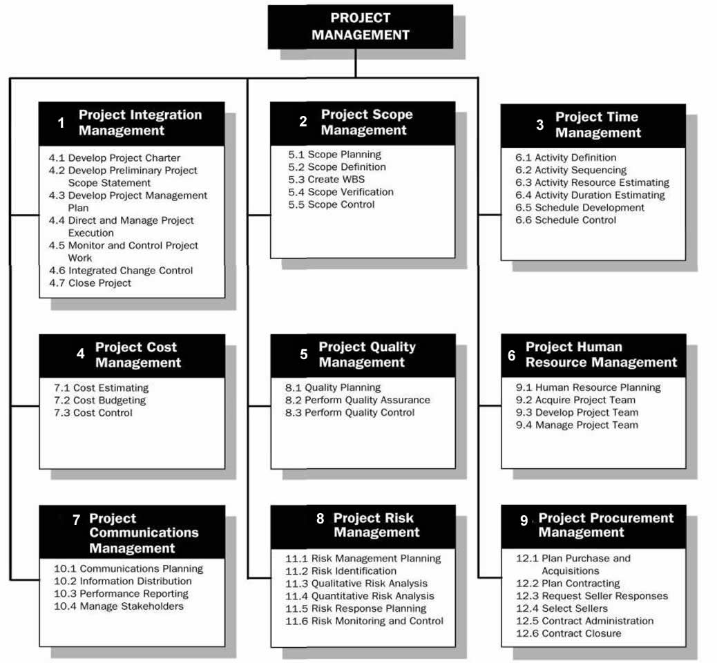
Project Management Knowledge Areas

