Slide 1
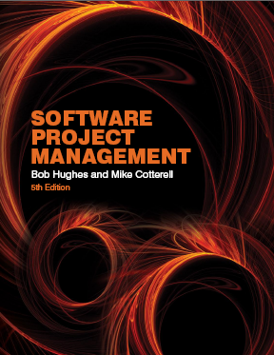
Software Project Management
Fifth Edition
Chapter 9
Monitoring
and
control
SPM (5e) monitoring and control© The McGraw-Hill Companies, 2009

Slide 2
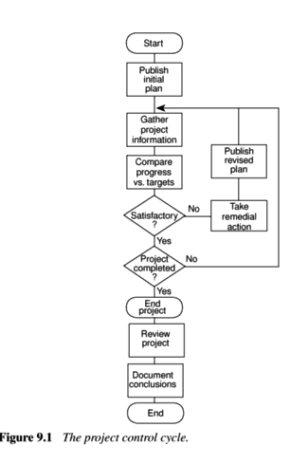
SPM (5e) monitoring and control© The McGraw-Hill Companies, 2009
Notes:
SPM monitoring and control
Define objectives – at the beginning of the project we decide on what we want to achieve
Making decisions/plans – we decide how we are going to achieve the objectives i.e. we create a plan
Modelling – as part of the process of creating a plan we will consider different approaches and attempt to assess the consequences of each of these approaches in terms of how much it will cost and how long it will take, and so on.
Implementation – the plan is now carried out
Data collection – we gather information at regular intervals about how the project is progressing. These raw details could be quite numerous and complex on a large project
Data processing – we process the progress data and convert it into ‘information’ which makes it easier for the project managers and others to understand the overall condition of the project
Making decisions/plans – in the light of the comparison of actual project progress with that planned, the plans are modified. This may require the modelling of the outcomes of different possible courses of action
…and so the cycle goes on.

Slide 3

Creating the framework
Responsibility
Assessing progress
Setting checkpoints
Taking snapshots
SPM (5e) monitoring and control© The McGraw-Hill Companies, 2009

Slide 4
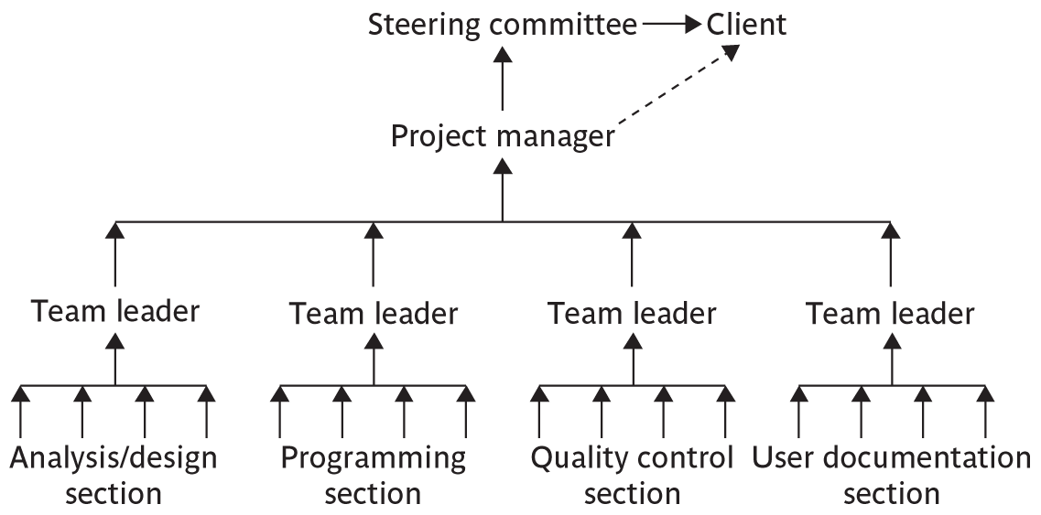
Responsibilities
SPM (5e) monitoring and control© The McGraw-Hill Companies, 2009
Notes:
SPM monitoring and control
The concept of a reporting hierarchy was introduced in Chapter 1.
The main lesson here is that the details relating to project progress have to originate with the people actually doing the work and have then to be fed up through the management structure. At each management level there is going to be some summarising and commentary before information is passed up to the next level. This means that there is always a danger of ‘information overload’ as information passes from the many to the few.

Slide 5
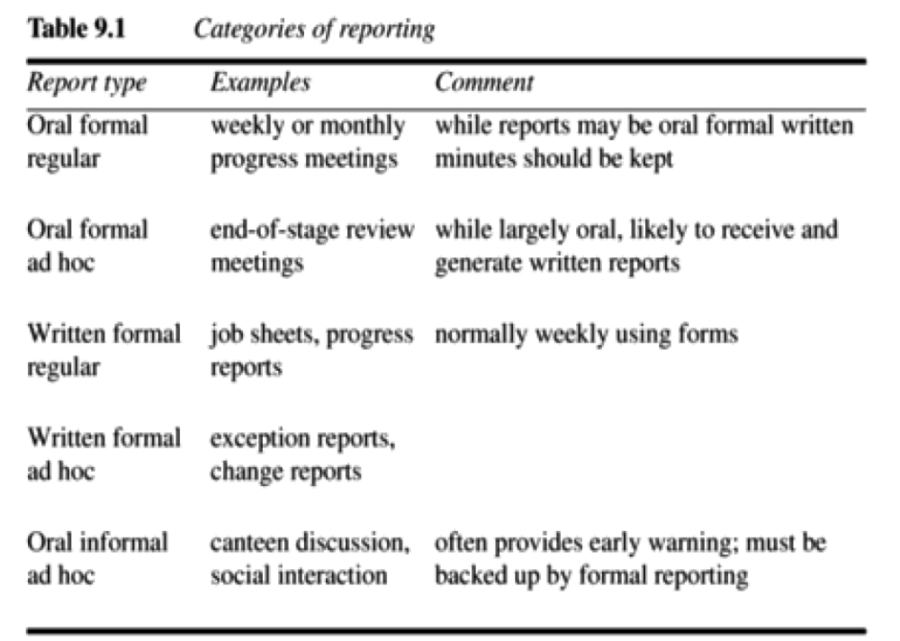
SPM (5e) monitoring and control© The McGraw-Hill Companies, 2009

Slide 6


Assessing progress information collected and collated information will be tangible and objective
Checkpoints – predetermined times when progress is checked
  Event driven: check takes place when a particular event has been achieved
  Time driven: date of the check is pre-determined
Taking snapshots
Frequency of reporting
  The higher the management level then generally the longer the gaps between checkpoints
SPM (5e) monitoring and control© The McGraw-Hill Companies, 2009
Notes:
SPM monitoring and control
Section 9.2 page 215

Slide 7

Collecting progress details/data
Need to collect data about:
Achievements
Costs
A big problem: how to deal with partial completions
99% completion syndrome
Possible solutions:
Control of products, not activities
Subdivide into lots of sub-activities
SPM (5e) monitoring and control© The McGraw-Hill Companies, 2009
Notes:
SPM monitoring and control
Projects have to be delivered on time and within budget, hence the concern with monitoring achievements and costs.
Partial completion is where, for example, data is being collected at the end of Week 2 of an activity that should take four weeks. We want to know if it is about 50% completed.
An example of the ’99% completion syndrome’ would be in the above case if the developer reported at the end of weeks 1,2 and 3 that the task was respectively 25%, 50% and 75% complete. However at the end of week 4 it is reported that the task is 99% complete. The same thing is reported at the end of week 5 and so on until the task is actually completed.
Control on products implies that actual examination of intermediate allows us to verify independently and objectively that sub-tasks have been completed.
Section 9.3 page 216

Slide 8
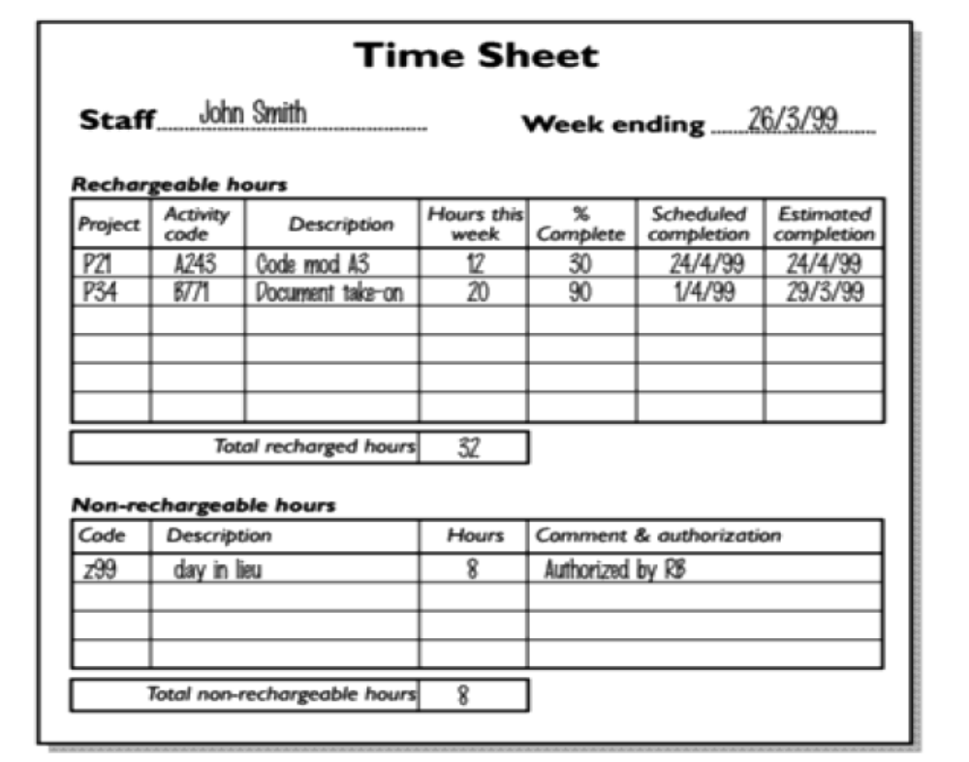
SPM (5e) monitoring and control© The McGraw-Hill Companies, 2009

Slide 9

Red/Amber/Green reporting
Identify key tasks
Break down into sub-tasks
Assess subtasks as:
  Green – ‘on target’
  Amber – ‘not on target but recoverable’
  Red – ‘not on target and recoverable only with difficulty’
  Review all second level assessment to arrive at first level
  Review all first and second level assessment to produce overall assessment
Status of ‘critical’ tasks is particularly important
SPM (5e) monitoring and control© The McGraw-Hill Companies, 2009
Notes:
SPM monitoring and control
RAG reporting highlights those activities which need particular attention. The status of a troubled activity might typically move from green to amber; if corrective action is possible it might go back to green, otherwise it could switch to red. If there are lots of instances where activities switch directly from green to red, this could indicate more management control.
‘Critical tasks’ would be those on the critical path and/or reliant on critical resources.
Page 217

Slide 10
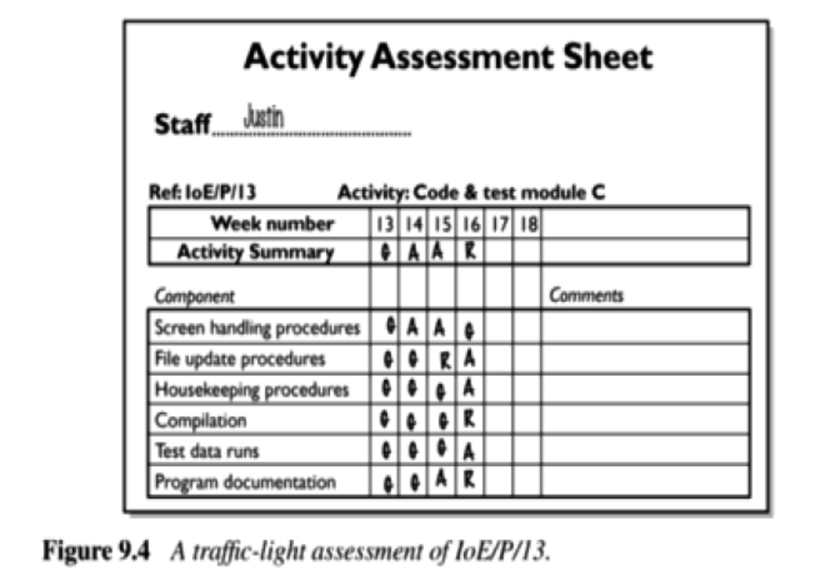
SPM (5e) monitoring and control© The McGraw-Hill Companies, 2009

Slide 11
Visualizing progress
The gantt chart
The slip chart
Ball charts
The timeline
SPM (5e) monitoring and control© The McGraw-Hill Companies, 2009

Slide 12
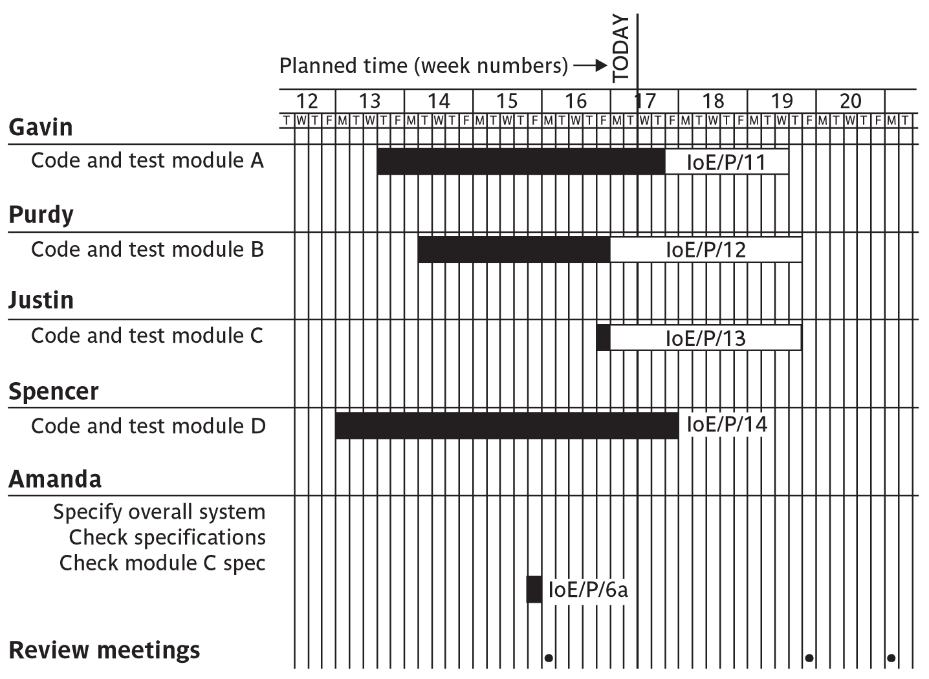
Gantt charts
SPM (5e) monitoring and control© The McGraw-Hill Companies, 2009
Notes:
SPM monitoring and control
Note that the Gantt chart is named after Henry Gantt (1861-1919) and so should not be written in capitals! You could ask students what they think GANTT stands for before you tell them this to impress this on them. I really find Gantt written as GANTT very, very annoying and threaten students with instant failure of the module if they do this!
The format of the Gantt chart here differs from the format used in Microsoft project as the activities for each team member are grouped together. You could input the details so that they came out in this format, but it would not occur automatically.

Slide 13
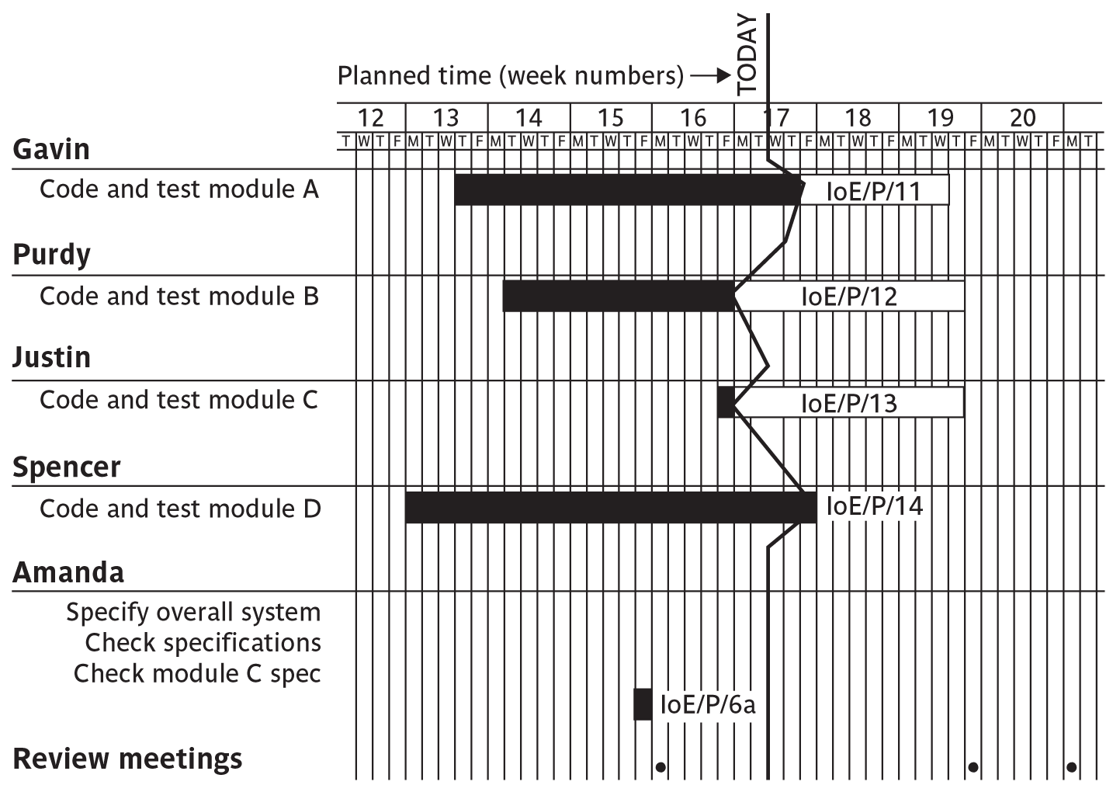
Slip charts
SPM (5e) monitoring and control© The McGraw-Hill Companies, 2009
Notes:
SPM monitoring and control
A slip chart is a version of the Gantt chart where a line is drawn from top to bottom. To the left of the line are all the completed activities and to the right those activities ( or parts of activities) that have not been completed.
The more jagged the line, the more it means that that there are some activities that are lagging to various degrees and some that are ahead of themselves. A very jagged line means that there is scope for re-planning to move resources from those activities that are ahead to those that are behind.

Slide 14
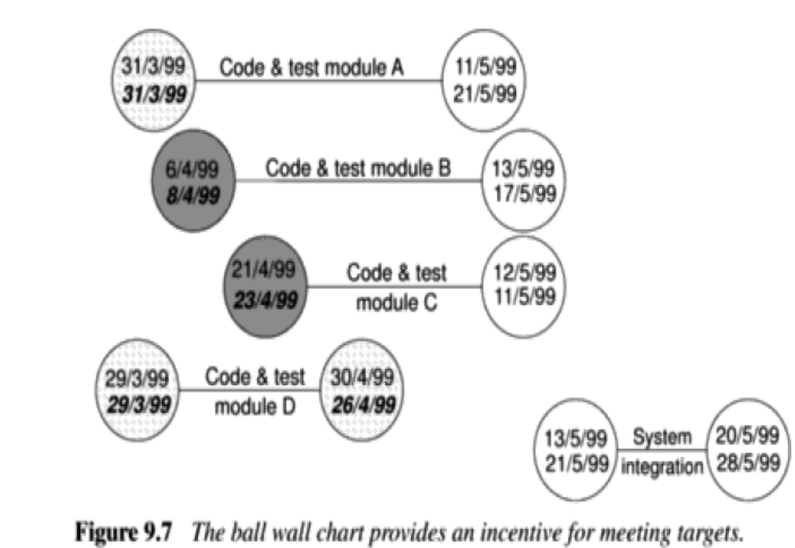
Ball Chart
SPM (5e) monitoring and control© The McGraw-Hill Companies, 2009

Slide 15
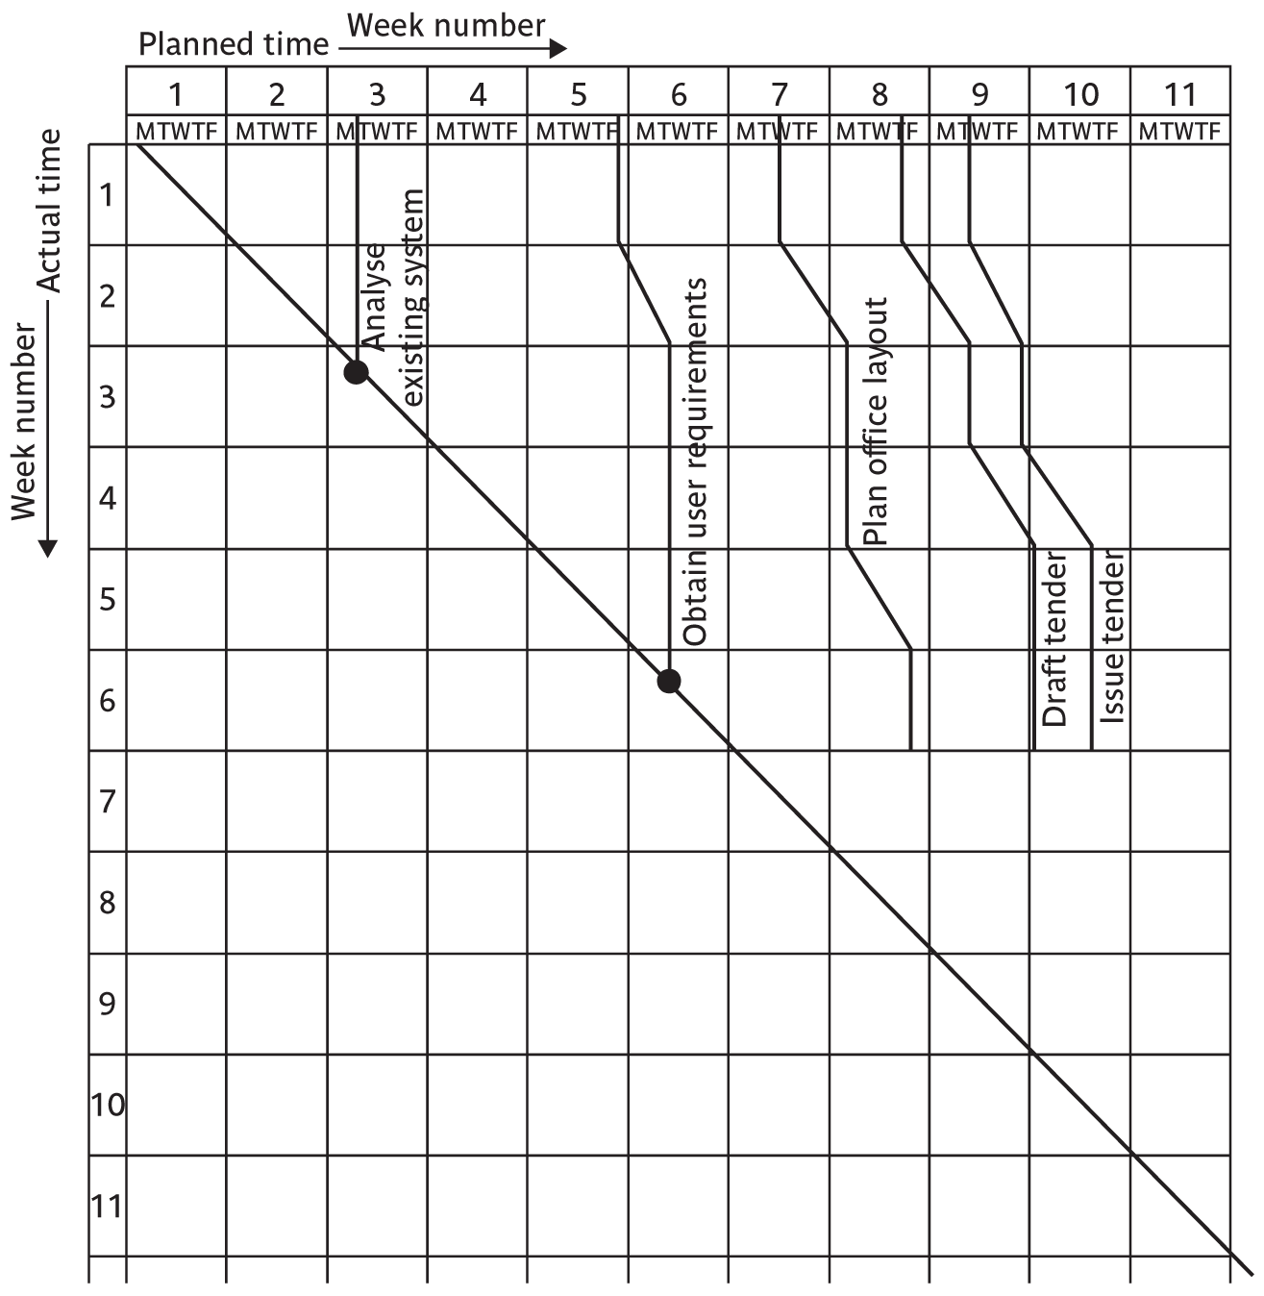
The Timeline
SPM (5e) monitoring and control© The McGraw-Hill Companies, 2009
Notes:
SPM monitoring and control
This records the way that targets have changed throughout the project.
Planned time is plotted on the horizontal axis, and actual time on the vertical axis. The bendy lines going from top to bottom represent the scheduled completion date for each activity e.g.
‘analyse existing system’ – at start this was due finish on the Monday of week 3 and it did finish then
‘obtain user requirements’ was originally planned to finish on the Thursday of week 5, but at the end of the first week it was rescheduled to finish on the Tuesday of week 6.

Slide 16
Cost monitoring
A project could be late because the staff originally committed have not been deployed.
In this case the project will be behind time but under budget.
A project could be on time but only because additional resources have been added and so be over budget.
Need to monitor both achievements and costs.
SPM (5e) monitoring and control© The McGraw-Hill Companies, 2009
Notes:
SPM monitoring and control

Slide 17
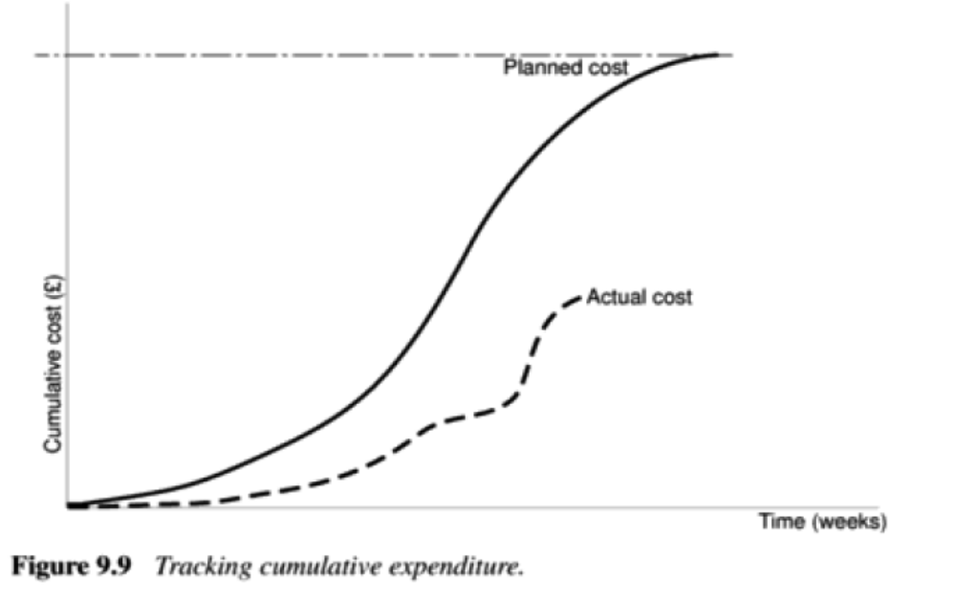
Tracking Cumulative expenditure
SPM (5e) monitoring and control© The McGraw-Hill Companies, 2009

Slide 18
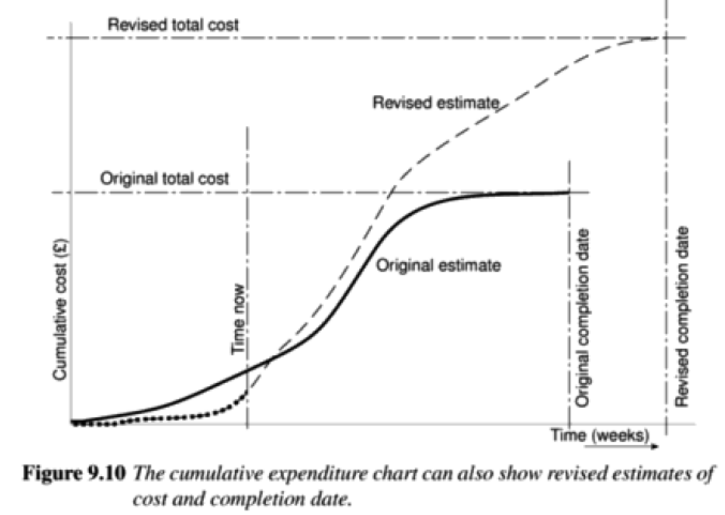
SPM (5e) monitoring and control© The McGraw-Hill Companies, 2009

Slide 19
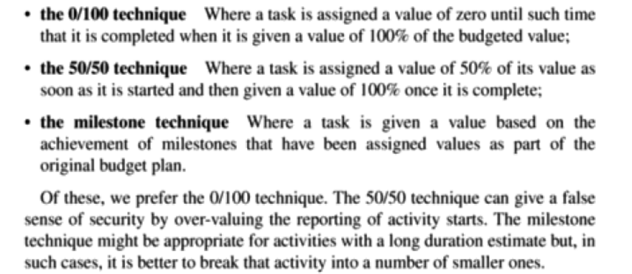
Earned value analysis
Planned value (PV) or Budgeted cost of work scheduled (BCWS) – original estimate of the effort/cost to complete a task (compare with idea of a ‘price’)
Earned value (EV) or Budgeted cost of work performed (BCWP) – total of PVs for the work completed at this time
SPM (5e) monitoring and control© The McGraw-Hill Companies, 2009
Notes:
SPM monitoring and control

Slide 20
Accounting conventions
Work completed allocated on the basis
  50/50 half allocated at start, the other half on completion. These proportions can vary e.g. 0/100, 75/25 etc
  Milestone current value depends on the milestones achieved
  Units processed
Can use money values, or staff effort as a surrogate
SPM (5e) monitoring and control© The McGraw-Hill Companies, 2009
Notes:
SPM monitoring and control

Slide 21
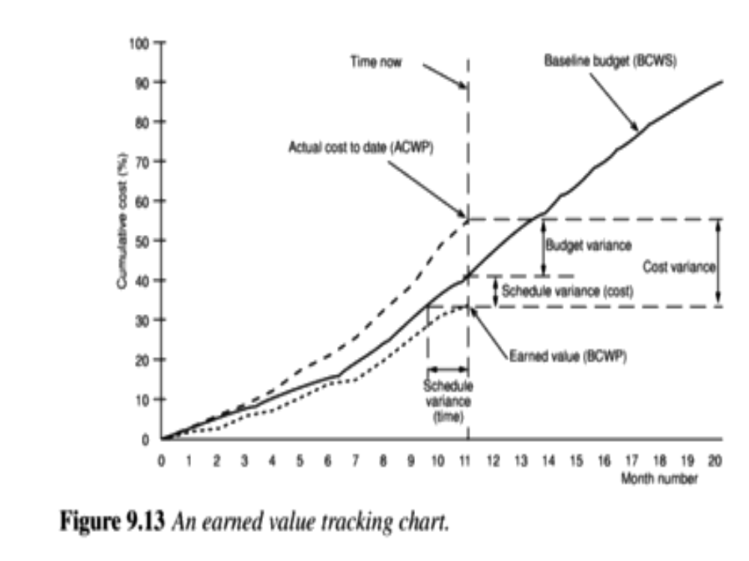
SPM (5e) monitoring and control© The McGraw-Hill Companies, 2009

Slide 22
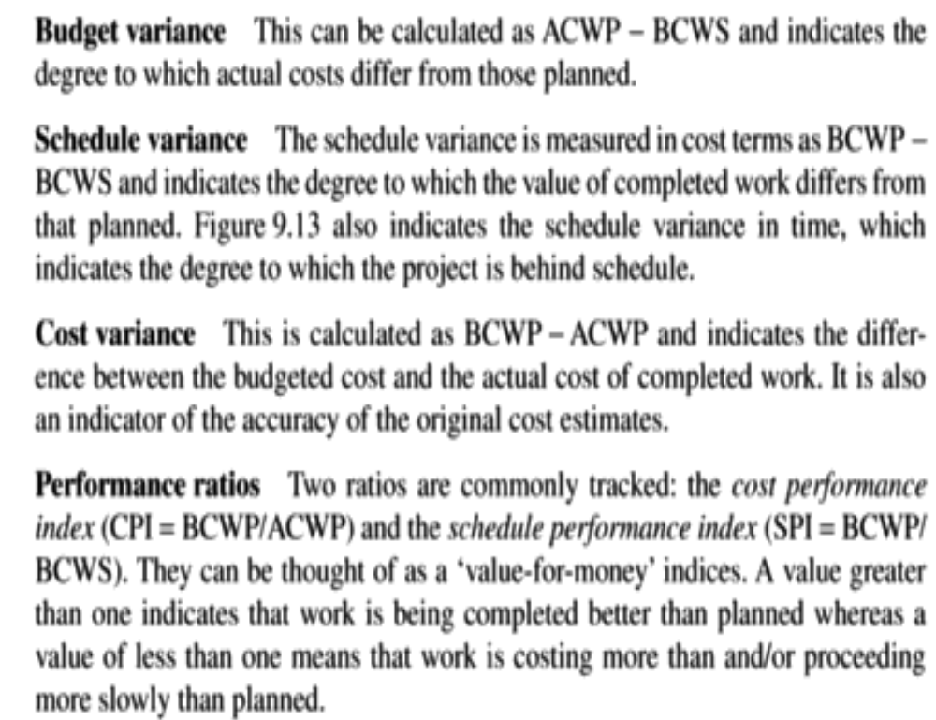
SPM (5e) monitoring and control© The McGraw-Hill Companies, 2009

Slide 23
Schedule variance (SV)
The schedule variance is measured in cost terms as EV-PV and indicates the degree to which the value of completed work differs from planned. Say for an example,
Planned Value – Rs. 40000
Earned value – Rs. 35000
Therefore SV = EV – PV = -5,000.
A negative value SV means the project is behind schedule.
Cost Variance (CV)
The cost variance indicates the difference between the earned value (EV) and the actual cost of completed work.
In the continuation to the previous example, Rs. 55000 had actually spent to get the EV.
Therefore, CV=EV-AC = 35000-55000= -20,000.
A negative CV means the project is over cost.
SPM (5e) monitoring and control© The McGraw-Hill Companies, 2009

Slide 24
Performance Ratio
The Schedule performance index (SPI = EV/PV)
The cost performance index(CPI = EV/AC)
  Using the Previous example,
  SPI = 35000/40000 = 0.88
  CPI =35000/55000 = 0.64
  A value greater than 1 indicates that work is being completed better than planned and within the cost, whereas the value of less than 1 indicates that work is costing more and proceeding more slowly than planned.
SPM (5e) monitoring and control© The McGraw-Hill Companies, 2009

Slide 25
Earned value analysis – actual costs
CPI can be used to produce new cost estimate
Budget at completion (BAC) – current budget allocated to total costs of project
Estimate at completion (EAC) – updated estimate = BAC/CPI
  e.g. say budget at completion is £19,000 and CPI is 1.86
  EAC = BAC/CPI = £10,215 (projected costs reduced because work being completed in less time)
SPM (5e) monitoring and control© The McGraw-Hill Companies, 2009

Slide 26
Time variance
Time variance (TV) – difference between time when specified EV should have been reached and time it actually was
For example say an EV of £19000 was supposed to have been reached on 1st April and it was actually reached on 1st July then TV = - 3 months
SPM (5e) monitoring and control© The McGraw-Hill Companies, 2009

Slide 27
You have a project to be completed in 12 months. The budget of the project is 100,000 USD. Six months have passed and the schedule says that 50% of the work should be completed.
Project duration: 12 months
Project cost (BAC): 100,000 USD
Time elapsed: 6 months
Percent complete: 50% (as per the schedule)
Planned Value = 50% of the value of the total work
= 50% of BAC
= 50% of 100,000
= (50/100) X 100,000
= 50,000 USD
Therefore, the project’s Planned Value (PV) is 50,000 USD.
SPM (5e) monitoring and control© The McGraw-Hill Companies, 2009

Slide 28
You have a project to be completed in 12 months. The budget of the project is 100,000 USD. Six months have passed and 60,000 USD has been spent, but on closer review, you find that only 40% of the work has been completed so far.
What is the project’s Actual Cost (AC)?
Actual Cost is the amount of money that you have spent so far.
In the question, you have spent 60,000 USD on the project so far.
Hence,
The project’s Actual Cost is 60,000 USD.
SPM (5e) monitoring and control© The McGraw-Hill Companies, 2009

Slide 29
You have a project to be completed in 12 months. The budget of the project is 100,000 USD. Six months have passed and 60,000 USD has been spent. On closer review, you find that only 40% of the work has been completed so far.
What is the project’s Earned Value (EV)?
In the above question, you can clearly see that only 40% of the work is actually completed, and the definition of Earned Value states that it is the value of the project that has been earned.
Earned Value = 40% of the value of total work
= 40% of BAC
= 40% of 100,000
= 0.4 X 100,000
= 40,000 USD
Therefore, the project’s Earned Value (EV) is 40,000 USD.
SPM (5e) monitoring and control© The McGraw-Hill Companies, 2009

Slide 30
Prioritizing monitoring
We might focus more on monitoring certain types of activity e.g.
Critical path activities
Activities with no free float – if delayed later dependent activities are delayed
Activities with less than a specified float
High risk activities
Activities using critical resources
SPM (5e) monitoring and control© The McGraw-Hill Companies, 2009
Notes:
SPM monitoring and control
Critical path activities – by definition if these are late then the project as a whole will be delayed
Activities with no free float – free float was defined in Lecture/Chapter 6. A project with no free float will delay following dependent activities, although the project end date may not be directly threatened.
Activities with less than a specified float – projects when being executed can be very dynamic: some activities will take longer than estimated others less; this could lead to the critical shifting. Activities with small floats are the most likely to find themselves turned into activities on the critical path if their floats get eroded.
High risk activities – recall the calculation of activity standard deviations in Chapter 7. If the standard deviation for an activity is large, this indicates that there is a lot of uncertainty about how long it will actually take.
Activities using critical resources – some resources may only be available for a limited period and if the activities that need the resource are delayed the resource could become unavailable.

Slide 31
Getting back on track: options
Renegotiate the deadline – if not possible then
Try to shorten critical path e.g.
  Work overtime
  Re-allocate staff from less pressing work
  Buy in more staff
Reconsider activity dependencies
  Over-lap the activities so that the start of one activity does not have to wait for completion of another
  Split activities
SPM (5e) monitoring and control© The McGraw-Hill Companies, 2009
Notes:
SPM monitoring and control
Renegotiating the deadline – one way of doing this is to divide the deliverables into ‘tranches’ (see Lecture/Chapter 3), delivering the ones most valuable to the client on or before the deadline, but delaying less valuable ones.
Shortening the critical path – the idea is to try to get things done more quickly by adding more staff. Some activities lend themselves to this more readily than others – it is often quite difficult to do this with software development. It also increases costs
Reconsidering activity dependencies – allowing activities to overlap often increases the risk of quality shortfalls

Slide 32
Exception planning
Some changes could affect
  Users
  The business case (e.g. costs increase reducing the potential profits of delivered software product)
These changes could be to
  Delivery date
  Scope
  Cost
In these cases an exception report is needed
SPM (5e) monitoring and control© The McGraw-Hill Companies, 2009

Slide 33
Exception planning - continued
First stage
  Write an exception report for sponsors (perhaps through project board)
    Explaining problems
    Setting out options for resolution
Second stage
  Sponsor selects an option ( or identifies another option)
  Project manager produces an exception plan implementing selected option
  Exception plan is reviewed and accepted/rejected by sponsors/Project Board
SPM (5e) monitoring and control© The McGraw-Hill Companies, 2009

Slide 34
Change control
The role of configuration librarian:
Identifying items that need to be subject to change control
Management of a central repository of the master copies of software and documentation
Administering change procedures
Maintenance of access records
SPM (5e) monitoring and control© The McGraw-Hill Companies, 2009
Notes:
SPM monitoring and control
Identifying items that need to be subject to change control – it is unlikely, for example, that a feasibility report would be subject to change control once agreement has been obtained to start the project
Management of a central repository of the master copies of software and documentation
Administering change procedures It is important that someone ensures that there is adherence to change control procedures.
Maintenance of access records. A situation to be avoided is where two different developers are making changes to the same software component.

Slide 35
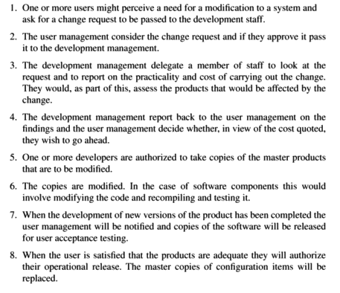
Change control procedures
SPM (5e) monitoring and control© The McGraw-Hill Companies, 2009

