Slide 1
Module 2: Queues
ITA5002 – Problem Solving with Data Structures and Algorithms

Slide 2
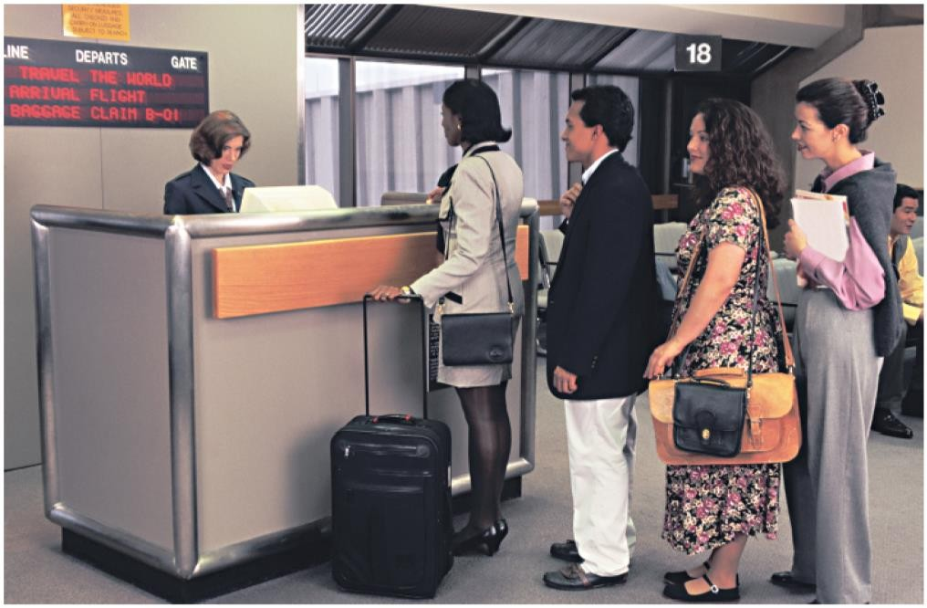
Queue ADT
Like a stack, a queue is a data structure that holds a sequence of elements.
A queue, however, provides access to its elements in first-in, first-out (FIFO) order.
The elements in a queue are processed like customers standing in a grocery check-out line: the first customer in line is the first one served.

Slide 3
Queue - Applications
In a multi-user system, a queue is used to hold print jobs submitted by users, while the printer services those jobs one at a time.
Communications software also uses queues to hold information received over networks.
Round Robin Scheduling
Buffers on MP3 players and portable CD players, iPod playlist
Call center phone systems will use a queue to hold people in line until a service representative is free.

Slide 4
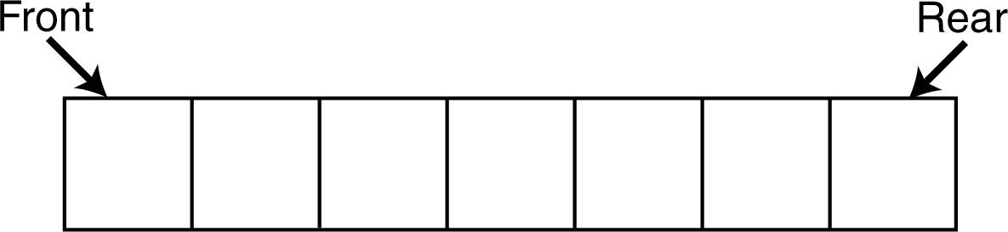
Queue ADT
A queue is a ordered list which enables insert operations to be performed at one end called REAR and delete operations to be performed at another end called FRONT.
Queue can also be defined as the list or collection in which the insertion is done from one end known as the rear end or the tail of the queue, whereas the deletion is done from another end known as the front end or the head of the queue.

Slide 5
Queue ADT – Basic Operations
Queue operations may involve initializing or defining the queue, utilizing it, and then completely erasing it from the memory.
enqueue() − add (store) an item to the queue. (rear)
dequeue() − remove (access) an item from the queue. (front)
Few more functions are required to make the above-mentioned queue operation efficient. These are −
peek() − Gets the element at the front of the queue without removing it.
isfull() − Checks if the queue is full.
isempty() − Checks if the queue is empty.

Slide 6


Queue ADT – peek()
This function helps to see the data at the front of the queue.
Algorithm
Example

Slide 7
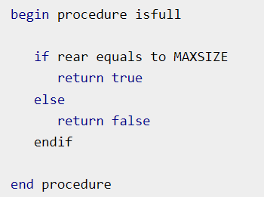
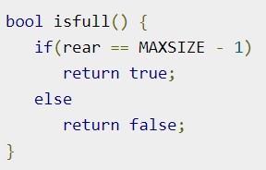
Queue ADT – isFull()
Check for the rear pointer to reach at MAXSIZE to determine that the queue is full.
Algorithm Example
Example

Slide 8
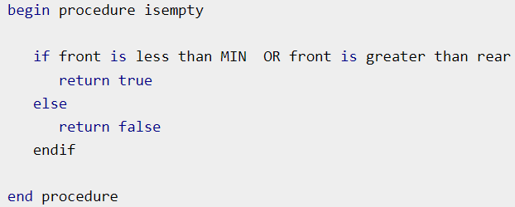
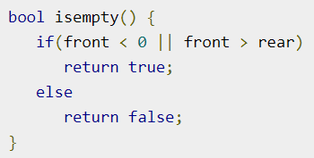
Queue ADT – isEmpty()
Check for the rear pointer to reach at MAXSIZE to determine that the queue is full.
Algorithm Example
Example

Slide 9
Queue ADT – enqueue()
Queues maintain two data pointers, front and rear.
The following steps should be taken to enqueue (insert) data into a queue −
Step 1 − Check if the queue is full.
Step 2 − If the queue is full, produce overflow error and exit.
Step 3 − If the queue is not full, increment rear pointer to point the next empty space.
Step 4 − Add data element to the queue location, where the rear is pointing.
Step 5 − return success.

Slide 10
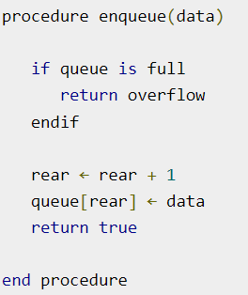
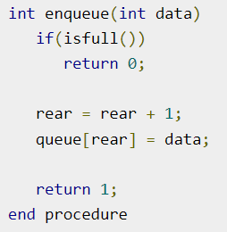
Queue ADT – enqueue()

Slide 11
Queue ADT – dequeue()
Accessing data from the queue is a process of two tasks − access the data where front is pointing and remove the data after access.
The following steps are taken to perform dequeue operation −
Step 1 − Check if the queue is empty.
Step 2 − If the queue is empty, produce underflow error and exit.
Step 3 − If the queue is not empty, access the data where front is pointing.
Step 4 − Increment front pointer to point to the next available data element.
Step 5 − Return success.

Slide 12
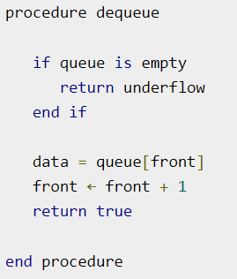
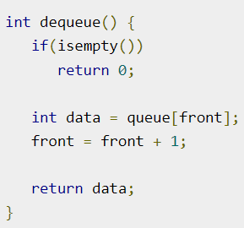
Queue ADT – dequeue()

Slide 13
Efficiency Problem of Dequeue & Solution
Shifting after each dequeue operation causes inefficiency.
Solution
Let front index move as elements are removed
let rear index "wrap around" to the beginning of array, treating array as circular
Similarly, the front index as well
Yields more complex enqueue, dequeue code, but more efficient
Enqueue(6); Enqueue(9); Dequeue(); Dequeue(); Enqueue(12); Dequeue();

Slide 14
Insert (&Queue, ‘A’)
an item (A) is inserted at the Rear of the queue
items[MAXQUEUE -1]
. | .
. | .
items[3]
items[2]
items[1]
items[0] | A | Front=0, Rear=0

Slide 15
Insert (&Queue, ‘B’)
an item (B) is inserted at the Rear of the queue
items[MAXQUEUE -1]
. | .
. | .
items[3]
items[2]
items[1] | B | Rear=1
items[0] | A | Front=0

Slide 16
Insert (&Queue, ‘C’)
an item (C) is inserted at the Rear of the queue
items[MAXQUEUE -1]
. | .
. | .
items[3]
items[2] | C | Rear=2
items[1] | B
items[0] | A | Front=0

Slide 17
Insert (&Queue, ‘D’)
an item (D) is inserted at the Rear of the queue
items[MAXQUEUE-1]
. | .
. | .
items[3] | D | Rear=3
items[2] | C
items[1] | B
items[0] | A | Front=0

Slide 18
char remove(&Queue)
an item (A) is removed (deleted) from the Front of the queue
items[MAXQUEUE-1]
. | .
. | .
items[3] | D | Rear=3
items[2] | C
items[1] | B | Front=1
items[0] | A

Slide 19
char remove(&Queue)
Remove two items from the front of the queue.
items[MAXQUEUE-1]
. | .
. | .
items[3] | D | Rear=3
items[2] | C | Front=2
items[1] | B
items[0] | A

Slide 20
char remove(&Queue)
Remove two items from the front of the queue.
items[MAXQUEUE-1]
. | .
. | .
items[3] | D | Front=Rear=3
items[2] | C
items[1] | B
items[0] | A

Slide 21
char remove(&Queue)
Remove one more item from the front of the queue.
items[MAXQUEUE-1]
. | .
items[4] |  | Front=4
items[3] | D | Rear=3
items[2] | C
items[1] | B
items[0] | A

Slide 22
Performance and Limitations
- array-based implementation of queue ADT
Performance
  Let n be the number of elements in the queue
  The space used is O(n)
  Each operation runs in time O(1)
Limitations
  The maximum size of the queue must be defined a priori , and cannot be changed
  Trying to enqueue a new element into a full queue causes an implementation-specific exception

Slide 23
Queue Summary
Queue Operation Complexity for Different Implementations
 | Array Fixed-Size | Array Expandable (doubling strategy) | List Singly- Linked
dequeue() | O(1) | O(1) | O(1)
enqueue(o) | O(1) | O(n) Worst Case O(1) Best Case O(1) Average Case | O(1)
front() | O(1) | O(1) | O(1)
Size(), isEmpty() | O(1) | O(1) | O(1)

Slide 24
Circular Queue
Why circular queue?
Because in queue, deleting an element, the front position is increment by 1, but that position is not used later.
So when we perform more add and delete operation, memory wastage increase.
But in Circular Queue memory is utilized, if we delete any element that position is used later, because it is circular.
What is a Circular Queue?
A circular queue is similar to a linear queue as it is also based on the FIFO (First In First Out) principle except that the last position is connected to the first position in a circular queue that forms a circle.
It is also known as a Ring Buffer.

Slide 25
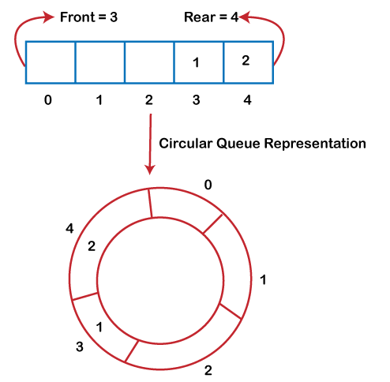
Circular Queue

Slide 26
Circular Queue
Applications
Memory Management
CPU Scheduling
Traffic System
Basic Operations
Front: It is used to get the front element from the Queue.
Rear: It is used to get the rear element from the Queue.
enQueue(value): This function is used to insert the new value at the rear end.
deQueue(): This function deletes an element from the Queue at the front end.

Slide 27
Circular Queue - Implementation
Step 1: define a queue 'SIZE' with specific value.
Step 2: Declare all user defined functions used in circular queue implementation.
Step 3: Create a one dimensional array with above defined SIZE (int cQueue[SIZE]).
Step 4: Define two integer variables 'front' and 'rear' and initialize both with '-1'. (int front = -1, rear = -1)
Step 5: Implement main method by displaying menu of operations list and make suitable function calls to perform operation selected by the user on circular queue.

Slide 28
Circular Queue – enqueue
In a circular queue, enQueue() is a function which is used to insert an element into the circular queue.
In a circular queue, the new element is always inserted at rear position.
The enQueue() function takes one integer value as parameter and inserts that value into the circular queue.
We can use the following steps to insert an element into the circular queue...

Slide 29
Circular Queue – enqueue
Step 1: Check whether queue is FULL.
((rear == SIZE-1 && front == 0) || (front == rear+1))
Step 2: If it is FULL, then
display "Queue is FULL!!!
Insertion is not possible!!!" and terminate the function.
Step 3: If it is NOT FULL, then check
rear == SIZE - 1 && front != 0
if it is TRUE, then set rear = -1.
Step 4: Increment rear value by one (rear++),
set queue[rear] = value and check
'front == -1' if it is TRUE, then set front = 0.

Slide 30
Circular Queue – dequeue
In a circular queue, deQueue() is a function used to delete an element from the circular queue.
In a circular queue, the element is always deleted from front position.
The deQueue() function doesn‘t take any value as parameter.
We can use the following steps to delete an element from the circular queue...

Slide 31
Circular Queue – dequeue
Step 1: Check whether queue is EMPTY.
(front == -1 && rear == -1)
Step 2: If it is EMPTY, then display "Queue is
EMPTY!!! Deletion is not possible!!!" and terminate.
Step 3: If it is NOT EMPTY, then display queue[front] as
deleted element and increment the front value by one
(front ++).
Then check whether front == SIZE,
if it is TRUE, then set front = 0.
Then check whether both
front - 1 and rear are equal (front -1 == rear),
if it TRUE, then set both front and rear to '-1’
(front = rear = -1).

Slide 32
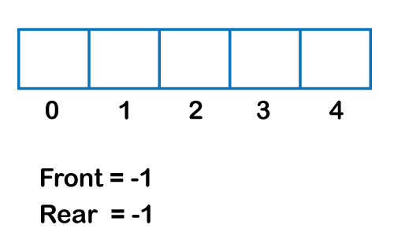
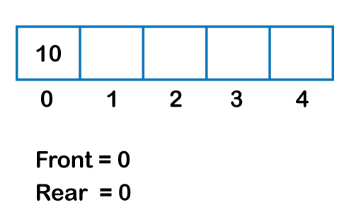
Circular Queue – Implementation
Initial Queue
Enqueue 10

Slide 33
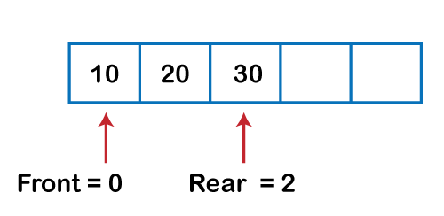
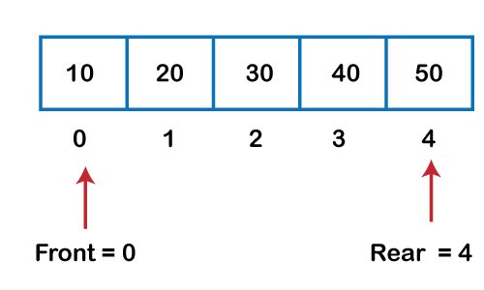
Circular Queue – Implementation
Enqueue 20, 30
Enqueue 40,50

Slide 34
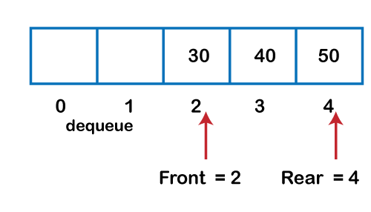
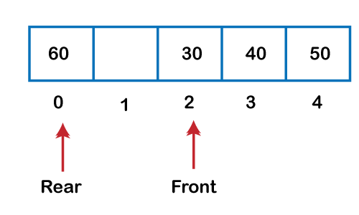
Circular Queue – Implementation
dequeue, dequeue
Enqueue 60

Slide 35
Priority Queue
A priority queue is a special type of queue in which each element is associated with a priority value.
Elements are served on the basis of their priority. That is, higher priority elements are served first.
The priority of elements determines the order of removal in a queue, i.e., the element with higher priority will leave the queue first, whereas the element with the lowest priority at last.
The priority queue supports only comparable elements, which means that the elements are either arranged in an ascending or descending order.

Slide 36
Priority Queue - Characteristics
Priority queue in a data structure is an extension of a linear queue that possesses the following properties:
Every element has a certain priority assigned to it.
Every element of this queue must be comparable.
It will delete the element with higher priority before the element with lower priority.
If multiple elements have the same priority, it does their removal from the queue according to the FCFS principle.

Slide 37
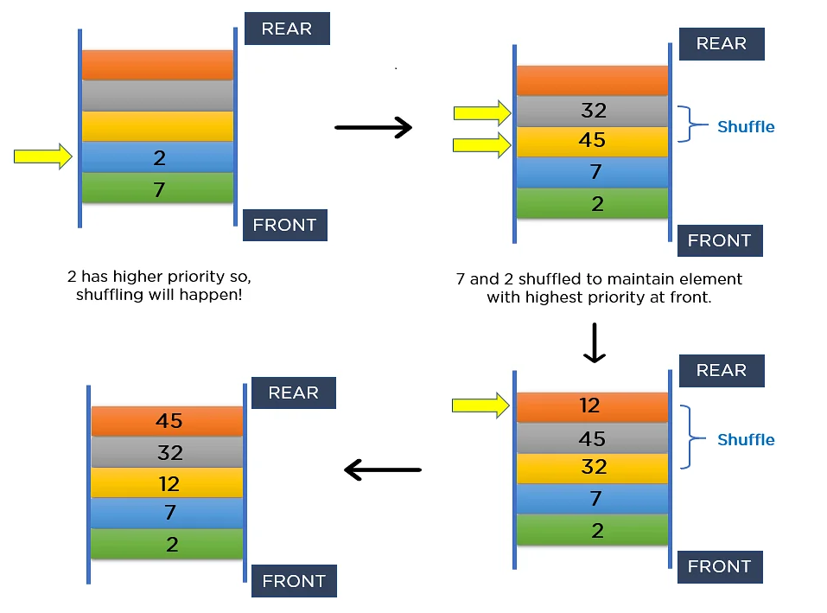
Priority Queue - Characteristics

Slide 38
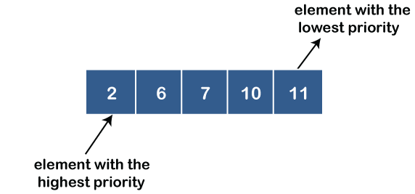
Priority Queue - Types
Ascending order priority queue: In ascending order priority queue, a lower priority number is given as a higher priority in a priority.

Slide 39
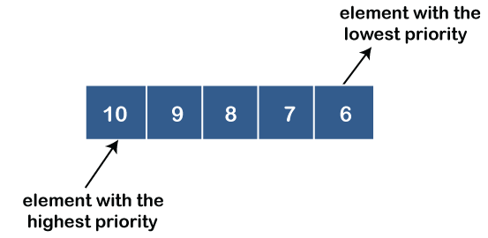
Priority Queue - Types
Descending order priority queue: In descending order priority queue, a higher priority number is given as a higher priority in a priority.

Slide 40
Priority Queue - Representation
Consider a linked queue having 3 data elements 3, 17, 43, respectively. It arranges all these elements according to priority.
But, what if you have to insert a new node into the linked queue consisting of value 2? Since 2 is smaller than the element at the front (head) node, insertion from the front will be more efficient.
Additionally, it will allow you to have O(1) time-complexity during deletion.

Slide 41
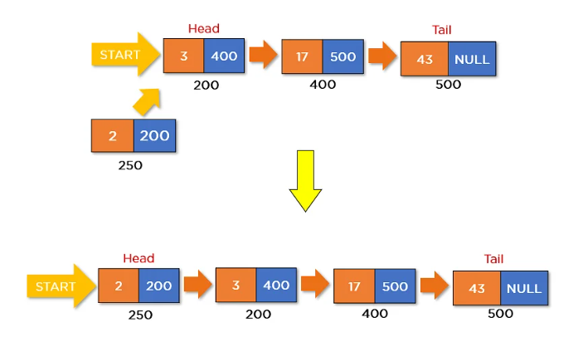
Priority Queue - Representation

Slide 42
Priority Queue - Representation
The diagram above shows how it will insert the new node consisting of elements in a linked queue.
This particular scenario of insertion seems perfect as it doesn’t cost you more time. But what if the element is significantly larger than all the nodes of a queue?
For instance, say you want to insert a node consisting of element 45. Here, it will compare element 45 with each element inside the queue. However, this insertion will cost you O(N). Representation of the linked queue below displays how it will insert element 45 in a priority queue.

Slide 43
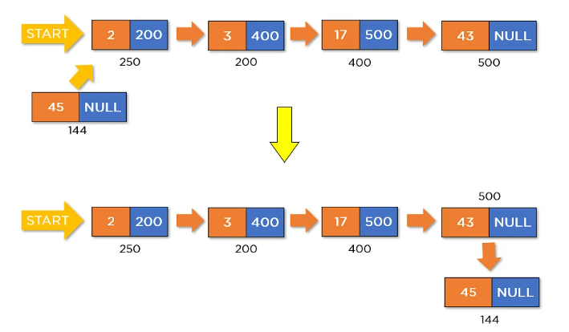
Priority Queue - Representation

Slide 44
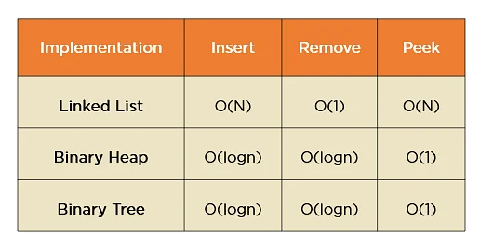
Priority Queue - Representation

Slide 45
Priority Queue - Applications
The following are the applications of the priority queue:
It is used in the Dijkstra's shortest path algorithm.
It is used in prim's algorithm
It is used in data compression techniques like Huffman code.
It is used in heap sort.
It is also used in operating system like priority scheduling, load balancing and interrupt handling.

Slide 46
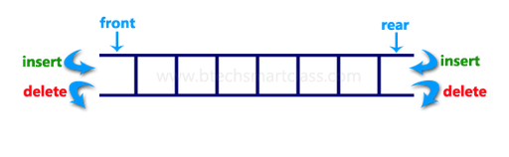
Double Ended Queue (Deque)
Double Ended Queue is also a Queue data structure in which the insertion and deletion operations are performed at both the ends (front and rear).
That means, we can insert at both front and rear positions and can delete from both front and rear positions.

Slide 47
Double Ended Queue (Deque)
Double Ended Queue can be represented in TWO ways, those are as follows…
Input Restricted Double Ended Queue
Output Restricted Double Ended Queue

Slide 48
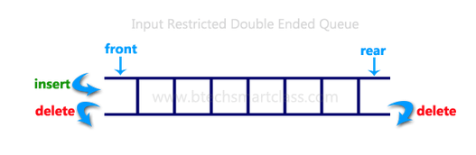
Double Ended Queue (Deque)
Input Restricted Double Ended Queue: insertion operation is performed at only one end and deletion operation is performed at both the ends.

Slide 49
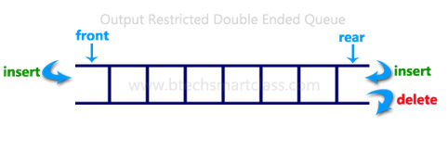
Double Ended Queue (Deque)
Output Restricted Double Ended Queue: deletion operation is performed at only one end and insertion operation is performed at both the ends.

Slide 50
Double Ended Queue (Insertion at front)
Insert an element at front:
Before implementing the operation, check whether the queue is full or not.
If the queue is not full, then the element can be inserted from the front end by using the below conditions –
  If the queue is empty, both rear and front are initialized with 0. Now, both will point to the first element.
  Otherwise, check the position of the front if the front is less than 1 (front < 1), then reinitialize it by front = n - 1, i.e., the last index of the array.

Slide 51
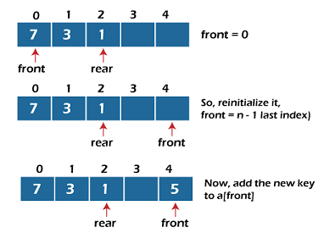
Double Ended Queue (Insertion at front)

Slide 52
Double Ended Queue (Insertion at rear)
Insert an element at rear:
Before implementing the operation, we first have to check again whether the queue is full or not. If the queue is not full, then the element can be inserted from the rear end by using the below conditions –
  If the queue is empty, both rear and front are initialized with 0. Now, both will point to the first element.
  Otherwise, increment the rear by 1. If the rear is at last index (or size - 1), then instead of increasing it by 1, we have to make it equal to 0.

Slide 53
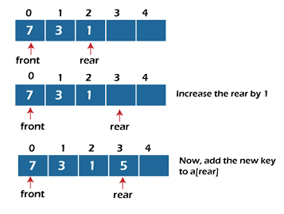
Double Ended Queue (Insertion at rear)

Slide 54
Double Ended Queue (deletion at front)
Delete an element at front
Before implementing the operation, we first have to check whether the queue is empty or not.
If the queue is empty, i.e., front = -1, it is the underflow condition, and we cannot perform the deletion. If the queue is not full, then the element can be inserted from the front end by using the below conditions
  If the deque has only one element, set rear = -1 and front = -1.
  Else if front is at end (that means front = size - 1), set front = 0.
  Else increment the front by 1, (i.e., front = front + 1).

Slide 55
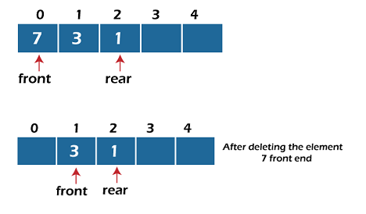
Double Ended Queue (delete at front)

Slide 56
Double Ended Queue (deletion at rear)
Delete an element at rear
In this operation, the element is deleted from the rear end of the queue. Before implementing the operation, we first have to check whether the queue is empty or not.
If the queue is empty, i.e., front = -1, it is the underflow condition, and we cannot perform the deletion.
If the deque has only one element, set rear = -1 and front = -1.
If rear = 0 (rear is at front), then set rear = n – 1.
Else, decrement the rear by 1 (or, rear = rear -1).

Slide 57
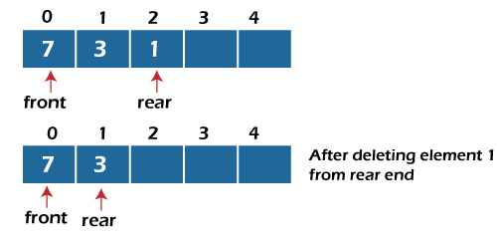
Double Ended Queue (deletion at rear)

Slide 58
Double Ended Queue (Applications)
Deque can be used as both stack and queue, as it supports both operations.
Deque can be used as a palindrome checker means that if we read the string from both ends, the string would be the same.

