Slide 1
Distributed Database Management Systems

Slide 2
Distributed
Database - A logically interrelated collection of shared data (and a description of this data), physically distributed over a computer network.
DBMS - Software system that permits the management of the distributed database and makes the distribution transparent to users.

Slide 3
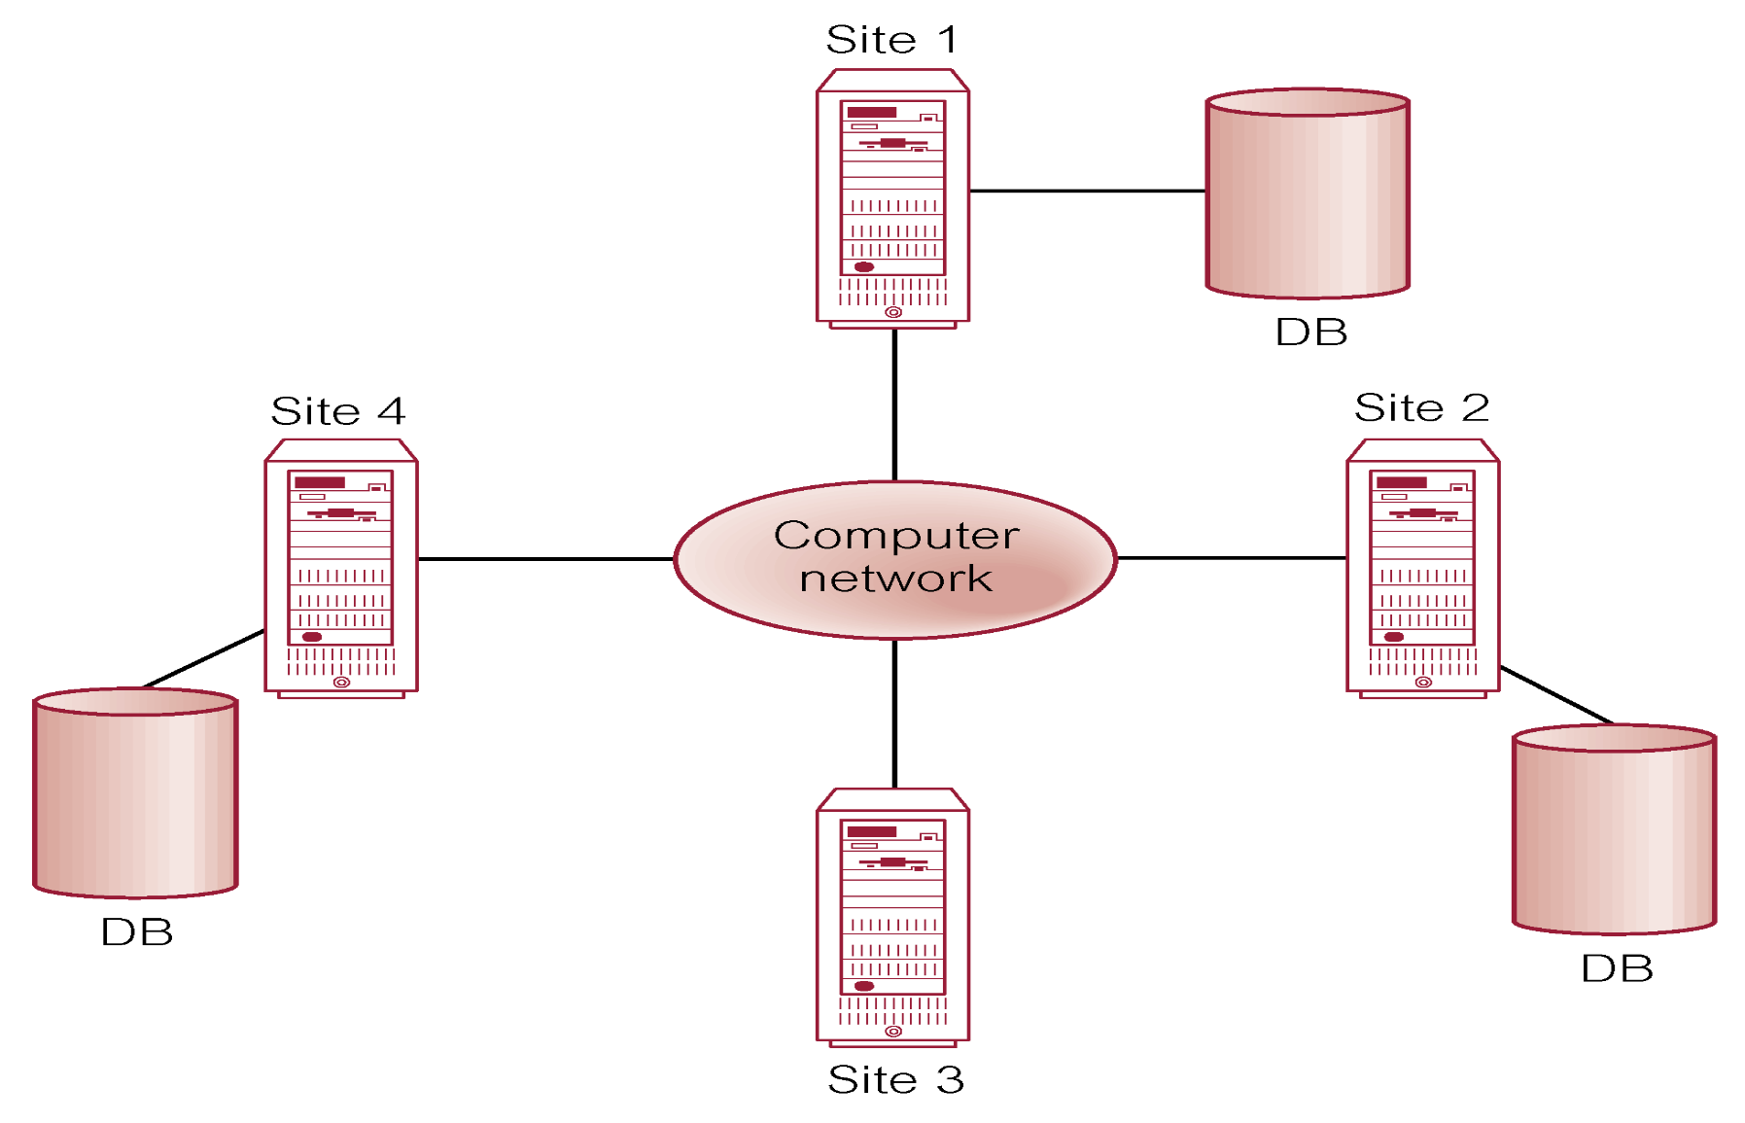
Distributed DBMS

Slide 4
Advantages of DDBMSs
Reflects organizational structure
Improved shareability and local autonomy
Improved availability
Improved reliability
Improved performance
Economics
Modular growth

Slide 5
Disadvantages of DDBMSs
Complexity
Cost
Security
Integrity control more difficult
Lack of standards
Lack of experience
Database design more complex

Slide 6
What is a Distributed Database
Data resides in multiple locations
A distributed database system consists of loosely coupled sites that share no physical component
Database systems that run on each site are independent of each other
Transactions may access data at one or more sites
Lets Assume that we have built an ecommerce application and we have become successful selling products online for Customers across the globe.
Lets take a look at the customer schema
ID | Name | Phone | Country

Slide 7

ID | Name | Phone | Country
121 | Sam | 11111 | US
122 | Ram | 22222 | India
123 | Tom | 33333 | UK
124 | Jeff | 44444 | UK
125 | Chris | 55555 | US
126 | Rahul | 66666 | India
127 | Mohan | 77777 | US
128 | Raj | 88888 | India
129 | Deep | 99999 | UK
130 | Harini | 12121 | UK
131 | Shyam | 13131 | India
132 | David | 14141 | US

Slide 8
Determine the total number of customers I have around the globe
Fragment2
ID | Name | Phone | Country
123 | Tom | 33333 | UK
124 | Jeff | 44444 | UK
129 | Deep | 99999 | UK
130 | Harini | 12121 | UK
ID | Name | Phone | Country
121 | Sam | 11111 | US
125 | Chris | 55555 | US
127 | Mohan | 77777 | US
132 | David | 14141 | US
ID | Name | Phone | Country
122 | Ram | 22222 | India
126 | Rahul | 66666 | India
128 | Raj | 88888 | India
131 | Shyam | 13131 | India
Fragment1
Fragment3

Slide 9
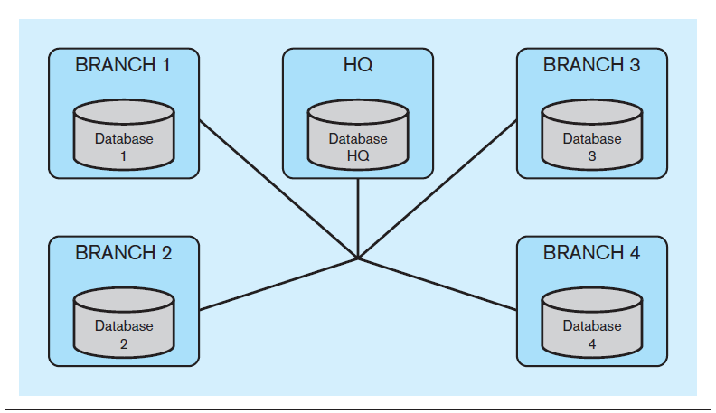
Distributed Databases, cont’d
Example: Bank headquarters and branches.
Each branch maintains data about its customers.
Each branch can access data from other branches.
Each branch can access administrative HQ data.
HQ can access branch data.

Slide 10
Distributed Databases, cont’d
Computers that run the DDBS do not share processing or storage devices.
The computers are connected by a network.
The computers can reside in the same building or they may be located in different continents.
Key property: distribution transparency

Slide 11
Distribution Transparency
End users of the DDBS should not be concerned about the distributed nature of the system.
End users of the DDBS should not know if the data they are accessing is stored locally or remotely at a different geographic location.
End users can use the DDBS in the same way as if the data were not distributed.

Slide 12
Assume relational data model
Replication
System maintains multiple copies of data, stored in different sites, for faster retrieval and fault tolerance.
Fragmentation
Relation is partitioned into several fragments stored in distinct sites
Replication and fragmentation can be combined
Relation is partitioned into several fragments: system maintains several identical replicas of each such fragment.

Slide 13
Fragmentation
System partitions a relation in to several fragments and stores each fragment at a different site
Two types of Fragmentation
Horizontal Fragmentation
Vertical Fragmentation

Slide 14
Horizontal Fragmentation
Each row from relation R is assigned to one or more Fragments.
A row from relation R should belong to at least one fragment.
ID | Name | Phone | Country
122 | Ram | 22222 | India
123 | Tom | 33333 | UK
124 | Jeff | 44444 | UK
126 | Rahul | 66666 | India

Slide 15
Horizontal Fragmentation
ID | Name | Phone | Country
122 | Ram | 22222 | India
123 | Tom | 33333 | UK
124 | Jeff | 44444 | UK
126 | Rahul | 66666 | India
ID | Name | Phone | Country
122 | Ram | 22222 | India
126 | Rahul | 66666 | India
ID | Name | Phone | Country
123 | Tom | 33333 | UK
124 | Jeff | 44444 | UK
SITE 1
SITE 2

Slide 16
Vertical Fragmentation
ID | Name | Phone | Country
122 | Ram | 22222 | India
123 | Tom | 33333 | UK
124 | Jeff | 44444 | UK
126 | Rahul | 66666 | India
ID | Name | Phone
122 | Ram | 22222
123 | Tom | 33333
124 | Jeff | 44444
126 | Rahul | 66666
ID | Country
122 | India
123 | UK
124 | UK
126 | India
SITE 1
SITE 2

Slide 17
Replication
System Maintains several identical copies of the relation R and stores each replica at a different site

Slide 18
ID | Name | Phone | Country
122 | Ram | 22222 | India
126 | Rahul | 66666 | India
128 | Raj | 88888 | India
131 | Shyam | 13131 | India
ID | Name | Phone | Country
121 | Sam | 11111 | US
125 | Chris | 55555 | US
127 | Mohan | 77777 | US
132 | David | 14141 | US
ID | Name | Phone | Country
121 | Sam | 11111 | US
125 | Chris | 55555 | US
127 | Mohan | 77777 | US
132 | David | 14141 | US
ID | Name | Phone | Country
122 | Ram | 22222 | India
126 | Rahul | 66666 | India
128 | Raj | 88888 | India
131 | Shyam | 13131 | India
Fragment1
Fragment2

Slide 19
Advantages of Replication
System can continue to process queries even when one site fails.
Achieve Parallelism on Read Operations- Can read from multiple replicas.

Slide 20
Disadvantages of Replication
Every replica should be updated.
Increased overhead in propagating changes to all replicas across all sites.

Slide 21
Homogeneous/Heterogeneous Distributed Databases
Homogeneous – All Sites have identical database management system software
Heterogeneous – Different Sites may use different Database Management Software

Slide 22
Homogeneous and Heterogeneous Distributed Databases
In a homogeneous distributed database
All sites have identical software
Are aware of each other and agree to cooperate in processing user requests.
Each site surrenders part of its autonomy in terms of right to change schemas or software
Appears to user as a single system
In a heterogeneous distributed database
Different sites may use different schemas and software
Difference in schema is a major problem for query processing
Difference in software is a major problem for transaction processing
Sites may not be aware of each other and may provide only limited facilities for cooperation in transaction processing

Slide 23
Oracle 11g
Oracle 11g
Homogeneous
Oracle 11g

Slide 24
MySQL
Oracle 11g
Heterogeneous
SQL Server

Slide 25
Accessing Data from Remote Tables
Use of Database links in Oracle for accessing data from remote tables.
What are Database links?
A database link is a pointer that defines a one-way communication path from an Oracle Database server to another database server.
A database link connection allows local users to access data on a remote database.

Slide 26
MySQL
Oracle 11g
Database links
SQL Server

Slide 27
Joins in a Distributed Database
Simple Join
Semi Join

Slide 28
Simple Join
Consider three relations r1,r2,r3 at three different sites s1,s2,s3. Need to find the
r1 r2 r3
Consider the query was initiated at Site S1.

Slide 29
Strategies
Ship the copies of the relations to site S1. Perform the join locally at S1.
(OR)
Ship a copy of r1 to S2 .
Compute temp1 ← r1 r2
Ship a copy of temp1 to S3
Compute temp2← temp1 r3
Ship temp2 to S1

Slide 30
Semi - Join
Let R1 and R2 be the schemas of relation r1 and r2 at Site S1 and S2.
We need to perform r1 r2 at Site S1
Step I – temp1 ← π R1 ∩ R2(r1) at S1
Step 2 – Ship temp1 to S2
Step3 – temp2 ← temp1 r2
Step4 – Ship temp2 to S1
Step5 – Result ← temp2 r1

Slide 31
Semi Join – Display Employee Name and Department Name for all Employees
Emp ID | Name | Dno
1 | Sam | 111
2 | Ram | 222
r1
At SITE S1
r2 at SITE S2
Dno | Dname
111 | SCOPE
222 | SBST
333 | SMEC
444 | SCE
555 | SBST
666 | SENSE
777 | SELECT
888 | VITBS
temp1 ← π R1 ∩ R2(r1) at S1
Dno
111
222

Slide 32
Site S2
temp2 ← temp1 r2
Dno | Dname
111 | SCOPE
222 | SBST
333 | SMEC
444 | SCE
555 | SBST
666 | SENSE
777 | SELECT
888 | VITBS
Dno | Dname
111 | SCOPE
222 | SBST
Dno
111
222

Slide 33
SITE 1
Result ← temp2 r1
Dno | Dname
111 | SCOPE
222 | SBST
Emp ID | Name | Dno
1 | Sam | 111
2 | Ram | 222
Name | Dname
Sam | SCOPE
Ram | SBST

Slide 34
Distributed Processing vs Distributed Database
Distributed processing – a database’s logical processing is shared among two or more physically independent sites that are connected through a network
One computer performs I/O, data selection and validation while second computer creates reports
Uses a single-site database but the processing chores are shared among several sites
Distributed database – stores a logically related database over two or more physically independent sites. The sites are connected via a network
Database is composed of database fragments which are located at different sites and may also be replicated among various sites

Slide 35
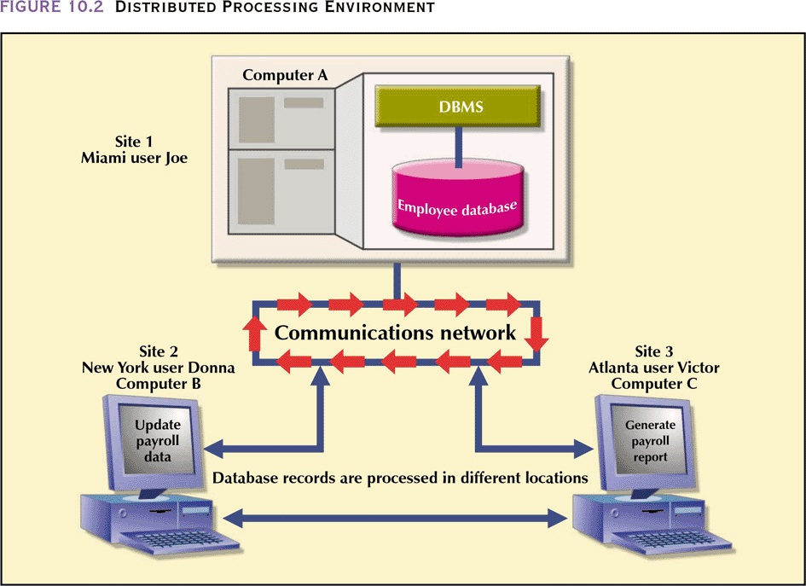
Distributed Processing Environment

Slide 36
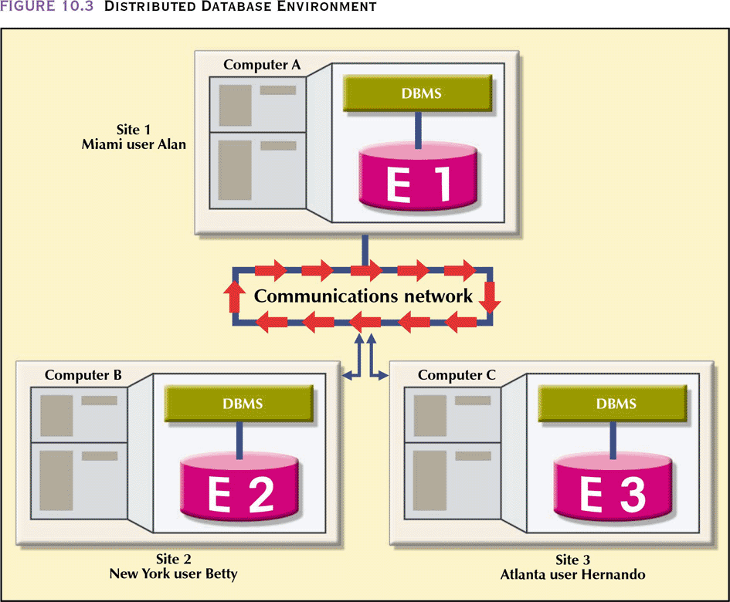
Distributed Database Environment

Slide 37
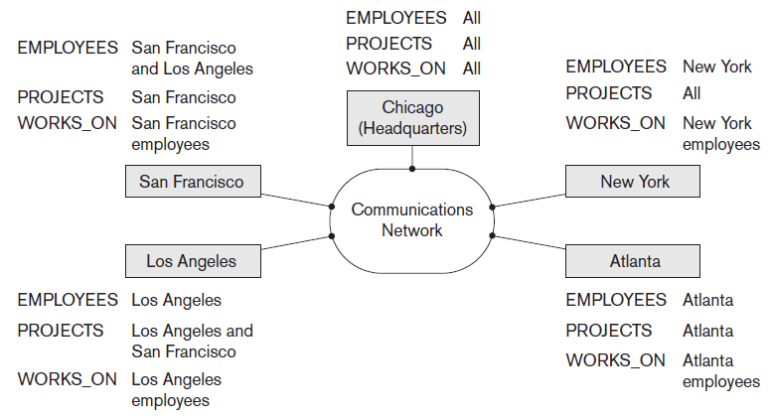
Distributed Databases

Slide 38
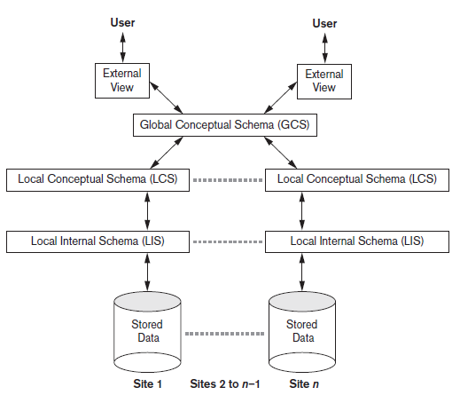
Schema Architecture of Distributed Databases
Schema architecture of distributed databases

Slide 39
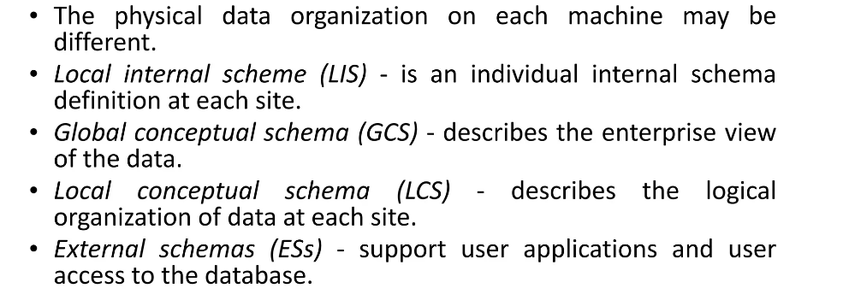

Slide 40
Data transparency: Degree to which system user may remain unaware of the details of how and where the data items are stored in a distributed system
Consider transparency issues in relation to:
Fragmentation transparency
Replication transparency
Network transparency
Location Transparency
Naming Transparency

Slide 41
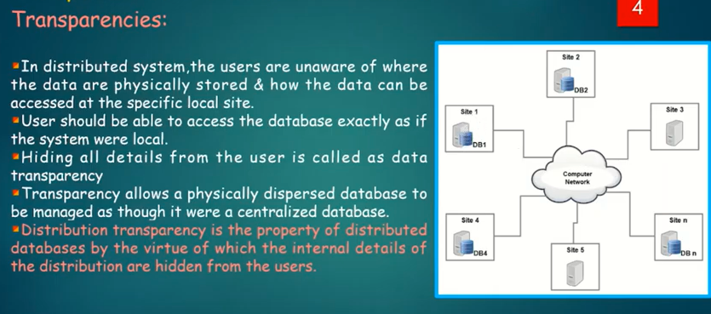

Slide 42
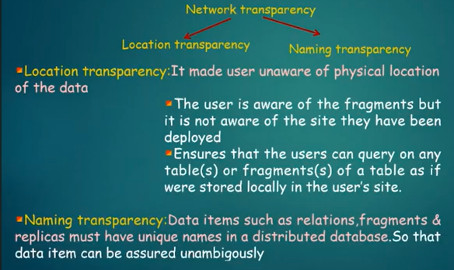

Slide 43
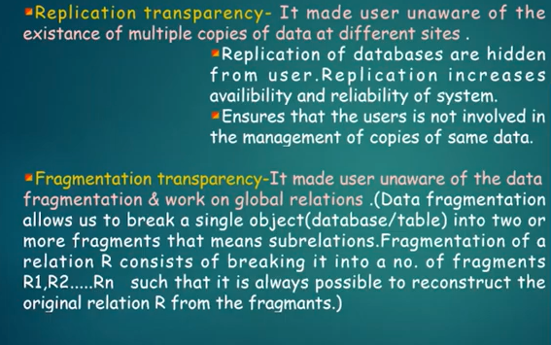

Slide 44
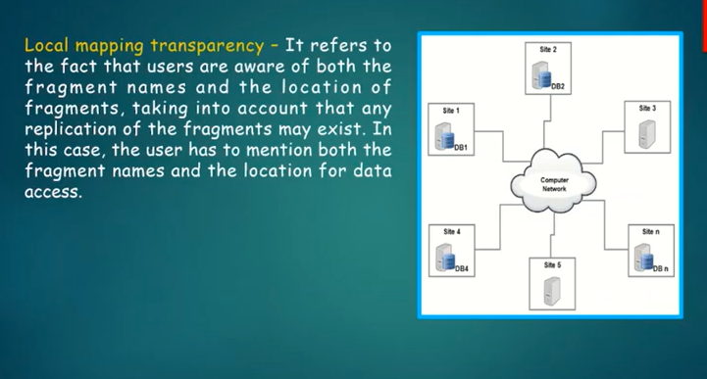

Slide 45
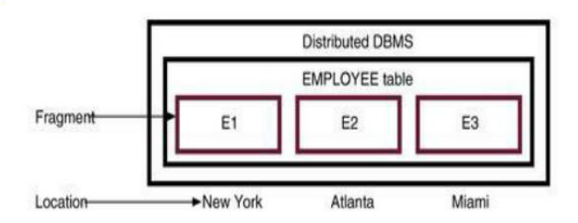
Distribution Transparency
The EMPLOYEE table is divided among three locations (no replication)
Suppose an employee wants to find all employees with a birthdate prior to jan 1, 1940

Slide 46
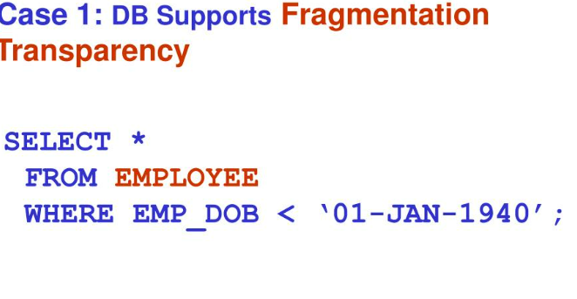
Here no fragmentation and location is specified

Slide 47
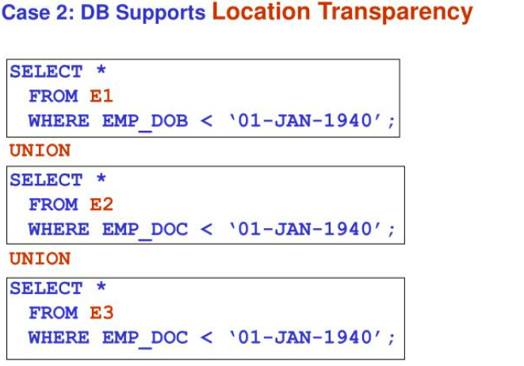

Slide 48
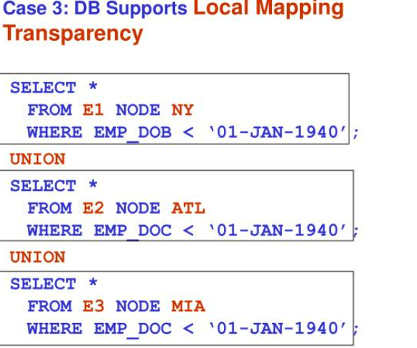

Slide 49
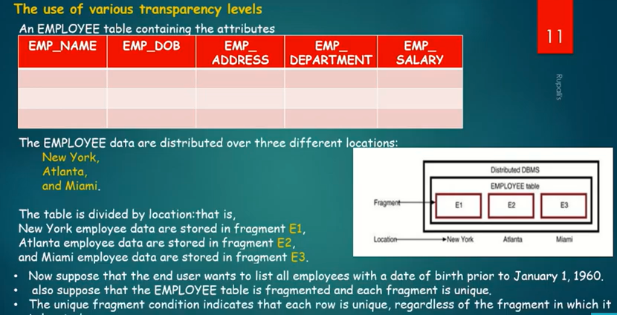

Slide 50
Transaction Transparency
Ensures database transactions will maintain distributed database’s integrity and consistency
A DDBMS transaction can update data stored in many different computers connected in a network
Transaction transparency ensures that the transaction will be completed only if all database sites involved in the transaction complete their part of the transaction

Slide 51
System Failure Modes
Failures unique to distributed systems:
Failure of a site.
Loss of messages
Handled by network transmission control protocols such as TCP-IP
Failure of a communication link
Handled by network protocols, by routing messages via alternative links
Network partition
A network is said to be partitioned when it has been split into two or more subsystems that lack any connection between them
Note: a subsystem may consist of a single node
Note: Network partitioning and site failures are generally indistinguishable.

